Slide 1
Occupational Specialism: Electrotechnical Engineering
K1.22 Methods of identifying potential issues before decommissioning systems
PowerPoint 1.22: Decommissioning issues

Slide 2
Introduction
What can go wrong if you don’t plan decommissioning?
Notes:
What problems could arise if you start removing or altering electrical systems without first reviewing their documentation or condition?
You might damage active live circuits.
You could remove something that's still in use.
Hazards such as asbestos or fire barriers could be disturbed.
Ask them to think about any decommissioning they’ve seen or been part of — what went well, and what didn’t?

Slide 3
Objectives
By the end of this session, you should be able to:
Explain why it is important to identify potential issues before decommissioning electrical systems
Identify sources of information used to plan decommissioning safely (e.g. O&M manuals, data sheets, drawings)
Recognise how to spot potential hazards or complications before physical work begins

Slide 4
Understanding the need for early planning
Planning decommissioning well in advance reduces the risk of unplanned disruption, safety hazards, and regulatory issues.
By identifying potential problems early, such as unknown services, incompatible materials or hazardous components, engineers can take pre-emptive steps to mitigate risk and ensure a smooth process.
Notes:
Use real examples from past decommissioning jobs where lack of planning led to costly delays or hazards. Emphasise why decommissioning should be considered during the original design process.

Slide 5
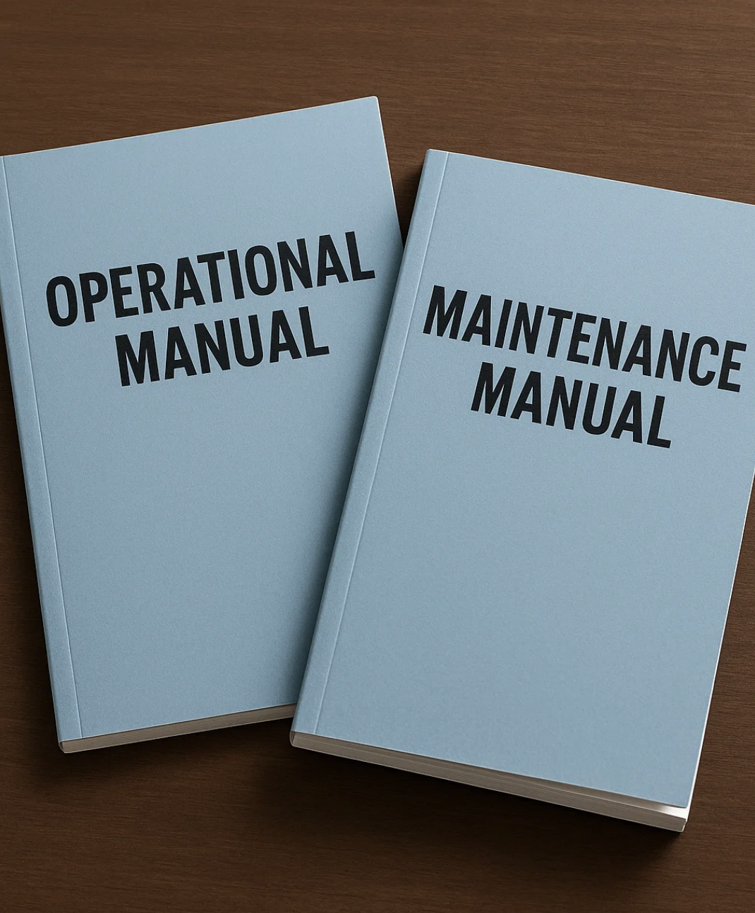
Reviewing O&M manuals before decommissioning
Operation & Maintenance (O&M) manuals provide essential information about the system's original design, modifications, materials used and safety warnings.
Reviewing these documents ensures that disconnections, removals and isolation are done correctly.
Notes:
If possible, show a real O&M manual. Explain how students can spot missing, outdated, or inaccurate content and what to do if it's not available.

Slide 6
Using as-fitted drawings and circuit schematics
‘As-fitted’ or ‘as-installed’ drawings show the actual installed layout, including hidden or buried elements.
These documents help identify cable routes, junction boxes and service entry points that may not be obvious on-site.
Notes:
Reinforce the difference between design drawings and as-fitted versions. Discuss challenges when drawings are missing or inconsistent with what’s on-site.

Slide 7
Consulting component data sheets
Manufacturer data sheets outline component ratings, safety considerations, installation guidance and disconnection requirements.
This information helps avoid damage to systems, components or connected equipment during decommissioning.
Notes:
Manufacturer data sheets outline component ratings, safety considerations, installation guidance, and disconnection requirements. This information helps avoid damage to systems, components, or connected equipment during decommissioning.

Slide 8
Engaging in stakeholder consultation
Before decommissioning, it’s essential to consult building users, clients and other trades.
Stakeholders may have information about legacy systems, operational concerns or upcoming changes that affect planning.

Slide 9
Benefits of identifying risks in advance
Reduced health and safety risks.
Better coordination with other trades.
More efficient scheduling.
Avoidance of unexpected costs.
Notes:
Ask learners to name possible benefits. Discuss how it also builds trust with clients and improves reputation.

Slide 10
Creating a decommissioning plan
A written decommissioning plan helps coordinate isolation procedures, physical removals and safety checks.
It should list all required documents, test records, materials to retain or discard, and any sequencing considerations.
Notes:
Show a sample template. Link this to earlier slides on documentation and planning. Emphasise that the plan evolves as more is discovered during site inspection.

Slide 11
Summary
You should now be able to:
Explain why it is important to identify potential issues before decommissioning electrical systems
Identify sources of information used to plan decommissioning safely (e.g. O&M manuals, data sheets, drawings)
Recognise how to spot potential hazards or complications before physical work begins

Slide 12
Any questions?
Copyright in this document belongs to and is used under licence from the Department for Education, © 2025.
‘T-LEVELS’ and ‘T Level’ are registered trademarks of the Department for Education.
WJEC is authorised by the Department for Education to develop and deliver this T Level Technical Qualification.
WJEC operates in England under the name Eduqas which is a registered trademark of WJEC.

