Slide 1
Occupational Specialism: Electrotechnical Engineering
K1.21 Ways of making systems safe to decommission
PowerPoint 1.21: Decommissioning

Slide 2
Introduction
What’s the first thing you should do before removing an electrical component from a circuit?
Notes:
Safe isolation

Slide 3
Objectives
By the end of this session, you should be able to:
Explain how to safely isolate electrical systems prior to decommissioning
Describe the steps involved in protecting, removing, or reconfiguring electrical components
Understand how to categorise and dispose of waste
Recognise how to make good the fabric of a building after component removal

Slide 4
Isolating from supply
Before any system can be decommissioned, it must be isolated from all live sources.
Identify and switch off the supply at the appropriate point.
Lock off the circuit using a safety lockout kit.
Verify isolation with approved test equipment.
Record isolation in accordance with permit-to-work procedures.
Notes:
Referred to safe isolation PowerPoint.
Demonstrate safe isolation if equipment is available. Link to Guidance Note 3 and HSG85.

Slide 5
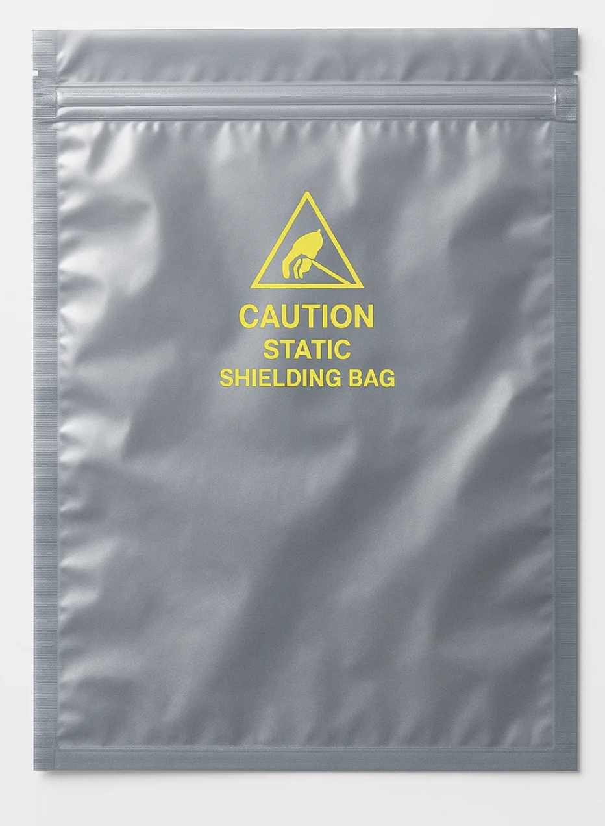
Protecting components during removal
In some cases, components may be removed for reuse, recycling, or warranty return. This requires careful handling to avoid:
physical damage
electrostatic discharge (ESD)
losing component labels or manufacturer markings
compromising environmental seals (IP-rated enclosures).

Slide 6
Reconfiguring the system
Sometimes, parts of the system remain operational while others are decommissioned. This might involve:
isolating and blanking off unused circuits
re-routing cables
installing temporary enclosures or control points
updating diagrams and schedules.
Notes:
Highlight the importance of keeping records updated and ensuring the system remains safe and functional.

Slide 7
Categorising and disposing of waste
Electrical decommissioning can generate various waste types.
WEEE (e.g. control boards, light fittings).
Hazardous (e.g. batteries, fluorescent lamps).
Metal and plastic recyclables.
General construction waste.
Waste must be categorised and disposed of according to site policy and legislation (e.g. Environmental Protection Act, WEEE regs).

Slide 8
Making good the building fabric
Once components are removed, installers must ensure the area is safe, sealed and compliant.
Remove cable ties, anchors or conduit carefully.
Seal up penetrations using fire-stopping or appropriate fillers.
Ensure reinstatement of ceilings, walls or floors if needed.
Leave area clean and safe.

Slide 9
Fire safety and compartmentation
Once cables, trunking, or conduits are removed, any penetrations through walls, floors or ceilings must be sealed in accordance with Building Regulations (Part B – Fire Safety).
Use suitable fire-stopping materials to reinstate fire barriers.
Notes:
Discuss fire-compartmentation and importance of not compromising safety during removal.
Highlight passive fire protection.
https://electrical.theiet.org/wiring-matters/years/2019/78-november-2019/fire-stopping/

Slide 10
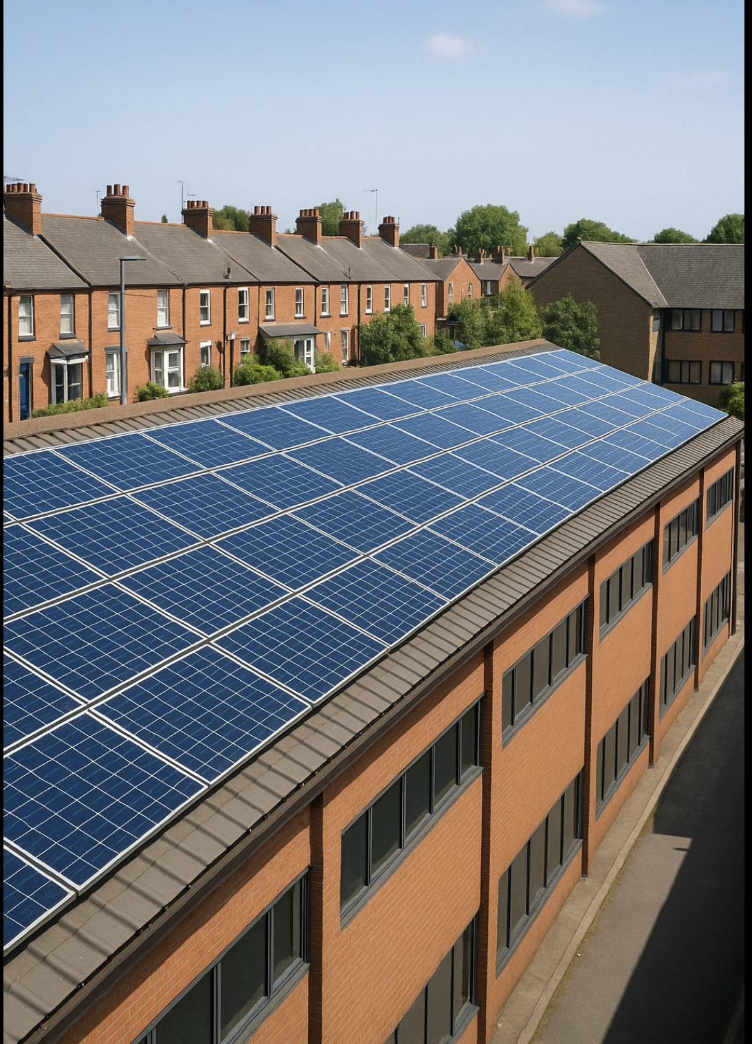
Preparing for retrofit and future use
Decommissioning should be seen as a stage in the lifecycle of a building.
Removing old equipment and making it safe presents a chance to improve systems through energy-efficient retrofits or smart controls, or repurposed use of space.
Notes:
Encourage learners to consider future technology integration (e.g. EV charging, solar PV) when planning decommissioning works.

Slide 11
Summary
You should now be able to:
Explain how to safely isolate electrical systems prior to decommissioning
Describe the steps involved in protecting, removing, or reconfiguring electrical components
Understand how to categorise and dispose of waste
Recognise how to make good the fabric of a building after component removal

Slide 12
Any questions?
Copyright in this document belongs to and is used under licence from the Department for Education, © 2025.
‘T-LEVELS’ and ‘T Level’ are registered trademarks of the Department for Education.
WJEC is authorised by the Department for Education to develop and deliver this T Level Technical Qualification.
WJEC operates in England under the name Eduqas which is a registered trademark of WJEC.

