Slide 1
Occupational Specialism: Electrotechnical Engineering
K1.20 Maintenance of older systems and installations
PowerPoint 1.20: Older installations
Notes:
https://electrical.theiet.org/wiring-matters/years/2021/84-march-2021/estimating-the-age-of-an-electrical-installation/
https://electrical.theiet.org/wiring-matters/years/2020/79-march-2020/the-electrical-safety-standards-in-the-private-rented-sector-england-regulations-2020/

Slide 2
Introduction
What makes a system ‘old’?
Notes:
Encourage learners to think about:
Cable types
Consumer units
Earthing arrangements
Protective devices
Labelling and bonding

Slide 3
Objectives
By the end of this session, you should be able to:
Identify features of older electrical systems and components that may not comply with current standards
Understand the risks and limitations associated with legacy installations
Refer to relevant regulations and guidance for assessing older systems
Report on the condition and suitability of older systems for continued use using correct procedures

Slide 4
Characteristics of older electrical installations
Older electrical installations often include materials and practices no longer considered compliant with current regulations.
Where VIR (Vulcanised India Rubber) cables and rewireable fuses (BS 3036) are found, an upgrade to newer types is strongly recommended.
These systems may lack essential modern safety features such as RCD protection, main protective bonding or even sufficient labelling.
While some older systems may still function, their continued use depends on thorough inspection and risk assessment.
Notes:
Consider what visual or functional signs point to a system being "old”.
Emphasise that not all outdated systems are immediately dangerous but must be assessed carefully.

Slide 5
Common outdated materials and components
Several materials used in older installations present risks today.
VIR-insulated cables degrade over time and can become brittle, posing a fire risk.
Rewireable fuses, though once standard, may not provide sufficient short-circuit or earth fault protection compared to modern MCBs or RCBOs.
Other issues may include cotton-braided flexible cords, wooden backboards, or metal-clad switches without proper earthing.
Notes:
Clarify how material degradation (e.g. insulation breakdown) impacts safety. Discuss how manufacturer guidance and testing help determine if replacement is needed.

Slide 6
Recognising regulatory non-compliance
Older installations often fail to meet modern standards outlined in BS 7671.
Key non-compliance indicators include lack of RCD protection on sockets, undersized main earthing conductors, or absence of bonding to gas and water pipes.
While these issues may have been acceptable when installed, they must be evaluated under current regulations.
The presence of obsolete systems doesn't automatically mean they are unsafe; it depends on the condition and test results.
Notes:
Discuss Regulation 621.5 (EICR coding) and how deviations from modern standards are documented and graded (C1–C3). Encourage learners to refer to GN3 and Appendix 6 of BS 7671 for inspection requirements.
https://electrical.theiet.org/wiring-matters/years/2022/91-july-2022/mythbusters-8-socket-outlets-must-be-protected-by-a-30-ma-rcd/

Slide 7
Suitability for continued use
The condition of an older system must be evaluated using inspection and testing.
If the system is safe and meets the requirements for disconnection times, insulation resistance, and earthing, it may remain in service. However, recommendations should be made for future upgrades.
Systems that fail critical safety tests or exhibit damage must be replaced.
Decisions should be documented using Electrical Installation Condition Reports (EICRs) with clear observations and coding.

Slide 8
Reporting and stakeholder communication
When assessing older systems, it is essential to clearly communicate findings to clients or stakeholders. This includes explaining whether the installation is safe for continued use, identifying areas for improvement, and recommending timelines for upgrades.
All communication should be recorded using standard documentation like EICRs and updated O&M manuals.
Using accessible language for non-technical stakeholders helps ensure understanding and informed decision-making.

Slide 9
Visual inspection
Effective maintenance of older systems begins with a thorough visual inspection.
This involves checking for signs of wear such as discolouration, heat damage, exposed conductors, loose fixings, or out-of-date labelling.
Notes:
Review visual inspection checklists from GN3. Ask learners to spot hazards from images or case scenarios.

Slide 10
Insulation resistance and continuity testing
Testing is critical to determine if older conductors still meet minimum standards.
Insulation resistance testing checks for breakdowns in cable sheathing, while continuity testing confirms integrity of conductors and terminations.
If readings fall below acceptable thresholds, this indicates a significant deterioration in safety.
Notes:
Recap standard thresholds (e.g. ≥1 MΩ) and use Appendix 6 from BS 7671. Show learners how to record results in EICR format and relate results back to decision-making (repair, replace, monitor).

Slide 11
Deciding when to recommend replacement
Not all older systems need immediate replacement, but some pose enough risk that continued use cannot be justified.
Factors include poor test results, extensive signs of deterioration, and non-compliance with critical safety measures (e.g. no CPC). A C2 or C1 code on an EICR typically triggers a strong recommendation to replace part or all of a system.
These decisions should always be evidence-based and clearly justified to clients.
Notes:
Link this slide to K1.18 (diagnosis and rectification). Explore common justifications for full rewires vs. partial upgrades. Encourage learners to reflect on risk management and professional duty of care.

Slide 12
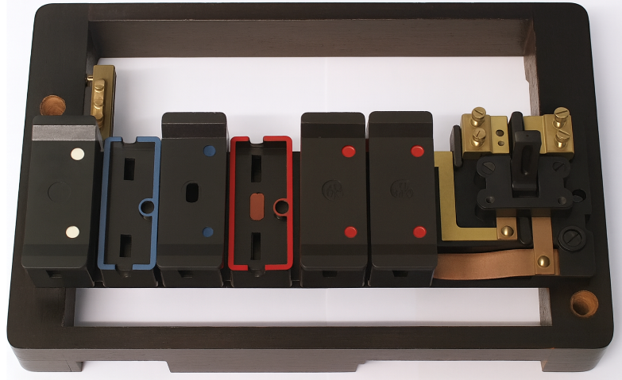
Identifying non-compliant materials
Some older systems contain materials that are no
longer considered safe or compliant.
Vulcanised Indian Rubber (VIR) cables, for example,
degrade over time and lose insulation properties.
Other examples include wooden consumer units,
asbestos-containing backboards, and lead sheathed cables.
These materials should be flagged for urgent replacement or isolation due to health and safety risks.
Notes:
Discuss the health and fire risks posed by obsolete materials. Refer to GN3 and BS 7671 Appendix 6 guidance on when systems are deemed unsatisfactory. Prompt learners to consider how to raise these issues professionally with clients.

Slide 13
Maintaining compliance with evolving standards
Electrical systems that were once compliant may no longer meet current requirements, especially following updates to BS 7671.
While installations aren't required to be retroactively upgraded, any additions or alterations must bring the affected parts up to standard.
Older systems may also lack protective devices such as RCDs or AFDDs, which are now expected in many locations.
Notes:
Use this slide to revisit the concept of "not unsafe, but not compliant“. Discuss Reg. 132.16 and explain how work on older systems often requires partial upgrades (e.g. fitting RCDs on new circuits).

Slide 14
Interacting with other building systems
Older installations often coexist with outdated heating, fire alarm, or emergency lighting systems.
When carrying out maintenance, engineers must be aware of interdependencies.
For example, an old fused spur controlling an emergency light or heating control system.
Disruption could compromise building safety or occupant comfort.
Notes:
Highlight the importance of reviewing O&M manuals and schematics. Encourage learners to investigate what each circuit feeds before making any disconnections. Emphasise testing before and after any works.

Slide 15
Communicating condition reports to stakeholders
When reporting on the condition of an older system, electricians must produce clear, evidence-based assessments.
This includes assigning EICR codes (C1–C3, FI), giving detailed observations.
The goal is to help clients understand the risks and make informed decisions.
Notes:
Demonstrate how to write clear, objective observations. Discuss the role of digital inspection tools and EICR apps. Link back to K1.14 on reporting and K1.18 on diagnosis.
Discuss the use of photographic evidence following a visual inspection to reinforce the condition report.

Slide 16
Balancing functionality with compliance
Maintenance may involve finding safe ways to preserve functionality within limits.
For example, installing RCBOs where physically possible on circuits that test well, or creating segregated ‘new’ and ‘old’ boards.
Electricians must apply professional judgement, document decisions, and always prioritise safety.
Notes:
Facilitate discussion on balancing budget, safety, and compliance. Introduce scenarios where a full rewire isn’t feasible. Ask learners how they would document and explain such compromises.

Slide 17
Summary
You should now be able to:
Identify features of older electrical systems and components that may not comply with current standards
Understand the risks and limitations associated with legacy installations
Refer to relevant regulations and guidance for assessing older systems
Report on the condition and suitability of older systems for continued use using correct procedures

Slide 18
Any questions?
Copyright in this document belongs to and is used under licence from the Department for Education, © 2025.
‘T-LEVELS’ and ‘T Level’ are registered trademarks of the Department for Education.
WJEC is authorised by the Department for Education to develop and deliver this T Level Technical Qualification.
WJEC operates in England under the name Eduqas which is a registered trademark of WJEC.

