Slide 1
Occupational Specialism: Electrotechnical Engineering
K1.19 Maintenance requirements for different building types and locations
PowerPoint 1.19: Maintenance requirements
Notes:
Link to part 7 BS7671

Slide 2
Introduction
Which types of buildings do you think require the most regular and detailed maintenance, and why?

Slide 3
Objectives
By the end of this session, you should be able to:
Explain the legal and regulatory requirements for electrical maintenance in various premises
Understand the implications of specialist environments (e.g. hospitals, chemical plants)
Recognise how maintenance strategies differ across residential, commercial, and HMO properties

Slide 4
What is electrical maintenance?
Electrical maintenance is the routine care and repair of systems to ensure safety, reliability, and compliance.
This includes inspections, testing, servicing, repairs, and updates to equipment or systems across various types of buildings.
Notes:
Emphasise link to legal compliance (EAWR 1989, BS 7671, PUWER)
Maintenance isn’t optional—it’s a duty under H&S law
Distinguish between general maintenance and electrical-specific

Slide 5
Maintenance requirements vary by building type
Maintenance needs differ depending on:
the type and use of the building
the risks to users
the complexity of electrical systems
regulatory requirements.
For example, hospitals require higher safety standards than private homes.
Notes:
Prompt learners to consider who uses the space—vulnerable people?

Slide 6
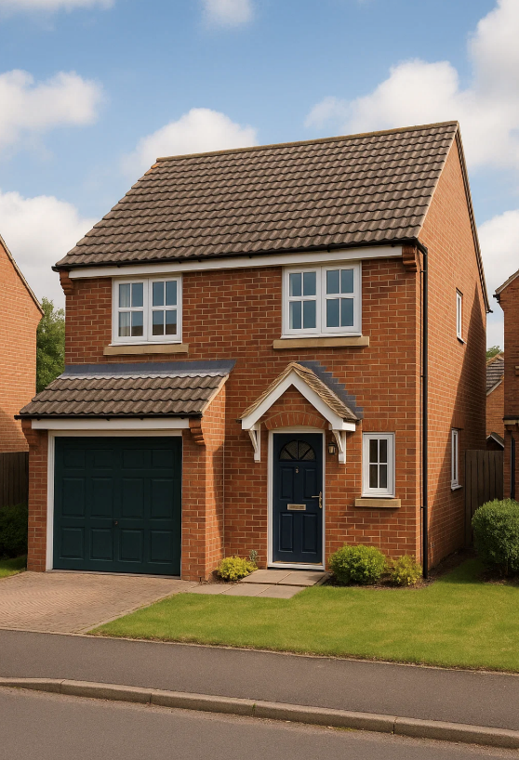
Private dwellings
Private homes usually have minimal legal requirements beyond safe installation.
Homeowners are responsible for safe maintenance.
Landlords (in rented homes) must carry out EICRs every 5 years or after the change of tenancy.
Notes:
Clarify the difference between owned and rented homes
PAT testing requirements in rented accommodation
https://electrical.theiet.org/wiring-matters/years/2021/87-september-2021/electrical-safety-standards-in-the-private-rented-sector/

Slide 7

Houses in multiple occupation (HMOs)
HMOs have stricter maintenance obligations due to shared occupancy.
Mandatory EICRs every 5 years.
Regular checks on communal areas.
Risk-based inspections by local authorities.
Fire detection and emergency lighting often required.
Notes:
Explain why higher occupancy = higher risk
Refer to Housing Act 2004, Management of HMO Regs 2006

Slide 8
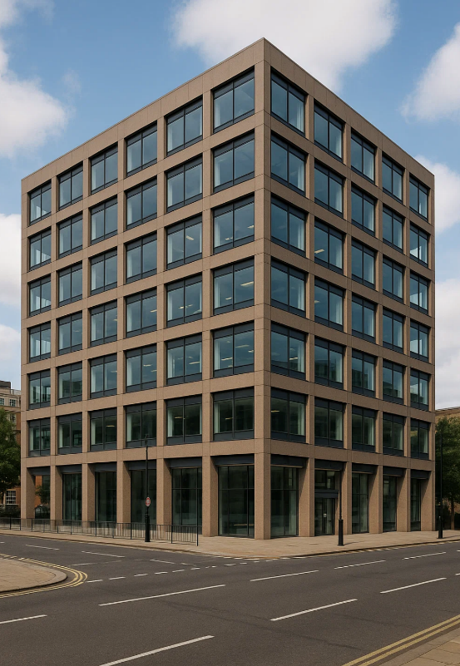
Commercial premises
Commercial buildings must follow workplace regulations.
Electricity at Work Regulations 1989.
PUWER 1998 (Provision & Use of Work Equipment Regs).
Regular testing of systems, including portable appliances (PAT).
Maintenance records must be kept.
Notes:
Discuss duty of employers under H&S at Work Act

Slide 9
Residential care and vulnerable occupants
Buildings with vulnerable occupants, care homes and supported living require:
more frequent inspections
fail-safe systems (e.g. emergency lighting, fire alarms)
specialist maintenance schedules.
Notes:
Risk to life is higher, so maintenance must be proactive
Mention use of tamper-proof fittings, robust emergency systems

Slide 10
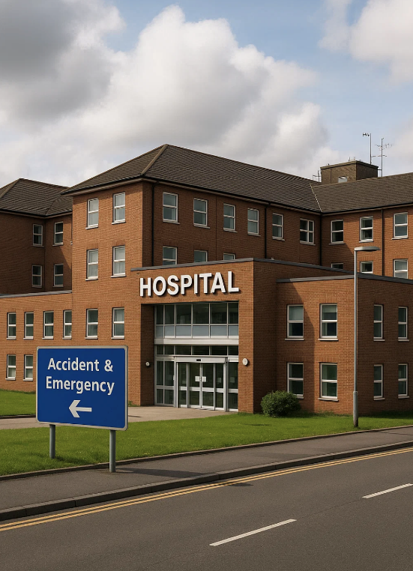
Hospitals and medical premises
Subject to HTM 06-01 (Health Technical Memorandum).
Critical care systems must be maintained regularly.
Backup power systems (UPS, generators).
Zoning and medical IT systems require specialised testing.
Notes:
BS 7671 Section 710 applies (Medical Locations)
Highlight staff and patient safety as key priority

Slide 11
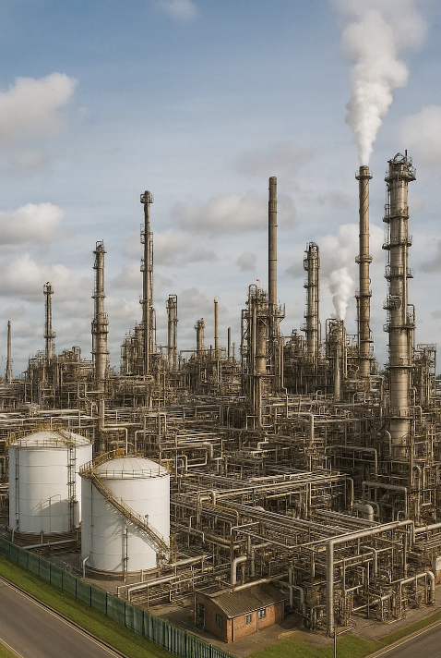
Industrial settings: Chemical plants and factories
High-risk environments
DSEAR (Dangerous Substances & Explosive Atmospheres Regulations).
ATEX-rated components and enclosures.
Ongoing inspection and maintenance of hazardous area equipment.

Slide 12
Paint stores and flammable storage
These areas present fire and explosion risks due to vapours:
Must use explosion-proof components.
Ventilation systems must be maintained.
Fire alarm and suppression systems tested regularly.
Notes:
Emphasise importance of risk assessment

Slide 13
Summary
You should now be able to:
Explain the legal and regulatory requirements for electrical maintenance in various premises
Understand the implications of specialist environments (e.g. hospitals, chemical plants)
Recognise how maintenance strategies differ across residential, commercial, and HMO properties

Slide 14
Any questions?
Copyright in this document belongs to and is used under licence from the Department for Education, © 2025.
‘T-LEVELS’ and ‘T Level’ are registered trademarks of the Department for Education.
WJEC is authorised by the Department for Education to develop and deliver this T Level Technical Qualification.
WJEC operates in England under the name Eduqas which is a registered trademark of WJEC.

