Slide 1
Occupational Specialism: Electrotechnical Engineering
K1.18 Fault-finding and rectification techniques
PowerPoint 1.18: Fault finding

Slide 2
Introduction
What’s the first thing you’d check if a socket stopped working?

Slide 3
Objectives
By the end of this session, you should be able to:
Understand the logical process used to diagnose electrical faults safely and effectively
Identify common fault symptoms and analyse technical data
Use test instruments and documentation to support diagnosis
Apply appropriate rectification techniques such as repair, replacement or adjustment

Slide 4
Understanding faults in electrotechnical systems
Faults in electrical systems may arise from poor workmanship, ageing components, environmental factors, or incorrect usage.
Understanding how and why these faults occur is the first step in applying a structured approach to diagnosis and repair.
Effective fault-finding requires a mix of technical knowledge, logical thinking, and safe working practices.
Notes:
Introduce the importance of fault-finding to safety and reliability.

Slide 5
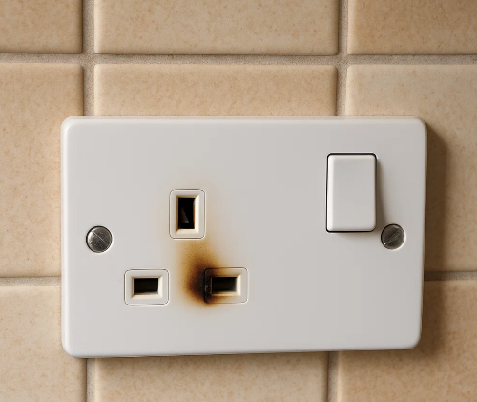
Common symptoms of electrical faults
Recognising the symptoms of faults is key to identifying the root cause.
Common indicators include tripping RCDs or MCBs, loss of power, flickering lights, overheating components, and unusual sounds or smells.
These signs help narrow down possible causes before any dismantling or testing begins.

Slide 6

Safe approach to fault diagnosis
Before beginning any investigation, it's essential to isolate the supply, verify safe isolation using appropriate procedures, and wear appropriate PPE.
Always follow the Electricity at Work Regulations 1989 and BS 7671 guidance, and the safe isolation process to prevent harm.
Notes:
Refer to safe isolation PowerPoint

Slide 7
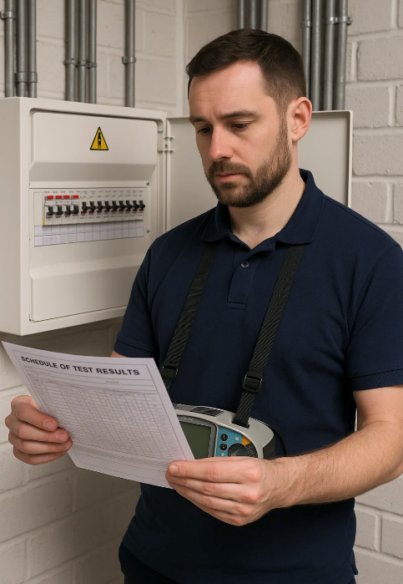
Collecting information from documentation
Useful information sources for fault diagnosis include circuit diagrams, schedules, previous test certificates, and O&M manuals.
These help the electrician understand the intended layout, protective devices in use, and any previous issues, supporting more efficient diagnosis.

Slide 8

Using questioning to gather context
Discussion with users or maintenance personnel can reveal important fault symptoms or recent changes to the installation.
Asking structured questions helps narrow down the potential fault area.
“When did the fault start?”
“Was any work recently carried out?”
“What was operating at the time of failure?”

Slide 9
Human senses
During the inspection process, we use the following senses:
sight
touch
smell
hearing.
How are each of these senses used?

Slide 10
Using human senses during the inspection process
Human Sense | Practical Use of the Human Sense
Sight | Look for poor workmanship, damaged components, defective terminations and identification markers, and judge the suitability of equipment in special locations.
Touch | Check to see if items of equipment are secure, and feel for enclosure temperature using the back of your hand.
Smell | Smell the possibility of burning/charred cables: smouldering or overheated PVC-insulation smells ‘fishy’.
Hearing | Be alert to the sounds of switches arcing, contactors chattering, ballasts rattling and motors rumbling due to worn bearings.

Slide 11
Logical fault-finding methods
Start with the simplest possible causes and work towards the more complex.
Visual inspections are often the most effective first step.
Use a process of elimination:
is it a supply issue?
a circuit fault?
faulty accessory?
Avoid guesswork, test and confirm at each stage.

Slide 12
Testing to confirm suspected faults
Use appropriate test instruments to validate your suspicions.
This may include insulation resistance tests, continuity tests, loop impedance, or RCD testing.
Ensure test equipment is functional, properly rated, and set to the correct scale.
Notes:
Recap tests covered in K1.15 and reinforce choosing the right instrument.

Slide 13
Analysing results and narrowing it down
Interpreting test results is crucial. For example, low insulation resistance could suggest moisture ingress or cable damage.
High loop impedance might point to poor earthing or loose terminations.
Accurate analysis leads to faster fault location and resolution.

Slide 14
Reviewing circuit schedules and diagrams
Circuit schedules, wiring diagrams, and installation drawings are critical for identifying circuit layout, protective devices, cable routes and component connections.
Reviewing these documents helps locate possible points of failure and confirms whether the installation matches the design. Always cross-reference any modifications or additions made since installation.

Slide 15
Functional checks
Carry out functional checks on switches, indicators, and controls to identify abnormal behaviour.
Functional issues (e.g. no response from a switch) often guide the next steps in the diagnosis.
Before any fault-finding begins, isolate the system safely and verify isolation with an approved voltage indicator and proving unit.

Slide 16
Testing continuity to locate breaks
Continuity testing is used to confirm that conductors, protective paths, and connections are intact.
A continuity fault may indicate a break in wiring, a loose terminal, or a failed protective device.
The results may indicate where the damage in the conductor is located.
Notes:
Emphasise correct instrument use and interpreting circuit readings.

Slide 17
Insulation resistance testing for damage
Insulation resistance tests help detect damaged insulation or moisture ingress.
A low resistance reading suggests a fault between conductors or to earth.
Tests must be conducted in line with BS 7671 and IET GN3 requirements, with circuits disconnected from sensitive equipment first.
Notes:
Discuss acceptable values and reasons for low readings.

Slide 18
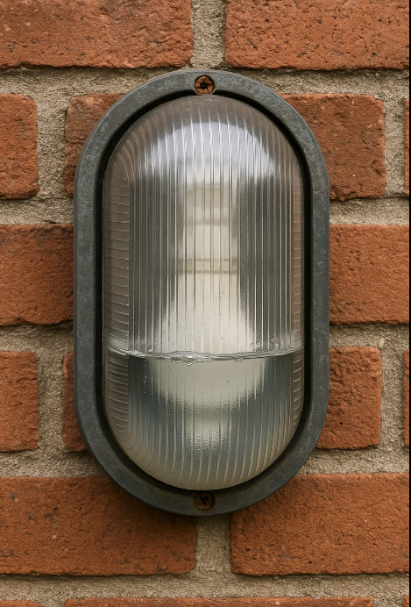
Faults caused by environmental influences
External influences such as water, heat, vibration, or mechanical damage often lead to faults over time. Look for evidence of UV degradation, crushed cables, or corrosion on terminations.
Consider if environmental factors were properly accounted for in the original design.
Notes:
Provide examples or photos of weathered/damaged components.

Slide 19
Intermittent and permanent faults
Permanent faults show up consistently during testing, while intermittent faults may only appear under load or after time.
Consider using data loggers, thermal imaging, or repeated operational tests to isolate an intermittent issue.
These faults often require patience and careful observation.
Notes:
Use examples like a loose terminal causing flickering or overload tripping.

Slide 20
Repair or replace
Some faults can be repaired on-site by replacing terminals, tightening connections, or resecuring cables.
Repair is often the quickest and most cost-effective solution but must be verified with follow-up testing and recorded appropriately.
Where repair isn't possible or safe, replacing the faulty item – such as an MCB, socket, or section of damaged cable – is necessary.

Slide 21
Recording the fault diagnosis process
Documenting symptoms, test results, actions taken, and recommendations is essential for traceability and accountability.
Records also assist future maintenance or troubleshooting.
Use standard fault sheets, maintenance logs, or digital reports as per site policy.

Slide 22
Communicating findings and handover
After rectification, communicate clearly with stakeholders or clients. This includes explaining the fault, what caused it, what was done, and any follow-up needed.
Always update any O&M documentation if applicable, particularly when equipment is adjusted or replaced.

Slide 23
Preventing future faults
Good maintenance, proper installation, and appropriate environmental protection reduce the likelihood of faults recurring.
After rectification, recommend any actions that would improve reliability, such as installing surge protection, relocating equipment, or improved documentation.
Notes:
Show example fault log entries and discuss legal responsibilities.

Slide 24
Summary
You should now be able to:
Understand the logical process used to diagnose electrical faults safely and effectively
Identify common fault symptoms and analyse technical data
Use test instruments and documentation to support diagnosis
Apply appropriate rectification techniques such as repair, replacement or adjustment

Slide 25
Any questions?
Copyright in this document belongs to and is used under licence from the Department for Education, © 2025.
‘T-LEVELS’ and ‘T Level’ are registered trademarks of the Department for Education.
WJEC is authorised by the Department for Education to develop and deliver this T Level Technical Qualification.
WJEC operates in England under the name Eduqas which is a registered trademark of WJEC.

