Slide 1
Occupational Specialism: Electrotechnical Engineering
K1.15 Testing for electrotechnical systems
PowerPoint 1.15: Verifying ADS
Notes:
https://electrical.theiet.org/wiring-matters/years/2024/100-may-2024/why-are-the-values-of-maximum-earth-fault-loop-impedance-different/

Slide 2
Introduction
Where in GN3 can information regarding ADS be found?

Slide 3
Objectives
By the end of this session, you should be able to:
Explain what ADS is and when it applies (TN and TT systems)
Check protective devices meet disconnection times and that breaking capacity ≥ recorded PFC

Slide 4
Verifying protection by ADS
ADS: Automatic Disconnection of Supply
Purpose: Ensure protective devices operate correctly in the event of a fault.
Procedure:
Measure Ze using a loop impedance tester.
Measure Zs at the furthest point of each circuit.
Compare measured values with BS 7671 tables (e.g., Table 41.3).
Ensure measured Zs does not exceed 80% of the tabulated value to account for temperature and other factors.

Slide 5
Measurement of external earth fault loop impedance
Ze is measured using a loop impedance tester at the origin of the installation supply.
The measurement is made between the main live supply and the main means of earthing with the main switch off.
The means of earthing will be isolated from the installation earthed equipotential bonding for the duration of the test.
Care should be taken to avoid any shock hazard to the testing personnel and other persons/livestock on the site while performing the test.
Ensure that the earth connection has been reconnected.
The measured value should not exceed the maximum for the type of earthing present.

Slide 6
Earth electrode resistance for TT earthing system
Two methods of ascertaining the earth electrode resistance value.
Method E1: Using an earth electrode resistance tester.
Method E3: Using an earth fault loop impedance tester.
Images supplied by www.test-meter.co.uk.
Notes:
BS 7671’s Regs 411.5.3, Reg. 643.7.2 and Table 41.5
Discuss method E2 and demonstrate using a test coil instrument.

Slide 7
Method E1: Earth electrode resistance tester
Before this test is undertaken, the earthing conductor to the earth electrode must be disconnected at either the electrode or the main earthing terminal to ensure that all the test current passes through the earth electrode alone (no parallel paths).
This will leave the installation unprotected against earth faults, so switch off the supply before disconnecting the earth and safely isolate using a lock-off kit.
Three readings are taken, then the average of the three readings is taken.
For reliable results, the distance between the electrode under test and the current spike should be 10 times the length of the earth electrode.
Ideally, the test should be carried out when the ground conditions are least favourable, such as when the soil is frozen or very dry.
Notes:
It is advised in Note 2 of Table 41.5 that earth electrode resistance values above 200Ω may not be stable, as soil conditions change due to factors such as soil drying and freezing.
Chapter 41,411.5.3, page 70.

Slide 8
Method E3: Earth fault loop impedance tester
Before this test is undertaken, the earthing conductor to the earth electrode must be disconnected at the main earthing terminal to ensure that all the test current passes through the earth electrode alone (no parallel paths).
This will leave the installation unprotected against earth faults, so switch off the supply and apply a lock-off kit before disconnecting the earth.
Tests are carried out as explained on the next slide.
After completion of the testing, ensure that the earthing conductor is reconnected.
Notes:
GN3 Section 2, 2.6.13, page 84.
Test method E3: Measurement using an earth fault loop impedance (EFLI) tester. An earth electrode may be tested using an EFLI tester. However, it is recognized that the results may not be as accurate as using a dedicated earth electrode tester.
FOR SAFETY REASONS, THE INSTALLATION MUST BE ISOLATED FROM THE SUPPLY BEFORE DISCONNECTING THE EARTHING CONDUCTOR. The EFLI tester is connected between the line conductor at the source of the installation and the earth electrode via the earthing conductor, and a test performed. The impedance reading taken is treated as the electrode resistance.

Slide 9
Method E3: Test steps
Main switch open
Disconnect main earth
Take measurement
Verify reading complies
Reconnect main earth
Max RA – 200Ω
Image supplied by www.test-meter.co.uk.
Notes:
Apply the Rₐ × Iₙ ≤ 50 V rule.

Slide 10
Measuring Ze on a TN-S and TN-C-S system
Main switch open
Disconnect main earth
Take measurement
Verify reading complies
Reconnect main earth
Max Ze
TNS – 0.8Ω
TN-C-S 0.35Ω

Slide 11
Why measure Zs?
The purpose of measuring Zs is to ensure that the protective device of each circuit operates within a specified time suited for that circuit, e.g. 0.2, 0.4 or 5 seconds.
This will ensure that the automatic disconnection of the supply in the event of a fault (ADS) operates effectively.
The measured values will be assessed against the maximum impedances given in BS 7671.
Notes:
Table 41.2, page 67, Table 41.3, page 68, Table 41.4, page 69 within BS 7671.

Slide 12
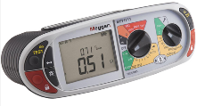
Earth fault loop impedance (Zs) on a TNCS supply
Zs Ω is the total impedance of the earth fault loop, starting and ending at the instrument. This measurement is to be taken at the furthest point of each final circuit.
Arrows symbolises the earth fault loop path
Main substation transformer
0.84 Ω

Slide 13
Earth fault loop impedance (Zs) on a TN-S supply
Zs Ω is the total impedance of the earth fault loop, starting and ending at the instrument. This measurement is to be taken at the furthest point of each final circuit.
Arrows symbolise the earth fault loop path
Main substation transformer
Earth fault loop
impedance (EFLI) tester
1.01 Ω

Slide 14
Earth fault loop impedance (Zs) on a TT supply
Zs Ω is the total impedance of the earth fault loop, starting and ending at the instrument. This measurement is to be taken at the furthest point of each final circuit.
Arrows symbolises the earth fault loop path
Main substation transformer
24 Ω
General mass of earth

Slide 15
Comparing measured Zs values
Comparing measured Zs values with the maximum tabulated figures as specified in BS 7671 including the application of the correction factor.
The measured value of Zs must not exceed 80% of the tabulated value in BS 7671.
Notes:
See Table 41.3

Slide 16
Calculation of Zs from given information
The earth fault loop impedance (Zs) must be determined for the furthest point of each circuit.
It may be determined by:
direct measurement of Zs
direct measurement of Ze at the origin, and adding (R1 + R2) measured during the continuity tests
adding (R1 + R2) measured during the continuity tests to the value of Ze declared by the distributor (see 1.1(d) and 1.3(d)).
Notes:
Section 10,10.3.6, page 124

Slide 17
Calculation of Zs from given information
Direct measurement of Zs can only be made on a live installation.
Neither the connection with earth nor the bonding conductors is disconnected.
The reading given by the loop impedance tester will usually be less than the sum of Ze + (R1 + R2) because of parallel earth return paths provided by any bonded extraneous-conductive-parts.
Notes:
BS7671 Section 10,10.3.6, page 124.

Slide 18
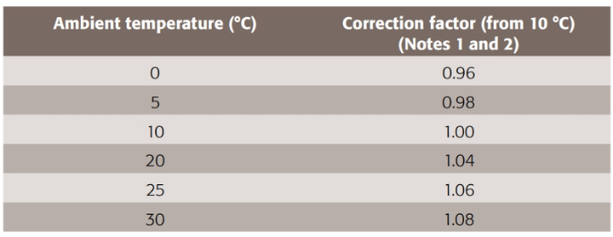
Calculation of Zs: Higher ambient temperature
Calculation of Zs after allowing for higher ambient temperature: Table B8 within the On-Site Guide or Table A7 in Guidance Note 3, refer to ambient temperature.
If testing a circuit with a 20 amp type B MCB protecting it, within an ambient temperature of 30 degrees, the Zs value would need to be connected to accommodate the higher temperature.
Take the Zs value of the 20 amp breaker from table A5 from guidance note 3 and multiply this by the temperature correction factor and the result would be the new maximum value. For example: 2.19 × 1.08 = 2.37Ω
Notes:
OSG Appendix B, page 146
GN3 Appendix A, page 176
https://electrical.theiet.org/wiring-matters/years/2023/94-march-2023/determining-the-maximum-earth-fault-loop-impedance-for-protective-devices-to-bs-en-60898-bs-en-60947-2/

Slide 19
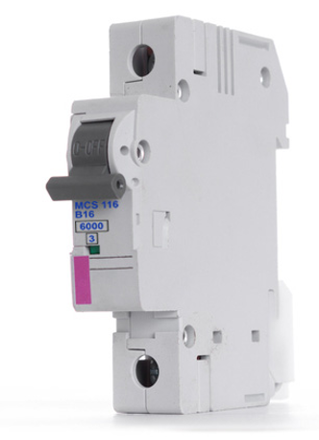
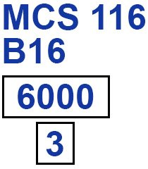
PSC – why do we measure it?
If the protective device's short circuit capacity value is lower than the measured PSC value, it will have to be changed. Otherwise, the device's breaking capacity will not be able to distinguish the fault current, and damage could occur.
On MCBs, the short-circuit capacity rating is identified in two forms: rms:
As an actual figure inserted in a box.
As an ‘M’ rating, i.e. M6 meaning 6 000 amp short circuit capacity.

Slide 20
Two perspective fault currents to consider
Prospective earth fault current – PEFC
Prospective short circuit current – PSCC
What’s the difference?
Earth fault current is the value of current produced when a fault occurs between a line conductor and earth.
Short circuit current is produced when you have a fault between live conductors, L–N.
Notes:
Note: whichever is the highest value of both test values will be the PSC value for the installation that will be recorded on the test certificate.
The prospective fault current shall be determined at every relevant point of the installation. This shall be done by calculation, measurement or enquiry. BS 7671, 434.1, page 97
By enquiry, we must contact the supply authority and they will give you a maximum value, but it may not always be accurate.

Slide 21
Methods for determining prospective fault current
With the power on, the maximum value of the prospective short-circuit current can be obtained by direct connection of the instrument between live conductors at the protective device at the origin or other relevant location within the installation.
Both two-lead and three-lead instruments capable of determining prospective fault currents are available; it is important that any instrument used is set to the correct range and connected in accordance with the manufacturer's instructions for its use.
The test process is the same for all earthing systems. Two measurements will be made: prospective earth fault current and prospective short circuit current.
Notes:
GN3 Section 2, Table 2.6.16, page 88

Slide 22
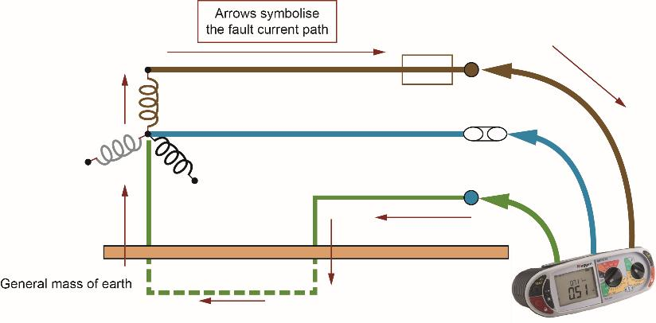
Step 1
Using a PFC tester to measure PEFC
This method measures the prospective earth fault current.
PEFC is the fault current, always written in KA, so this value would be 0.164KA.
Main substation transformer
164 A
Image supplied by www.test-meter.co.uk.

Slide 23
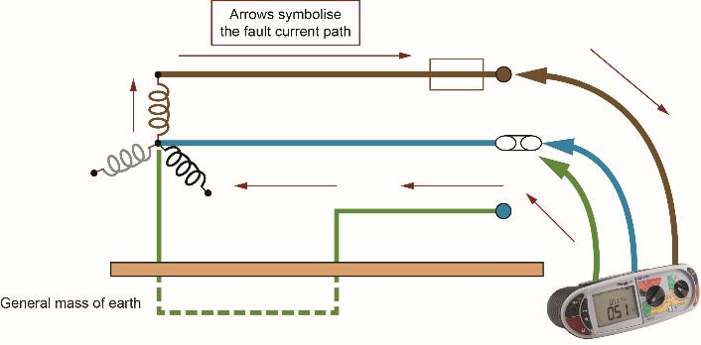
Step 2
Using a PFC tester to measure PSSC
This method is measuring the prospective short-circuit current.
PSSC is the fault current, always written in KA and whichever is the highest value between step 1 or step 2 will be the value of PFC to be recorded. In this case, 0.614KA would be recorded.
614 A

Slide 24
Summary
You should now be able to:
Explain what ADS is and when it applies (TN and TT systems)
Check protective devices meet disconnection times and that breaking capacity ≥ recorded PFC

Slide 25
Any questions?
Copyright in this document belongs to and is used under licence from the Department for Education, © 2025.
‘T-LEVELS’ and ‘T Level’ are registered trademarks of the Department for Education.
WJEC is authorised by the Department for Education to develop and deliver this T Level Technical Qualification.
WJEC operates in England under the name Eduqas which is a registered trademark of WJEC.

