Slide 1
Occupational Specialism: Electrotechnical Engineering
K1.15 Testing for electrotechnical systems
PowerPoint: 1.15 RCD testing
Notes:
Reference BS7671 regulation 643.3 insulation resistance and guidance note 3. Section 2.6.7 : insulation resistance
https://electrical.theiet.org/wiring-matters/years/2022/91-july-2022/changes-to-rcd-testing-in-bs-76712018plusa22022/

Slide 2
Introduction
What could go wrong if the RCD isn’t tested regularly?
Notes:
https://electrical.theiet.org/wiring-matters/years/2019/77-september-2019/which-rcd-type/

Slide 3
Objectives
By the end of this session, you should be able to:
Explain the purpose of RCD testing and when it is required
Select the correct test device and set the appropriate test current
Perform the trip test and accurately record the operating time
Compare your results with the maximum permitted times

Slide 4
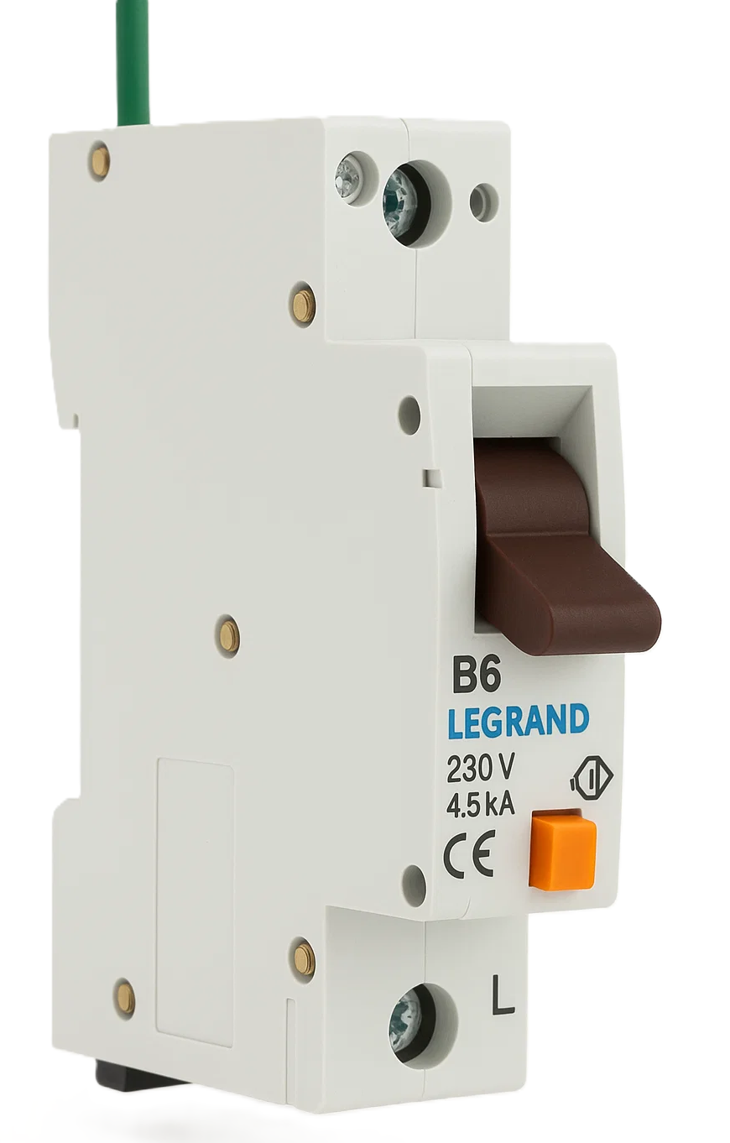
Additional protection: RCDs
In AC systems, residual current devices (RCDs) with a rated residual operating current not exceeding 30mA are recognised as additional protection in the event of failure of the provision for basic protection and/or the provision for fault protection or carelessness by users.
RCDs are a group of devices that provide extra protection to people and livestock by reducing the risk of electric shock.
Notes:
BS7671 Chapter 41,145.1.1, page 79

Slide 5
Testing RCDs
The object of the test is to verify the effectiveness of the residual current device:
operating with the correct sensitivity
proving the integrity of the electrical and mechanical elements.
Where an installation incorporates an RCD, an instruction notice shall be fixed in a prominent position at or near each RCD in the installation.
The notice shall be inscribed in indelible characters and shall read as shown above.
Notes:
Chapter 51, 514.12.2, page 136

Slide 6
Precautions to be taken before conducting IR tests
Where RCDs are required for additional protection, the effectiveness of automatic disconnection of supply by RCDs shall be verified using suitable test equipment according to BS EN 61557-6.
The trip times of RCDs are required to be verified to ensure adequate disconnection under fault conditions.
RCDs are tested by applying a test load to the RCD, inducing a calibrated test current to flow in the L–E circuit. This creates an imbalance in the L–N currents in the RCD and the device trips. The time it takes to trip is then displayed.
Failing to factor in all the relevant circumstances and guidance from BS 7671 into a design is very risky.
Notes:
BS7671 Chapter 64, 643.8, page 237
GN3 Section 4, 4.7, page 143

Slide 7






RCD leakage type detection
RCCB type | Residual/leakage current components
 | AC 50Hz | AC 50Hz | Smooth DC | AC>50Hz<kHz
AC | ✅ | ❌ | ❌ | ❌
A | ✅ | ✅ | <6mA (1) | ❌
F | ✅ | ✅ | <10mA (1) | ✅
B | ✅ | ✅ | ✅(1) | ✅
Notes:
(1) Type B RCCBs detect DC residual currents and trip if the smooth DC current exceeds the trip threshold.
Note: Type A and Type F will function safely with smooth DC residual currents present up to the levels indicated but they do not detect smooth DC. Therefore,
they must not be installed upstream of Type B RCCBs.
Discuss DC blinding and upstream, downstream testing procedure

Slide 8
Test current
RCDs are usually tested to ensure:
they do not trip with fault currents less than 50% of their operational rating
they trip in the required time at fault current of 100% of their operational rating.
Instruments also offer the ability to test the RCD’s tripping current threshold.
For this test, a ramp current is applied. The current at which the RCD trips is then displayed. This identifies if the RCD is overly sensitive and may cause nuisance tripping.
You need to know the tripping times of older and modern RCDs and RCBOs.
Notes:
There is no longer a requirement to perform a test using a test current equal to or higher than five times the rated residual current.
Whilst BS 7671:2018+A2:2022 doesn’t require other types of RCD testing, however additional tests are not precluded and may be useful for fault finding purposes, these tests could include:
½ x I_{Δn} test
5 x I_{Δn} test
RCD type (AC, A, B, F)
RCD tripping current (ramp test)
Phase angle (0° & 180°)

Slide 9
Phase-angle dependent testing
Why: RCD sensitivity and trip time can vary with residual current waveform angle.
How:
Set test instrument to deliver the test current at 0°
Repeat at 180°
The longer operating time should be recorded.
Both readings must fall within BS 7671 maximum trip-time limits.

Slide 10
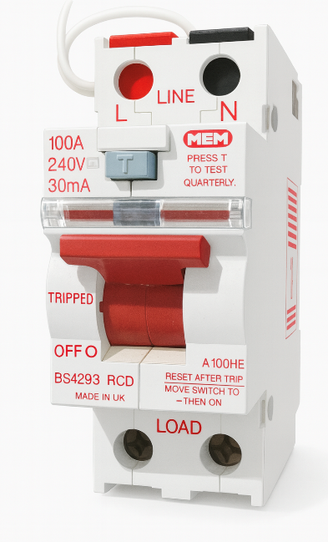
Electromagnetic RCDs: BS 4293
A built-in toroidal sensor detects even tiny residual currents and trips the device.
No separate earth reference is needed - the fault current itself powers the trip mechanism.
Unaffected by brief supply interruptions.
RCD rating (mA) | Tripping times
 | @x0.5 | @x1
30 or less | No trip | 200mS
100 or more | No trip | 200mS
Notes:
https://electrical.theiet.org/media/1482/rcd.pdf

Slide 11
Electronic RCDs and RCBOs
BS EN 61008 or BS EN 61009
Electronic circuits inside the device amplify imbalance signals—no separate toroid is needed.
A dedicated earth reference connection ensures tripping if the neutral supply is lost, since the device draws power from both the mains and fault current.
Always isolate these devices before performing insulation resistance tests to prevent damage and avoid misleading results.
RCD rating (mA) | Tripping times
 | @x0.5 | @x1
30 or less | No trip | 300mS
100 or more | No trip | 300mS

Slide 12
Test sequence
RCD testing is a live test.
Turn on the RCD and its upstream MCB.
Press Test button on the RCD to confirm mechanical operation.
Set the instrument to the RCD test function.
Select the test current to match the RCD’s rated residual operating current (IΔn), e.g. 30 mA.
Notes:
Discuss DC blinding and upstream, downstream testing procedure.

Slide 13
Test sequence continued
Connect the test leads or probes to the protected circuit.
Test 0.5 × IΔn to confirm no nuisance tripping.
Test 1 × IΔn at both 0° and 180°
Confirm results are satisfactory.
Record highest value of the 1 × IΔn test on schedule of test results sheet.
Notes:
Testing the RCDs can be done on the circuit or at the device in the distribution board.
Traditionally a ×5 test was done with a maximum trip time of 40mS, but this is not necessary today.
GN3 table 2.17 recommended tests and optional RCD tests
Note 4: ﻿﻿This test is required by Regulation 643.7 of BS 7671 (where the RCD is used for automatic disconnection of supply) or Regulation 643.8 of BS 7671 (where the RCD is used for additional protection). RCD to BS 4293 or BS 7288:1990 should meet the operating times of the appropriate product standard, where these are shorter than those specified in BS 7671:2018+A2:2022, because a longer operating time than that in the relevant product standard may indicate that the RCD is no longer operating correctly. The longest tripping time for each of the two tests (0° and 180°) is recorded in column 28 of the Schedule of Test Results

Slide 14
Summary
You should now be able to:
Explain the purpose of RCD testing and when it is required
Select the correct test device and set the appropriate test current
Perform the trip test and accurately record the operating time
Compare your results with the maximum permitted times

Slide 15
Any questions?
Copyright in this document belongs to and is used under licence from the Department for Education, © 2025.
‘T-LEVELS’ and ‘T Level’ are registered trademarks of the Department for Education.
WJEC is authorised by the Department for Education to develop and deliver this T Level Technical Qualification.
WJEC operates in England under the name Eduqas which is a registered trademark of WJEC.

