Slide 1
Occupational Specialism: Electrotechnical Engineering
K1.15 Testing for electrotechnical systems
PowerPoint 1.15: Insulation resistance
Notes:
Reference BS7671 regulation 643.3 insulation resistance and guidance note 3. Section 2.6.7 : insulation resistance

Slide 2
Introduction
Why do you think it's important to test insulation resistance before energising a circuit?

Slide 3
Objectives
By the end of this session, you should be able to:
Describe the purpose of insulation resistance (IR) testing and where it is applied
Identify the correct instruments and test voltages for IR tests
Explain the effect of circuit length and parallel connections on IR values
Interpret IR test results and understand what low readings might indicate
Notes:
Insulation resistance testing is a key safety check performed before energising a new installation. It confirms the integrity of the insulation between conductors and from live conductors to earth.

Slide 4
Precautions to be taken before conducting IR tests
Ensure that neons and capacitors are disconnected from circuits to avoid inaccurate test values being obtained.
Disconnect control equipment or apparatus constructed with semiconductor devices that are voltage-sensitive.
These devices will be liable to damage if exposed to the high-test voltages used.
This includes RCDs incorporating electronic amplifiers.
Ensure all lamps and current-using equipment are disconnected and all fuses and switches are closed.

Slide 5
Precautions to be taken before conducting IR tests
Loop out the strappers of two-way lighting circuits or test in every switch combination.
Where connected equipment is likely to influence the measurement or result of the test, or be damaged, the test shall be done before the connection of such equipment.
The test should be made at the distribution board with the supply off.
When testing individual circuits, it is important to remove the fuse or open the circuit breaker of that circuit to ensure that no other circuit within the board influences the test value.

Slide 6
Test voltages
The required test voltages and minimum insulation resistance values for circuits operating at various voltages:
Circuit nominal voltage (V) | Test voltage DC (V) | Minimum insulation resistance MΩ
SELV AND PELV | 250 | 0.5
Up to and including 500V with the exception of the above systems | 500 | 1.0
Above 500V | 1000 | 1.0
Notes:
BS7671 Chapter 64, 643.3.2, Table 64, page 234

Slide 7
Methods of testing insulation resistance
Insulation resistance testing is a fundamental test for inspectors.
Often, on larger construction sites, cables are insulation-resistant tested during various stages of installation to prove their integrity.
Retesting cables and equipment for insulation resistance as part of initial verification and during construction is always preferred.
BS 7671 permits reducing the test voltage applied to circuits following equipment connection to 250V DC, provided that cables were tested at 500V DC before connection.
Notes:
GN3 Section 2, 2.6.7, page 67
643.3.1 The insulation resistance shall be measured between:
(i) live conductors, and
(ii)live conductors and the protective conductor connected to the earthing arrangement. During this measurement, line and neutral conductors may be connected together.

Slide 8
Methods of testing insulation resistance: continued
Circuits can be tested individually or as a whole on less complex installations.
Tests are made between live conductors and live conductors and earth, with the earth being connected to the earthing arrangement.
The purpose of the test is to ensure that there are no circuits between live conductors and live conductors and earth.
This will verify that the insulation around the conductors is in good order and that the wiring is free of errors before it is energised.
Notes:
GN3 Section 2, 2.6.7, page 67

Slide 9
Insulation resistance tests
1. Insulation resistance test of the whole installation at the same time.
2. Insulation resistance test between line conductors of a circuit.
3. Insulation resistance test between line conductors and earth.
Notes:
Use the diagrams from the IET to describe how each of the insulation resistance tests are done.

Slide 10
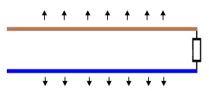
How cable length affects insulation resistance values
When we undertake the test, the insulation resistance of a cable length results from several small individual leakage paths or resistances between the conductor and the cable insulation.
These leakage paths are distributed along the cable, as shown by the arrows in the image.
What would be the insulation value if it were 200 metres?
Assume the cable length of this circuit is 100 metres with an insulation resistance value of 100MΩ.
Notes:
See next slide for answer to question.

Slide 11
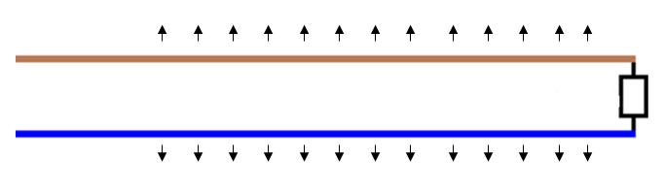
How length affects insulation resistance values
What would be the insulation value if it were 200 metres?
The longer the cable, the greater the number of leakage paths and the lower the insulation resistance.
There are twice as many leakage currents as the length has doubled.
Therefore, the insulation resistance value would have halved to 50MΩ.
The longer the circuit, the lower the insulation resistance value will fall.

Slide 12
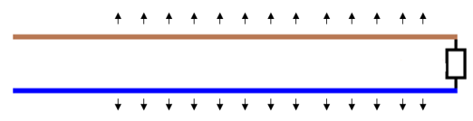
Insulation resistance values for parallel circuits
If two final circuits have an L–N insulation resistance of 100MΩ each and an insulation resistance test is carried out on each individually, the reading will be 100MΩ for each circuit.
100MΩ
100MΩ
Images supplied by www.test-meter.co.uk.

Slide 13
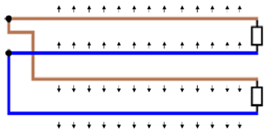
What is illumination and why does it matter?
What if the same two final circuits are connected together in parallel, as they would be in a consumer unit/distribution board?
Their combined insulation will be less than that for one circuit.
In this case, the test value would be 50MΩ
Let’s prove this by calculation.
100MΩ
100MΩ

Slide 14
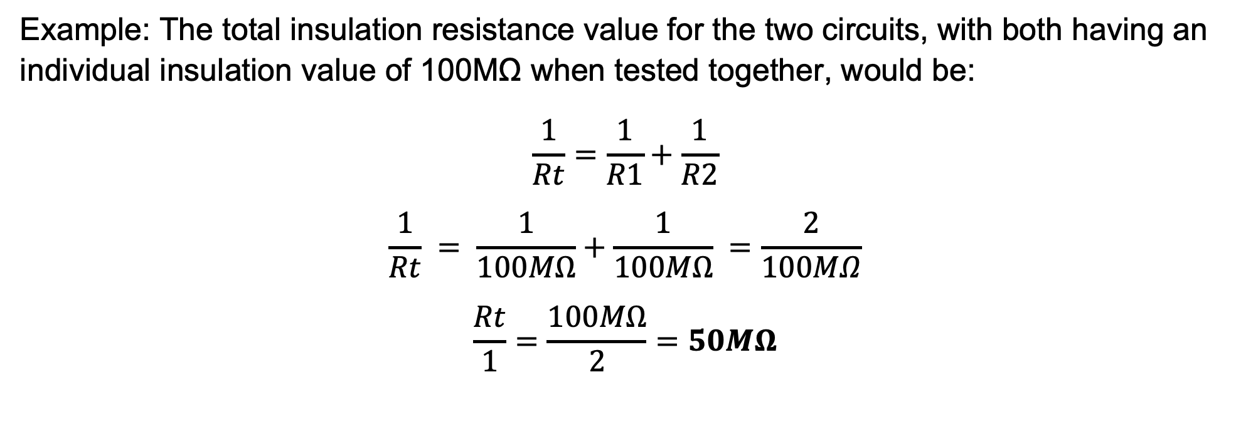
Cables connected in parallel
Example: The total insulation resistance value for the two circuits, with both having an individual insulation value of 100MΩ when tested together, would be:
$$\frac{1}{Rt}=\frac{1}{R1}+\frac{1}{R2}$$
$$\frac{1}{Rt} = \frac{1}{100MΩ}+\frac{1}{100MΩ} =\frac{2}{100MΩ}$$
$$\frac{Rt}{1}=\frac{100MΩ}{2}=50MΩ$$
Notes:
The more circuits connected to the consumer unit/distribution board and all tested at the same time (all together), the lower the insulation resistance value will be.
Note: the total resistance should always be lower than any individual circuit. In this case, the lowest value was 100MΩ and the total resistance for the two circuits was 50MΩ. This is a quick check to make sure your calculation is on the right track.

Slide 15
When insulation resistance readings are too low
If an insulation resistance reading falls below the minimum required value, it indicates possible faults or deterioration in the wiring system.
The first step is to isolate the affected circuit and check for obvious signs of damage, moisture or contamination. Disconnect sensitive equipment, then retest each circuit individually.
Persistent low readings may suggest faulty insulation, trapped moisture or cable degradation. In these cases, repair or replacement of the damaged section may be necessary before the installation can be safely energised.

Slide 16
Summary
You should now be able to:
Describe the purpose of insulation resistance (IR) testing and where it is applied
Identify the correct instruments and test voltages for IR tests
Explain the effect of circuit length and parallel connections on IR values
Interpret IR test results and understand what low readings might indicate

Slide 17
Any questions?
Copyright in this document belongs to and is used under licence from the Department for Education, © 2025.
‘T-LEVELS’ and ‘T Level’ are registered trademarks of the Department for Education.
WJEC is authorised by the Department for Education to develop and deliver this T Level Technical Qualification.
WJEC operates in England under the name Eduqas which is a registered trademark of WJEC.

