Slide 1
Occupational Specialism: Electrotechnical Engineering
K1.11 Methods of cable installation and wiring system supports
PowerPoint 1.11: Containment

Slide 2
Introduction
Where have you seen different types of cable supports in everyday common situations?

Slide 3
Objectives
By the end of this session, you should be able to:
Explain how to install cables and containment in line with current legislation and industry standards
Identify appropriate cable support systems, including trays, trunking, conduit, baskets, cleats, clips and hangers
Apply guidance from BS 7671, the On-Site Guide, and manufacturer instructions when fixing and routing cables
Notes:
This session builds on prior knowledge of cable types from K1.8. Learners now focus on how those cables are installed safely using the correct support systems. Tutor should reference real-world scenarios, manufacturer examples (e.g. Doncaster Cables or Prysmian), and show physical samples or videos where possible.

Slide 4
Why cable supports matter
Cable supports are essential for maintaining the safety, durability, and compliance of an electrical installation.
Properly selected and installed supports prevent mechanical strain, sagging, damage from external influences, and hazards during fire or maintenance.
Poor support breaches BS 7671 regulations and can lead to early failure, fire risk, or legal liability.

Slide 5
Following regulations and guidance
Electrical cable installations must meet the requirements of BS 7671, Building Regulations, and manufacturer instructions.
Key guidance includes the IET Wiring Regulations, On-Site Guide, and Guidance Notes such as GN1 (Selection & Erection) and GN4 (Protection Against Fire).
Installers must always follow manufacturer data and ensure systems are both compliant and safe.
Notes:
Reinforce that compliance isn’t just about BS 7671, Building Regs and manufacturer info matter too.
Refer to Reg. 134.1.1: Good workmanship by one or more skilled or instructed persons and proper materials shall be
used in the erection of the electrical installation. The installation of electrical equipment shall take account of manufacturers' instructions.

Slide 6
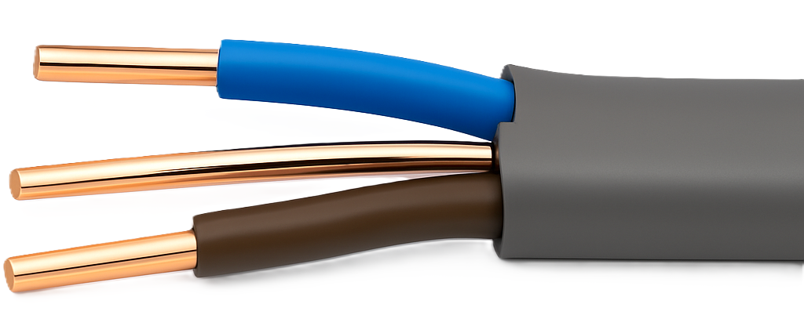
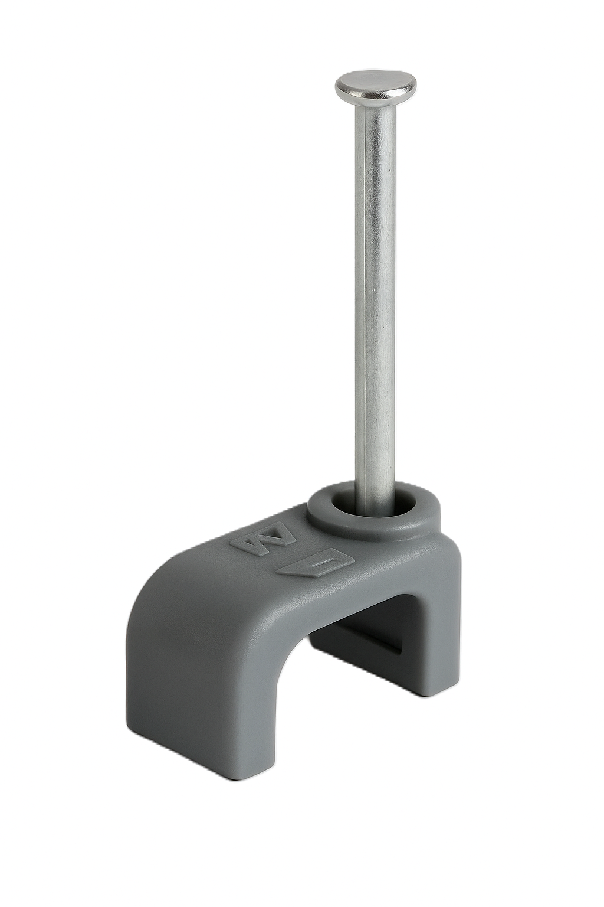
Thermoplastic cable installation
PVC-insulated and sheathed thermoplastic cables (e.g. twin and earth) are common in domestic and light commercial settings.
These cables can be clipped directly, run in trunking or conduit, and should be kept clear of excessive heat.
Support spacing and grouping must comply with BS 7671 and manufacturer guidance.
Notes:
Reference Reg. 521.10
Show support spacing and minimum bend radius from OSG Appendix D or manufacturer's guidance

Slide 7
SWA cable for external and underground use
Steel Wire Armoured (SWA) cables are ideal for outdoor or buried installations due to their mechanical strength.
They must be terminated with proper glands, earthed correctly, and laid with warning tape if buried.
Fixings must be secure and spaced according to the cable size and route.
Cleats are often used to hold the cable securely, or steel ties when fixed to containment.
Bending radius and burial depth must follow BS 7671 and manufacturer data.
Notes:
Show support spacing and minimum bend radius from OSG Appendix D or manufacturer's guidance.

Slide 8
Installing MICC cable
Mineral Insulated Copper Clad (MICC) is used in high-risk or fire-critical areas.
Offers excellent fire resistance and mechanical strength.
Requires specialist tools and training to install and terminate.
Must be supported with saddles or clips at regular intervals.
Bend radius and sheath integrity are critical.
Notes:
Reference IET GN4 (Protection Against Fire).
Reg. 521.10.202
Emphasise that incorrect bending or poor terminations will compromise integrity.
Demonstrate the different size glands, and how to choose the correct pots/glands.
https://wrexhammineralcables.com
Discuss installation methods and how they will be correctly supported.

Slide 9
FP200 and fire-resistant cables
FP200 and other fire-resistant cables are used in emergency lighting, alarms and essential systems.
These cables must maintain integrity during fire and be supported with steel clips or fixings that will not melt or fall apart.
Notes:
Some learners may confuse FP200 with MICC, clarify use cases.

Slide 10
Flexible cables and their applications
Flexible cables are used where frequent movement or vibration occurs, such as for handheld tools or appliances.
Always follow the manufacturer’s bend radius and ensure strain relief at terminations.
Notes:
Useful to show real cable types: PVC flex, rubber flex, braided flex.
Discuss uses and typical fixing methods.

Slide 11
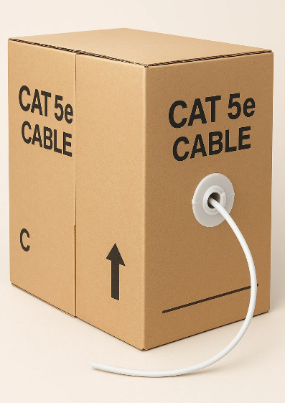
Data cables: CAT5 and CAT6
Used for structured data, internet and smart systems.
Must be kept clear of power cables to avoid interference.
Never over-bend or tightly tie - risk of signal loss.
Use appropriate connectors for the installation requirements and test with a data tester.
Notes:
Discuss cable segregation, such as bridges and trunking.
Discuss data cable in containment.

Slide 12
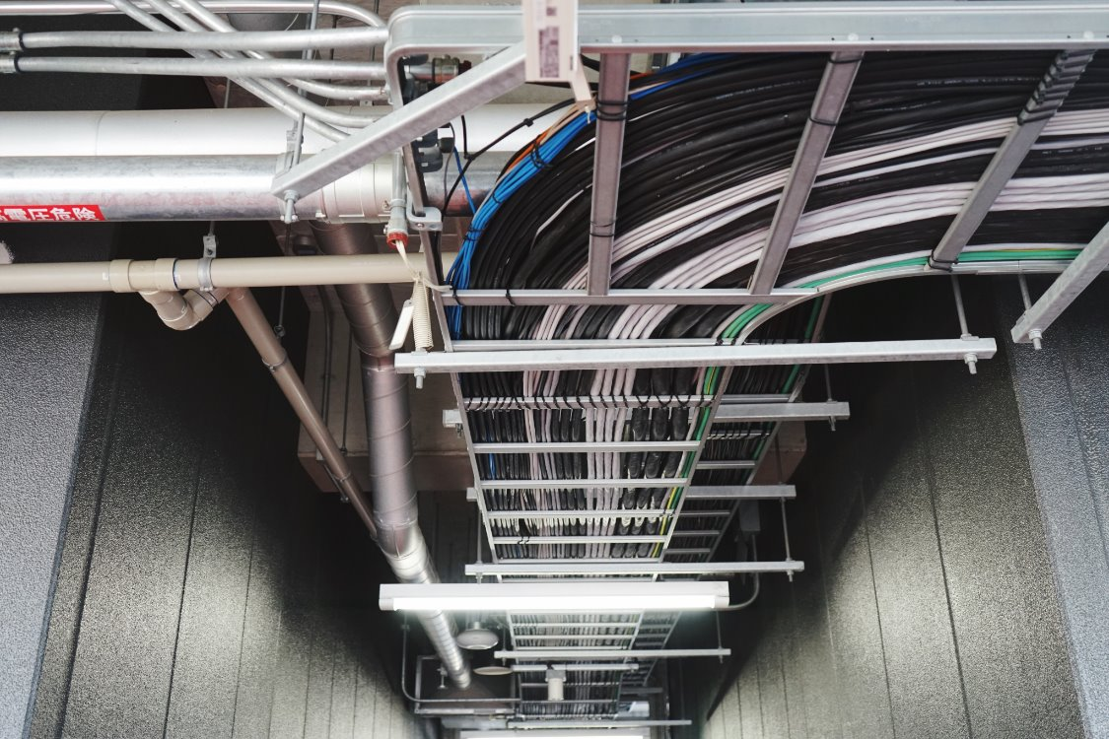
Cable tray: open containment for grouped circuits
Cable trays are metal open support systems for multiple cables, commonly used in commercial and industrial settings.
They allow heat dissipation and easy inspection, but cables must be fixed securely using appropriate ties or cleats, with weight evenly distributed.
Notes:
Discuss uses and advantages of the containment.
Prefabricated and on-site fabrication of bends.
Use correct tray couplers and earthing continuity method.
Demonstrate cable ties in class compare nylon vs steel fire-resistant types.

Slide 13
Steel and PVC conduit: Mechanical protection
Conduit systems enclose and protect individual cables.
Steel conduit offers high impact resistance, while PVC conduit is lightweight and corrosion-resistant.
Both require secure fixing and appropriate accessories like saddles and boxes.
Notes:
Reference BS 7671 Section 522.8 and Reg. 134.1.1 (manufacturer instructions).
Explain threading steel conduit and thermal expansion in PVC.
Discuss conduit fill capacity and pulling in single-core cables.
Discuss what scenarios would warrant steel conduit over PVC.
Refer to On-Site Guide Table D3 for fixing spacings.

Slide 14
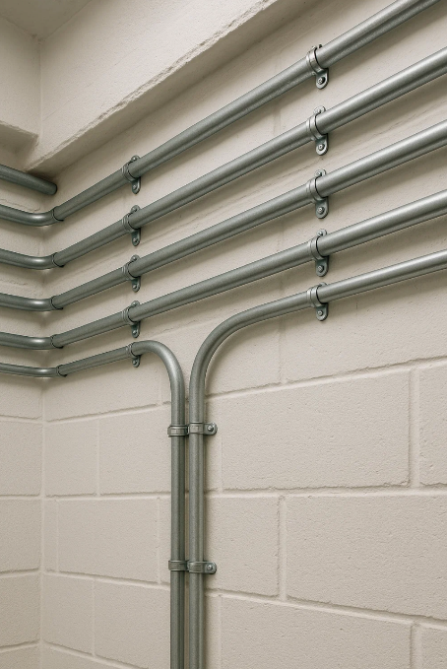
Steel conduit
Steel conduit is used in areas where mechanical protection is essential, such as workshops or external walls.
It must be securely supported, earthed, and threaded correctly.
Only single-core insulated cables are used inside.
Notes:
Refer to BS EN 61386 and BS 7671 Reg. 543.2.7 (earthing via conduit).
Highlight fire-resistance, durability, impact protection and industrial uses.
High installation and material costs.
Point out need for thread cutting and couplers.

Slide 15
PVC conduit
Easy to install and low-cost.
For domestic and light commercial use: Used in garages, schools, and some surface domestic installs.
Requires secure fixing at regular intervals.
Must allow for expansion in warm environments.
Notes:
Discuss use of inspection bends vs solid elbows.
Consider UV effects if installed outdoors.
Discuss the need for metal saddles on PVC conduit.

Slide 16
Cable trunking
Trunking allows cables to be grouped and routed around rooms while remaining accessible for maintenance and additions.
It can be plastic or steel and is ideal for offices, schools, or retrofit work.
Bends and sets can be purchased pre-fabricated or fabricated on-site.
Neat and accessible containment.
Notes:
Refer to BS 7671 Reg. 521.8
Discuss fire barriers if containment passes through fire barrier walls or floors.
Emphasise accessibility for maintenance and testing.
Discuss pre-fab/fabrication, fixing methods, fire rated fixings where required.

Slide 17
Ladder racking
Stronger than cable tray.
For large, heavy-duty cabling use.
Ideal for SWA or heavy LV power cabling.
Used in plant rooms, data centres and high-load areas.
Requires cleats or ties to prevent cable movement.
Notes:
Encourage learners to distinguish between tray and ladder.
Discuss need for supports, and weight distribution.

Slide 18
Cable basket
Cable basket systems are wire-mesh trays ideal for small-diameter flexible data or lighting cables.
They are lightweight, easy to cut and bend, and often used in ceilings or raised floors.
Fixing is typically done with plastic/steel cable ties.
Notes:
Useful in offices, hotels, or commercial lighting circuits.
Not suitable for heavy cabling.

Slide 19
Cable trunking: organised multi-cable routing
Rigid enclosure for surface wiring.
Metal or PVC options with clip-on lids.
Allows separation of circuits inside.
Easy access for maintenance and additions.
Notes:
Reference BS 7671 Reg. 523.5 Reg 523.6
Appendix tables 4C1 to 4C6
Discuss fire safety (e.g. fire barrier inserts).

Slide 20
Fixing accessories: cleats, clips and hangers
Cables must be supported using appropriate fixings to prevent sagging, movement, or damage.
Cleats are used for heavy-duty or armoured cables; clips suit lighter applications
Hangers are useful for high-level or ceiling routes. Fixing spacing depends on cable type and orientation.
Notes:
Refer to BS 7671 Reg. 521.10.202 – cables must be supported to prevent collapse in the event of fire (especially escape routes).
Mention max spacing guidelines from the IET On-Site Guide.
Discuss the importance of matching fixings to cable weight and installation conditions.

Slide 21
Regulations and standards for cable installation
BS 7671- wiring regulations.
Electricity at Work Regulations 1989.
IET On-Site Guide - practical installation advice.
Building Regulations Part P - domestic installations.
Always follow the manufacturer’s data for cable ratings and installation.
Notes:
Emphasise the legal duty to comply with EAWR and BS 7671, and how the selection of containment is affected by these regulations.
Reg. 134.1.1
Explain how Part P applies to notifiable domestic work.

Slide 22
Key principles for cable installation
Cable installations must follow current standards, use appropriate support systems, and match the environmental and mechanical demands of the site.
Proper fixing, containment and circuit planning ensure long-term safety, accessibility and compliance with legislation.

Slide 23
Summary
You should now be able to:
Explain how to install cables and containment in line with current legislation and industry standards
Identify appropriate cable support systems including trays, trunking, conduit, baskets, cleats, clips, and hangers
Apply guidance from BS 7671, the On-Site Guide, and manufacturer instructions when fixing and routing cables

Slide 24
Any questions?
Copyright in this document belongs to and is used under licence from the Department for Education, © 2025.
‘T-LEVELS’ and ‘T Level’ are registered trademarks of the Department for Education.
WJEC is authorised by the Department for Education to develop and deliver this T Level Technical Qualification.
WJEC operates in England under the name Eduqas which is a registered trademark of WJEC.

