Slide 1
Occupational Specialism: Electrotechnical Engineering
K1.9 Methods of selecting and erecting electrical installation components
PowerPoint 1.9: Methods of selecting and erecting electrical installation components

Slide 2
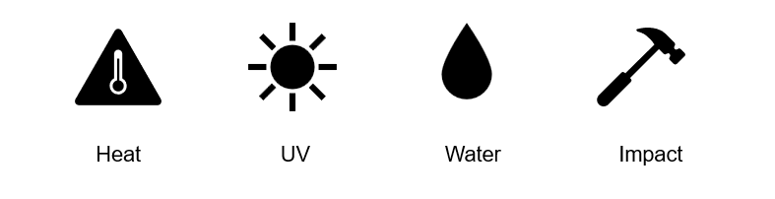
Introduction
What external influences should be considered when installing electrical components?
Notes:
Introduce this learning outcome as a continuation of K1.8. Emphasise that this section is regarding what is installed in or around the wiring systems covered in the previous section

Slide 3
Objectives
You should be able to:
Select suitable electrical components based on environmental, mechanical and electrical factors
Explain how different circuits (radial, ring-final, lighting, SELV/PELV) influence component choice
Understand how installation method and location impact the durability and safety of components

Slide 4
Guidance notes
When planning and selecting components, electricians should consult the full range of IET guidance documents:
GN1: Selection and erection
GN2: Isolation and switching
GN3: Inspection and testing
GN4: Protection against fire
GN5: Protection against electric shock
GN6: Protection against overcurrent
GN7: Special locations
GN8: Earthing and bonding
Notes:
Introduce learners to the physical IET books or PDFs. Explain that each Guidance Note focuses on a particular area of BS 7671 in more detail, offering practical advice and example applications.
Consider a task where students match scenarios to the right GN.
Which notes might be more useful for a designer vs an installer vs a tester?
When might GN7 be particularly critical?

Slide 5
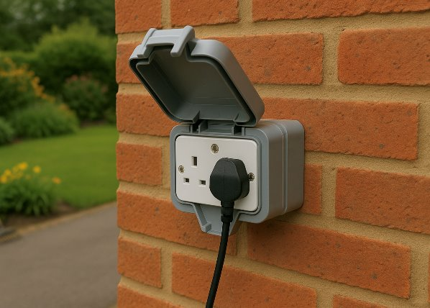
Introduction to selecting installation components
Every electrical installation includes a wide range of components, from switches and sockets to isolators, enclosures and circuit protection devices.
Choosing the right ones is about more than just cost or appearance. Each item must be suitable for its environment, load and installation method.
The goal is to ensure it is safe, durable and compliant with both BS 7671 and manufacturer instructions.
Notes:
Reinforce the importance of suitability based on mechanical, electrical, and environmental demands.
Highlight that manufacturer instructions and BS 7671 must both be followed — neither overrides the other.
Refer to the image: why is a weatherproof socket used here?
Discussion prompt:
What might happen if the wrong component was selected for an outdoor environment?

Slide 6
Electrical compatibility of components
All components must be rated for the circuit’s voltage and current.
For example:
a switch must have a voltage rating ≥ the system voltage (e.g. 230 V AC)
socket outlets must match the intended load current
protective devices short-circuit capacity ≥ the system short-circuit capacity.
Under-rated components can lead to overheating or dangerous failure.
Notes:
MCB rated at 6 kA on a board with 16 kA prospective fault = not suitable, emphasise the importance of this and explain why. Have an MCB/ components to demonstrate where to locate the rating.
Cover regulation 512.1 operational conditions.
Talk about BS1363 being the standard for socket outlets

Slide 7
Physical compatibility and space constraints
It’s not just about what a component can handle electrically; it also needs to fit physically.
Examples include:
devices that are too deep for surface boxes.
enclosures that don’t align with existing fixings.
cable entries that cause strain or tight bending.
BS 7671 Reg. 522.8.1 requires that wiring systems be installed to avoid damage from mechanical stress during erection and use.
Notes:
This slide explains that selecting components isn’t just about electrical ratings — physical fit is equally important for safe and compliant installations. Poor compatibility can result in strain, overheating, or long-term damage.
Examples to expand on in delivery:
Too-deep devices: A socket or dimmer module that protrudes from a shallow surface box may prevent correct fitting or leave terminals exposed.
Mismatched enclosures: If the backbox doesn’t align with the accessory or fixings, installers must not use makeshift solutions that compromise safety.
Cable strain: If entries are misaligned or entry holes too small, cables may be forced into tight bends or awkward angles, increasing mechanical stress and potentially reducing lifespan.

Slide 8
Choosing components based on the circuit type
The components you choose will depend heavily on the circuit they’re part of.
Ring-final circuits: Sockets, fused spurs, or appliance outlets.
Lighting circuits: 6 A rated switches or dimmers.
Radial circuits: Sockets, fused spurs, or appliance outlets.
Three-phase circuits: 400 V-rated isolators, Motors.
Auxiliary circuits: Control relays, timers,
Always check compatibility between circuit design and component type.
Notes:
Reinforce the link between design current, protection devices, and component ratings.
Encourage learners to match components to circuits.
https://buildings.honeywell.com/gb/en/br
https://electrical.theiet.org/wiring-matters/ands/our-brands/mk-electric

Slide 9
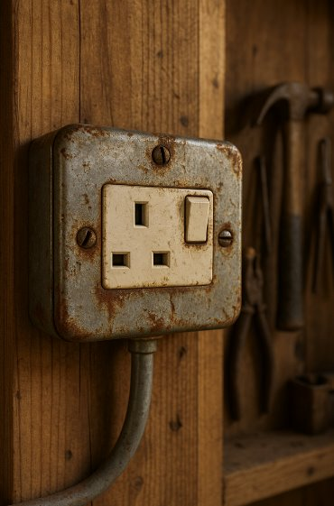
Understanding environmental influences
Environmental conditions can affect a component’s safety and lifespan. BS 7671 Section 522 requires the consideration of:
moisture (e.g. bathrooms, outdoor areas)
dust or solid particles (e.g. workshops)
corrosive chemicals or vapours (e.g. farms, swimming pools)
mechanical impact (e.g. public corridors, garages).
Each environment must be assessed, and suitable components must be chosen accordingly.
Notes:
Environmental factors can drastically reduce the performance, safety, and lifespan of electrical components if not properly accounted for during design and installation. Section 522 of BS 7671 requires installations to be suitable for their surroundings.
Key standards and regulations:
BS 7671 Section 522 External influences
BS EN 60529 – Ingress Protection (IP) ratings: dust/moisture protection
Use practical examples in class to make it memorable:
Metal socket rusting in a shed → moisture, unsuitable material
Plastic consumer unit cracking near a south-facing window → UV damage
Corroded light fittings in a stable or swimming pool → chemical vapours
Damaged trunking in a corridor due to repeated knocks by trolleys → mechanical impact

Slide 10
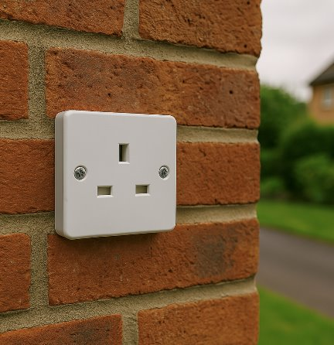
Choosing by IP rating (ingress protection)
Ingress Protection (IP) ratings define a component’s resistance to dust and water.
Typical examples:
IP20 Indoor dry areas only
IP44 Splash protection (e.g. kitchens, external walls with cover)
IP65/IP66 Hose-proof or jet-proof (outdoor use).
BS EN 60529 defines IP codes. Always match the IP rating to the zone or environment.
Notes:
Explain the IP code system (first digit = solids, second = water). Relate to bathroom zones or garden sockets.
https://uk.rs-online.com/web/content/discovery/ideas-and-advice/ip-ratings
https://www.iec.ch/ip-ratings
IP (Ingress Protection) ratings are essential for selecting components that can withstand the environmental hazards of dust and water. These ratings ensure safety, reliability, and longevity, especially in challenging locations.
Regulation 522.3 Requires appropriate protection from external influences like moisture
Also supports Regulation 512.2 external influences
Common examples to use in delivery:
IP20 socket in a dry lounge is acceptable, but not in a utility room with risk of splashing from a dog wash station.
IP44 for bathroom zones 2 or outdoor areas with a cover.
IP65/IP66 for garden sockets, garage lighting, car parks, or food processing areas with hose-down cleaning.
Consider questioning:
“What would happen if an IP20 fitting was installed in a barn?”
“What minimum IP rating would you choose for a socket on an external wall?”

Slide 11
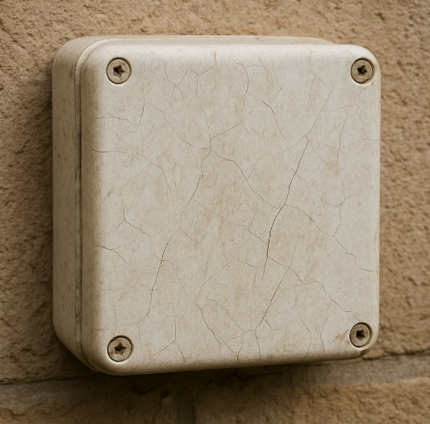
Components exposed to heat or cold
Components must operate reliably in temperature extremes.
Thermoplastic parts may deform near heat sources (e.g. cooker switches).
Outdoor enclosures may become brittle in cold climates.
Metal housings can cause condensation and internal corrosion.
Use components rated for the actual ambient range. See BS 7671 Reg. 522.1.2 and manufacturer datasheets for allowable temperature ranges.
Notes:
Components must be selected based on the temperature range they will encounter during operation and installation. Extreme heat or cold can damage or alter materials and electrical properties, potentially leading to unsafe conditions.
IET GN1 (Selection & Erection) and GN7 (Special Locations) provide guidance on installing in heat-exposed or cold environments.
Show learners degraded PVC cables (e.g. sun-damaged insulation or melted near cooker hobs).
Demonstrate the difference between ambient temperature (surrounding air temp) and operating temperature (heat generated during use).
Discuss how cold can lead to brittle plastics or condensation in metal enclosures, especially in garages or external sheds.
Demonstrate components that have been near a heat source which have degraded.
Demonstrate PVC that has been in contact with UV rays, showing how it degrades the material.
Highlight “ambient” vs “operating” temp.

Slide 12
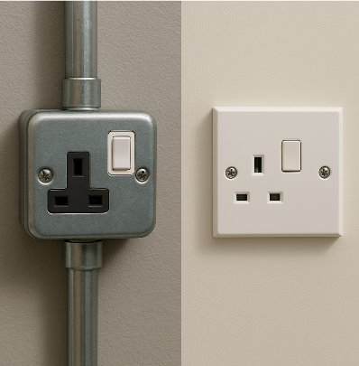
Mechanical protection and mounting
Some environments require components to resist knocks, impacts or physical strain.
Use metal-clad accessories in workshops.
Use reinforced enclosures in public areas.
Use flush-mounted fittings to reduce exposed edges.
All fixings must suit the surface and weight.
Follow BS 7671 Reg. 522.8 for mechanical protection and secure fixing methods.
Notes:
This slide focuses on ensuring electrical components are physically secure and protected against mechanical damage in environments where knocks, impacts, vibration, or tampering may occur. Mounting methods and protective construction play a key role in system safety and durability.
BS 7671 Regulation 522.8 — requires that wiring systems and equipment are installed so they are not subject to mechanical damage.
Fixings, supports and mounting should resist the intended load, vibrations, and accidental contact.
Contrast surface vs flush mounting:
"When would you want easy access (surface), and when is protection or appearance more important (flush)?"
Discuss the use of metal-clad vs plastic:
Metal = stronger, impact-resistant (e.g., workshops); plastic = safer around electrics but weaker.
Demonstrate typical mounting failures:
Loose sockets, cracked boxes, or wall plugs pulled out due to overloading or wrong fixings.

Slide 13
Chemical and fire-resistant components
In chemically aggressive or fire-sensitive areas, choose materials carefully.
Low smoke zero halogen (LSZH) enclosures or conduits in public buildings.
Corrosion-resistant metalwork for farms, commercial kitchens.
FP-rated (fire performance) junction boxes for emergency circuits.
BS 7671 Section 422 and IET Guidance Note 1 give guidance on special locations and materials.
Notes:
In environments where there is a higher risk of fire, chemical corrosion, or toxic smoke, components must be chosen to resist these hazards. This supports safety in escape routes and high-risk areas such as plant rooms, data centres, or kitchens.
BS 7671 Section 422: Protective measures where there is a risk of fire.
BS 8519: Application of fire-resistant power and control cable systems.
Guidance Note 1 (Design): Specifies material choices for particular environmental and fire risks.
Introduce the role of FP-rated components (e.g. FP200 Gold cable, fire-rated junction boxes) in emergency circuits like fire alarms or smoke extraction systems.
Explain LSZH (Low Smoke Zero Halogen): Reduces toxic smoke if the component burns. Commonly required in public buildings and confined spaces like train stations or tunnels.
Compare materials: Standard PVC vs LSZH vs metal vs heat-resistant plastics.
Suggested questions to learners:
“What might happen if you use PVC trunking in a corridor that's a fire escape route?”
“Why is LSZH used in data centres or hospitals?”

Slide 14
Selecting accessories for demanding environments
Sockets, switches and control gear must be selected for the location and use case. Examples:
metal-clad switches in workshops
weatherproof sockets for outdoor use
tamper-proof accessories in public spaces
isolators with padlock points for maintenance.
Always match the accessory to the environmental and mechanical demands of the site.
Notes:
Electrical accessories (sockets, switches, isolators, control devices) must be chosen to suit environmental, mechanical, and operational demands. In demanding locations, durability, ingress protection, safety, and tamper resistance become critical.
Contrast domestic accessories with industrial/commercial equivalents.
Emphasise how failure to select appropriate accessories can result in unsafe conditions, frequent replacement, or non-compliance.
Examples to expand on:
Metal-clad switches: Durable and impact-resistant, suited for workshops and garages.
Weatherproof accessories: IP66-rated sockets ideal for outdoor use or washdown areas.
Tamper-proof accessories: Public restrooms, train stations, and schools often use vandal-resistant fittings.
Lockable isolators: Used during planned maintenance or where accidental energisation poses a risk (e.g. rooftop AHUs or plant areas).

Slide 15
Compatibility with mounting systems
Components must be chosen to suit the mounting method.
Back box depth and format must match the device and the wall.
DIN-rail fittings, standard in most boards.
Panel-mounting, control cabinets and industrial setups.
Clip-in modular devices.
Improper mounting can lead to loose connections, overheating or failure to comply with BS 7671 Reg. 526.1 (connections must be sound and reliable).
Notes:
Components must be selected to match the mounting system in use—failure to do so can lead to poor fitment, unsafe connections, or non-compliance with BS 7671 Reg. 526.1, which states all connections must be “sound and reliable.”
Break down for learners:
Back box compatibility:
A switch or socket that doesn’t align with the wall box (e.g. overhangs, doesn’t screw flush) may cause strain or fail to meet IP ratings.
DIN-rail fittings:
Most consumer units and distribution boards are based on DIN rail. MCBs, RCBOs, AFDDs, etc., must match the busbar profile and slot in correctly. Show an MCB that doesn’t align or clips loosely as an example of incompatibility.
Show a mismatched MCB that doesn’t engage with the busbar.
Show a socket that overhangs a surface box, leaving exposed gaps.

Slide 16
Labelling, identification and accessibility
Correct labelling ensures safety during inspection, testing, and future work.
Requirements include:
circuit ID (e.g. CU1-L1 = lighting ground floor)
warning notices (e.g. RCD, SPD fitted)
device functions (e.g. cooker isolator, PV disconnector)
permanent markings, not handwritten, weather-resistant if outside.
BS 7671 Reg. 514.9.1 requires every circuit to be clearly identified.
Notes:
Accurate labelling is essential for safety during inspection, testing, maintenance, and emergency shutdowns. Clear circuit identification reduces fault-finding time, ensures correct device operation, and fulfils legal obligations under BS 7671

Slide 17
Maintaining safe access to installed components
Install components so they’re accessible for inspection and maintenance.
Don’t bury junction boxes in walls or ceilings (unless maintenance-free and documented).
Isolators must be reachable and clearly visible.
Allow space in enclosures for safe testing.
Avoid obstructing switchgear with cupboards or furniture.
BS 7671 Reg. 513.1 requires all electrical equipment to be accessible for inspection and maintenance.
Notes:
Use examples from real installations (e.g. sockets behind kitchen appliances or boards inside wardrobes). Ask learners where they've seen inaccessible equipment.

Slide 18
Grouping of circuits and components
When multiple circuits run together or are housed in one enclosure, consider the effects of grouping.
Increased heat: Potential derating of cables and devices.
Risk of electromagnetic interference (EMI) between control and power circuits.
Overcrowding makes maintenance and inspection difficult.
Notes:
Explain the link between grouping and derating factors (see BS7671 Tables 4C1/4C2). Discuss proper layout of boards to avoid cramming circuits side by side.
BS 7671 Reg. 523.7 and 536.4.202

Slide 19
Circuit segregation for safety and reliability
Certain circuits must be kept separate to avoid interference or for safety.
Low voltage and ELV (e.g. 230 V vs fire alarm cabling).
Data and power circuits (e.g. CAT6 and lighting cables).
BS 7671 Reg. 528 requires segregation by suitable barriers, spacing or insulation.
Notes:
Segregating different circuit types is essential for both electrical safety and signal integrity. Mains circuits can introduce electromagnetic interference (EMI) to sensitive data or safety-critical ELV systems (e.g. fire alarms).
BS 7671 Regulation 528 outlines how segregation must be achieved: by spacing, barriers, or insulation.

Slide 20
Ventilation and thermal effects in enclosures
Poor airflow around installed components can lead to:
overheating of protective devices (nuisance tripping or derating)
shortened lifespan of RCDs, RCBOs, control gear
loose terminals due to thermal expansion.
Ensure:
enclosures have ventilation space
cable entry points are sealed without blocking airflow
device layout allows cooling.
Notes:
Excess heat in enclosures can cause serious performance issues, particularly with RCDs, RCBOs, and control devices that are sensitive to temperature. BS 7671 Regulation 512.1.5 requires compliance with manufacturer’s installation data, especially around maximum ambient temperature and derating curves.

Slide 21
Verifying components before energisation
Before turning on power, the entire installation must be checked for:
correct type and location of each component
secure fixings, suitable mounting and accessibility
matching cable sizes, terminals and connections
functional labels.
This forms part of Initial Verification (BS 7671 Part 6) and should be recorded on a test certificate.
Notes:
Explain that visual checks come before any dead or live testing. That it’s a ongoing process throughout the installation.Reference GN3 or sample test sheets showing schedule of inspections.

Slide 22
How to read a component datasheet
Manufacturer datasheets provide essential details for selecting components correctly.
Electrical ratings: Voltage, current, frequency.
Environmental ratings: IP code, temperature range.
Mechanical dimensions: Fixing centres, knockout sizes.
Standards compliance: BS EN codes.
Always verify datasheet values against your design criteria and installation environment before selecting.
Notes:
Show a real example (e.g. a Schneider RCBO datasheet). Highlight how learners can locate rated current, terminal torque, and compatibility info.
https://www.se.com/uk/en/product/A9D31806/ic60h-earth-leakage-circuit-breaker-1p-+-n-b-curve-6-a-30-ma-240-v/

Slide 23
Derating when components must be adjusted
Some components cannot operate at full rating in all conditions. You must derate:
for ambient temperature: high heat reduces current capacity
for grouping: multiple circuits together increase internal heat
In enclosures: restricted airflow causes thermal stress.
BS 7671 Appendix 4 and the On-Site Guide provide correction factors to apply when selecting components.
Notes:
Refer to Table 4C1 and 4C2 (grouping) and Appendix 4 for ambient effects. A worked example of a 32 A MCB derated due to heat would be helpful here.

Slide 24
When components don’t work together
Some components can create problems when used together.
LEDs with older dimmers = flickering or damage.
Switches with inductive loads = arcing and shortened lifespan.
Timers or PIRs with high inrush loads = tripping or failure.
Always check compatibility on datasheets and use manufacturer-tested combinations when possible.
Notes:
Some components may not be compatible due to differences in technology or electrical characteristics. This can cause damage, nuisance tripping, or dangerous failure. Compatibility should always be verified using manufacturer datasheets.
Give examples: trailing-edge dimmers vs leading-edge dimmers; PIRs switching LED fittings.

Slide 25
Prefabricated modular wiring systems
Prefabricated wiring systems are increasingly used in commercial and domestic work. Benefits include:
pre-tested factory assemblies
plug-and-play installation (e.g. flex7, Apex)
reduced labour time and human error.
BUT they must be installed to manufacturer guidelines and tested fully on-site per BS 7671 Part 6.
Notes:
https://electrical.theiet.org/media/1556/specification-of-prefabricated-wiring-systems.pdf
Show an image of modular ceiling rose or prewired grid. Emphasise that installers must not modify or extend them without approval — they’re pre-certified.

Slide 26

Choosing components for accessibility and needs
Component selection must consider all users, especially in public or assisted living environments. Consider:
switch height and position, wheelchair accessible
clear labelling and large toggles for visually impaired users
low-force switching for arthritis or limited mobility
door entry, lighting controls linked to assistive systems.
This aligns with BS 8300 and the Equality Act 2010.

Slide 27
Smart accessories and emerging technologies
Modern installations may use “smart” components that link with home automation or energy management.
Smart switches and sockets (e.g. WiFi or Zigbee).
PIRs and timers with programmable logic.
Energy monitoring circuit breakers and distribution boards.
Voice-activated lighting or load control.
These must still comply with BS 7671 and manufacturer installation instructions.
Notes:
This slide introduces learners to the increasing use of smart components in modern electrical installations. These devices support home automation, energy monitoring, and programmable control. Emphasise that while these technologies offer enhanced functionality, they must still comply with BS 7671 and manufacturer installation instructions.
Demonstrate a smart switch or app-controlled accessory. Highlight the need for good connectivity, and isolation during maintenance.
“Have you ever installed or used a smart accessory at home?”
“What happens if the WiFi drops out, will the switch still work?”
“How would you isolate a voice-controlled switch to work on it safely?”

Slide 28
Summary
You should now be able to:
Select suitable electrical components based on environmental, mechanical and electrical factors
Explain how different circuits (radial, ring-final, lighting, SELV/PELV) influence component choice
Understand how installation method and location impact the durability and safety of components

Slide 29
Any questions?
Copyright in this document belongs to and is used under licence from the Department for Education, © 2025.
‘T-LEVELS’ and ‘T Level’ are registered trademarks of the Department for Education.
WJEC is authorised by the Department for Education to develop and deliver this T Level Technical Qualification.
WJEC operates in England under the name Eduqas which is a registered trademark of WJEC.

