Slide 1
Occupational Specialism: Electrotechnical Engineering
K1.8 Methods of selecting and installing wiring systems
PowerPoint 1.8: Installing wiring systems to meet industry standards

Slide 2
Introduction
Which cable type do you think is used the most in UK homes, and why?

Slide 3
Objectives
By the end of this session, you should be able to:
Identify different types of wiring systems used in installations
Explain how cable types are selected based on environmental and technical factors
Compare circuit arrangements such as ring-final and radial power circuits, and lighting circuit wiring systems

Slide 4
Which documents can be consulted?
Wiring must follow legal and industry rules.
Electricity at Work Regulations (1989): Law.
BS 7671: Technical standard.
IET On-Site Guide: Simplified guide for general use.
Manufacturer datasheets: Must be followed.
Notes:
BS 7671 tells you how to meet the law in practice. Focus on Regulation 134.1.1 (install to recognised standard) and 120.3 (equipment must be fit for service).
Explain the importance of manufacturers instructions,

Slide 5
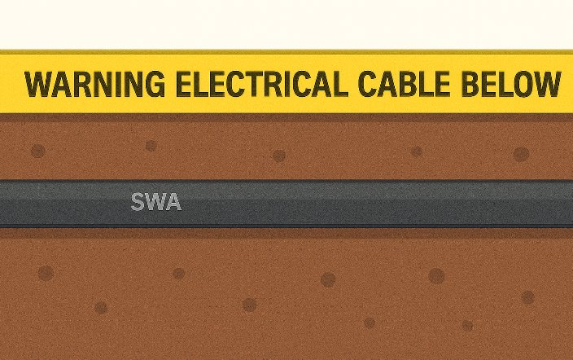
Selecting the right cable – what matters?
Where is the cable to be installed? Indoor/outdoor, hot/cold, wet/dry.
Will it be subjected to impact, chemicals, or UV light?
How much current will it carry?
Will the cable be grouped with others or buried?
Notes:
This relates to BS 7671 Reg. 522.1.1. Ask learners: “Would you install the same cable in a shed, a bathroom, and a loft space?”

Slide 6
Wiring system categories
Wiring systems are grouped into four categories.
Voltage: Low voltage (e.g. 230 V) or extra-low voltage (e.g. 12 V control).
Installation: Fixed or flexible.
Construction: Armoured or non-armoured.
Function: Power, lighting, control, or data.
Notes:
Relate this to real installations. ELV: door access systems, alarm loops. Fixed: twin-and-earth. Flexible: appliance leads. Armoured: SWA for outdoor use.

Slide 7
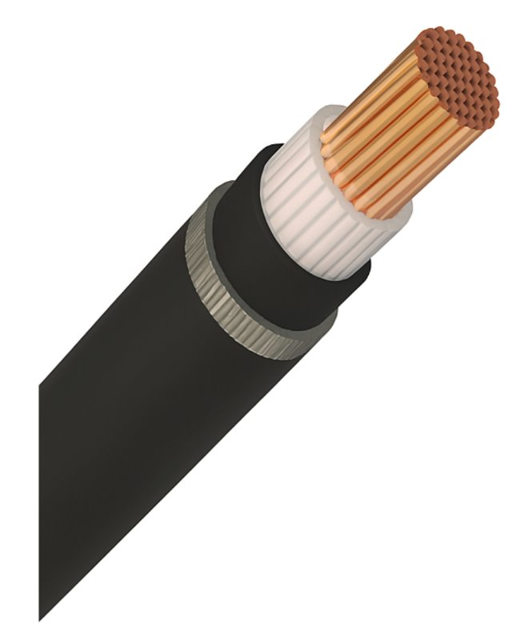
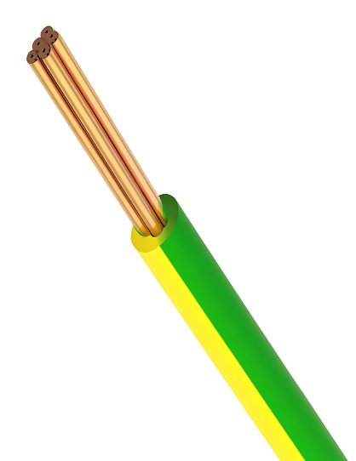
What makes up a cable?
A typical cable includes a copper conductor and insulation (like PVC or XLPE).
It may have extra protection like steel wire armour and an outer sheath.
Each part helps the cable do its job safely, carrying current and avoiding overheating in its installed environment.
Notes:
Introduce the structure using a visual (diagram or cross-section). Explain that sheath choice matters for fire safety and insulation type matters for temperature or voltage.

Slide 8
Twin and earth (6242Y)
This flat PVC/PVC cable is widely used in domestic wiring for lighting and socket circuits. It includes:
line and neutral cores
a bare CPC (earth)
a flat PVC sheath.
Used indoors in dry areas, it must be installed at safe depths (Reg. 522.6.202) or protected by an RCD.
Notes:
Show a sample cable. Highlight that it’s not suitable for outside or wet conditions. Mention CPC and how it must be sleeved at terminations.
Reg. 522.6.202 A cable installed in a wall or partition at a depth of less than 50 mm from a surface of the wall or partition shall:
(i) be installed in a zone within 150mm from the top of the wall or partition or within 150 mm of an angle formed by two adjoining walls or partitions. Where the cable is connected to a point, accessory or switchgear on any surface of the wall or partition, the cable may be installed in a zone either horizontally or vertically, to the point, accessory or switchgear. Where the location of the accessory, point or switchgear can be determined from the reverse side, a zone formed on one side of a wall of 100 mm thickness or less or partition of 100 mm thickness or less extends to the reverse side, or
(ii) comply with Regulation 522.6.204.
Where indent (i) but not indent (ii) applies, the cable shall be provided with additional protection by means of an RCD having the characteristics specified in Regulation 415.1.1.
Advantages of PVC/PVC flat profile cable:
This cable type is economical and can be installed directly onto surfaces.
It is capable of withstanding a broad temperature range, from very cold to very hot conditions, and maintains performance.
Its flexibility and durability under movement make it a practical choice for many installation scenarios.
Advantages of PVC/PVC flat profile cable
This cable type is economical and can be installed directly onto surfaces.
It is capable of withstanding a broad temperature range, from very cold to very hot conditions, and maintains performance.
Limitations of PVC/PVC flat profile cable
Its flexibility and durability under movement make it a practical choice for many installation scenarios.
PVC/PVC flat profile cable is not intended for use in areas exposed to regular mechanical damage, movement, or environmental extremes. It must be securely supported to avoid sagging, and cannot be suspended on catenary systems.
Additionally, the PVC sheath is susceptible to degradation under ultraviolet light, making the cable unsuitable for prolonged outdoor use unless protected. Although it can last for decades in optimal conditions, exposure to direct sunlight or harsh weather significantly shortens its lifespan.
https://datasheet.draka.com/pdf/datasheet/en-GB/313111

Slide 9
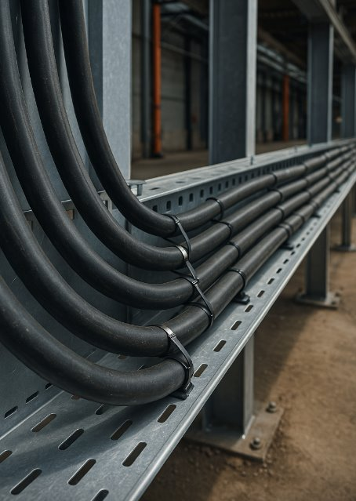
Why we use steel wire armoured (SWA) cable
SWA is designed for strength and safety. It’s ideal for:
outdoor lighting or garage supplies
buried cables (in ducts or with marker tape)
harsh areas like workshops or farms.
The armour protects the conductors and can be used as a CPC (Reg. 543.2.7).
Notes:
Demonstrate glanded cables with indoor and outdoor glands if you have samples. Emphasise gland earthing and waterproofing.
Mention
Reg. 522.8.5 (every cable or conductor shall be supported in such a way that it is not exposed to undo mechanical strain).
Reg. 543.2.7 where the protective conductor is formed by metal conduit, trunking or ducting or the metal sheath and/or armour of a cable the earthing terminal of each accessory shall be connected by a separate protective conductor to an earthing terminal incorporated in the associated box or the enclosure.
Reg. 522.8.10 Except where installed in a conduit or duct which provides equivalent protection against mechanical
damage, a cable buried in the ground shall incorporate an earthed armour or metal sheath or both, suitable for use as a protective conductor. The location of buried cables shall be marked by cable covers or a suitable marker tape.
Buried conduits and ducts shall be suitably identified. Buried cables, conduits and ducts shall be at a sufficient depth to avoid being damaged by any reasonably foreseeable disturbance of the ground.

Slide 10
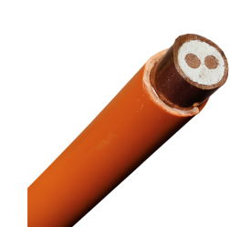
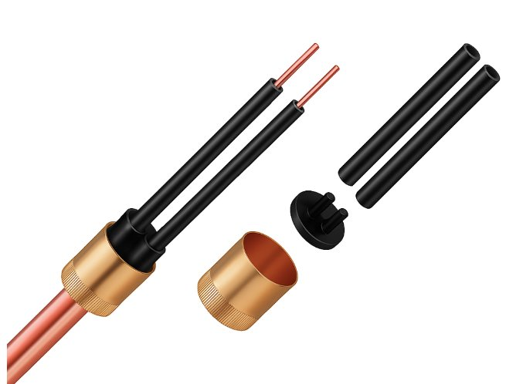
Mineral-insulated cable (MICC)
MICC cables have a copper sheath and compacted mineral insulation.
They’re highly fire-resistant and don’t release toxic fumes.
These cables are used in escape routes, emergency lighting and critical circuits. Often found in hospitals or industrial installations.
Installation is more difficult and requires special tools.
Notes:
If available, show a piece of MICC and accessories. Explain that they're required in some fire strategies (e.g. BS 8519). Ask learners where they'd expect to find these installed.
https://wrexhammineralcables.com/micc/

Slide 11
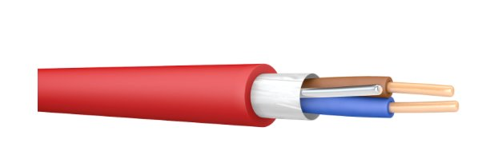
Fire performance and LSZH cables
Low smoke zero halogen (LSZH) cables like FP200 are designed to limit smoke and toxic gases during a fire.
They're used in:
emergency systems (alarms, lighting)
public spaces like hospitals and schools
escape routes (Reg. 422).
Supports must be metallic (Reg. 521.10.202).
Notes:
Compare PVC vs. LSZH in fire: show a video or diagram if possible. Reinforce that the fixings matter as much as the cable, plastic clips melt under heat.
Discuss regulations 422 and their implications to choice of materials.
Reg. 521.10.202 Wiring systems shall be supported such that they will not be liable to premature collapse in the event of a fire.
NOTE 1: Wiring systems hanging across access or egress routes may hinder evacuation and firefighting activities.
NOTE 2: Cables installed in or on steel cable containment systems are deemed to meet the requirements of this regulation.
Discuss appendix 13 ESCAPE ROUTE AND FIRE PROTECTION
https://www.powerandcables.com/product/product-category/prysmian-fp200-flex-fire-resistant-cable/
https://datasheet.prysmian.com/pdf/datasheet/en-GB/312421/GB00_6491B
https://uk.prysmian.com/markets/electrification/industrial-and-construction/fire-performance-cables/fp200-gold

Slide 12
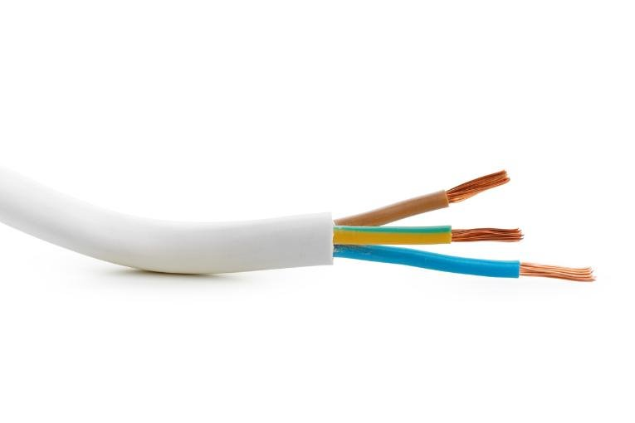
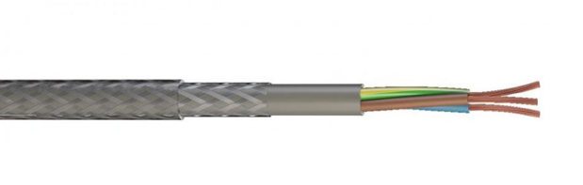
Understanding flexible and control cables
Flexible cables are used where movement is expected, like appliances, lighting pendants or machinery.
Control cables (like SY or CY types) often include screening to reduce interference and are common in building automation or industrial settings.
These cables must still meet mechanical and insulation requirements (Reg. 522.6.1, 522.8.1).
Notes:
Show differences between flexible flex, SY screened control cable, and rubber flex. Ask: “Would you use these for fixed wiring?”
Reg. 521.9.1A flexible cable shall be used for fixed wiring only where the relevant provisions of BS 7671 are met.
Flexible cables used for fixed wiring shall be of the heavy duty type unless the risk of damage during installation and damage is provided.
service, due to impact or other mechanical stresses, is low or has been minimized or protection against mechanical
Reg. 522.6.1 Wiring systems shall be selected and erected so as to minimize the damage arising from mechanical
stress, e.g. by impact, abrasion, penetration, tension or compression during installation, use or maintenance.
Reg. 522.8.1 A wiring system shall be selected and erected to avoid during installation, use or maintenance, damage to the sheath or insulation of cables and their terminations. The use of any lubricants that can have a detrimental effect on the cable or wiring system are not permitted
https://dk.prysmian.com/sites/default/files/atoms/files/Draka%20M-Flex%20Control%20Cables%20Web.pdf

Slide 13
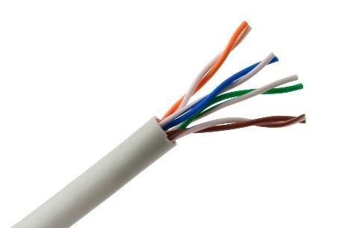
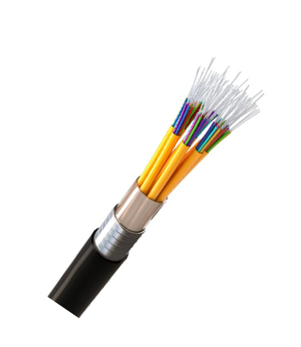
Data and fibre-optic cable basics
Twisted pair: Used for data (Cat 5e, Cat 6).
Coaxial: Common for CCTV and TV.
Fibre optic: EMI-proof, high speed over distance.
ELV systems: Usually 12 V or 24 V control or signalling.
Segregation: Cables used for band 1 and band 2 voltages should not be run in the same wiring system unless the requirements of regulation 528.1 are met.
Notes:
Emphasise data/fibre are not power cables, must be installed with proper separation (e.g. trunking dividers). Show bend radius limits on fibre (tight bends = signal loss).
Reg. 528.1 Proximity to electrical services
Except where one of the following methods is adopted, neither a voltage Band I nor a voltage Band II circuit shall be contained in the same wiring system as a circuit of nominal voltage exceeding that of low voltage, and a Band I circuit shall not be contained in the same wiring system as a Band II circuit:
(i)Every cable or conductor is insulated for the highest voltage present
(ii) Each conductor of a multicore cable is insulated for the highest voltage present in the cable
(iii) The cables are insulated for their system voltage and installed in a separate compartment of a cable ducting
or cable trunking system
(iv) The cables are installed on a cable tray system where physical separation is provided by a partition
(v) A separate conduit, trunking or ducting system is employed
(vi)For a multicore cable, the cores of the Band I circuit are separated from the cores of the Band II circuit by an earthed metal screen of equivalent current-carrying capacity to that of the largest core of a Band Il circuit.
For SELV and PELV systems the requirements of Regulation 414.4 shall apply.
NOTE 1: In the case of proximity of wiring systems and lightning protection systems, BS EN 62305 should be considered.
NOTE 2: Recommendations for separation and segregation in relation to safety services are given in BS 5266, BS 5839 and
BS 8519.

Slide 14
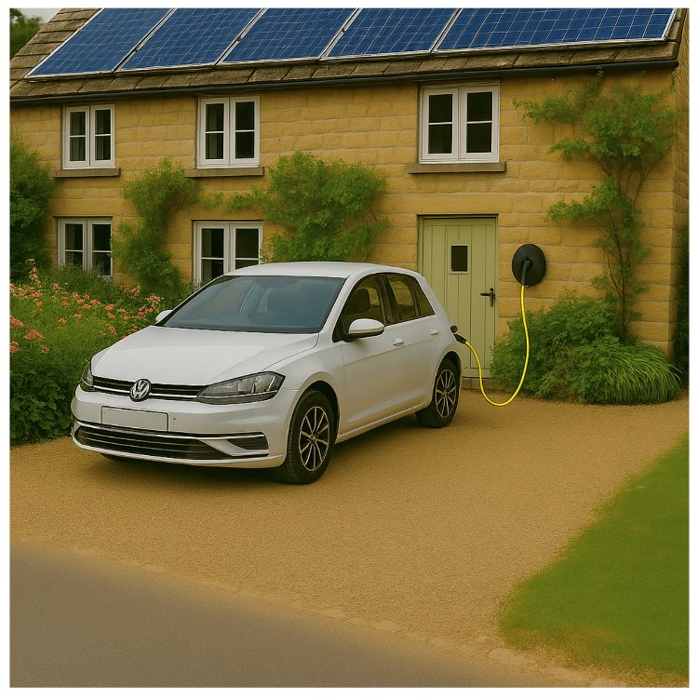
DC-rated cables
Solar panels, battery storage and EV chargers often use DC wiring.
These systems require cables with appropriate insulation and current capacity for DC use.
Polarity is critical, and RCDs must be carefully selected as some DC currents can blind Type AC RCDs (see IET Code of Practice on EV Charging).
Use double-insulated cables and verify voltage drop on long runs.
Notes:
Mention how DC arcs behave differently (harder to extinguish). Ask: “Why is DC cabling a growing topic for electricians?” – link to renewables and net zero goals.
Talk about DC RCD blinding and the increase in DC circuits due to renewable technology.
https://www.prysmian.com/staticres/Solar-Photovoltaic-Cables/6-7/
https://www.prysmian.com/staticres/525-kV-HVDC/
https://www.prysmian.com/staticres/Prysmian-PRYSOLAR/12/index.html

Slide 15
What is a radial circuit?
A radial circuit starts at the distribution board and supplies each point in sequence.
If an open circuit occurred in the line or neutral conductors at one point, then power to downstream sockets is lost.
Radial circuits are often used for small socket runs, outdoor supplies or fixed loads.
Notes:
Ask: “what would be classified as a fixed load in a house?”
See diagram: https://sparkyhelp.co.uk/what-is-a-radial-circuit/

Slide 16
Understanding the ring-final circuit
Ring-final circuits loop from the consumer unit and return, supplying sockets along the way.
They allow current to flow both ways and help reduce voltage drop.
Typically protected by a 32 A MCB and wired in 2.5 mm² twin and earth.
These circuits must meet Reg. 433.1.1, especially if they supply fixed equipment over 2 kW.
Notes:
See diagram: https://electrical.theiet.org/media/1618/iee-ring-final-circuit-meeting.pdf
Mention testing for ring continuity (end-to-end resistance). Ask: “What happens if one leg of the ring breaks?”
Reg. 433.1.204 Accessories to BS 1363 may be supplied through a ring final circuit, with or without unfused spurs,
protected by a 30 A or 32 A protective device complying with BS 88 series, BS 3036, BS EN 60898, BS EN 60947-2 or BS EN 61009-1 (RCBO). The circuit shall be wired with copper conductors having line and neutral conductors with a minimum cross-sectional area of 2.5 mm² except for two-core mineral insulated cables complying with BS EN 60702-1, for which the minimum cross-sectional area is 1.5 mm² Such circuits are deemed to meet the requirements of Regulation 433.1.1 if the current-carrying capacity (Iz) of the cable is not less than 20 A and if, under the intended conditions of use, the load current in any part of the circuit is unlikely to exceed for long periods the current-carrying capacity (Iz) of the cable.
Reg. 433.1.1 The operating characteristics of a device protecting a conductor against overload shall satisfy the
following conditions:
(i) The rated current or current setting of the protective device (In) is not less than the design current (Ib) of the circuit, and
(ii) the rated current or current setting of the protective device (In) does not exceed the lowest of the current-carrying capacities (Iz) of any of the conductors of the circuit, and
(iii) the current (I2) causing effective operation of the protective device does not exceed 1.45 times the lowest of the current-carrying capacities (Iz) of any of the conductors of the circuit.
For adjustable protective devices, the rated current (In) is the current setting selected.
The current (I2) causing effective operation of the protective device is given in the product standard or may be provided by the manufacturer.
NOTE 1: Where overload protection is provided by BS 3036 fuses, refer to Regulation 433.1.202.
NOTE 2: Protection in accordance with this regulation may not provide protection in all cases, for example, where sustained
overcurrents less than I2 occur.

Slide 17
Ring-final versus radial
Ring-final
Used in UK domestic socket outlet circuits.
Shares the load current in both directions of the ring.
Larger floor area can be served.
Radial
Simpler layout.
Easier to extend.
Suits dedicated equipment like cookers or immersion heaters.
Notes:
Link to BS 7671 Appendix 15 RING AND RADIAL FINAL CIRCUIT ARRANGEMENTS

Slide 18
Lighting circuit design
Lighting circuits are usually radial in form and rated at 6 A. Two main arrangements are used.
1. Loop-in: All connections made at ceiling roses, with switch lines down to switches.
2. Switch fed: Connections made at the light switch, with a switch line taken up to the light.
Lighting conductors are often 1.0 or 1.5 mm² with a minimum of 1 mm².
Notes:
Draw both lighting circuit arrangements. Show where switch drops connect. Ask which method learners have seen more often.
Discuss table 52.3

Slide 19
1. Three-plate loop-in method
The three-plate method is common in domestic lighting.
Line, neutral and CPC conductors are looped at the ceiling rose, with switch wires going down to switches.
This eliminates the need for separate junction boxes.
Notes:
Use a photo or diagram of a ceiling rose with three-plate wiring. Discuss the old method of junction box lighting

Slide 20
2. Switch-fed method
The conductors are fed to the switch first, before continuing to the light fitting.
Neutral and CPC conductors terminated at the switch and connect directly at the light.
This method is often used when switches are easier to access than ceiling roses, or multiple lights are used, such as spotlights.
Notes:
. Emphasise colour-coding of switch wires.

Slide 21
Auxiliary and control wiring
Auxiliary circuits are used for switching, timing, signalling or control.
Examples include contactor coils, fire alarm interfaces, or BMS control.
These are usually ELV or control-voltage and must be separated from power cables unless they're rated for mixed use (Reg. 528.).
When used in containment, segregation is essential.
Notes:
Discuss where control cables are found in commercial systems. Ask: “What could happen if a 230 V power cable and 12 V signal cable were run together?”
Discuss Reg. 528

Slide 22
Emergency and safety systems wiring
Wiring for fire alarms, emergency lighting and smoke vents must remain operational during a fire.
Use fire-resistant cable (e.g. FP200 or MICC) that complies with BS EN 50200 or BS 7629-1.
Fixings must withstand heat; plastic clips are not acceptable (Reg. 521.10.202).
These circuits must also be clearly labelled and segregated from other services.
Notes:
Ask learners: “What features make a cable ‘fire resistant’?” and “Why must fixings be metal?” Use case studies of real fire incidents where cable failure made evacuation harder.

Slide 23
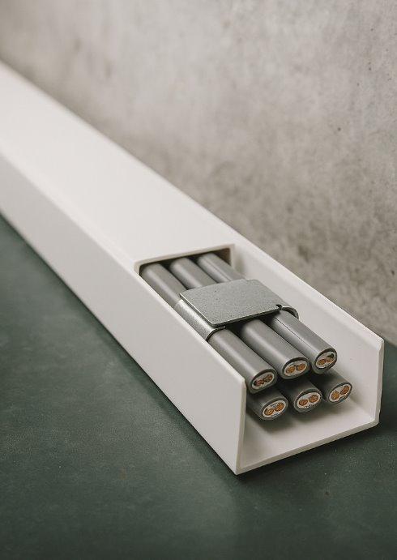
Supporting and fixing wiring systems
Cables must be securely supported and fixed to prevent strain and damage.
Fixing spacing depends on cable type and orientation.
For example, PVC sheathed cable with a diameter of up to 9 mm should be clipped:
horizontal runs: fix every 250 mm
vertical runs: fix every 400 mm.
Notes:
Discuss appendix D in the on-site guide

Slide 24
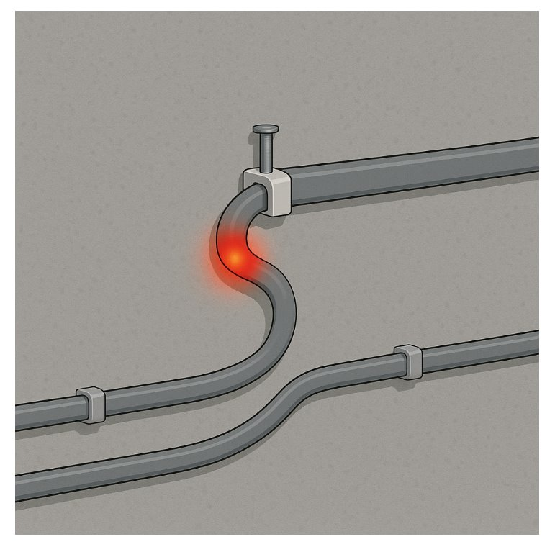
Bending radius
Cables must be installed without sharp bends or twists.
Most cables have a minimum bend radius, which can be found on the datasheet from the manufacturer.
For example: Four times the diameter for twin-and-earth.
Avoid running cables in areas with potential crushing, excessive heat or chemical exposure unless they are designed for it.
Notes:
Use flexible conduit or tray as examples. Ask: “What might happen if a bend is too tight?” (Insulation stress, conductor fracture).
https://datasheet.prysmian.com/pdf/datasheet/en-GB/312889/GB00_6243Y0300015CL1GY
https://datasheet.draka.com/pdf/datasheet/en-GB/313114

Slide 25
Cable jointing and terminations
Terminations must provide a reliable electrical and mechanical connection. This includes:
correct stripping and conductor preparation
use of compatible lugs, crimps or terminal blocks
proper tightening using calibrated tools
no loose strands or over-tightened connections.
Reg. 526.1 and 526.3 require joints to be accessible and durable unless encapsulated types are used.
Notes:
Show poor vs. good termination examples. Ask: “Why are torque settings important?” Link to overheating, arcing or insulation damage.

Slide 26
Summary
You should now be able to:
Identify different types of wiring systems used in installations
Explain how cable types are selected based on environmental and technical factors
Compare circuit arrangements such as ring-final and radial power circuits, and lighting circuit wiring systems

Slide 27
Any questions?
Copyright in this document belongs to and is used under licence from the Department for Education, © 2025.
‘T-LEVELS’ and ‘T Level’ are registered trademarks of the Department for Education.
WJEC is authorised by the Department for Education to develop and deliver this T Level Technical Qualification.
WJEC operates in England under the name Eduqas which is a registered trademark of WJEC.

