Slide 1
Occupational Specialism: Electrotechnical Engineering
K1.5 Application of the fundamental principles of national standards
PowerPoint 1.5 Part 6

Slide 2
Introduction
Which comes first during initial verification: inspection or testing?

Slide 3
Objectives
You should be able to:
Explain the scope of BS 7671 Part 6 and why inspection precedes testing

Slide 4
Chapter 64
641.6 The verification shall be made by one or more skilled persons competent in such work.
641.7 On completion of the verification, according to Regulations 641.1 to 641.6, a certificate shall be prepared (model forms in Appendix 6).

Slide 5
Chapter 64
641.1 Every installation shall, during erection and on completion before being put into service, be inspected and tested to verify, so far as reasonably practicable, that the requirements of BS 7671 have been met. 641.3 The verification shall include comparison of the results with relevant criteria to confirm that the requirements of BS 7671 have been met. 641.4 Precautions shall be taken to avoid danger to persons and livestock, and to avoid damage to property and installed equipment during inspection and testing. 641.5 For an addition or alteration to an existing installation, it shall be verified that the addition or alteration complies with BS 7671 and does not impair the safety of the existing install.

Slide 6
642 Inspection
642.1 Inspection shall precede testing and shall normally be done with that part of the installation under inspection disconnected from the supply.
642.2 The inspection shall be made to verify that the installed electrical equipment is:
in compliance with the requirements of Section 511
correctly selected and erected, taking into account manufacturers’ instructions, and not visibly damaged or defective so as to impair safety.
642.3 The inspection should cover the items listed.

Slide 7
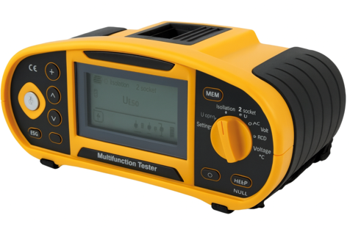
643 Testing
The tests of Regulations 643.2 to 643.6, where relevant, shall be carried out in that order before the installation is energised.
If any test indicates a failure to comply, that test and any preceding test, the results of which may have been influenced by the fault indicated, shall be repeated after the fault has been rectified.
Notes:
Refer to K1 .15 for more information on the testing sequence and procedures.

Slide 8
643.2 Continuity of conductors
643.2.1 The continuity of conductors and connections to exposed-conductive-parts and extraneous-conductive-parts, if any, shall be verified by a measurement of resistance of protective conductors, including protective bonding conductors and in the case of ring final circuits, live conductors.

Slide 9
643.3 Insulation resistance
643.3.1 The insulation resistance shall be measured between:
live conductors and
the protective conductor connected to the earthing arrangement. During this measurement, line and neutral conductors may be connected together.

Slide 10
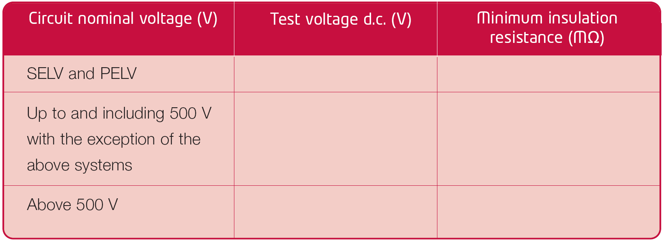
Table 64: Minimum values of insulation resistance
250
≥0.5
500
≥1.0
1000
≥ 1.0

Slide 11
643.3.3
Where connected equipment is likely to influence the measurement or result of the test or be damaged, the test shall be applied prior to the connection of such equipment, in accordance with Table 64.
Following connection of the equipment, a test at 250V DC shall be applied between live conductors and the protective conductor connected to the earthing arrangement. The insulation resistance shall have a value of at least 1MΩ.
Note: The manufacturer’s instructions may recommend disconnecting some equipment during 250V DC insulation resistance tests, as this may influence the test results.

Slide 12
643.6 Polarity
Where relevant, the polarity of the supply at the origin of the installation shall be verified before the installation is energised.
Every fuse and single-pole control and protective device is connected in the line conductor only.
The centre contact bayonet and Edison screw lamp holders have the outer or screwed contacts connected to the neutral conductor.
Wiring has been correctly connected throughout the installation.

Slide 13
643.7.3
643.7.3 Earth fault loop impedance and prospective fault current.
643.7.3.1 Relevant impedances shall be measured or determined by an alternative method. An electrical continuity test shall be carried out before conducting the earth fault loop impedance measurement. The measured earth fault loop impedance shall comply with Chapter 4.
Note 1: The validity of readings may be adversely affected by equipment, such as inverters.
Note 2: Further information on measurement of earth fault loop impedance can be found in Appendix 3.

Slide 14
643.7.3.201 Prospective fault current
The prospective short-circuit current and prospective earth fault current shall be measured, calculated or determined by another method at the origin and at other relevant points in the installation.
Note: Further information on the determination of prospective fault current can be found in Appendix 14.

Slide 15
643.8 Additional protection
Where RCDs are required for additional protection, the effectiveness of automatic disconnection of supply by RCDs shall be verified using suitable test equipment to confirm that the relevant requirements of Chapter 41 are met.
Note: Regardless of RCD type, effectiveness is deemed to have been confirmed where an RCD disconnects within the time stated below with an alternating current test at rated residual operating current I∆n.
For general non-delay type, 300ms maximum.

Slide 16
Phase sequence and functional testing
643.9 Check of phase sequence
For polyphase circuits, it shall be verified that the phase sequence is maintained at all relevant points throughout the installation.
643.10 Functional testing
Equipment shall be subjected to functional testing, as listed.
Note: This list is not exhaustive.
RCD and AFDD test buttons should be checked.

Slide 17
643.11 Verification of voltage drop
Where required to verify compliance with Chapter 52, the voltage drop shall be evaluated by measurement or by calculation.
Note: Verification of voltage drop is not normally required during initial verification.

Slide 18
644 Certification for initial verification
644.1 Except where Regulation 644.4.201 applies (minor works), upon completion of the verification of a new installation or an addition or alteration to an existing installation, including the replacement of a distribution board or consumer unit, an Electrical Installation Certificate based on the model given in Appendix 6 shall be issued to the person ordering the work.
644.1.1 For a new installation, any defect or omission revealed during the inspection and testing shall be corrected before the certificate is issued.

Slide 19
644.1.2
For an addition and/or alteration to an existing installation, any defect or omission that will affect the safety of the addition or alteration that is revealed during inspection and testing shall be corrected before the Certificate is issued.
Note: See Regulation 132.16.
The person responsible for the new work, or a person authorised to act on their behalf, shall record on the Electrical Installation Certificate or the Minor Electrical Installation Works Certificate any defects found, so far as is reasonably practicable, in the existing installation.

Slide 20
644
644.4.201 Where electrical installation work does not include the provision of a new circuit or replacement of a distribution board or consumer unit, a Minor Electrical Installation Works Certificate, based on the model given in Appendix 6, may be provided for each circuit that has been added to or altered as an alternative to an Electrical Installation Certificate.
644.5 Electrical Installation Certificates and Minor Electrical Installation Works Certificates shall be compiled and signed or otherwise authenticated by one or more skilled persons, competent to verify that the requirements of BS 7671 have been met.

Slide 21
Chapter 65: Periodic inspection and testing
651 General
651.1 Where required, periodic inspection and testing of every electrical installation shall be carried out in accordance with Regulations 651.2 to 651.5 in order to determine, so far as is reasonably practicable, whether the installation is in a satisfactory condition for continued service.

Slide 22
651.2
Periodic inspection shall be carried out without dismantling, or with partial dismantling, as required, supplemented by appropriate tests and measurements from Chapter 64, to provide for:
the safety of persons and livestock against the effects of electric shock and burns
protection against damage to property by fire and heat arising from an electrical installation defect
confirmation of correct rating and setting of protective devices required by Chapter 41
confirmation of correct rating and setting of monitoring devices (continued on next slide)

Slide 23
651.2 continued
confirmation that the installation is not damaged or deteriorated so as to impair safety
the identification of installation defects and non-compliances with the requirements of the relevant parts of BS 7671, that may give rise to danger.
Note 1: A generic list of examples of items requiring inspection is given in Appendix 6.
Note 2: Existing installations may have been designed and installed to conform to previous editions of BS 7671, applicable at the time of their design and erection. This does not necessarily mean that they are unsafe.

Slide 24
651
651.3 Periodic inspection and testing shall not cause danger to persons or livestock and shall not cause damage to property or equipment even if the circuit is defective.
651.4 Details of any damage, deterioration, defects or dangerous conditions shall be recorded in a report.
651.5 The periodic inspection and testing shall be carried out by one or more skilled persons competent in such work.

Slide 25
652 Frequency of periodic inspection and testing
652.1 The frequency of periodic inspection and testing of an installation shall be determined having regard to the type of installation and equipment, its use and operation, the frequency and quality of maintenance and the external influences to which it may be subjected. The results and recommendations of previous certificates and condition reports shall also be taken into account.

Slide 26
652.2
652.2 In the case of an installation under an effective management system for preventative maintenance in normal use, periodic inspection and testing may be replaced by an adequate regime of continuous monitoring and maintenance of the installation and all its constituent equipment by one or more skilled persons competent in such work. Appropriate records shall be kept.

Slide 27
653 Reporting for periodic inspection and testing
653.1 Upon completion, an Electrical Installation Condition Report based on the model given in Appendix 6 shall be produced. 653.2 The report shall include the following details of those parts of the installation that have been inspected and tested:
any limitations of the inspection and testing
any damage, deterioration, defects or dangerous conditions
any non-compliance with the requirements of BS 7671 which may give rise to danger.
Inspection schedule(s) as appropriate to those detailed in Section 642, schedules of circuit details and test results of the appropriate tests detailed in Section 643.

Slide 28
653 Reporting for periodic inspection and testing
653.4 The report shall indicate a recommended interval until the next inspection, supported by an explanation for the recommendation.
653.5 The report shall be compiled and signed or otherwise authenticated by one or more skilled persons competent in such work.
653.6 The report shall be issued to the person ordering the inspection and testing.

Slide 29
Summary
You should now be able to:
Explain the scope of BS 7671 Part 6 and why inspection precedes testing

Slide 30
Any questions?
Copyright in this document belongs to and is used under licence from the Department for Education, © 2025.
‘T-LEVELS’ and ‘T Level’ are registered trademarks of the Department for Education.
WJEC is authorised by the Department for Education to develop and deliver this T Level Technical Qualification.
WJEC operates in England under the name Eduqas which is a registered trademark of WJEC.

