Slide 1
Occupational Specialism: Electrotechnical Engineering
K1.5 Application of the fundamental principles of national standards.
PowerPoint 1.5: Fault protection

Slide 2
Introduction
What do you think overload, short circuit and earth faults are?

Slide 3
Objectives
By the end of this session, you should be able to:
Explain the principles of ADS (automatic disconnection of supply) and where it’s applied
Identify earthing and bonding requirements that enable ADS (earthing systems, CPCs, main bonding)
Select protective devices (fuse/MCB/RCBO/RCD) that meet disconnection times for the system (TN/TT) using Chapter 41

Slide 4
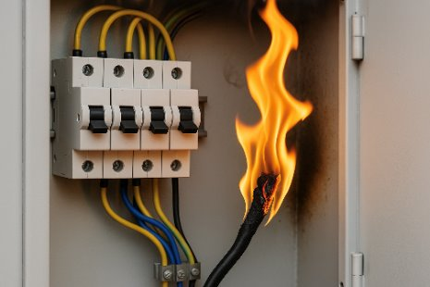
What is overcurrent?
Overcurrent occurs when a conductor or circuit carries more current than it is designed to handle.
This excess current can cause overheating, fire or damage to electrical equipment and components.
Three main types of overcurrent must be understood: short-circuit, earth fault and overload.

Slide 5

Short-circuit
A short-circuit: This is a fault of negligible impedance between live conductors at different potentials under normal operating conditions.
This is typically caused by accidental contact between conductors, such as line-to-line or line-to-neutral.
This results in a sudden, large flow of current, often due to wiring faults or equipment failure, and places severe stress on the supply transformer.

Slide 6
Earth fault
An earth fault happens when a line conductor unintentionally comes into contact with an earthed surface or part.
This causes current to flow to earth, bypassing the intended path. It can result in equipment damage, power disruption, and a risk of electric shock to users.
The earth fault current may flow through the installation’s CPC or external earthed parts, depending on the fault location.

Slide 7
Overcurrent protection: Two main types
Overload current
Occurs when a circuit carries more current than it is designed to handle, over an extended period.
Builds up gradually and may be caused by mechanical faults or excessive load.
Short-duration overloads may be tolerated; sustained overloads will cause the protective device to trip via thermal means.
2. Fault current
High-magnitude current that flows due to a fault condition, such as a short-circuit or earth fault.
Creates a very low impedance path that allows excessive current to flow, posing significant risk to equipment and safety.

Slide 8
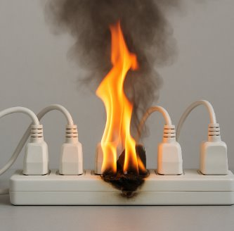
Overload
Overload occurs when a circuit is required to carry more current than its rated load under normal operating conditions.
Unlike short-circuits or earth faults, overloads develop gradually, due to mechanical issues in motors or excessive simultaneous use of appliances, for example.
Overload currents are lower in magnitude but can still cause overheating and insulation breakdown if sustained.

Slide 9
Overcurrent protection devices
Overcurrent protection prevents current from exceeding safe levels by disconnecting the circuit. Several devices can be used for protection, such as:
Circuit breakers (CBs)
Fuses
Residual current breakers with overcurrent (RCBOs).

Slide 10
Overcurrent disconnection requirements
Overcurrent can result from short circuits or overloads.
BS 7671 requires that protective devices must disconnect all line conductors before heat or energy can damage conductors or insulation (Reg 430.3).

Slide 11
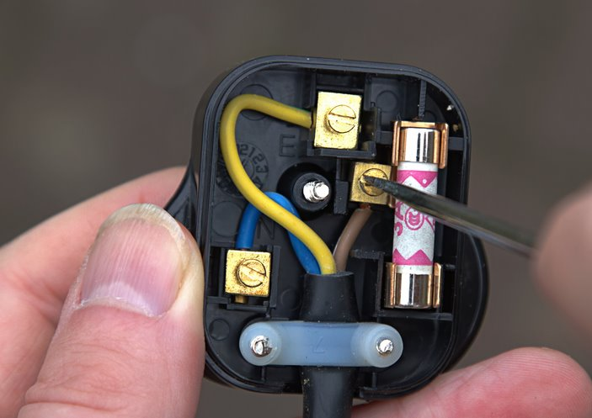
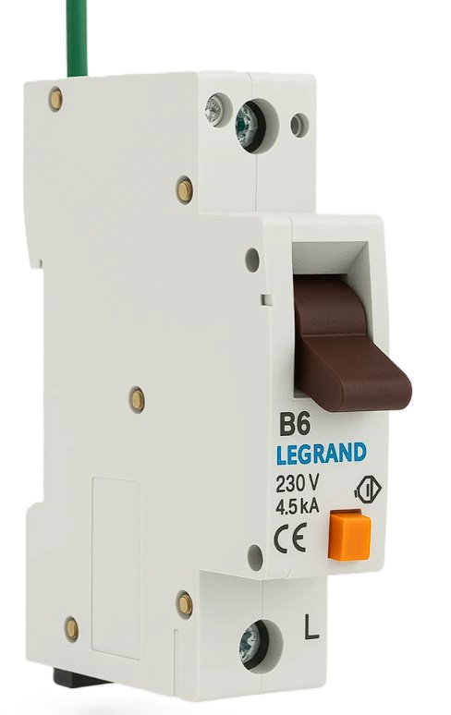
Protection after a change in cable size
Overload protection must be installed where the current-carrying capacity of a cable reduces, such as at changes in conductor size.
In practice, this could be:
a fuse in a plug
a circuit breaker or RCBO in a consumer unit.

Slide 12
Circuit and equipment protection
Circuit protection: OCPDs (Overcurrent Protection Devices) protect conductors from overheating by disconnecting the supply when excessive current is detected. CBs and fuses are commonly used.
Equipment protection: OCPDs also protect equipment by interrupting current during faults. Equipment should have a fault current rating suitable for use with OCPDs to minimise damage.

Slide 13
Location of overcurrent protective devices (OCPDs)
Overcurrent protection for conductors and connected loads is generally installed at the point where the conductors receive their supply.
According to BS 7671 Regulation 433.3.1, overload protection must be located at the origin of the conductor, unless specific conditions are met (e.g. limited conductor length, minimal overload risk, and fault protection is in place).
Short-circuit and earth fault protection is also usually positioned at or near the origin of the circuit.

Slide 14
Earth fault protection: What it is and why it matters
Earth fault protection safeguards equipment and individuals when an insulation fault causes a line conductor to come into contact with earth.
This protection reduces the risk of electric shock from exposed conductive parts that become live during a fault condition.
According to BS 7671 Part 2, an earth fault current is defined as: “A current resulting from a fault of negligible impedance between a line conductor and an exposed conductive part or a protective conductor”.

Slide 15
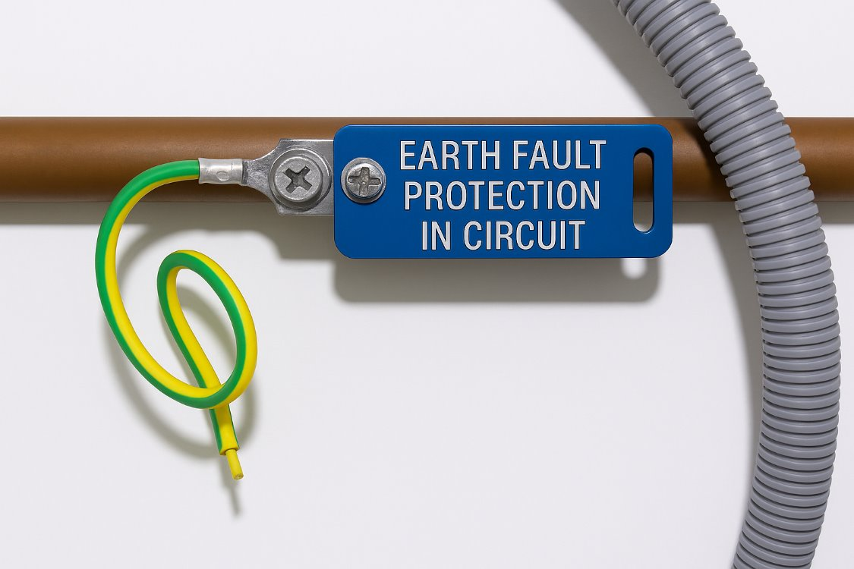
Earth fault protection: Key methods
The following methods are used to provide protection against earth faults.
Earthing of circuits and equipment.
Protective equipotential bonding.
Automatic disconnection of supply (ADS).
By providing a low-resistance path to earth (via the CPC), we direct fault current away from users, preventing them from becoming part of the circuit.

Slide 16
Earth fault protection: when earthing may fail
Earthing is only effective if the CPC presents a lower resistance than the human body.
It may fail to protect in situations such as:
a poor earth connection
working in wet or damp environments
contact with metal objects.

Slide 17
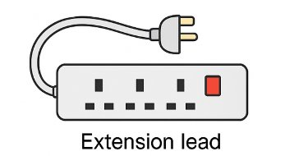
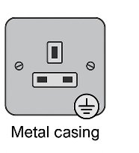
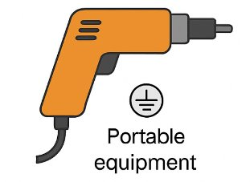
Earthing
What must be earthed?
All low-voltage circuits and extension leads.
All accessible metal parts not intended to carry current.
Portable and semi-portable equipment unless double insulated.

Slide 18
What is an extraneous conductive part?
BS 7671 defines an extraneous conductive part as: “A conductive part liable to introduce a potential, generally Earth potential, and not forming part of the electrical installation”.
This refers to parts that can bring earth potential into the system and, therefore, require bonding consideration.

Slide 19
Examples of extraneous conductive parts
Metal structural components of a building.
Metal pipework for gas, water or heating systems.
Non-insulated floors or walls that may conduct electricity.
These components can introduce potential and pose a safety risk if left unbonded.

Slide 20
What is an exposed conductive part?
An exposed conductive part is a metal part of electrical equipment that can be touched and may become live if a fault occurs.
Under normal conditions, these parts are not energised because they are protected by insulation. However, if they are not correctly earthed during a fault, they could present a shock risk.

Slide 21
Examples of exposed conductive parts
Metal housings of electrical appliances (e.g. washing machines, fridges).
Metal fittings such as switch plates or consumer unit covers.
Metallic parts of the wiring system, including trunking or conduit.
These must be earthed to ensure user protection during fault conditions.

Slide 22
Protective conductors and bonding
Equipotential bonding ensures all exposed and extraneous conductive parts remain at the same potential, reducing the risk of electric shock.
Bonding involves linking all accessible metalwork, whether part of the electrical system or not, to the main earthing terminal, preventing harmful voltage differences.
Note: Main protective bonding (where necessary) connects extraneous conductive parts to the MET, while the cpc connects exposed conductive parts to the MET.

Slide 23
Protective conductors
In every electrical installation, main equipotential bonding conductors must be connected to the main earthing terminal for the following metallic parts:
water service pipes
gas installation pipes
other service pipes and ducting
exposed structural metalwork
lightning protection systems.

Slide 24
Protection against electric shock
Effective earthing helps protect people from electric shock by ensuring a low impedance path to earth for fault current.
The most common method in the UK is automatic disconnection of supply (ADS).

Slide 25
Protection against electric shock: Basic protection
Basic protection aims to prevent contact with live parts during normal conditions.
Insulation of live parts.
Barriers or enclosures (e.g. cabinets, panels).
Obstacles or restricted access (e.g. out of reach or skilled personnel only).
Use of extra-low voltage (ELV) or limited discharge energy.

Slide 26
Protection against electric shock: Fault protection
Equipotential bonding networks and Automatic Disconnection of Supply (ADS) are both protective measures for electrical safety, working together to prevent electric shock and fire hazards.

Slide 27
Protection against electric shock: Main protective bonding conductors
To ensure effective ADS, all extraneous conductive parts should be bonded to the main earthing terminal. This includes:
Circuit protection: Automatic disconnection by appropriate devices.
Additional protection: Use of RCDs.
Circuit protective conductors: Connecting exposed conductive parts to the MET.
Suitable earthing methods: As previously described.
Earth fault loop impedance: Impacts disconnection times.

Slide 28
Earth fault protection: Protective bonding
Protective equipotential bonding ensures that exposed and extraneous conductive parts remain at the same potential.
Main protective bonding conductors must connect from the main earthing terminal to any extraneous conductive parts.
This reduces the risk of electric shock if someone touches an exposed part that has become live.
By bonding everything at the same voltage, we ensure that no dangerous voltage difference exists under fault conditions.

Slide 29
Earth fault protection: Equal potentials under fault
During a fault, bonding ensures all exposed and extraneous conductive parts are at the same potential (e.g. 70V).
This prevents harmful current flow through a person in contact with two points at the same voltage.
The protective device must disconnect the supply rapidly (typically within 0.4 seconds) to eliminate risk during this short time.

Slide 30
Earth fault protection: Automatic disconnection
Automatic disconnection of supply (ADS) must occur within the time limits specified in Chapter 41 of BS 7671:2018.
To comply, measured values of earth fault loop impedance (Zs) must not exceed 80% of the values listed in Table 41.3.
This ensures protective devices operate fast enough to prevent electric shock or equipment damage to compensate for temperature differences.

Slide 31
Functional bonding
Functional bonding connects electronic systems for communication or safety. While similar to protective bonding, its purpose is operational performance rather than protection from electric shock.
These systems still require connection to the main earth terminal at a designated point for compliance and system stability.

Slide 32
Circuit breaker BS EN 60898
A circuit breaker is a switching device used to interrupt abnormal or fault current in a circuit.
It operates using a thermomagnetic mechanism that detects and stops high current flow.
In addition to providing protection, it can also be used to manually open or close a circuit.
Its main function is to protect the installation by disconnecting the supply during faults.

Slide 33
Circuit breaker operation
Circuit breakers contain a bimetallic strip and a magnetic trip.
The bimetallic strip responds to overloads by heating up and bending, which triggers the breaker.
The magnetic trip reacts instantly to high fault currents.
The operating time depends on the size and duration of the overload.

Slide 34
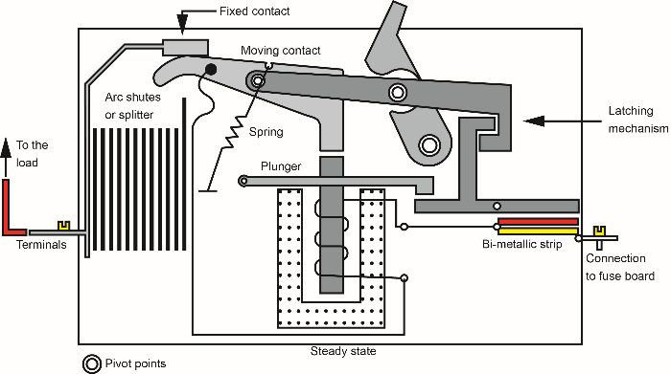
Circuit breaker operation diagram

Slide 35
Types of circuit breaker
There are two main types of circuit breaker.
Miniature circuit breaker (MCB): Commonly used in domestic and small commercial installations.
Moulded-case circuit breaker (MCCB): Typically used in larger installations and distribution boards.

Slide 36
Advantages of circuit breakers
Resettable: Unlike fuses, they can be easily reset after tripping.
Cost-effective: They are reusable, which reduces replacement costs over time.
Reliable: Less prone to failure due to age or vibration compared to fuses.
Faster response: They disconnect circuits more quickly in the event of a fault.

Slide 37
Disadvantages of circuit breakers
Complexity: More mechanically complex than fuses, requiring skilled installation.
Lifespan: Components may wear over time and require replacement.
Cost: Generally, more expensive than traditional fuses.

Slide 38
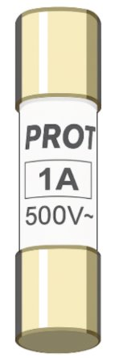
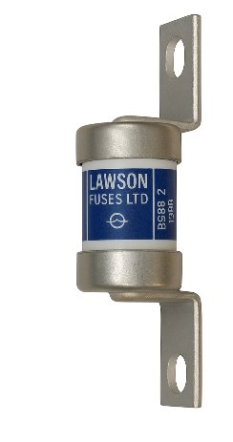
Fuses
Fuses are protective devices that prevent overcurrent by melting and breaking the circuit when current exceeds a set limit. This reduces the risk of fire and electrocution.
When a fuse blows, it must be replaced to restore the circuit.
Types of fuses
In the electrotechnical industry, the most common types of fuse are:
Cartridge fuses
Rewireable fuses

Slide 39
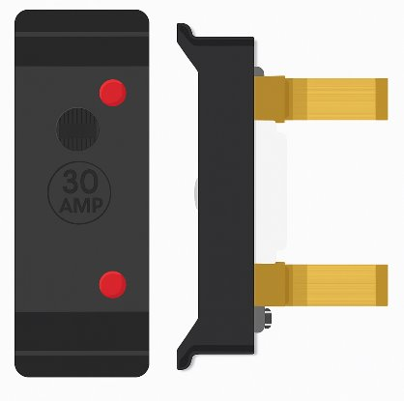
BS 3036 fuses
BS 3036 fuses are commonly found in older installations. These are semi-enclosed, rewireable fuses using a length of fuse wire.
BS 3036 fuses are prone to incorrect fuse wire fitting and have a lower breaking capacity.
They are not recommended for new installations and must be derated if used.

Slide 40
BS 3036 derating
According to BS 7671, when a BS 3036 (semi-enclosed) fuse is used as the protective device, the effective current-carrying capacity of the circuit conductor (Iz) must be multiplied by a derating factor of 0.725 to ensure safety.

Slide 41
BS 1361
BS 1361 is the British Standard for HRC (high rupturing capacity) cartridge fuse links used in household consumer units and similar low-voltage applications.
These fuses are available in ratings from 5 A to 100 A.
Type 1: Typically found in older domestic consumer units (fuse boxes).
Type 2a and 2b: Commonly used as the main service cut-out fuse to protect the entire installation.

Slide 42
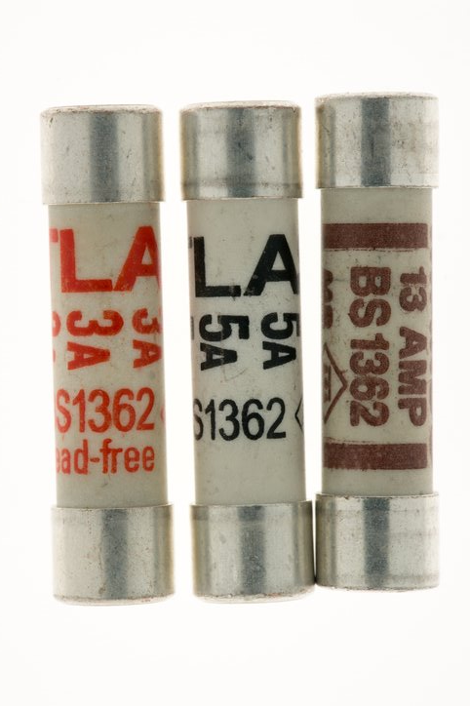
BS 1362
BS 1362 specifies cartridge fuses used in UK 13 A plug tops. These are designed to protect appliance flexes and connected equipment from overloads and minor over-currents. They are also used in fused connection units (e.g. for boilers, alarms).
Available in ratings from 1 A to 13 A.
Colour coding:
3 A fuses – red
13 A fuses – brown
All other ratings – black

Slide 43
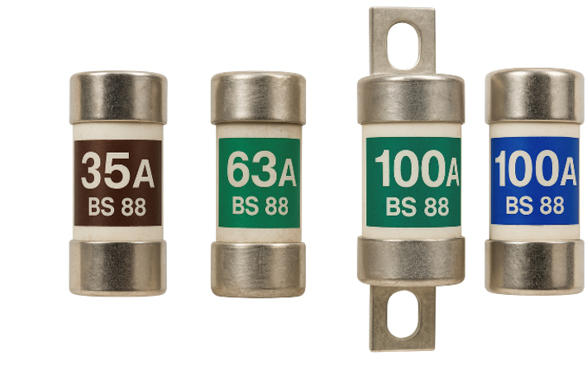
Cartridge fuses
Cartridge fuses are enclosed in a glass or ceramic tube with a metal fuse element inside.
The BS 88 cartridge fuse is widely used for its high reliability and breaking capacity.
These fuses are favoured for their simplicity and consistent performance in protecting circuits.

Slide 44
The HRC fuse (BS 88)
The High Rupturing Capacity (HRC) fuse is a refined version of the cartridge fuse, commonly used in industrial circuits and motor protection.
Constructed from a porcelain body filled with silica sand and sealed with silver-plated caps.
Contains an indicating element that visually breaks through the body when operated, aiding fault identification.
The silica sand ensures rapid arc extinction when the fuse blows.
Highly discriminative: able to distinguish between harmless inrush currents (e.g. motor start-up) and actual overloads.

Slide 45
Advantages and disadvantages of HRC fuses
Advantages
Reliable and consistent performance.
Rapid operation and arc suppression.
Disadvantages
More expensive than other fuse types.

Slide 46
Advantages and disadvantages of rewireable fuses
Advantages
No mechanical parts to fail.
Low initial cost.
Easy to tell if the element has blown.
Inexpensive to replace the fuse wire.
Disadvantages
Degrades with age.
Time-consuming to replace the element.
Higher risk of incorrect wire size being fitted.

Slide 47
Advantages and disadvantages of cartridge fuses
Advantages
Compact and space-saving.
No moving parts.
Accurate and consistent current rating.
Long lifespan without deterioration.
Disadvantages
More expensive to replace than rewireable types.
Risk of being bypassed with foil, defeating safety.

Slide 48
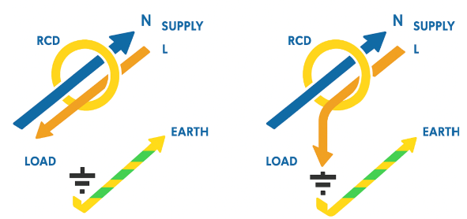
Residual current devices
RCDs (Residual Current Devices) are life-saving devices designed to protect against electric shock in domestic and commercial settings.
They operate by detecting any difference between the current flowing in the line and neutral conductors. If an imbalance is found, the device disconnects the supply almost instantly.
Normal, not operating
Imbalance of L and N currents

Slide 49
Residual current devices
This imbalance is often caused by earth leakage, for example, when current escapes due to damaged cables or poor DIY work (e.g. drilling into a wire). The electricity may take an alternative path through a person or object, leading to electric shock.
RCDs act as a safeguard against this by monitoring the current paths and disconnecting the circuit when leakage is detected.

Slide 50
Residual current devices (technical detail)
Inside an RCD, an iron ring (toroid) is wrapped with both the line and neutral conductors.
Under normal operation, equal but opposite currents flow through the toroid, cancelling out any magnetic effect.
If an imbalance occurs, a small current flows through a third coil connected to a relay (sometimes called the 'detector coil').
The resulting magnetic field triggers the relay, disconnecting the supply.

Slide 51
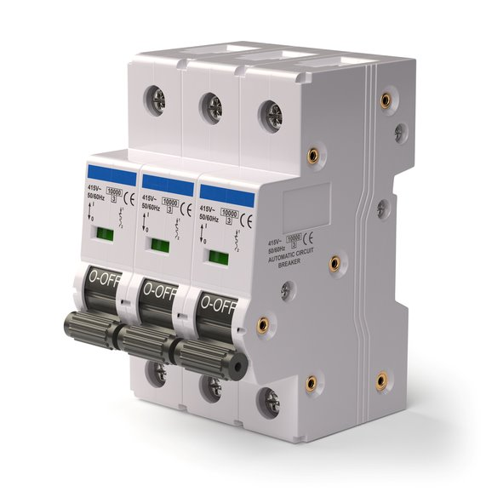
Residual current devices
When the current in the neutral conductor exceeds that in the line conductor, the opposing magnetic fields within the toroid become unbalanced.
This imbalance generates a net magnetic field, inducing a current in the detector coil.
The resulting signal activates a relay, causing the RCD to trip and interrupt the circuit, thereby disconnecting the power supply.

Slide 52
Types of RCDs
There are several types of RCDs:
Portable plug-in RCDs: Typically used as a temporary safety measure.
Socket outlet RCDs: Also referred to as ‘safety sockets’.
DIN rail-mounted RCDs: Installed within consumer units or distribution boards.
The first two options usually provide protection for a single appliance or circuit. RCDs used in consumer units, however, are available in various configurations to protect multiple circuits.

Slide 53





RCD types (AC, A, F, B)
Type AC: Suitable for general use on circuits with purely alternating currents.
Type A: Used where DC components may be present, such as with appliances containing rectifiers (e.g. Class I equipment).
Type F: Suitable for circuits with DC components and high-frequency chopping currents, often found in single-phase frequency converters.
Type B: Designed for circuits using multi-phase frequency converters or electric vehicle chargers. Type B offers broad compatibility with applications suited to Types AC, A, and F.

Slide 54
Advantages of RCDs
Provides rapid disconnection in the event of earth faults or leakage currents.
Enhances protection against electric shock by automatically disconnecting the supply when the leakage current exceeds the rated sensitivity.

Slide 55
Disadvantages of RCDs
While RCDs offer significant safety benefits, one limitation is that when a fault occurs, the RCD disconnects all protected circuits.
This means all connected circuits will remain off until the fault is identified and resolved.

Slide 56
RCBO
An RCBO (Residual Current Breaker with Overcurrent) is a device that combines the functions of an RCD and an MCB. It protects electrical installations from both residual current (earth leakage) and overcurrent (overload or short circuit).
Earth leakage can occur due to damaged wiring or accidental contact with a line conductor. The RCBO detects and interrupts the circuit to prevent electric shock or equipment damage.

Slide 57
RCBO: Functionality and benefits
Overcurrent conditions arise when too many devices are connected or a short circuit occurs. RCBOs provide dual protection by detecting both overcurrent and residual current faults.
In domestic installations, RCDs are often preferred due to cost-effectiveness. However, RCBOs are particularly useful in situations where selective disconnection is critical. Unlike RCDs, which may disconnect several circuits simultaneously, RCBOs isolate only the affected circuit. This makes them especially valuable in commercial or industrial settings where continuity of supply is important.

Slide 58
Disadvantages of RCBOs
Typically, they are more expensive than standalone MCBs or RCCBs.
Standard RCBOs are not suitable for DC circuits unless specifically designed for such use.

Slide 59
Arc fault detection devices (AFDDs)
Arc Fault Detection Devices (AFDDs) are installed within consumer units to provide protection against arc faults. They contain microprocessor technology which monitors the electrical waveform to detect abnormal patterns that indicate arcing.
When an arc is detected, the AFDD disconnects the circuit to reduce the risk of fire. These devices are more sensitive to arc faults than traditional protective devices.

Slide 60
AFDD test feature and regulation
AFDDs often include a test button, similar to RCDs and RCBOs, allowing users to check that the device is functioning correctly.
BS 7671:2018 recommends the use of AFDDs in certain situations. The mandatory fitting situations are listed in REG 421.1.7.

Slide 61
Situations where AFDDs are recommended
AFDDs are recommended for circuits with an increased fire risk, such as:
Properties with sleeping accommodation (e.g. houses, hotels, hostels).
Locations storing or processing flammable materials.
Buildings made with combustible materials (e.g. timber structures).
Thatched or fire-propagating structures.
Locations containing valuable or irreplaceable items (e.g. museums).
AFDDs can also be combined with an RCBO for dual protection.

Slide 62
Advantages and disadvantages of AFDDs
Advantages
More sensitive than standard devices, great for safety and fire prevention.
Contain advanced detection technology.
Disadvantages
Require a minimum load to operate.
Take up additional space in consumer units.
Additional cost to the customer.

Slide 63
Surge protection devices (SPDs)
SPDs protect electrical installations, including consumer units, wiring, and accessories, from transient over-voltages (surges).
These surges can damage sensitive electronics such as TVs, computers, safety circuits, and appliances.
Surges can cause immediate failure or long-term damage.

Slide 64
Types of SPD
Surge protective devices (SPD) are used to protect the electrical installation from electrical power surges known as transient voltages.
There are three different types.
Type 1 SPD installed at the origin of the supply or main distribution board.
Type 2 SPD installed at distribution boards.
Type 3 SPD installed close to a vulnerable load.

Slide 65
Advantages and disadvantages of SPDs
Advantages
Provide protection from spikes and surges
Easy to maintain
Lower cost of repair or replacement.
Disadvantages
Only effective up to their rated limit
May fail if exposed to high or repeated surges.

Slide 66
Breaking capacities (Definition)
The breaking capacity is the maximum current a protective device can safely interrupt without causing damage or forming an arc.
This rating ensures the device can handle any likely fault current.
It is measured in kiloamperes (kA), where 1 kA = 1,000 A.

Slide 67
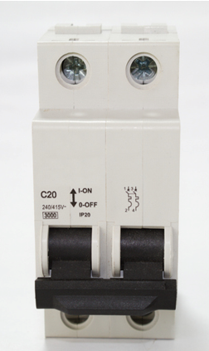
Selecting the correct breaking capacity
Devices must be selected based on the expected prospective fault current (PFC).
If the fault current exceeds the breaking capacity, the device may not operate safely, increasing the risk of damage or fire.
Breaking capacity values are typically printed on the front or side of the protective device.

Slide 68
Selectivity
Selectivity is defined in BS 7671 as the coordination of two or more protective devices so that, when a fault occurs, only the device nearest the fault operates while the others remain unaffected.
By doing this, the impact of the fault is localised, reducing disruption and potential damage. Section 536 of BS 7671 provides detailed guidance on selectivity between overcurrent protective devices (OCPDs), RCDs, and other protective components.

Slide 69
Selectivity in practice
Selectivity is achieved when the protective devices closest to the fault disconnect first, before those nearer the origin of the installation. This is required in both normal and overload conditions.
The aim is to ensure that only the part of the system affected by the fault is isolated, while power remains on in unaffected areas. Selectivity can be achieved using either current or time-based methods.

Slide 70
Current selectivity and design
Current selectivity is the most common approach.
Section 536 of BS 7671 provides requirements for the selection of electrical devices to achieve electrical co-ordination between them.
Careful design is required to ensure selectivity between devices is achievable under all fault and overload conditions.

Slide 71
What is the earth fault impedance?
Earth fault loop impedance is the path followed by fault current during a fault between line and earth. The higher the impedance, the lower the fault current and the slower the disconnection.
This is represented as Zs and is critical in determining appropriate cable size and ensuring timely disconnection.

Slide 72
Disconnection times
Disconnection time is the time taken to cut power during a fault. The quicker this happens, the lower the risk of injury or death.
BS 7671 provides tables showing maximum Zs values to ensure disconnection times based on the OCPD type.
Meeting these ensures safe disconnection times.
Notes:
Point out the BS 7671 tables

Slide 73
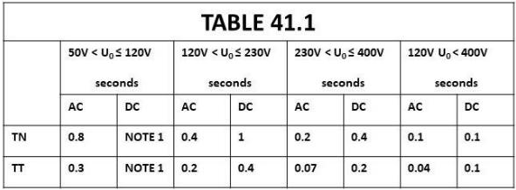
Disconnection times: Maximum values
According to Regulation 411.3.2.2, the disconnection times stated in Table 41.1 are valid for:
final circuits with socket outlets with rated currents not exceeding 63A
final circuits with only fixed equipment not exceeding 32A.
For other circuits consult 411.3.2.3 and 411.3.2.4.
Notes:
Refer to Table 41.1 in BS 7671 for precise values.

Slide 74
Selecting suitably sized protective conductors
Earth fault loop impedance, together with Uo (Voltage between a line conductor and earth), can be used to calculate the earth fault current from the point of the fault.
Although BS 7671 provides minimum CPC sizes in Table 54.7, these values can be overly conservative. Calculating the correct size often leads to a more efficient and cost-effective installation.
Calculating the CPC cross sectional area ensures that it can safely withstand the energy released during an earth fault, in line with the characteristics of the protective device (CPD) such as a fuse or circuit breaker.

Slide 75
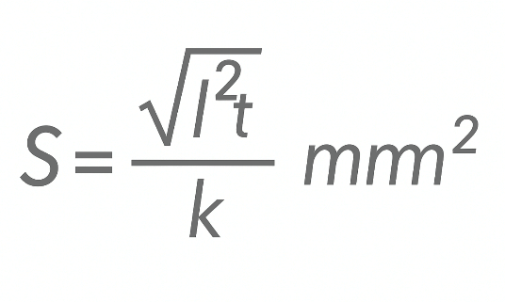
Formula for sizing CPCs (BS 7671:2018)
According to Regulation 543.1.3 of BS 7671:2018, the cross-sectional area of a protective conductor must not be less than the value calculated using the formula:
Where S is in mm²

Slide 76
Understanding each variable in the formula
Where:
S = Minimum cross-sectional area in mm².
I = Fault current in amperes.
t = Disconnection time in seconds.
k = A constant depending on the conductor material, resistivity, temperature coefficient, and initial/final temperatures.

Slide 77
How to find values for I, t and k
To find I, use the formula: I = Uo / Zs (Line voltage to earth and earth fault loop impedance need to be known).
To find t – Refer to the disconnection time from the time-current characteristics in Appendix 3 of BS 7671 once I is known.
To find k – Use values from Tables 54.2 to 54.6 of BS 7671:2018.

Slide 78
Worked example (step 1)
Question: What is the smallest copper CPC that can safely carry 1200 A of fault current for 0.4 seconds in a domestic final circuit?
The cable is thermoplastic, bunched with others, and rated at 70 ˚C
Step 1: Check the k value in Table 54.3. For 70˚C thermoplastic cable, k = 115.

Slide 79
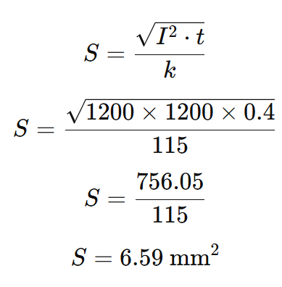
Worked example (step 2)
Use the formula:

Slide 80
Worked example (step 3)
Result: The calculation gives a required CSA of 6.59 mm²
This is not a standard cable size, so we must round up to the next standard size.
Final answer: 10 mm² CPC
We cannot round down to 6 mm², as this would risk overheating or failure under fault conditions.

Slide 81
Summary
You should now be able to:
Explain the principles of ADS (automatic disconnection of supply) and where it’s applied
Identify earthing and bonding requirements that enable ADS (earthing systems, CPCs, main bonding)
Select protective devices (fuse/MCB/RCBO/RCD) that meet disconnection times for the system (TN/TT) using Chapter 41

Slide 82
Any questions?
Copyright in this document belongs to and is used under licence from the Department for Education, © 2025.
‘T-LEVELS’ and ‘T Level’ are registered trademarks of the Department for Education.
WJEC is authorised by the Department for Education to develop and deliver this T Level Technical Qualification.
WJEC operates in England under the name Eduqas which is a registered trademark of WJEC.

