Slide 1
Occupational Specialism: Electrotechnical Engineering
K1.5 Application of the fundamental principles of national standards
PowerPoint 1.5: Cable rating

Slide 2
Introduction
Why is it important to select the correct size cable?

Slide 3
Objectives
By the end of this session, you should be able to:
Identify the factors that affect current-carrying capacity: installation method, ambient temperature, grouping, thermal insulation, conductor temperature/class
Apply correction factors
Calculate voltage drop

Slide 4

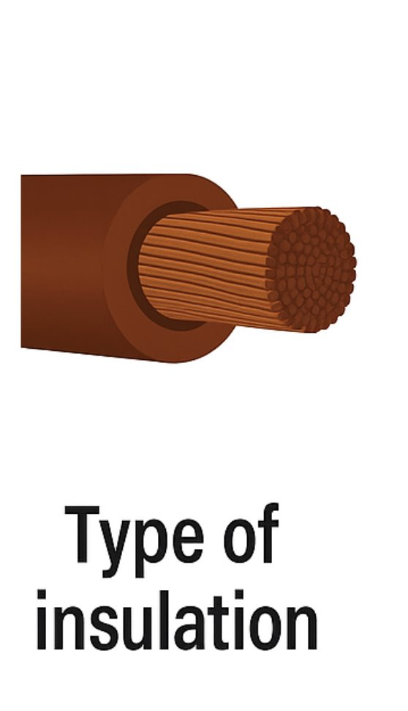
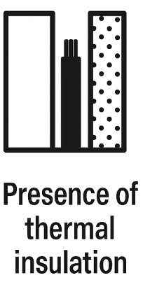
Factors affecting current-carrying capacity
Several factors influence a cable’s ability to carry current safely.
Type of insulation.
Ambient temperature.
Presence of thermal insulation.
Installation method.

Slide 5
Factors affecting current-carrying capacity
For example, thermoplastic insulation typically has a 70˚C rating, which sets the upper thermal limit.
Appendix 4 of BS 7671 and Table F6 in the On-Site Guide provide guidance on current-carrying capacities and acceptable voltage drops.

Slide 6
De-rating factors and rating tables
Standard conditions assume an ambient temperature of 30˚C. If this differs, correction factors must be applied.
C_{a} (Ambient Temperature Correction Factor): Tables 4B1 and 4B2 in BS 7671 and Table F1 in the On-Site Guide.
C_{i} (Thermal Insulation Factor): Used when cables are surrounded by thermal insulation. See Table 52.2 in BS 7671 and Table F2 in the On-Site Guide.
C_{g} (Grouping Factor): When circuits are installed in groups or shared containment. Refer to Table 4C1 in BS 7671 and Table F3 in the On-Site Guide.

Slide 7
Installation method and design current
The installation method influences the ability of the cable to dissipate heat. Reference installation methods are listed in Table 4A2 of BS 7671.
The design current (lb) is the current that will be drawn by the load under normal operating conditions. To calculate the design current (Ib):
determine the total circuit load (accounting for diversity)
select a protective device (In)
ensure: In ≥ Ib ≤ Iz (Iz is the cable's rated current).
You’ll also need to determine the circuit length and installation method.

Slide 8
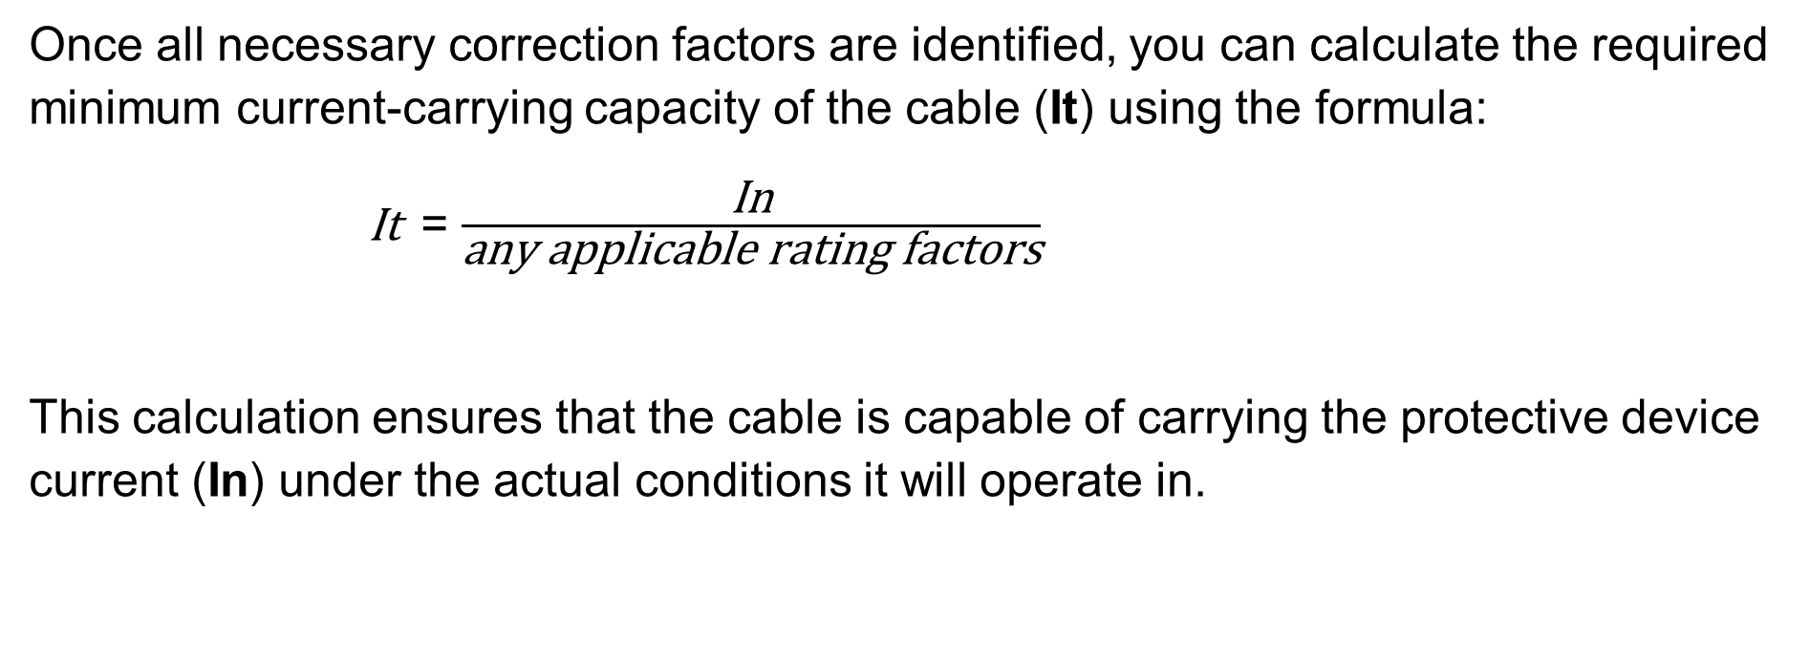
Apply correction factors to determine cable capacity
Once all necessary correction factors are identified, you can calculate the required minimum current-carrying capacity of the cable (It) using the formula:
It = $\frac{\text{In}}{\text{any} \text{applicable} \text{rating} \text{factors}}$
This calculation ensures that the cable is capable of carrying the protective device current (In) under the actual conditions it will operate in.

Slide 9
Examples of applicable rating factors
Correction factors account for real-world installation conditions that may reduce a cable’s ability to carry current safely. Common factors include:
Ca: Ambient temperature (e.g. above or below 30˚C)
Cg: Grouping of cables together in containment systems
Ci: Thermal insulation surrounding the cable
Cc: Rating factor for cables buried in the ground
Cf: Rating factor used where protection is by a BS 3036 fuse.
Notes:
Reference: BS 7671 Appendix 4 and On-Site Guide Tables F1–F6

Slide 10
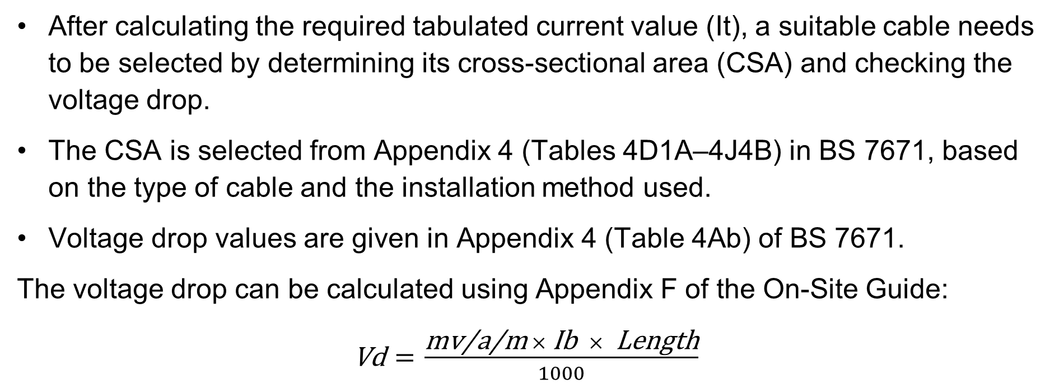
Current-carrying capacity of conductors
After calculating the required tabulated current value (It), a suitable cable needs to be selected by determining its cross-sectional area (CSA) and checking the voltage drop.
The CSA is selected from Appendix 4 (Tables 4D1A–4J4B) in BS 7671, based on the type of cable and the installation method used.
Voltage drop values are given in Appendix 4 (Table 4Ab) of BS 7671.
The voltage drop can be calculated using Appendix F of the On-Site Guide:
Vd = $\frac{\text{mv}\text{/}\text{a}\text{/}\text{m} × \text{Ib} × \text{Length}}{1000}$

Slide 11
Cable calculation - example data
Using the information below, calculate the minimum cable size required.
Load: 6.5 kW at 230 V
Cable type: PVC flat twin and CPC (thermoplastic 70˚C), clipped direct
Circuit length: 20 metres
Protective device: BS 3036 fuse
Ambient temperature: 35 ˚C
No thermal insulation or cable grouping
Allowable voltage drop: 5%
Notes:
Note that this slide is an example of the process, as it would be unlikely that a BS 3036 fuse would be used in a new installation today.

Slide 12
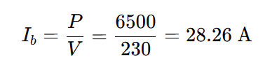
Step 1: Calculate design current and protective device
First, calculate the design current Ib:
Choose 30 A BS 3036 fuse (as per Regulation 433.1.202), the next standard rating above 28.26 A
Satisfies In ≥ Ib

Slide 13
Step 2: Apply rating factors
Now apply rating factors to determine the required current-carrying capacity It​:
Ca=0.94 (ambient temp of 35 ˚C from Table 4B1)
Cg not applied (no grouping)
Ci not applied (no thermal insulation)
Cf=0.725 (BS 3036 semi-enclosed fuse)

Slide 14
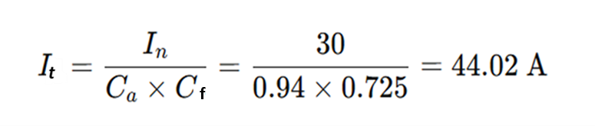
Step 3: Calculate required cable capacity
From Table 4D5 (ref method C), a 6 mm² PVC cable is rated at 47 A, so it meets this requirement.
It is not necessary to know Iz when calculating by this method (See page 425 BS 7671). It would need a check that it meets voltage drop requirements.

Slide 15

Step 4: Voltage drop calculation
Now calculate the voltage drop where:
7.3 = mV/A/m drop from Table 4D5 for 6 mm² cable
28.26A = design current
20m = circuit length
Allowable voltage drop = 5% of 230 V = 11.5 V
Calculated drop = 4.12 V, which is within limit so the 6 mm² is suitable.

Slide 16
Summary
You should now be able to:
Identify the factors that affect current-carrying capacity: installation method, ambient temperature, grouping, thermal insulation, conductor temperature/class
Apply correction factors
Calculate voltage drop

Slide 17
Any questions?
Copyright in this document belongs to and is used under licence from the Department for Education, © 2025.
‘T-LEVELS’ and ‘T Level’ are registered trademarks of the Department for Education.
WJEC is authorised by the Department for Education to develop and deliver this T Level Technical Qualification.
WJEC operates in England under the name Eduqas which is a registered trademark of WJEC.

