Slide 1
Occupational Specialism: Electrotechnical Engineering
K1.5f Application of the fundamental principles of national standards
PowerPoint 1.5f: Part 4

Slide 2
Introduction
What’s the difference between basic protection and fault protection?

Slide 3
Objectives
By the end of this session, you should be able to:
Explain the difference between basic protection and fault protection
Select overcurrent protective devices with adequate breaking capacity and basic coordination/selectivity
Address risks from thermal effects (fire/overheating) and voltage disturbances

Slide 4
Chapter 41: Protection against electric shock
Chapter 41 is based on BS EN 61140, the basic safety standard that applies to the protection of persons and livestock.
Basic protection: Protection under fault-free (or normal) conditions is provided by basic protective provisions.
Fault protection: Protection under single fault conditions is provided by fault protective provisions.
Notes:
Protection in use without a fault (now designated basic protection) was referred to as protection against direct contact And protection under fault conditions (now designated fault protection) was referred to as protection against indirect contact.

Slide 5
410: Protection against electric shock
Fundamental rule: Hazardous-live parts shall not be accessible, and accessible conductive parts shall not be hazardous-live, either in use without a fault or in single-fault conditions.
This is achieved by a combination of basic protection and fault protection.
Notes:
Basic protection relates to protection under fault-free conditions.
Basic protection is covered in Section 416 of BS 7671.
A person (or livestock) can receive a shock in one of two ways:
1. contact with a live part while in contact with earth
2. contact with live parts at different potentials.
Basic protection is provided by basic insulation of live parts or by barriers or enclosures in accordance with Section 416.

Slide 6
Fault protection
Fault protection is defined as:
‘protection against electric shock under single fault conditions’.
Fault protection is provided by protective earthing, protective equipotential bonding and automatic disconnection in case of a fault, in accordance with Regulations 411.3.

Slide 7
410.3.3: Protective measures generally permitted
The conditions of external influences must be taken into account when determining the most appropriate form of protection:
automatic disconnection of supply
double or reinforced insulation
electrical separation
extra-low voltage (SELV or PELV).

Slide 8
410.3.2: Protective measures
Each protective measure has to consist of:
an appropriate combination of a provision for basic protection and an independent provision for fault protection OR
an enhanced protective provision which provides both basic protection and fault protection.

Slide 9
410.3.6
Protective measures specified in section 418 such as non-conducting locations, earth-free equipotential bonding shall be applied only where the installation is under the supervision of skilled or instructed persons so that unauthorised changes cannot be made.
What is a non-conducting location?
This is basically an area in which the floor, walls and ceiling are all insulated. Within such an area, there must be no protective conductors and socket outlets will have no earthing connections.

Slide 10
What is an earth-free equipotential zone?
This is, in essence, a Faraday cage, where all metals are bonded together.
Great care must be taken when entering such a zone to avoid differences in potential differences (PD) between inside and outside.

Slide 11
411.1: Automatic disconnection of supply
Automatic disconnection of supply is a protective measure in which basic protection is provided (basic insulation, barriers or enclosures) and fault protection is provided by protective earthing, protective equipotential bonding and automatic disconnection in case of a fault.
In other words, automatic disconnection of supply is a means of fault protection (protection against indirect connect).
Automatic disconnection of supply (ADS for short) is the most commonly used protective measure.

Slide 12
411.3.1.2: Protective equipotential bonding
To comply with Chapter 54, connect the main earthing terminal to the following extraneous-conductive parts through bonding conductors:
water installation pipes
gas installation pipes
other installation pipework and ducting
central heating and AC systems
lightning protection systems to BS EN 62305.
Notes:
Note: where non-metallic pipes (eg plastic) enter a building and are then connected to metallic pipes within the building, the metal pipes within the building do not normally require protective bonding as they are unlikely to be extraneous-conductive parts.

Slide 13
Regulation 411.3.3
In AC systems, additional protection by means of an RCD with a rated residual operating current not exceeding 30mA shall be provided for:
socket outlets with a rated current not exceeding 32A in locations where they are liable to be used by persons of capability BA1, BA3 or children (BA2, BA3)
socket outlets with a rated current not exceeding 32A in other locations
mobile equipment with a rated current not exceeding 32A for use outdoors.
An exception to (ii) but not (i) or (iii) is permitted where a suitably documented risk assessment undertaken with the involvement of a skilled person (electrically) determines that RCD protection is not necessary.

Slide 14
Maximum earth fault loop impedance
Table 41.2 – gives maximum Zs values for fuses to disconnect in no longer than 0.4 seconds.
Table 41.4 – gives maximum Zs values for fuses to disconnect in no longer than 5 seconds.
Table 41.3 – gives maximum Zs values for CBs and RCBOs to disconnect in between 0.4 and 5 seconds.
Notes:
In order to compensate for the difference in temperature of the conductors during testing, a correction factor must be applied.
Appendix 3 – page 410
suggests a correction factor of 0.8 should be applied to confirm that the circuit earth loop impedance (Zs) complies with the appropriate value in BS 7671.
The measured earth loop impedance value obtained must be compared with Tables 41.2, 41.3 or 41.4 in Chapter 41 with the correction factor applied.
The adjusted values are shown in GN3 and the OSG.

Slide 15
412: Protective measure: double/reinforced insulation
412.1.1
Basic protection is provided by basic insulation, and fault protection is provided by supplementary insulation
or
Basic and fault protection is provided by reinforced insulation between live parts and accessible parts.
Note: This protective measure is intended to prevent the appearance of a dangerous voltage on the accessible parts of electrical equipment due to a fault in the basic insulation.

Slide 16
413 – Protective measure: Electrical separation
Electrical separation is a protective measure that provides both basic and fault protection.
Basic protection is provided by basic insulation of live parts or by barriers or enclosures in accordance with section 416
and
Fault protection is provided by simple separation of the separated circuit from other circuits and from earth.

Slide 17
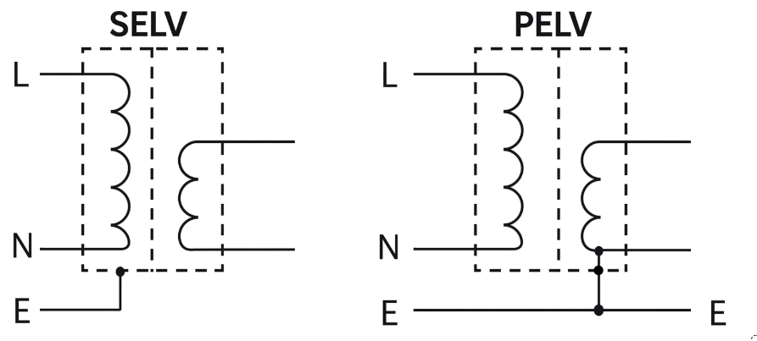
Reg. 414: Extra-low voltage provided by SELV/PELV
Protection by extra-low voltage is a protective measure that consists of either of two different extra-low-voltage systems.
Separated extra-low voltage (SELV).
Protective extra-low voltage (PELV).
Notes:
SELV is defined as:
‘An extra-low voltage system which is electrically separated from Earth and from other systems in such a way that a single fault cannot give rise to the risk of an electric shock.’
PELV is defined as:
‘An extra-low voltage system which is not electrically separated from Earth, but which otherwise satisfies all the requirements for SELV.’
The design of a SELV circuit typically involves an isolating transformer, guaranteed minimum distances between conductors and electrical insulation barriers. The electrical connectors of SELV circuits should be designed such that they do not mate with connectors commonly used for non-SELV circuits.

Slide 18
415: Additional protection
415.1.1 The use of RCDs with a rated residual operating current not exceeding 30mA is recognised in AC systems as additional protection in the event of failure of the provision for basic protection and/or the provision for fault protection or carelessness by users.
415.1.2 The use of RCDs is not recognised as a sole means of protection and does not obviate the need to apply one of the protective measures specified in Sections 411 to 414.
Notes:
Requirements for RCD protection of a rating not exceeding 30mA from throughout BS 7671
All socket outlets rated at no more than 32A
Mobile equipment rated at not more than 32A for use outdoors
All domestic circuits supplying luminaires
All circuits in a bath/shower room
Preferred for all circuits in a TT system
All cables installed less than 50mm from the surface of a wall or partition unless they are adequately mechanically protected or have earthed screening or armouring; also at any depth if the construction of the wall or partition includes metallic parts
In zones 0, 1 and 2 of swimming pool locations.
All circuits in a location containing saunas, etc.
Circuits supplying class II equipment in restrictive conductive locations
Each socket outlet in caravan parks and marinas and final circuits for houseboats
All socket-outlet circuits rated not more than 32A for show stands, etc.
All socket-outlet circuits rated not more than 32A for construction sites (where reduced low-voltage, etc. is not used)
All socket outlets supplying equipment outside mobile or transportable units.
All circuits in caravans
All circuits in circuses, etc.
A circuit supplying class II heating equipment for floor and ceiling heating systems
Socket outlets rated up to 63A for onshore units for inland navigation vessels.
100mA
Socket outlets of a rating exceeding 32A in agricultural locations.
300mA
At the origin of a temporary supply to circuses, etc.
Where there is a risk of fire due to storage of combustible materials
All circuits (except socket outlets) in agricultural locations
Socket outlets over 63A for onshore units for inland navigation vessels.
500mA
Any circuit supplying one or more socket outlets of a rating exceeding 32A on a construction site.

Slide 19
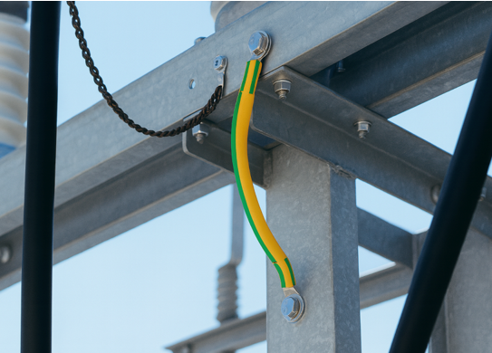
415.2: Supplementary bonding
Supplementary bonding is an additional protective provision used to enhance the standard fault protection system, as outlined in Chapter 41.
It may be required where disconnection times cannot be met or where required due to the special nature of the installation.

Slide 20
416: Provision for basic protection
416: Provision for basic protection is the most basic method in protecting against ‘direct contact' with electricity
Insulation around cables.
A barrier or an enclosure preventing us from touching live parts.
Placing obstacles out of reach to avoid direct contact (note: this method is limited to areas that are controlled by skilled or instructed persons only – see Reg: 417.1).
Notes:
Basic insulation of live parts:
416.1 Live parts shall be completely covered with insulation which can only be removed by destruction
416.2.1 Live parts shall be inside enclosures or behind barriers providing at least the degree of protection IPXXB or IP2X
416.2.2 A horizontal top surface of a barrier or enclosure which is readily accessible shall provide a degree of protection of at least IPXXD or IP4X
417.1 The protective measures of obstacles and placing out of reach provide basic protection only. They are for applications that are controlled or supervised by skilled persons
417.3 Arms reach is defined as 2.5m.

Slide 21
Part 4: Chapter 42
420: Scope
Detrimental thermal effects result from badly designed or incorrectly installed electrical equipment.
Harmful effects of heat or thermal radiation developed by electrical equipment.
Ignition, combustion or degradation of materials.
Flames and smoke (where a fire hazard could be propagated from an electrical installation to other nearby fire compartments).
Safety services being cut off due to the failure of electrical equipment.

Slide 22
Protection against thermal effects
421.1.3 and 421.1.4 If permanently connected electrical equipment can emit high-temperature arcs, sparks or particles in normal service, measures must be applied to the equipment such as:
total enclosure in arc-resistant material
placing an arc-resistant screen between the equipment and materials
allowing sufficient distance between the equipment and materials.
Notes:
421.1.5 Where electrical equipment in a single location contains flammable liquid in significant quantity, adequate precautions shall be taken to prevent the spread of liquid, flame and the products of combustion.
Note 2: the generally accepted lower limit for a significant quantity is 25 litres.
421.1.201
Within domestic (household) premises, consumer units and similar switchgear assemblies shall comply with BS EN 61439.3.
Note 4: products of combustion of liquid arc considered to:
have their enclosure manufactured from non-combustible material or
be enclosed in a cabinet or enclosure constructed of non-combustible material and complying with regulation 132.12.
421.1. 7
Arc fault detection devices (AFDD) conforming to BS EN 62606 shall be provided for single-phase AC final circuits supplying socket outlets with a rated current not exceeding 32A in:
higher risk residential buildings (HRRB)
houses in multiple occupation (HMO)
purpose-built student accommodation
care homes.
Note 1: residential buildings over 18m in height or in excess of six storeys.
For all other premises, the use of AFDDs conforming to BS EN 62606 are recommended for single-phase AC final circuits supplying socket outlets not exceeding 32A.

Slide 23
Protecting against arc faults
Arc fault detection devices (AFDD) provide the best defence against electrically ignited fires. These work by digitally monitoring the wire for specific frequencies that can indicate an arc fault.
They can be installed alongside traditional circuit devices like circuit breakers, which use thermal and magnetic detection to identify short circuit and over-current hazards, as well as residual current devices, which use a balance transformer to detect earth faults.
Technological advances have now enabled power management companies to introduce new versions that combine all three devices.
Notes:
Regulation 422.1 (precautions where particular risks of fire exist) now introduces requirements for the fire safety design of the building(s) to be documented. Also, requirements have been added where cables should have an improved fire performance.
422.1.2 Electrical equipment shall be so selected and erected that its normal temperature rise and foreseeable temperature rise during a fault cannot cause a fire. This shall be achieved by the construction of the equipment or by additional protective measures taken during erection.
Regulation 422.2 now introduces separate requirements for escape routes and a new concept of 'protected escape routes’.
Cables of other electrical equipment shall not be installed in a protected escape route unless part of:
an essential fire safety or related safety system
general needs lighting
socket outlets provided for cleaning or maintenance.
422.3.1 and 422.4.2 – Locations with risks of fire due to the nature of processed materials or stored materials
Luminaires
Spotlights and projector lamps to be installed from combustible materials by a minimum of:
up to 100W – 0.5m
100W to 300W – 0.8m
300W to 500W – 1m.
Guidance is given in Appendix 13 :
Cables should be as short as possible.
Cable systems are limited to conduit, trunking, non-flame propagating tray/ladder/powertrack, and unsheathed MICC.

Slide 24
423: Protection against burns
Except where a harmonised standard specifies otherwise, electrical equipment within arm’s reach should not attain a temperature more than the appropriate limit stated in Table 42.1. Temperature of equipment within arm's reach to comply with Table 42.1.
Accessible part | Surface material | Max temp. ºC
Hand-held | Metallic Non-metallic | 55 65
Touched | Metallic Non-metallic | 70 80
Not touched | Metallic Non-metallic | 80 90
Notes:
Equipment above those temperatures to be guarded to prevent accidental contact.

Slide 25
Chapter 43: Protection against overcurrent
This chapter provides requirements for the protection of live conductors from the effects of overcurrent.
It describes how live conductors are protected by one or more devices for the automatic disconnection of the supply in the event of overload current (Section 433) and fault current (Section 434).

Slide 26
430.3 – The protection against overload current and fault current shall be co-ordinated in accordance with BS7671 section 435
Overload current: an overcurrent occurring in a circuit that is electrically sound. Short circuit current: an overcurrent resulting from a fault of negligible impedance between live conductors having a difference in potential under normal operating conditions. The protective device shall be selected to break any overcurrent before danger is caused, either thermal or mechanical effects including:
Insulation
Connections, termination, joints
Surrounding of conductors.

Slide 27
432: Nature of protective devices
A protective device shall be of the appropriate types indicated in 432.1 to 432.3.
432.1 A device providing both overload and fault protection shall be capable of breaking (and for a CB making) any overcurrent up to the maximum prospective fault current at the point where the device is installed.
Notes:
431.3 – Disconnection and reconnection of the neutral conductor
Where a switch is placed in a neutral conductor, disconnection and reconnection shall be such that the neutral conductor shall not be disconnected before the line conductors and shall be reconnected at the same time as or before the line conductors.
The time/current characteristics of an overcurrent protective device shall comply with those specified in BS 88 series, BS 3036, BS EN 60898,
BS EN 60947-2 or BS EN 61009-1.
The use of another device is not precluded provided that its time/current characteristics provide a level of protection not less than that given by the devices listed above.
433.1 – Coordination between conductor and overload protective device
Coordination will be met and comply with Regulation 433.1.1 if:
Ib ≤ In ≤ Iz
where:
Ib is the design current of the circuit (in other words, the load)
In is the rated current or current setting of the protective device
Iz is the current-carrying capacity of the conductor (in other words, a cable, busbar or powertrack).
(Where the current (I2) causing effective operation of the protective device does not exceed 1.45 times the lowest of the current-carrying capacities (Iz) of any cable of the circuit, represented as:
I2 ≤ 1.45 x Iz
In circumstances when the circuit is subjected to an overload current, this condition is intended to ensure operation of the device within a time suitable to protect the insulation against damage from any high conductor temperatures caused by the overload current.
Condition 1: In ≥ Ib Condition 2: In ≤ Iz Condition 3: I2 ≤ 1.45 Iz
Meeting the requirement of condition 3
Provided the requirements of conditions 1 and 2 are met, the requirement of condition 3 is deemed to be met where the protective device is a type (gG) fuse to BS 88-2, a fuse to BS 88-3, a circuit breaker to BS EN 60898 or BS EN 60947-2, or an RCBO of any type to BS EN 61009-1. (Regulation 433.1.201 refers.)
Where the protective device is a semi-enclosed (rewireable) fuse to BS 3036, the requirement of condition 3 is met where In does not exceed 0.725 times the current-carrying capacity of the circuit conductors (Iz), provided the requirements of conditions 1 and 2 are also met. (Regulation 433.1.202 refers.)
This is to compensate for the high value of I2 of a BS 3036 fuse, which can be up to 2 × Iz.
In simple terms, we downrate cables if protected by a rewireable fuse.

Slide 28
Section 433 Co-ordination between conductor and OCPD
30A/32A radial circuit:
Historically, the circuit is limited to serving 75m²
The live conductors on the circuit must be at least 4.0mm²
An unfused spur run in 2.5mm² cable can feed one single or one twin socket
A fused spur can supply any number of sockets and can be wired in 1.5mm² cable.
20A radial circuit:
Historically, the circuit is limited to serving 50m²
The live conductors on the circuit must be at least 2.5mm²
See Appendix 15 BS 7671 for details.
Notes:
See: Appendix: 15: Ring and radial final circuit arrangements

Slide 29
Co-ordination continued
30A/32A Ring final circuits:
Historically, the circuit is limited to serving 100m²
The live conductors on the ring must be at least 2.5mm² or 1.5mm² for MI cable
The protective device, fuse or MCB protecting the circuit must be rated at 30A or 32A
Non-fused spurs must have live conductors of 2.5mm²
A non-fused spur can feed one single or one twin socket only. An unlimited number of sockets may be fed from fused spurs
Appendix 15 of BS 7671 has details.
C

Slide 30
433.2: Position of devices for overload protection
433.2.1 A device for protection against overload shall be installed at the point where a reduction occurs in the value of the current-carrying capacity of the conductors of the installation. This may be due to a change in cross-sectional area, method of installation, type of cable or conductor or environmental conditions.
433.2.2 The protective device may be placed in the cable run provided it is protected against fault currents and short circuit currents. Between the reduction and the protective device must be not more than 3m, installed to minimise the risk of faults, and erected to minimise the risk of fire and danger.
Notes:
433.3.3 – Omission of overload devices for safety reasons
Where operation of a protective device would cause danger, it may be omitted, as in the case of:
fire extinguishing device
lifting magnets
current transformer secondary
exciter circuits of rotating machines
life support machines
safety service, in other words, gas alarms etc.
\434.2.1No device for fault current protection is required provided the conductor:
does not exceed 3m in length
and
is installed in such a manner as to reduce the risk of fault to a minimum
and
is installed in a manner to reduce to a minimum the risk of fire or danger to persons.

Slide 31
434.1: Determination of prospective fault current
The prospective fault current shall be determined at every relevant point of the installation. This shall be done by calculation, measurement or enquiry.
The rated short circuit capacity of the OCPD must not be less than the prospective fault current at the point where it is installed.
The general characteristics of the supply are referenced in regulation 313.1 with the added note that the distributor can provide this information including the prospective short circuit current at the origin.

Slide 32
Chapter 44
Protections against voltage disturbances and electromagnetic disturbances: What are ‘voltage disturbances’?
The regulations are concerned with protection against four forms of voltage and electromagnetic disturbances:
temporary over-voltages due to faults (Section 442)
Over-voltages caused by atmospheric or switching effects (Section 443)
electromagnetic disturbances (Section 444)
Under-voltages (Section 445).
Notes:
Section 442: Power frequency stress voltages
442.2.3 states 'the calculation for U1, U2 and Ur is normally not necessary for the LV system installer’.

Slide 33
Section 443
Transient over-voltages caused by atmospheric or switching effects.
Covers lightning strikes to the distribution system not direct or nearby to the structure.
Transient overvoltage due to switching generally refers to switching of equipment within the installation, e.g., motors, high inductive loads found in some lighting circuits.
Because transient over-voltages of atmospheric origin are usually higher than those from switching effects, the protection arrangements for atmospheric origin instances usually also provide protection against switching effects.
Notes:
Section 442: Power frequency stress voltages
442.2.3 states 'the calculation for U1, U2 and Ur is normally not necessary for the LV system installer’.

Slide 34
Measures against electromagnetic disturbances
Any cables carrying high electrical currents will emit electromagnetic radiation (fields). Where the currents are rapidly changing, such as in lift control equipment, this results in rapidly changing electromagnetic field.
Such fields can interfere with the operation of information technology systems, medical equipment or electronic control modules such as fire alarms, air conditioning controls or even the coffee machine.
Notes:
444.4.1
Consideration must be given to the positioning of equipment and the routing of cables in an electrical installation in relation to other electrical or electronic equipment (and vice versa).
For example, when considering the addition of a sub-main distribution board to an existing installation, installing it next to the fire alarm control panel would not be a good idea.
Conversely, the fire alarm company should not consider locating their control equipment next to existing electrical control equipment or cables.
Potential sources of EMD could be:
switching devices for inductive loads
electric motors
fluorescent lighting
welding machines
lifts
transformers
switchgear.
Measures to reduce EMD:
use additional conductors
use surge protection devices (SPDs)
the selection of a common route for all conductors
the separation of power and signal cables
the installation of equipotential bonding networks.

Slide 35
444: Electromagnetic disturbance protection
Appendix 16: Devices for protection against overvoltage
This appendix provides detailed diagrams illustrating how to connect SPDs to RCD-protected circuits, for differing conditions.
Table 16A provides information on the classification of SPD.
Notes:
SPDs are devices or components that turn on within nanoseconds as voltage rises. They handle surge currents safely, diverting then to earth and disconnecting after the event.
To provide maximum protection, SPDs should be connected at the point of service entry.
Surge protection is not new, is not expensive and is easy to install.

Slide 36
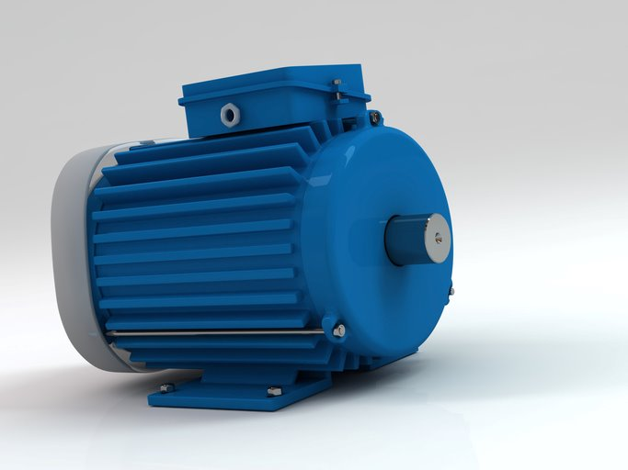
445 – Protection against undervoltage
Suitable precautions need to be taken where a reduction or loss in voltage may occur to such a level as to cause failure of equipment or damage depending on the nature of the equipment connected. For example, a three-phase motor may be damaged by the motor drawing current from only two phases.
Where unexpected restarting of a motor might cause danger, it should be fitted with means to prevent automatic restarting after a stoppage due to a drop in voltage or failure of supply.

Slide 37
Summary
You should now be able to:
Explain the difference between basic protection and fault protection
Select overcurrent protective devices with adequate breaking capacity and basic coordination/selectivity
Address risks from thermal effects (fire/overheating) and voltage disturbances

Slide 38
Any questions?
Copyright in this document belongs to and is used under licence from the Department for Education, © 2025.
‘T-LEVELS’ and ‘T Level’ are registered trademarks of the Department for Education.
WJEC is authorised by the Department for Education to develop and deliver this T Level Technical Qualification.
WJEC operates in England under the name Eduqas which is a registered trademark of WJEC.

