Slide 1
Occupational Specialism: Electrotechnical Engineering
K1.5d Application of the fundamental principles of national standards
PowerPoint 1.5d: Chapter 55

Slide 2
Introduction
Which British standard applies to socket outlets?

Slide 3
Objectives
You should be able to:
Identify what Chapter 55 covers and when it applies

Slide 4
Chapter 55: Other equipment
Regulation 550.1 Scope
Chapter 55 specifies requirements and recommendations for the selection and erection of low-voltage electrical equipment not covered by other parts of BS 7671 except Part 7 and Chapter 82. Intended to be part of the fixed installation.

Slide 5
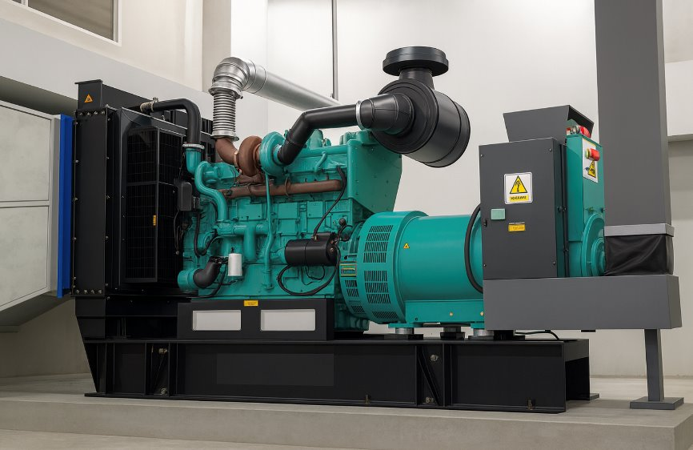
Part 5: 551 Low-voltage generating sets
Section 551 applies to both low-voltage and extra-low-voltage installations, which incorporate generating sets intended to supply, either continuously or occasionally, all or part of the installation.

Slide 6
551.4.4.2: Low-voltage generating sets
Where the installation and generating set are not permanently fixed, an RCD with a rated residual operating current of not more than 30mA should be installed in accordance with Regulation 415.1 for every circuit.

Slide 7
552: Rotating machines
Motors require additional consideration in relation to their starting currents and control equipment. The starting, accelerating and load currents of a motor must be considered when assessing the suitability of the equipment and cables carrying these currents.
Every electric motor having a rating exceeding 0.37kW shall be provided with control equipment incorporating means of protection against overload of the motor.
Every motor should be fitted with means to prevent automatic restarting after a stoppage due to a drop in voltage or failure of supply, where unexpected restarting of the motor might cause danger.

Slide 8
553: Accessories
Type of plug and socket outlet | Rating (amperes) | Applicable British Standard
Fused plugs and shuttered socket outlet, two-pole and earth, for AC | 13 | BS 1363 (fuses to BS 1362)
Plugs, fused or non-fused and socket outlets, two-pole and earth | 2, 5, 15, 30 | BS 546 (fuses, if any, to BS 646)
Plugs and socket outlets (industrial type) | 16, 32, 63, 125 | BS EN 60309-2
BS 7671 Table 55.1
Notes:
553.1.201 Every socket-outlet for household and similar use shall be of the shuttered type and for an AC installation, shall preferably be of a type complying with BS 1363.
Note: USB charging ports, coaxial outlets, data outlets, HDMI and other AV outlets are not regarded as socket outlets for the purposes of this regulation.

Slide 9
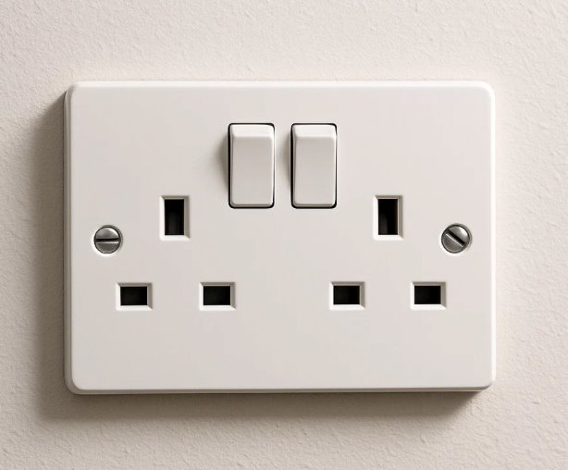
553: Accessories
553.1.6 A socket-outlet on a wall or similar structure shall be mounted at a height above the floor or any working surface to minimise the risk of mechanical damage to the socket outlet or to an associated plug and its flexible cable, which might be caused during insertion, use or withdrawal of the plug.
Notes:
Discuss mountain heights of accessories according to building regulations

Slide 10
554: Current-using equipment
Electrode water heaters or boilers.
Used to heat water or raise steam in certain domestic, commercial and industrial applications. They can be either single-phase or three-phase.
Typical applications include saunas, central heating, humidifying, cleaning and sterilising. Electrode boilers can be low-voltage or high-voltage.
Special requirements must be complied with relating to earthing and bonding, overcurrent protection, isolation, and switching.

Slide 11
557: Auxiliary circuits
557.3.1: The power supply AC or DC for an auxiliary circuit may be either dependent or independent of the main circuit according to its required function.
557.3.201: Control circuits shall be designed, arranged and protected to limit dangers resulting from a fault between the control circuit and other conductive parts liable to cause a malfunction (inadvertent operation) of the controlled equipment.
Notes:
Power supplies, see Fig 55.1, 55.2 and 55.3.
Minimum CSA, see Table 55.2.

Slide 12
559: Luminaires and lighting installations
559.1 Scope This section applies to the selection and erection of luminaires and lighting installations intended to be part of the fixed installation. Note: For outdoor lighting installations, extra-low voltage lighting installations and lighting installations in special locations, refer to Part 7.

Slide 13
559.5.1: Connection to the fixed wiring
At each fixed lighting point or position, one of the connection devices listed in Regulation 559.6.1.1, such as a pendant set or luminaire supporting coupling (LSC), should be used.

Slide 14
559.5.1.200
559.5.1.201 Max 250 volts
559.5.1.202 One flex only
559.5.1.203 Designed for lights only
559.5.1.204 Maximum rating 16A
559.5.1.206 Edison screw lamp holders, outer thread to be the neutral
559.5.1.208 Consideration regarding provision of a neutral at switches (future proofing)

Slide 15
559.5.2: Fixing of luminaires
Luminaires must be fixed securely and the means of fixing must be able to support the weight of the luminaire.
Cables and cords between the fixing means and the luminaire should be installed to accommodate any expected stress in the conductors or terminals so as not to impair the safety or operation of the luminaire (see Table 4F3A).

Slide 16
559.9: Stroboscopic effect
In the case of lighting for premises where machines with moving parts are in operation, consideration shall be given to stroboscopic effects, which can give a misleading impression of moving parts being stationary. Such effects may be avoided by selecting luminaires with suitable lamp control gear, such as high-frequency control gear or by distributing lighting loads across all the phases or a poly-phase supply.
The stroboscopic effect is a visual illusion that makes rotating machines look stationary. Examples are lathes, motors and wagon wheels.

Slide 17
Summary
You should now be able to:
Identify what Chapter 55 covers and when it applies

Slide 18
Any questions?
Copyright in this document belongs to and is used under licence from the Department for Education, © 2025.
‘T-LEVELS’ and ‘T Level’ are registered trademarks of the Department for Education.
WJEC is authorised by the Department for Education to develop and deliver this T Level Technical Qualification.
WJEC operates in England under the name Eduqas which is a registered trademark of WJEC.

