Slide 1
Occupational Specialism: Electrotechnical Engineering
K1.5c Application of the fundamental principles of national standards
PowerPoint 1.5c: Chapter 54

Slide 2
Introduction
What’s the difference between earthing and bonding, and why do we need both?

Slide 3
Objectives
By the end of this session, you should be able to:
Explain how earthing, CPCs and bonding enable ADS (fault protection)
Select suitable earth electrodes and state installation requirements (corrosion resistance, mechanical strength)

Slide 4
Part 5: Chapter 54
542: Earthing arrangements
The main earthing terminal (MET) of an installation should be connected with earth by one of the following earthing systems.
TN-S to the earthed point of the source of energy (part of the connection may be formed by the distributor’s lines and equipment).
TN-C-S where protective multiple earthing is provided to the neutral of the source of energy.
TT and IT via an earthing conductor to an earth electrode.
Notes:
Refer back to K1 .4.

Slide 5
What is recognised as a suitable earth electrode?
Regulation 542.2
Earth rods or pipes
Earth tapes or wires
Earth plates
Underground structural metalwork embedded in foundations
Welded metal reinforcement of concrete
Lead sheaths and other metal coverings of cables
Other suitable underground metalwork.

Slide 6
Foundation earthing
Reg 542.2.3: Where foundation earth electrodes are installed, the materials and dimensions of the earth electrodes shall be selected to withstand corrosion and to have adequate mechanical strength.
Notes:
The installation of a foundation earthing system has been a requirement in a number of other countries around the world for some time. In Germany, the primary purpose behind installing foundation earthing systems is to improve earth fault loop impedance for TT systems.
However, there are some other benefits, including the reduction of potential difference between the general mass of earth and any exposed or extraneous-conductive parts in the event of a PEN conductor failure.

Slide 7
Table 54.1
Minimum cross-sectional area of a buried earthing conductor
 | Protected against mechanical damage | NOT protected against mechanical damage
Protected against corrosion by a sheath | 2.5 mm² copper 10 mm² steel | 16 mm² copper 16 mm² coated steel
NOT protected against corrosion | 25 mm² copper 50 mm² steel

Slide 8
543: Protective conductors
There are two methods that may be employed when choosing a protective conductor as required by Regulation 543.1.1. The cross-sectional area (CSA) of every protective conductor (other than protective bonding conductors, which are discussed later) must either be:
Calculated (in accordance with Regulation 543.1.3) or selected (in accordance with Regulation 543.1.4).
Notes:
Refer back to the adiabatic equation

Slide 9
Table 54.7
Minimum cross-sectional area of protective conductor in relation to the cross-sectional area of associated line conductor
Cross-sectional area of line conductor S | Minimum cross-sectional area of the corresponding protective conductor
 | If the protective conductor is of the same material as the line conductor | If the protective conductor is not the same material as the line conductor
(mm²) S ≤ 16 16< S ≤ 35 S > 35 | (mm²) S 16 S 2 | (mm²) k₁ x S k₂ k₁ x 16 k₂ k₁ x S k₂ 2
Notes:
Note: Where k1 is the k value for the line conductor, and k2 is the k value for the protective conductor

Slide 10
543.2: Types of protective conductor
543.2.1 A protective conductor may consist of one or more of the following:
a single-core cable
a conductor in a cable
an insulated or bare conductor in a common enclosure with insulated live conductors
a fixed bare or insulated conductor
a metal covering, for example, the sheath, screen or armouring of a cable
a metal conduit, metallic cable management system or other enclosure or electrically continuous support system for conductors
an extraneous-conductive-part complying with Regulation 543.2.6.

Slide 11
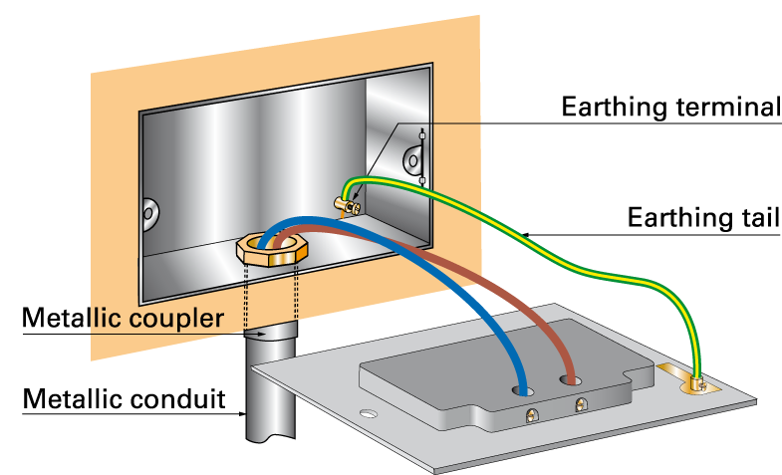
543.2.7
Where the protective conductor is formed by metal conduit, trunking or ducting or the metal sheath and/or armour of a cable, the earthing terminal of each accessory shall be connected by a separate protective conductor to an earthing terminal incorporated in the associated box or other enclosure.

Slide 12
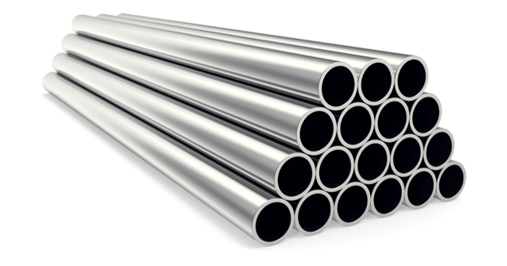
543.3.6
Every joint in a metallic conduit shall be mechanically and electrically continuous.

Slide 13
543.4 – Combined protective and neutral (PEN) conductors
543.4.1 PEN conductors shall not be used within an installation except as permitted by Regulation 543.4.2.
Note: Regulation 8(4) of the Electricity Safety, Quality and Continuity Regulations (ESQCR) prohibits the use of PEN conductors in consumers’ installations.

Slide 14
543.7
Earthing requirements for the installation of equipment having high protective conductor currents
When energised and in normal use, some electrical equipment can cause current to flow in the circuit protective conductors. Equipment having such currents may include:
information technology equipment
industrial and telecommunications equipment with radio-frequency interference suppression filtering
high-frequency luminaires
certain types of heating elements.

Slide 15
543.7.2 – Socket-outlet final circuits
543.7.2.201
For a final circuit with a number of socket outlets or connection units intended to supply two or more items of equipment, where it is known or reasonably to be expected that the total protective conductor current in normal service will exceed 10mA, the circuit shall be provided with a high integrity protective conductor connection complying with the requirements of Regulation 543.7.1.

Slide 16
Continued
The following arrangements of the final circuit are acceptable:
A ring final circuit with a protective conductor. Spurs if provided require high integrity protective conductor connections complying with the requirements of Regulation 543.7.1.
A radial final circuit with a single protective conductor:
the protective conductor being connected as a ring
a separate protective conductor being provided at the final socket outlet by connection to the metal conduit or ducting.

Slide 17
543.7.1.205
At the distribution board, information shall be provided indicating those circuits having a high protective conductor current.
This information shall be positioned so as to be visible to a person who is modifying or extending the circuit.

Slide 18
544: Protective bonding conductors
544.1.1 Main protective bonding conductors
When selecting the size of protective bonding conductors, you must consider if the supply earthing arrangements are:
TN-S
TN-C-S protective multiple earthing (PME).
If the supply is TN-S, then the main protective bonding conductors are to be no less than half the CSA of the main earthing conductor (subject to min of 6mm² and need not exceed 25mm²). If the supply is TN-C-S, then the bonding conductors are selected in accordance with Table 54.8.

Slide 19
Table 54.8
Minimum CSA of main protective bonding conductor in relation to the PEN conductor of the supply.
Copper equivalent CSA neutral | Minimum copper equivalent CSA of the bonding conductor
35mm² or less | 10mm²
Over 35mm² up to 50m² | 16mm²
Over 50mm² up to 95mm² | 25mm²
Over 95mm² up to 150mm² | 35mm²
Over 150mm² | 50mm²

Slide 20
Summary
You should now be able to:
Explain how earthing, CPCs and bonding enable ADS (fault protection)
Select suitable earth electrodes and state installation requirements (corrosion resistance, mechanical strength)
The Zs of an electrical circuit must be low enough to ensure that the OCPD will operate within the disconnection time stated in BS 7671.
With both low Zs values and effective main protective bonding, ADS requirements would be met.

Slide 21
Any questions?
Copyright in this document belongs to and is used under licence from the Department for Education, © 2025.
‘T-LEVELS’ and ‘T Level’ are registered trademarks of the Department for Education.
WJEC is authorised by the Department for Education to develop and deliver this T Level Technical Qualification.
WJEC operates in England under the name Eduqas which is a registered trademark of WJEC.

