Slide 1
Occupational Specialism: Electrotechnical Engineering
K1.5 Application of the fundamental principles of national standards
PowerPoint 1.5b: Chapter 52 Selection and erection of wiring systems
Notes:
BS7671 522. External Influences.
522 SELECTION AND ERECTION OF WIRING SYSTEMS IN RELATION TO EXTERNAL
INFLUENCES
The installation method selected shall be such that protection against the expected external influences is provided in all appropriate parts of the wiring system. Particular care shall be taken at changes in direction and where wiring enters into equipment.
NOTE: The external influences categorized in Appendix 5 which are of significance to wiring systems are included in this section.
522.1 Ambient temperature (AA)
522.1.1 A wiring system shall be selected and erected so as to be suitable for the highest and lowest local ambient temperatures and so that the limiting temperature in normal operation (see Table 52.1) and the limiting temperature in case of a fault (see Table 43.1) will not be exceeded.
522.1.2 Wiring system components, including cables and wiring accessories, shall only be installed or handled at temperatures within the limits stated in the relevant product specification or as given by the manufacturer.
522.2 External heat sources
522.2.1 In order to avoid the effects of heat from external sources, one or more of the following methods or an equally effective method shall be used to protect a wiring system:
(i) Shielding
(ii) Placing sufficiently far from the source of heat
(iii) Selecting a system with due regard for the additional temperature rise which may occur
(iv) Local reinforcement or substitution of insulating material.
NOTE: Heat from external sources may be radiated, conducted or convected, e.g.:
- from hot water systems
- from plant, appliances and luminaires
- from a manufacturing process
- through heat conducting materials
- from solar gain of the wiring system or its surrounding medium.
522.2.201 Parts of a cable within an accessory, appliance or luminaire shall be suitable for the temperatures likely to be encountered, as determined in accordance with Regulation 522.1.1, or shall be provided with additional insulation suitable for those temperatures.
522.3 Presence of water (AD) or high humidity (AB)
522.3.1 A wiring system shall be selected and erected so that no damage is caused by condensation or ingress
of water during installation, use and maintenance. The completed wiring system shall comply with the IP degree of
protection (see BS EN 60529) relevant to the particular location.
NOTE: Special considerations apply to wiring systems liable to frequent splashing, immersion or submersion.
522.3.2 Where water may collect or condensation may form in a wiring system, provision shall be made for
its escape.
522.3.3 Where a wiring system may be subjected to waves (AD6), protection against mechanical damage
shall be afforded by one or more of the methods of Regulations 522.6 to 8.
139
522.4 Presence of solid foreign bodies (AE)
522.4.1 A wiring system shall be selected and erected so as to minimize the danger arising from the ingress of
solid foreign bodies. The completed wiring system shall comply with the IP degree of protection (see BS EN 60529)
relevant to the particular location.
522.4.2 In a location where dust in significant quantity is present (AE4), additional precautions shall be taken
to prevent the accumulation of dust or other substances in quantities which could adversely affect heat dissipation
from the wiring system.
NOTE: A wiring system which facilitates the removal of dust may be necessary (see Section 529).
522.5 Presence of corrosive or polluting substances (AF)
522.5.1 Where the presence of corrosive or polluting substances, including water, is likely to give rise to corrosion or deterioration, parts of the wiring system likely to be affected shall be suitably protected or manufactured from a material resistant to such substances.
NOTE: Suitable protection for application during erection may include protective tapes, paints or grease.
522.5.2 Dissimilar metals liable to initiate electrolytic action shall not be placed in contact with each other,
unless special arrangements are made to avoid the consequences of such contact.
522.5.3 Materials liable to cause mutual or individual deterioration or hazardous degradation shall not be placed in contact with each other.
522.6 Impact (AG)
522.6.1 Wiring systems shall be selected and erected so as to minimize the damage arising from mechanical stress, e.g. by impact, abrasion, penetration, tension or compression during installation, use or maintenance.
522.6.2 In a fixed installation where impacts of medium severity (AG2) or high severity (AG3) can occur protection shall be afforded by:
(i) the mechanical characteristics of the wiring system, or
(ii) the location selected, or
(iii) the provision of additional local or general protection against mechanical damage, or
(iv) any combination of the above.
NOTE: Examples are areas where the floor is likely to be penetrated and areas used by forklift trucks.
522.6.4 The degree of protection of electrical equipment shall be maintained after installation of the cables and conductors.
522.6.201 A cable installed under a floor or above a ceiling shall be run in such a position that it is not liable to be damaged by contact with the floor or ceiling or their fixings.
A cable passing through a joist within a floor or ceiling construction or through a ceiling support (e.g. under floorboards), shall:
(i) be installed at least 50 mm measured vertically from the top, or bottom as appropriate, of the joist or batten, or
(ii) comply with Regulation 522.6.204.
522.6.202 A cable installed in a wall or partition at a depth of less than 50 mm from a surface of the wall or partition shall:
(i) be installed in a zone within 150 mm from the top of the wall or partition or within 150 mm of an angle formed by two adjoining walls or partitions. Where the cable is connected to a point, accessory or switchgear on any surface of the wall or partition, the cable may be installed in a zone either horizontally or vertically, to the point, accessory or switchgear. Where the location of the accessory, point or switchgear can be determined from the reverse side, a zone formed on one side of a wall of 100 mm thickness or less or partition of 100 mm thickness or less extends to the reverse side, or
(ii) comply with Regulation 522.6.204.
Where indent (i) but not indent (ii) applies, the cable shall be provided with additional protection by means of an RCD having the characteristics specified in Regulation 415.1.1.
140
522.6.203 Irrespective of its buried depth, a cable concealed in a wall or partition, the internal construction of which includes metallic parts, other than metallic fixings such as nails, screws and the like, shall:
(i) be provided with additional protection by means of an RCD having the characteristics specified in Regulation 415.1.1, or
(ii) comply with Regulation 522.6.204.
For a cable installed at a depth of less than 50 mm from the surface of a wall or partition the requirements of Regulation 522.6.202(i) shall also apply.
522.6.204 For the purposes of Regulation 522.6.201(ii), Regulation 522.6.202(ii) and Regulation 522.6.203(ii), a cable shall:
(i) incorporate an earthed metallic covering which complies with the requirements of these Regulations for a protective conductor of the circuit concerned, the cable complying with BS 5467, BS 6724, BS 7846, BS 8436 or BS EN 60702-1, or
(ii) be installed in earthed conduit complying with BS EN 61386-21 and satisfying the requirements of these Regulations for a protective conductor, or
(iii) be enclosed in earthed trunking or ducting complying with BS EN 50085-2-1 and satisfying the requirements of these Regulations for a protective conductor, or
(iv) be provided with mechanical protection against damage sufficient to prevent penetration of the cable by nails, screws and the like, or
(v) form part of a SELV or PELV circuit meeting the requirements of Regulation 414.4.
522.7 Vibration (AH)
522.7.1 A wiring system supported by or fixed to a structure or equipment subject to vibration of medium severity (AH2) or high severity (AH3) shall be suitable for such conditions, particularly where cables and cable connections are concerned.
522.7.2 For the fixed installation of suspended current-using equipment, e.g. luminaires, connection shall be made by cable with flexible cores. Where no vibration or movement can be expected, cable with non-flexible cores may be used.
522.8 Other mechanical stresses (AJ)
522.8.1 A wiring system shall be selected and erected to avoid during installation, use or maintenance, damage to the sheath or insulation of cables and their terminations. The use of any lubricants that can have a detrimental effect on the cable or wiring system are not permitted.
522.8.2 Where buried in the structure, a conduit system or cable ducting system, other than a pre-wired conduit assembly specifically designed for the installation, shall be completely erected between access points before any cable is drawn in.
522.8.3 The radius of every bend in a wiring system shall be such that conductors or cables do not suffer damage and terminations are not stressed.
522.8.4 Where conductors or cables are not supported continuously due to the method of installation, they shall be supported by suitable means at appropriate intervals in such a manner that the conductors or cables do not suffer damage by their own weight.
522.8.5 Every cable or conductor shall be supported in such a way that it is not exposed to undue mechanical strain and so that there is no appreciable mechanical strain on the terminations of the conductors, account being taken of mechanical strain imposed by the supported weight of the cable or conductor itself.
NOTE: Consumer unit meter tails are included in the requirements of this regulation.
522.8.6 A wiring system intended for the drawing in or out of conductors or cables shall have adequate means of access to allow this operation.
522.8.7 A wiring system buried in a floor shall be sufficiently protected to prevent damage caused by the intended use of the floor.
522.8.8 Not used
522.8.9 Not used
522.8.10 Except where installed in a conduit or duct which provides equivalent protection against mechanical damage, a cable buried in the ground shall incorporate an earthed armour or metal sheath or both, suitable for use as a protective conductor. The location of buried cables shall be marked by cable covers or a suitable marker tape.
Buried conduits and ducts shall be suitably identified. Buried cables, conduits and ducts shall be at a sufficient depth to avoid being damaged by any reasonably foreseeable disturbance of the ground.
NOTE: BS EN 61386-24 is the standard for underground conduits.
522.8.11 Cable supports and enclosures shall not have sharp edges liable to damage the wiring system.
522.8.12 A cable or conductors shall not be damaged by the means of fixing.
522.8.13 Cables, busbars and other electrical conductors which pass across expansion joints shall be so selected or erected that anticipated movement does not cause damage to the electrical equipment.
522.8.14 No wiring system shall penetrate an element of building construction which is intended to be load bearing unless the integrity of the load-bearing element can be assured after such penetration.
522.9 Presence of flora and/or mould growth (AK)
522.9.1 Where the conditions experienced or expected constitute a hazard (AK2), the wiring system shall be selected accordingly or special protective measures shall be adopted.
NOTE 1: An installation method which facilitates the removal of such growths may be necessary (see Section 529).
NOTE 2: Possible preventive measures are closed types of installation (conduit or channel), maintaining distances to plants and regular cleaning of the relevant wiring system.
522.10 Presence of fauna (AL)
522.10.1 Where conditions experienced or expected constitute a hazard (AL2), the wiring system shall be selected accordingly or special protective measures shall be adopted, for example, by:
(i) the mechanical characteristics of the wiring system, or
(ii) the location selected, or
(iii) the provision of additional local or general protection against mechanical damage, or
(iv) any combination of the above.
522.11 Solar radiation (AN) and ultraviolet radiation
522.11.1 Where significant solar radiation (AN2) or ultraviolet radiation is experienced or expected, a wiring
system suitable for the conditions shall be selected and erected or adequate shielding shall be provided. Special precautions may need to be taken for equipment subject to ionising radiation.
NOTE: See also Regulation 522.2.1 dealing with temperature rise.
522.12 Seismic effects (AP)
522.12.1 The wiring system shall be selected and erected with due regard to the seismic hazards of the location of the installation.
522.12.2 Where the seismic hazards experienced are low severity (AP2) or higher, particular attention shall be paid to the following:
(i) The fixing of wiring systems to the building structure
(ii) The connections between the fixed wiring and all items of essential equipment, e.g. safety services, shall be selected for their flexible quality.
522.13 Movement of air (AR)
522.13.1 See Regulation 522.7, Vibration (AH), and Regulation 522.8, Other mechanical stresses (AJ).
522.14 Nature of processed or stored materials (BE)
522.14.1 See Section 527, Selection and erection of wiring systems to minimize the spread of fire and
Section 422, Precautions where particular risks of fire exist.
522.15 Building design (CB)
522.15.1 Where risks due to structural movement exist (CB3), the cable support and protection system
employed shall be capable of permitting relative movement so that conductors and cables are not subjected to excessive mechanical stress.
142
522.15.2 For a flexible structure or a structure intended to move (CB4), a flexible wiring system shall be used.

Slide 2
Introduction
What factors would you consider when choosing a wiring system for a damp or thermally insulated environment?

Slide 3
Objectives
You should be able to:
Recall the main types of wiring systems and their reference installation methods
Explain how to select and erect wiring in accordance with BS 7671, taking account of external influences and safety regulations

Slide 4
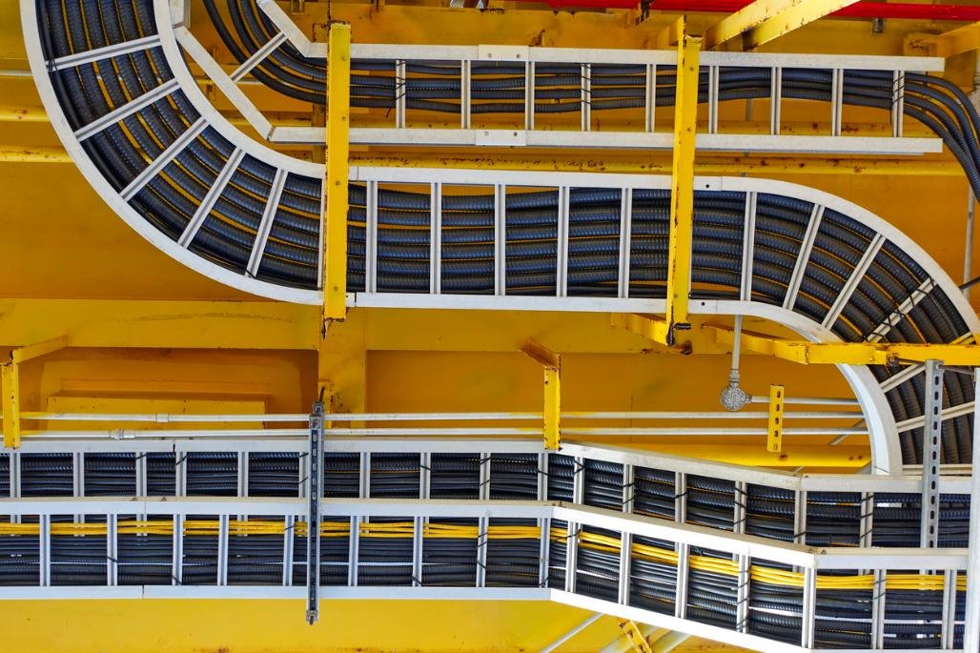
Chapter 52: Selection and erection of wiring systems

Slide 5
520.4: General
Consideration shall be given to the application of the fundamental principles of Chapter 13 as it applies to:
cables and conductors
their connections, terminations and/or jointing
their associated supports or suspensions
their enclosure or methods of protection against external influences.

Slide 6
521: Types of wiring system
521.1
The installation method of a wiring system in relation to the type of conductor or cable used shall be in accordance with Table 4A1 of Appendix 4 (page 432) provided the external influences are taken into account according to Section 522.
521.2 and 521.3
The installation method shall be in accordance with Table 4A2 or Appendix 4. Examples of wiring systems are shown in Table 4A2 including reference methods for obtaining current-carrying capacity.

Slide 7
521.5: AC circuits: Electromagnetic effects
521.5.1
The conductors of an AC circuit installed in a ferromagnetic enclosure shall be arranged so that all line conductors and the neutral conductor, and the appropriate protective conductor are contained within the same enclosure.
Where such conductors enter a ferrous enclosure, they shall be arranged such that the conductors are only collectively surrounded by ferromagnetic material.

Slide 8
521.5 AC circuits: Electromagnetic effects
521.5.2
Single-core cables armoured with steel wire or steel tape shall not be used for an AC circuit.
Note: the steel wire or steel tape armour of a single-core cable is regarded as a ferromagnetic enclosure. For single-core armoured cables, the use of aluminium armour may be considered.
521.5.201
Every conductor or cable shall have adequate strength and be so installed as to withstand the electromechanical forces that may be caused by current, including fault current, it may have to carry in service.

Slide 9
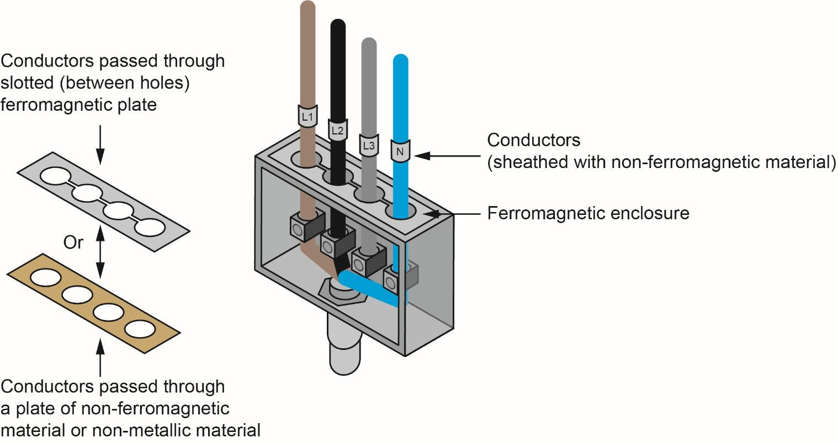

Slide 10
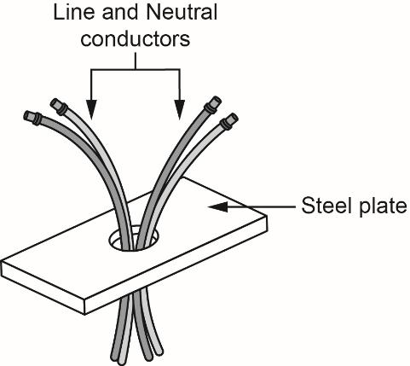
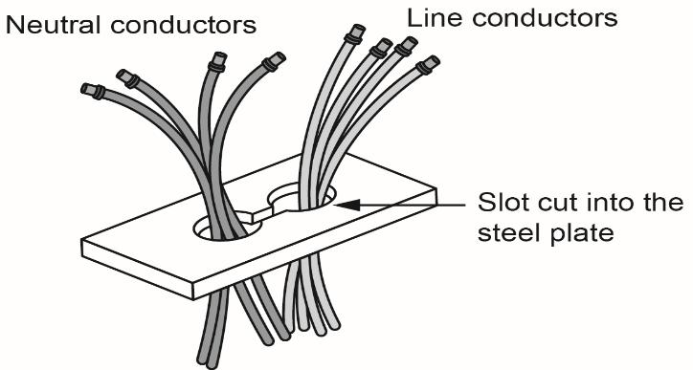
What are eddy currents?
Currents that are induced into a conductive material (usually perpendicular to a magnetic field).
Generated by a changing magnetic field/flux (such as those created in an AC circuit).

Slide 11
521.10: Installation of cables
521.10.1
Non-sheathed cables for fixed wiring shall be enclosed in conduit, ducting or trunking. This requirement does not apply to a protective conductor complying with Section 543.
521.10.202
Wiring systems shall be supported such that they will not be liable to premature collapse in the event of a fire.

Slide 12
521.10: Installation of cables
Note 3: This regulation precludes, for example, the use of non-metallic cable clips or cable ties as the sole means of support where cables are clipped directly to exposed surfaces or suspended under the cable tray and the use of non-metallic cable trunking as the sole means of support of the cables therein.
Note 4: Suitably spaced steel or copper clips, saddles or ties are examples that will meet the requirements of this regulation.

Slide 13
521.8: Circuit arrangements
521.8.1
Circuits shall not be distributed over different multi-core cables or systems.
521.8.2
Line and neutral of each final circuit to be electrically separate from the other final circuits to prevent indirect energising of an isolated circuit.
No borrowed neutrals.

Slide 14
522: Selection and erection of wiring systems in relation to external influences
The installation method selected shall be such that protection against the expected external influences is provided.
Note: the external influences categorised in Appendix 5 which are of significance to wiring systems are included in this section.
Appendix 5 (page 492) is split into three areas which are subdivided further.
A: Environment
B: Utilisation
C: Construction of building.

Slide 15
522.5: Presence of corrosive, polluting substances (AF)
522.5.2
Dissimilar metals liable to initiate electrolytic action shall not be placed in contact with each other, unless special arrangements are made to avoid the consequences of such contact.
522.5.3
Materials liable to cause mutual or individual deterioration or hazardous degradation shall not be placed in contact with each other.

Slide 16
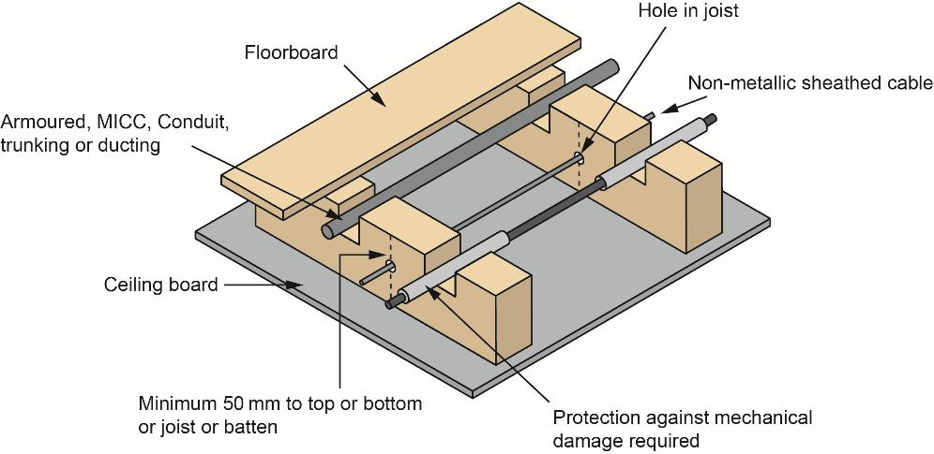
522.6: Impact (AG)
522.6.201: A cable installed under a floor or above a ceiling shall be run in such a position that it is not liable to be damaged by contact with the floor or ceiling or their fixings.

Slide 17
522.6: Impact (AG)
522.6.201: A cable passing through a joist within a floor or ceiling construction or through a ceiling support (e.g., under floorboards), shall:
i. be installed at least 50mm measured vertically from the top, or bottom as appropriate, of the joist or batten
or
ii. comply with Regulation 522.6.204.

Slide 18
522.6.202
All cables should be in a safe zone and:
cables to be 50mm deep or
incorporate an earthed metal covering or
enclosed in earthed metal conduit or
mechanically protected (capping not sufficient).
Additional protection by RCD may be required: If it is necessary to install cables outside of these zones, they must be of the armoured type, installed in steel conduit, steel trunking or have mechanical protection from nails and screws.

Slide 19
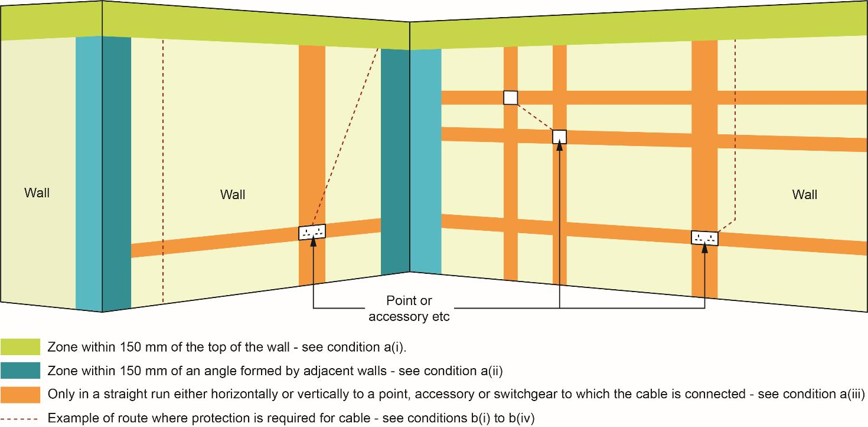
Conditions applying to cables embedded in a wall or partition at a depth of less than 50mm from surfaces

Slide 20
522.6.203
Irrespective of its buried depth, a cable concealed in a wall or partition, the internal construction of which includes metallic parts, other than metallic fixings such as nails, screws and the like shall:
i. be provided with additional protection by means of an RCD having the characteristics specified in Regulation 415.1.1
or
ii. comply with Regulation 522.6.204.
For a cable installed at a depth of less than 50mm from the surface of a wall or partition, the requirements of Regulation 522.6.202(i) shall also apply.

Slide 21
522.6.204
For the purposes of Regulation 522.6.201 (ii), Regulation 522.6.202 (ii) and Regulation 522.6.203 (ii), a cable shall:
i. incorporate an earthed metallic covering or
ii. be installed in earthed conduit or
iii. be enclosed in earthed trunking or ducting or
iv. be provided with mechanical protection against damage sufficient to prevent penetration of the cable by nails, screws and the like, or
v. form part of a SELV or PELV circuit meeting the requirements of Regulation 414.4.

Slide 22
522.7: Vibration (AH)
522.7.1
A wiring system supported by or fixed to a structure or equipment subject to vibration of medium severity (AH2) or high severity (AH3) shall be suitable for such conditions, particularly where cables and cable connections are concerned.

Slide 23
522.8: Other mechanical stresses (AJ)
522.8.1: Damage to cables, terminations not to occur during installation or maintenance. Lubricants that may damage cables not to be used.
522.8.2: Conduit systems to be erected prior to installation cable.
522.8.3: Bending radii to be correct for the system and the cable.
522.8.4: Cables to be supported at appropriate intervals.
522.8.5: Cables to be supported to reduce mechanical strain (including tails).

Slide 24
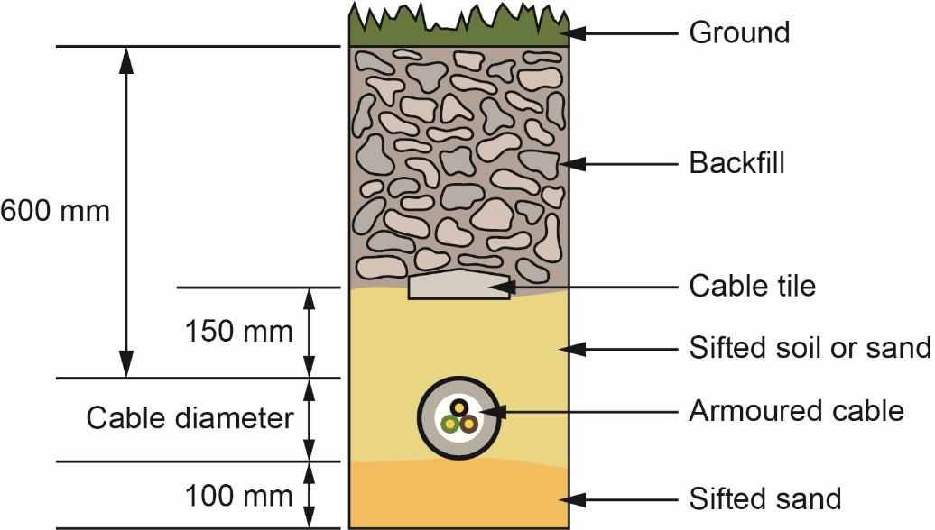
522.8.10
Except where installed in a conduit or duct that provides equivalent protection against mechanical damage, a cable buried in the ground shall incorporate an earthed armour or metal sheath or both, suitable for use as a protective conductor. The location of buried cables shall be marked by cable covers or a suitable marker tape.

Slide 25
522.8.11 and 522.8.14
522.8.11: No sharp edges on supports of structures.
522.8.14: Systems not to penetrate load-bearing structures, unless the integrity can be assured.

Slide 26
Miscellaneous external influences to be considered
The following external influences may also need to be considered:
522.11 Solar radiation (AN) and ultra-violet radiation
522.12 Seismic effects (AP)
522.13 Movement of air (AR)
522.14 Nature of processed or stored materials (BE)
522.15 Building design (CB).

Slide 27
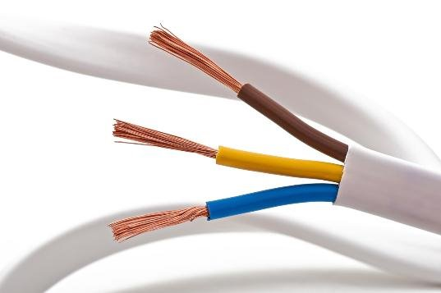
523: Current-carrying capacities of cables
Cable sizing is a process of calculating a cable’s cross-sectional area (CSA) taking into consideration the load on the conductors and voltage drop.
Refer to Appendix 4 of BS 7671 for current-carrying capacity and voltage drop for cables and flexible cords.

Slide 28
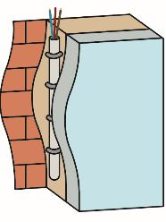
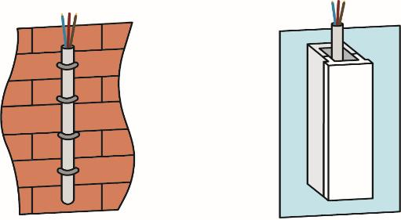
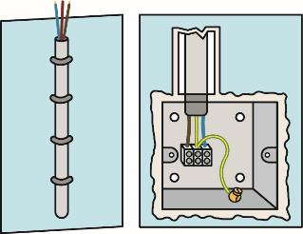
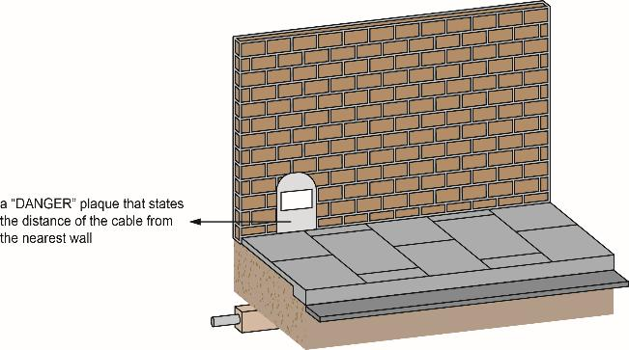
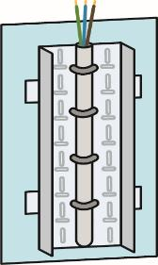
Installation methods
Reference method C
Clipped direct
Reference method A
Cables in multi-core cables in a thermally insulated wall
Reference method B
Cables enclosed in trunking or conduit
Reference method D
Cable laid direct in the ground
Reference method E or F
On a perforated tray

Slide 29
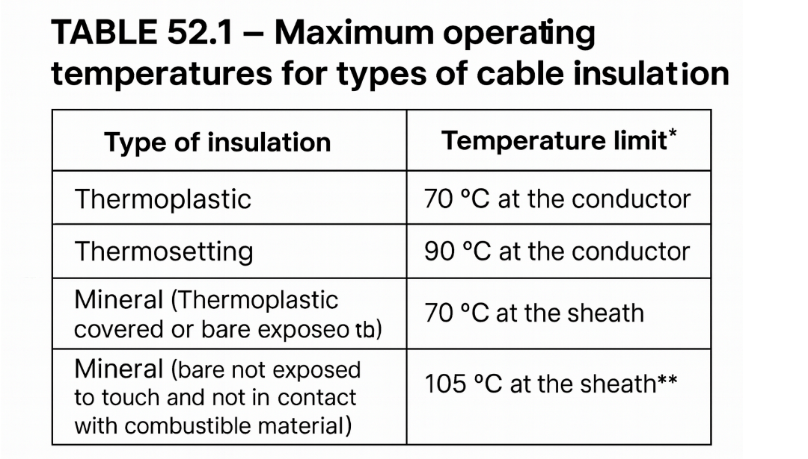
523: Current-carrying capacities of cables
523.1
The current, including any harmonic current, to be carried by any conductor for sustained periods during normal operation shall be such that the appropriate temperature limit specified in Table 52.1 is not exceeded.
Notes:
https://electrical.theiet.org/media/3023/wiring-matters-issue-93-november-2022.pdf

Slide 30
Harmonic currents
What are harmonic currents?
Picture a voltage sine wave: A voltage applied across a constant resistance creates a current (also in the form of a sine wave). However, when the wave form is distorted by a non-linear load (such as an electronic lighting ballast), it can distort the current wave form and create harmonic currents.

Slide 31
523.2
The requirement of Regulation 523.1 is considered to be satisfied if the current for non-sheathed and sheathed cables does not exceed the appropriate values selected from the tables of current-carrying capacity given in Appendix 4 with reference to Table 4A2, subject to any necessary rating factors.

Slide 32
523.6: Number of loaded conductors
523.6.1: Where polyphase circuits carry balanced currents, the neutral need not be considered.
523.6.2: Where the neutral carries imbalanced currents, then its size shall be selected based on the highest line conductor current.
523.6.3: If harmonic currents produced in a three-phase system are greater than 15%, then the neutral conductor size shall not be smaller than the line conductor under these conditions.
Remember: polyphase just means multi-phase, such as two or three phases.

Slide 33
523.9: Cables in thermal insulation
Avoid insulation coverage: Wherever possible, don’t route cables where they might be enclosed by thermal insulation.
Partially insulated runs: If a cable lies against an insulated wall or ceiling (contact on one side), use the current-carrying capacities in Appendix 4.
Fully surrounded ≥ 0.5 m: For a single cable completely encased in insulation over 0.5 m or more, assume 50% of its open-air, surface-clipped rating (Reference method C).
Fully surrounded < 0.5 m: Apply the appropriate derating factors from Appendix 4, item 2.6 (for conductors up to 10 mm²).

Slide 34
Correction factor terminology
Correction factors (for when carrying out current-carrying capacity calculations) are referred to as ‘rating factors’.
Rating factor | Relating to:
C_{a} | ambient temperature
C_{c} | circuits buried in the ground
C_{d} | depth of burial
C_{f} | semi-enclosed fuse to BS 3036
C_{g} | grouping
C_{i} | thermal insulation
C_{s} | thermal resistivity of soil
Notes:
Also take note of Table 52.3 on page 148

Slide 35
526: Electrical connections
526.3: Every connection shall be accessible for inspection, testing and maintenance, except:
joint designed for burial
compound-filled joint
cold tail connections
welded, soldered, brazed, compression
part of equipment with appropriate product standard
equipment complying with BS 5733 for maintenance free.

Slide 36
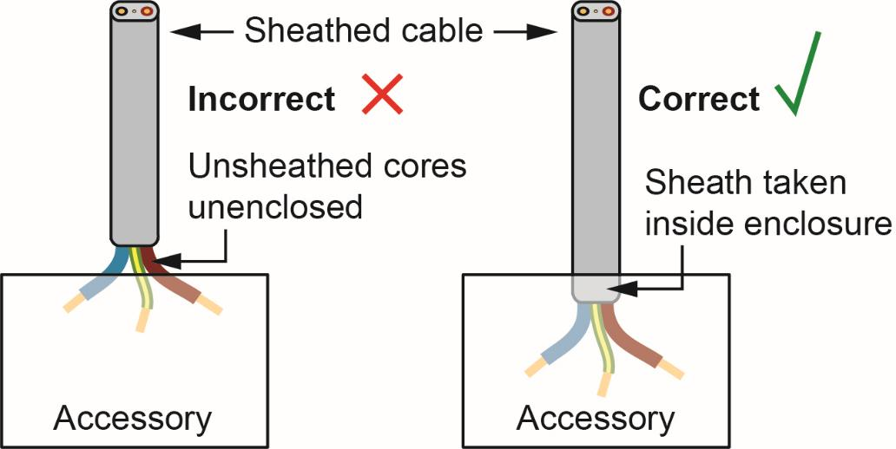
526.8: Requirements for sheathed and non-sheathed cable enclosure
Cores of sheathed cables from which the sheath has been removed and non-sheathed cables at the termination of conduit, ducting or trunking shall be enclosed as required by Regulation 526.5.

Slide 37
Selection and erection of wiring systems to minimise the spread of fire
Regulation 527.1.3: This states that cables also need to satisfy the requirements of the Construction Products Regulation (CPR) in respect of their reaction to fire.
Regulation 527.2.1: Where a wiring system passes through elements of building construction such as floors, walls, roofs, ceilings, partitions or cavity barriers, the openings remaining after passage of the wiring system shall be sealed according to the degree of fire-resistance (if any) prescribed for the respective element of building construction before penetration.

Slide 38
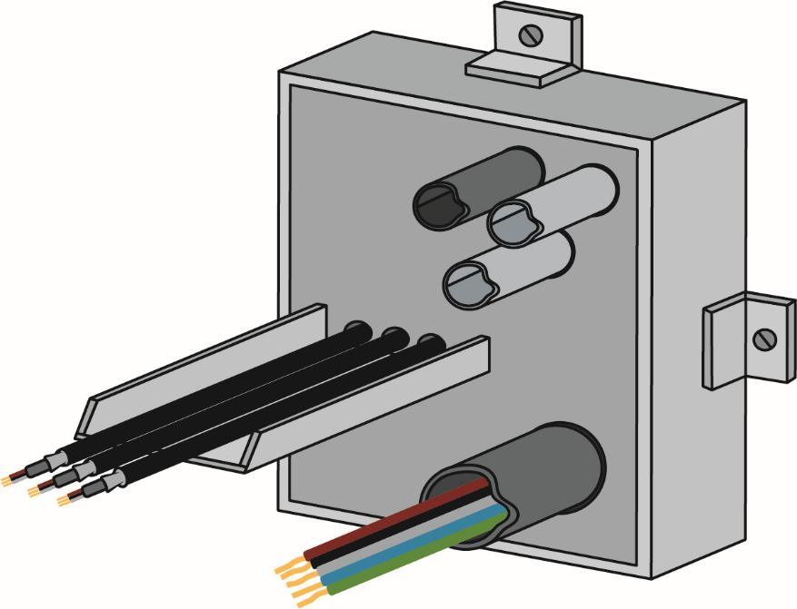
Multi-service barrier

Slide 39
528
Section 528 sets out requirements for measures to be taken where electrical equipment, including wiring systems, are in close proximity to other electrical services and to non-electrical services.

Slide 40
528: Proximity of wiring systems to other services
528.3.1: A wiring system shall not be installed in the vicinity of services that produce heat, smoke or fumes likely to be detrimental to the wiring, unless it is protected from harmful effects by shielding.
528.3.2: Where a wiring system is routed below services liable to cause condensation (such as water, steam or gas services), precautions shall be taken to protect the wiring system from deleterious effects.
528.3.5: No cable shall be run in a lift or hoist well unless it forms part of the lift installation.

Slide 41
529: Selection and erection of wiring systems in relation to maintainability, including cleaning
529.1: With regard to maintainability, reference shall be made to Regulation 132.12 (accessibility).
529.3: Provision shall be made for safe and adequate access to all parts or a wiring system which may require maintenance, ladders, walkways etc.

Slide 42
Summary
You should now be able to:
Recall the main types of wiring systems and their reference installation methods
Explain how to select and erect wiring in accordance with BS 7671, taking account of external influences and safety regulations

Slide 43
Any questions?
Copyright in this document belongs to and is used under licence from the Department for Education, © 2025.
‘T-LEVELS’ and ‘T Level’ are registered trademarks of the Department for Education.
WJEC is authorised by the Department for Education to develop and deliver this T Level Technical Qualification.
WJEC operates in England under the name Eduqas which is a registered trademark of WJEC.

