Slide 1
Occupational Specialism: Electrotechnical Engineering
K1.5 Application of the fundamental principles of national standards
PowerPoint 1.5a: Chapter 51

Slide 2
Introduction
What warning notices or labels should you put up on a new electrical installation?

Slide 3
Objectives
You should be able to:
Recall the core principles of national and harmonised standards for electrical equipment selection and erection
Explain the BS 7671 requirements for safety, proper functioning and external influences
Describe the rules for accessibility, identification, warning notices and documentation

Slide 4
Part 5: Selection and erection of equipment
510.1
This chapter deals with the selection of equipment and its erection. It provides common rules for compliance with measures of protection for safety, requirements for proper functioning for intended use of the installation and requirements appropriate to the external influences.
510.3
Every item of equipment shall be selected and erected so as to allow compliance with the regulations stated in this chapter and the relevant regulations in other parts of BS 7671 and shall take account of manufacturers’ instructions.

Slide 5
511: Compliance with standards
511.1
Every item of equipment shall comply with the relevant requirements of the applicable British or harmonised standard, appropriate to the intended use of the equipment.
Alternatively, if equipment complying with a foreign national standard based on an IEC standard is to be used, the designer or other person responsible for specifying the installation shall verify that any differences between that standard and the corresponding British or harmonised standard will not result in a lesser degree of safety.

Slide 6
512: Operational conditions and external influences
Equipment must be suitable for its intended use, therefore must be suitable for the following:
512.1.1 – Voltage
512.1.2 – Current
512.1.3 – Frequency
512.1.4 – Power
512.1.5 – Compatibility
512.1.6 – Impulse withstand voltage.

Slide 7

512.2: External influences
Equipment shall be of a design appropriate to the situation in which it is to be used, or its mode of installation shall take into account the conditions likely to be encountered.
Notes:
AI image

Slide 8
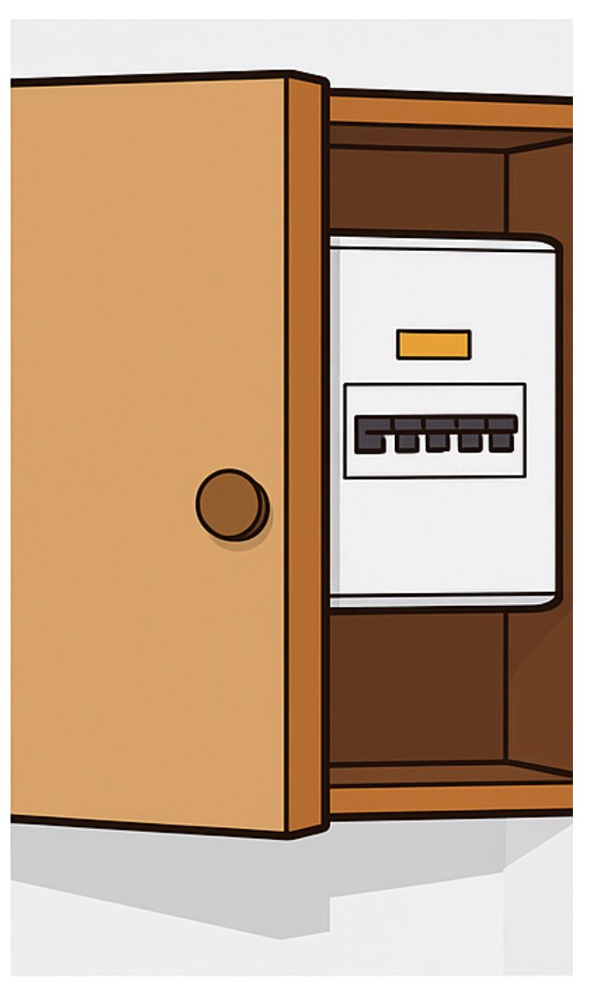
513: Accessibility of equipment
Equipment to be installed so that it can be easily operated, inspected and maintained, and provide ease of access to any connections (exceptions are listed later in 526).

Slide 9
514: Identification and notices
Each item of equipment/switchgear to be labelled where there may be cause for confusion.
514.1.2 Wiring identified for ease of inspection, testing, repair or alteration.
514.1.3 Except where there is no possibility of confusion, unambiguous marking shall be provided at the interface between conductors identified in accordance with BS 7671 and conductors identified to previous versions of BS 7671.

Slide 10
Identification of protective conductor
514.4.2
Bi-colour combination of green/yellow is used exclusively for the identification of the protective conductor at a ratio of at least 70/30.
Single-core cables and conductors in multicore cables identified by green-and-yellow throughout their length shall only be used as a protective conductor and shall not be overmarked at their terminations.

Slide 11
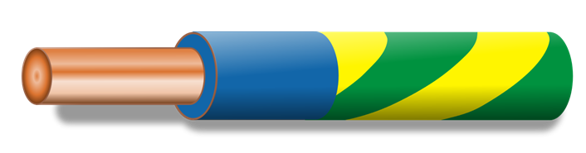
Identification of PEN conductor
514.4.3
A PEN conductor when insulated, shall be marked either:
green/yellow throughout its length with blue markings at the terminations
or
blue throughout its length with green/yellow markings at the terminations.

Slide 12
514 – Identification and notices
514.4.4
Other conductors shall be identified by colour in accordance with Table 51.
514.4.5
Single colour green shall not be used for the identification of:
live conductors in power circuits
protective conductors
functional earthing and bonding conductors.

Slide 13
Omissions
514.6 Concentric cable conductors
Add sheath/armour of a cable when used as protective conductor
Bare conductors where not practicable
Extraneous conductive parts when used as protective conductor
Exposed conductive parts when used as protective conductor
514.8 Identification of a protective device
Protective device arranged and identified so the circuit protected may be easily identified.

Slide 14
514.9: Diagrams and documentation
Legible and durable diagrams, charts and tables to be provided in or near distribution board to contain:
composition of each circuit.
method of compliance with basic/fault protections to 410.3.2
identification of each device performing function of protection, isolation, switching and location.
equipment vulnerable to testing.

Slide 15
514.9 continued
For simple installations, the foregoing information may be given in a schedule. A durable copy of the schedule relating to a distribution board shall be provided within or adjacent to each distribution board.
The requirements of this regulation need not be applied for domestic (household) premises or similar installations where certification for initial verification, complete with guidance for recipients as detailed in Appendix 6, has been issued to the person ordering the work.

Slide 16
514.10 Warning notice: Voltage
514.10.1
Every item of equipment or enclosure within which a nominal voltage exceeding 230 volts to earth exists and where the presence of such a voltage would not normally be expected, shall be so arranged that before access is gained to a live part, a notice warning of the maximum voltage to earth present is clearly visible.

Slide 17
514.12 – Notices: Periodic inspection and testing
514.12.1 An instruction notice… shall be fixed in a prominent position at or near the relevant distribution board or boards upon completion of the work… The notice shall be inscribed in indelible characters and shall read as follows:
Important
This installation should be periodically inspected and tested and a report on its condition obtained, as prescribed in BS 7671 Requirements for Electrical Installations.
Date of last inspection_____________
Recommended date of next inspection ___________

Slide 18
514.12: Notices: Periodic inspection and testing
514.12.1
The requirements of this regulation need not be applied for domestic (household) premises or similar installations where certification for initial verification, complete with guidance for recipients as detailed in
Appendix 6, has been issued to the person ordering the work.

Slide 19
514.12: Notices: Periodic inspection and testing
514.12.2 Where an installation incorporates an RCD, an instruction notice shall be fixed in a prominent position at or near each RCD in the installation. The notice shall be inscribed in indelible characters and shall read as follows:
This installation, or part of it, is protected by a device which automatically switches off the supply if a fault develops.
Test six-monthly by pressing the relevant test button(s) which should operate the device. Afterwards, manually switch on the device. If the device does not operate, or indicates a fault, seek expert advice.

Slide 20
514.12 – Notices: periodic inspection and testing
514.12.2
The requirements of this regulation need not be applied for domestic (household) premises or similar installations where certification for initial verification, complete with guidance for recipients as detailed in Appendix 6, has been issued to the person ordering the work.

Slide 21
514.13: Warning notices: Earthing, bonding connections
514.13.1 A durable warning notice with the words 'Safety electrical connection - do not remove' shall be securely fixed in a visible position at or near:
the point of connection of every earthing conductor to an earth electrode
the point of connection of every bonding conductor to an extraneous-conductive-part
the main earthing terminal, where separate from main switchgear.
The warning notice may be provided by a clamp according to BS 951. Note: an example of a suitable warning notice is provided in Figure 11C of Appendix 11.

Slide 22
Earth-free equipotential bonding
514.13.2 Where Regulation 418.2.5 or 418.3 applies, the warning notice specified shall be durably marked and shall incorporate the following wording:
The protective bonding conductors associated with the electrical installation in this location MUST NOT BE CONNECTED TO EARTH.
Equipment having exposed-conductive-parts connected to earth must not be brought into this location.

Slide 23
514.15: Warning notice: Alternative, additional supplies
514.15.1 Where an installation includes alternative or additional sources of supply, warning notices shall be affixed at the following locations in the installation:
at the origin of the installation
at the meter position, if remote from the origin
at the consumer unit or distribution board to which the alternative or additional sources are connected
at all points of isolation of all sources of supply.
The warning notice shall be durably marked and identify the relevant point(s) of isolation.

Slide 24
514.16: Notice: Presence of SPDs in an installation
514.16.1
The presence of SPDs in an installation shall be indicated by an information notice at or near the relevant distribution board(s).
The requirements of this regulation need not be applied for domestic (household) premises or similar installations where the information is recorded on the appropriate certification for initial verification, complete with guidance for recipients as detailed in Appendix 6 and issued to the person ordering the work.

Slide 25
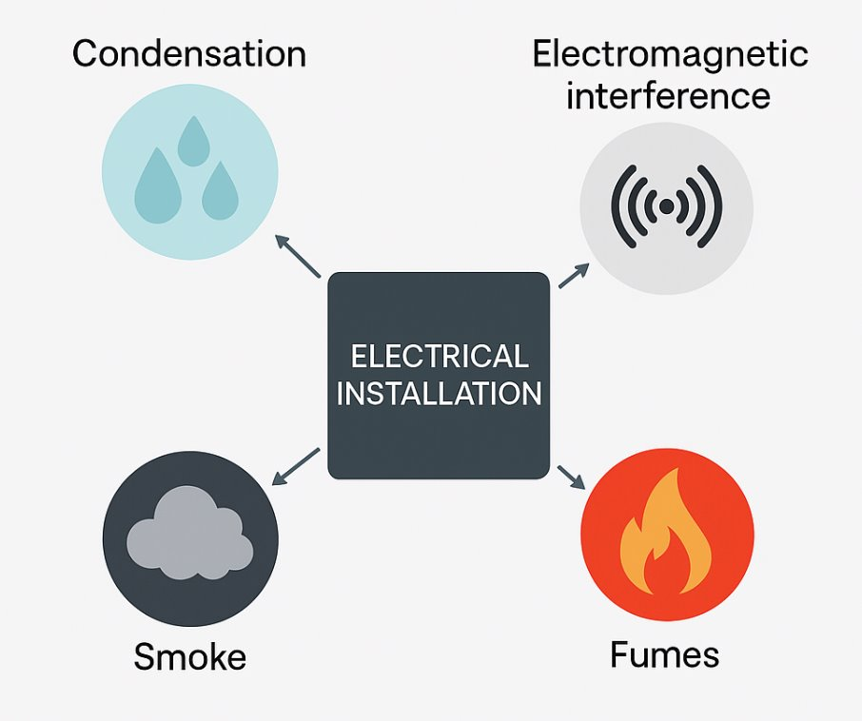
515 – Prevention of mutual detrimental influences
Electrical equipment shall be selected and erected so as to avoid any harmful influences between the electrical installation and any non-electrical installations envisaged.

Slide 26
Summary
You should now be able to:
Recall the core principles of national and harmonised standards for electrical equipment selection and erection
Explain the BS 7671 requirements for safety, proper functioning and external influences
Describe the rules for accessibility, identification, warning notices and documentation

Slide 27
Any questions?
Copyright in this document belongs to and is used under licence from the Department for Education, © 2025.
‘T-LEVELS’ and ‘T Level’ are registered trademarks of the Department for Education.
WJEC is authorised by the Department for Education to develop and deliver this T Level Technical Qualification.
WJEC operates in England under the name Eduqas which is a registered trademark of WJEC.

