Slide 1
Occupational Specialism: Electrotechnical Engineering
K1.4 Assessment of general characteristics outlined in national standards
PowerPoint 1.4: General characteristics

Slide 2
Introduction
This session looks at how installation design is shaped by factors such as earthing systems, load demands and environmental influences.
We'll also cover key considerations for renewable energy systems and the need for safe isolation procedures.

Slide 3
Objectives
By the end of this session, you should be able to:
Identify common earthing systems (TT, TN-S, TN-C-S)
Explain the risks of diverted neutral current and broken PEN conductors
Calculate maximum demand using diversity
Understand how environmental factors affect installation choices
Define key terms related to renewable energy systems

Slide 4
Earthing and bonding
Earthing and bonding are two separate but often confused safety methods used to prevent electric shock.
Earthing ensures that if a fault occurs and an exposed conductive part becomes live, the electrical current has a safe, low-resistance path back to earth. This helps disconnect the supply quickly and limits the duration of dangerous touch voltages.
Bonding connects separate metal parts within an installation (such as pipes or structural steel) to prevent voltage differences between them. This reduces the risk of shock if someone touches two different metallic parts during a fault.

Slide 5
Earthing arrangements
An earthing arrangement describes how an electrical installation is connected to earth for safety.
It ensures that, if a fault occurs, fault current has a low-resistance path back to the supply, allowing protective devices (such as fuses or circuit breakers) to disconnect the supply quickly.
Effective earthing minimises the risk of electric shock and reduces the potential for dangerous voltages on exposed conductive parts during a fault.

Slide 6
Types of earthing arrangements
There are five main earthing arrangements.
TN-S: Separate neutral and earth conductors.
TN-C-S: Combined neutral and earth (PEN) to the supply point, then separate.
TT: Earth connection made at the installation via local earth electrode.
TN-C: Combined neutral and earth throughout (not common in the UK).
IT: System isolated from earth or connected through high impedance.

Slide 7
Earthing system letter codes
Letter meanings in earthing system codes:
T = earth (from French terre)
N = neutral
S = separate neutral and protective conductor
C = combined neutral and protective conductor
I = isolated or impedance-earthed system.

Slide 8
Identifying the earthing system
When designing an electrical installation, one of the first steps is identifying the type of earthing system. The electricity distributor will provide details of the supply system. For low-voltage supplies, the system will usually be:
TN-S
TN-C-S (also known as PME)
TT
This follows the requirements of the Electricity Safety, Quality and Continuity Regulations 2002.

Slide 9
TN-C and IT
TN-C systems require a legal exemption under the Regulations and are rarely used.
IT systems (with isolated or impedance-earthed supplies) are not permitted for low-voltage public supplies in the UK. An exception to this rule is medical settings, such as hospitals, in specific situations.
Therefore, TN-C and IT systems are both very uncommon in UK domestic and commercial installations.

Slide 10
TN-S
TN-S systems use a single neutral-to-earth connection placed as close as possible to the supply transformer.
Separate neutral and earth conductors run all the way through the supply network.
In low-voltage setups, the transformer’s earth connection is often bonded to the metal sheath of the supply cable, providing a direct earth path back to the substation transformer.

Slide 11
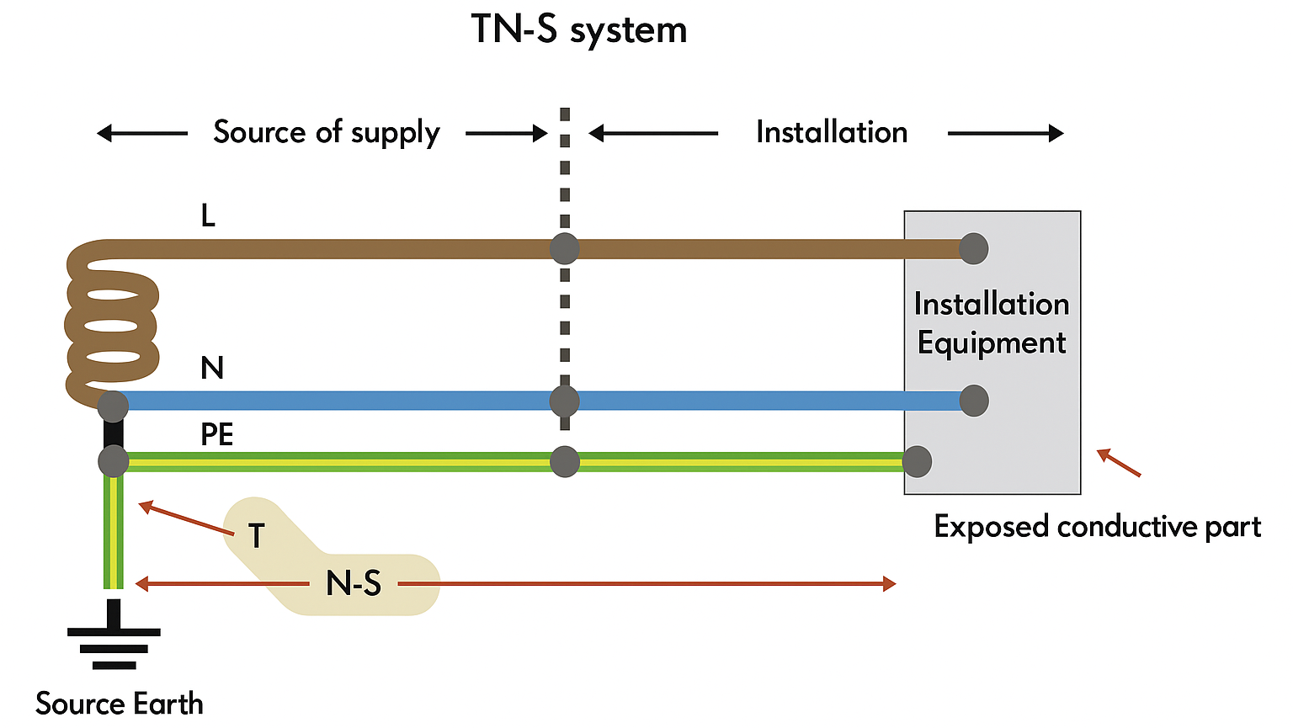

Slide 12
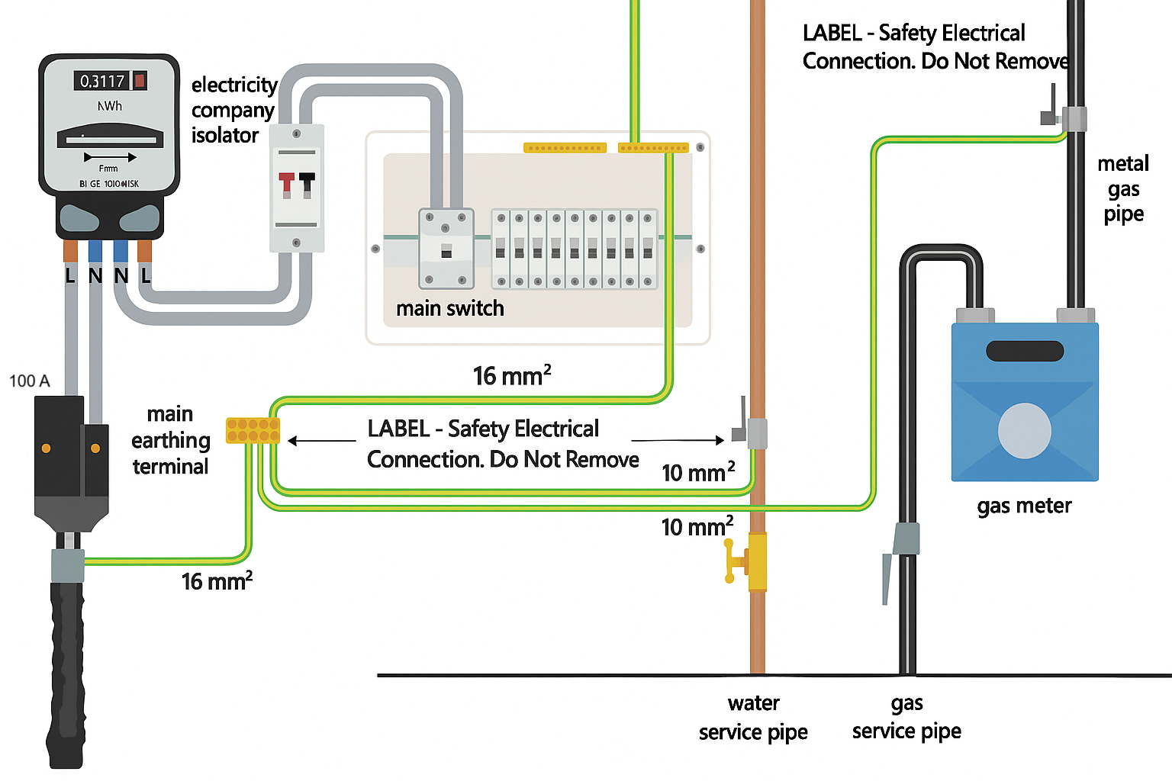
The distribution network operator (DNO) typically maintains a maximum external earth fault loop impedance of around 0.8 Ω in TN-S systems.

Slide 13
TN-C-S (Protective multiple earthing: PME)
TN-C-S is the most common earthing system in the UK.
Widely known as protective multiple earthing (PME).
Provides a safe and reliable low-voltage supply by using a combined neutral and earth conductor (PEN) along the supply route.
To ensure safety, the PEN conductor is earthed at multiple points along the distribution network.
The neutral conductor is earthed close to the supply source (at the intake to the installation) and at key points across the system to maintain protective functionality.

Slide 14
TN-C-S system considerations
Despite its widespread use, the TN-C-S arrangement carries risks.
If the PEN conductor becomes open (broken), the installation loses its main return path, creating an electric shock hazard.
This risk is why certain installations (such as petrol stations, construction sites, caravan parks, and some detached outbuildings) are prohibited from using TN-C-S systems.
Guidance Note 3 (Appendix D) now includes procedures for safe checking of diverted neutral currents to help mitigate these hazards.

Slide 15
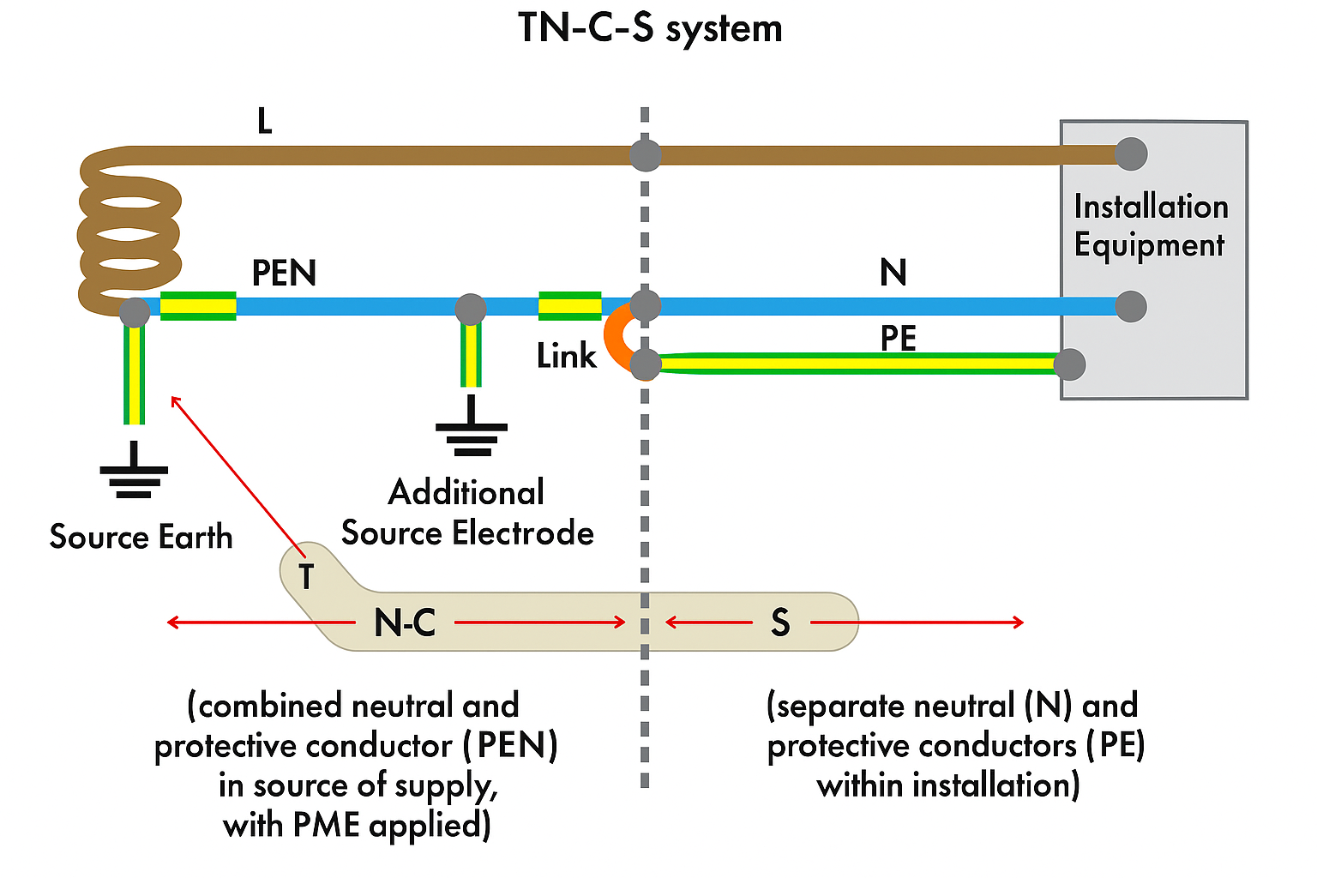

Slide 16
Because the DNO (Distribution Network Operator) uses a combined neutral and PEN (Protective Earth and Neutral) return path, the maximum external earth fault loop impedance is typically 0.35 Ω.

Slide 17
TN-C system (terre-neutral combined)
In a TN-C system, one of the live conductors (usually the neutral) is also used as the earth.
All exposed conductive parts (such as the metal casings of Class I equipment) are connected to the earthed neutral at the transformer.
The PEN conductor (protective earthed neutral) carries both the neutral return current and provides the protective earth path.
Notes:
worth noting that regs prohibit the use of RCD’s on a TN-C system which would exclude its use on modern installations.

Slide 18
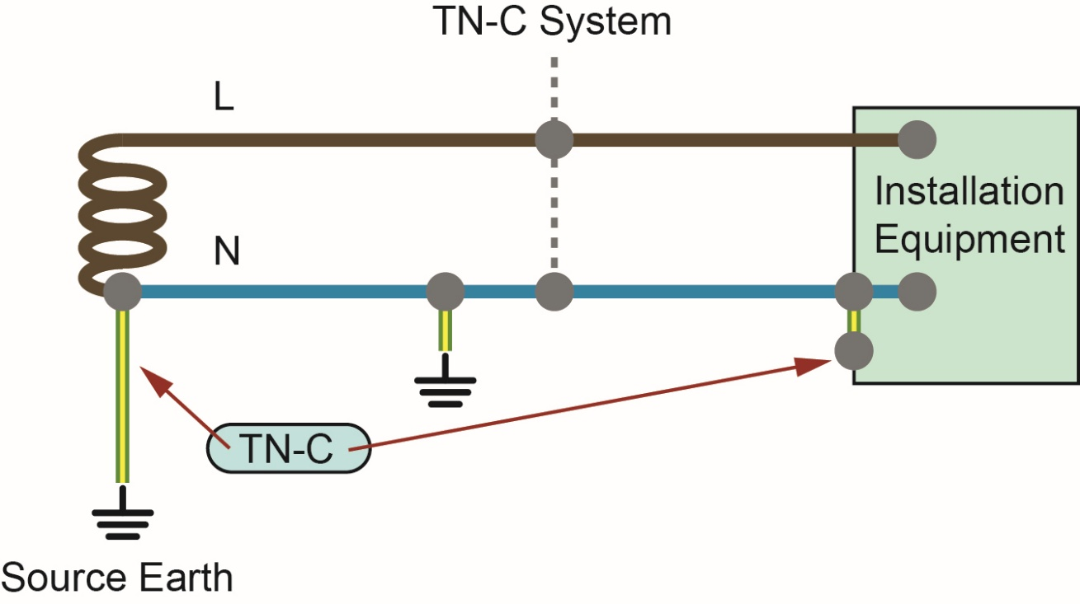
TN-C system (terre-neutral combined)

Slide 19
TT system
TT system is similar to TN-S but doesn’t provide the consumer with a dedicated earth connection from the supply. The consumer must install their own earth electrode (e.g. earth rod or plate) to establish a local earth connection with sufficiently low impedance.
TT systems are often used:
where TN-C-S cannot be used (e.g. petrol stations)
in rural areas where supply is delivered via overhead lines.
Because soil conditions can vary, shock protection often relies on residual current devices (RCDs) to ensure automatic disconnection of supply when needed, especially where earth fault loop impedance may be high.

Slide 20
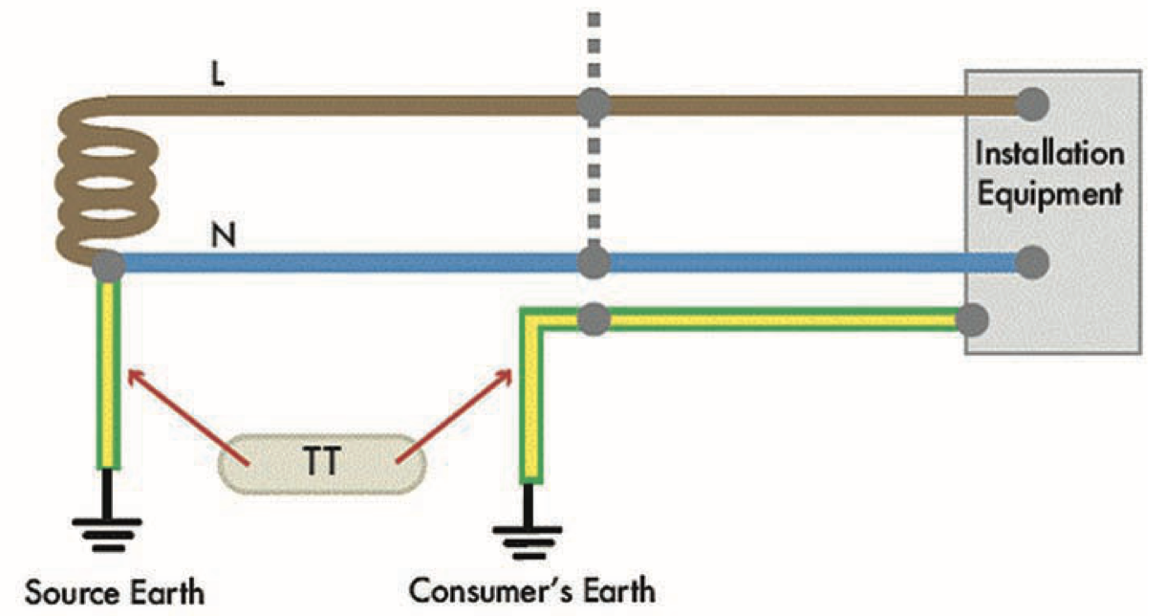

Slide 21
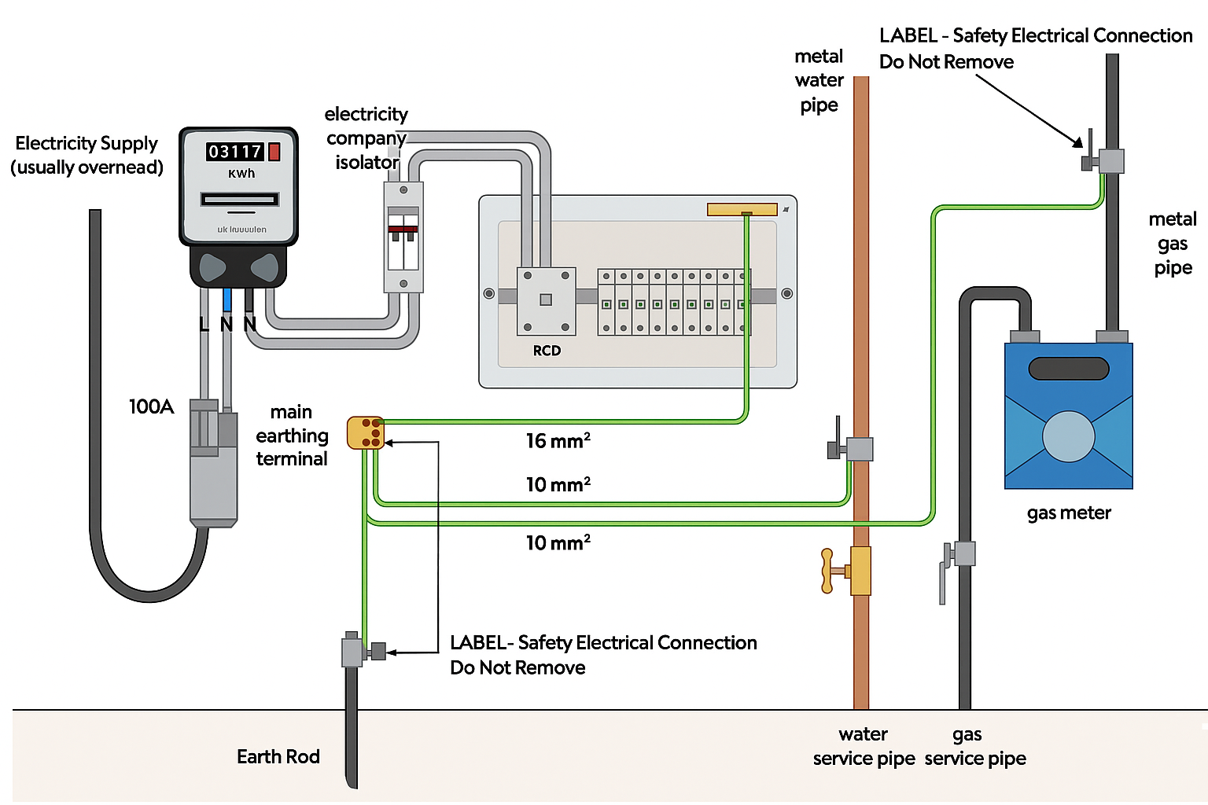

Slide 22
IT system (isolated terra)
IT systems use a transformer or an independent power source (like a battery or generator) that is unearthed or connected to earth through a high impedance.
No active conductor is directly connected to earth. In the event of a short circuit or earth fault, only a small fault current flows, determined by system insulation and capacitance. This setup minimises the risk of high earth fault currents and can keep the system operational during the first fault.
Standards require that an insulation monitoring device be installed to continuously monitor system integrity.

Slide 23
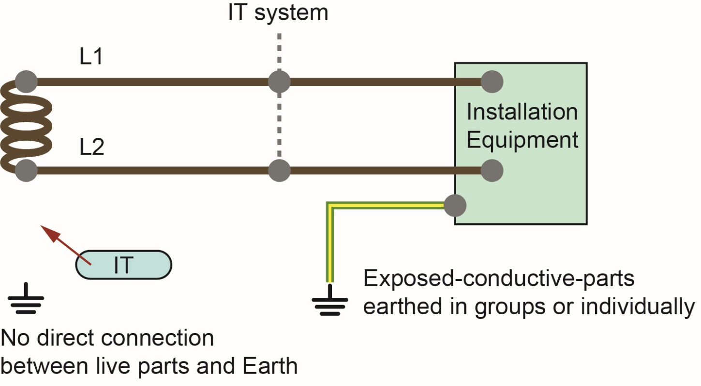
IT system (isolated terra)

Slide 24
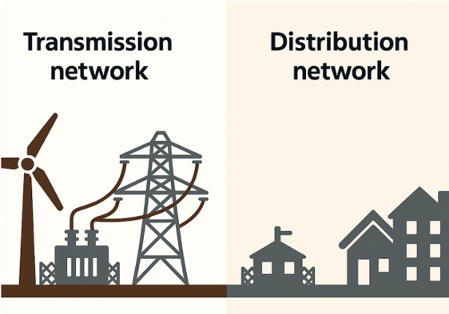
Electrical supply systems
In the United Kingdom, electrical energy generated at power stations, wind farms and other renewable sources is delivered to consumers through a national network.
This system is divided into two key sections: transmission and distribution.

Slide 25
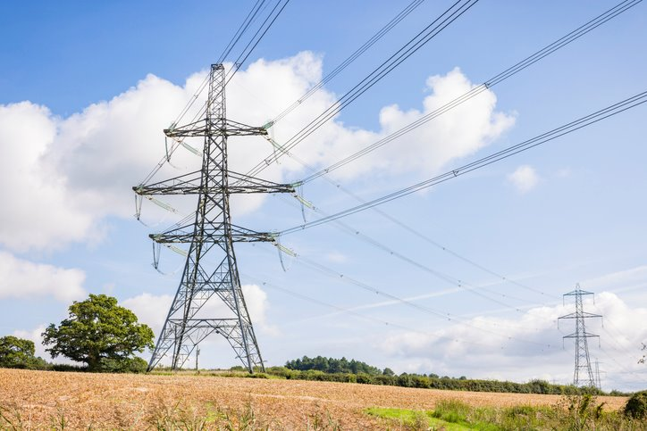
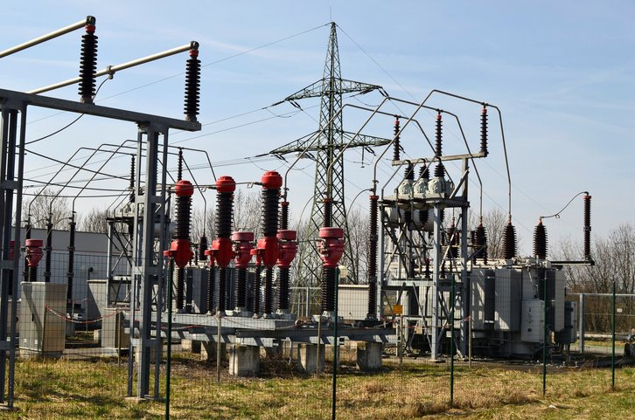
Electrical supply systems
The transmission network is a high-voltage system that transports electricity over long distances.
It uses pylons, overhead lines and underground cables.
This part of the network moves electricity from generation sites to major substations.
Operated by companies such as National Grid in England and Wales.

Slide 26
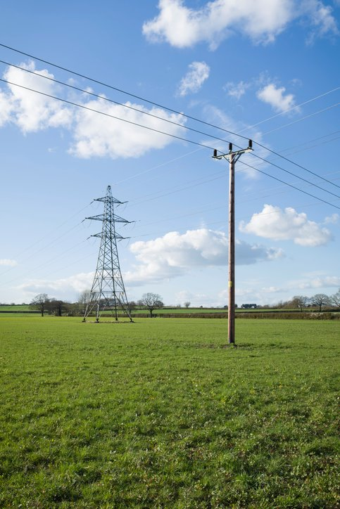
Electrical supply systems
From there, the distribution network takes over.
It reduces voltage levels through substations.
Delivers electricity through local cables and lines.
Ensures safe and reliable power supply to homes, schools and businesses across the country.

Slide 27
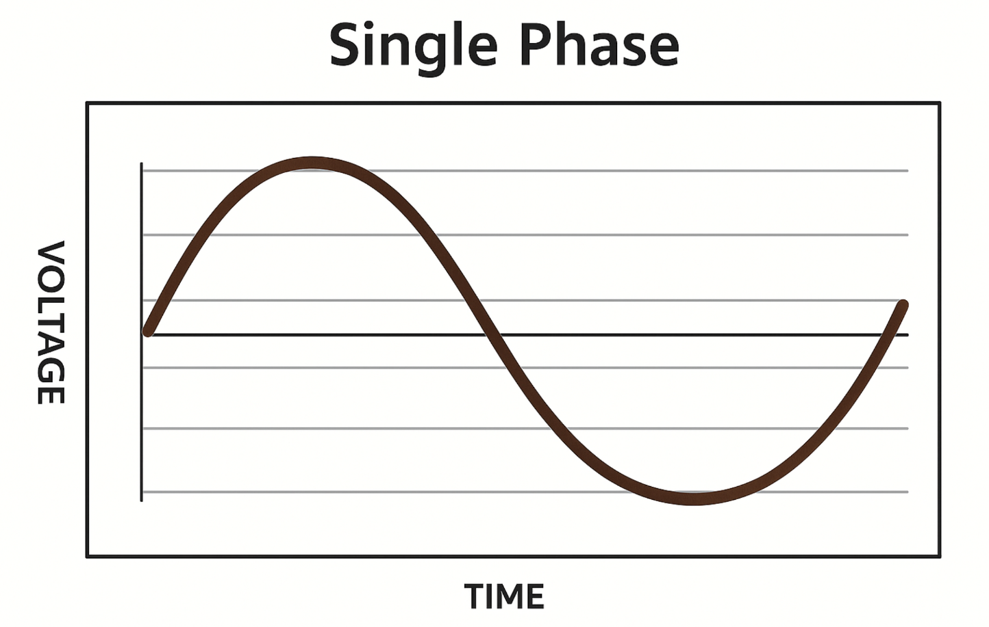
Electrical supply systems: Single phase
Electricity supply to users can be either single-phase or three-phase.
Single-phase
One line conductor and one neutral conductor.
Typical in dwellings, small shops and small outlets.

Slide 28
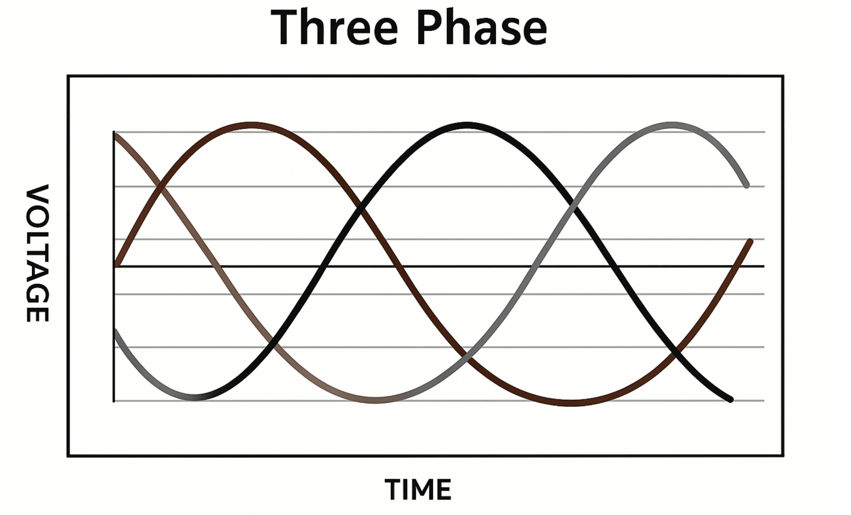
Electrical supply systems: Three phase
Three-phase
Three line conductors, spaced 120 degrees apart and, optionally, a neutral.
Typically used in larger installations requiring more power.

Slide 29

Single- and three-phase supplies
Domestic and similar premises usually have a single-phase 230 V supply, meaning two conductors (line and neutral).
For larger installations needing over 100 A, a three-phase supply is usually provided, using either a three-wire or four-wire system.

Slide 30
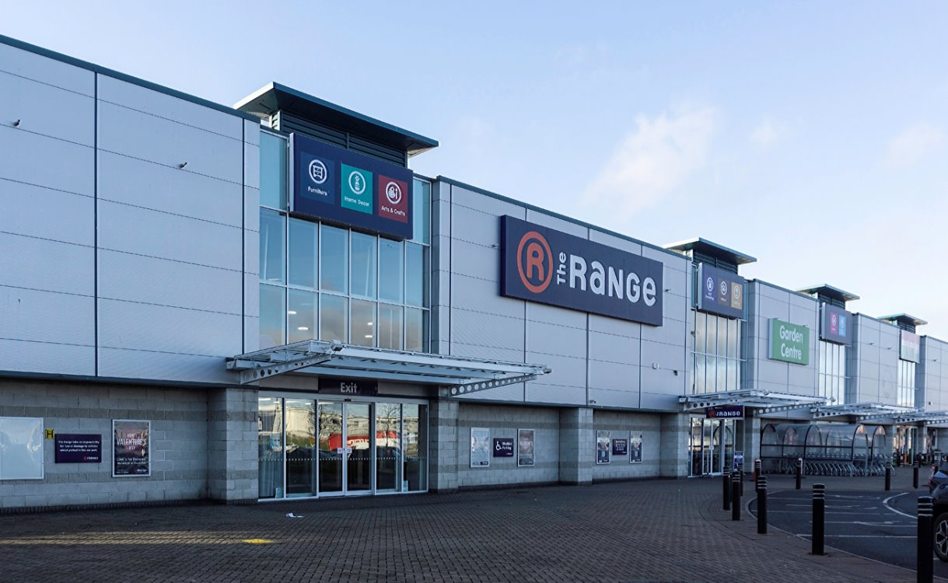
Four-wire system
If one phase draws more current, the system becomes unbalanced, and a neutral conductor is needed to carry the imbalance.
This type is used in larger retail spaces, commercial buildings and industrial premises where loads are unevenly distributed across phases.

Slide 31
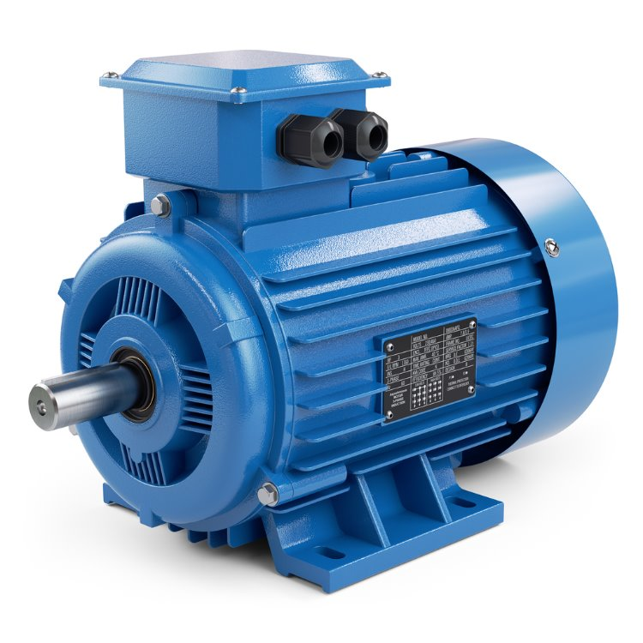
Three-wire system
When the loads across the three phases are balanced (equal), the current in each phase is the same.
In a perfectly balanced system, no current flows through the neutral conductor.
Common in equipment like motors and certain machinery.

Slide 32
Prosumer and Consumer
Prosumer installations generate electricity and may consume electricity (e.g. solar PV systems on homes).
Consumer installations only use energy supplied from the grid or another source.
When grid power is lost, a prosumer system may switch to island mode, operating independently as a temporary backup. This isolates the property from the grid while maintaining essential supply.
Although some systems can operate off-grid by design, most island mode setups are intended for short-term autonomy during outages.

Slide 33
Load curtailment and load shedding
Load curtailment is the intentional reduction of electricity consumption by limiting or adjusting loads. It is often done automatically in smart energy systems to prevent overloading or conserve power.
Example: Reducing EV charger output during peak times.
Load shedding is the automatic disconnection of non-essential circuits when supply is limited or in fault conditions, ensures critical loads (e.g. lighting, medical equipment) remain powered.
Example: Common in island mode to preserve battery life.

Slide 34
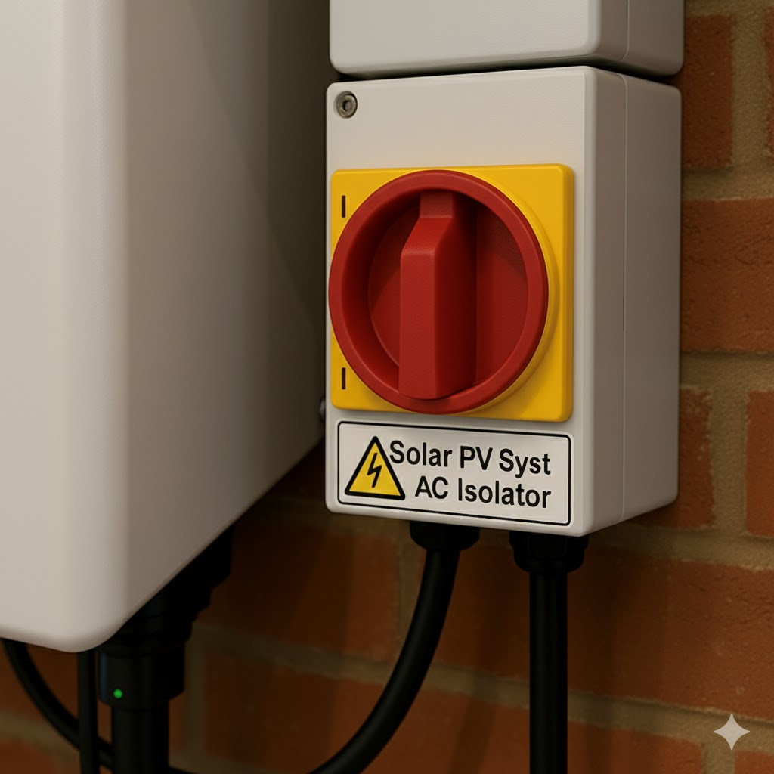
Isolation requirements
When systems like solar PV or batteries are installed, the entire installation must be fully and safely isolated from all power sources, including grid supply and local generation.
This prevents back-feed hazards and is essential for safe maintenance and emergency procedures.

Slide 35
Isolation requirements
All alternative supplies, such as solar PV or battery storage systems, must be clearly labelled at the origin of the installation to indicate the presence of multiple power sources and the need for full isolation before work is carried out, in accordance with BS 7671 Regulation 514.15.

Slide 36
Maximum demand and diversity
When a new electrical supply is requested, the distribution network operator (DNO) must ensure that the supply can meet the installation's maximum demand, the highest level of electrical load that may be used.
To calculate this, the designer needs to evaluate the general characteristics of the installation.
This assessment helps avoid issues such as overloading circuits or inadequate protection.

Slide 37
BS 7671 (Chapter 30): Factors to consider
The purpose or use of the installation.
General layout and type of supply.
External environmental influences.
Compatibility with connected equipment.
Maintainability of the installation.
Essential safety services.
Continuity of supply requirements.

Slide 38
Determining maximum demand
Maximum demand is calculated by summing the design current of each circuit per phase.
However, adding all design currents without adjustment often results in an overestimate.
In real use, not all electrical loads operate at the same time.
This is where diversity comes in.
Notes:
311.1
In determining the maximum demand of an installation, diversity may be taken into account

Slide 39
What is diversity?
Diversity is a principle that recognises not all connected loads run simultaneously.
For example, in a home, it is unlikely the lights, cooker, kettle, shower and other appliances will all be used at once.
By applying diversity, we reduce the total calculated load to more realistically reflect likely usage.

Slide 40
Diversity factor
The diversity factor is the ratio of the total demand of individual loads to the maximum expected load of the system at any one time.
This allows smaller supply cables and components to be used safely and economically.
The IET On-Site Guide (Appendix A) provides standard diversity allowances for common loads.

Slide 41
Diversity guidelines
Lighting: 66% of total load
Heating: 100% of first 10 A, 50% of the remainder
Cooking: 10 A + 30% of load above 10 A (+5 A if cooker outlet)
Instant water heaters: 100% of largest + 100% second + 25% rest
Immersion heaters: 100%
Floor heating/Storage heaters: 100%
Sockets: 100% of largest load + 40% of others
Notes:
Point out this guide – can read through some of the other guidelines from Table A2.

Slide 42
Design current (Ib)
The design current is the current a circuit is expected to carry during normal operation.
It is calculated after maximum demand and diversity have been assessed.
This value helps inform the selection of cable sizes and protective devices.
BS 7671 defines design current as: 'The magnitude of current (rms value for AC) to be carried by the circuit in normal service’.

Slide 43
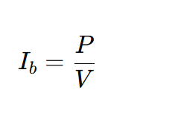
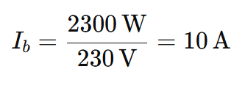
Worked example: Design current
You are designing a radial circuit to supply a 2.3 kW electric heater on a 230 V single-phase supply.
Where:
Ib = Design current (Amps)
P = Total power (Watts)
V = Supply voltage (Volts)
The design current for this circuit is 10 A

Slide 44
Worked example: Cooker with diversity
A 10 kW cooker is installed. The control unit includes a socket outlet.
Total load: I=10 kW V=230V 10,000/230 = 43.47A
Applying diversity (On-Site Guide A2, item 3):
10 A + 30% of remainder above 10 A 10+(0.30×33.47) = 20.04 A
Add 5 A for socket outlet 20.04+5= 25.04 A

Slide 45
External influences: Why they matter
Electrical installations must be designed to withstand the environmental conditions they are exposed to.
These conditions affect the selection of:
wiring systems
enclosures and equipment
installation methods
protective measures.

Slide 46
Main categories of influence
BS 7671 identifies three main categories of influence:
Code | Influence Type | Example
A | Environmental | Moisture, temperature, corrosive atmospheres, UV exposure
B | Use-related | Mechanical impact, vibration, movement, user access
C | Building construction | Fire risk, accessibility, structural features

Slide 47
Examples of external influences in practice
Scenario | Design Consideration
Outdoor lighting | IP-rated enclosures, UV-resistant cables
Industrial workshop with machinery | Steel conduit for mechanical protection
Wet rooms (bathrooms, commercial) | IP-rated fittings, RCD protection (Reg. 701)
Agricultural buildings | Corrosion-resistant materials, dust protection
High temperature areas | Cables rated for ambient conditions (Reg. 523.1)

Slide 48
Maintainability in electrical design
When designing an installation, it’s important to consider how easily the system can be maintained, tested, or modified throughout its life. Poor design choices can make future work unsafe, time-consuming, or even non-compliant.
Designers should ensure:
equipment is accessible for inspection, testing and servicing
terminations, junction boxes, isolation devices are not hidden or obstructed
cables are routed using accessible containment systems
room is allowed for future expansion, such as additional circuits or equipment.

Slide 49
Certification and regulation requirements
Maintainability must also be considered when certifying an installation. The designer must show that the installation allows for safe ongoing operation and inspection.
BS 7671 Regulation 132.12: Accessibility of electrical equipment
Electrical equipment shall be arranged to provide:
sufficient space for the initial installation and later replacement of individual items of electrical equipment
accessibility for operation, inspection, testing, fault detection, maintenance and repair.

Slide 50
Diverted neutral current
What is a diverted neutral? Like a road diversion takes you on a different route, a diverted neutral happens when return current flows along a different path instead of its usual route via the PEN conductor.
What is an alternative path? This means current is returning via other conductors, typically earthing or bonding conductors, rather than through the main PEN route.
Why is this a concern? This situation can lead to dangerous voltages appearing on exposed or extraneous metalwork. The risk of electric shock is high if the installation is not isolated properly.

Slide 51
When a diverted neutral occurs
Why does it happen?
In a TN-C-S (PME) earthing system, neutral and earth share the same conductor.
If the external PEN conductor is damaged or broken, neutral current will try to return via the installation's earth/bonding system.
What’s the risk?
If the PEN conductor breaks, the earth and bonding conductors within the premises can rise to full supply voltage, potentially 230V.
This poses a serious shock or fire hazard as metalwork becomes energised.

Slide 52
Why a broken PEN might go unnoticed
The installation may appear to function normally: appliances still work because the return current is flowing, just not through the intended path.
Only when someone receives a shock, such as touching outdoor metalwork like a tap, does the issue become apparent.

Slide 53
Normal operating conditions
Under normal operating conditions, current returns from each property via the PEN conductor to the distribution transformer.
In these conditions, there is no potential difference between the PME neutral and Earth.

Slide 54
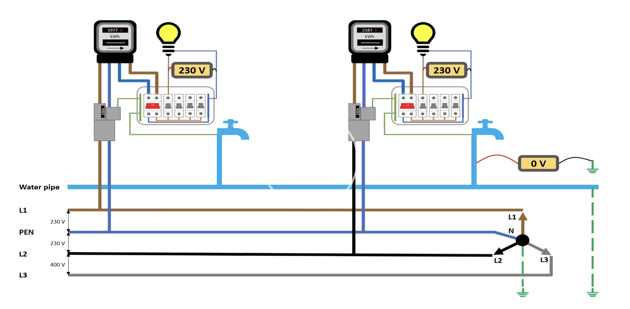
Normal operating conditions

Slide 55
Open-circuit PEN conductor in single-phase section
If a break occurs in the PEN conductor on the single-phase section of the supply, the return path may be through an extraneous conductive part. This could be a shared metallic water pipe connected to a neighbouring installation, for example.
This can result in a touch voltage between exposed and extraneous conductive parts and Earth, with the voltage level depending on the resistance of the return path.

Slide 56
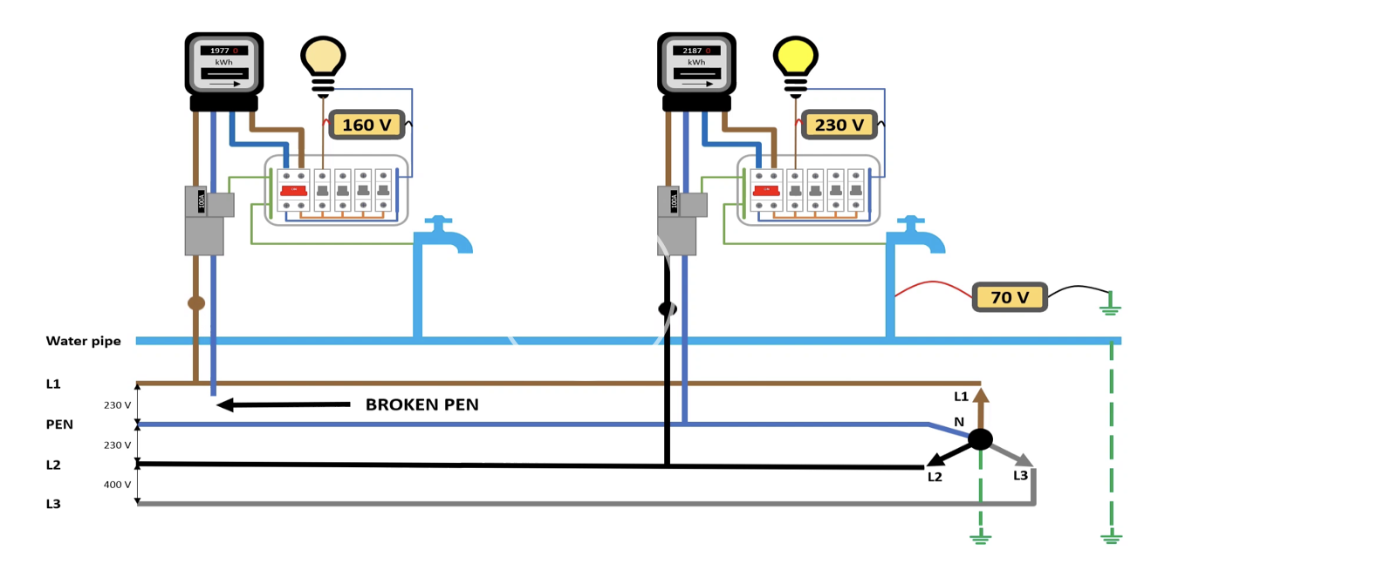
Open-circuit PEN conductor in single-phase section

Slide 57
Open-circuit PEN conductor in three-phase section
If the PEN conductor becomes open-circuit within a section of three-phase cable, the return current may flow via a neighbouring installation, back to the supply via another phase (e.g. L2).
As a result, voltages of up to 400 V can appear within a single-phase installation.
The voltage to Earth can be even higher if the distribution network is unbalanced.

Slide 58
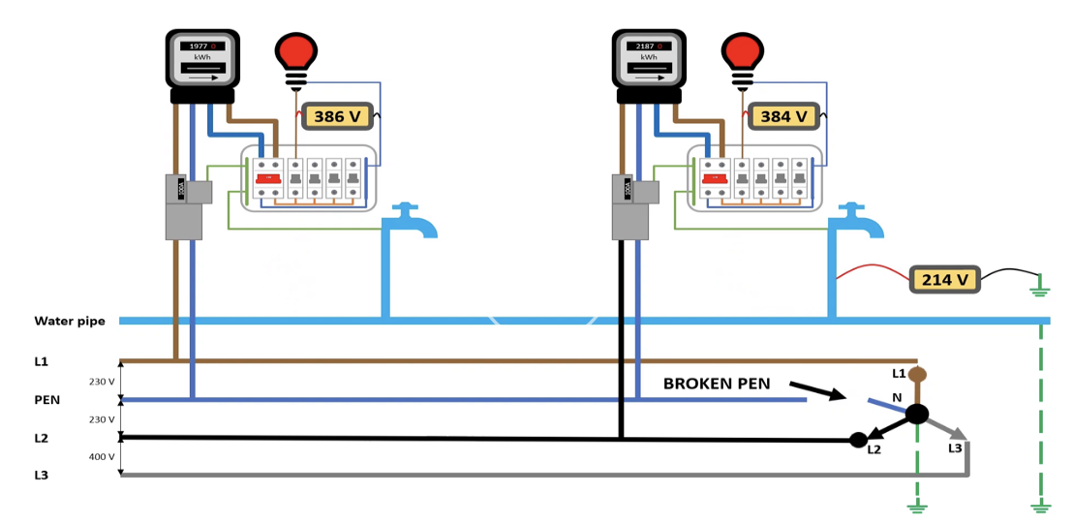
Open-circuit PEN conductor in three-phase section

Slide 59
Detecting diverted neutral current
A diverted neutral current can be identified using a standard clamp meter.
Clamp the meter around the main earthing conductor while the installation is under load.
A current reading indicates that neutral current is being diverted through the earthing path.
The meter can also be clamped around metallic pipework to detect diverted currents via extraneous-conductive-parts.

Slide 60
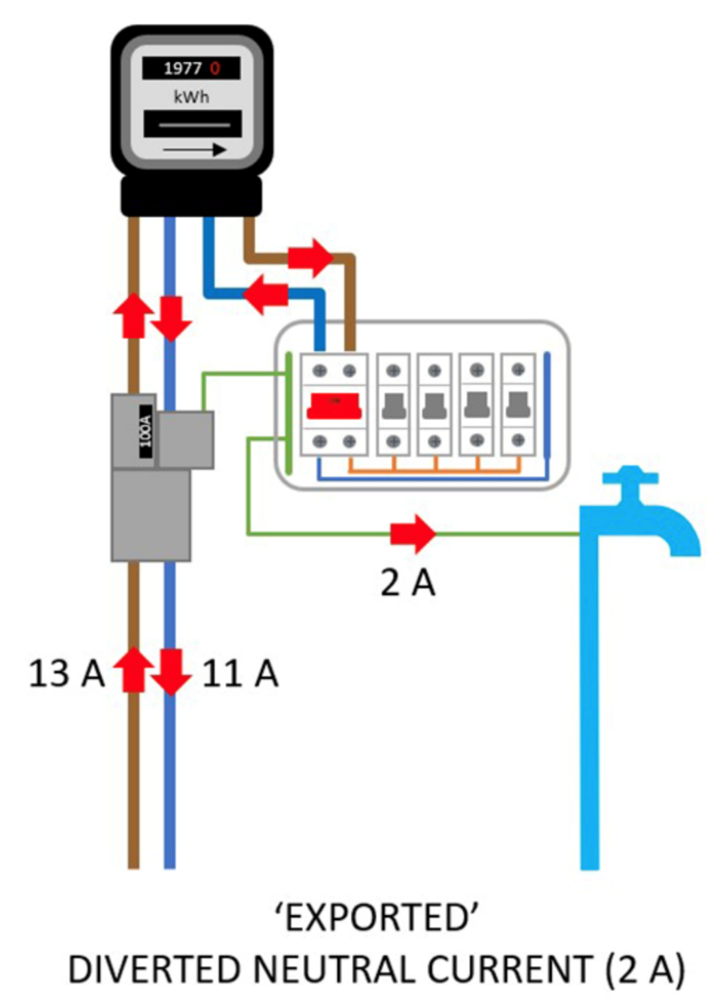
Exported diverted neutral current
In this scenario, part of the installation’s neutral current returns via extraneous paths such as metallic water pipes.
13A enters the installation, 11A returns via the neutral conductor.
The remaining 2A is exported through the main earthing terminal and pipework.
This can pose a shock hazard to adjacent installations and public pipework systems.

Slide 61
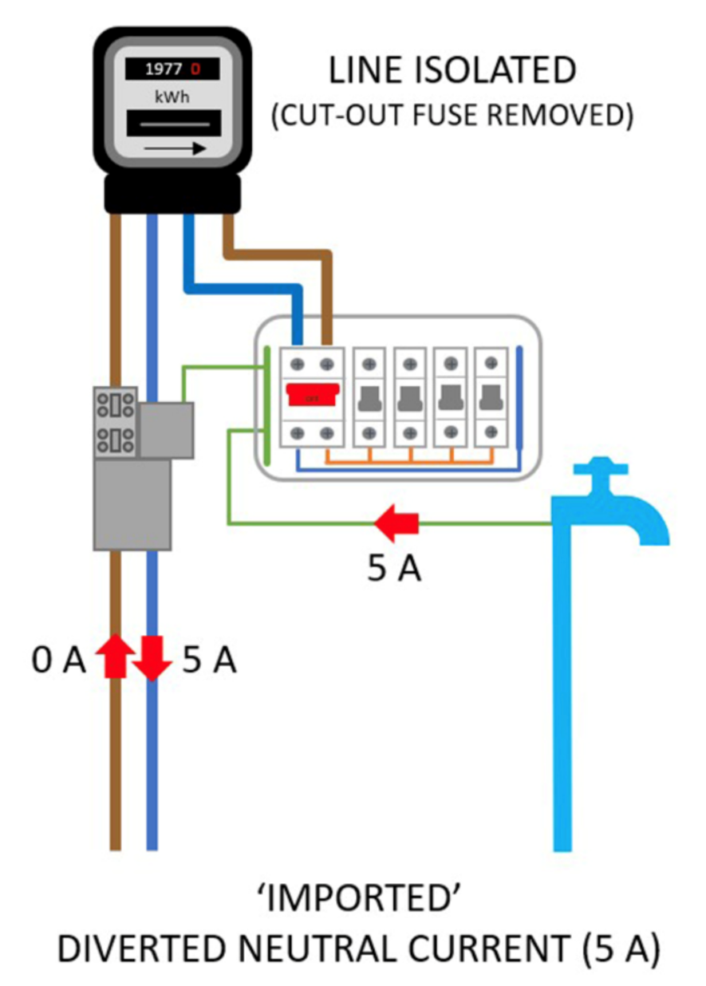
Imported neutral current
With the supply fuse removed, current may still enter the installation through bonded pipework.
A 5A neutral current is imported via the water pipe.
This is due to return currents from other installations using shared services (e.g. PME network).
It illustrates the hidden danger of diverted currents when PEN conductors are compromised.

Slide 62
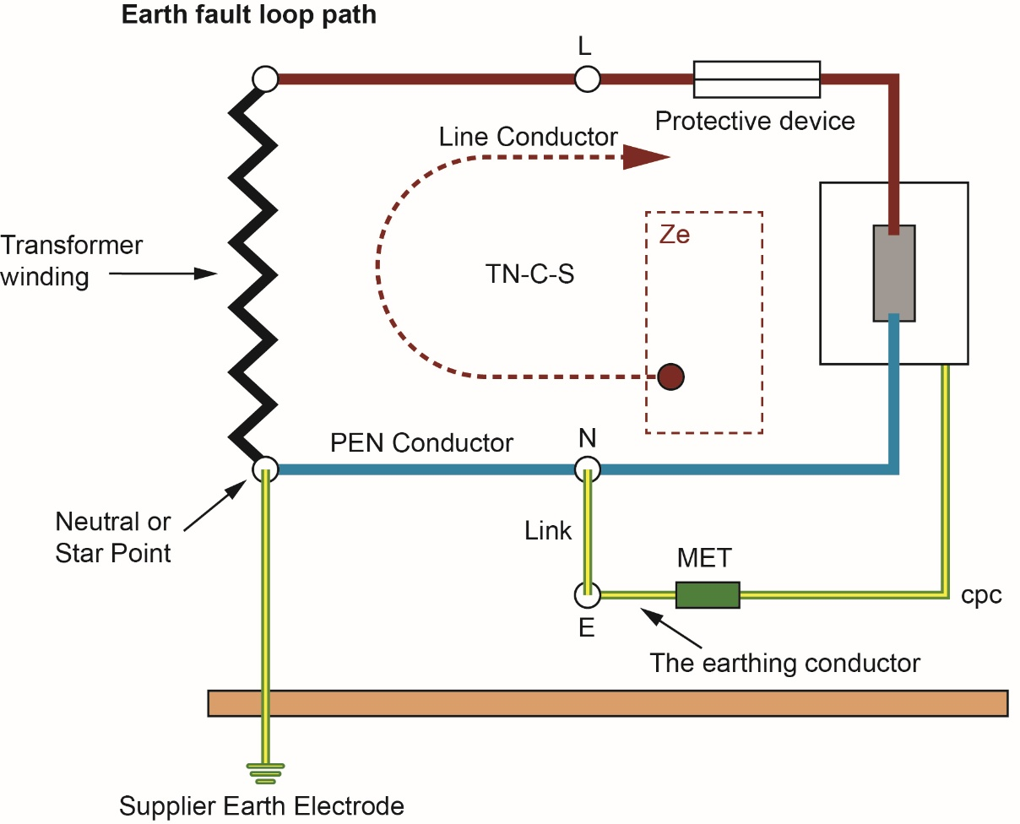
Effect on Ze (external earth fault loop impedance)
If there is a diverted neutral, Ze (the impedance between the supply earth and the installation) will rise significantly.
For TN-C-S systems, the expected Ze should be ≤ 0.35 Ω.
If a diverted neutral is present, Ze will usually be much higher, alerting you to a fault with the PEN conductor.

Slide 63
Identifying the Fault (from GN3 Appendix D)
Step | Action | Expected result | Possible indication of diverted neutral currents or a broken PEN conductor
1 | Before isolating the installation, measure the current flowing in the main earthing conductor and main protective bonding conductors of the installation using a current clamp meter. | A small current will be expected, when compared with line conductor currents. In dwellings, and similar installations with a maximum demand of up to 100 A, this is typically a few milliamps. | Large currents flowing in the earthing conductor and/or main bonding conductors.
2 | Switch off power to the installation, lock-off or otherwise secure the point(s) of isolation, and prove the installation is dead using an approved 2-pole contact voltage tester. | The test for proving that the installation is dead shows it is dead. | The installation does not appear to be dead as expected.
3 | Check for current flowing in the main earthing conductor and main protective bonding conductors of the installation using a current clamp meter. | The current has dropped to zero, or to an extremely small level. | Current continues to flow in the earthing conductor and/or main bonding conductors. Current measured in the customer bonding conductors or pipework can be influenced by adding load to the customer’s installation, using a simple technique such as boiling a kettle or switching a heater on.

Slide 64
Step | Action | Expected result | Possible indication of diverted neutral currents or a broken PEN conductor
4 | Check for the presence of voltage using a non-contact voltage detector at the main earthing terminal, along the length of the main earthing conductor, main protective bonding conductors, and at extraneous-conductive-parts. | No voltage is indicated. | Voltage appears to be present. Voltage indicators do not detect diverted neutral currents while it is able to flow using an alternative path. A volt-stick should also be used.
5 | Disconnect the main protective bonding conductors. | Nothing unusual is noted. | Evidence of current flow when the main protective bonding conductors are disconnected.
6 | Re-check for the presence of voltage using a non-contact voltage detector at the main earthing terminal, along the length of the main earthing conductor, main protective bonding conductors, and at extraneous-conductive-parts. | No voltage is indicated. | Voltage appears to be present. Voltage indicators do not detect diverted neutral currents while it is able to flow using an alternative path. A volt-stick should also be used.

Slide 65
Step | Action | Expected result | Possible indication of diverted neutral currents or a broken PEN conductor
7 | Re-connect the main protective bonding conductors so that insulation resistance tests can be carried out. | Nothing unusual is noted. | Evidence of current flow when the main protective bonding conductors is connected.
8 | In TN systems, during the course of inspection and testing, check the external EFLI. | External EFLI measurement appears to be acceptable. The following is a rule of thumb, but occasionally slightly higher readings may be experienced: • in TN-C-S systems, Ze ≤ 0.35 Ω • in TN-S systems, Ze ≤ 0.80 Ω A check against previous readings, where available, would provide more accurate information. | External EFLI is high.

Slide 66

What should you do if diverted neutral is suspected?
Immediate action
Do not touch exposed metal parts.
Contact your distribution network operator (DNO) immediately via the emergency number 105.
This line will automatically connect you to your local electricity provider.

Slide 67
Summary
You should now be able to:
Identify and compare earthing systems
Understand risks from diverted currents and PEN failures
Determine maximum demand using diversity
Consider environmental and maintenance factors in design
Define essential terms in renewable energy installations

Slide 68
Any questions?
Copyright in this document belongs to and is used under licence from the Department for Education, © 2025.
‘T-LEVELS’ and ‘T Level’ are registered trademarks of the Department for Education.
WJEC is authorised by the Department for Education to develop and deliver this T Level Technical Qualification.
WJEC operates in England under the name Eduqas which is a registered trademark of WJEC.

