Slide 1
Occupational Specialism: Electrotechnical Engineering
K1.3 Principles of electrical circuits and loads
PowerPoint 1.3: Principles of electrical circuit arrangements

Slide 2
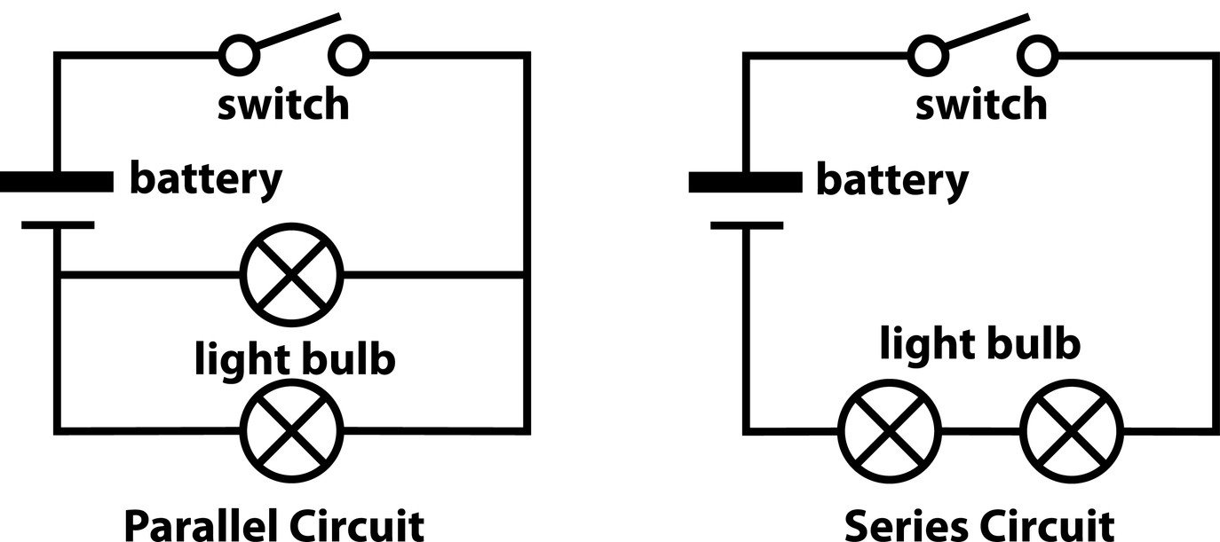
Introduction
What might be a benefit of wiring in parallel, and where could you find this-
Notes:
Modern Christmas tree lights are wired in parallel.

Slide 3
Objectives
By the end of this session, you should be able to:
Describe typical circuit types used in domestic and commercial installations
Apply Ohm’s Law and basic electrical formulas to real-world circuits
Explain how series and parallel circuits affect current and voltage
Identify different types of loads, including resistive, inductive and capacitive
Interpret power factor and its implications in electrical systems

Slide 4
Introduction to electrical circuits
Electrical circuits are the foundation of all electrotechnical systems. They allow current to flow to loads such as lights, sockets and appliances.
There are many ways to arrange circuits, each with its own advantages depending on:
the type of load
the location and layout of the installation
the need for control or switching.

Slide 5
Introduction to electrical circuits
In this section, we’ll explore:
common circuit types used in domestic and commercial installations
how these arrangements affect current and voltage
why certain layouts are chosen for specific applications.

Slide 6
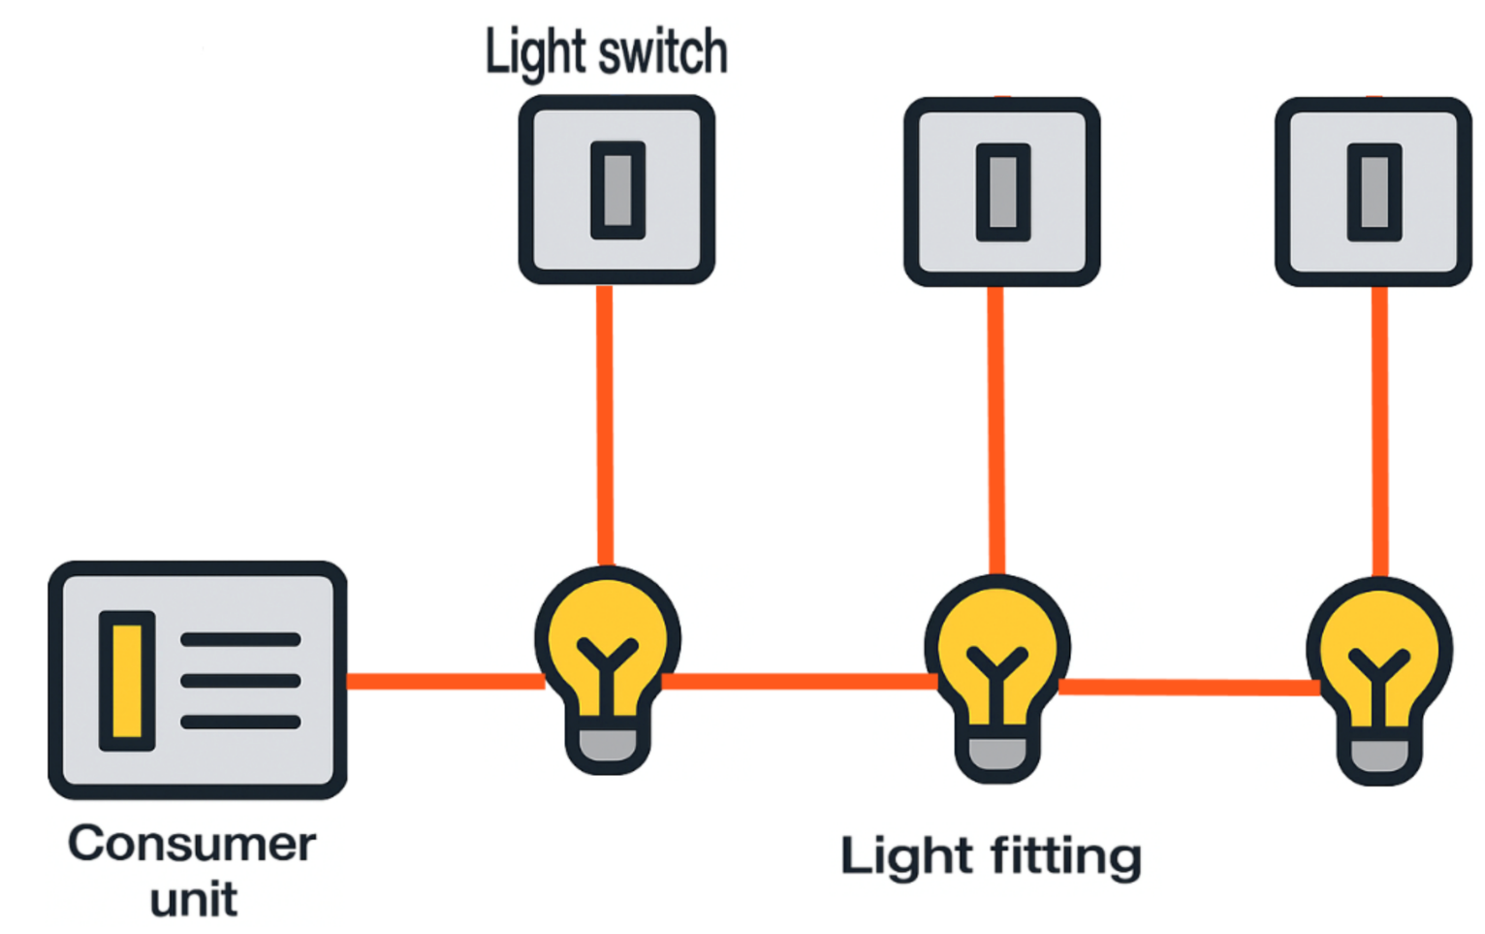
1. Lighting circuits: Loop-in
In a loop-in lighting circuit, the line, neutral and circuit protective conductors (CPC) are looped continuously between ceiling roses.
The ceiling rose serves as both a fixture holder and a junction box, providing a safe and convenient point for wiring connections and facilitating circuit continuity.

Slide 7
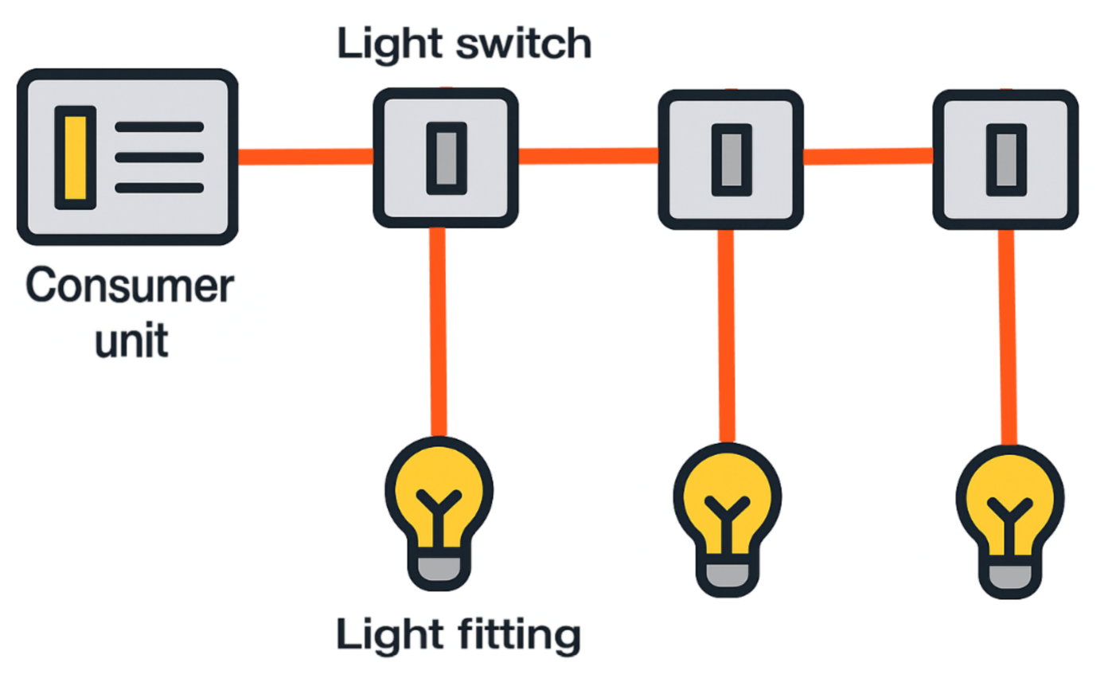
2. Lighting circuits: Switch fed
In a switch-fed lighting circuit, the live feed is routed directly to the switch position.
Neutral and circuit protective conductors (CPC) are connected at the switch using non-screwed compression joints for secure and easy wiring.
This method is particularly suited for downlight installations or fittings that do not have loop terminals.

Slide 8
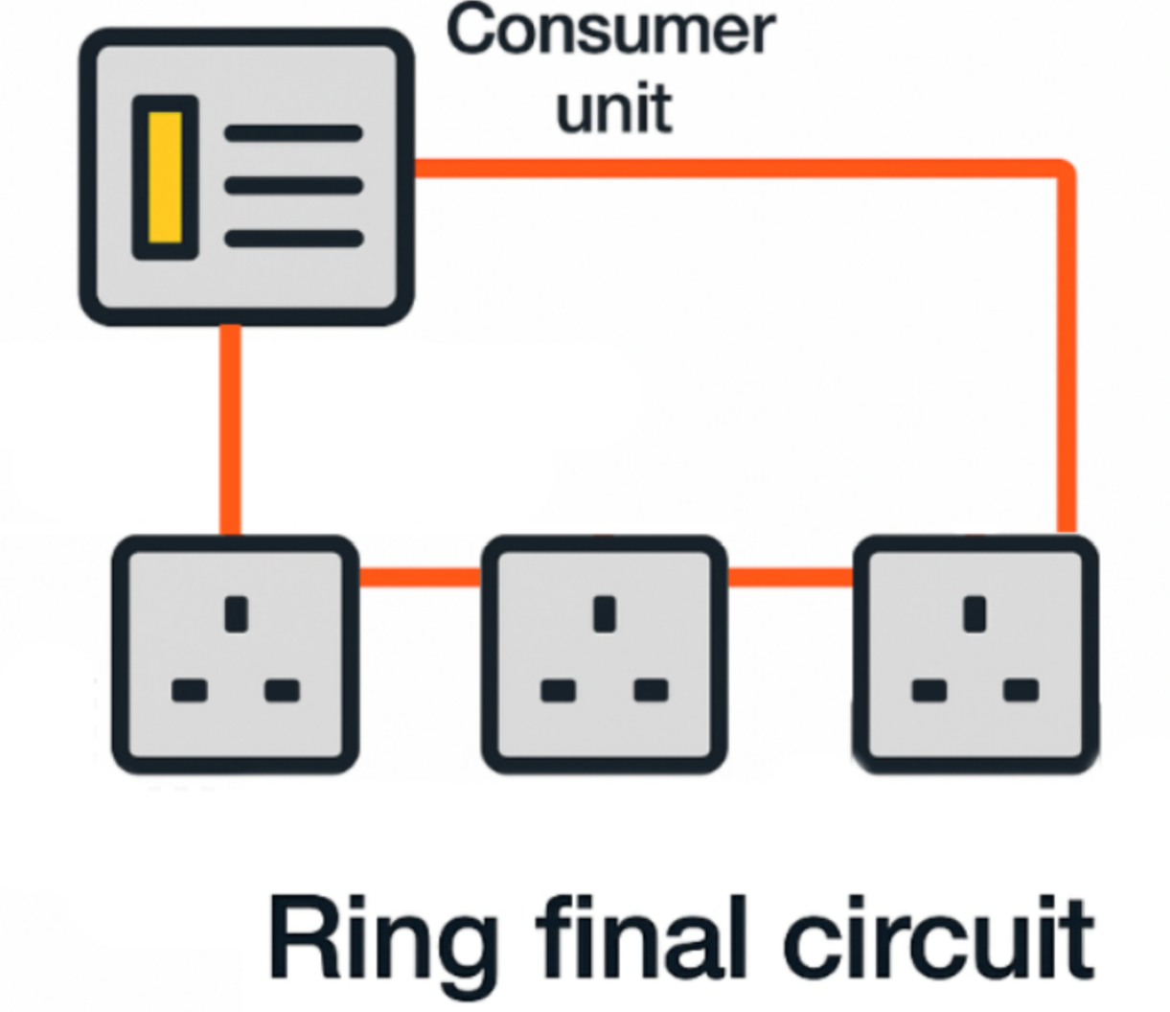
1. Power circuits: Ring final wiring
Ring final circuits are widely used in UK installations to supply socket outlets and small power loads.
The circuit forms a closed loop, with conductors returning to the consumer unit at the same point.
Current divides between two parallel paths, reducing each conductor's resistance and voltage drop.

Slide 9
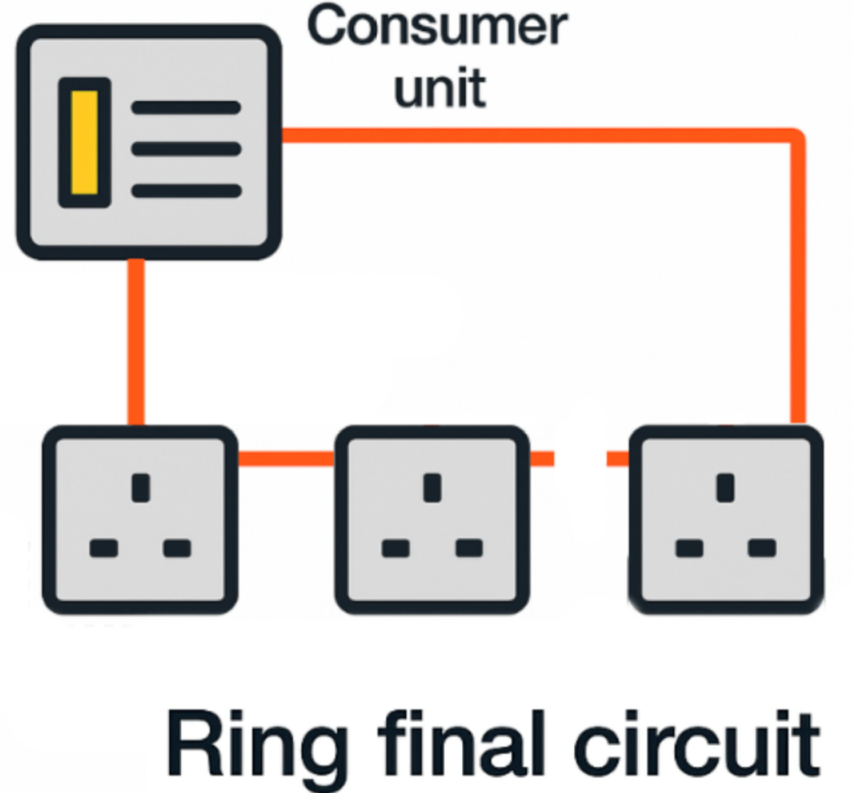
2. Power circuits: Ring final wiring
To maintain safety and performance, loads must be evenly distributed around the ring to prevent overloading one leg.
If one leg of the ring becomes an open circuit, as shown, the circuit can still function. However, this fault condition can lead to overheating if large loads are connected, as it would no longer be a ring final circuit but two inadequately protected radial circuits.

Slide 10
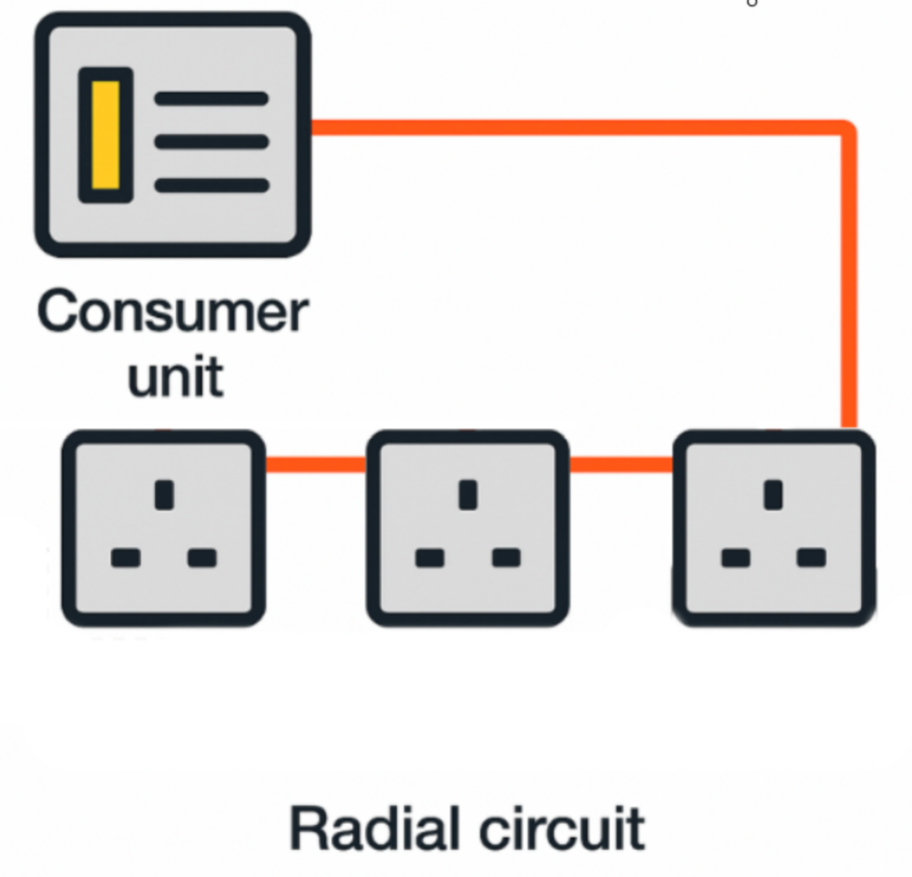
3. Power circuits: Radial wiring
Radial circuits are commonly used to supply socket outlets, fixed appliances or small power loads.
The circuit runs from the consumer unit to a single final outlet without a return path.
Current flows along a single path, so if a fault occurs, the circuit is interrupted.

Slide 11
4. Power circuits: Radial wiring
Radial circuits are often used for specific appliances such as cookers, heaters, or dedicated sockets.
They are generally simpler to install and test compared to ring final circuits.
However, because there is no return path, voltage drop can have a greater effect over long radial circuits.

Slide 12
Voltage drop
Voltage drop occurs when electrical energy is lost as current flows through a conductor with resistance. Several factors can affect voltage drop.
Conductor length: Longer cables increase resistance and voltage drop.
Conductor size: Smaller cross-sectional areas have higher resistance.
Current load: Higher current increases the voltage drop (V=I×R).
Temperature: Resistance increases as the conductor temperature rises.

Slide 13
Effects of voltage drop
Excessive voltage drop leads to:
reduced voltage at the load, causing poor appliance performance or failure
increased energy losses as heat, reducing system efficiency
potential safety hazards due to overheating cables.

Slide 14
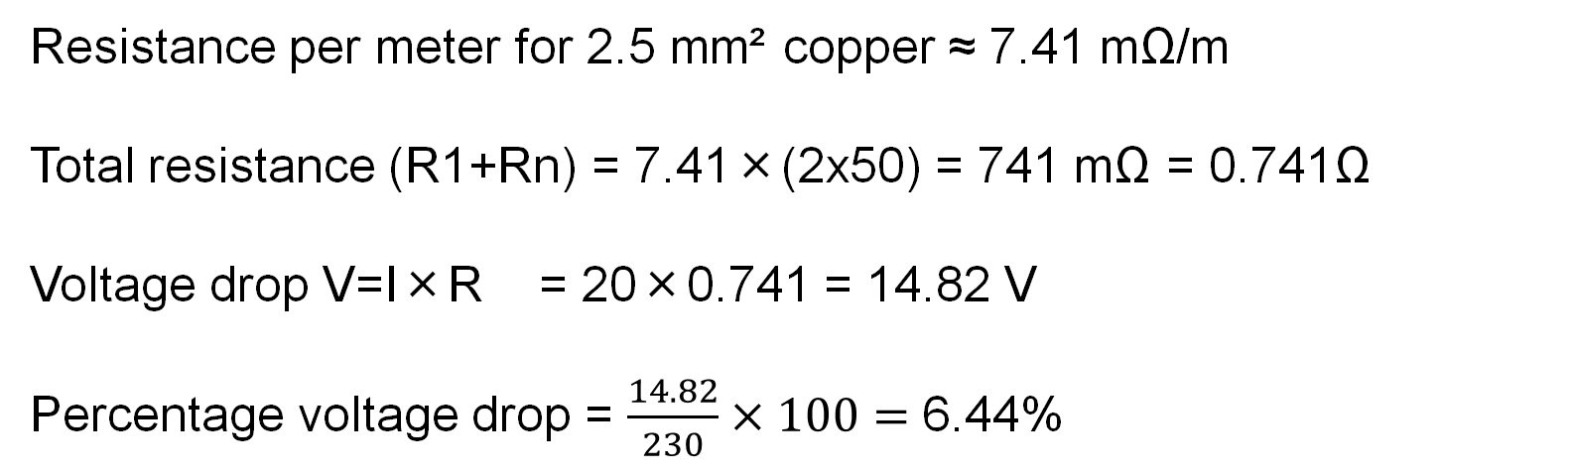
Voltage drop worked example
Calculate the voltage drop for a 20 A load on a 50 m run of 2.5 mm² copper cable.
Resistance per meter for 2.5 mm² copper ≈ 7.41 mΩ/m
Total resistance (R1+Rn) = 7.41×(2x50) = 741 mΩ = 0.741Ω
Voltage drop V=I×R = 20×0.741 = 14.82 V
Percentage voltage drop = $\frac{14.82}{230}×100=$ 6.44%
Notes:
Point learners to the On-Site Guide: Resistance/metre for copper.
State this is accurate only at 20 Degrees C. (and if required x 1.2 to bring to max operating temp of a 70 deg. cable)
Demonstrate alternative method, calculate using the voltage drop per metre as given in BS7671 for a 2.5 mm sq cable circuit 18mV/A/m, then multiply by the 50 m length X load current and divide by 1000.
Answer (18 x 20 x 50) /1000 = 18V

Slide 15
Voltage drop limits
BS 7671 sets limits to ensure safe and efficient operation.
A maximum of 3% voltage drop is allowed for lighting circuits and 5% for power circuits.
Exceeding these limits can cause lights to dim and appliances to underperform or overheat, so cables must be sized appropriately to keep voltage drop within these boundaries.

Slide 16
Temperature effects on electrical conductors
Copper and aluminium conductors increase in resistance as temperature rises.
Resistance rises approximately 0.4% per degree above 20 degrees Celsius for copper.
Increased resistance leads to higher voltage drop and heating, which can accelerate insulation degradation.
High load currents cause conductor heating, potentially triggering thermal protection devices.

Slide 17

Three-phase systems
Three-phase systems are commonly used in industrial and commercial installations to deliver power more efficiently than single-phase systems.
A typical three-phase system uses three-line conductors, each 120 degrees out of phase, supplying either three-phase or single-phase loads.

Slide 18
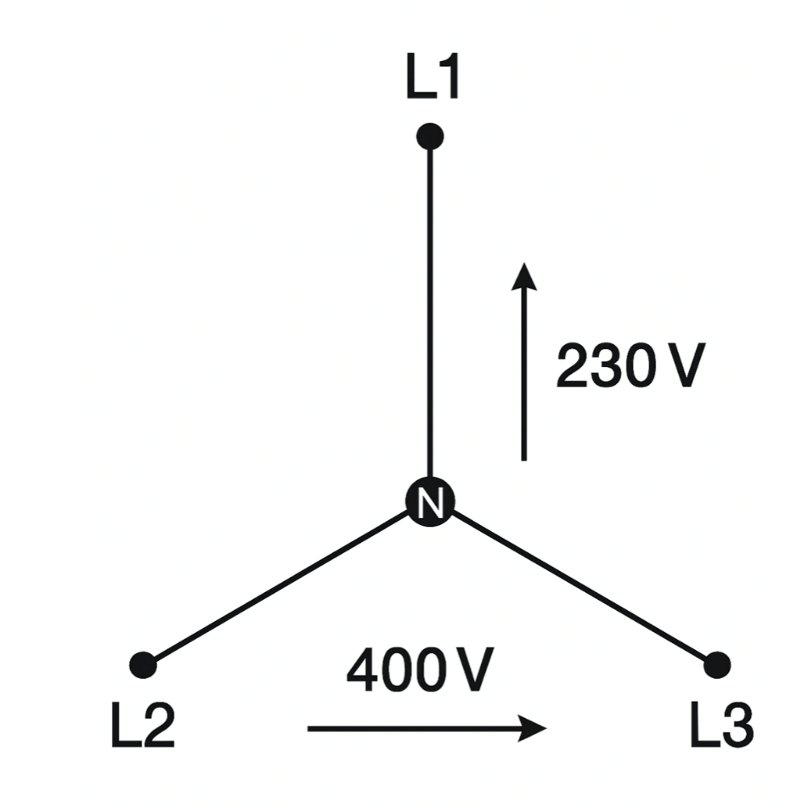
Three-phase circuit arrangements
In a star configuration, each phase is connected to a common neutral point. This gives:
line-to-neutral voltage: 230 V (used for standard single-phase loads)
line-to-line voltage: 400 V (used for three-phase loads like motors).
Three-phase circuits provide constant power transfer, making them ideal for heavy machinery and reducing vibration in motor operation.

Slide 19
Advantages of three-phase systems
Three-phase supply offers several benefits over single-phase.
Improved efficiency: Delivers more power using less conductor material.
Smoother operation: Motors run with less vibration and more consistent torque.
Balanced load: Power is delivered continuously, not in pulses.
Scalable supply: Suitable for both small and large electrical loads.
Flexible distribution: Single-phase circuits can be derived from the three-phase system.

Slide 20
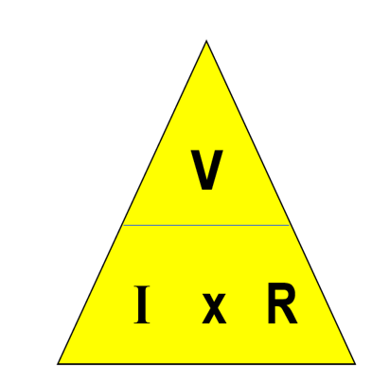
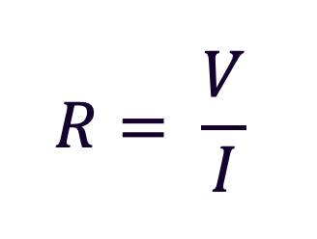
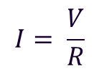

Ohm’s Law
It is vital that an electrician understands Ohm’s Law.
It can be represented by three formulas or the Ohm’s Law triangle.
$$V = I x R$$

Slide 21

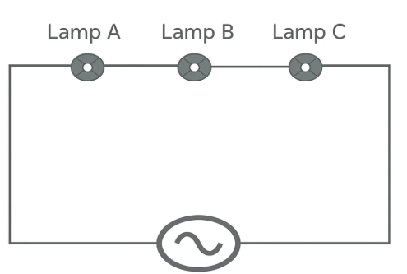

Resistors in series
Only one path for the current to flow.
Current is therefore the same and common to all resistors.
Total resistance is determined by adding up all values
Christmas lights were once wired in series.
$$R1+R2+Rn$$

Slide 22
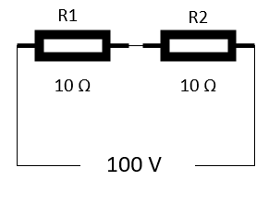
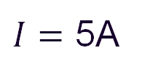


Voltage in series
Voltage is shared equally if all resistors are of equal value.
V
Total resistance = R1 + R2
= 10 + 10
= 20Ω
I x R
$$I= \frac{V}{R}$$
$$I= \frac{100}{20}$$
$I=$ 5A
VR1 = I × R
VR1 = 5 × 10
VR1 = 50V
VR2 = I × R
VR2 = 5 × 10
VR2 = 50V

Slide 23
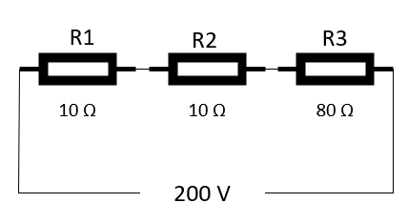



Resistors in series
The largest voltage drop will appear across the
highest resistor value.
Total resistance = R1 + R2 + R3
= 10 + 10 + 80
= 100Ω
$$I= \frac{V}{R}$$
$$I= \frac{200}{100}$$
$I=$ 2A
VR1 = I × R
VR1 = 2 × 10
VR1 = 20V
VR2 = I × R
VR2 = 2 × 10
VR2 = 20V
VR3 = I × R
VR3 = 2 × 80
VR3 = 160V

Slide 24
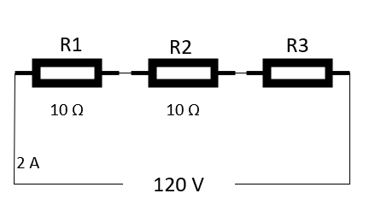
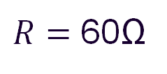


Resistors in series
The largest voltage drop will appear across the highest resistor value.
$$R= \frac{V}{I}$$
$$R= \frac{120}{2}$$
$R=$ 60Ω
If total resistance = 60Ω
R3 = 40Ω

Slide 25
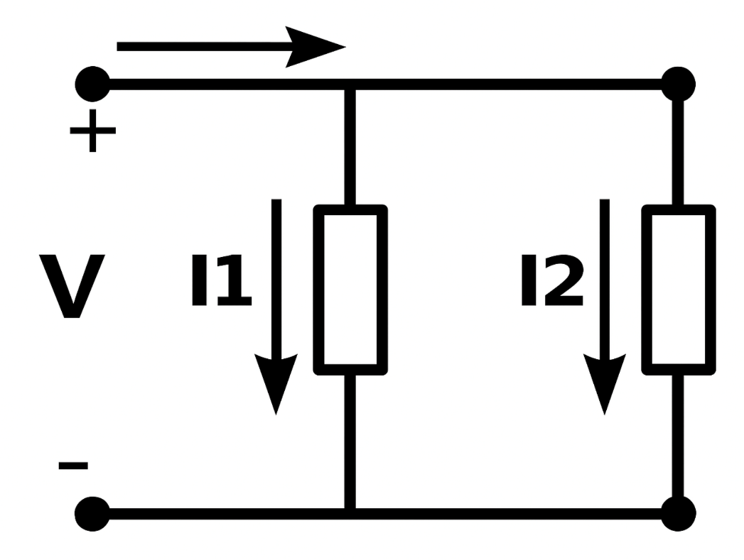
Resistors in parallel
Current is split and travels down each branch.
Voltage is common to all resistors.
Total resistance is determined by using the reciprocal method.

Slide 26
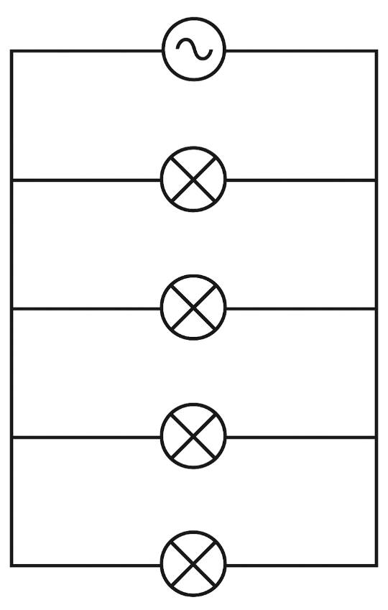
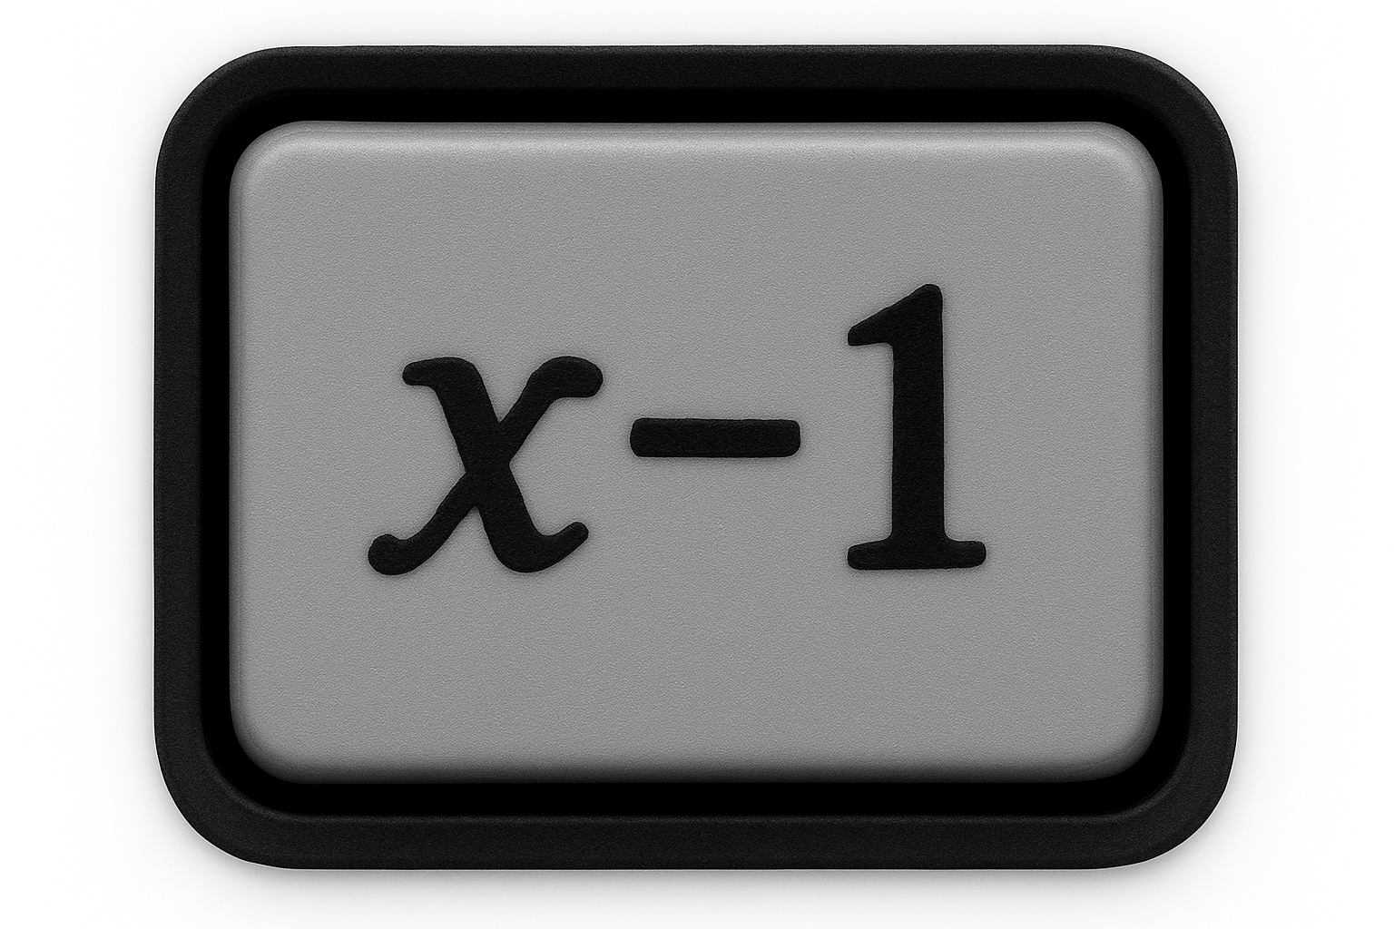

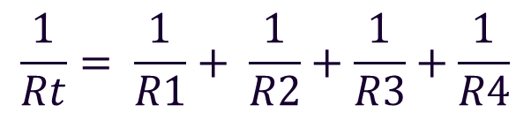
Reciprocal method
When resistors are connected in parallel, you cannot simply add the values. Instead, use the reciprocal method:
Example:
The easiest way is to use the or function on your calculator.
$$\frac{1}{Rt}= \frac{1}{R1}+ \frac{1}{R2}+\frac{1}{R3}+\frac{1}{R4}$$
100Ω
30Ω
20Ω
40Ω

Slide 27
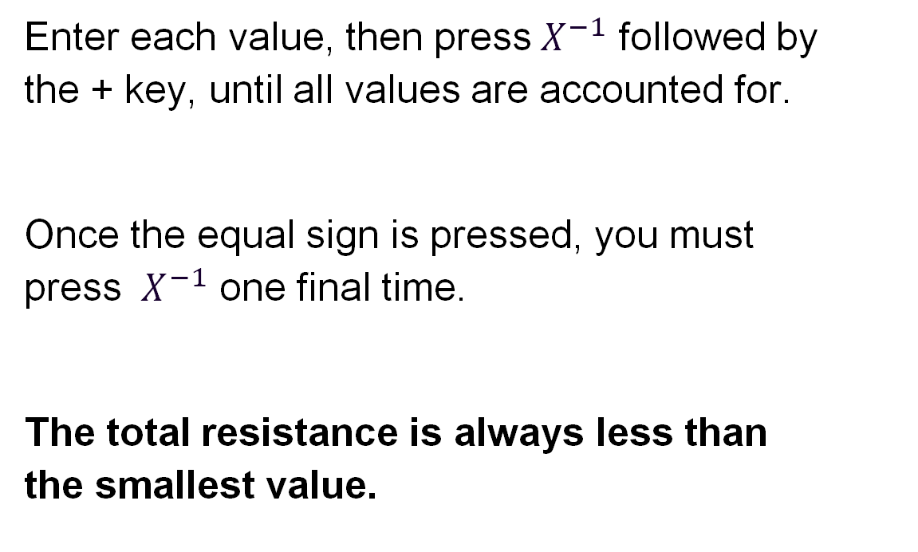
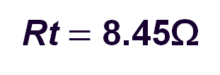
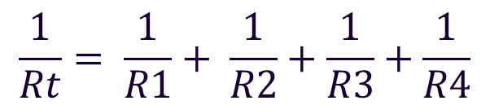
Using the calculator
Enter each value, then press${ X}^{−1}$ followed by
the + key, until all values are accounted for.
Once the equal sign is pressed, you must
press ${ X}^{−1}$ one final time.
The total resistance is always less than
the smallest value.
$$\frac{1}{Rt}= \frac{1}{R1}+ \frac{1}{R2}+\frac{1}{R3}+\frac{1}{R4}$$
Rt$=$ 8.45Ω

Slide 28
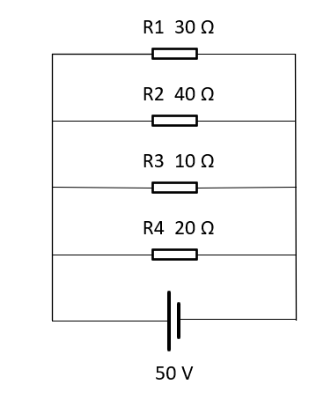
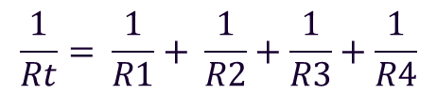



Resistors in parallel example
$$Rt = 4.8Ω$$

Slide 29
Introduction to parallel resistor current
In a parallel circuit, each resistor has the same voltage across it, but the current splits across the branches depending on resistance.
Ohm’s Law can be used to calculate unknown values of branch currents and the total current drawn from the supply.
This can then be confirmed by adding the individual branch currents together.

Slide 30
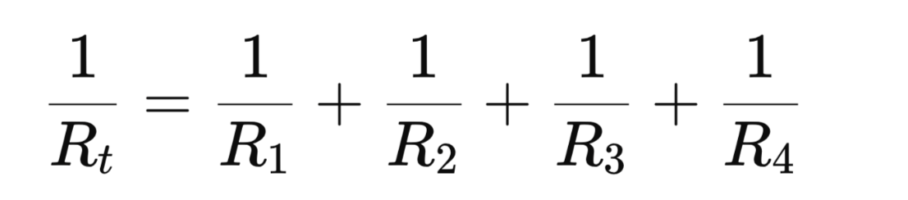
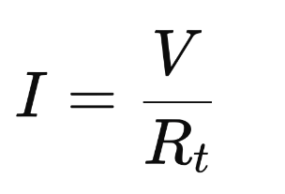
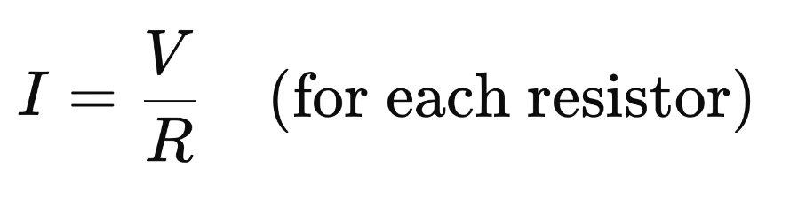
Method and formula
Find total resistance (Rt) using the reciprocal formula:
Calculate total current (It) using Ohm’s Law:
Calculate individual branch currents using:

Slide 31
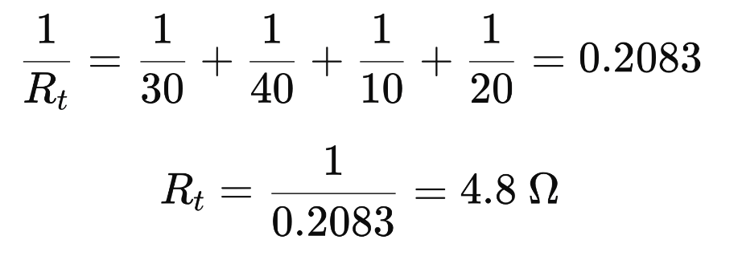
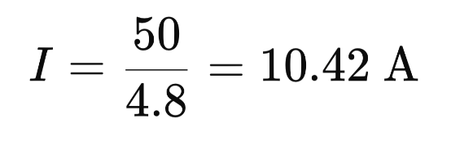
Worked example
Circuit values:
R1 = 30 Ω, R2 = 40 Ω, R3 = 10 Ω, R4 = 20 Ω
Voltage supply = 50 V
Total resistance:
Total current:

Slide 32
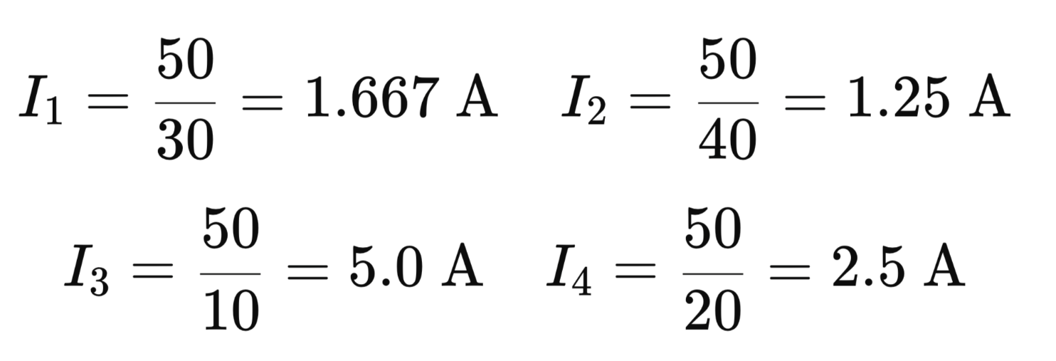
Worked example continued
Current in each branch:
Total = 1.667 + 1.25 + 5.0 + 2.5 = 10.42 A which confirms the result.

Slide 33
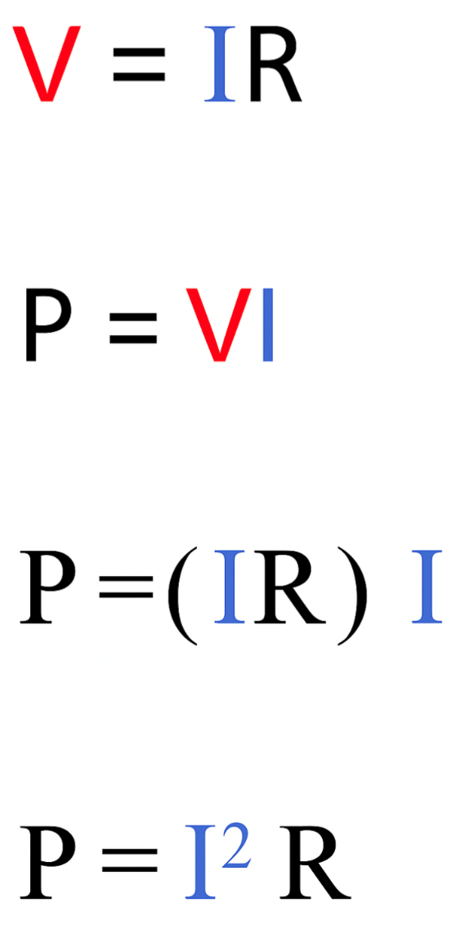
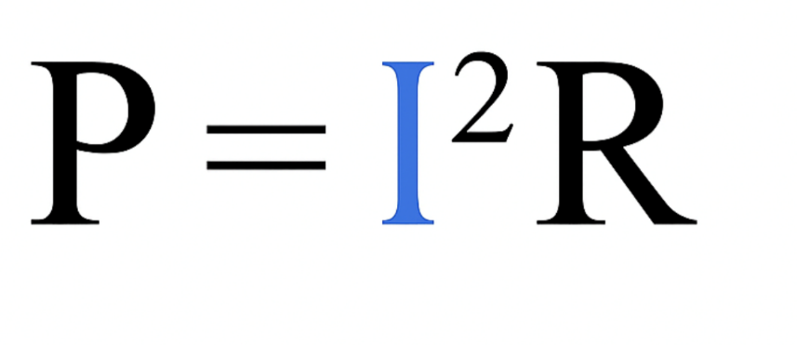
Transposition
By transposing Ohm’s Law and the power triangle,
another formula for power can be determined.

Slide 34
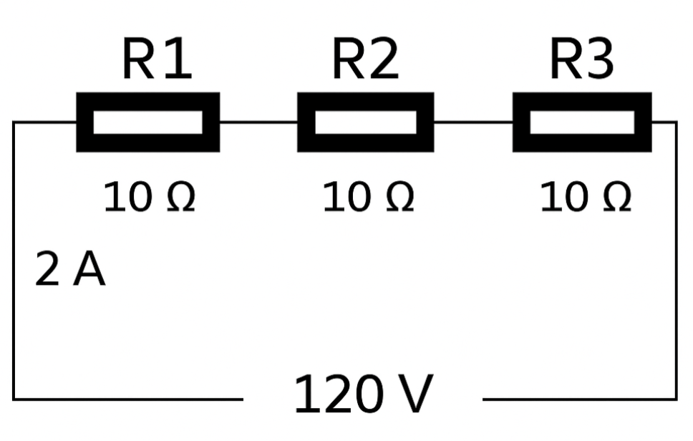
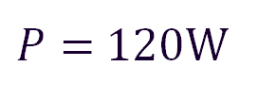


Transposition
This formula is beneficial for a series circuit because current is common to all components.
Total resistance = R1 + R2 + R3
= 30Ω
$$P= I^{2}R$$
$P= 2^{2}×$30
$P=$120W

Slide 35
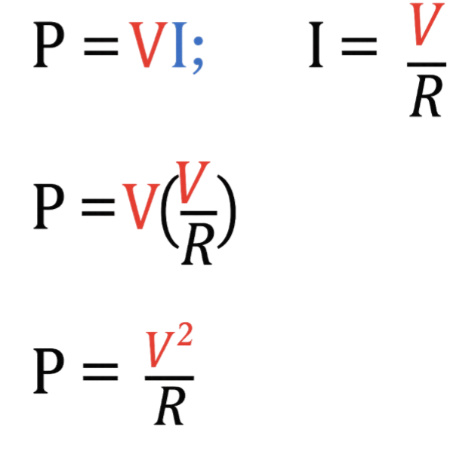
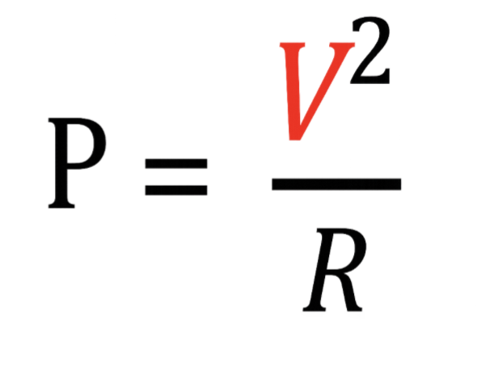
Transposition
By transposing Ohm’s Law and the power triangle,
another formula for power can be determined.

Slide 36
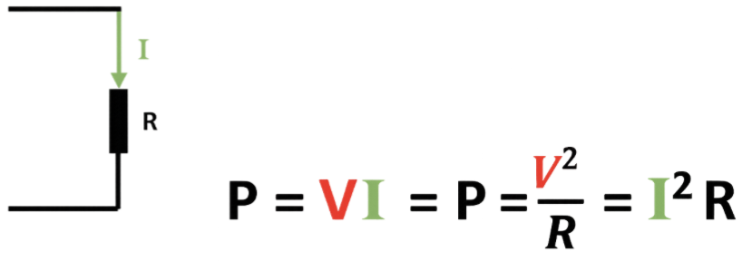
Power formulas
By transposing Ohm’s Law and the power triangle, another formula for power can be determined.

Slide 37
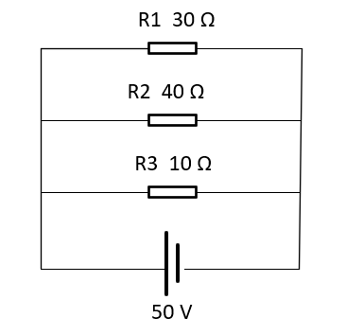
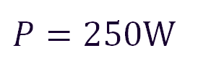


Transposition
This formula is especially useful for parallel circuits, because voltage is common to all components.
How much power is being dissipated in R3?
P = $\frac{V²}{R}$
P = $\frac{50²}{10}$
$P=250$W

Slide 38
Resistive load
In a resistive load, both the voltage and current are in phase with each other.
In other words, they rise and fall together.
I
V
Current
Voltage

Slide 39
Self-induction
Self-induction is the phenomenon where a change in current within a coil induces an electromotive force (EMF) within the same coil.
Essentially, it's the coil's own magnetic field opposing any change in the current flowing through it.
The SI unit of self-induction is the henry (H).

Slide 40
Inductive load
A phasor diagram showing current lagging voltage by an angle (ø) of 90 degrees.
Voltage
V
Current
I

Slide 41


Inductive reactance
Inductive reactance is the opposition an inductor offers to the flow of alternating current (AC).
Inductive reactance $X_{L}$can be calculated from:
$X_{L}$= the inductive reactance in ohms.
$f$ = frequency in hertz
$L$ = inductance in henrys
$$X_{L}=2πfL$$
$$X_{L}=2π×50×100×10¯^{3}$$
$$X_{L}=31.4Ω$$

Slide 42

Inductance
Any circuit involving an inductor will have two values of voltage:
the one in phase across the resistance (VR)
the out of phase (leading) voltage across the inductance (VL).
The total voltage is the phasor sum, which is the supply (Vs).

Slide 43
Capacitance in an AC circuit
In an AC circuit, a capacitor’s voltage lags behind the current.
Before a voltage can develop across the plates, the capacitor must first accumulate charge.
This storing-and-releasing process introduces a time delay, so the voltage waveform trails the current waveform.

Slide 44
Capacitive load
Phasor diagram showing current leading voltage by an angle (ø) of 90 degrees.
I
V

Slide 45




Capacitive reactance
Capacitive reactance is the opposition a capacitor offers to the flow of alternating current (AC).
Capacitive reactance $X_{C}$can be calculated from:
$X_{C}=$Ohms x
f = frequency in hertz
C = capacitance in farads
$$X_{C}=\frac{1}{2πfC }$$
$$X_{C}=\frac{1}{2π ×50×250×{10ˉ}^{6}}$$
$$X_{C}=12.73Ω$$

Slide 46


Impedance
Impedance is the effective opposition to an alternating current rising from the combined effects of both resistance and reactance.
Impedance is represented by the letter Z and measured in ohms.
There are three other primary equations:
$$Z=\sqrt{R^{2}+X_{C²}}$$
$$Z=\sqrt{R^{2}+X_{L²}}$$
$Z=\sqrt{R^{2}+{(X}_{L− }X_{C }}$)²

Slide 47



Impedance
$$X_{L}=2πfL$$
$$Z=\sqrt{R^{2}+X_{L²}}$$
$$X_{L}=2π×50×100×10¯^{3}$$
$$Z=\sqrt{{50}^{2}+31.41²}$$
$$X_{L}=31.41 Ω$$
$Z=$ 59 Ω

Slide 48




Impedance
$$X_{C}=\frac{1}{2πfC }$$
$$Z=\sqrt{R^{2}+X_{C²}}$$
$$X_{C}=\frac{1}{2π×50×250×{10ˉ}^{6}}$$
$$Z=\sqrt{{50}^{2}+12.73²}$$
$$X_{C}=12.73 Ω$$
$Z=$ 51.59 Ω

Slide 49




Combined resistance, capacitance and inductance
$Z=\sqrt{R^{2}+{(X}_{L− }X_{C }}$)²
$Z=\sqrt{{50}^{2}+(30−10}$)²
$Z=$ 53.85 Ω

Slide 50
Magnetic induction in electrical circuits
Magnetism can be induced in conductors when current flows through them, creating a magnetic field.
This principle is used in components such as transformers, contactors and motors.
When a conductor is moved through a magnetic field, or when a magnetic field around a conductor changes, a voltage is induced. This is known as electromagnetic induction.
The strength of this effect depends on factors such as the current, coil turns and core material.
Inductive components can influence circuit behaviour by introducing reactance, which affects current flow and energy efficiency.

Slide 51




Ohm’s Law
The Ohm’s Law triangle also changes depending on which circuit components are present.

Slide 52









Finding current (I) in a combined resistance, capacitance and inductive circuit
$Z=\sqrt{R^{2}+{(X}_{L− }X_{C }}$)²
$$XL =$$
$$R=$$
$Z=\sqrt{{50}^{2}+(30−10}$)²
$$Xc=$$
$Z=$ 53.85 Ω
$$I=\frac{V}{Z}$$
$$I=\frac{230}{53.85}$$
$$I= 4.27 A$$

Slide 53



Power factor
Power factor is used to express energy efficiency and ranges from 0 to 1.
The lower the number, the less efficient the power usage.
The ideal state is a power factor of 1, which is referred to as unity.
In an inductive (R–L) circuit, the lagging component is the inductive reactance, XL
From Pythagoras, we can express power factor as: $Cos ∅$.

Slide 54




Power factor
$$X_{L}=2πfL$$
$$Z=\sqrt{R^{2}+X_{L²}}$$
$$Z=\sqrt{{50}^{2}+31.41²}$$
$$X_{L}=2π×50×100×10¯^{3}$$
$$X_{L}=31.41 Ω$$
$Z=$ 59 Ω
$Power Factor=\frac{R}{Z}$
$Power Factor=\frac{50}{59}$
$Power Factor=0.84 lagging$

Slide 55


Power factor
Cos ∅ expresses the angle caused by the inductive component.
$If Power Factor=0.84$
To express 0.84 in degrees, use Cos-1
= 32.85˚

Slide 56

Power triangle
Power factor (PF) is also expressed through the power triangle.
1. True or real power, measured in kilowatts (kW).
2. Apparent power, measured in kilovolt amperes (kVA).
3. Reactive power, measured in (kVAr).

Slide 57
Power triangle
The true or real power is the useful power that can be used to power machines.
Reactive power is useless power, because it cannot drive machinery. Measured in kVAr.
Apparent power is the product of the rms voltage and current supplied to the circuit. This is why generators are rated in kVA.

Slide 58

Power triangle

Slide 59




Power triangle calculation
Calculate the power factor if a generator produces 2kVA of apparent power and 1.9kW of real power.
$$Power Factor=\frac{Real Power}{Apparent Power}$$
$$Power Factor=\frac{1900}{2000}$$
$Power Factor$ = 0.95

Slide 60

Effect of power factor
Power in a single-phase circuit is given by: $P=V x I cos ∅$
In a purely resistive circuit, $cos ∅$ would be unity, and therefore power factor has no overall effect.
For a voltage of 230V and a current of 30A: $P=230×30×1$ = 6900 W or 6.9 kW
But most loads are inductive, therefore compare when $cos ∅$is 0.85 $P=230×30×0.85=$5865W or 5.8kW
Therefore, the amount of true power has reduced.

Slide 61
Power factor
Unfortunately, industrial machines will still extract the amount of power that they require and, in doing that, the amount of current drawn is increased dramatically.
If power factor is not corrected, then this has implications because:
the conductors might have to be scaled up
the environment suffers because surplus energy is required
even the companies’ bills will rise significantly.

Slide 62
Methods to improve power factor
Capacitor banks: Connected in parallel with inductive loads to provide leading reactive power, offsetting lagging inductive effects.
Synchronous motors: Can be over-excited to provide reactive power correction.
Load management: Scheduling heavy inductive loads to minimise peak demand and improve overall PF.

Slide 63
Power factor correction: Worked example
A factory has a 50kW load operating at 0.7 power factor. Calculate the required kvar to improve to 0.95 power factor:
Initial angle: cos−1(0.7) =45.57°
Target angle: cos−1(0.95) =18.19 °
Initial reactive power Q1= P×tan (45.57 °) =50×1.02= 51kvar
Target reactive power Q2= 50×tan (18.19 °) =50×0.33=16.5 kvar
Required capacitor kvar Qc=Q1−Q2=34.5 kvar
Installing capacitors rated at 35 kvar will improve power factor to near 0.95.

Slide 64






Formula summary
$X_{C}=\frac{1}{2πfC }$ Capacitive Reactance
$$X_{L }=2πfL Inductive Reactance$$
$$Z=\sqrt{R^{2}+X_{L²}}$$
$$Z=\sqrt{R^{2}+X_{C²}}$$
$Z=\sqrt{R^{2}+{(X}_{L− }X_{C }}$)²
$$Power Factor=\frac{Real Power}{Apparent Power}$$
$Power Factor=\frac{R}{Z}$

Slide 65
Summary
You should now be able to:
Describe typical circuit types used in domestic and commercial installations
Apply Ohm’s Law and basic electrical formulas to real-world circuits
Explain how series and parallel circuits affect current and voltage
Identify different types of loads including resistive, inductive and capacitive
Interpret power factor and its implications in electrical systems

Slide 66
Any questions?
Copyright in this document belongs to and is used under licence from the Department for Education, © 2025.
‘T-LEVELS’ and ‘T Level’ are registered trademarks of the Department for Education.
WJEC is authorised by the Department for Education to develop and deliver this T Level Technical Qualification.
WJEC operates in England under the name Eduqas which is a registered trademark of WJEC.

