Slide 1
Occupational Specialism: Electrotechnical Engineering
K1.2 Operation and handling requirements
PowerPoint 1.2: Safe use of hand and power tools

Slide 2
Introduction
In this session, we’ll focus on the safe and effective use of hand and power tools within an electrical installation environment. We’ll look at the importance of inspection, handling and calibration, as well as legal responsibilities under PUWER 1998.
You’ll also explore how to identify and report defective equipment, assess visual safety cues, and understand good storage practices. These underpin the safe operation of electrical systems and tools.

Slide 3
Objectives
By the end of this session, you should be able to:
Identify key requirements for tool inspection and PAT testing
Describe the safety checks required before using electrical equipment
Explain legal obligations under PUWER (1998) and COSHH
Apply safe working procedures for storing, handling and disposing of tools and substances
Assess risks associated with faulty or inappropriate tool use

Slide 4
Electrical tool inspection and testing
Key requirements to ensure compliance, improve safety, and help identify issues before they become dangerous:
All equipment must be clearly identified and logged
The type and quantity of appliances must be recorded
Inspectors must be competent and appropriately trained
Test equipment must be calibrated and maintained
A recording and monitoring system must be in place and kept up to date
Staff involved in testing must have ongoing training.

Slide 5
Visual inspection checklist: Electrical equipment
Before using an electrical tool or appliance, check the following:
Has it been PAT tested recently and is the label visible?
Are there any bare wires or exposed conductors?
Is the cable insulation intact and free from cuts or damage?
Is the cable length appropriate, and not a trip hazard or under tension?
Is the plug top undamaged and secure?
Are there any joints or tape repairs in the cable?

Slide 6
Checklist continued
Does the cord grip hold the cable securely at both ends?
Is the outer casing of the appliance in good condition, with no cracks or missing screws?
Are there signs of overheating or scorching?
Are trip devices (e.g. RCDs) functioning correctly?
If anything looks damaged or unsafe, report it and remove it from service until inspected.

Slide 7
Storage of tools
Keep tools off the floor to avoid damage and reduce trip hazards.
Coil leads neatly and position them where they won't be stepped on.
Never hang tools or appliances by their cords; this can damage the cable or internal wiring.
Secure the tool store to prevent loss, misuse or unauthorised access.
Use a sign-out system so tools are tracked and accounted for.
Good housekeeping reduces accidents and keeps equipment in working order.

Slide 8
Legal requirements for tools (PUWER 1998)
Provision and Use of Work Equipment Regulations 1998 (PUWER) applies to all equipment used at work.
Key employer duties under PUWER:
Ensure all tools are suitable for their intended task and environment
Maintain tools in a safe condition through regular inspection and servicing
Provide clear instructions, training and supervision for all staff using equipment
Ensure necessary safety measures (guards, warnings, protective devices) are in place.

Slide 9
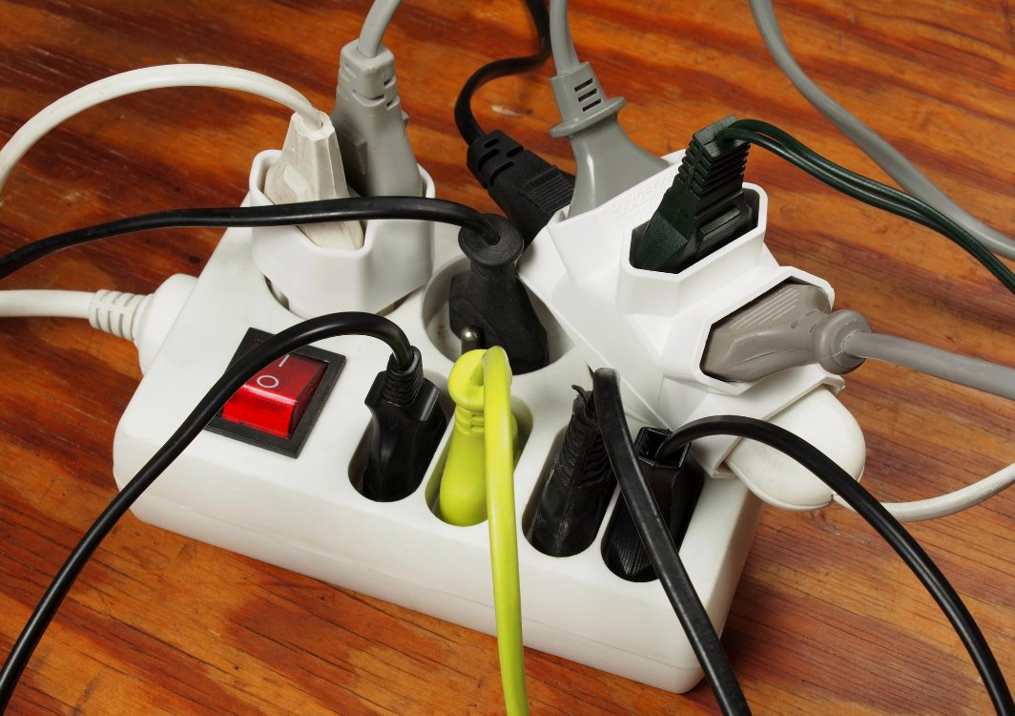
Equipment failure
Equipment failure can occur due to a range of factors:
badly formed terminations
overloading, as shown in the image
incorrect wiring
equipment malfunction
damaged insulation causing series or parallel arcing.

Slide 10
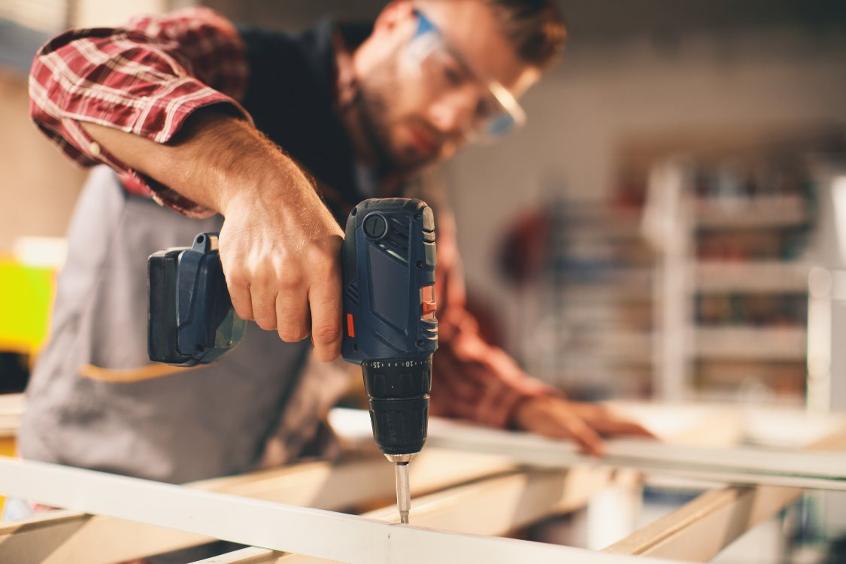
Accidents
Hand-held equipment poses greater risk because the operator is in very close contact with the tool.
Twenty-five percent of all electrical accidents involve portable electrical appliances.

Slide 11
Safety practices and procedures
There is a need for several practices and procedures regarding equipment in order to safeguard people.
This includes training and reminding employees of the importance of undertaking a pre-use (user check) before the equipment is employed. This is particularly important where electrical equipment is concerned.

Slide 12
Portable appliance testing (PAT)
Every electrical tool and appliance must undergo regular PAT (portable appliance testing) to ensure it is safe to use.
PAT includes essential tests like:
earth continuity (for Class I equipment)
insulation resistance to check the integrity of insulation
visual inspection of the plug and cable for damage.

Slide 13
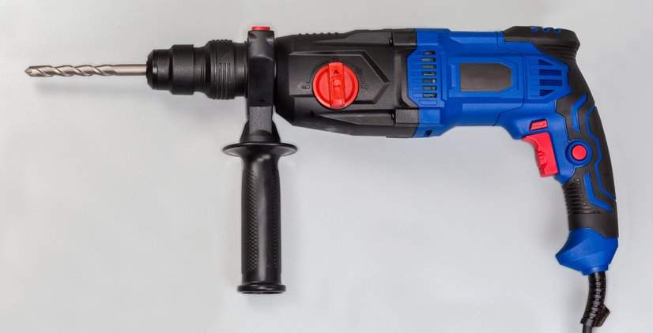
Visual inspection
In addition to formal PAT, every power tool must be visually inspected before each use for signs of damage or wear (such as damaged cables, cracked casings, or loose connections).
All PAT results must be recorded, and any failed item must be removed from service until it is repaired or replaced.

Slide 14
Visual inspection checklist
Look for any signs of damage or defects.
Look for any signs of overheating.
Check cables are not worn or frayed, or have any exposed conductors.
Check equipment for any water ingress.
Ensure hand-held equipment is used with a 110 V supply.
Ensure that the correct rating of fuse is fitted.

Slide 15
Equipment checks
Tools should also be subjected to a pre-use check.
Look for any mushrooming of a chisel head.
Look for any signs of debris within a file.
Check the handle of a hammer is attached tightly to the head.
Check tape is not wrapped around a handle.
Check the body or casing is not cracked.
Check that a screwdriver has not been used as a chisel.
In addition, an electrician’s tool needs to be insulated along most of its length.

Slide 16
Defective equipment
On finding a defective piece of equipment, carry out the following actions:
Remove the item to quarantine from further use.
Label it as being defective.
Lock the item away in a secure location.
Arrange for the item to be repaired.

Slide 17
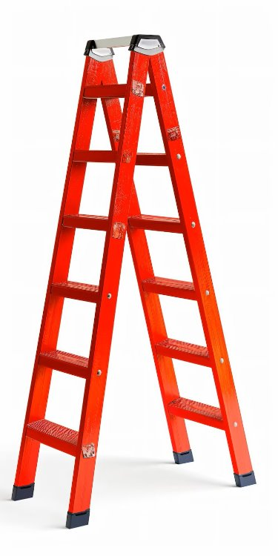
Working at height
Working at height is defined as any activity above ground.
Always plan and organise the work properly.
Always work from a secure place within the platform.
Always install edge protection.
Always discuss problems with your immediate supervisor.
Always ensure you are trained and competent to do a
given task.

Slide 18
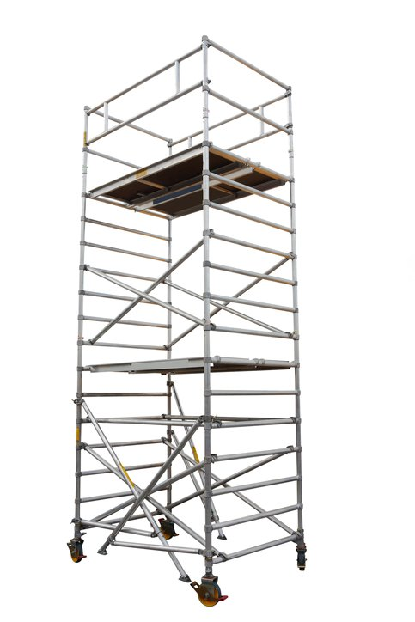
Working at height: Access towers
Access equipment is regulated by the Pre-fabricated, Access, Suppliers and Manufacturers’ Association (PASMA).
PASMA has developed a strict code of practice for the use of mobile access towers.
Ensure that the scaffold has PASMA inspection records up to date before use.

Slide 19
PASMA recommendations
An inspection should be carried out after assembly or significant alteration, where it is possible to fall two metres or more following construction.
A PASMA tower inspection record should be used.
Access equipment must be tied with sufficient, suitably strong, rigid two-way ties (four-metre height intervals).
Tower platforms should be sufficiently close and vertically aligned to the accessed area.
Tower scaffolds should not be used if the average wind speed reaches 17 miles per hour.

Slide 20
Working at height: Ladders
Only use ladders for activities
involving less than 30 minutes.
Carry out a pre-use check to establish its condition.
Always erect a ladder at 75 degrees
or 1 out for 4 up.
Tie a ladder to secure it (footing should be a last resort).
Ensure ladders are properly maintained.
Always maintain three points of contact.
Extend the top of a ladder one metre or five rungs above a platform.
Never use a painted ladder because paint can hide defects.
Never use a ladder with missing or damaged parts.
Never over-reach (keep within the styles).

Slide 21

Calibration
Electrical test equipment requires calibration to ensure its accuracy remains within two percent over a useful proportion of its scale.
An appointed person will control when the test equipment is sent away, as detailed within a given register.
Some electrical installation companies will undertake calibration internally.
The manufacturer sets the period between calibrations.

Slide 22
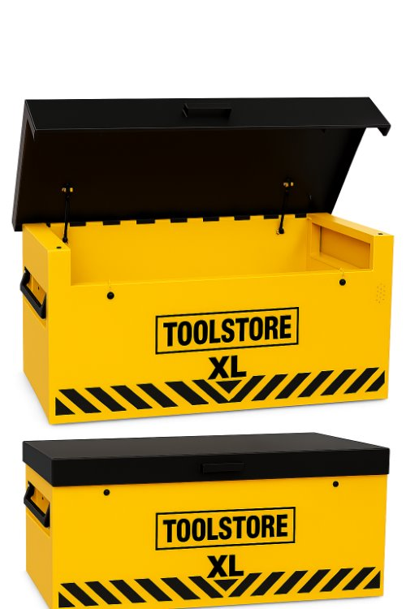
Storing equipment correctly
Store equipment on proper racking and never on the floor.
Make sure leads are safely coiled.
Never hang electrical appliances by their cords.
Make sure the tool store is secure.
Utilise an appropriate logging-out system to ensure all tools and equipment are accounted for.

Slide 23
Additional safety procedures
Some industrial equipment, such as pillar drills, cartridge guns, and grinders, requires additional procedures before authority to use them is granted.
Authority in their use is only given following initial training, which includes assigning what PPE is required and what safety features, such as guards, are in place.
Induction training will include what procedures must be followed when undertaking mechanical maintenance.
Refresher training will periodically be given to ensure operators remain competent.

Slide 24
Safe use of substances
Any substance used in any industrial environment must be strictly regulated to eliminate or reduce risks from hazardous substances.
Substances will need to be periodically examined in order to ensure that they have not expired.
Some substances will also need to be kept in a cool, secure area.
Substances such as cutting compounds or adhesives are always accompanied by a manufacturer’s data sheet when sold.

Slide 25
Safe use of substances: COSHH
A Control of Substances Hazardous to Health Regulations
(COSHH) risk assessment must be carried out in relation
to the manufacturer’s data sheet to implement control
measures such as appropriate PPE, ventilation or even
minimising exposure.
First aid facilities must be matched against data sheets to target specific areas, such as providing eye wash bottles in case of contact that leads to severe eye irritation.
Periodic toolbox talks are often used to refresh COSHH protocols.

Slide 26
Summary
You should now be able to:
Identify key requirements for tool inspection and PAT testing.
Describe the safety checks required before using electrical equipment.
Explain legal obligations under PUWER (1998) and COSHH.
Apply safe working procedures for storing, handling and disposing tools and substances.
Assess risks associated with faulty or inappropriate tool use.

Slide 27
Any questions?
Copyright in this document belongs to and is used under licence from the Department for Education, © 2025.
‘T-LEVELS’ and ‘T Level’ are registered trademarks of the Department for Education.
WJEC is authorised by the Department for Education to develop and deliver this T Level Technical Qualification.
WJEC operates in England under the name Eduqas which is a registered trademark of WJEC.

