Slide 1
Occupational Specialism: Electrotechnical Engineering
K1.1 Tools and equipment used for installation
PowerPoint 1.1: Selecting correct hand and power tools

Slide 2
Introduction
In this session, you will learn about the hand tools and power tools essential for safe and effective electrical installation work.
We will explore commonly used tools, their specific purposes, and how correct selection improves safety, quality and efficiency in the workplace.

Slide 3
Objectives
By the end of this session, you should be able to:
Identify key hand tools and power tools used in electrical work
Explain the correct applications and safety considerations for each tool
Select appropriate tools for different installation tasks

Slide 4
Selection of appropriate tools and equipment
The right tools don’t just make the job easier – they also improve safety, efficiency and quality of work.
A professional toolkit is the foundation of every installation.
Knowing which tools to use and how to use them properly is key to delivering safe and reliable results.

Slide 5
Common hand tools and equipment
VDE tools
Pliers
Wire cutters
Screwdrivers
Wire strippers
Saws
Tape measure
Level
Claw hammer
Spanners and wrenches
Files and reamers
RJ45 crimper
Insulation displacement connector (IDC)
Notes:
Over the next few slides, we’ll look at the most common hand tools and equipment used in electrical installation and maintenance.

Slide 6
1. VDE tools
Insulated hand tools designed for electrical work.
Tested to strict safety standards to protect against electric shock during accidental contact with live parts.
Rated for use up to 1000V AC.
Using VDE-rated tools supports compliance with the Electricity at Work Regulations 1989, which require safe working practices and the use of appropriate tools during electrical installation and maintenance.

Slide 7
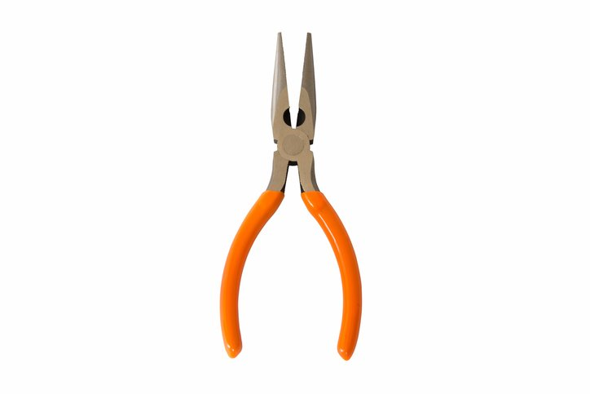
2. Pliers
Available in a variety of types.
Used for many common electrical tasks.
Essential for bending, cutting and twisting wires, especially when making screw-terminal connections.
Some pliers, such as needle-nose or long-nose types, have long, narrow jaws that make them ideal for precise and detailed work, particularly in tight spaces.

Slide 8
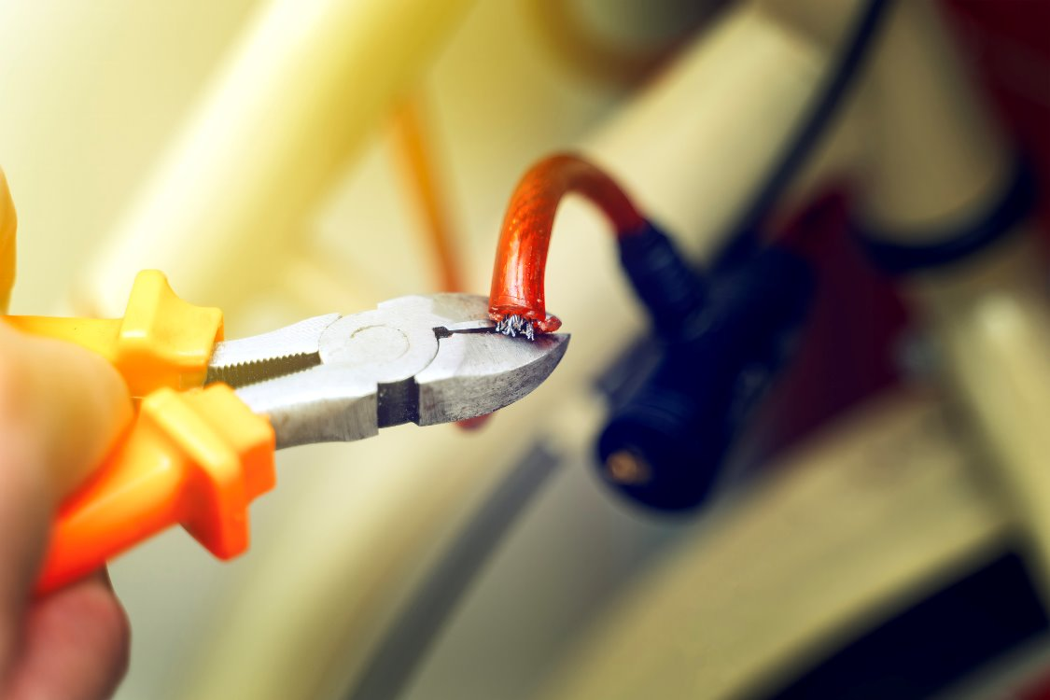
3. Wire cutters
Specifically designed to trim conductors cleanly without damaging the surrounding insulation.
Ensure safe and reliable electrical terminations.
They are commonly used when cutting:
solid and stranded copper conductors
tails and flex cables during installation
cable ties or small fixings during containment work.

Slide 9
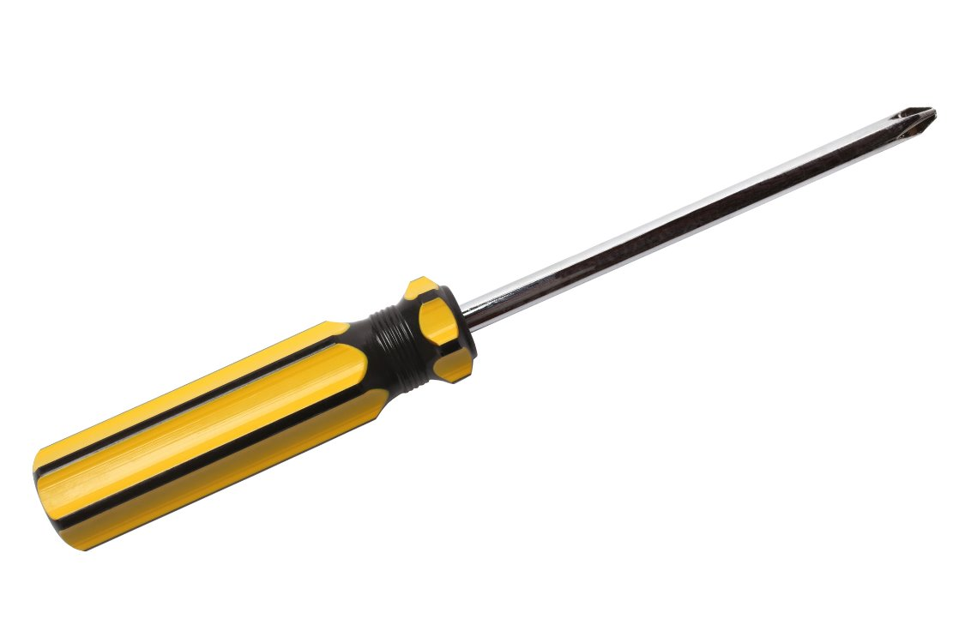
4. Screwdrivers
Essential for fitting electrical accessories and securing terminals.
The right type and size screwdriver prevents damage to screws and ensures a safe, tight connection.
Different types suited to different fixings and electrical components.
Common types include flat/slotted, Pozi-drive, Phillips and terminal screwdrivers.

Slide 10
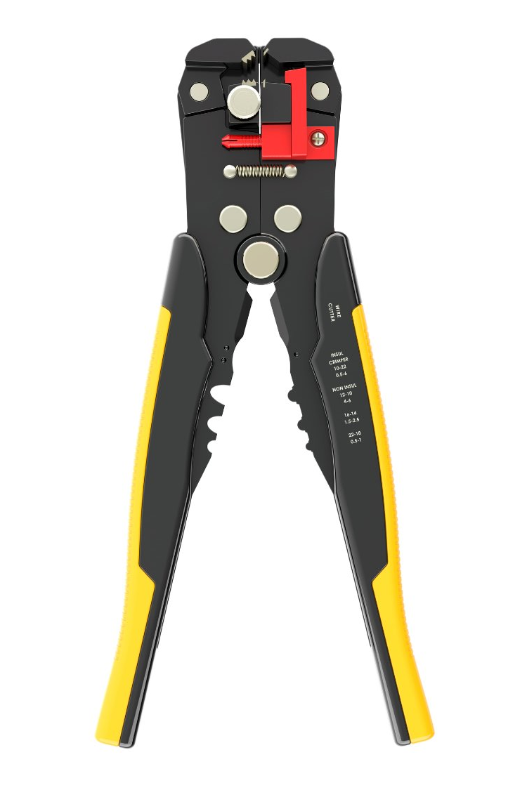
5. Wire strippers
Used to remove insulation from electrical cables without damaging the conductor inside.
Allow for accurate, controlled stripping by applying just the right amount of pressure.
Some types are also suitable for stripping the outer sheath of twin and earth cable.
Using the correct stripper helps maintain cable integrity and ensures safe terminations.

Slide 11
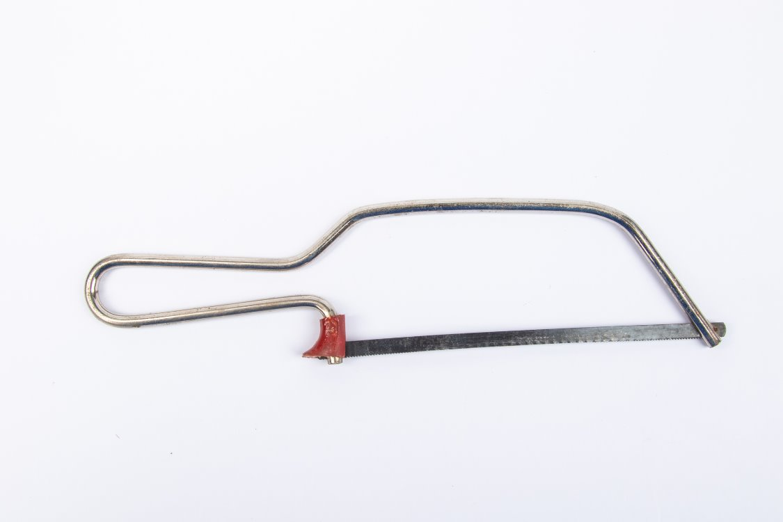
6. Saws
Regular and junior hacksaws are used for cutting plastic and metal trunking as well as conduit.
The type of saw depends on the material and precision required.
Junior hacksaws are ideal for tight spaces and lighter materials.
Full-size hacksaws offer better control for larger cuts.
Always use the correct blade type and ensure it’s securely fitted for safe, accurate cutting.

Slide 12
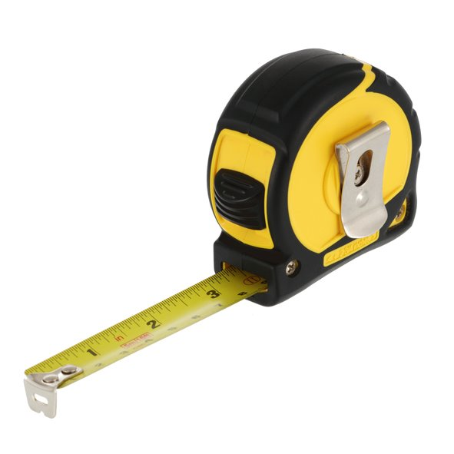
7. Tape measure
Used to take accurate distance or height measurements on-site.
A retractable, flexible ruler that often shows both metric and imperial units.
Electricians use tape measures for:
setting heights for sockets and switches
marking positions for cutouts, fixings and cable runs.
A reliable tape measure helps maintain consistency across installations and ensures compliance with building layout standards.

Slide 13
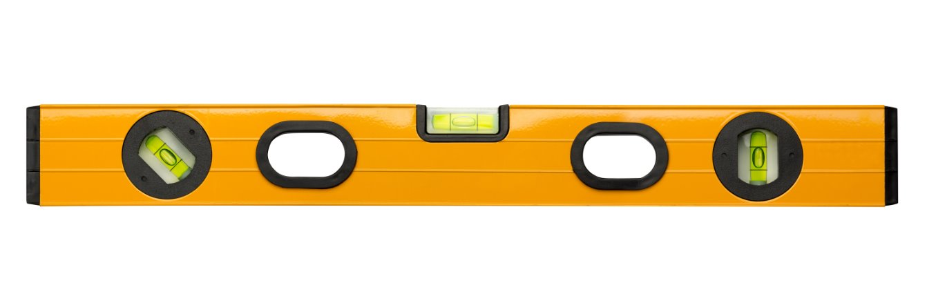
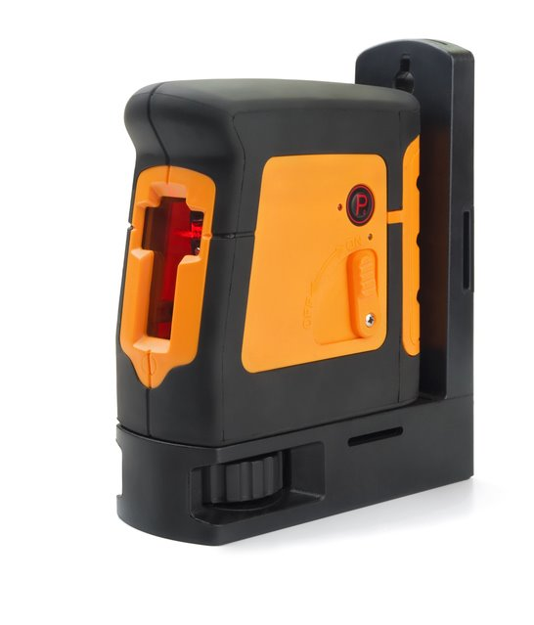
8. Levels
Ensure that fixtures, containment and accessories are straight and properly aligned.
A small spirit level fits easily into a tool pouch and is ideal for checking alignment during socket and trunking installation.
A laser level projects a clear line across surfaces, making it easier to mark fixings accurately over longer distances.
Using the correct level ensures a neat, professional finish every time.

Slide 14
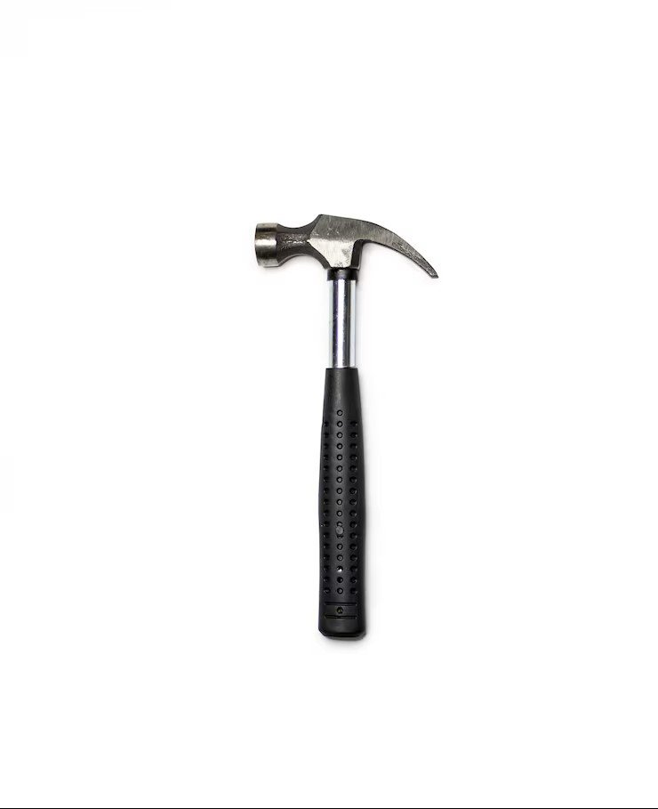
9. Claw hammer
Most used hammer.
Ideal for:
fixing cable clips
fitting backboxes
removing nails or battens during preparation work.
Its curved claw is perfect for pulling out fixings, making it a reliable multi-use tool on-site.

Slide 15
10. Spanners and wrenches
Used to tighten fixings on gland plates, conduit, or cable brackets.
The most commonly used type is the adjustable spanner, which fits a range of nut sizes.
You might also come across:
footprint wrenches: useful for older conduit fittings
pipe wrenches: typically used in industrial or containment work.

Slide 16
11. Files and reamers
Used to remove burrs, sharp edges or rough finishes from conduit and metal fittings after cutting or drilling.
File: Smooths the outer edges of cut conduit or trunking.
Reamer: Cleans out the inside edge of the conduit, helping to prevent cable damage during pulling.
Proper finishing prevents damage to insulation and keeps installations safe and professional.

Slide 17
12. RJ45 crimper
Specialist tools needed to terminate data connections correctly when working with structured cabling (e.g. Cat5e, Cat6).
A crimping tool is used to attach RJ45 plugs to the ends of data cables.
Ensures solid contact between conductors and the plug’s internal pins.
Often includes a cable stripper and cutter in one tool.

Slide 18
13. Insulation displacement connector (IDC)
Used for terminating data cables into patch panels, outlets or keystone jacks.
Punches wires into terminals without stripping insulation.
Ensures firm, consistent connections for high-speed data performance.

Slide 19
Specialist tools in electrical installations
Electricians don’t always use just a basic toolkit.
In commercial or industrial environments, specialist tools are often needed to install, modify or terminate more advanced systems.
These tools are usually shared across a team and found in larger workshops, stores or site-based setups.
Conduit vice and bender
Stock and die
Tray bender
MICC (Pyro) tools
Notes:
Over the next few slides, we’ll look at some specialist tools used in electrical installation and maintenance.

Slide 20
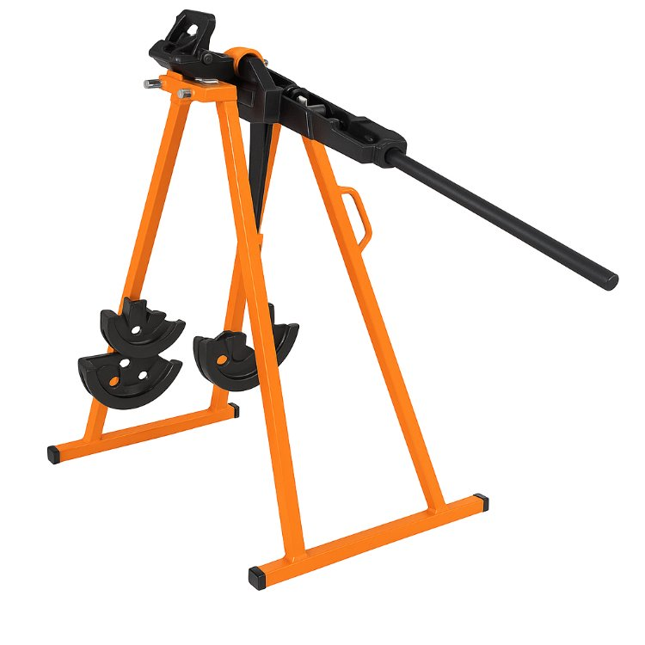
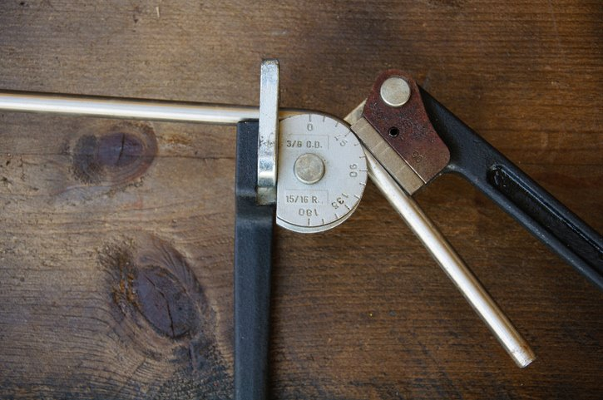
1. Conduit vice and bender
Used to prepare rigid conduit systems for installation.
Conduit vice: Secures steel conduit firmly while cutting or threading.
Conduit bender: Creates smooth, accurate bends in conduit without flattening the walls.

Slide 21
2. Stock and die
Stock and die sets are used to cut threads onto the ends of steel conduit.
The die cuts a spiral thread so conduit ends can screw into couplings, boxes or glands.
Used when mechanical joints are required in metal conduit systems, which comply with BS EN 61386.

Slide 22
3. Tray bender
It allows electricians to shape metal cable trays without compromising their structure.
Used to form bends or offsets in tray sections around obstacles.
Prevents weak points that would be introduced by cutting and rejoining.
Maintains neatness, alignment and cable containment.

Slide 23
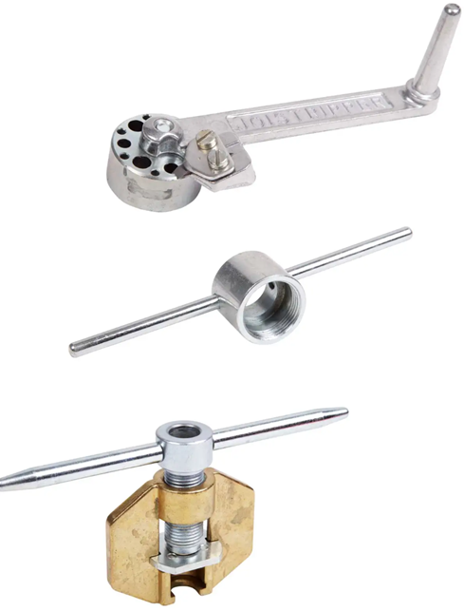
4. MICC (Pyro) tools
MICC (Pyro) cables require specific tools to prepare and terminate correctly.
Sheath stripper: Removes the copper jacket without damaging internal insulation.
Pot wrench: Used to install the pot onto the sheath correctly.
Pot crimper tools: Used to attach and seal the pot to prevent moisture ingress.

Slide 24
Safe use of power tools
On UK construction sites, power tools should operate at the lowest safe voltage to reduce the risk of electric shock.
Use battery or 110V tools wherever possible to stay compliant with site safety standards and reduce electrical risks.
Battery-powered tools are the preferred choice whenever suitable because they are safer, more portable and avoid trailing cables.
When mains-powered tools are required, they should preferably be supplied via a 110V centre-tapped to earth (CTE) transformer, which limits the voltage to earth to 55V.

Slide 25
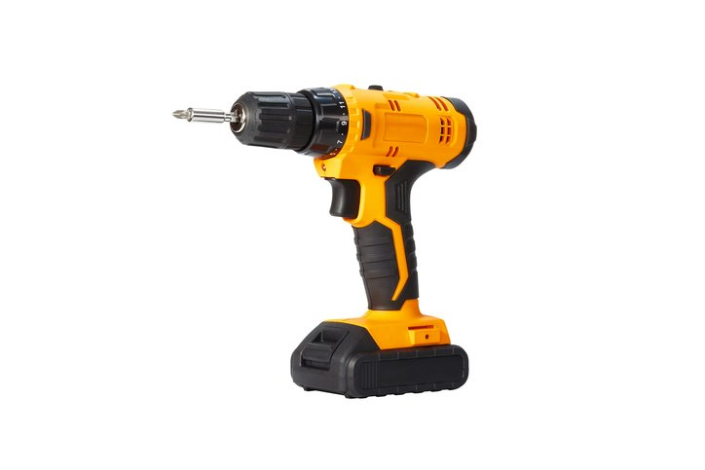
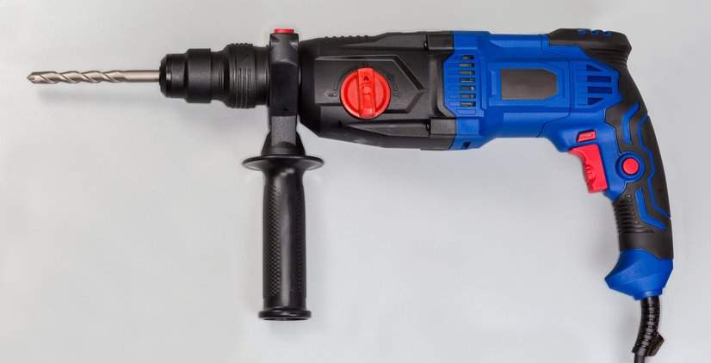
Drills
Electricians widely use battery-powered drills to drill into walls, wood or metal, and to fix screws and fasteners to surfaces or containment.
The type of drill depends on the task:
A lightweight cordless drill is ideal for fastening fixings and drilling wood.
A hammer drill is better for harder surfaces like brick or concrete, providing more power and speed.

Slide 26
Oscillating multi-tool
Versatile power tool used for cutting, trimming or sanding materials in tight or awkward spaces.
Commonly used for:
neatly cutting plasterboard to install backboxes or cable runs
trimming skirting or flooring for containment or trunking
making minor adjustments without damaging surrounding surfaces.

Slide 27
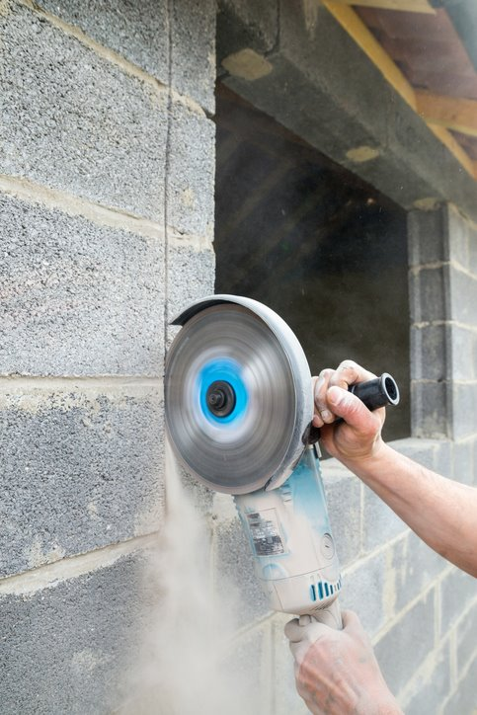
Wall chaser
Power tools with dual rotating blades are used to cut neat, parallel channels into walls for cable runs.
Electricians use wall chasers to:
install cables flush into solid walls
create precise chases for boxes or cable drops
speed up repetitive work and reduce manual chiselling.
Often used with a vacuum or dust extraction unit to minimise mess and comply with dust control regulations (e.g. COSHH).

Slide 28
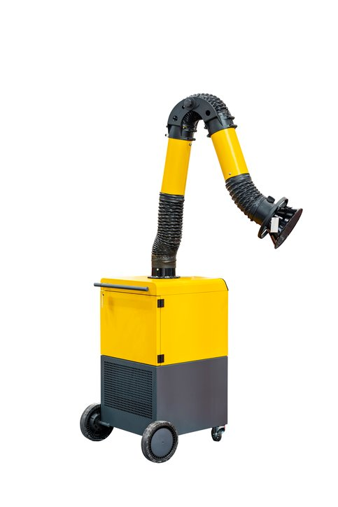
Dust extractor
A powered unit designed to remove airborne dust and debris directly from the source.
Used alongside tools like wall chasers, drills, and saws to:
minimise dust spread and protect worker health
maintain visibility and accuracy during work
reduce cleanup time and site contamination.
Often fitted with HEPA filters or similar to capture fine dust, including silica and wood dust.

Slide 29
Electrical testing and safety equipment
The following tools are essential for ensuring the safe testing, verification and isolation of electrical installations in accordance with industry standards.
Multifunctional tester (MFT)
Plug-in socket tester
Voltage indicator and proving unit
Lock-off kit

Slide 30
1. Multifunctional tester (MFT)
A versatile electrical testing device is used to perform key tests required by wiring regulations.
Used to check:
continuity of conductors
insulation resistance
earth loop impedance
RCD (residual current device) performance
polarity and phase sequence.

Slide 31
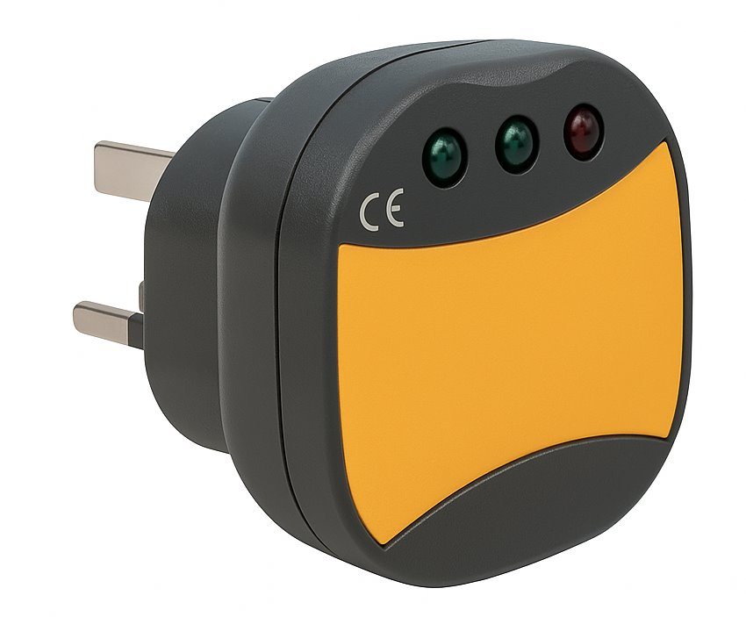
2. Plug-in socket tester
A simple device used to quickly check if a standard UK socket is wired correctly.
Plugs directly into the socket outlet and uses indicator lights to show wiring status.
This tester does not replace full electrical testing with calibrated instruments.

Slide 32
3. Voltage indicator and proving unit
Voltage indicator
A test tool is used to confirm the presence or absence of voltage at a circuit or equipment, ensuring it is safe to work on.
Proving unit
A dedicated device is used to verify that a voltage indicator is working both before and after use.
Supplies a known voltage to check the tester’s correct function, ensuring the tester is reliable and preventing false ‘dead’ readings.

Slide 33
4. Lock-off kit
Essential for safely isolating electrical circuits and preventing accidental re-energising during maintenance or installation work.
Why it matters
Helps meet Electricity at Work Regulations.
Protects both the worker and others on-site.
Ensures equipment stays safely isolated until work is complete.

Slide 34
Summary
You should now be able to:
Identify key hand tools and power tools used in electrical work.
Explain the correct applications and safety considerations for each tool.
Select appropriate tools for different installation tasks.

Slide 35
Any questions?
Copyright in this document belongs to and is used under licence from the Department for Education, © 2025.
‘T-LEVELS’ and ‘T Level’ are registered trademarks of the Department for Education.
WJEC is authorised by the Department for Education to develop and deliver this T Level Technical Qualification.
WJEC operates in England under the name Eduqas which is a registered trademark of WJEC.

