Slide 1
Occupational Specialism: Plumbing & Heating Engineering
K1.42 Documentation required for maintenance and verification of maintenance activities
Planned maintenance of non-potable water systems

Slide 2
Starter
Warm-up:
Why might regular maintenance of a rainwater or drainage system prevent structural damage to a property?

Slide 3
Objectives
You should be able to:
Understand maintenance requirements for non-potable systems.
Identify appropriate documentation for maintenance tasks.
You might also be able to:
Prepare for and carry out planned maintenance work.
Communicate findings to clients effectively.

Slide 4
Systems covered in this session
      Rainwater systems (gutters, downpipes).
      Sanitation systems (appliances, traps).
      Drainage systems (foul and surface).
      Grey water systems (recycling and reuse).

Slide 5
What is planned maintenance?
Planned maintenance is the scheduled checking and upkeep of systems to prevent failure, ensure compliance, and maintain performance. It includes cleaning, inspecting, repairing, and updating parts.
This proactive approach helps to reduce unexpected breakdowns, minimising downtime and operational disruptions. It also ensures that systems remain compliant with relevant UK regulations, such as the Health and Safety at Work Act and the Part G & Part H of Building Regulations.
Regular planned maintenance contributes to a safer working environment, extends equipment life, and improves overall system efficiency.

Slide 6
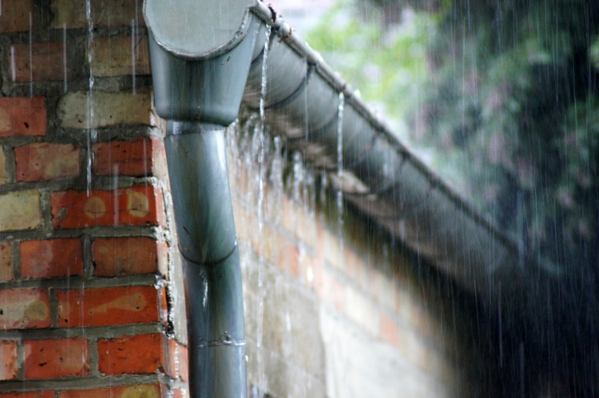
Rainwater systems – maintenance tasks
In pairs compile a list of 5 items you would check during a maintenance operation on a rainwater system in a domestic property.
Question: Why are rainwater systems important?

Slide 7
Rainwater systems – maintenance tasks
      Clear gutters and downpipes of debris.
      Check brackets and fixings.
      Inspect joints for leaks.
      Test flow to soakaways or water butts.
      Check for blockages at ground level.
      Question: What could be the consequence of blocked gutters in heavy rain?

Slide 8
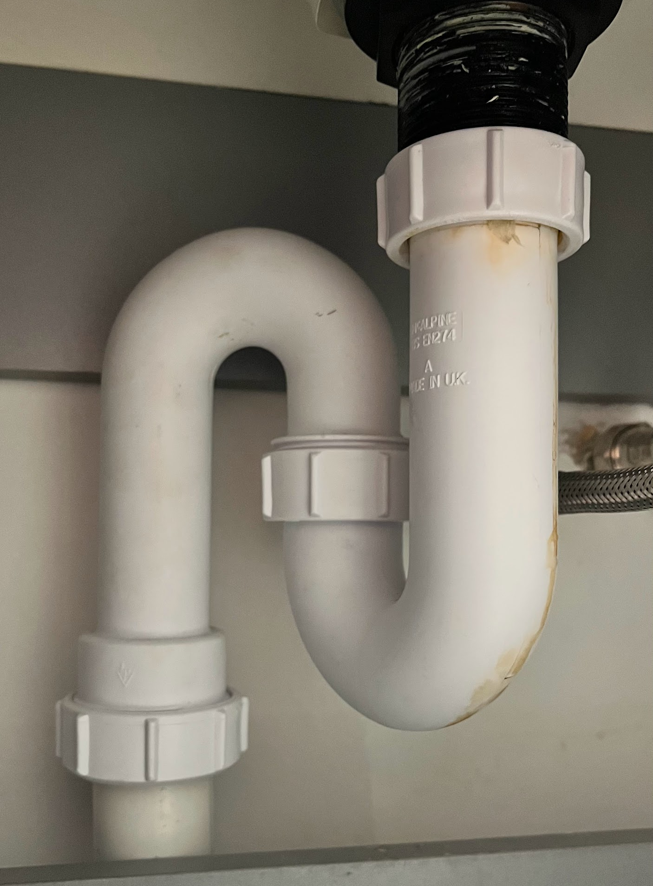
Sanitation systems – maintenance tasks
In pairs, compile a list of 5 items you would check during maintenance of a sanitation system in a domestic property.
Question: What is the purpose of a trap?

Slide 9
Sanitation systems – maintenance tasks
      Inspect soil stack connections.
      Check WC flush mechanisms.
      Test traps for seal integrity (and possibly performance test).
      Inspect air admittance valves (AAVs).
      Confirm ventilation and fall.

Slide 10
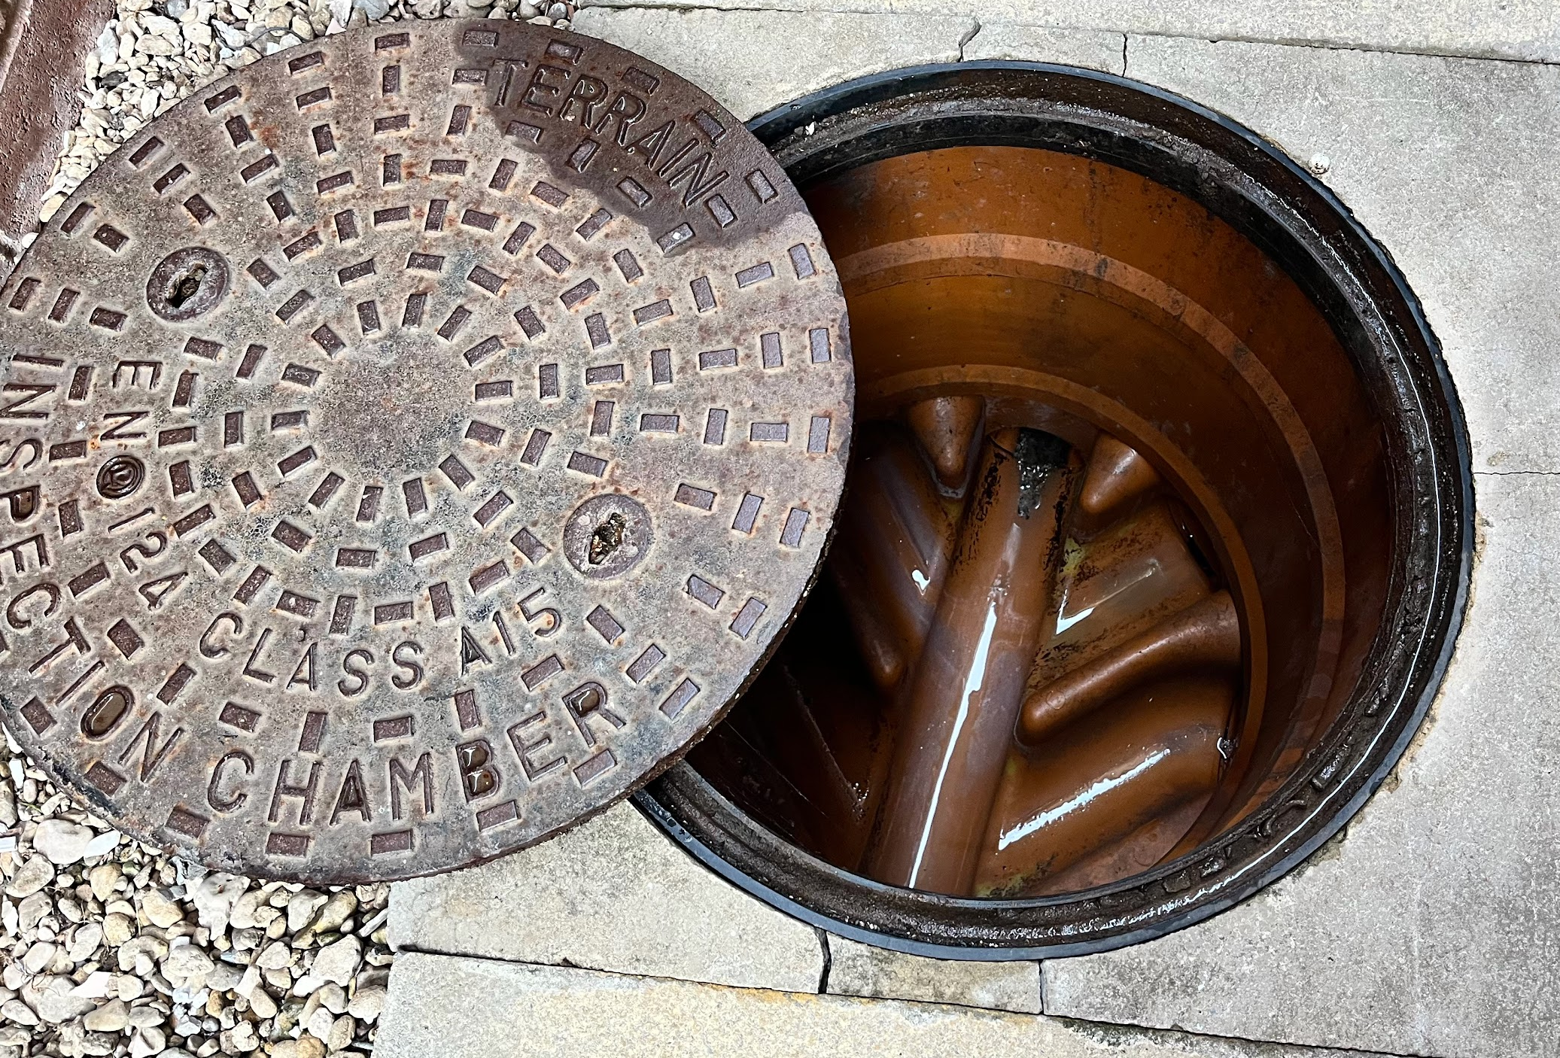
Drainage systems – maintenance tasks
In pairs, compile a list of 5 items you would check during maintenance of a drainage system in a domestic property.
Question: What steps can you take to correctly identify a drainage pathway for an appliance?

Slide 11
Drainage systems – maintenance tasks
      Flush and CCTV inspect drains.
      Check for root ingress or silt build-up.
      Check for correct connections.
      Inspect manholes and access points.
      Test for correct gradients and flow.
      Clean gullies and traps.

Slide 12
Grey water systems – maintenance tasks
      Inspect and clean filters and strainers.
      Check tanks for sediment and odour.
      Test UV disinfection systems (if installed).
      Ensure pump operation and controls.
      Clean refuse outlets (e.g., toilets).

Slide 13
Documentation requirements
      Manufacturer’s instructions
      Maintenance record
      Maintenance programme
      Maintenance checklist
      Service history
      Job sheets.

Slide 14
Maintenance checklist example – rainwater
      Gutters clear of leaves and moss ✔
      Downpipes flowing freely ✔
      All brackets secure ✔
      Joints watertight ✔
      Discharge path unobstructed ✔

Slide 15
Maintenance checklist example – sanitation
      WC flushing correctly ✔
      Soil pipe brackets secure ✔
      AAV intact and operational ✔
      No leaks at joints ✔
      Traps filled and sealing ✔

Slide 16
Maintenance record keeping
      Monitor system condition over time.
      Log repeat faults.
      Ensure legal compliance.
      Provide evidence of upkeep.
      Inform future repair/replacement decisions.

Slide 17
Job sheet contents
      Customer details and system type.
      Tasks completed.
      Materials used.
      Notes on findings.
      Client and engineer signature.

Slide 18
Preparing for maintenance work
      Review previous service history.
      Check all required tools are available.
      Ensure safe access to roofs or manholes.
      Notify the client.
      Review manufacturer and site instructions.

Slide 19
Manufacturer guidance
      Frequency of maintenance.
      Approved cleaning agents.
      Component replacement intervals.
      System-specific safety guidance.
      Must not be substituted with generic advice.
      Question: What might happen if the wrong product is used in a grey water system?

Slide 20
End-user awareness
End-users should be informed about their responsibilities for system upkeep. They need to understand how often gutters and gullies should be cleared and the importance of maintaining grey water hygiene.
They should be made aware of the early signs of sanitation problems, such as slow drainage or odours. Knowing when and how to report issues can prevent small defects from developing into costly repairs.
Education also improves compliance with maintenance schedules and reduces the risk of emergency call-outs.

Slide 21
Midpoint knowledge check
Name 3 documents used in planned maintenance.
Why is a CCTV inspection used in drainage?
What does an AAV do?
What risks are present when maintaining grey water systems?
Why must rainwater discharge be kept clear?

Slide 22
Midpoint knowledge - answers
Job sheet, checklist, manufacturer guide.
To view blockages or damage internally.
Prevents vacuum and allows air into soil / waste pipe.
Biological contamination, odour, confined space.
Prevents overflow and building damage.

Slide 23
Identifying system failures
      Staining or water marks
      Slow drainage
      Unusual odours
      Overflowing gullies or pipes
      Backflow.

Slide 24
Common issues – rainwater systems
Rainwater systems can develop issues such as blocked downpipes, loose brackets, or leaking joints. Prolonged blockages can cause water to overflow and penetrate walls, leading to damp problems.
Brackets may loosen over time due to weathering or poor installation, causing sections to sag and disrupt flow.
Leaks often occur at joint points where sealant has failed. Identifying these early prevents expensive building repairs and improves system longevity.

Slide 25
Common issues – sanitation systems
      Blocked or partially obstructed traps.
      Damaged soil pipes.
      Faulty WC flush valves.
      Failed seals at connections.
      Venting issues leading to slow drainage.
      Questions: Which fault in a sanitation system could cause unpleasant odours inside a property?

Slide 26
Common issues – drainage systems
Drainage systems are prone to blockages from debris, grease, or roots that infiltrate the pipework. Over time, silt can accumulate, reducing flow efficiency.
In some cases, pipe collapses may occur due to ground movement or material deterioration. Regular inspection and maintenance reduce these risks.
Early detection of slow-flowing drains can prevent total blockages and costly excavation work.​

Slide 27
Common issues – grey water systems
      Filter clogging
      Pump failure
      Bacterial growth in tanks
      Blocked outlets
      Odour issues from stagnant water
      Question: What is a common maintenance task to prevent odours in grey water systems?

Slide 28
Tools for maintenance
Effective maintenance of these systems requires the right tools. For rainwater and drainage, ladders, gutter scoops, and drain rods are essential.
Sanitation systems may require inspection cameras and seal replacement kits. Grey water systems benefit from pump testing equipment and water quality test kits.
Using correct, well-maintained tools ensures work is carried out efficiently and safely.

Slide 29
Safety procedures
      Wear appropriate PPE.
      Isolate water supply where required.
      Follow confined space protocols.
      Use ladders and access equipment safely.
      Dispose of waste materials correctly.
      Question: What illnesses and diseases are plumbers at risk of encountering during sanitation and drainage maintenance?

Slide 30
Barriers to maintenance
Common barriers include cost concerns, lack of awareness, and access issues. Clients may delay work to save money, but this often leads to larger expenses later.
In some properties, system components are located in hard-to-reach areas, requiring specialist equipment.
Addressing these barriers involves education, clear cost-benefit explanations, and planning for safe access.

Slide 31
Final knowledge check
Name one common fault in rainwater systems.
What can cause slow drainage in sanitation systems?
How often should grey water filters be cleaned?
Give one seasonal factor affecting maintenance.
What is a key reason for keeping detailed maintenance records?

Slide 32
Final knowledge - answers
Blocked downpipes
Venting issues or blockages or incorrect gradient
As per manufacturer’s instructions, typically every few months
Autumn leaf fall
Tracking system condition and compliance

Slide 33
Summary
You should now be able to:
      Describe maintenance needs for rainwater, sanitation, drainage, and grey water systems.
      Use appropriate documentation for maintenance planning and recording.
      Prepare and carry out planned maintenance safely and effectively.
You might also be able to:
      Communicate effectively with clients.
      Anticipate and overcome maintenance barriers.
      Integrate maintenance tasks into a wider building care plan.

Slide 34
Exit quiz
What is the main purpose of planned maintenance?
Which system may require confined space entry?
What is one tool used for gutter maintenance?
Name one barrier to regular maintenance
Why is odour control important in grey water systems?

Slide 35
Exit quiz – answers
To prevent system failure and ensure compliance
Drainage systems
Gutter scoop or ladder
Cost or access issues
Prevents unhygienic conditions and complaints

Slide 36
Any questions?
Copyright in this document belongs to and is used under licence from the Department for Education, © 2025.
‘T-LEVELS’ and ‘T Level’ are registered trademarks of the Department for Education.
WJEC is authorised by the Department for Education to develop and deliver this T Level Technical Qualification.
WJEC operates in England under the name Eduqas which is a registered trademark of WJEC.

