Slide 1
Occupational Specialism: Plumbing & Heating Engineering
K1.42 Documentation required for maintenance and verification of maintenance activities
Planned maintenance of plumbing & heating systems

Slide 2
Starter
Warm-up:
Why is regular maintenance essential for plumbing and heating systems?

Slide 3
Objectives
You should be able to:
Understand planned maintenance of heating, hot and cold water systems.
Identify required documentation and how to use it.
You might also be able to:
Assess information needed before maintenance begins.
Communicate effectively with clients about maintenance.

Slide 4
What is planned maintenance?
Planned maintenance is a proactive process to preserve system efficiency, prevent breakdowns, and ensure safety. It includes regular checks, cleaning, part replacement, and system performance analysis. Maintenance must follow legal, regulatory, and manufacturer guidance.
By identifying and resolving issues early, planned maintenance helps to avoid costly emergency repairs and system downtime. It also extends the operational lifespan of equipment, ensuring consistent performance over time.
Maintaining accurate service records supports compliance and aids future diagnostics or system upgrades.

Slide 5
Systems that require maintenance
Heating systems (boilers, pumps, zone valves, thermostats)
Hot water systems (cylinders, controls, showers)
Cold water systems (storage cisterns, valves, pipework)
Controls and thermostats
Safety and regulatory systems (expansion vessels, pressure and temperature relief valves)

Slide 6
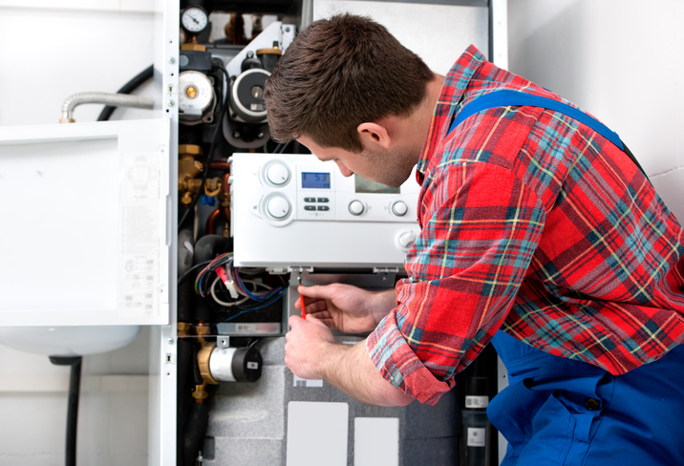
Heating system maintenance tasks
Bleed radiators.
Check boiler pressures and settings.
Check water quality and add or top-up chemical inhibitors.
Clean or replace filters.
Check safety valves and expansion vessel.
Inspect circulation pumps and valves.
Question: What could happen if a heating pump fails due to lack of maintenance?

Slide 7
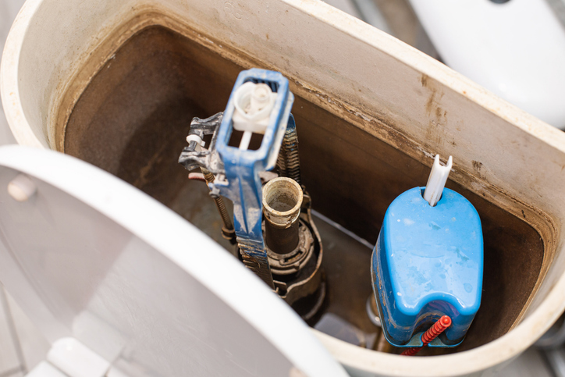
Cold water system maintenance
Check cistern lid, vent pipes, and insulation.
Ensure float valves are working correctly.
Clean cisterns and remove debris.
Inspect for leaks or corrosion.
Confirm cold supply to outlets is unobstructed.
Question: What could happen if a CWSC is not inspected during maintenance?

Slide 8
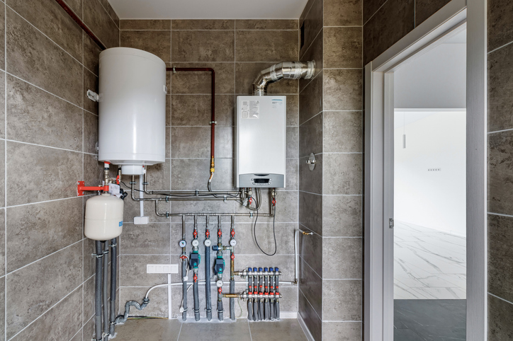
Hot water system maintenance
Check temperature and pressure relief valves.
Inspect immersion heaters.
Check thermostat operation and temperature settings.
Flush out cylinder and check anode where appropriate.
Confirm lagging is intact.
Question: What could happen if an unvented cylinder is not maintained?

Slide 9
Preventative vs reactive maintenance
Preventative Maintenance | Reactive Maintenance
Scheduled and regular | Only when faults arise
Cost-effective long-term | Can lead to higher costs
Improves system lifespan | May involve emergency work

Slide 10
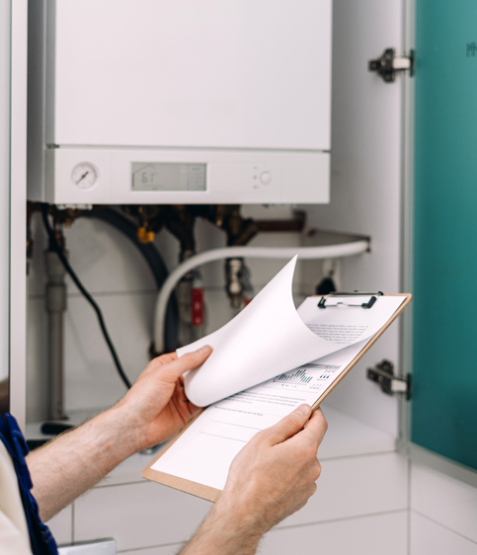
Documentation for maintenance
Manufacturer’s instructions.
Maintenance record.
Maintenance programme.
Maintenance checklist.
Service history.
Job sheets.
Question: Why is it important to complete all maintenance documentation?

Slide 11
Manufacturer’s instructions
Provide detailed steps for maintaining specific products. Include intervals for checks, cleaning, and parts replacement. Must be followed to maintain warranty and safe performance.
Always refer to the latest version.
These intervals should be clearly defined based on manufacturer guidance and the working environment in which the product is used.
Failure to carry out timely maintenance can lead to reduced efficiency, unexpected failures, and potential safety hazards. Maintenance logs should be updated regularly to provide a verifiable record of compliance and support future troubleshooting.

Slide 12
Maintenance records
Show dates and details of past work.
Helps with diagnosing reoccurring issues.
Required for system audits and inspections.
Often signed by installer and customer.
Must be stored securely.

Slide 13
Maintenance programme
A maintenance programme is a scheduled outline of what tasks should be done and when. Often created annually for commercial sites and ensures timely checks and consistent performance. Can be digital or paper-based.
This schedule typically includes monthly, quarterly, and annual tasks, prioritised by risk and regulatory requirements. It helps site managers allocate resources efficiently and avoid disruption to operations.
Scheduled maintenance also supports legal compliance and reduces the likelihood of emergency repairs. In larger organisations, integration with digital facility management systems allows for automated reminders and performance tracking.

Slide 14
Maintenance checklist
Used to ensure no steps are missed.
Specific to the system (boiler, cylinder, pump).
Water testing, electrical checks, flow/pressure tests.
Technician signs off each item.
Keeps engineers consistent.
Supports compliance and safety audits.

Slide 15
Service history
A service history is a chronological record of past servicing. It’s helpful for identifying trends, failures, or irregularities and should be shared between engineers to aid diagnosis.
Should be updated after every service or repair.
This log provides a valuable reference point for planning future maintenance and prioritising component replacements. It can also be used as evidence of compliance during audits or inspections.

Slide 16

Job sheets
Created per job or visit.
Include site details, tasks completed, parts used.
Signed by engineer and client.
Often submitted for invoicing.
Legal proof of work done.

Slide 17
Using documentation effectively
Before starting any maintenance, always review:
Manufacturer’s instructions.
Service history and job sheets.
Fault diagnosis charts.
Customer concerns.
Question: What problems could arise if you don’t review service history before maintenance?

Slide 18
Verifying maintenance requirements
Cross-check with:
Manufacturer’s service schedule.
End user expectations.
Landlord certificates (Annual).
Benchmark & Gas Safe register requirements.
Regulatory and safety guidance.
Site-specific records or permits.
Notes:
Note to tutor: Link to Benchmark Gas Boiler Checklist - https://londongas.co.uk/wp-content/uploads/2022/11/Benchmark_Template_Vdi.pdf

Slide 19
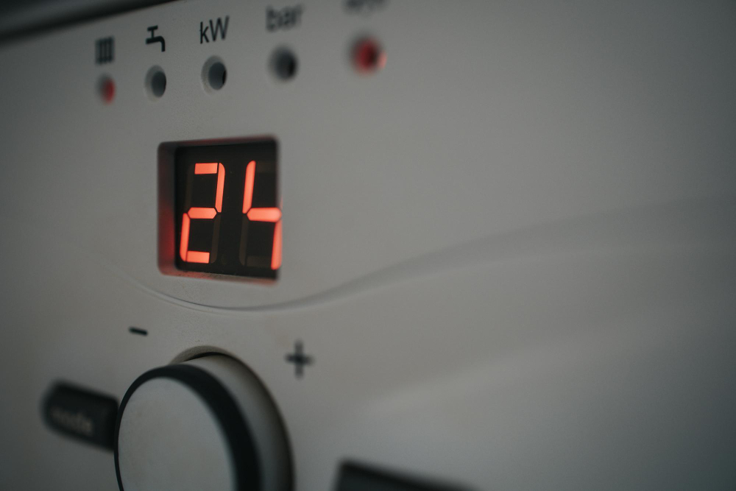
Fault diagnosis tools
Fault diagnosis flow charts.
Error codes and control panel data.
Flue gas analyser readings.
Pressure and temperature readings.
Visual and audio cues.
End user feedback.
Notes:
Note to tutor: Link to an example of Baxi boiler fault diagnosis flowchart - https://www.baxicombiboiler.co.uk/troubleshooting-manual/

Slide 20
Communicating with the end user
Discuss purpose and scope of maintenance.
Explain findings clearly and professionally.
Suggest preventative measures.
Record user concerns for reference.
Confirm agreement before repair or changes.
Question: Why is clear communication with the customer so important?

Slide 21
Understanding the end user's needs
Different users have different priorities, some value energy efficiency, while others want to minimise disruption, so maintenance schedules should be tailored to the specific use of the property.
Asking about previous issues, planned renovations, and the client’s expectations helps ensure maintenance plans are both practical and cost-effective. Residential settings may favour off-peak times, while commercial properties often require out-of-hours scheduling.
Clear, early communication builds trust and helps avoid unnecessary work or misunderstandings.

Slide 22
Explaining documentation to clients
Show what checks are included.
Explain manufacturer’s schedules.
Clarify safety or warranty points.
Offer simple summaries for residential users.
Question: How can you explain a maintenance checklist to a non-technical customer?

Slide 23
Barriers to maintenance
Cost concerns.
Lack of access to equipment.
Time or disruption worries.
Mistrust in contractors.
Poor understanding of importance.
Question: How can you overcome these barriers?

Slide 24

Overcoming maintenance barriers
Offer flexible scheduling.
Provide clear, transparent pricing.
Build rapport and trust.
Educate users on cost-benefit value.
Use plain language.

Slide 25
Sustainability in maintenance
Sustainable maintenance involves using long-lasting components, efficient systems, and eco-friendly practices that minimise environmental impact. Avoid replacing parts unnecessarily by prioritising repair and regular servicing to extend their life.
Where possible, choose recyclable or sustainably sourced parts, and focus on reducing water and energy waste through smart technologies and responsible usage.
Maintain insulation to prevent heat loss and improve overall system efficiency.

Slide 26
Cost considerations in maintenance
Compare costs of repair vs replacement.
Consider long-term efficiency savings.
Inform client of costs before proceeding.
Use job sheets to justify billing.
Offer preventative maintenance to reduce emergencies.

Slide 27
Health and safety in maintenance
Isolate electrical and water supplies.
Use lock-off procedures where needed.
Use correct PPE for system (gloves, goggles).
Test for safe isolation before dismantling.
Dispose of waste parts safely.
Question: Why is isolating a system important before maintenance begins?

Slide 28
Legal and regulatory compliance
Gas Safe Register for gas appliance work.
Water Regulations Advisory Scheme (WRAS).
Health & Safety at Work Act.
Manufacturer-specific warranty conditions.
Local authority compliance (e.g. landlord inspections).

Slide 29
Midpoint knowledge check
Name three types of maintenance documents.
What’s a key feature of a job sheet?
List two barriers to regular maintenance.
Why must PPE be used?
How does planned maintenance save money?

Slide 30
Midpoint knowledge check - answers
Checklist, job sheet, service history
Records work done, signed by client
Cost, time, access, mistrust
Prevent injury or exposure to hazards
Prevents breakdowns and extends lifespan

Slide 31
Maintenance schedule creation
Create a 12-month maintenance schedule for a 4-bed home with the following:
A heat only condensing boiler + filter.
An open vented indirect cylinder with immersion heater.
A shower booster pump.
A feed & expansion cistern and a cold water storage cistern.
3 toilets, 3 basins, 2 showers, 1 bath, 2 sinks, 1 water softener, 1 outside tap.
Include monthly checks, quarterly servicing, and an annual inspection.
Question: What tasks would you include in the summer vs. winter months?

Slide 32
Fault finding example – no hot water
Symptoms:
A customer has called you out to their property to fix their hot water. The supply is unaffected and the heating is working perfectly. The customer has a double feed indirect system with an s plan control layout.
Checklist:
What would the checklist be for this issue?

Slide 33
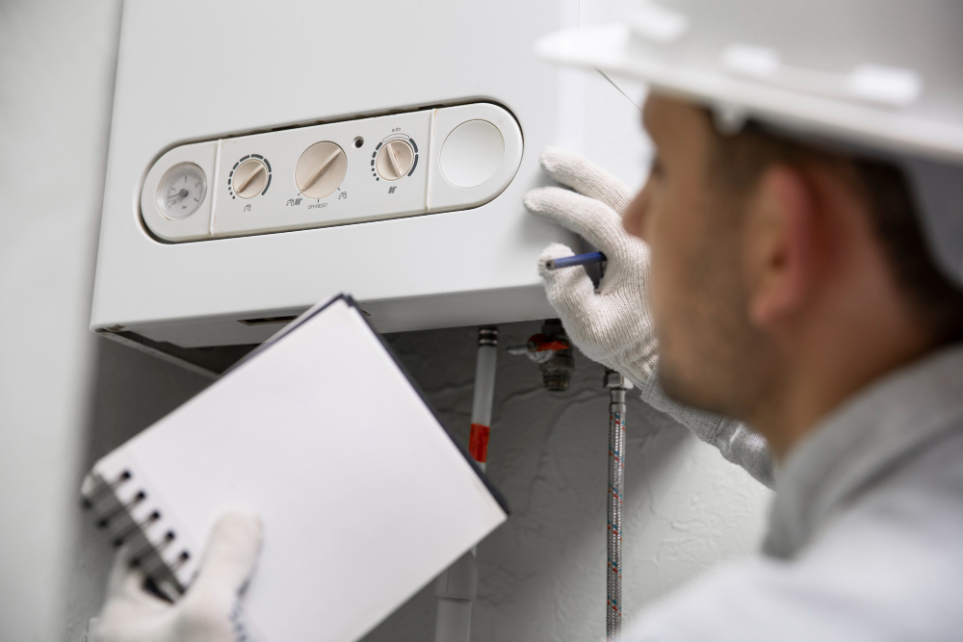
Client scenario task
Your client is unsure whether to replace an old boiler. It works, but they’ve had several breakdowns.
How would you use documentation to advise?
What sustainable options might you suggest?

Slide 34
Recording maintenance – best practices
Write legibly or use digital system.
Sign and date every record.
Be specific about work done and parts used.
Photograph key issues if needed.
Get client signature to confirm work.

Slide 35
Technology in maintenance
Mobile job sheet apps.
Online manufacturer guides.
QR code scan for service logs.
Automated fault diagnostics.
Cloud-based maintenance schedules.
Question: What technology have you seen or used during maintenance?

Slide 36
Summary table – maintenance documents
Document Type | Use Case
Job sheet | Work summary and signature
Checklist | Ensure each item is completed
Manufacturer's guide | Warranty compliance, service intervals
Service history | Diagnose faults and schedule planning

Slide 37
Reflective question
Why is keeping accurate maintenance records beneficial to both engineers and clients?
What steps can you take to improve your day to day efficiency and job planning?

Slide 38
Final knowledge check
Name four documents used in planned maintenance.
Why might a service history help fault diagnosis?
What are three client barriers to accepting planned maintenance?
Give two examples of cold water maintenance tasks.
What is the benefit of manufacturer’s instructions?

Slide 39
Summary
You should now be able to:
Describe maintenance needs for heating and water systems.
Use and explain essential documentation.
Assess requirements and tailor plans to each job.
You might also be able to:
Communicate clearly with clients.
Create maintenance plans.
Address barriers and promote compliance.

Slide 40
Exit quiz
What’s the purpose of a maintenance programme?
Which system part should be checked for insulation?
What tool helps engineers step through fault symptoms?
What should be done before disassembling any system?
Why record end user concerns?

Slide 41
Exit quiz - answers
Schedule and guide checks over time
Hot water cylinder plus pipework within 1m (plus any other appropriate areas)
Fault diagnosis chart or flow diagram
Isolate power (safe isolation procedure) and turn off water and drain down
Helps tailor maintenance and spot trends

Slide 42
Practical activities
You should now practice maintenance activities on;
Isolation valves / taps / float valves / radiator valves
Zone valves / circulator pumps / radiators / filters
Pressure and temperature relief valves / backflow protection devices / pressure vessels
Shower valves / booster pumps

Slide 43
Any questions?
Copyright in this document belongs to and is used under licence from the Department for Education, © 2025.
‘T-LEVELS’ and ‘T Level’ are registered trademarks of the Department for Education.
WJEC is authorised by the Department for Education to develop and deliver this T Level Technical Qualification.
WJEC operates in England under the name Eduqas which is a registered trademark of WJEC.

