Slide 1
Occupational Specialism: Plumbing & Heating Engineering
K1.32 Bending techniques
Copper pipe bending, offsets and passovers

Slide 2
Starter
Warm-up:
What might happen if a copper pipe bend is made too sharply without the correct tool?
When would bending copper pipe be appropriate and necessary?

Slide 3
Objectives
You should be able to:
Identify bending techniques for copper pipe.
Understand how to create offsets and passovers.
You might also be able to:
Use correct tools for safe and accurate bends.
Apply calculations to measure and plan bends.

Slide 4
Why bend copper pipe?
Bending copper reduces the need for fittings, which saves time, cost, and reduces potential leak points. It gives cleaner installations and can improve flow efficiency. Learning to bend accurately is essential for a neat and professional installation.
Correctly executed bends reduce turbulence in the pipework, supporting better system performance. It also allows for more flexible routing of pipework through tight or awkward spaces. Approved Document A guidance on notching and drilling will influence pipe routes.
Practising on offcuts and using the correct tools ensures bends are smooth, precise, and free from kinks or damage.

Slide 5
Tools used for bending
Hand pipe bender + guides
Spring benders (rarely used in modern installations)
Pipe vice (if available)
Steel rule or tape measure and pencil or fine tip marker
Calculator for offset measurements
Question: Why is it important to practice using hand benders without a vice?

Slide 6
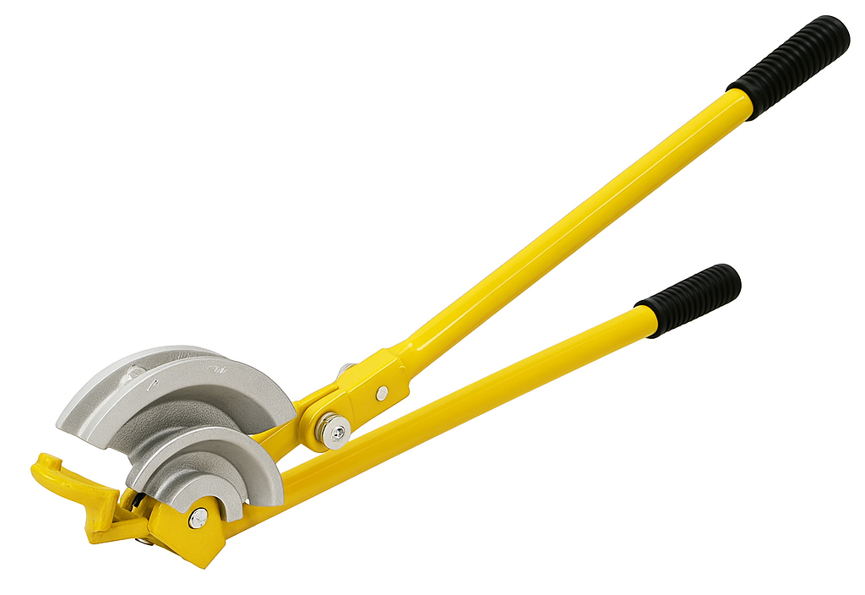
Manual pipe bender – parts overview
Formers (15mm & 22mm)
Angle guides
Arms
Hook
Roller (one on each side)

Slide 7
Offset bends – what are they?
Offsets allow pipes to navigate around obstacles. Consist of two equal bends (usually 45°).
Offset height and spacing must be calculated.
Precision is key to alignment.

Slide 8
Step-by-step offset bend
Let’s calculate the exact amount of pipe required for the offset below, assuming the offset will be equal both ends.
290mm
50mm
A
45°

Slide 9
Step 1
290mm
50mm
A
45°
Step 1
The offset angle is 45°, therefore, sides a & b of the triangle are equal. So the middle section of the offset occupies 50mm.
45°
c
b
45°
a

Slide 10
Step 2
290mm
C
Step 2
The required offset length is 290mm, so we take the 50mm from 290mm
This leaves 240mm, which we then split evenly for sections A & C
(290 – 50) / 2
B
50mm
A
45°
50mm

Slide 11
Step 3
A = (290 – 50) / 2
= 120mm
B = 50 x 1.414
= 70.7mm
C = (290 – 50) / 2
= 120mm
Total = 310.7mm
290mm
120mm
C
70.7mm
B
50mm
Step 3
The offset angle is 45° and sides a & b of the triangle are equal.
The quick method to calculate side c of the triangle is to multiply the clearance (50mm) by 1.414.
50 x 1.414
120mm
45°
A

Slide 12
Examples
1
290mm
A =
B =
C =
Total = ………………………….
Calculate the required length for the following examples.
50mm
45°
2
320mm
A =
B =
C =
Total = ………………………….
60mm
45°

Slide 13
Examples
3
A =
B =
C =
Total = ………………………….
375mm
Calculate the required length for the following examples.
75mm
45°
4
405mm
A =
B =
C =
Total = ………………………….
90mm
45°

Slide 14
Answers
1
270mm
A = 110mm
B = 70.7mm
C = 110mm
Total = 290.7mm
Calculate the required length for the following examples.
50mm
45°
2
320mm
A = 130mm
B = 84.84mm
C = 130mm
Total = 344.84mm
60mm
45°

Slide 15
Answers
3
A = 150mm
B = 106.05mm
C = 150mm
Total = 406.05mm
375mm
Calculate the required length for the following examples.
75mm
45°
4
405mm
A = 157.5mm
B = 127.26mm
C = 157.5mm
Total = 442.26mm
90mm
45°

Slide 16
Step by step – offset fabrication
Here is a step by step guide of the fabrication process for the offset in the first example.
290mm
50mm
45°

Slide 17
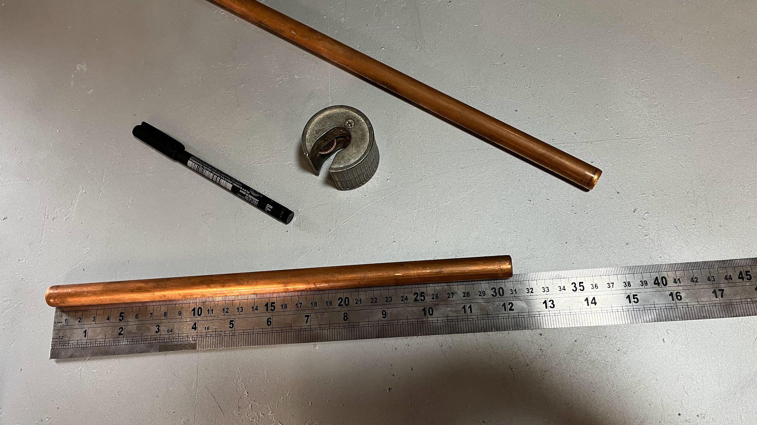
Offset fabrication: Step 1
Mark and cut the pipe to the calculated length (310.7mm in this case).

Slide 18
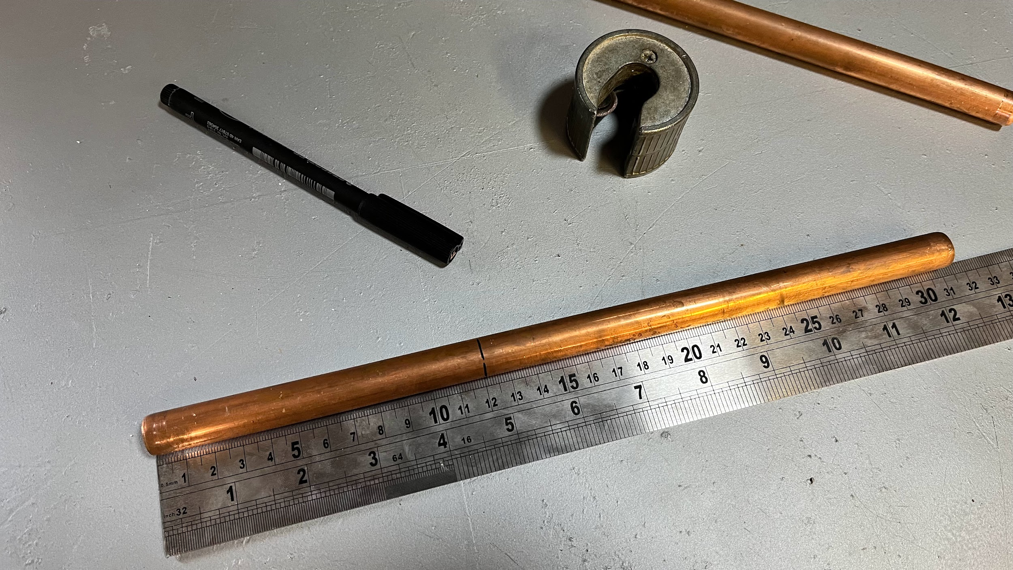
Offset fabrication: Step 2
Mark the first bending point (120mm in this case).

Slide 19
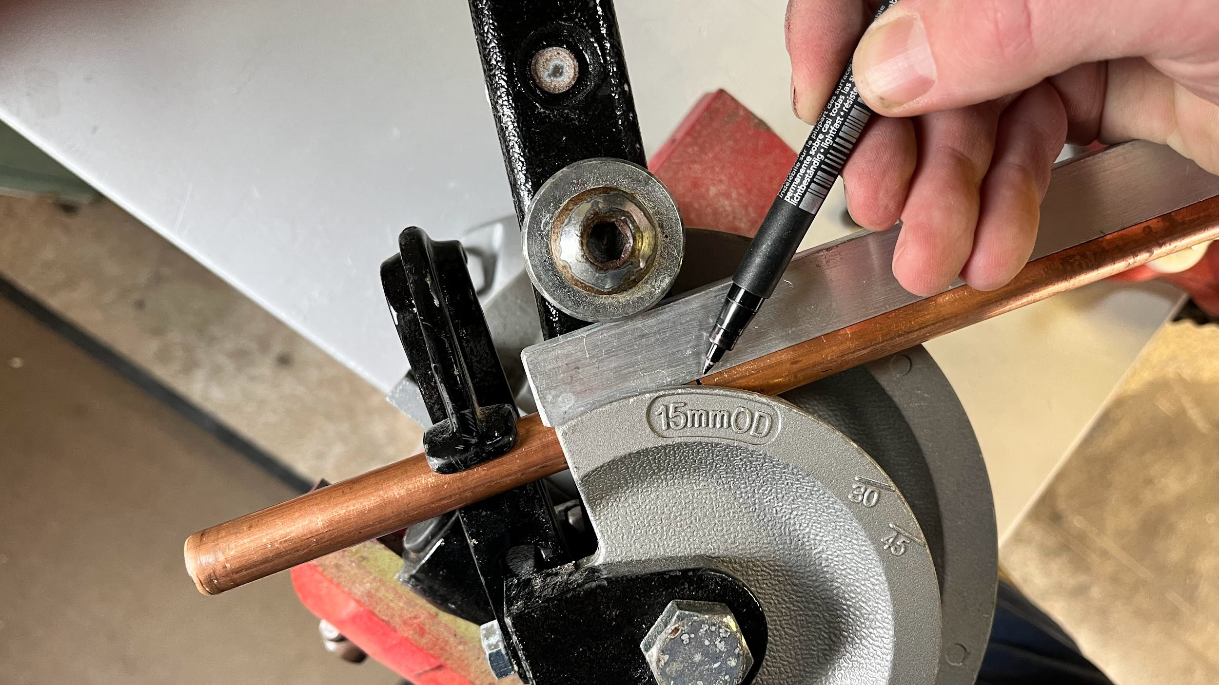
Offset fabrication: Step 3
Place the measured end into the hook of the benders and place your mark on the pivot point (essentially where the guide and former almost meet – indicated here by the pen).

Slide 20
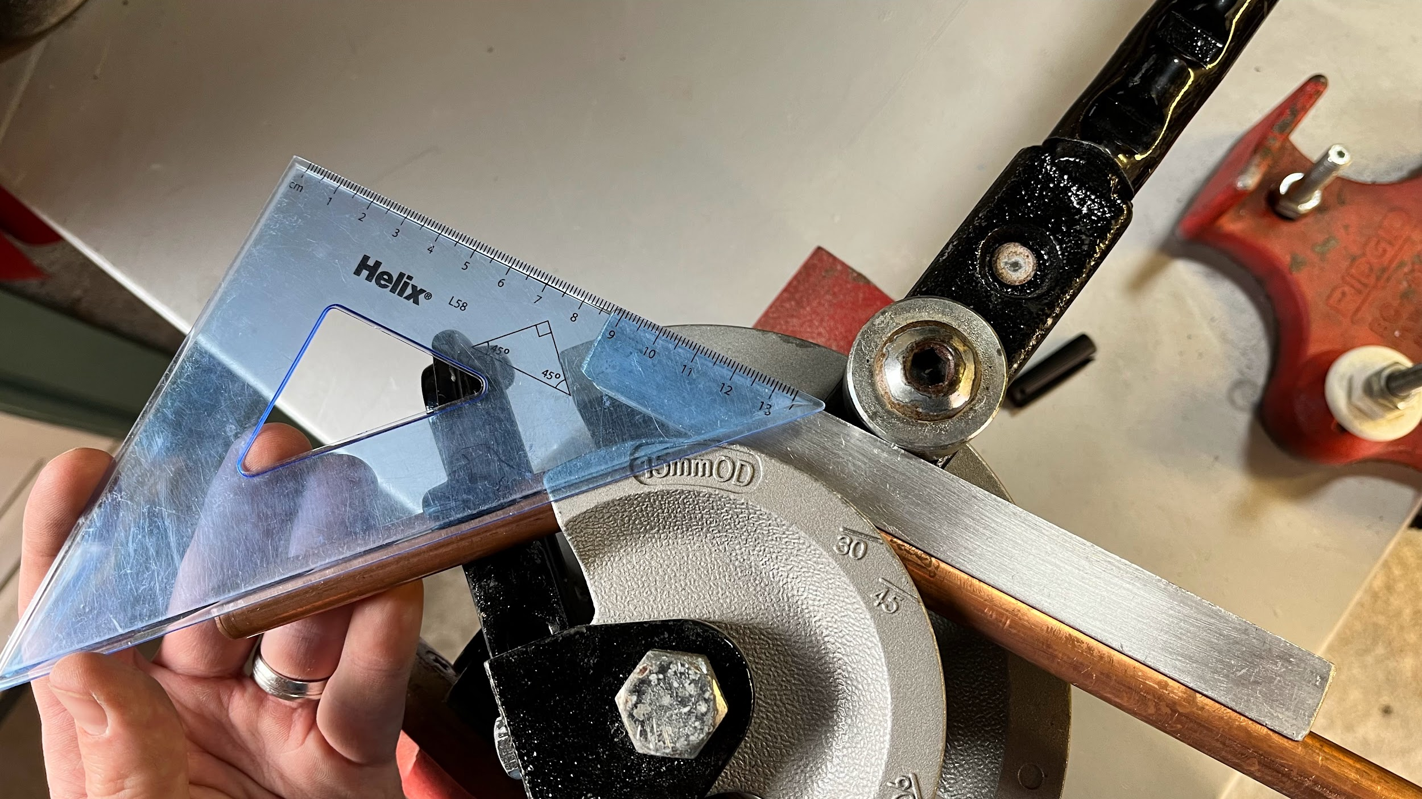
Offset fabrication: Step 4
Bend the pipe until 45°. Check your angle with a digital angle finder or any suitable angle finding tool.

Slide 21
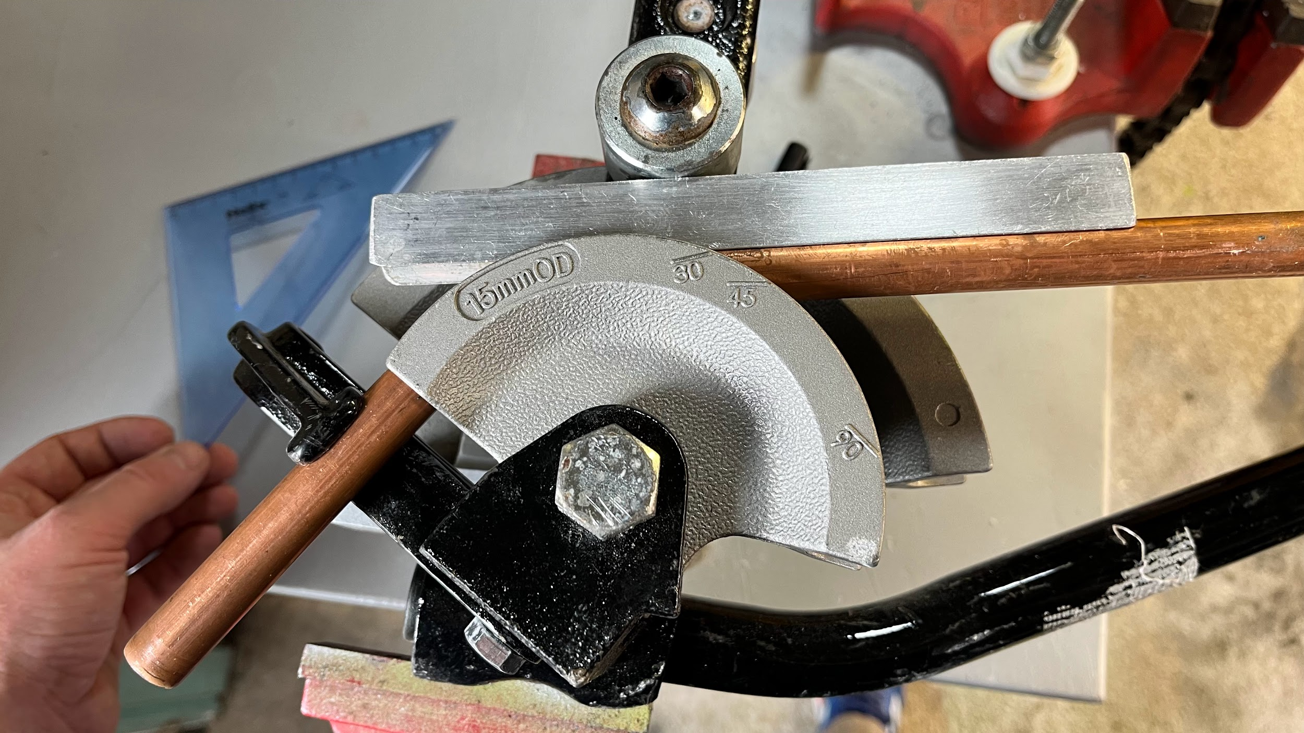
Offset fabrication: Step 4 (alternative)
Many hand benders have angle indicators ready marked on the former.
Alternatively, installers often mark their own benders with pen or hacksaw grooves to assist them with certain angles.

Slide 22
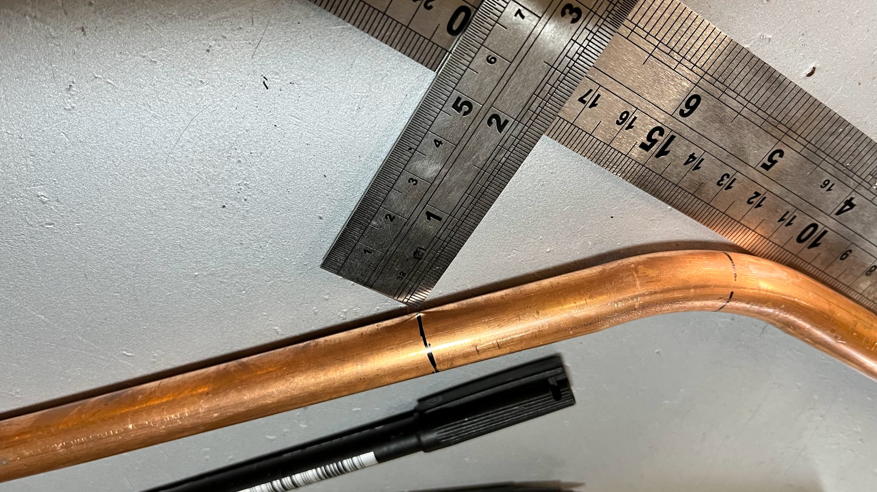
Offset fabrication: Step 5
Now you need the mark the second bending point.
You can either measure up from the base of the first bend (50mm in this case).

Slide 23
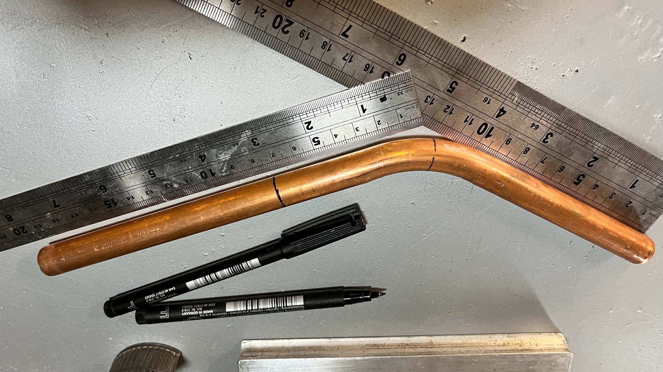
Offset fabrication: Step 5 (alternative)
Or you can measure from the first point along the hypotenuse (70.7mm in this case).
If both methods lead you to the same point, this means your angle is spot on!

Slide 24
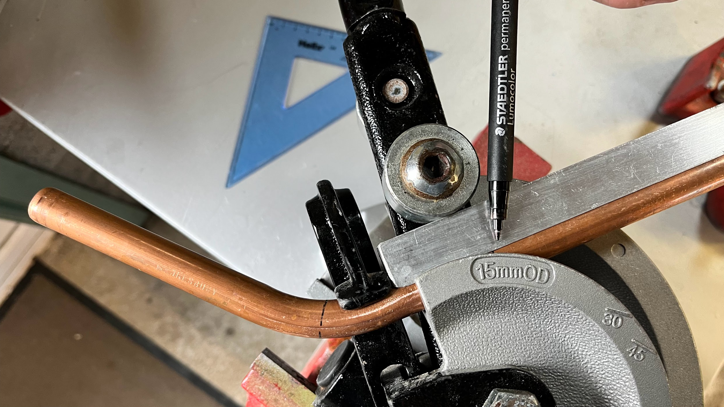
Offset fabrication: Step 6
The second mark is placed into the former at the pivot point.
Don’t forget to align your first bend – it must not kick to one side.
Also note - the first bend should always be in the hook – not behind the bend!
First bend

Slide 25
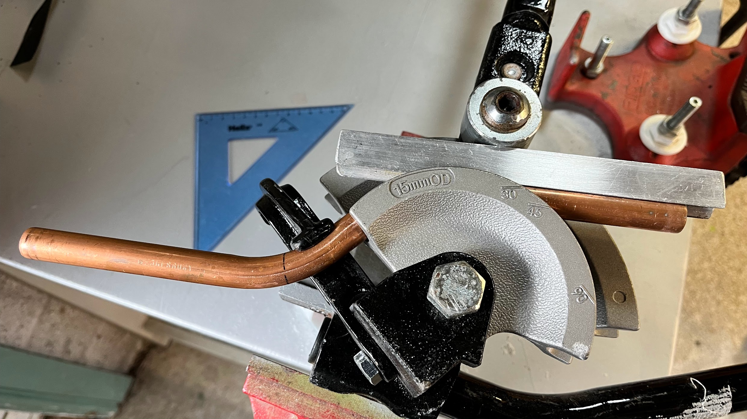
Offset fabrication: Step 7
Pull the second bend until it is parallel with the first.
If the second angle is under pulled, you can always put the pipe back into the benders to make adjustments – don’t risk using your knees!
First bend

Slide 26
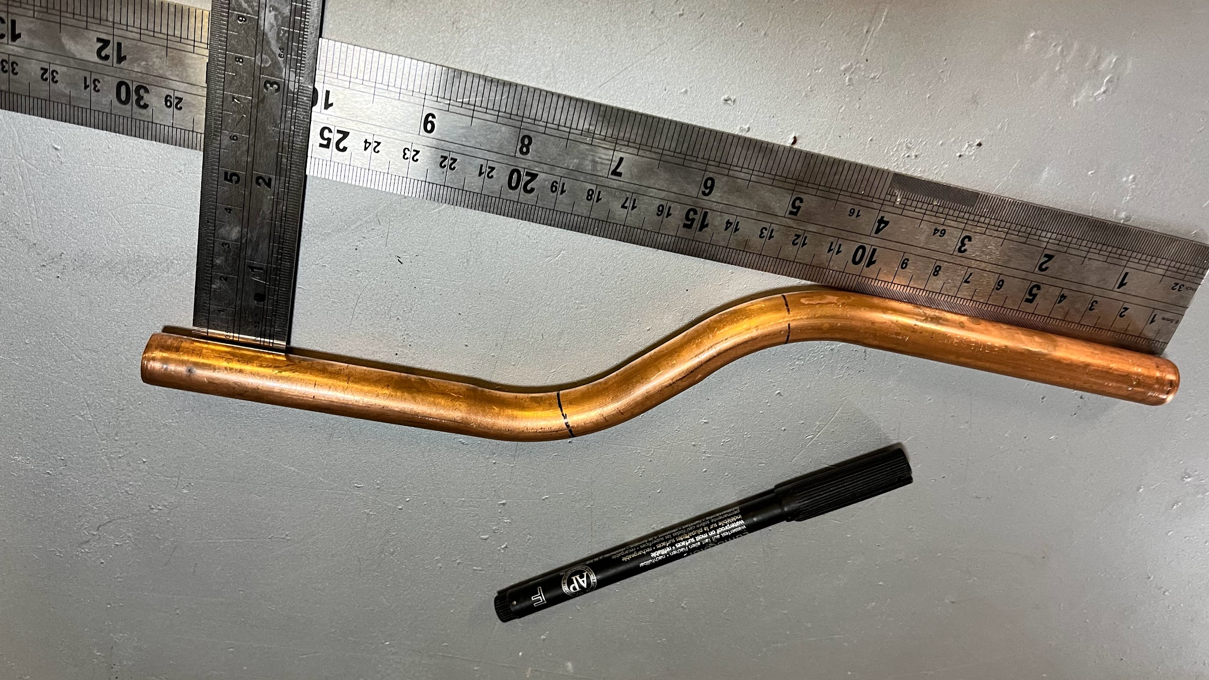
Offset fabrication: Step 8
Check your measurements.
You should now have a 290mm offset with a clearance of 50mm!

Slide 27
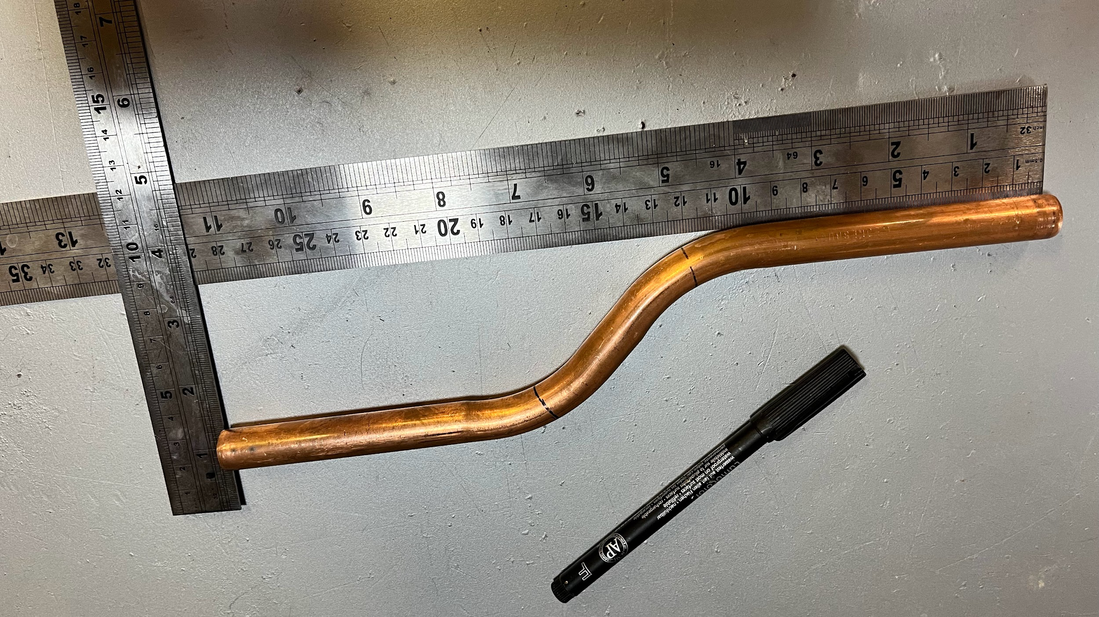
Offset fabrication: Outcome

Slide 28
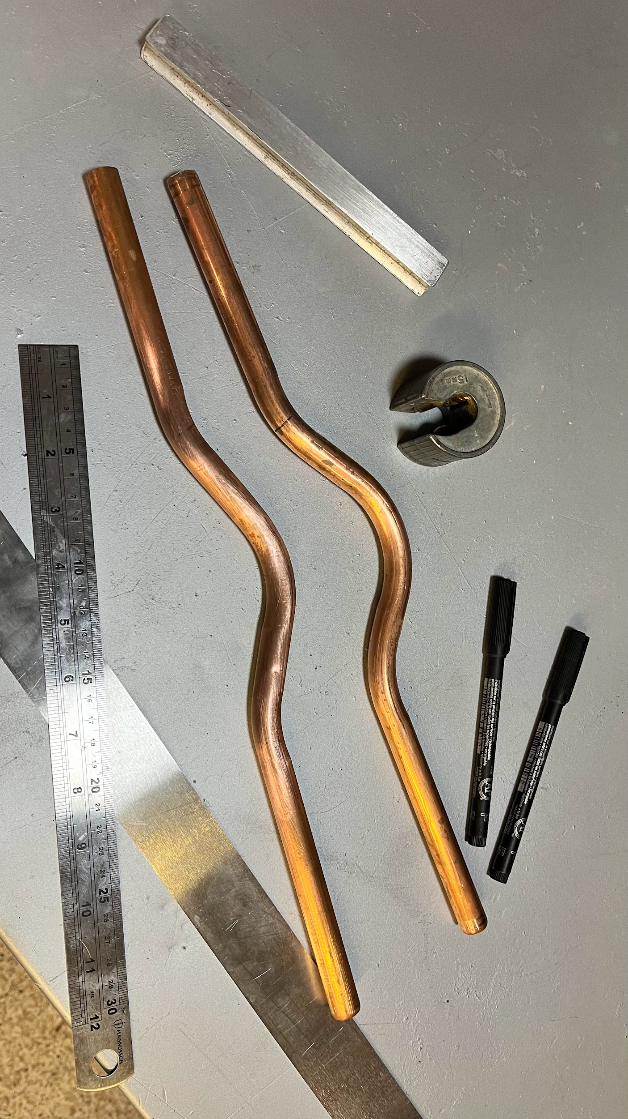
Passovers explained
Passovers allow a pipe to ‘pass-over’ obstacles and return to their original path. Fabrication of these bends can save time and money and avoid unnecessary disruption to an installation.
The bend consists of three parts and can clear large obstacles and look very impressive and neat when constructed accurately.

Slide 29
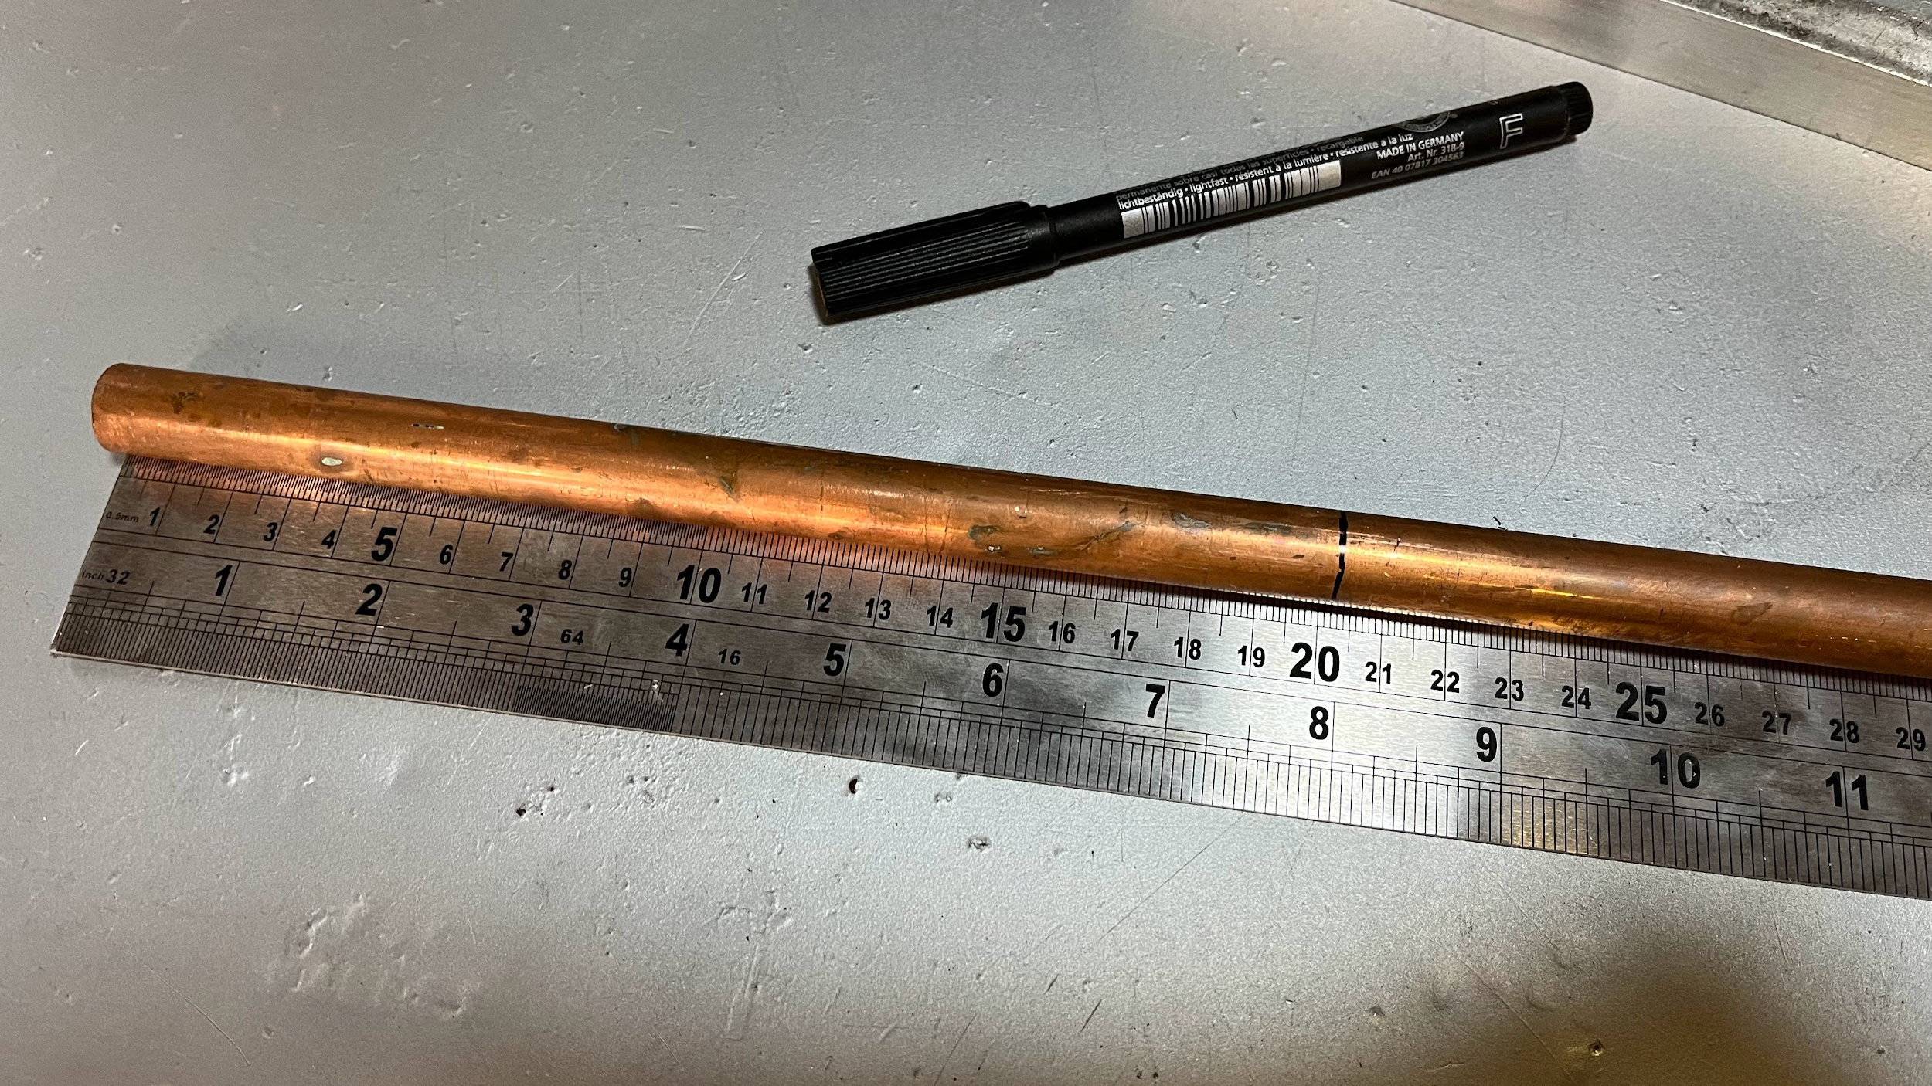
Passover fabrication: Step 1
Here is a step by step guide of the fabrication process for a passover with a 30mm clearance at 200mm.
Mark the pipe to the length of the obstacle – 200m in this case.

Slide 30
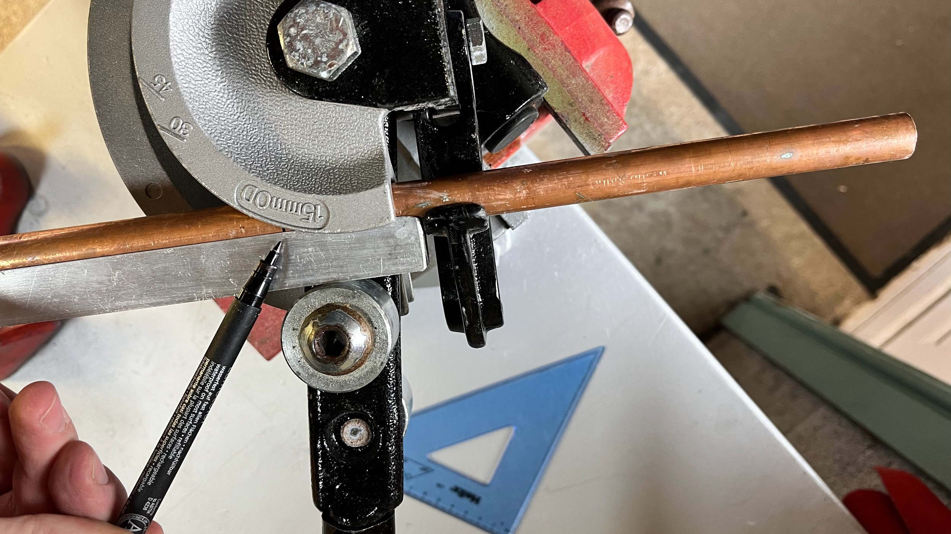
Passover fabrication: Step 2
Place the 200mm mark at the pivot point.
The measured end must be in the hook.
Measured end

Slide 31
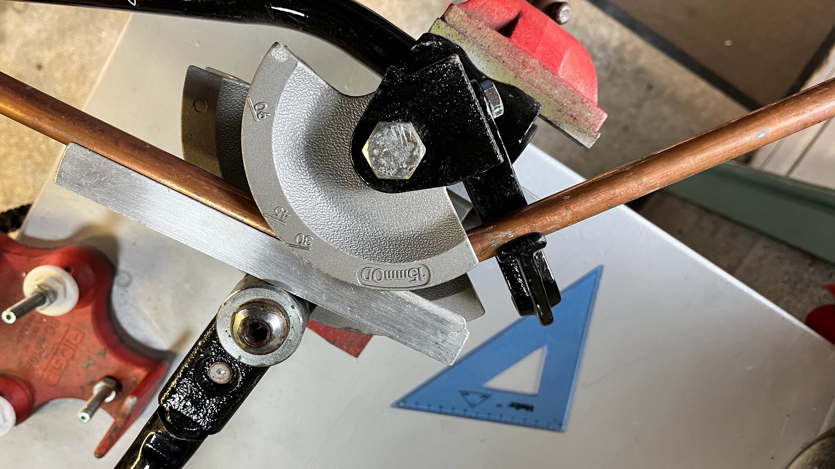
Passover fabrication: Step 3
Bend to 45°.
A bigger clearance would require a larger angle – possibly 60° or even 90°.

Slide 32
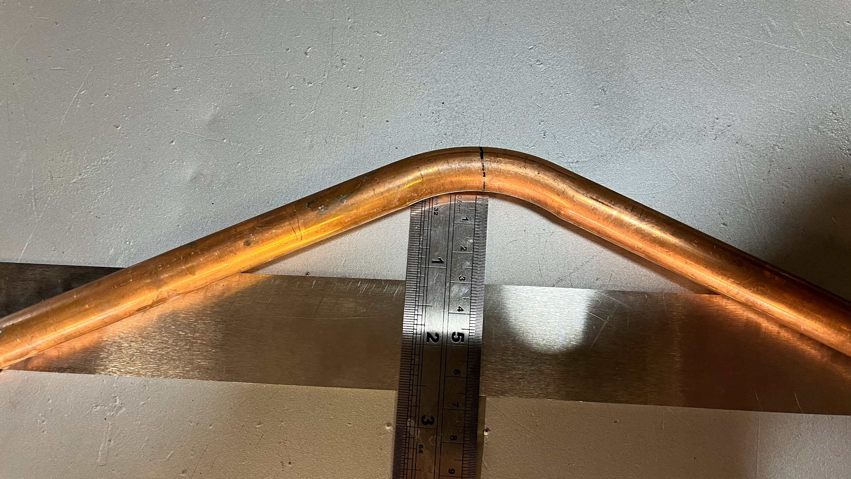
Passover fabrication: Step 4
Position the bend on a straight edge (such as a ruler or edge of a workbench).
Ensure the angle is even on both sides (the bend isn’t favouring one side).
Position the bend so the desired clearance is present (30mm in this case).

Slide 33
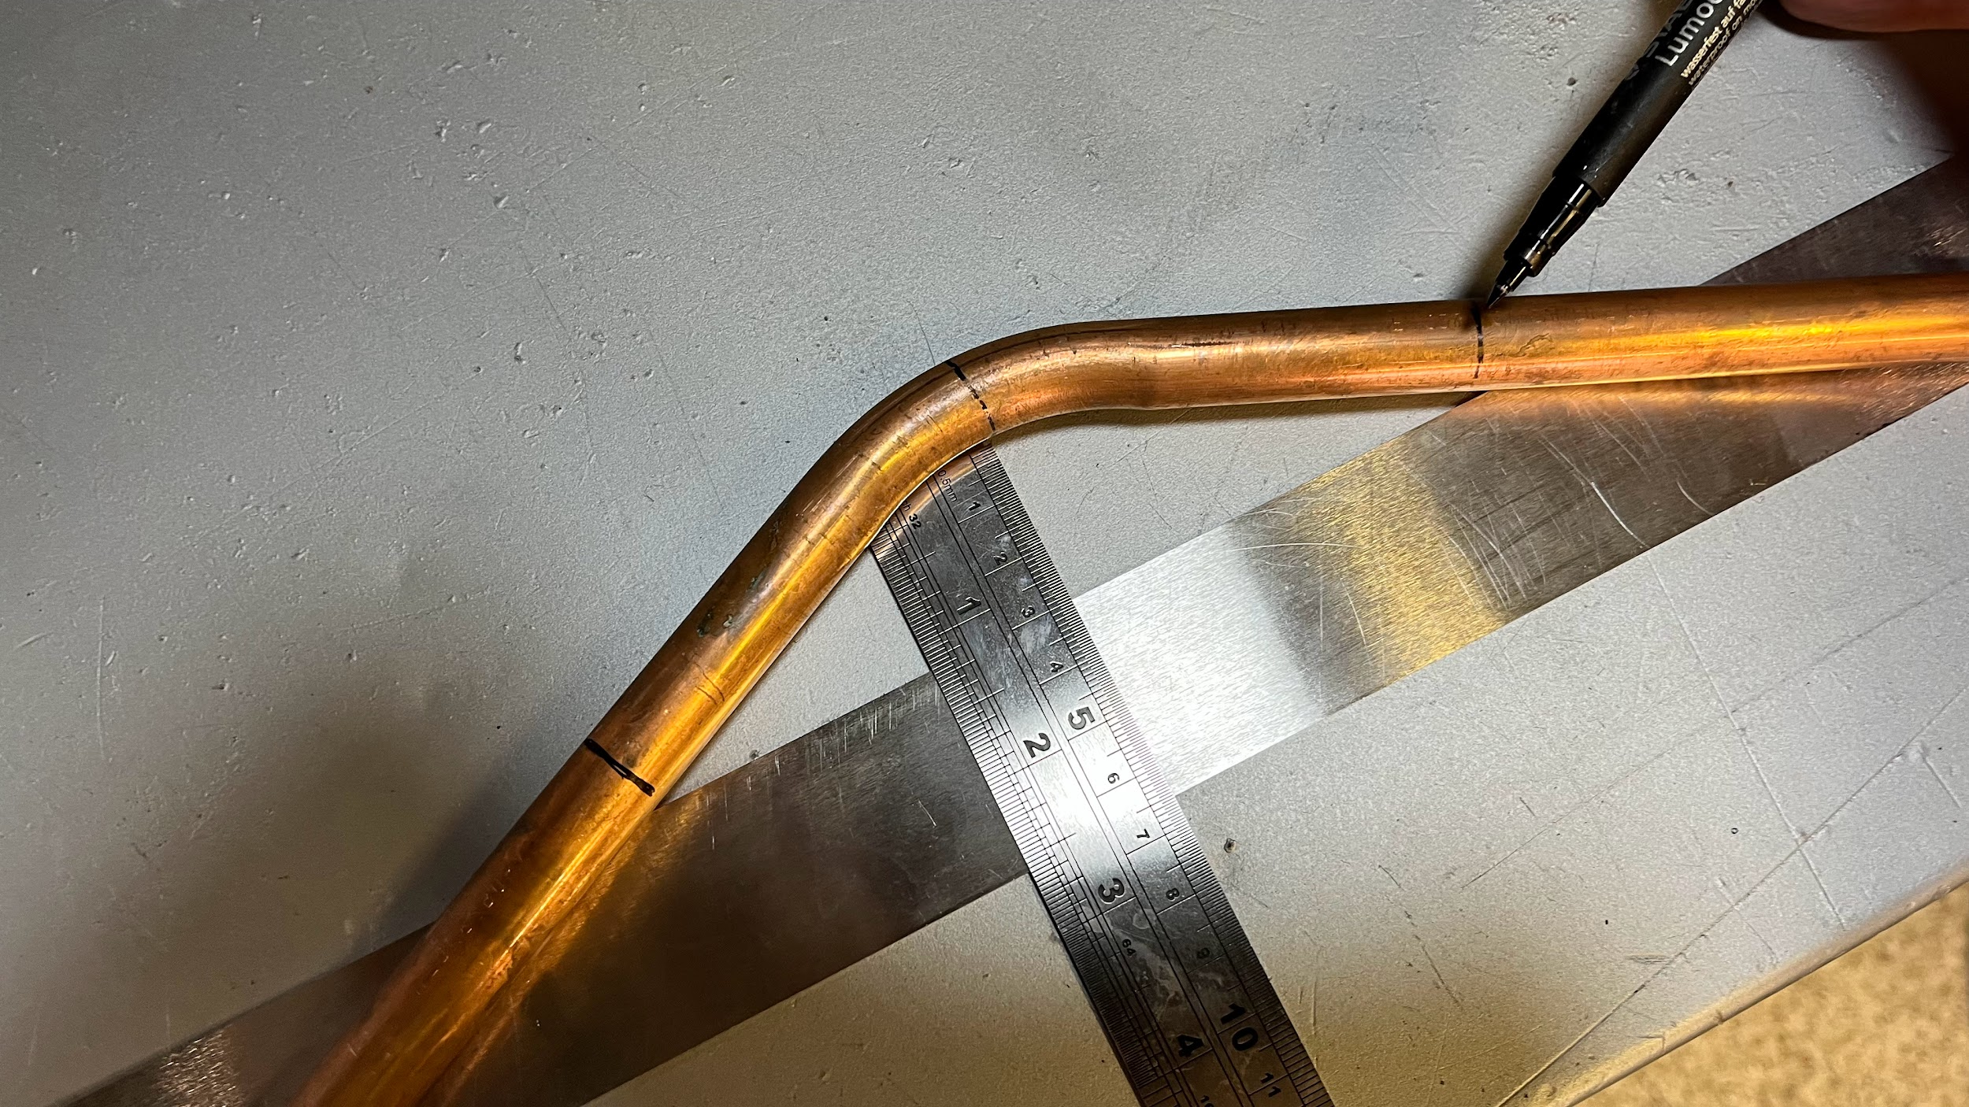
Passover fabrication: Step 5
Without moving the bend – mark where both sides of the copper touch the straight edge.
Start the mark from the touch point and continue to mark across the pipe.

Slide 34
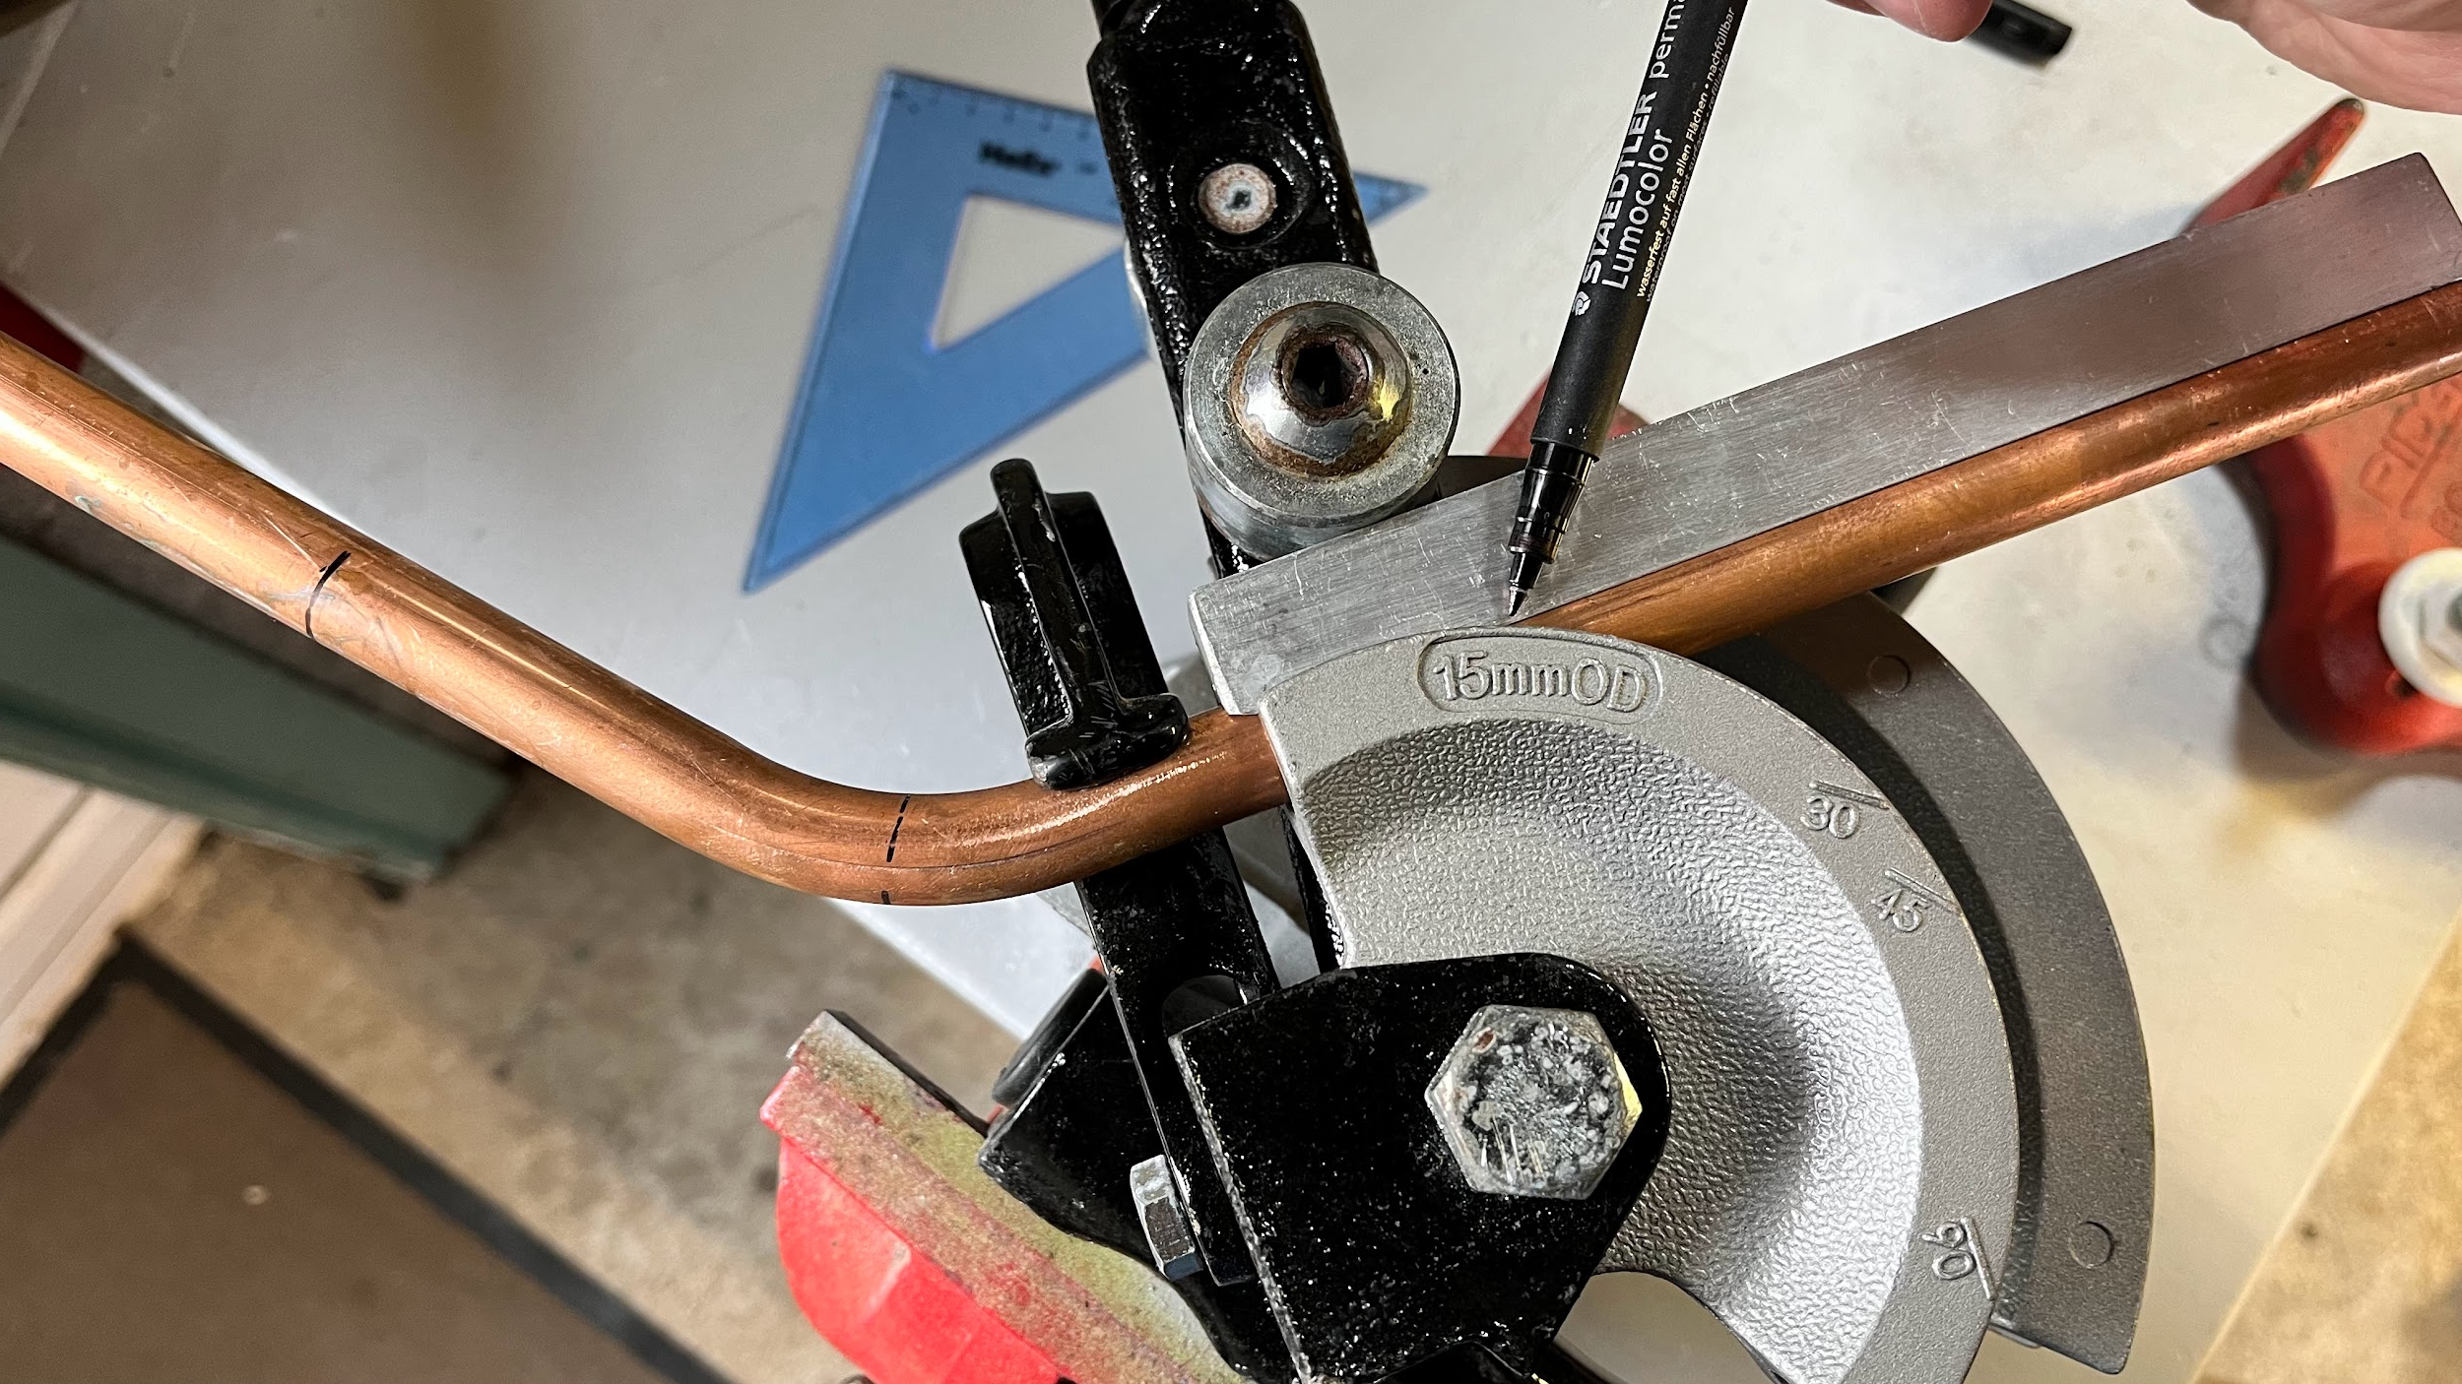
Passover fabrication: Step 6
Now place the pipe into the benders and line up one of the marks (either one will do) with the pivot point.
Check alignment and bend the pipe until the pulled side is aligned with the final mark.
Pulled side

Slide 35
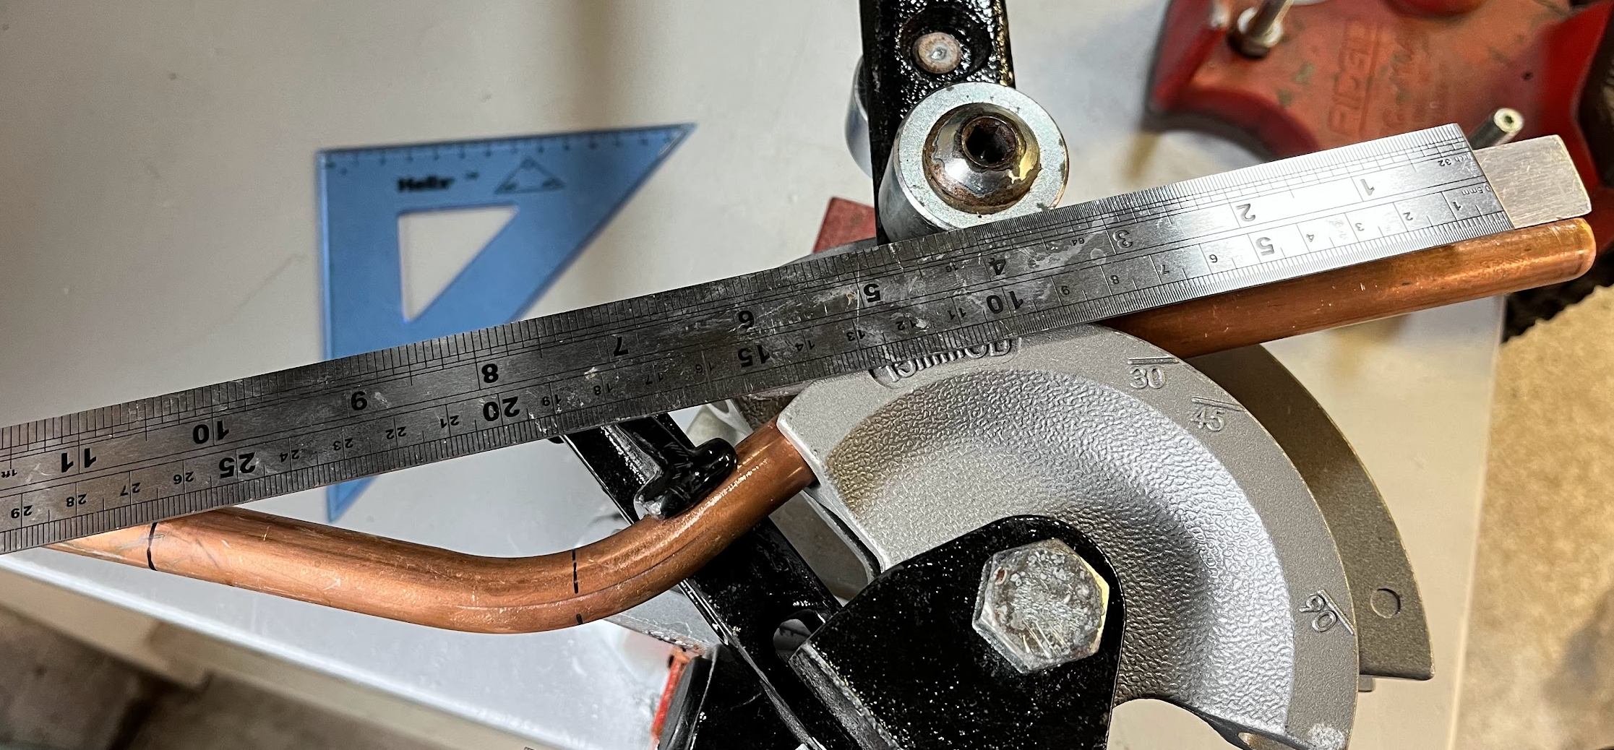
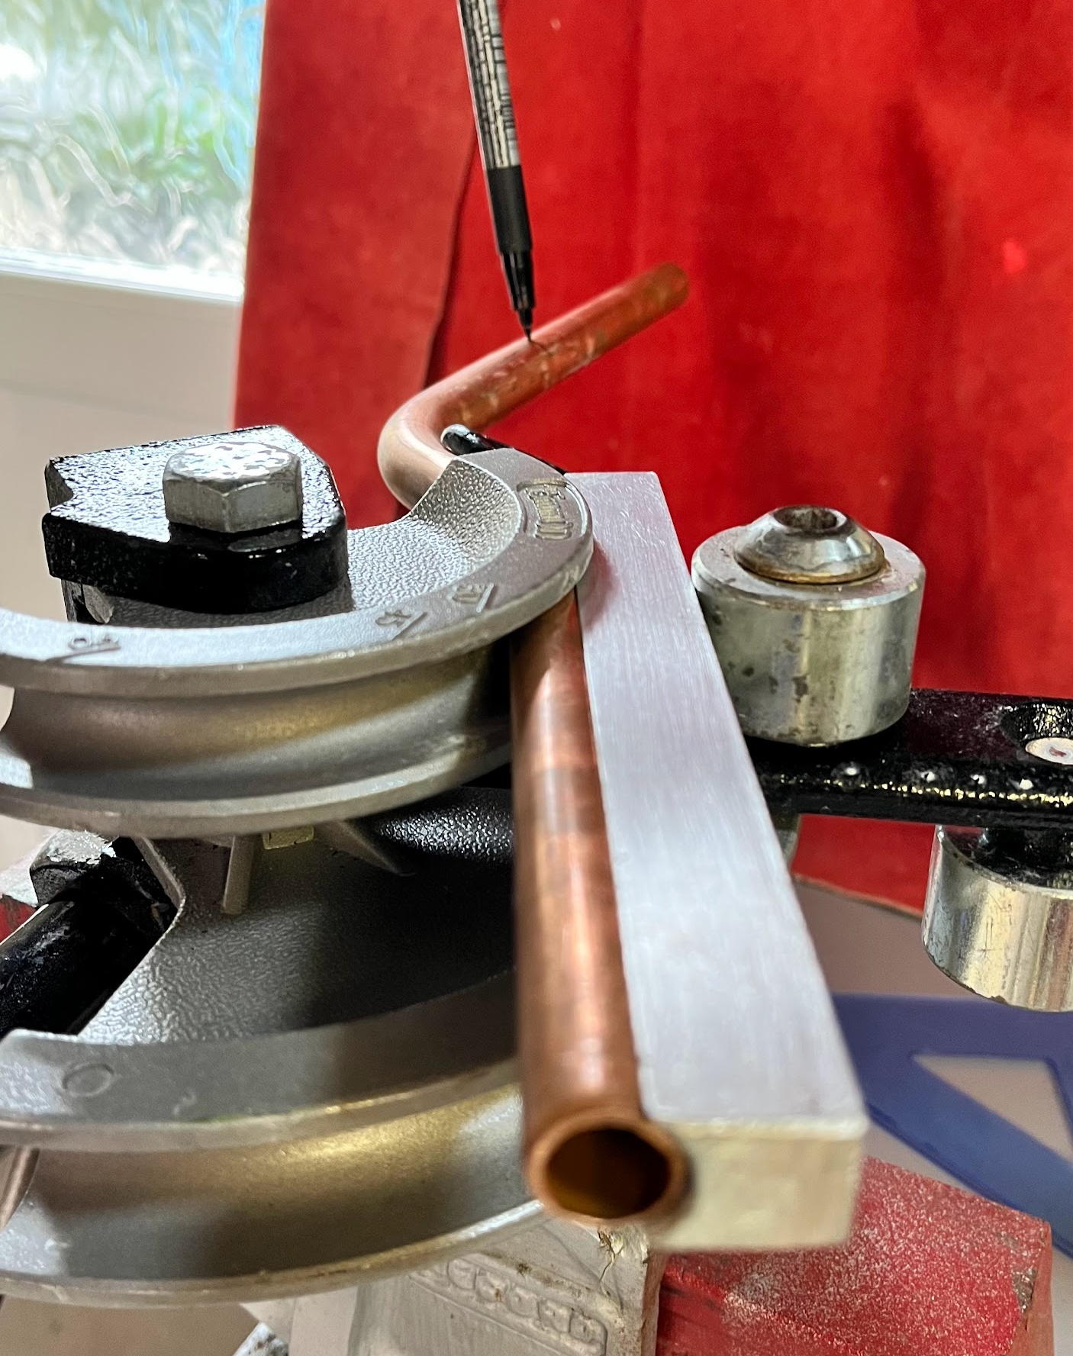
Passover fabrication
Here is the desired outcome – the angle is not important – you’re aiming for the final mark.

Slide 36
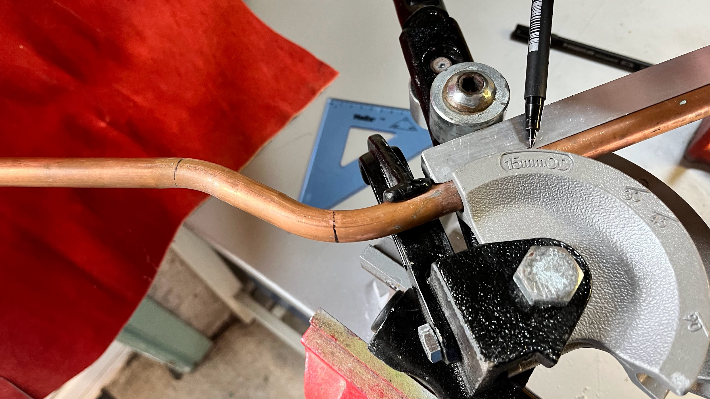
Passover fabrication: Step 7
Now place the first two bends into the hook and place the final mark at the pivot point.
Check alignment and bend until both sections are parallel.

Slide 37
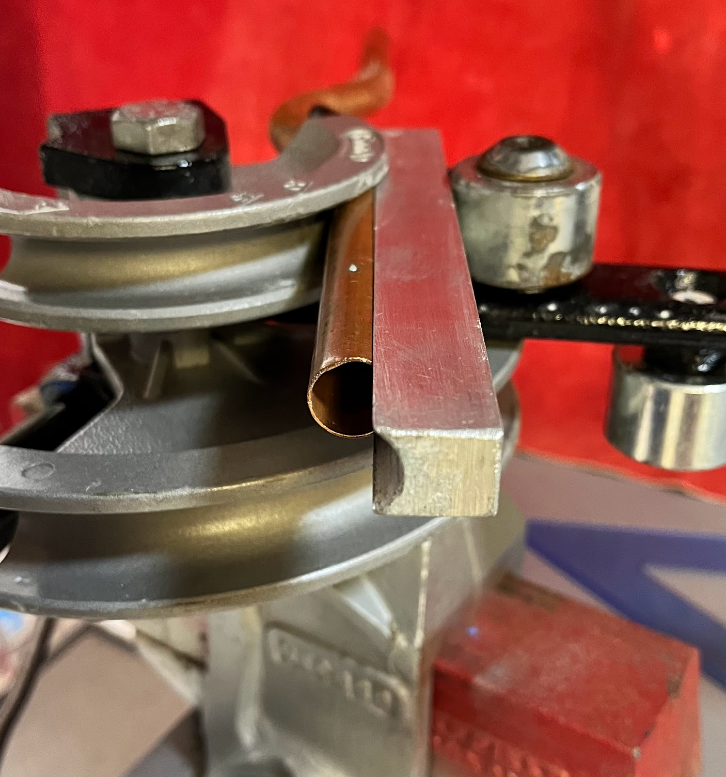
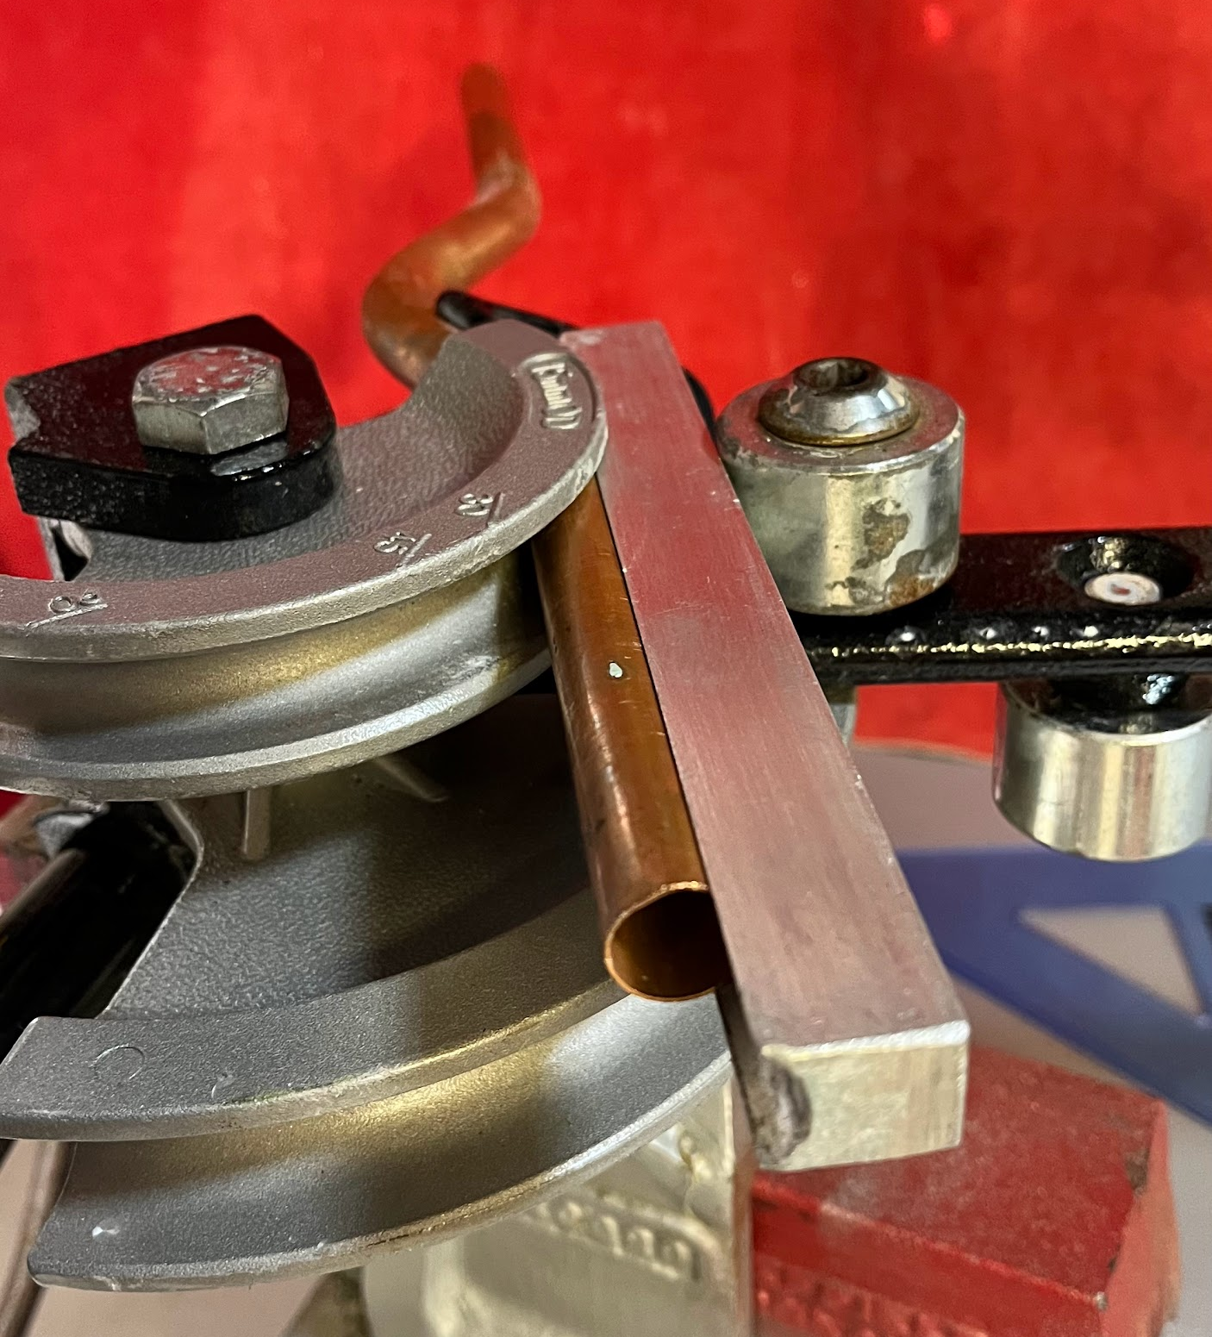
Passover fabrication
Here is the desired outcome.
Once again, the angle is not important – you’re aiming to get both pipes running parallel.

Slide 38
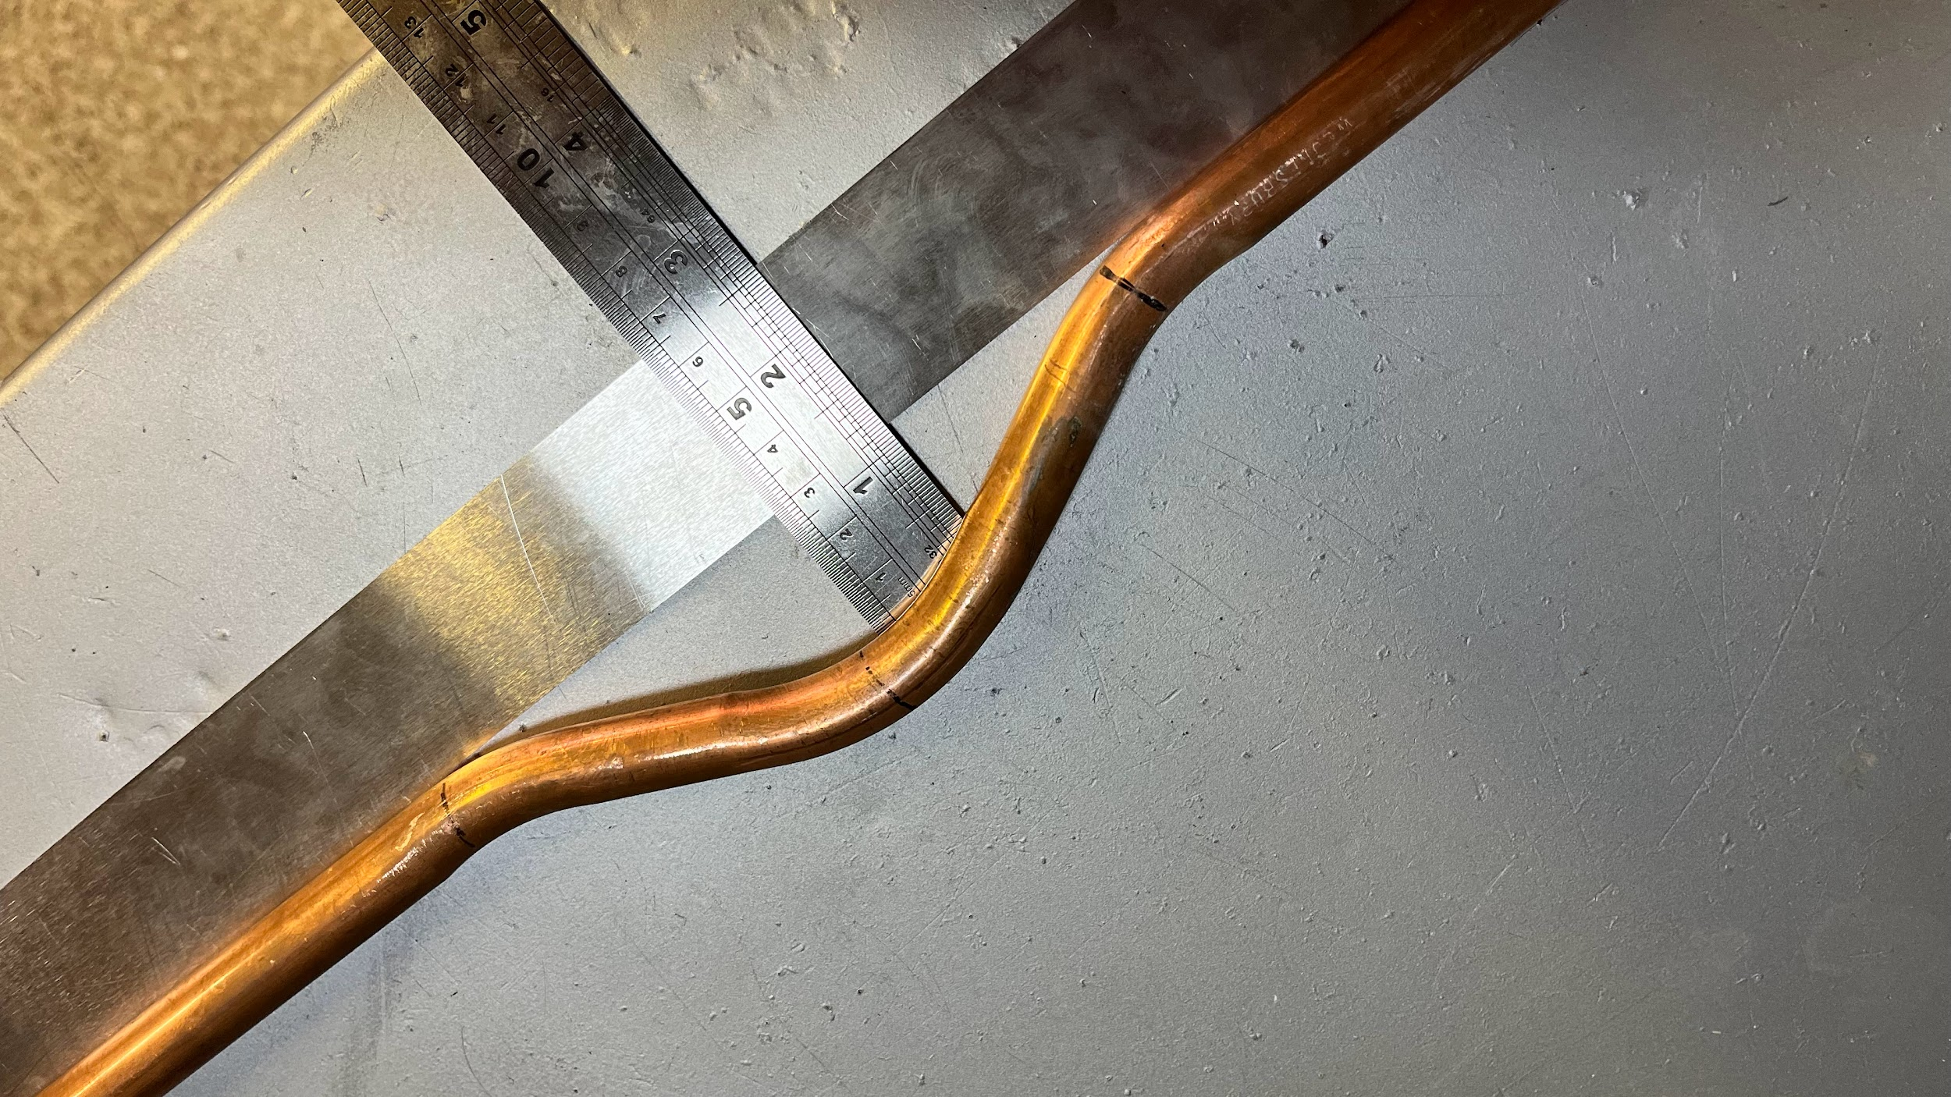
Passover fabrication: Step 8
Check the clearance, bend alignment and angles.
If any tweaks are required, place the bend back into the machine for minor adjustments – avoid using your knee or a flat surface as this may cause injury or damage the pipe.

Slide 39
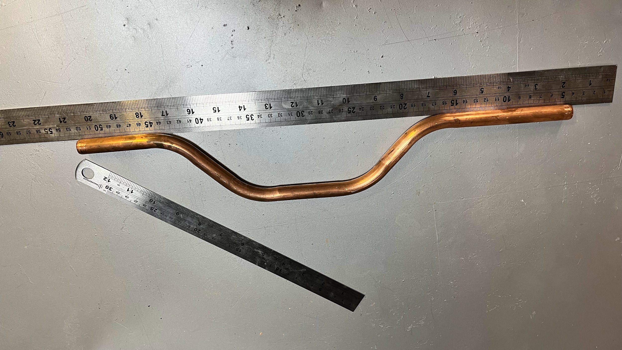
Double offset or offset passover
An offset passover may be required to avoid a long obstacle or multiple pipes. The principle of fabrication is identical to an offset, but features two offsets in the same run, returning to the original line or pipe run.
The calculations of the offset apply to offset passovers and the key component is equal angles – if you start with a 45°, then you should generally continue this angle for the remaining 3 bends.

Slide 40
Knowledge check
What is a passover used for?
What’s the difference between R220 and R290?
Why is it important to calculate offset distances?
What tools would you need alongside a hand bender?
How does bending reduce the risk of system leaks?

Slide 41
Knowledge check – answers
To route a pipe over another.
R220 is soft, R290 is hard and not bendable.
It ensures pipes align properly and reduces waste.
Correct pipe guide, clean former, steel rule, angle finder and thin-tipped marker.
Fewer joints and fittings are required – less risk.

Slide 42
Summary
You should now be able to:
Recall the main types of copper pipe bending tools.
Explain the process for creating offsets and passovers.
You might also be able to:
Calculate accurate offset lengths for installation.
Plan and prepare complex pipe runs using double offsets and passovers.
Assess and select the appropriate copper grade and tool for each job.

Slide 43
Any questions?
Copyright in this document belongs to and is used under licence from the Department for Education, © 2025.
‘T-LEVELS’ and ‘T Level’ are registered trademarks of the Department for Education.
WJEC is authorised by the Department for Education to develop and deliver this T Level Technical Qualification.
WJEC operates in England under the name Eduqas which is a registered trademark of WJEC.

