Slide 1
Occupational Specialism: Plumbing & Heating Engineering
K1.32 Bending techniques
Bending techniques: 90° bends in copper pipe to length using machine and spring

Slide 2
Starter
Warm-up:
Why might precision be especially important when bending copper pipework?
What are the benefits of bending pipe efficiently?
Share any personal experience you have using a pipe bender.
Notes:
Tutor to link to WRAS compliance and efficiency etc.

Slide 3
Objectives
You should be able to:
Identify types of bending equipment.
Demonstrate how to bend copper pipe to a precise 90°
You might also be able to:
Explain the importance of accuracy and safety.
Evaluate the advantages and limitations of different bending techniques.

Slide 4
Why do we bend pipe?
To change direction of pipe runs.
To reduce the need for fittings and joints.
To ensure neat, compact, and safe installations.
To save cost and time in labour and materials.

Slide 5
Safety considerations
Wear PPE: gloves, goggles.
Use correct grip and technique – free-hand bending (vice bending limits skill development and effectiveness in real world installations).
Ensure bending springs and machines are undamaged – don't use if damaged.
Watch for recoil or pipe slippage.

Slide 6
Tools for bending copper
Hand benders (lever-type).
Bending springs (internal/external).
Hydraulic/electric benders (for larger pipes).
Notes:
Note to tutor: Show examples of these tools online or in class.

Slide 7
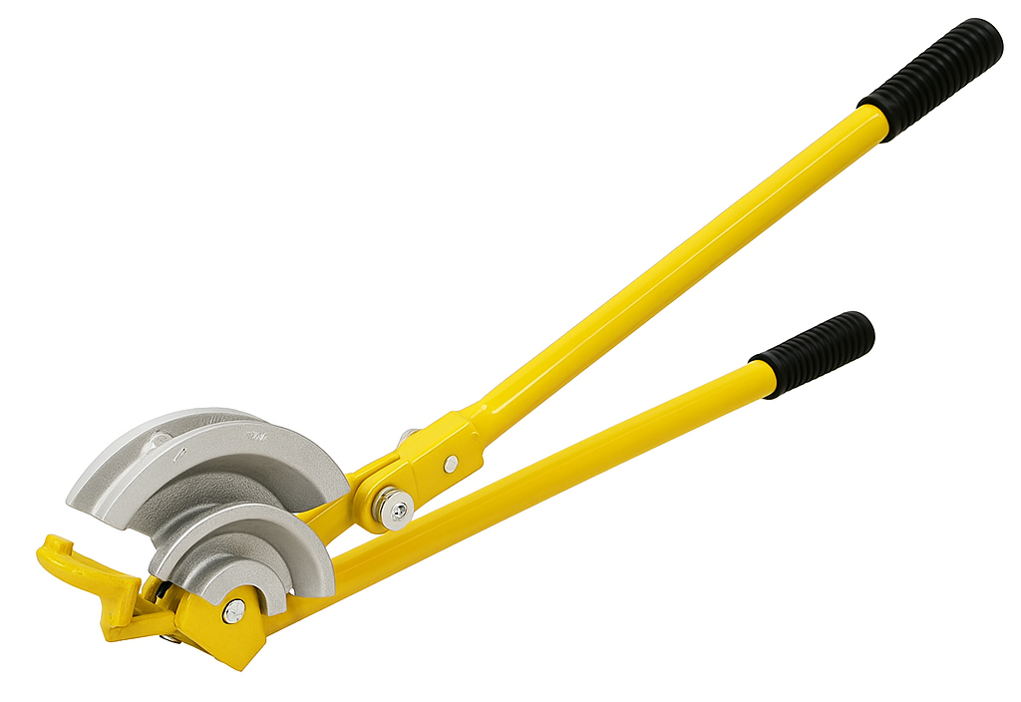
Manual pipe bender – parts overview
Formers (15mm & 22mm)
Angle guides
Arms
Hook
Roller (one on each side)

Slide 8
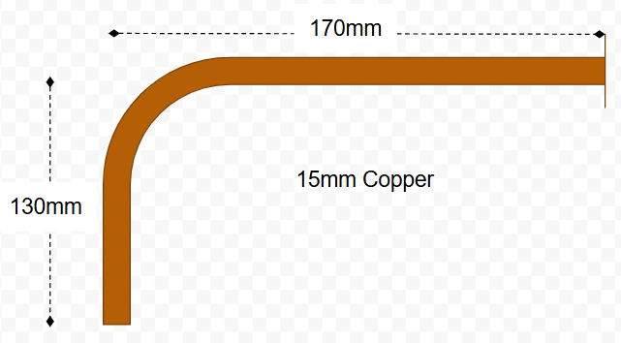
Calculations and bending guide
How much pipe is required to form this 90° bend?

Slide 9
Calculations and bending guide
Given the centre-to-end measurements shown, the actual length of pipe required would be shorter than some of the end-to-centre measurements due to the ‘shortcut’ taken by the pipe in order to achieve the 90-degree bend.

Slide 10
Calculations and bending guide
You may assume that to form the bend above, you would simply calculate 130mm + 170mm = 300mm.
The actual length required will be shorter due to the path taken by the radius of the bend (plus a small stretch).

Slide 11
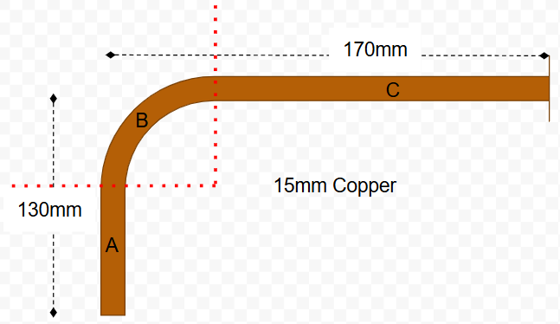
Calculations and bending guide: Step 1
Split the pipe into 3 sections:
a straight section
the bend
the remaining straight section.

Slide 12
Calculations and bending guide: Step 2
Deduct 4 times the pipe diameter from section A (the diameter in this example being 15mm).
So, the calculation is:
Section A length – (4 x d)
130mm – (4 x 15mm) = 70mm

Slide 13
Calculations and bending guide: Step 3
Calculate the centreline length (length of a 90-degree bend) as previously described. Note that Pi or π is 3.14.
The calculation is:
4 x diameter x ½ π
4 x 15mm x 1.57 = 94.2mm

Slide 14
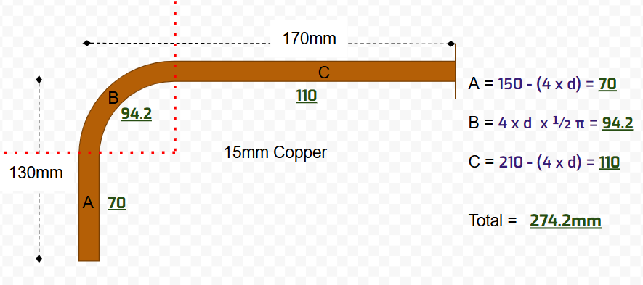
Calculations and bending guide: Step 4
Repeat step 2 with section C:
170 – (4 x 15) = 110mm
Add the 3 calculated measurements to find your total length required (274.2mm).

Slide 15
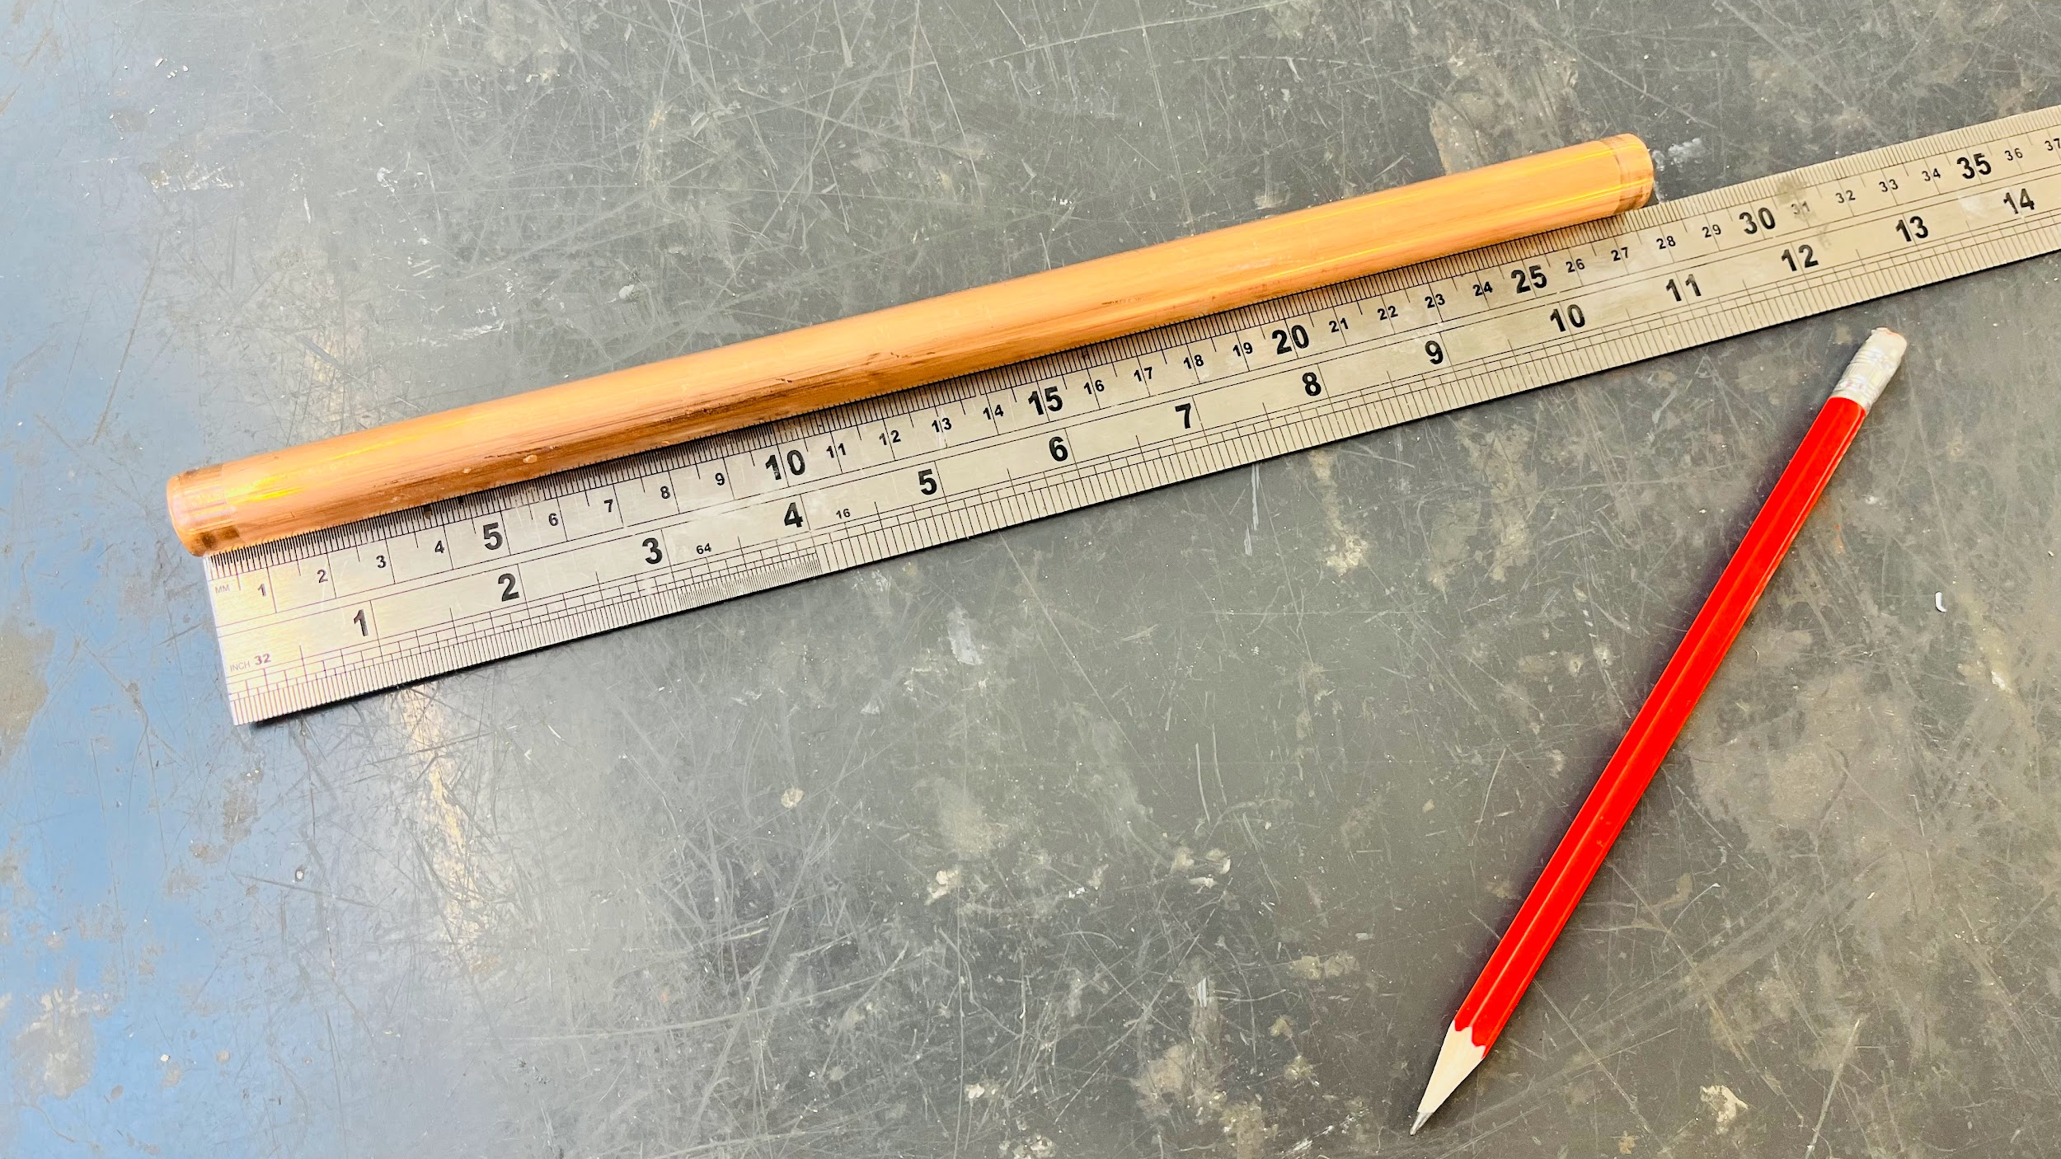
Fabrication – 15mm copper only: Step 1
Once we have calculated the required length, we can begin the fabrication as follows.
Cut the pipe to the desired length (274.2mm in this case).

Slide 16
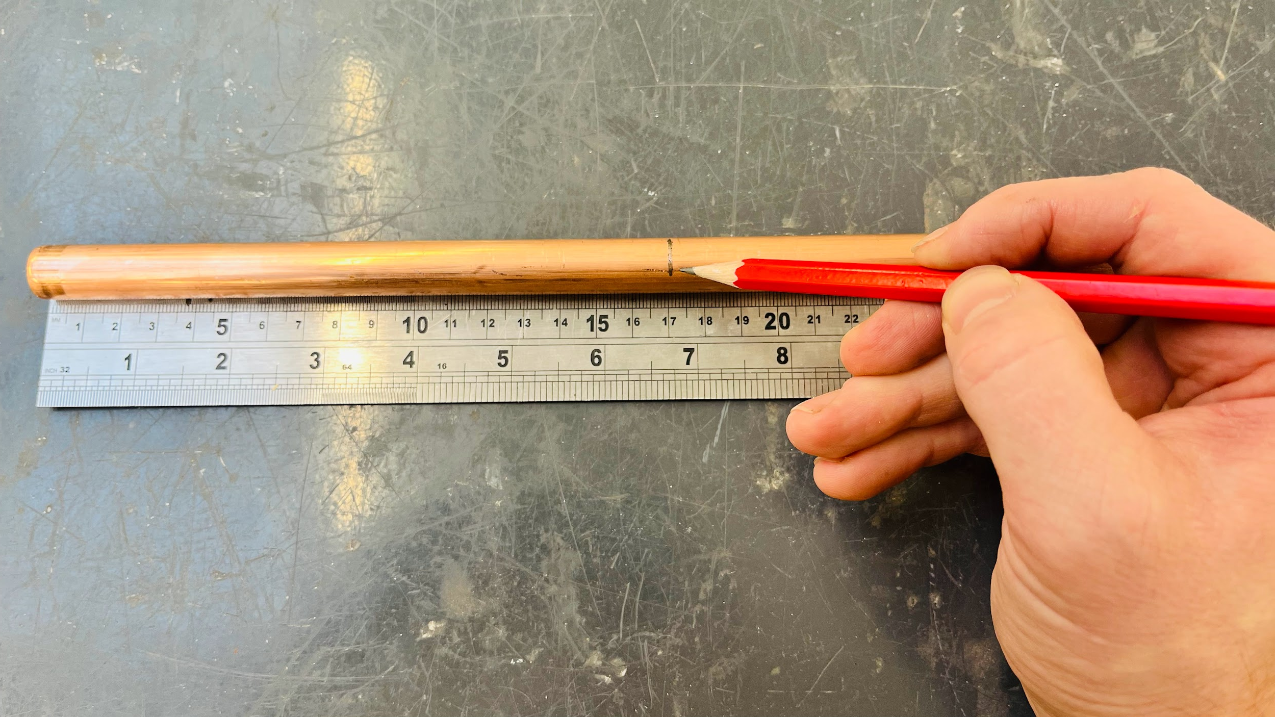
Fabrication – 15mm copper only: Step 2
Choose one of the original lengths (the desired length – 130mm or 170mm).
In this example, we will choose 170mm.
Mark the pipe at 170mm.

Slide 17
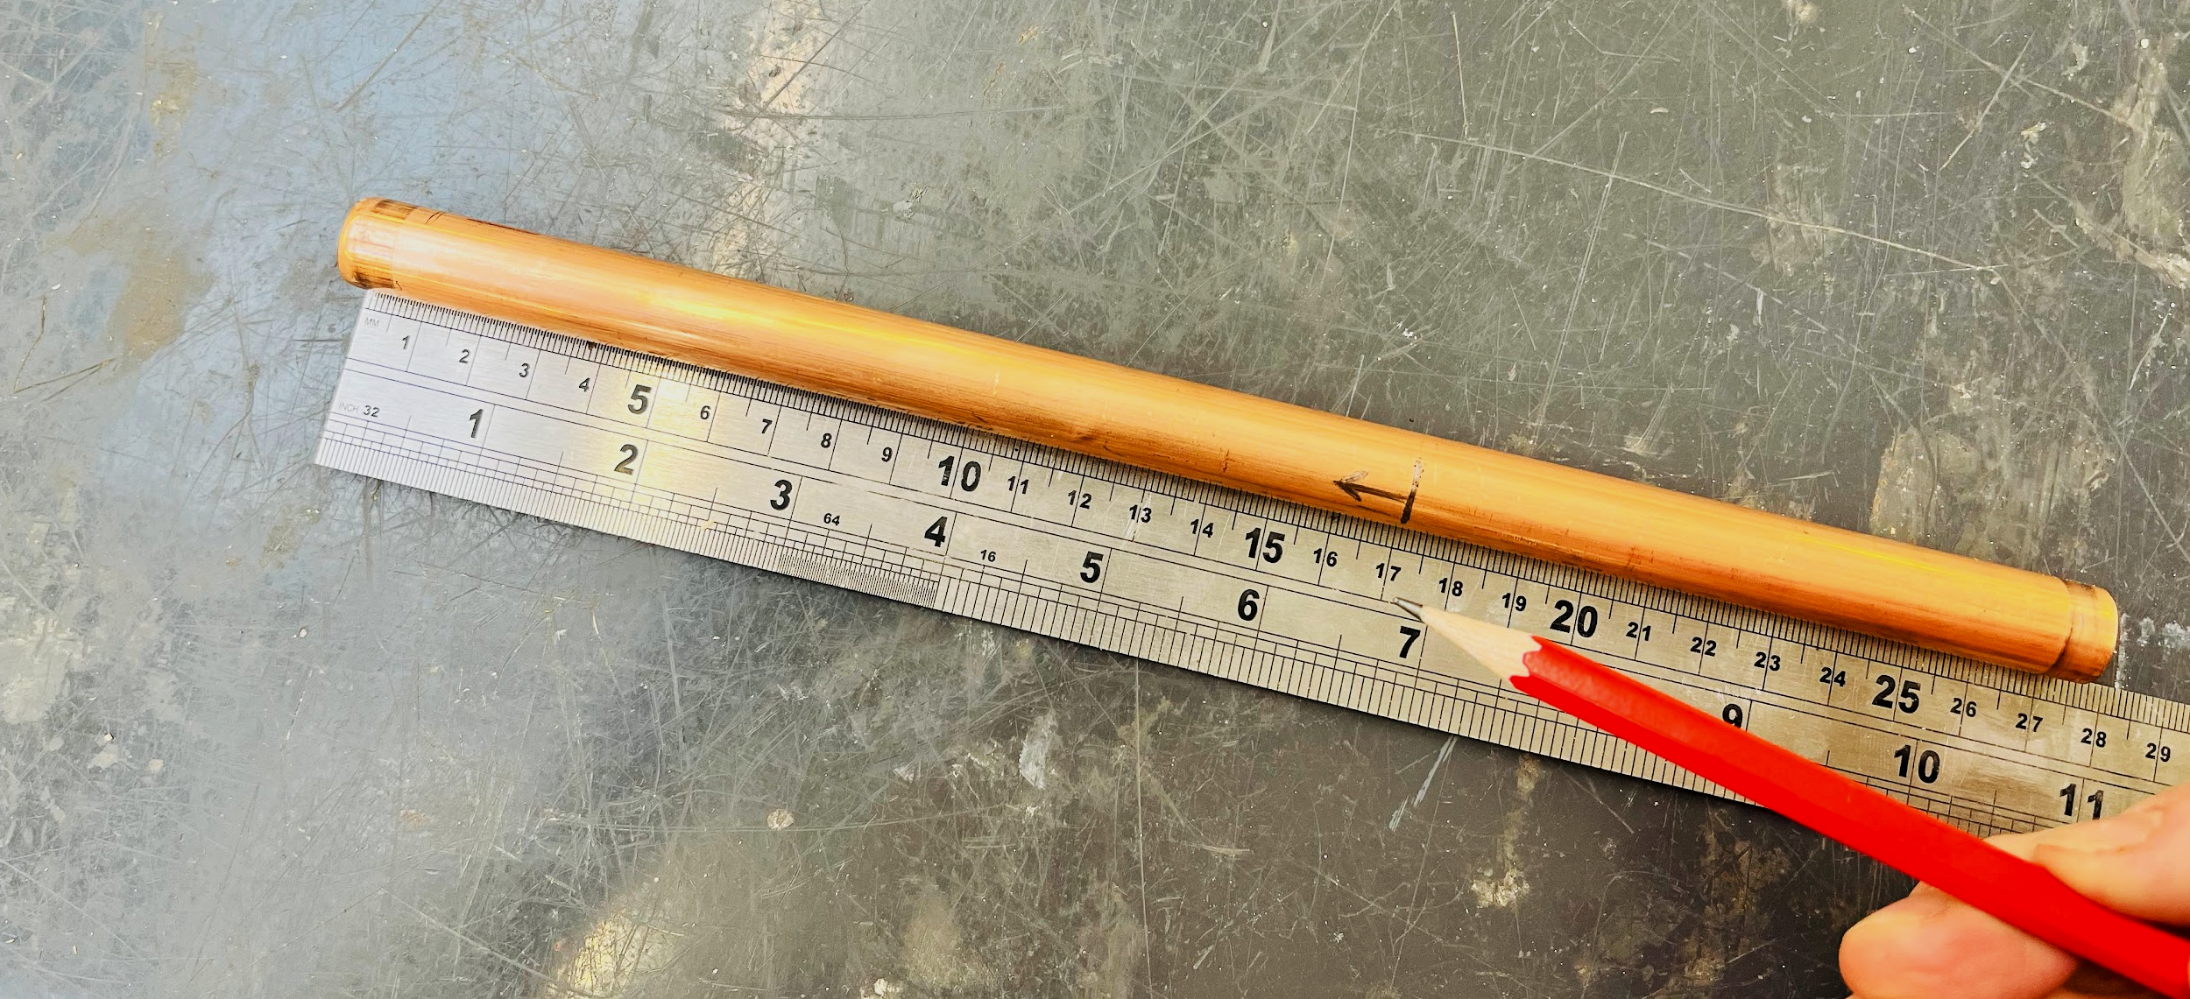
Fabrication – 15mm copper only: Step 3
Make sure you highlight the side you’ve measured (arrow indicating below).
This side will be known as the ‘measured end’.

Slide 18
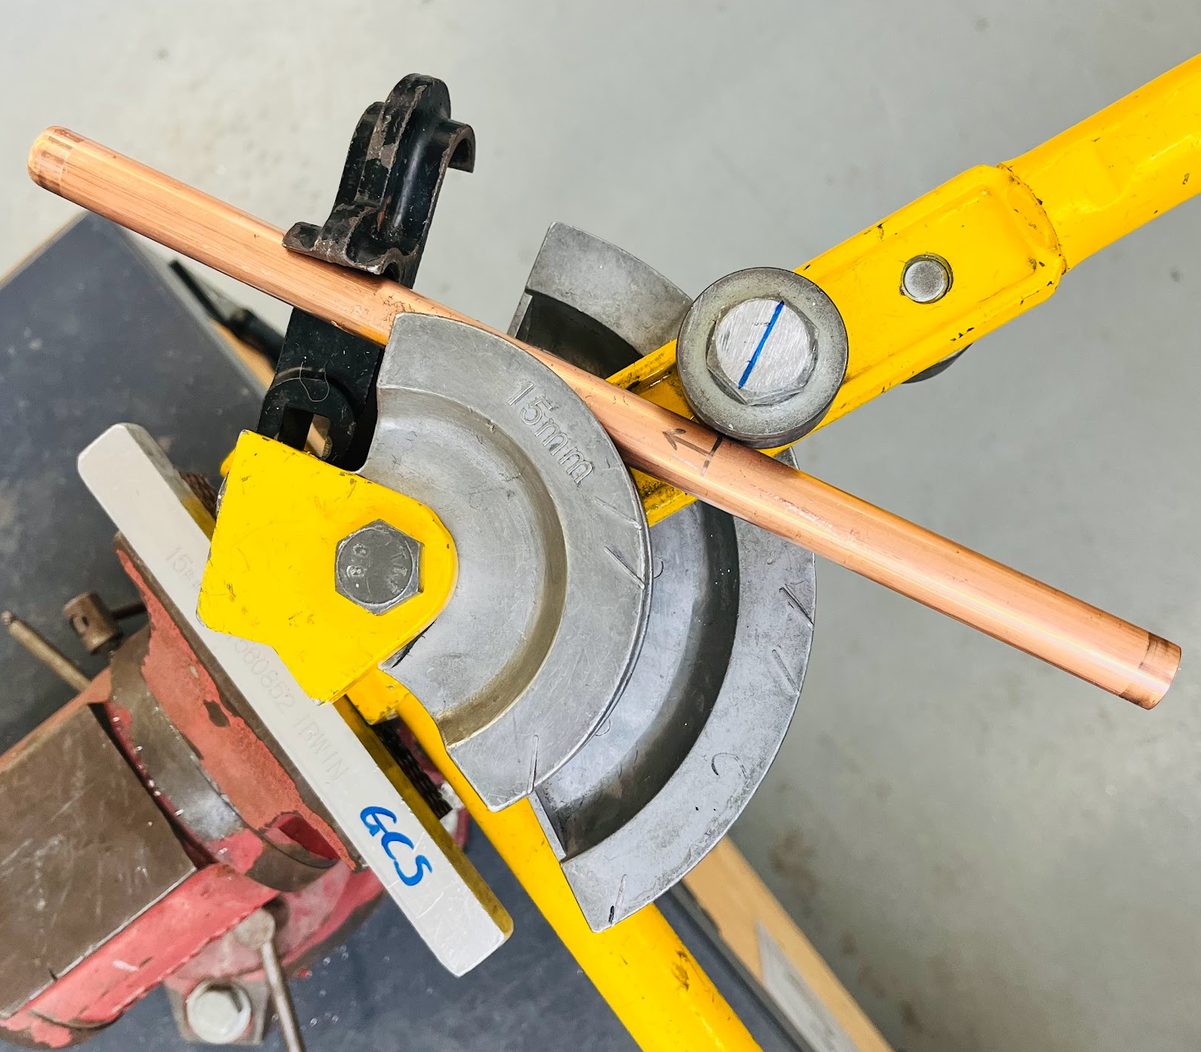
Fabrication – 15mm copper only: Step 4
Position the pipe in the bending machine so that the ‘measured end’ is in the hook.
Line the pencil mark up with the centre of the roller before the guide is inserted.

Slide 19
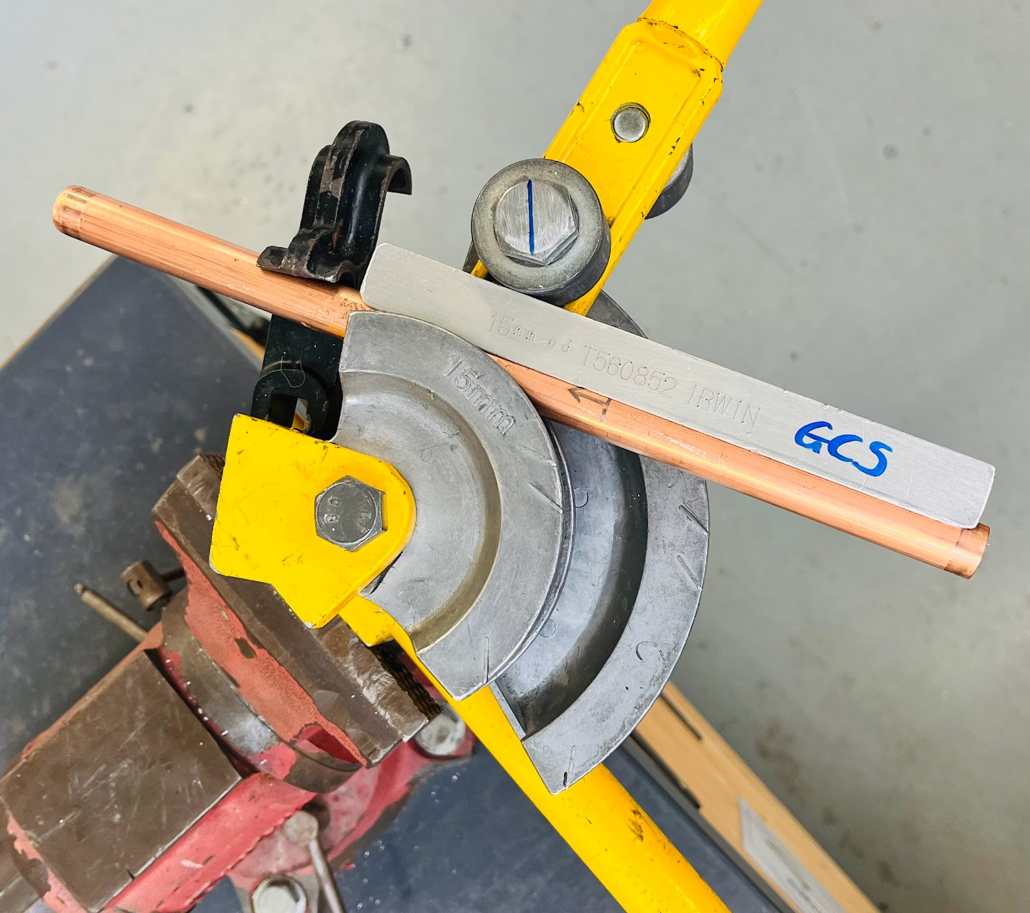
Fabrication – 15mm copper only: Step 5
Without moving the pipe, lift the bending arm and insert the guide between the roller and the pipe.

Slide 20
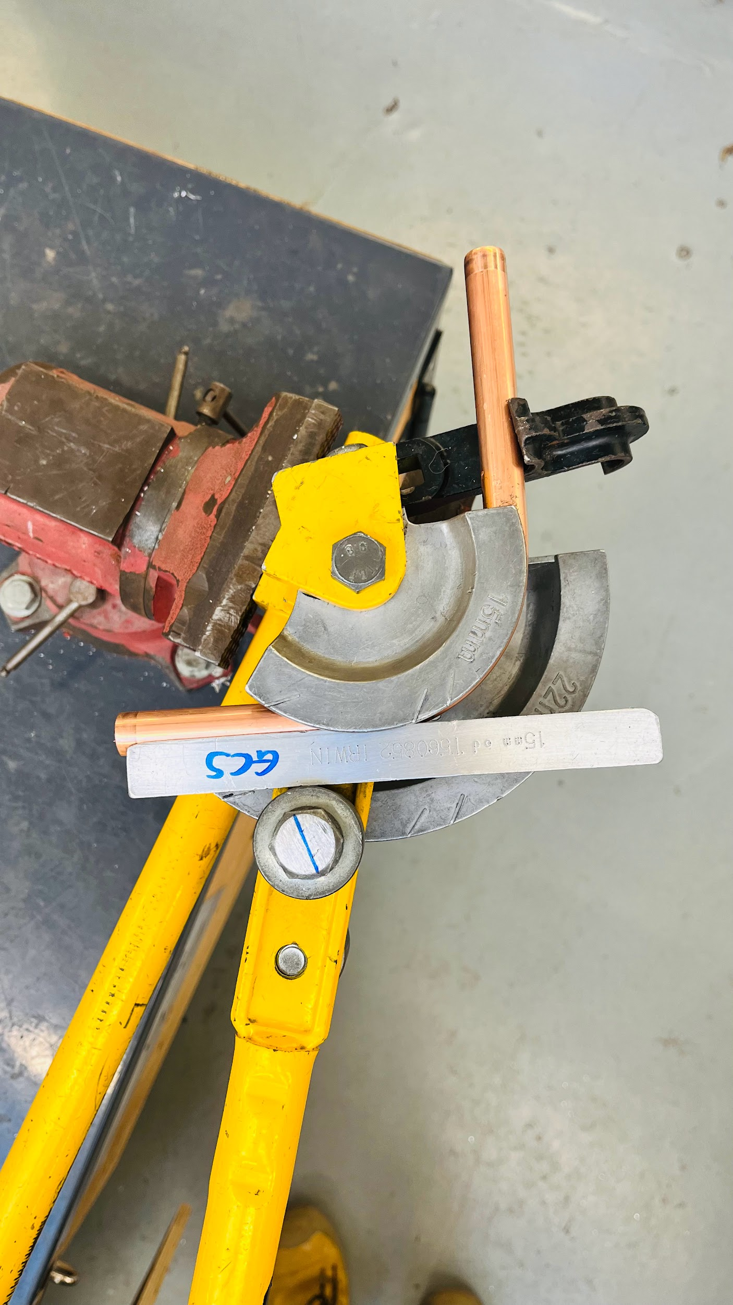
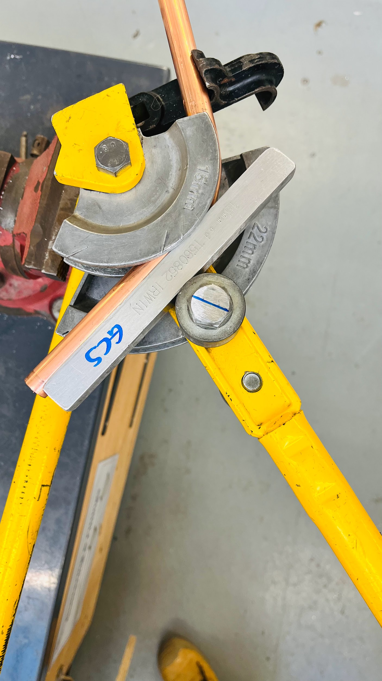
Fabrication – 15mm copper only: Step 6
Bend the pipe to 90॰

Slide 21
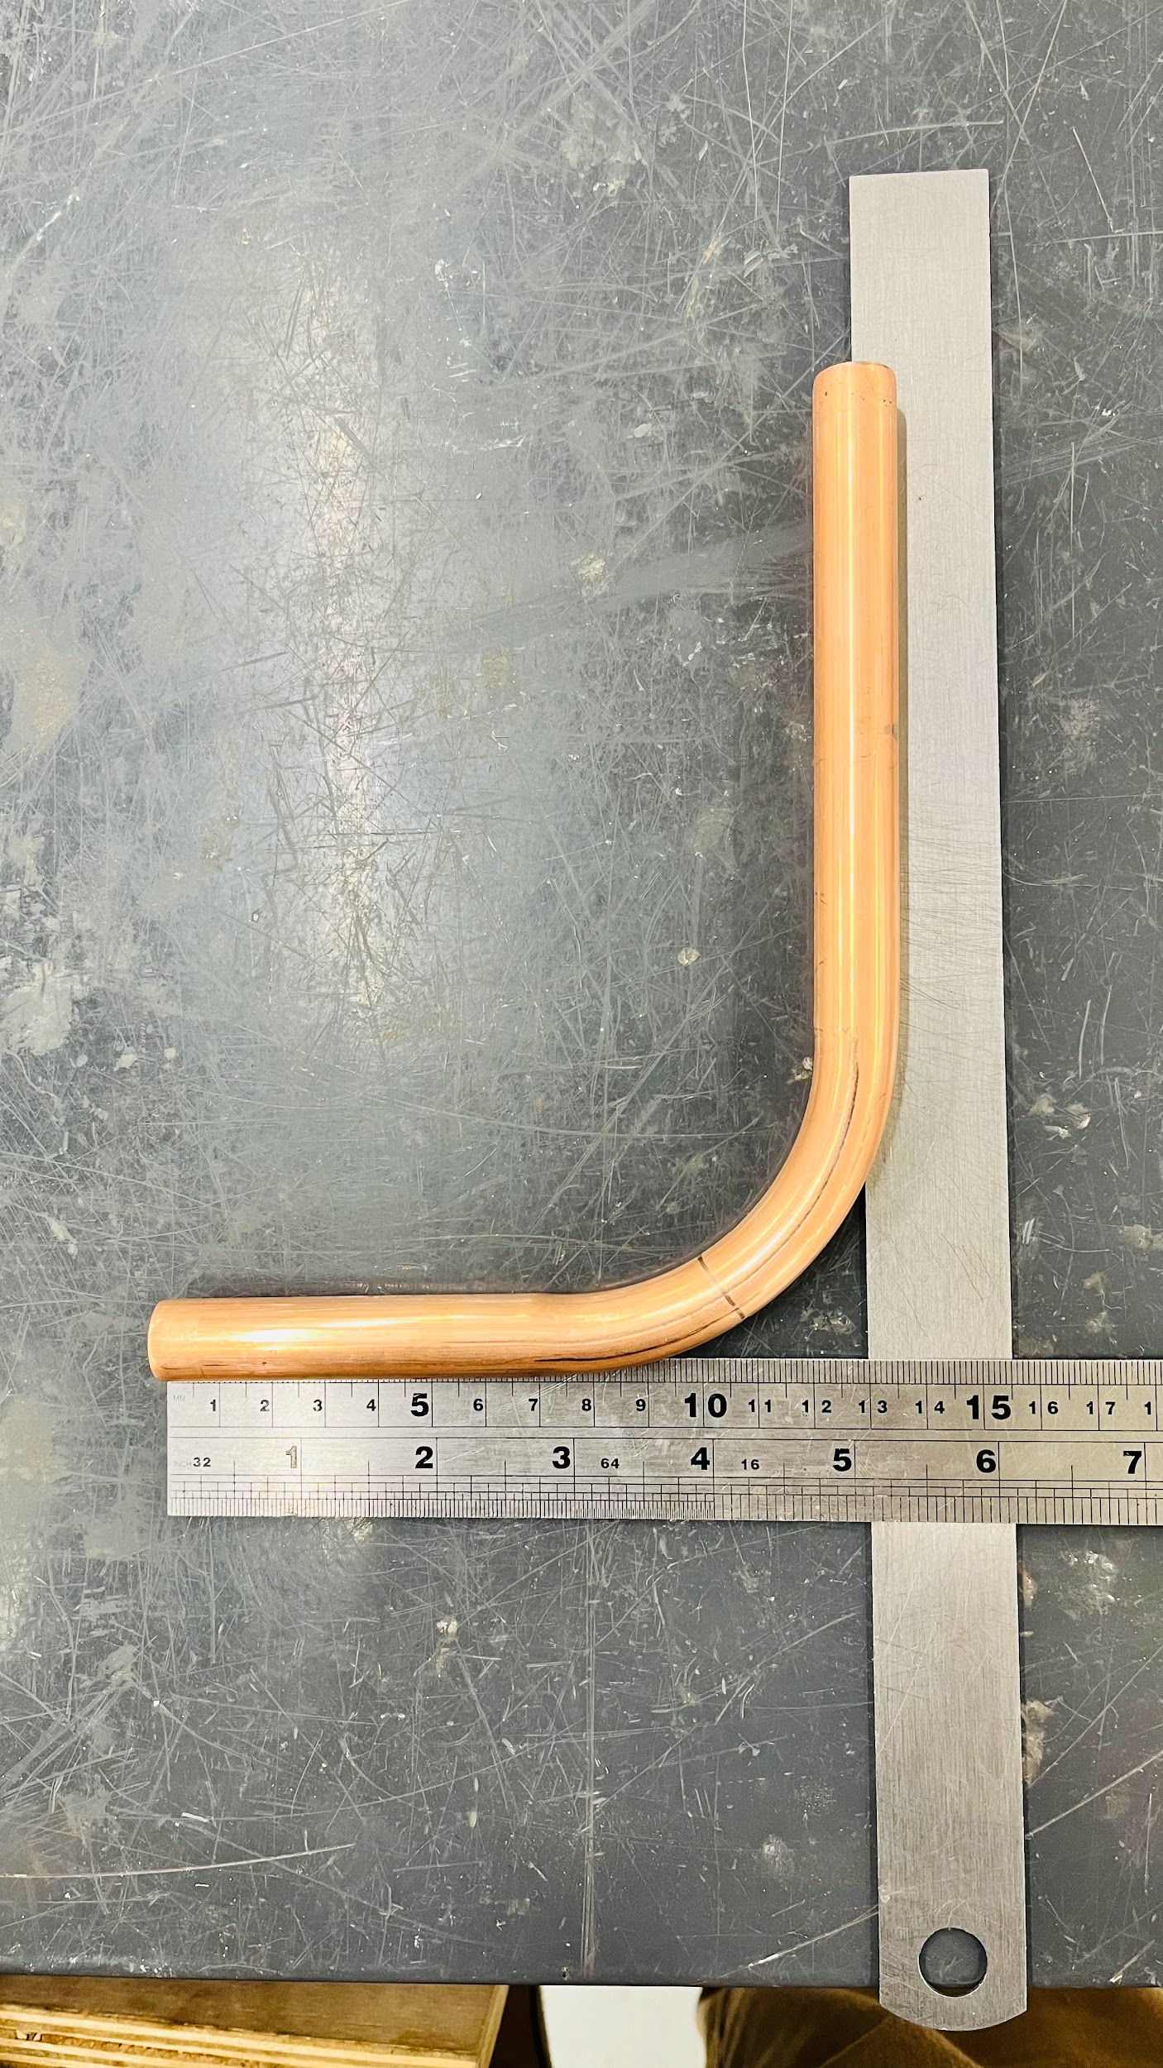
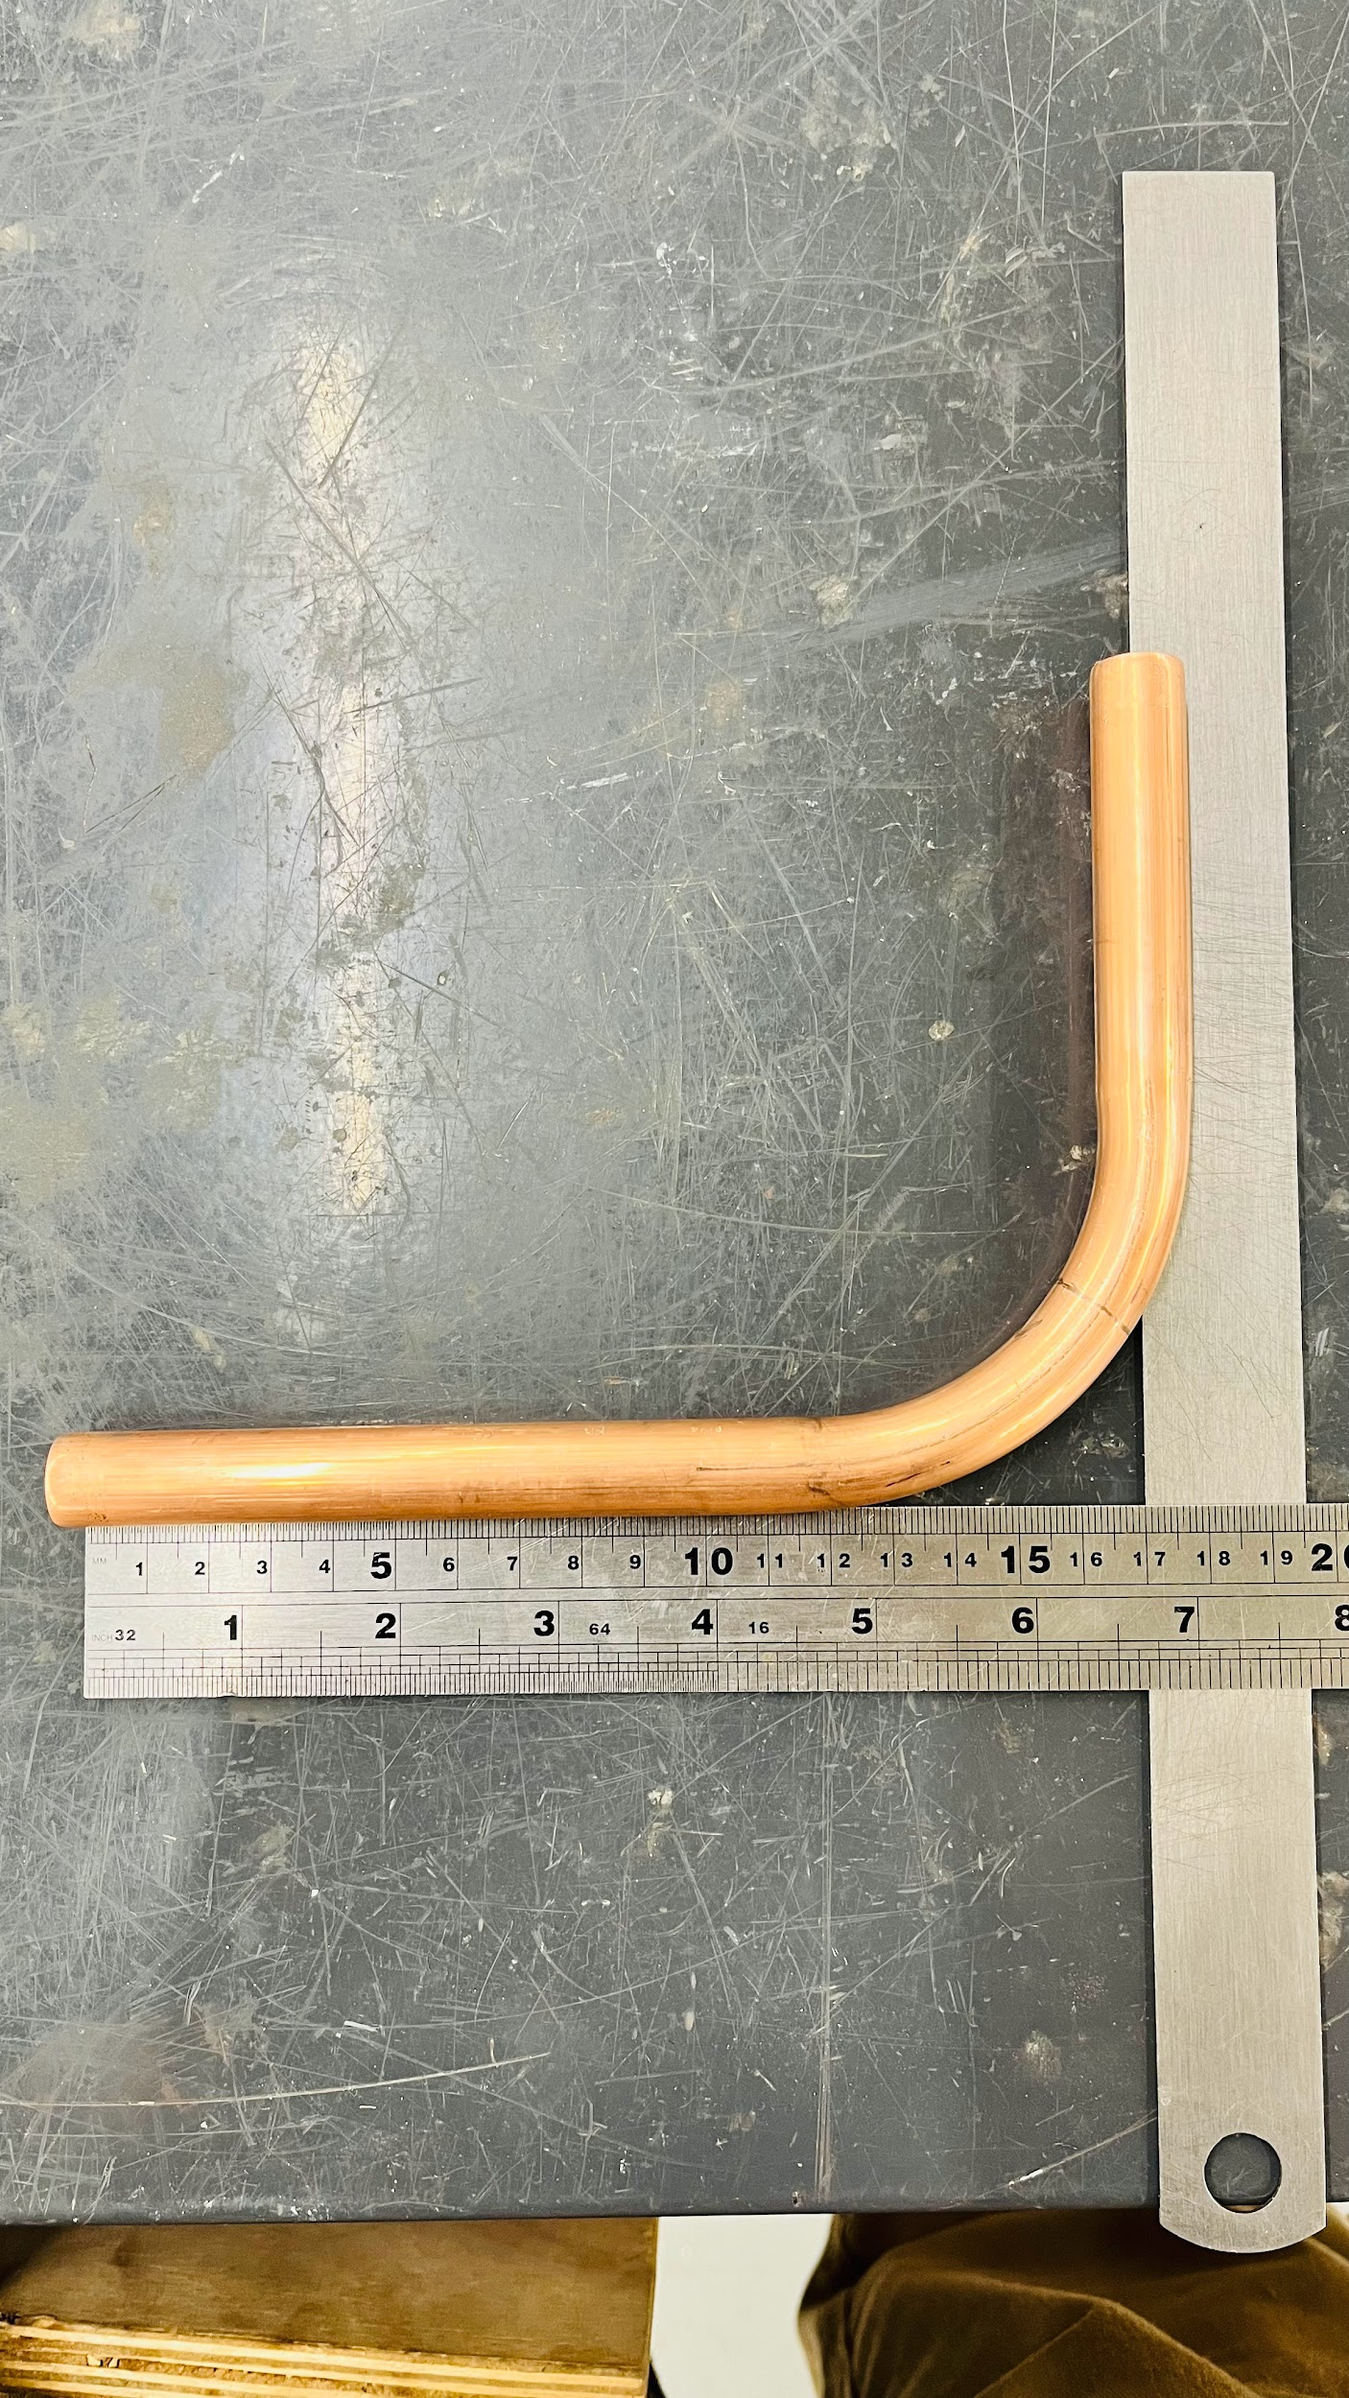
Fabrication – 15mm copper only: Step 6
Check the measurements and angle.
Minor adjustments are possible. Place the pipe back into the former to tweak if the pipe is 'under bent’.
Ensure finish is not rippled and pipe is not twisted or flattened.

Slide 22
Bending with spring – introduction
Spring inserted into or around pipe.
Supports pipe wall to prevent kinking.
Common for 15mm – possibly 22mm, but very rare.
10mm microbore – although microbore benders more suitable to pull tighter angles.

Slide 23
Internal vs external bending springs
Internal: Slips inside the pipe, must match bore.
External: Wraps around the pipe, useful for confined spaces.
Note: Always lubricate spring and pipe if needed.
Notes:
Note to tutor: Show examples of springs online or in class.

Slide 24
Bending with spring – step-by-step
Measure and mark bend point.
Insert spring fully.
Gently bend over knee or thigh.
Check for kinks.
Remove spring (twist if tight).

Slide 25
Common bending faults
Kinking due to over-bending or insufficient support.
Flattening caused by incorrect former use or tool slippage.
Spring stuck inside pipe: twist and lubricate to extract.
Crooked bends from poor marking or unstable footing.

Slide 26
Method comparison – machine vs spring
Machine Bender |  | Spring Bender
Pro | Con | Pro | Con
More accurate, less manual effort | Bulky, not ideal for tight spaces | Compact, cheap | Tight bends and passover bends almost impossible
Suitable for consistent bends in certain settings |  | Can produce long radius bends | Spring can become stuck
Easier to develop consistency

Slide 27
Calculation example 1 – how much pipe do you need?
210mm
A = 150 - (4 x d) = 90
B = 4 x d x ½ π = 94.2
C = 210 - (4 x d) = 150
Total = 335.2mm
C
B
150
94.2
15mm Copper
150mm
A
90
Now have a go at the next 3 examples…

Slide 28
Calculation example 2
170mm
A =
B =
C =
Total = ………………………….
120mm
15mm Copper

Slide 29
Calculation example 3
190mm
A =
B =
C =
Total = ………………………….
130mm
22mm Copper

Slide 30
Calculation example 4
215mm
A =
B =
C =
Total = ………………………….
22mm Copper
145mm

Slide 31
Calculation example 2 – answer
170mm
A = 60mm
B = 94.2mm
C = 110mm
Total = 264.2mm
120mm
15mm Copper

Slide 32
Calculation example 3 – answer
190mm
A = 42mm
B = 138.16mm
C = 102mm
Total = 282.16mm
130mm
22mm Copper

Slide 33
Calculation example 4 – answer
215mm
A = 57mm
B = 138.16mm
C = 127mm
Total = 322.16mm
22mm Copper
145mm

Slide 34
Summary
You should now be able to:
Recall different methods of bending copper pipe (machine and spring).
Explain how to measure, mark, and execute accurate 90° bends.
You might also be able to:
Examine bends for faults such as kinks, flattening or misalignment.
Calculate the exact amount of pipe required to fabricate a 90° bend.

Slide 35
Any questions?
Copyright in this document belongs to and is used under licence from the Department for Education, © 2025.
‘T-LEVELS’ and ‘T Level’ are registered trademarks of the Department for Education.
WJEC is authorised by the Department for Education to develop and deliver this T Level Technical Qualification.
WJEC operates in England under the name Eduqas which is a registered trademark of WJEC.

