Slide 1
Occupational Specialism: Plumbing & Heating Engineering
K1.19 Types of insulation materials
Install thermal insulation materials

Slide 2
Starter
Warm-up:
What types of insulation materials have you come across in buildings?
How important is insulation for energy efficiency?
What might happen if insulation is poorly installed?

Slide 3
Objectives
You should be able to:
Recall the types of thermal insulation materials used in the industry.
Explain the basic principles and methods for installing insulation.
You might also be able to:
Evaluate the suitability of different materials for given scenarios.

Slide 4
What is thermal insulation?
Thermal insulation is a method used to reduce the rate of heat transfer. In buildings, this means keeping heat in during winter and out during summer. It improves energy efficiency and helps maintain comfortable temperatures.
Materials used for insulation have low thermal conductivity. They slow down the movement of heat through building elements such as walls, ceilings, and pipes.
Question: Have you noticed any places in a home where insulation is clearly lacking?

Slide 5
Importance in plumbing & heating
Protects against freezing in cold conditions.
Prevents heat loss and undue warming (heat transfer to cold water)
Reduces energy consumption.
Increases system efficiency and longevity.
Enhances user comfort and system reliability.

Slide 6
Applications of thermal insulation
Thermal insulation is applied to various parts of building services:
Around pipework for hot and cold water systems
On hot water cylinders and tanks
Within floor voids and roof spaces
On external pipe runs and underground services
Question: Which of these do you think is most common in domestic homes?

Slide 7
Basic principles of installation
Proper installation ensures performance:
Always clean and dry surfaces first.
Avoid compressing insulation as it reduces effectiveness.
Overlap or butt sections tightly to eliminate gaps.
Fix securely using clips, ties, or adhesives.
Inspect and test after installation.

Slide 8
Health & safety considerations
Wear appropriate PPE: gloves, safety glasses, dust mask.
Use tools safely when cutting materials.
Follow COSHH for adhesives or sealants.
Maintain clean workspace to reduce trip hazards.
Dispose of offcuts and packaging responsibly.

Slide 9
Types of thermal insulation
Overview of commonly used types:
Polyisocyanurate (PIR) foam
PVC foam
Polyethylene foam
Each has specific properties and applications based on flexibility, moisture resistance, and thermal performance.

Slide 10
Other types of thermal insulation
Overview of alternative types:
Elastomeric: A flexible, closed-cell rubber foam.
Mineral Wool: A non-combustible fibrous insulation ideal for hot water pipes.
Phenolic: A rigid, highly efficient foam with a very low thermal conductivity.
Cellular Glass: A rigid insulation made from sealed glass cells.
Armaflex: A brand of flexible elastomeric foam insulation known for superior condensation control on chilled and cold pipes, high thermal efficiency, and easy installation.

Slide 11
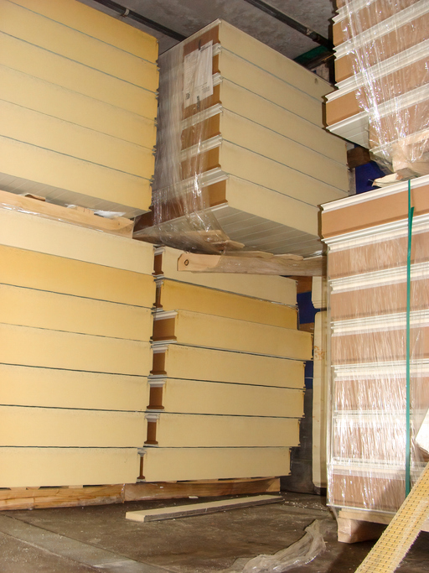
Polyisocyanurate (PIR) foam
PIR foam is a rigid insulation material with excellent thermal resistance. It often comes in pre-formed pipe sections or flat boards.
Some are foil-faced to act as vapour barriers. It's widely used for ductwork, pipe lagging, and cylinder insulation where space is limited but high performance is needed.

Slide 12
Installing PIR foam
Measure and cut boards accurately using a fine-toothed saw.
Use foil tape to seal all joints to reduce heat loss and fix with cable ties, straps or proprietary clips.
Protective outer covers for PIR insulation that shield against damage and maintain the vapour barrier, crucial for both weatherproofing and visual finish.
Non-conductive spacers used at pipe supports and hangers to prevent metal from bridging the insulation and causing heat loss or condensation.
Identification tags that are reapplied after any maintenance to ensure pipe functions, contents, and flow are clearly labelled.

Slide 13

PVC foam
Flexible, closed-cell structure.
Suitable for irregular shapes and awkward areas.
Moderate thermal performance.
Often used for surface-mounted pipe insulation where bends and joints are common.

Slide 14
Installing PVC foam
Cut foam to length using scissors or knife.
Secure using clips or self-adhesive backing.
Overlap joints slightly to ensure continuity.
Ensure edges are pressed firmly to avoid gaps.

Slide 15
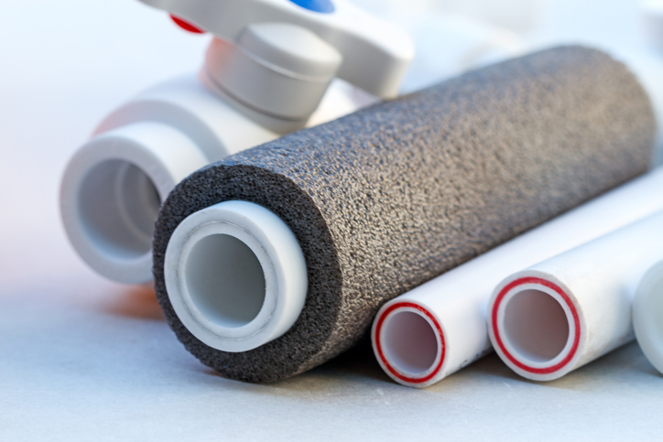
Polyethylene foam
Polyethylene foam is commonly used in domestic pipe insulation. It is lightweight, flexible, and resistant to moisture and many chemicals.
It comes in a range of sizes to suit various pipe diameters and wall thicknesses.

Slide 16
Installing polyethylene foam
Select the correct bore and wall thickness for the pipe.
Fit directly onto pipe or split open and wrap around.
Use matching adhesive tape to seal joints and ends.
Avoid stretching or tearing the material during fitting.

Slide 17
Comparison of materials
Material | Flexibility | Thermal Performance | Common Use
PIR Foam | Rigid | Excellent | Cylinders, ductwork
PVC Foam | Flexible | Moderate | Irregular surfaces, walls
Polyethylene Foam | Flexible | Good | Pipe insulation (domestic)
Question: Which would you use in a narrow loft with copper pipework?

Slide 18
Method summary: Pipes
Measure pipe length and diameter accurately.
Choose insulation with appropriate inner bore.
Cut to required length.
Fit without leaving gaps.
Seal with tape or clips.

Slide 19
Method summary: Cylinders
Cylinder insulation involves:
Selecting a well-fitting preformed jacket.
Wrapping it fully around the cylinder.
Securing it with ties or Velcro straps.
Ensuring any thermostats or immersion heaters are still accessible.
Modern cylinders are highly likely to feature factory installed lagging/insulation
Question: What safety risks could arise if insulation blocks these components?

Slide 20
Common issues to avoid
Leaving gaps or overlaps which reduce effectiveness.
Compressing insulation reducing thermal resistance.
Using inappropriate material in damp or outdoor areas.
Failing to seal joins allowing heat loss and condensation.

Slide 21
Environmental considerations
Use materials with recycled content where possible.
Dispose of waste responsibly in line with site policy.
Choose reusable or recyclable products.
Minimise offcuts and avoid unnecessary wastage.

Slide 22
Thermal insulation and regulations
You must comply with:
Building Regulations Part L (conservation of fuel and power).
BS/EN standards on thermal performance and materials.
Manufacturer's instructions for correct usage.
Question: Why do you think standards and guidance are so important?

Slide 23
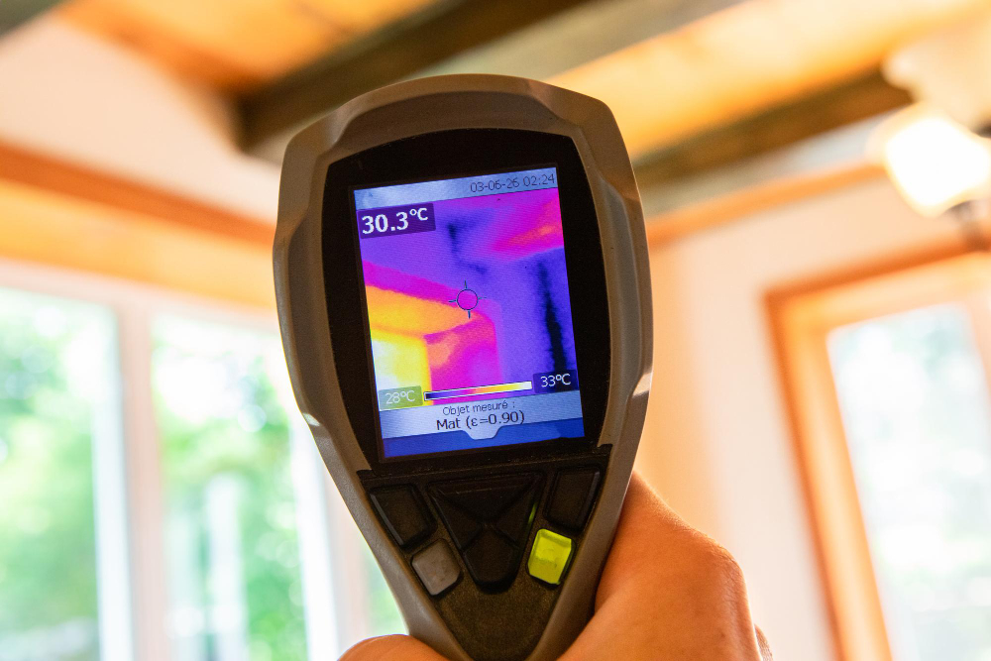
Thermal bridging
Thermal bridging occurs where insulation is interrupted. It allows heat to escape at junctions, corners or supports.
These areas must be carefully detailed and insulated to prevent energy loss and condensation.

Slide 24
Fire safety
Some insulation materials are combustible.
Always check fire rating before installation.
Avoid direct contact with hot surfaces unless rated.
Maintain safe distances from ignition sources.

Slide 25
Thermal insulation in practice
In real-world projects, follow plans and specs exactly. Use the correct materials for each zone. Work methodically and check for completeness.
An inspection should confirm that all components are insulated to standard.
Have you seen poor practice in past jobs?

Slide 26
Activity: Material selection task
Scenario: A double feed indirect hot water & heating system with a CWSC and F+E installed in the loft.
Which insulation types would you use and why?
Justify your choice with key properties.
Would it change if the loft were damp or unventilated?

Slide 27
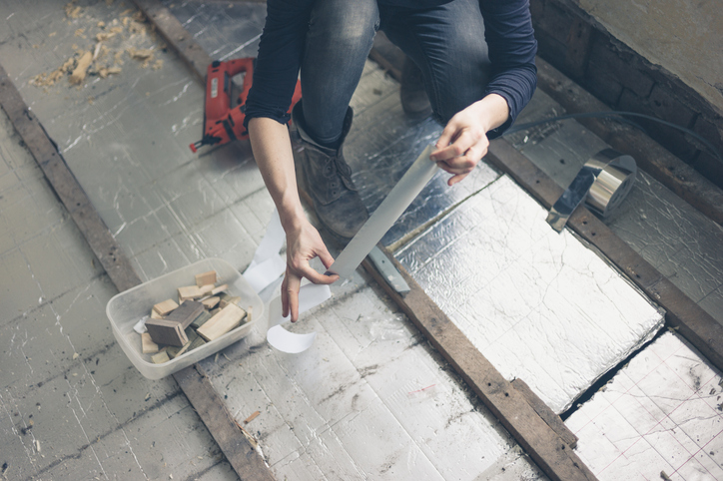
Activity: Installation walkthrough
View demonstration (video or diagram).
Note key steps from prep to securing.
Discuss the sequence and quality checks.
What would you look for in a final inspection?

Slide 28
Quick quiz
What does PIR stand for?
Which material is most moisture-resistant?
Why must insulation not be compressed?
What could happen if cylinder jackets are not properly secured?

Slide 29
Quick quiz – answers
Polyisocyanurate.
Polyisocyanurate (PIR) insulation is highly moisture-resistant compared to materials like mineral wool or fibreglass.
Insulation must not be compressed because doing so reduces air pockets within the material, which are essential for trapping heat. Compression reduces the thermal efficiency.
Heat may escape, reducing system efficiency. It might interfere with safety components, like thermostats or pressure valves, which can pose serious safety risks.

Slide 30
Recap
Thermal insulation improves energy efficiency and safety.
PIR, PVC foam and polyethylene foam are widely used.
Correct installation is key to performance.
Regulations must be followed for compliance and safety.

Slide 31
Summary
You should now be able to:
Recall the types of thermal insulation materials used in the industry.
Explain the basic principles and methods for installing insulation.
You might also be able to:
Evaluate the suitability of different materials for given scenarios.

Slide 32
Any questions?
Copyright in this document belongs to and is used under licence from the Department for Education, © 2025.
‘T-LEVELS’ and ‘T Level’ are registered trademarks of the Department for Education.
WJEC is authorised by the Department for Education to develop and deliver this T Level Technical Qualification.
WJEC operates in England under the name Eduqas which is a registered trademark of WJEC.

