Slide 1
Occupational Specialism: Protection Systems Engineering
K1.4 Operation and handling requirements of tools and commissioning equipment
PowerPoint 1.4: How to operate and handle tools and commissioning equipment

Slide 2
Introduction
This session covers essential procedures for:
user checks
calibration procedures
proper equipment operation
to ensure:
accuracy
safety
compliance
with industry standards.

Slide 3
Objectives
By the end of this session, you should be able to:
Identify the operation and handling requirements of tools and commissioning equipment.
Safely handle and use commissioning equipment.
Understand calibration and verification requirements for commissioning equipment.

Slide 4

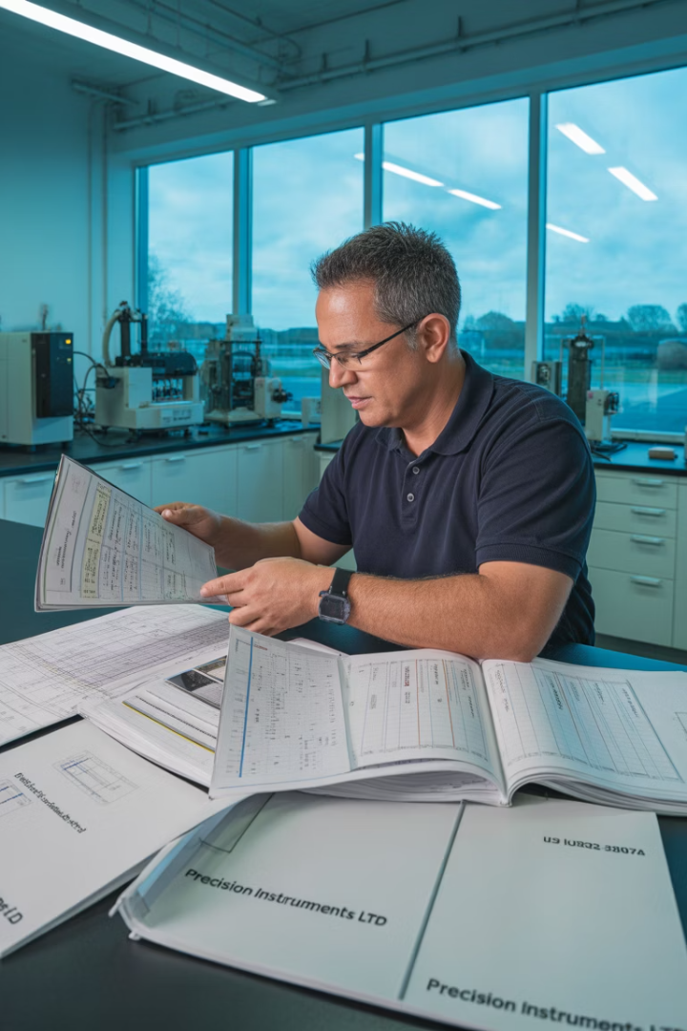



Overview
Understand legal requirements
Identify regulatory frameworks governing commissioning equipment in the UK, including Electricity at Work Regulations 1989 and BS 7671 requirements.
Master equipment handling
Develop proficiency in the correct operation, storage and transportation of sensitive calibration tools and testing instruments.
Implement Quality Assurance
Establish systematic verification processes to ensure equipment accuracy and traceability to national standards.
Ensure safety compliance
Apply proper procedures to maintain both personal safety and equipment integrity throughout commissioning activities.

Slide 5








Equipment categories and applications
Precision measurement
Digital multimeter, clamp meter, insulation resistance tester,
laser distance measurer
Mechanical tools
Cable cutters, screwdrivers, spanners, conduit benders,
hole saws
Protection testing
RCD tester, earth loop impedance tester, safe isolation
kit, voltage indicator (GS38 compliant)
Communication/Protocol
Laptop with software, IP/network tester,
serial-to-USB converter, programming tools
for fire/intruder panels

Slide 6
Equipment categories and applications
Commissioning equipment falls into several distinct categories, each serving specific functions within protective system engineering. Understanding these categories helps technicians select the appropriate tools for specific tasks and apply the correct handling procedures based on equipment sensitivity and application requirements.
The precision of these instruments directly impacts the reliability of commissioned systems, making proper tool selection and handling paramount to successful outcomes.

Slide 7








Pre-use visual inspections
Physical condition
Cable integrity
Check for case damage, cracks or deformation
Inspect leads for insulation damage or connector issues
Power systems
Display functionality
Confirm battery condition and power connectivity
Verify displays are clear, readable and fully operational

Slide 8
Pre-use visual inspections
Visual inspection is the critical first step in equipment handling. Before any operational checks or testing can begin, you must thoroughly inspect all equipment for signs of damage or deterioration that could compromise its functionality or safety.
A consistent application of visual inspection protocols helps identify potential issues early, preventing equipment failure during critical commissioning activities and reducing the risk of erroneous measurements that could impact system safety.

Slide 9





Functional safety checks
Reference check
Safety systems
Indicator check
Self-test
Test against known reference values.
Verify protective features and failsafes.
Test alarms, buzzers and visual indicators.
Run built-in diagnostic
routines.

Slide 10
Functional safety checks
Functional safety verification ensures that equipment will operate safely and reliably during commissioning activities. These checks confirm that all safety mechanisms are operational and that the equipment will respond appropriately to fault conditions or improper use.
Particular attention should be paid to equipment with high voltage capabilities, where failure of safety systems could pose significant risks to both personnel and connected equipment. All safety features must function exactly as designed before equipment is deployed.

Slide 11
Handling sensitive electronic equipment
Electrostatic Discharge (ESD) protection
Temperature considerations
Mechanical protection
Allow temperature stabilisation after transport.
Avoid rapid temperature changes that cause condensation.
Observe operating temperature ranges from manufacturers.
Consider temperature effects on measurement accuracy.
Use appropriate cases with shock absorption.
Secure equipment properly during transport.
Avoid exposing sensitive components to vibration.
Handle with appropriate force for connectors and controls.
Use wrist straps and mats when handling sensitive components.
Maintain proper grounding when working on electronic circuits.
Store sensitive equipment in anti-static packaging.
Control humidity in storage areas (40-60% ideal).

Slide 12
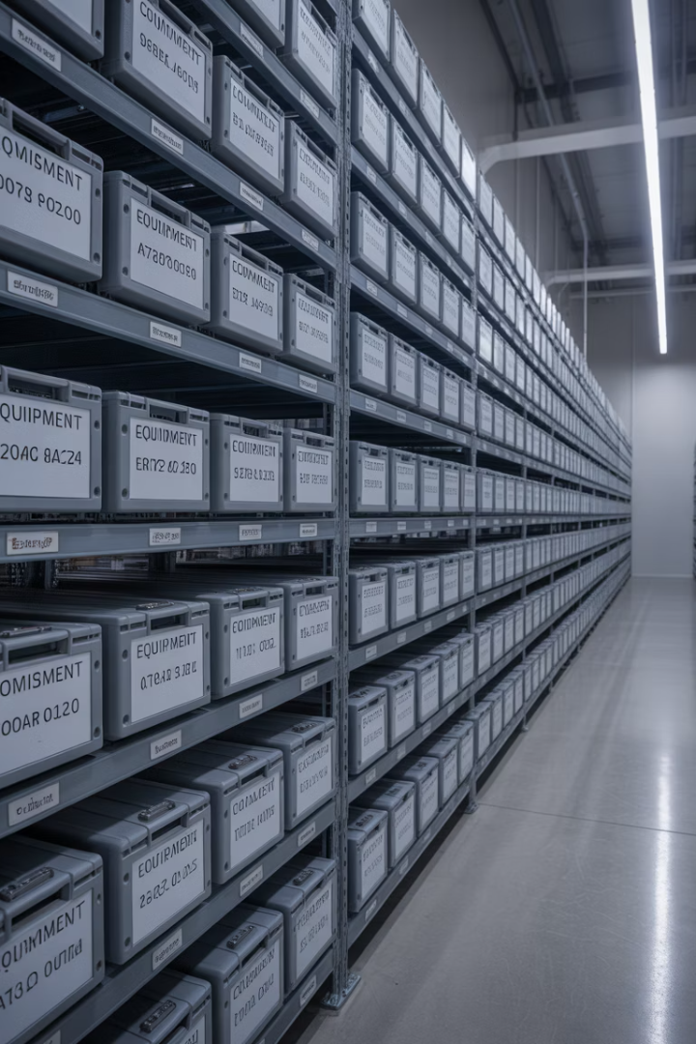



Transport and storage requirements
Environmental controls
Store equipment in controlled environments with temperature ranges of 10-30°C and humidity levels between 30-70% to prevent component deterioration and calibration drift. Avoid storage near sources of electromagnetic interference or strong magnetic fields
Packaging systems
Use the original manufacturer’s packaging with custom foam inserts. For transit between sites, use ruggedised cases with appropriate IP ratings for environmental protection and impact resistance appropriate to the sensitivity of the contained equipment
Long-term storage
Remove batteries to prevent leakage damage during extended storage periods. Apply protective covers to sensitive connectors and apply appropriate preservatives to mechanical components that might be susceptible to corrosion or degradation

Slide 13
Battery management procedures
Battery type
Storage procedure
Charging requirements
Disposal method
Lithium-Ion
40-60% charge level, cool environment
Use manufacturer-approved chargers only
Dedicated recycling, never general waste
NiMH/NiCad
Fully discharged for short term, periodic cycling for long term
Monitor for heat during charging, avoid overcharging
Specialist battery recycling facilities
Lead-Acid
Maintain full charge, use trickle chargers for long storage
Slow charging preferred, maintain ventilation
Return to supplier or dedicated recycling point
Alkaline
Remove from equipment when not in use
Non-rechargeable
Standard battery recycling schemes

Slide 14
Battery management procedures
Proper battery management is essential for both equipment reliability and safety. Different battery technologies require specific handling and maintenance protocols to ensure optimal performance and lifespan.
Regular battery condition checks should be incorporated into equipment preparation routines, with particular attention to signs of:
swelling
leakage
abnormal temperature
during charging cycles.

Slide 15
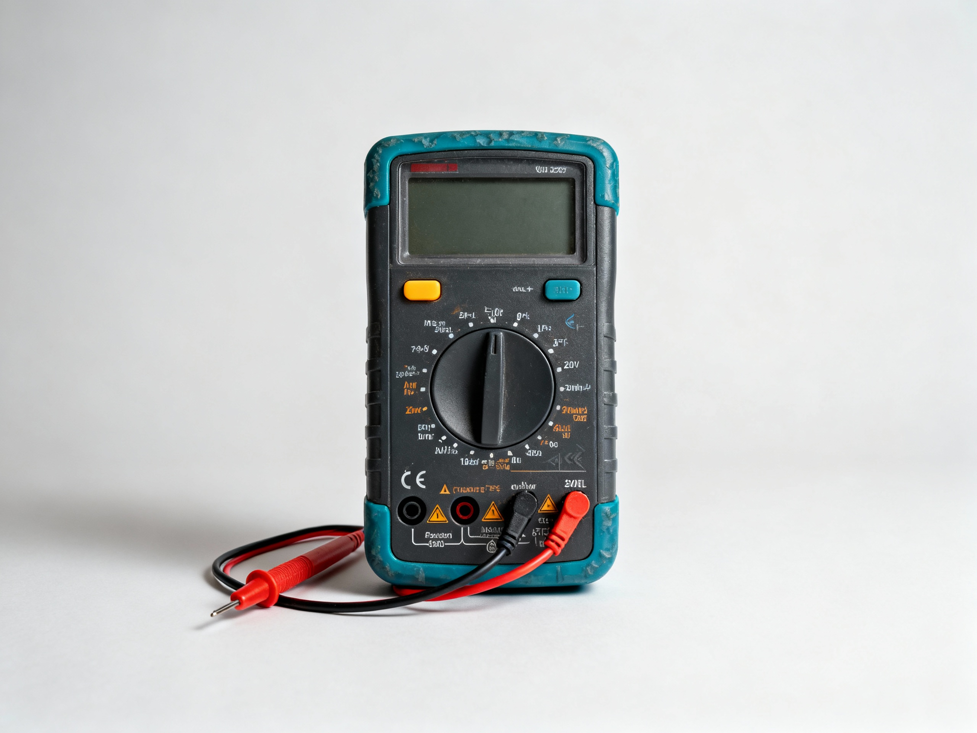
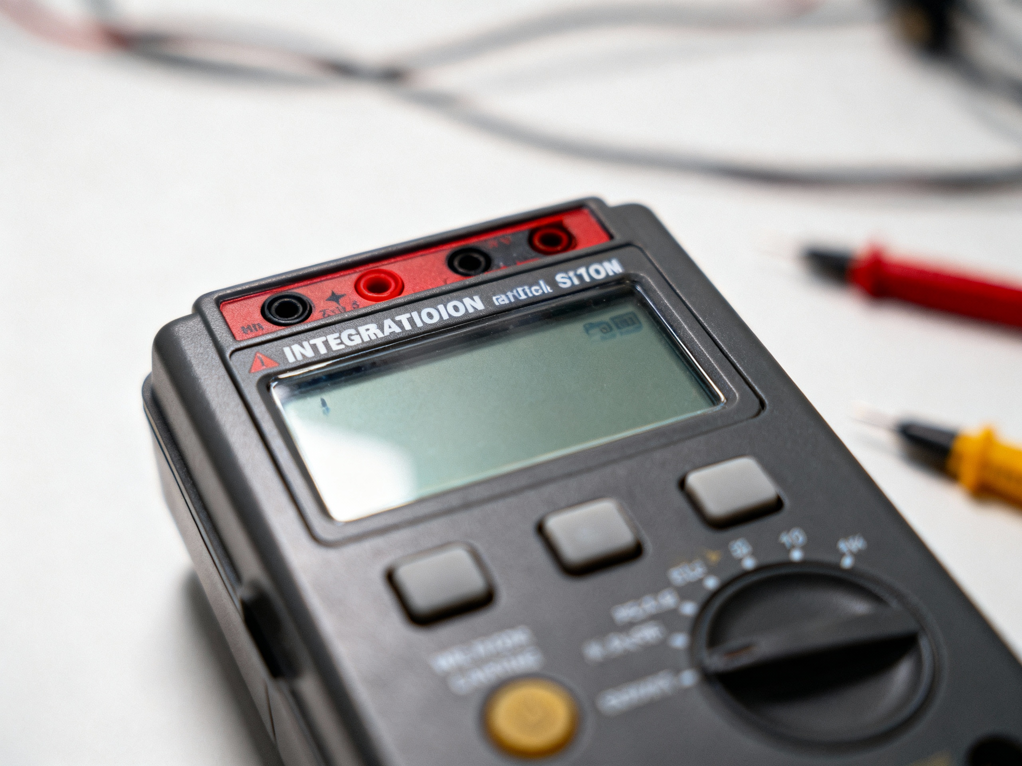
Equipment-specific operational procedures
Digital multimeters
Verify category rating matches the application.
Use appropriate test leads.
Insulation resistance tester
Verify circuit isolation.
Maintain proper cooling during operation.

Slide 16
Equipment-specific operational procedures
Different equipment types have unique operational requirements and potential hazards. Technicians must understand the specific procedures for each instrument type they use, particularly regarding safety precautions, connection sequences, and operational limitations.
Equipment-specific training should be provided for complex instruments, with periodic refresher sessions to ensure that best practices are maintained and that technicians remain up-to-date with the latest operational recommendations.

Slide 17
Measurement techniques for accuracy
Accurate measurements require more than properly calibrated equipment - they need correct measurement techniques. Factors such as lead routing, grounding practices, and connection methods can significantly impact measurement quality, particularly for low-level signals or high precision requirements.
For low resistance measurements, four-wire (Kelvin) techniques are essential to eliminate lead resistance effects. For high voltage or current measurements, proper positioning relative to other conductors helps minimise induced errors. For all measurements, understanding loading effects and input impedance considerations ensures results that truly represent system conditions.

Slide 18




Fault-finding in test equipment
Symptom identification
Documentation review
Document all abnormal behaviour in detail:
Consult manufacturer resources:
Note specific error messages or codes.
Check troubleshooting sections in manuals.
Record when issues occur and conditions.
Review known issues and bulletins.
Check if problem is repeatable or intermittent.
Search for firmware update notes.
Resolution pathway
Basic diagnostics
Determine appropriate action:
Perform systematic checks:
Implement manufacturer-approved fixes.
Reset to factory defaults when appropriate.
Quarantine equipment if accuracy compromised.
Verify power supply and battery condition.
Document resolution for future reference.
Test with alternative accessories.

Slide 19
Summary
You should now be able to:
Identify the operation and handling requirements of tools and commissioning equipment.
Safely handle and use commissioning equipment.
Understand calibration and verification requirements for commissioning equipment.

Slide 20
Any questions?
Copyright in this document belongs to and is used under licence from the Department for Education, © 2025.
‘T-LEVELS’ and ‘T Level’ are registered trademarks of the Department for Education.
WJEC is authorised by the Department for Education to develop and deliver this T Level Technical Qualification.
WJEC operates in England under the name Eduqas which is a registered trademark of WJEC.

