Slide 1
Occupational Specialism: Protection Systems Engineering
K1.3 Tools and equipment used when working with protective systems
PowerPoint 1.3: Tools and equipment used for protection systems

Slide 2
Introduction
This session is about using essential tools and equipment for protection systems.
We'll explore the variety of hand tools, power tools, and specialised equipment required for installing, maintaining, and troubleshooting security and protection systems.
Your proficiency with these tools directly impacts the quality, efficiency, and safety of your work, so we'll cover proper:
selection
usage techniques
safety protocols and
maintenance practices.

Slide 3
Objectives
By the end of this session, you should be able to:
Understand the selection and use of tools and equipment when working with protection systems.
Inspect tools and equipment before use.
Understand the safe use and maintenance of tools and equipment.

Slide 4
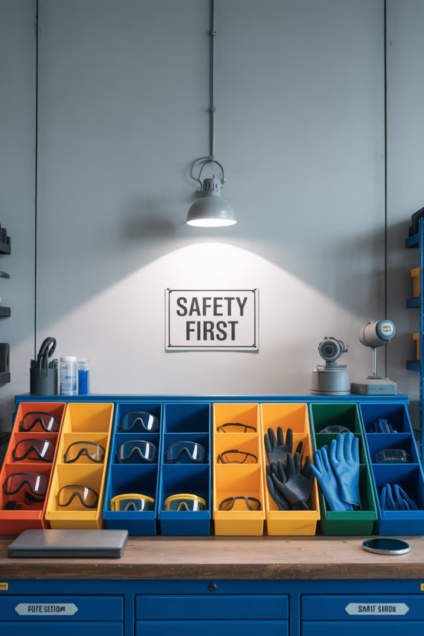




Overview
Hand tools overview
Comprehensive review of essential hand tools for
protection system work.
Power tools
Detailed examination of power tools required for installation
and maintenance.
Specialised equipment
In-depth look at testing, commissioning and programming
equipment.
Tool selection and safety
Guidelines for appropriate tool selection and essential safety
protocols.

Slide 5




Measurement tools
Rules
Levels
Precision measuring instruments essential for accurate component placement and ensuring correct distances between system elements. Metal rules provide durability in field conditions.
Critical for ensuring horizontal alignment of control panels, sensors and other protection system components. Spirit levels provide quick verification of surface orientation.
Laser levels
Plumb lines
Advanced measurement tools projecting straight lines across walls and ceilings, essential for consistent alignment of multiple components in large installations.
Traditional tools providing vertical reference points, useful where electronic methods may be impractical or for verification of laser level readings.

Slide 6
Measurement tools
Precise measurements are the foundation of reliable protection system installations.
Even minor misalignments can result in system failures or false alarms, making these measurement tools indispensable for quality workmanship.

Slide 7
Cutting tools for cables
Cable cutters
Wire cutters
Selection criteria
Specifically designed for cleanly severing larger multi-conductor cables without crushing or distorting the internal conductors. Features include:
Precision tools for cutting smaller gauge wires used in control circuits and terminations. Key characteristics include:
Proper selection depends on specific application requirements:
Cable/wire diameter and composition.
Required cutting precision.
Workspace constraints.
Frequency of use (durability needs).
Sharp pointed tips for accessing confined spaces.
Integrated wire stripping notches.
Insulated handles for electrical safety.
Hardened steel blades for durability.
Ergonomic handles reducing hand fatigue.
Various sizes for different cable diameters.
Using the appropriate cutting tool prevents damage to conductors and insulation, ensuring the integrity of the protection system's wiring. Low-quality cuts may create electrical faults that are difficult to diagnose later.

Slide 8



Pliers for protection system work
Combination pliers
All-purpose pliers with multiple functions including gripping, bending and cutting. Essential for general work on protection systems when specific pliers aren't required.
Needle-nose pliers
Feature long, tapered jaws for precision work in confined spaces. Ideal for manipulating small wires and components within control panels and connection boxes.
Lineman's pliers
Heavy-duty pliers with substantial cutting edges, designed for handling thicker wires and cables. Provide additional leverage for tougher applications.
Quality pliers should feature insulated handles rated for appropriate voltages encountered in protection systems. When selecting pliers, consider the specific tasks you'll be performing - general installation work requires different tools than delicate sensor wiring or heavy-duty cable installation. Regularly maintain pliers by keeping the jaws and pivot points clean and lightly oiled to prevent binding.

Slide 9





Essential screwdrivers
Precision screwdrivers
For delicate components and small fasteners
Insulated screwdrivers
VDE-certified for electrical safety
Standard drivers
Phillips, flathead and Torx in various sizes

Slide 10
Essential screwdrivers
Screwdrivers are perhaps the most frequently used tools in protection system installation and maintenance. A complete set should include various sizes of:
Phillips (cross-head)
Slotted (flathead)
Pozidriv, and
Torx drivers
to accommodate the range of fasteners encountered in different system components.
Insulated screwdrivers are essential when working with powered systems, providing protection against accidental electric shock. Look for screwdrivers with the VDE certification, indicating they've been tested to 1000V. Magnetic tips can be particularly useful when working in confined spaces where dropped screws might be difficult to retrieve.

Slide 11
Wire preparation tools
Wire strippers
Insulation displacement tools
Specialised tools for precisely removing insulation without damaging the conductor. Advanced models include:
Adjustable gauges for different wire sizes
Self-adjusting mechanisms
Built-in crimping and cutting features.
Specialised for quick connection without stripping, commonly used with certain terminal types:
Category-specific designs (Cat5/6)
Ratcheting mechanisms for consistent pressure
Integrated wire cutters.
Proper wire preparation is crucial for reliable electrical connections in protection systems.
Poor stripping technique can nick conductors, creating weak points that may fail over time.
Rough or uneven cuts can make termination difficult and compromise connection quality.

Slide 12
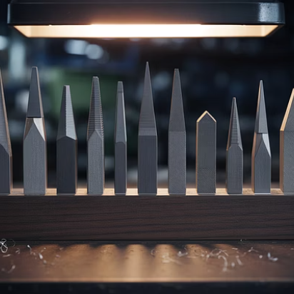
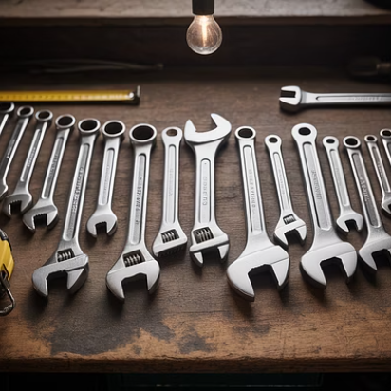
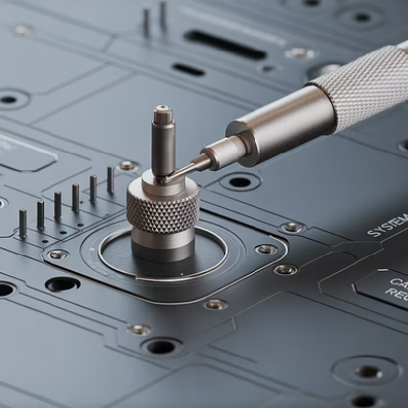

Finishing and adjustment tools
Files and wrenches are essential for the precision finishing work often required during protection system installation.
Files are used to remove burrs and smooth edges on cut metal surfaces, ensuring components fit correctly and preventing damage to cables from sharp edges. A basic set should include flat, round, and half-round profiles in both coarse and fine cuts.
Wrenches and spanners are needed for securing mounting hardware and making mechanical adjustments. Both adjustable and fixed-size wrenches are valuable, with adjustable types offering versatility and fixed sizes providing better grip and leverage for frequently encountered fastener sizes.

Slide 13
Impact tools
Hammers
Hand saws
Safety considerations
While not used directly on electronic components, hammers are essential for mounting brackets, housings, and structural elements of protection systems. A medium-weight claw hammer is most versatile, allowing both installation and removal of nails and light prying when necessary.
Required for cutting mounting boards, plastic enclosures, conduit, and other structural elements. A junior hacksaw is particularly useful for precision cutting of smaller items, while a standard handsaw may be needed for larger materials like mounting boards.
When using impact tools, always wear appropriate eye protection to guard against flying debris. Ensure tools have secure handles without cracks or splinters. Never use hammers with mushroomed heads as this can cause dangerous fragments to break off during use.

Slide 14
Impact tools
While electronic aspects of protection systems require delicate handling, the physical installation often demands more substantial tools.
Using the proper technique with these tools ensures secure mounting without damage to either the mounting surface or the protection system components.

Slide 15




Wire termination tools
Hand crimping tools
Terminal types
Essential for creating secure electrical connections using crimp terminals. Professional-grade crimpers feature ratcheting mechanisms that ensure complete crimps and prevent premature release before full compression is achieved.
Different crimping tools are designed for specific terminal types, including spade connectors, butt splices, ferrules, and specialised connectors used in protection systems. Using the correct die set for each terminal type is crucial.
Wire gauges
Insulation considerations
Crimping tools are typically designed to handle specific ranges of wire gauges. Using a tool outside its rated range will result in either insufficient compression (too large) or damage to the conductor (too small).
Many modern crimping tools feature dual-action dies that crimp both the conductor and the insulation sleeve, providing strain relief and preventing moisture ingress at the connection point.

Slide 16
Wire termination tools
Proper crimping technique is essential for reliable connections in protection systems.
Poor crimps can lead to high-resistance connections that may cause system failures or even present fire hazards under load conditions.

Slide 17




Insulation Displacement Connection (IDC) tools
Cable preparation
Strip outer jacket only, maintaining insulation on individual conductors. Organise wires according to colour-coding standards for the specific system type.
Tool positioning
Place the wire in the appropriate slot on the terminal block. Position IDC tool perpendicular
to ensure even pressure distribution during termination.
Apply pressure
Use firm, steady pressure to drive the wire into the IDC contact. Listen for the click
indicating proper seating on tools with impact mechanisms.
Trim excess
Some IDC tools automatically trim excess wire length. For tools without this feature,
use wire cutters to trim flush with the connection point.

Slide 18
Insulation Displacement Connection (IDC) tools
Insulation displacement connection technology is widely used in modern protection systems, particularly for network and communication cabling.
The primary advantage is speed of installation, as it eliminates the need to strip individual wires before termination.
Make sure you use the proper technique to make reliable connections.

Slide 19



SDS and Hammer drills
Power and impact rating
Select appropriate size for installation requirements
Bit selection
Match to mounting surface and hardware specifications
Dust management
Use extraction systems to maintain equipment
cleanliness

Slide 20
SDS and Hammer drills
SDS and hammer drills are essential power tools for protection system installations, particularly when mounting components to masonry, concrete, or other hard surfaces. The hammering action allows efficient drilling into these materials without excessive pressure.
When selecting an SDS drill, consider the typical mounting requirements for your protection systems:
For standard alarm panels and lighter components, a compact SDS-plus drill offers sufficient power while remaining manageable
For heavier installations or deeper anchor points, an SDS-max drill provides additional power but at the cost of increased weight and reduced manoeuvrability.

Slide 21
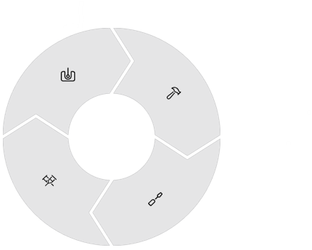
Combi drills for protection system installation
Drilling mode
Hammer drilling mode
Used for creating pilot holes in various materials including wood, plastic, and light metals commonly used in protection system housings
Provides light impact action for drilling into brick and masonry when installing sensors or running cable paths
Torque settings
Driver mode
Adjustable to prevent over-tightening and damage to delicate protection system components
For inserting and removing screws and bolts during component mounting and equipment housing assembly

Slide 22
Combi drills for protection system installation
Combination drills represent one of the most versatile power tools in a protection system technician's arsenal.
Their multi-functionality allows a single tool to handle multiple aspects of installation work, from creating mounting holes to driving fasteners.
When selecting a combi drill, consider battery life and charging time for cordless models, as these factors significantly impact workflow on larger installations. Modern lithium-ion batteries offer improved performance, but carrying a spare battery ensures uninterrupted work.

Slide 23
Impact drivers
An impact driver is a power tool designed to drive screws and bolts with high torque and minimal effort. It uses a rotational hammering action to deliver bursts of force, making it especially effective for tough materials and long fasteners.
Key features
High torque output: Much greater than a standard drill, ideal for driving large screws or bolts.
Compact design: Typically, shorter and lighter than drills, making it easier to use in tight spaces.
Hex chuck: Accepts ¼-inch hex shank bits, allowing quick bit changes.
Impact mechanism: Combines rotation with concussive blows to reduce strain on the user’s wrist.

Slide 24
Impact drivers
Common uses
Driving long screws into wood or metal.
Fastening lag bolts and deck screws.
Automotive work (e.g. removing stubborn bolts).
Construction and framing tasks.

Slide 25
Impact drivers – advantages over a drill
Feature | Impact Driver | Drill
Torque | High | Moderate
Bit Grip | Hex Chuck | Keyless
Screw Driving | Excellent | Good
Hole Drilling | Limited | Excellent
Wrist Strain | Limited | Higher under load
Limitations
Not ideal for precise drilling (use a drill instead).
Requires hex-shank bits.
Can be noisy due to the impact mechanism.

Slide 26
Electric screwdrivers
Electric screwdrivers significantly increase efficiency when working with protection systems that require numerous fasteners, such as control panels, junction boxes, and equipment housings.
The ability to maintain consistent torque across multiple fasteners ensures uniform pressure on gaskets and seals, which is particularly important for components installed in exposed or damp locations.
Cordless models offer the greatest flexibility, especially when accessing confined spaces or working at heights.
When selecting an electric screwdriver, prioritise models with ergonomic designs that reduce fatigue during extended use, as well as those with LED work lights to illuminate connection points in dimly lit equipment housings and cabinets.

Slide 27
Digital multimeters
Essential measurement functions
Advanced features
Safety considerations
DC voltage (0-50V typical for protection systems)
Resistance (verifying continuity and component values)
Continuity with audible indication (tracing circuits)
Current measurement (system power consumption)
Auto-ranging capability
Data hold function
Min/max recording
Backlit display for low-light environments
True RMS measurement for accuracy with non-linear loads
CAT III or better safety rating
Properly rated test leads
Fused current inputs
Double insulation construction
Regular verification of meter functionality

Slide 28
Digital multimeters
The digital multimeter is the primary diagnostic tool for a protection system. A quality multimeter can:
verify power supplies
check sensor operation
troubleshoot system faults.
When selecting a meter, choose one specifically designed for electronic work with sufficient resolution for low-voltage measurements.
These meters are specifically manufactured for use with electronic systems and are not generic.

Slide 29
RF signal strength meters
Applications in protection systems
Key measurement parameters
RF signal strength meters are essential when installing and maintaining wireless protection system components such as:
Wireless door/window contacts
Motion sensors with wireless transmission
RF-based panic buttons and personal alarms
Wireless cameras and recording devices
Signal repeaters and network extenders.
These specialised meters provide critical
measurements including:
Signal strength in dBm or relative units
Signal-to-noise ratio (SNR)
Frequency verification
Interference detection
Transmission quality assessment.

Slide 30
RF signal strength meters
Proper use of RF signal strength meters ensures reliable wireless protection system operation by identifying optimal component placement and detecting potential sources of interference.
During initial system design, these meters help determine the necessary coverage patterns and identify dead spots requiring additional repeaters or alternative component positioning.
When troubleshooting existing installations, the meter can quickly identify whether communication problems stem from signal weakness, interference, or component failure.
This targeted diagnostic approach significantly reduces resolution time compared to trial-and-error methods.

Slide 31




Network cable testers
Basic continuity testing
Wire map analysis
Verifies all conductors in the cable are properly connected from end to end without shorts or opens. This is the minimum testing requirement for any network cable in a protection system.
Identifies specific wiring errors including crossed pairs, reversed pairs, and split pairs that may not be detected by simple continuity tests but can impact data transmission.
Performance certification
Fault location
Advanced testers verify that cables meet transmission standards for the required category (Cat5e, Cat6, etc.), measuring parameters such as near-end crosstalk, attenuation, and return loss.
Time-domain reflectometry (TDR) functionality determines the precise distance to faults in the cable, allowing targeted repairs without unnecessary cable replacement.

Slide 32
Network cable testers
Modern protection systems increasingly rely on network infrastructure for communication between components, central monitoring, and integration with building management systems.

Slide 33
Smoke testing equipment
Smoke detectors
Approved testing methods:
Functional smoke test
Use aerosol smoke or a smoke-generating device to simulate real smoke entering the detector chamber.
Calibrated test mode
Some detectors allow activation via a magnet or remote tester to simulate alarm conditions.
Test poles with smoke capsules
Used for high-mounted detectors, allowing safe ground-level testing.
Manufacturer-specific tools
Always refer to the manufacturer’s instructions for approved testing procedures.

Slide 34
Smoke testing equipment
When testing smoke detection systems, it's essential to use equipment that produces appropriate particulates that will reliably trigger sensors without causing damage or leaving residue.
The testing method should be matched to the detector technology (ionisation, photoelectric, or multi-sensor) for accurate results.

Slide 35
Commissioning test equipment
System-specific test sets
Universal test equipment
Calibration equipment
Manufacturer-provided test equipment designed specifically for their protection systems. These typically include simulators for various alarm conditions, calibration tools, and specialised interface cables. They provide the most comprehensive testing capability but are limited to specific system types.
Third-party devices capable of testing multiple system types. These offer greater versatility for technicians working with various manufacturers' equipment but may not support all specialised functions of proprietary systems. Modern versions often feature software updates to accommodate new system types.
Precision instruments for verifying and adjusting sensor accuracy. These include temperature simulators, gas concentration sources, pressure references, and optical calibration tools. Proper calibration ensures the protection system responds appropriately to actual threat conditions.

Slide 36
Commissioning test equipment
Commissioning represents the critical final phase of protection system installation, where proper operation must be verified under various conditions.
Using appropriate test equipment ensures that all system components function correctly both individually and as an integrated system.

Slide 37




Programming devices
Laptops and Tablets
Dedicated programmers
On-board programming
Mobile applications
General-purpose computing devices used with manufacturer-specific software. These offer flexibility and familiar interfaces but require appropriate connection adaptors and up-to-date software installations.
Manufacturer-specific devices designed exclusively for configuring their protection systems. While limited to specific brands, they typically offer more streamlined workflows and robust connections.
Some systems allow direct programming through integrated keypads and displays. This method requires no additional equipment but offers less intuitive interfaces and limited documentation capabilities.
Increasingly popular for modern systems, these apps convert smartphones into programming interfaces, often using Bluetooth or NFC connections for secure local access.

Slide 38
Programming devices
Programming devices provide the interface between the user and the protection system's configuration settings.
The appropriate choice depends on system complexity, frequency of programming tasks, and manufacturer requirements.
Many modern systems support multiple programming methods, giving flexibility based on the specific situation.

Slide 39


Programming software
Basic configuration tools
Entry-level software for simple system setup
Advanced programming suites
Comprehensive tools for complex installations
System simulation software
3
Virtual testing before physical implementation

Slide 40
Programming software
Programming software serves as the primary interface for configuring protection system behaviour, establishing monitoring parameters, and defining response protocols. Basic configuration tools typically offer template-based setup with limited customisation options, suitable for standard installations following common patterns.
Advanced programming suites provide comprehensive control over all system aspects, including complex logic operations, integration with other building systems, and detailed reporting configurations. These typically include visual programming interfaces, allowing technicians to create custom behaviours without extensive coding knowledge.
System simulation software enables virtual testing of configurations before deployment, identifying potential issues with interaction between components and verifying proper operation under various scenarios. This reduces commissioning time and improves system reliability.

Slide 41
Tool selection principles
Task suitability
Quality assessment
Select tools specifically designed for the particular operation being performed on the protection system
Evaluate tool construction, materials, and durability for professional-grade performance in repeated use
Efficiency impact
Safety features
Consider how the tool affects work speed, precision, and overall installation quality
Prioritise tools with appropriate safety features such as insulation, guards, and ergonomic design

Slide 42
Tool selection principles
Proper tool selection is fundamental to protecting system installation quality and safety. The principle of task suitability ensures that each tool is appropriate for its intended purpose. Using improper tools not only reduces work quality but often increases the risk of damage to the system.
When assessing tool quality, consider not just the immediate purchase cost but the total lifecycle value. Professional-grade tools typically offer greater precision, longer service life, and better reliability, resulting in superior installations with fewer callbacks and maintenance issues.

Slide 43





Manufacturer's instructions
System-specific requirements
1
Tools and procedures explicitly required by manufacturer
Warranty compliance
Using approved tools to maintain system certification
General best practices
Industry-standard approaches for common tasks

Slide 44
Manufacturer's instructions
Manufacturer's instructions are the authoritative source for tool selection and usage when installing protection systems. These instructions often specify:
particular tool types • calibration requirements • usage techniques
that have been validated through extensive testing with the specific system components.
System-specific requirements may include specialised tools unique to certain brands or models, particularly for programming, calibration, and commissioning operations. Using these specified tools ensures compatibility and proper system functionality, while substitutions may lead to inconsistent performance or damage.
Warranty is particularly important, as many manufacturers stipulate that installation and maintenance must be performed using approved tools and methods to maintain certification. Non-compliance can void warranties and potentially affect insurance or regulatory approval of the installed system.

Slide 45




Safety checks: equipment condition
Visual inspection
Functional testing
Before using any tool or equipment, conduct a thorough visual inspection for signs of damage including cracked casings, frayed cords, loose components, and excessive wear. Pay particular attention to insulation on electrical tools.
Verify proper operation of all tools before beginning work on protection systems. This includes checking that moving parts operate smoothly, power tools run without unusual noise or vibration, and test equipment provides accurate readings.
Calibration verification
Cleanliness assessment
Confirm that all measuring and testing equipment is within its calibration period. Using out-of-calibration equipment can lead to improper installations that fail to meet required standards or function incorrectly.
Ensure tools are clean and free from debris that could contaminate protection system components. This is particularly important for tools used on optical components and sensitive electronic devices.

Slide 46
Safety checks: equipment condition
Establishing a routine of safety checks before beginning work is essential.
This practice not only enhances personal safety but also contributes significantly to installation quality and system reliability.

Slide 47
Selecting appropriate test leads
Voltage rating
Connector types
Test leads must be rated for the maximum voltage present in the system being tested. Using underrated leads creates serious safety hazards including insulation breakdown and potential electric shock.
CAT I: Electronic equipment (0-50V)
CAT II: Single-phase loads (50-250V)
CAT III: Three-phase distribution (250-600V)
CAT IV: Primary supply level (>600V)
Select test leads with appropriate connectors for both the test equipment and the connection points on the protection system. Using improper adapters or forcing connections can damage equipment and compromise test accuracy.
Banana plugs for standard multimeters
BNC connectors for oscilloscopes
Alligator clips for hands-free connections
Fine-tip probes for circuit board testing
IC hooks for connecting to component leads

Slide 48
Selecting appropriate test leads
The selection of appropriate test leads is often overlooked but represents a critical safety and functionality consideration.
Quality test leads provide accurate measurements, reliable connections, and essential safety barriers between the technician and potentially hazardous voltages.

Slide 49
Power tool speed settings
Drilling applications
Driving applications
Material considerations
Speed selection for drilling operations depends on both the material being drilled and the hole diameter:
High speed (1500-2500 RPM): Small holes in soft materials like wood and plastic.
Medium speed (800-1500 RPM): General purpose drilling in mixed materials.
Low speed (400-800 RPM): Large diameter holes or dense materials like masonry.
When using power tools to drive screws and fasteners in protection system installations:
Low speed with high torque for large fasteners.
Medium speed for general assembly work.
Higher speeds with reduced torque for small fasteners in soft materials.
Different materials require specific speed settings to prevent damage:
Plastic enclosures: Lower speeds to prevent melting.
Metal panels: Moderate speeds with cooling periods.
Circuit board mounting: Precise low-speed control.

Slide 50
Power tool speed settings
Proper speed setting selection is essential for both work quality and tool longevity. Excessive speed generates heat that can damage both the material being worked and the tool itself.
Insufficient speed may cause binding and stalling, potentially resulting in loss of control or incomplete operations.

Slide 51

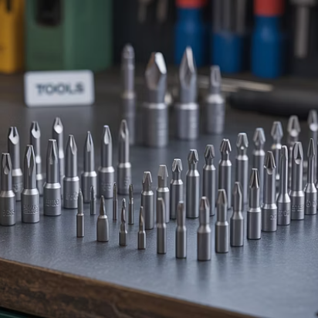

Tool attachments
Selecting the appropriate attachments for power tools is crucial for the quality of protection system installation. Drill bits must match both the material being drilled and the mounting hardware being used. Using masonry bits for concrete installations, wood bits for timber mounting boards, and metal bits for steel enclosures ensures clean, properly sized holes.
Screwdriver bits must precisely match fastener types to prevent stripping, particularly with security fasteners often used in protection systems. Many modern systems use specialised screw heads specifically to prevent tampering.

Slide 52




Correct attachment installation
Select appropriate attachment
Inspect before installation
Secure properly
Test before use
Follow manufacturer's procedure for attachment installation, ensuring it is fully seated and locked.
Briefly operate the tool at low speed to verify attachment is secure and operating correctly.
Choose the correct type and size for the specific task, ensuring compatibility with both the tool and the material.
Check attachment for damage, wear, or debris that could affect performance or create hazards.

Slide 53
Correct attachment installation
Installing the attachment correctly is fundamental to both safety and work quality when using power tools for protection system installation. Improperly secured attachments can come loose during operation, potentially causing injury or damage to system components or users.
For drill bits, ensure they are inserted to the full depth of the chuck jaws and tightened evenly. With SDS tools, verify that bits are fully seated and locked into the mechanism before applying power. For quick-change systems common on electric screwdrivers, confirm that attachment retention mechanisms have fully engaged before applying torque.

Slide 54
Safety guards
Inspection
1
Before using any power tool, verify that all guards are present, undamaged, and properly attached. Guards with cracks, distortion, or missing components must be replaced before use
2
Positioning
Ensure guards are correctly positioned according to manufacturer specifications. Many guards are adjustable to provide protection for different operations and working positions
Maintenance
3
Regularly clean and lubricate guard mechanisms to ensure smooth operation. Check mounting points for security and proper alignment during routine tool maintenance
Replacement
4
Never modify or remove guards. If a guard becomes damaged or lost, obtain a manufacturer-approved replacement before continuing to use the tool for protection system work

Slide 55
Safety guards
Safety guards are critical protection features on power tools, designed to prevent injuries from moving parts, ejected materials, and accidental contact.
In the context of protection system installation, they also help prevent damage to sensitive components from debris and accidental tool contact.

Slide 56



Personal Protective Equipment (PPE)
Eye protection
Hand protection
Safety glasses or goggles provide essential protection against flying debris, dust, and splinters common during drilling and cutting operations. Select models with side shields for comprehensive protection and consider impact ratings appropriate for the work being performed.
Work gloves protect against abrasions, punctures, and chemical exposure. For precision work on electronic components, consider ESD-safe gloves that prevent static discharge while maintaining tactile sensitivity and dexterity.
Respiratory protection
Hearing protection
Dust masks or respirators prevent inhalation of particulates generated during drilling into concrete, drywall, or other materials. Select the appropriate filtration level based on the materials being worked with.
Earplugs or earmuffs should be worn when using power tools that generate noise exceeding 85dB, including most drills, saws, and impact tools.

Slide 57
Personal Protective Equipment (PPE)
Consistent use of appropriate PPE is essential for safety during protection system installation and maintenance.
Different tasks require specific protective equipment.

Slide 58
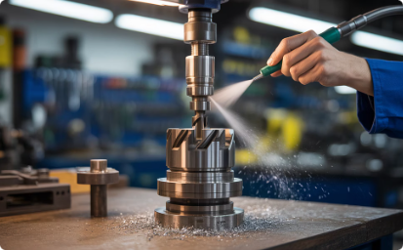
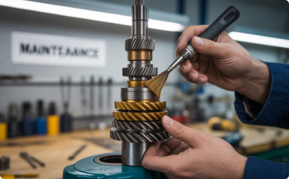

Tool maintenance
Regular cleaning
Remove dust, debris, and contaminants after each use to prevent buildup that can affect tool performance and longevity. Pay particular attention to moving parts, ventilation openings, and electrical contacts.
Proper lubrication
Apply manufacturer-recommended lubricants to moving parts according to the specified maintenance schedule. Different tools require specific lubricants - using incorrect types can damage components or attract debris.
Electrical safety
Regularly inspect cords, plugs, and internal wiring for damage, particularly after heavy use or accidental impacts. Replace damaged components immediately rather than attempting repairs.

Slide 59
Tool maintenance
Consistent maintenance extends tool life, improves performance, and enhances safety during the installation of protection systems.
Establish a routine maintenance schedule based on usage frequency and working conditions, with more frequent attention for tools used in dusty, humid, or corrosive environments.

Slide 60
Storage and transport
Protective cases
Tool bags and belts
High-quality cases with custom foam inserts provide the best protection for delicate test equipment and precision tools. These cases should:
Absorb impact through multi-layer foam.
Prevent moisture ingress with sealed designs.
Include pressure equalisation valves for air transport.
Feature secure latching mechanisms.
For commonly used hand tools, appropriate organisational systems include:
Padded tool bags with multiple compartments.
Tool belts with specific pouches for each tool.
Modular storage systems adaptable to daily requirements.
High-visibility internal colours to prevent tool loss.

Slide 61
Storage and transport
Proper storage and transport systems serve multiple functions beyond mere convenience. They:
protect tools from physical damage
prevent exposure to moisture and contaminants
allow quick verification that all necessary tools are present before departing a work site.
For travelling between multiple sites, vehicle organisation systems that secure tools during transport while providing easy access are particularly valuable. These may include:
drawer systems
secure shelving
quick-release mounting brackets for larger power tools and test equipment.

Slide 62
Tool inspection protocols
100%
Visual Inspection Rate
Every tool must undergo visual inspection before each use.

Slide 63
Tool inspection protocols
Establishing consistent tool inspection protocols is a fundamental safety practice.
Visual inspections should focus on identifying obvious defects such as damaged cords, cracked casings, loose components, and excessive wear that could compromise tool function or safety.
A more detailed examination of all tools and equipment is recommended and should be conducted in accordance with company policy, with documentation of the condition and any maintenance performed. These records provide traceability and help identify patterns of wear or damage that might indicate improper use or storage practices.
Formal electrical safety testing (PAT testing) should be conducted according to local regulations, typically annually for most equipment. This testing verifies that insulation remains intact and that protective earthing connections maintain continuity, preventing electric shock hazards.

Slide 64




Battery maintenance
Charging protocols
Temperature management
Storage practices
Replacement and disposal
Follow manufacturer's guidelines for charging cycles, avoiding both overcharging and complete depletion. Use only original or approved chargers designed specifically for the battery type.
Store and charge batteries within the specified temperature range, typically 10-25°C. Avoid exposure to extreme heat or cold, which can permanently damage cells.
For extended storage periods, maintain batteries at approximately 40-60% charge. Store in dry conditions away from metal objects that could cause short circuits.
Replace batteries showing signs of swelling, leakage, or significantly reduced capacity. Dispose of old batteries through appropriate recycling channels, never in general waste.

Slide 65
Battery maintenance
Battery-powered tools have become standard for protection system installation due to their portability and convenience.
However, maximising their reliability and service life requires specific maintenance practices tailored to the battery chemistry involved.

Slide 66
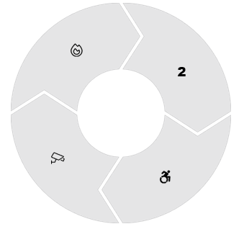

Tool selection for specific protection systems
Fire detection systems
Intrusion detection
Installation requires specialised tools for detector head installation, smoke testing equipment, and precision multimeters for circuit verification
Needs wireless signal strength meters, motion detector alignment tools, and glass-break simulators for sensitivity adjustment
Access control
CCTV systems
Requires specialised crimp tools for credential readers, door position switch alignment tools, and electronic lock adjustment equipment
Demands network cable testers, lens focus tools, and angle measurement devices for optimal camera positioning

Slide 67
Tool selection for specific protection systems
Different protection system types require specialised tools beyond the general toolkit.
Developing system-specific tool packages ensures you always arrive at job sites fully equipped for each installation's specific requirements, improving efficiency and quality.
When assembling these specialised kits, prioritise tools that address the unique challenges of each system type.
For example:
Fire detection installations often involve working at ceiling height, so extended-reach tools and stable work platforms are essential.
CCTV installations may require outdoor work in various weather conditions, necessitating tools that function reliably in those environments.

Slide 68
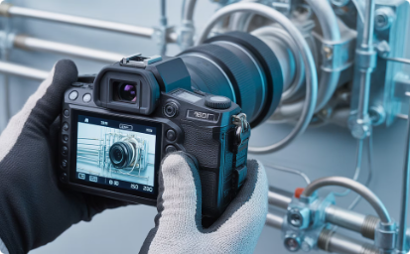
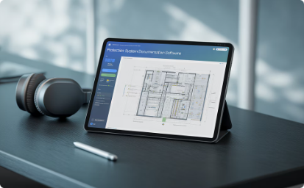
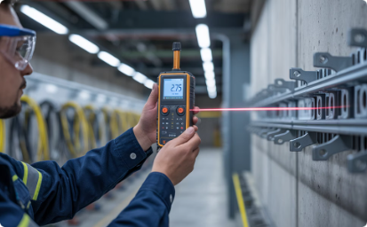
Documentation tools
Photography equipment
Digital cameras or smartphones with adequate resolution for capturing installation details, connection points, and site conditions. These visual records provide valuable reference for future maintenance and troubleshooting.
Digital documentation
Tablets and laptops with specialised software for recording installation details, test results, and system configurations. Modern solutions include integration with project management systems and cloud storage for immediate updates.
Measurement records
Tools for precisely documenting component locations and cable runs, including laser distance meters, measuring wheels, and digital angle finders. These measurements are essential for accurate as-built documentation.

Slide 69
Documentation tools
Thorough documentation is an essential component of protection system installation.
Proper records enable:
future maintenance
system expansions
troubleshooting
while also providing evidence of compliance with standards and specifications.

Slide 70




Key takeaways
Comprehensive toolkit
Maintain a complete set of hand tools, power tools, and specialised equipment
appropriate for protection system installation and maintenance tasks.
Proper tool selection
Choose tools based on specific task requirements, manufacturer recommendations,
and safety considerations rather than convenience or availability.
Regular inspection
Implement systematic inspection protocols for all tools and equipment, with particular
attention to safety-critical items like electrical testers.
Preventive maintenance
Follow established maintenance schedules for cleaning, lubrication, calibration,
and parts replacement to ensure tool reliability and longevity.

Slide 71
Key takeaways
The quality and reliability of protection system installations depend significantly on the tools used during the process. Investing in appropriate tools and maintaining them properly is not merely a cost of doing business but a fundamental aspect of delivering dependable protection systems.
By following the principles and practices outlined in this presentation, you'll be well-equipped to select, use, and maintain the complete toolkit required for professional protection system work.
Remember that your tools are an extension of your expertise-their condition and appropriateness directly reflect on your professionalism and the quality of your installations.

Slide 72
Summary
You should now be able to:
Understand the selection and use of tools and equipment when working with protection systems.
Inspect tools and equipment before use.
Understand the safe use and maintenance of tools and equipment.

Slide 73
Safety summary
We also highlighted the necessary safety checks to ensure equipment is safe to use. These checks include:
selecting appropriate instrument leads for tests, setting the correct speed
using the correct attachments, ensuring attachments are properly secured
having guards in place
using the correct personal protective equipment (PPE).

Slide 74
Any questions?
Copyright in this document belongs to and is used under licence from the Department for Education, © 2025.
‘T-LEVELS’ and ‘T Level’ are registered trademarks of the Department for Education.
WJEC is authorised by the Department for Education to develop and deliver this T Level Technical Qualification.
WJEC operates in England under the name Eduqas which is a registered trademark of WJEC.

