Slide 1
Occupational Specialism: Protection Systems Engineering
K1.17 Maintenance requirements for different building types and locations
PowerPoint 17: Maintenance requirements for different building types and locations

Slide 2
Introduction
This session outlines the regulatory frameworks and specific maintenance considerations for private, commercial, HMO and residential properties throughout the United Kingdom.
We'll explore how specialist regulations apply to unique facilities such as hospitals and chemical plants, helping engineers implement effective protective engineering systems that ensure both compliance and safety.

Slide 3
Objectives
By the end of this session, you should be able to:
Understand how maintenance requirements differ between general buildings and specialist premises (e.g. hospitals, data centres, heritage sites, high-rise residential).
Understand the impact of building use, occupancy, and risk profile on the frequency, scope, and method of system maintenance.
Complete maintenance planning that takes account of building type, specialist requirements, and applicable British Standards (e.g. BS 5839-1, BS 6266, BS EN 50131/50132/50133).

Slide 4
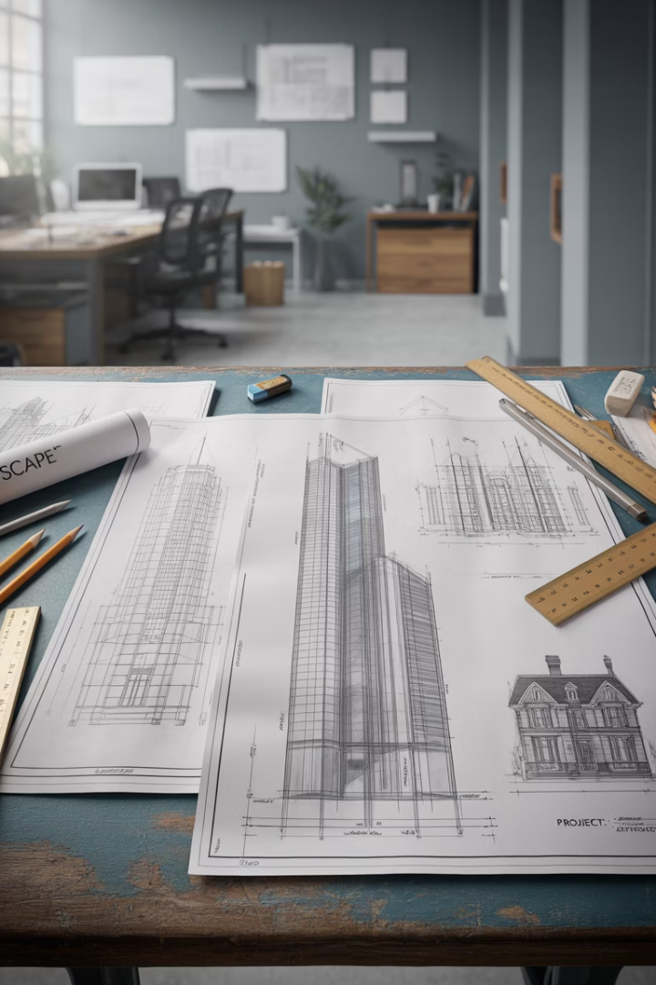




Overview
Private dwellings
Single-family homes, apartments, and duplexes primarily used for residential purposes by individual owners or tenants.
Commercial properties
Buildings used for business purposes including offices, retail spaces, warehouses, and industrial facilities.
Houses in Multiple Occupation (HMOs)
Residential properties occupied by three or more unrelated people forming more than one household, sharing facilities like bathrooms and kitchens.
Residential blocks
Purpose-built or converted buildings containing multiple separate dwelling units, including blocks of flats and apartment complexes.

Slide 5










Regulatory framework principles
Primary legislation
Acts of Parliament establishing fundamental requirements
Building regulations
Technical standards for construction and alteration
Approved documents
Practical guidance on meeting regulatory requirements
British Standards
Detailed specifications for materials, products and services
Industry codes of practice
Best practice guidance for specific sectors

Slide 6
Regulatory framework principles
The UK's building maintenance requirements follow a hierarchical structure, with each tier adding specificity.
This comprehensive regulatory framework ensures that buildings remain safe and functional throughout their lifecycle, while allowing for flexibility in various building types and uses.

Slide 7
Private dwelling maintenance requirements
Core responsibilities
Key maintenance areas
For privately owned dwellings, maintenance responsibilities primarily fall to the owner. However, certain systems must still meet regulatory standards to ensure safety and habitability. The Housing Act 2004 introduces the Housing Health and Safety Rating System (HHSRS) which identifies 29 potential hazards in dwellings.
Electrical systems: 10-yearly inspections recommended (5-year for rental)
Gas appliances: Annual safety checks required
Heating systems (gas): Regular servicing advised
Smoke/carbon monoxide detectors: Regular testing required
Structural integrity: Ongoing assessment needed
Energy efficiency: Minimum EPC ratings for rentals
Local authorities have enforcement powers to ensure these hazards are addressed, even in private dwellings, when they pose significant risks.

Slide 8










Commercial building maintenance
Scheduled inspections
Preventive maintenance
Regular professional assessments of all building systems
Proactive servicing to prevent
failures
Issue identification
Prompt recognition of developing problems
Documentation
Comprehensive record-keeping of all maintenance actions
Corrective repairs
Swift resolution of identified
issues

Slide 9
Commercial building maintenance
Commercial buildings require a more rigorous and formalised maintenance regime than private dwellings. The Regulatory Reform (Fire Safety) Order 2005 places particular emphasis on maintaining fire safety systems.
Additionally, the Workplace (Health, Safety and Welfare) Regulations 1992 require the suitable maintenance of workplaces, equipment, and devices.

Slide 10




Commercial building specific requirements
Fire safety systems
Weekly testing, 6-monthly and annual inspections
Electrical installations
5-yearly comprehensive inspections
HVAC Systems
Quarterly maintenance, annual efficiency testing
Lifts and Escalators
6-monthly thorough examinations

Slide 11
Houses in Multiple Occupation (HMOs)
Licensing requirements
Enhanced fire safety
Specific maintenance
schedules
Large HMOs (housing five or more unrelated people forming more than one household) require mandatory licensing from local authorities. This ensures they meet specific safety and quality standards before they can be legally let. Some councils have additional licensing schemes covering smaller HMOs.
HMOs require comprehensive fire safety measures including interconnected smoke alarms on each floor, heat detectors in kitchens, fire doors on high-risk rooms, protected escape routes, and potentially fire extinguishers/blankets. Annual fire risk assessments are mandatory, with documented evidence of compliance.
HMO regulations specify more frequent maintenance cycles than standard dwellings. This includes annual gas safety certificates, 5-yearly electrical safety certificates, regular PAT testing of provided appliances, and documented maintenance of all communal facilities including heating, lighting and sanitation systems.

Slide 12
Residential block maintenance
Safety systems
Fire alarm testing and maintenance
Emergency lighting inspections
Dry/wet riser testing
Smoke ventilation system servicing
Entrance door and access system upkeep
Lighting maintenance and testing
Disabled refuge
Intruder alarm system
Disabled alarms
Nurse call

Slide 13

Risk assessment and maintenance planning
Effective maintenance begins with systematic risk assessment, identifying critical systems whose failure would have significant safety, operational or financial impacts.
This risk-based approach helps to prioritise maintenance activities and resource allocation where they deliver maximum benefit.

Slide 14



Technology in building maintenance
Building management systems (BMS)
Integrated digital systems that control and monitor building mechanical and electrical equipment. Modern BMS platforms provide real-time data on system performance, allowing for predictive maintenance based on operational parameters rather than fixed schedules.
Augmented reality maintenance
AR technologies allow maintenance engineers to visualise hidden building systems and access digital maintenance manuals in real-time. This improves efficiency by providing contextual information exactly when and where it's needed during inspection or repair processes.
Remote inspection technologies
Drones, robots, and IoT sensors enable inspection of difficult-to-access areas without scaffolding or confined space entry. These technologies reduce risk to personnel while providing comprehensive data on building condition through high-resolution imagery and sensor readings.

Slide 15
Summary
Identify building classification and applicable regulations
Develop comprehensive maintenance programmes
Implement robust documentation systems
Ensure competent
personnel
Determine the precise regulatory framework applicable to your specific building type and use. Consider overlapping regulations when buildings have mixed uses or contain specialist facilities. Always apply the most stringent requirements when multiple regulations could apply.
Create tailored maintenance schedules that address all building systems with appropriate frequencies. Incorporate manufacturer recommendations, regulatory requirements, and historical performance data. Include provisions for both planned preventive maintenance and condition-based interventions.
Establish systematic record-keeping processes that demonstrate regulatory compliance. Maintain digital and physical records of all maintenance activities, inspection certificates, and remedial actions. Regularly review documentation to identify trends and systemic issues requiring attention.
Verify that all maintenance personnel possess appropriate qualifications and certifications for their roles. Provide ongoing training to keep staff updated on regulatory changes and technological advancements. Maintain records of staff competency for audit purposes.

Slide 16
Summary
You should now be able to:
Understand how maintenance requirements differ between general buildings and specialist premises (e.g. hospitals, data centres, heritage sites, high-rise residential).
Understand the impact of building use, occupancy, and risk profile on the frequency, scope, and method of system maintenance.
Complete maintenance planning that takes account of building type, specialist requirements, and applicable British Standards (e.g. BS 5839-1, BS 6266, BS EN 50131/50132/50133).

Slide 17
Any questions?
Copyright in this document belongs to and is used under licence from the Department for Education, © 2025.
‘T-LEVELS’ and ‘T Level’ are registered trademarks of the Department for Education.
WJEC is authorised by the Department for Education to develop and deliver this T Level Technical Qualification.
WJEC operates in England under the name Eduqas which is a registered trademark of WJEC.

