Slide 1
Occupational Specialism: Protection Systems Engineering
K1.16 Fault-finding and rectification techniques
PowerPoint 16: Fault-finding and rectification techniques

Slide 2
Introduction
This session is designed to equip you with the skills and knowledge necessary to identify, diagnose, and resolve electrical faults efficiently and safely.
We'll explore systematic approaches to fault diagnosis, practical testing methods, and effective rectification techniques that will enhance your technical capabilities in the field.
By mastering these essential skills, you'll become more proficient at maintaining and repairing electrical systems to the highest industry standards.

Slide 3
Objectives
By the end of this session, you should be able to:
Understand how to identify and analyse symptoms or data to recognise faults.
Explain the use of documentation (circuit schedules, specifications, drawings) to support fault-finding.
Complete fault diagnosis by:
determining characteristics through questioning and testing
applying rectification (adjust, repair, replace)
following safe systems of work
diagnosing electrical, electronic, and software-related faults
taking efficient action to resolve issues.

Slide 4

Overview
1
Understanding fault-finding methodology
Master systematic approaches to identifying electrical faults through symptom recognition and data analysis.
2
Diagnostic testing techniques
Learn proper use of testing equipment and interpretation of results to pinpoint fault locations.
3
Effective rectification methods
Develop skills in adjustment, repair, and replacement techniques to resolve identified issues.
4
Safety and compliance
Ensure all diagnostic and rectification work meets safety standards and regulatory requirements.

Slide 5



The importance of systematic fault-finding
Reduces downtime
Minimises system outages and production losses
Cost-effective solutions
Prevents unnecessary component replacement
Enhanced safety
Ensures hazards are properly identified
and managed

Slide 6
The importance of systematic fault-finding
A systematic approach to fault-finding is essential in modern electrical systems.
Without proper methodology, you can waste valuable time pursuing incorrect diagnoses, leading to extended downtime and unnecessary expenditure.
An unsystematic approach increases safety risks as intermittent or hidden faults may be overlooked.
By following structured diagnostic procedures, you'll develop the confidence to tackle complex systems efficiently, saving time and resources while maintaining safety standards.

Slide 7






The six-step fault-finding framework
Identify symptoms
Gather initial information about system behaviour, abnormalities, and user reports.
Collect and analyse data
Review system specifications, historical records, and documentation.
Question and discuss
Consult with operators and staff to understand fault characteristics.
Check and test
Perform systematic measurements and diagnostic tests.
Analyse results
Interpret findings to determine fault location and cause.
Implement solution
Apply appropriate rectification techniques (adjust, repair, replace).

Slide 8
The six-step fault-finding framework
This six-step framework provides a structured approach to electrical fault-finding that ensures no critical aspects are overlooked.
Each step builds upon the previous, creating a logical path from symptom identification to solution implementation.

Slide 9
Step 1: Symptom identification
Observable symptoms
Performance symptoms
Complete system failure
Slow response times
Intermittent operation
Unexpected behaviour
Unusual noises or vibrations
Partial functionality
Visual indications (smoke, sparks)
Voltage/current irregularities
Warning lights or error codes
Excessive heat generation
Symptom identification is the foundation of effective fault diagnosis. Clear, detailed observations provide crucial clues about potential fault locations. During this phase, document all abnormalities without making assumptions about their causes.
Remember to consider both what is happening and what should be happening but isn’t.
Often, the absence of expected behaviour is as significant as the presence of abnormal behaviour.
Be methodical in recording exact conditions under which symptoms occur, as intermittent faults may only appear under specific circumstances.

Slide 10
Symptom documentation best practices
Be specific
Note timing patterns
Capture environmental factors
Record exact nature of abnormalities with precise measurements where possible. Avoid vague descriptions like "not working properly" in favour of specific observations like "voltage drops from 240V to 195V under load".
Document when symptoms occur, including time of day, duration, frequency, and any correlation with other events or operations. For intermittent faults, identify any triggering conditions that precede the symptom.
Record ambient conditions such as temperature, humidity, vibration, or electromagnetic interference that might influence system operation. These factors often contribute to intermittent or elusive faults.

Slide 11
Symptom documentation best practices
Proper documentation creates a valuable record that can reveal patterns not immediately obvious.
Use standardised forms whenever possible to ensure consistency across your organisation.
Include photographs or videos of visual symptoms when appropriate, as these can prove invaluable during consultation with colleagues or manufacturers.

Slide 12



Step 2: Data collection and analysis
Review technical documentation
Analyse drawings and diagrams
Investigate maintenance history
Examine circuit schedules, installation specifications, equipment manuals, and maintenance records to understand expected system behaviour and historical issues.
Study circuit diagrams, installation layouts, and schematics to trace signal paths, identify components, and understand system architecture.
Review previous fault reports, repairs, and modifications to identify patterns or recurring issues that might indicate underlying problems.

Slide 13
Step 2: Data collection and analysis
Thorough data collection provides essential context for fault diagnosis.
Equipment rarely fails without reason, and maintenance history often reveals valuable clues about potential weak points or environmental factors affecting system performance.
Consider recent changes or modifications as potential fault sources. Even seemingly unrelated alterations to connected systems can introduce unforeseen issues through electromagnetic interference, voltage fluctuations, or grounding problems.

Slide 14










Critical technical documentation for fault-finding
Equipment manuals
Schematic diagrams
Original manufacturer documentation with specifications, operating parameters, and troubleshooting guides
Circuit schematics showing component interconnections and electrical relationships
Installation drawings
Physical layout plans showing equipment positioning, cable routes, and connection points
Test certificates
Commissioning data and baseline performance metrics
Maintenance records
History of repairs, modifications,
and recurring issues

Slide 15
Critical technical documentation for fault-finding
Always obtain the most current versions of technical documentation.
Outdated schematics can lead to misdiagnosis if modifications have been made without proper documentation updates.
Where possible, verify diagrams against the actual installation, as "as-built" conditions often differ from original designs.

Slide 16
Using circuit diagrams effectively
Identify system boundaries
Trace signal paths
Mark test points
Create testing
strategy
Determine which parts of the system are affected by the fault and trace the relevant sections of the circuit. Focus on functional blocks that relate to the observed symptoms.
Follow the flow of electricity through the system, identifying potential points of failure. Pay special attention to inputs, outputs, and control circuits related to the fault symptoms.
Identify strategic locations for measurements based on the circuit's architecture. Prioritise junction points, component terminals, and locations where signals change characteristics.
Develop a logical sequence of tests to narrow down potential fault locations efficiently. Start with subsystem isolation before moving to component-level testing.

Slide 17
Using circuit diagrams effectively
Circuit diagrams provide the roadmap for your diagnostic journey.
By methodically tracing signal flows and understanding component relationships, you can develop targeted testing strategies that minimise redundant checks and focus on likely fault areas.

Slide 18




Step 3: Gathering information through discussion
Operators
Maintenance staff
Facility managers
Technical support
Can provide details about when symptoms first appeared and any unusual events preceding them.
May have insights into recent work, modifications, or recurring issues.
Can explain operational patterns and environmental factors affecting equipment.
Manufacturer expertise on known issues and recommended testing procedures.

Slide 19
Step 3: Gathering information through discussion
Human intelligence is often your most valuable diagnostic resource.
Staff who work with equipment daily frequently notice subtle changes in operation before catastrophic failure occurs. Their observations can provide context that might not be apparent from technical measurements alone.
Ask open-ended questions that avoid suggesting specific causes, as this might bias responses. Focus on objective observations rather than interpretations. For example, ask "What did you notice before the machine stopped?" rather than "Did you hear a buzzing sound?"

Slide 20
Effective questioning techniques
Chronological approach
Sensory observations
Establish a timeline of events leading to the fault:
Gather information about perceptible signs:
When was the equipment last known to work correctly?
Were there any unusual sounds, smells, or vibrations?
What was happening immediately before the fault appeared?
Did any indicators or displays show abnormal readings?
Have similar issues occurred previously?
Was there any visible damage or discolouration?
Were any changes made to the system or environment recently?
Did temperature changes precede the fault?

Slide 21
Effective questioning techniques
Remember that different stakeholders notice different aspects of equipment operation.
Operators often focus on functional outcomes, while maintenance staff may be more attuned to mechanical or electrical symptoms.
By consulting multiple sources, you can build a more complete picture of the fault's characteristics.

Slide 22










Step 4: Checking and testing methods
Visual inspection
Sensory checks
Examine components for physical damage, overheating, loose connections
Listen for unusual noises, check for burning smells, feel for excessive heat
Software diagnostics
Run built-in tests, examine error logs, and analyse program execution
Basic measurements
Verify supply voltages, continuity, resistance, and insulation integrity

Slide 23
Step 4: Checking and testing methods
Testing should progress from non-invasive to more intrusive methods, starting with simple checks before proceeding to complex diagnostics. This approach minimises the risk of introducing new faults during the diagnostic process.
Always follow proper test equipment safety procedures and ensure instruments are appropriately rated for the circuits being tested. Incorrect application of test equipment can damage components or expose users to safety hazards.

Slide 24
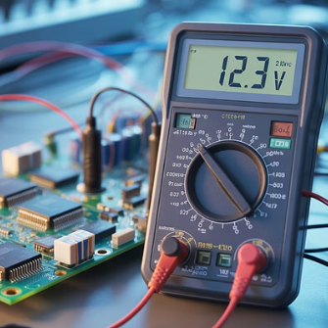
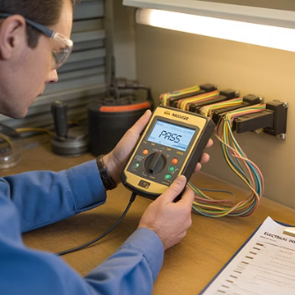

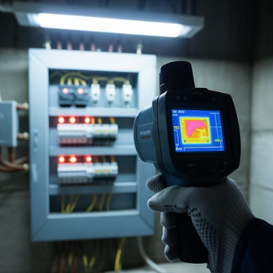
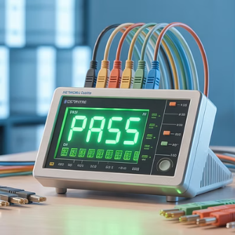
Essential diagnostic equipment
Your diagnostic toolkit should include instruments appropriate for the systems you maintain.
Basic equipment includes multimeters for voltage, current, and resistance measurements; insulation testers for checking cable integrity; and continuity testers for verifying circuit paths.
Investing in quality instruments ensures accurate readings and reliable diagnoses, ultimately saving time and resources.

Slide 25
Safety during testing procedures
Risk assessment
Personal Protective Equipment (PPE)
Safe isolation procedures
Always conduct a pre-work risk assessment to identify potential hazards.
Wear appropriate PPE for the task, including insulated gloves, safety glasses, boots and GS38-compliant tools, ensuring tools have proper insulation ratings for the voltage levels involved.
Follow proper lockout/tagout procedures when disconnecting equipment for testing. Verify isolation with appropriate instruments before beginning work and use insulated barriers for adjacent live parts.

Slide 26
Safety during testing procedures
Never compromise on safety during diagnostic procedures.
Live testing should only be performed when absolutely necessary and when no safer alternative exists. Even then, it should only be undertaken by qualified personnel following proper procedures and using appropriate equipment.
Remember that diagnostic activities often require unusual operating conditions or bypassing of normal safety systems, increasing the risk.
Always document temporary modifications and ensure they are properly restored after testing.

Slide 27







Voltage and current testing techniques
Verify supply voltage
Check input power quality and voltage levels
Test continuity of circuits
Measure cable continuity to ensure cables are sound
Check component terminals
Verify voltage at device inputs and outputs
Test current
4
Check current to ensure results match manufacturer
data sheets

Slide 28
Voltage and current testing techniques
When conducting voltage measurements, always work from the power source toward the load to systematically trace the path of electricity through the system.
This helps identify where voltage drops occur or where signals become distorted.
For current measurements, clamp meters provide safe, non-contact measurement without breaking the circuit.
Abnormal current readings often indicate problems such as excessive loads, partial short circuits, or failing components drawing more current than specified.

Slide 29
Continuity and resistance testing
Continuity testing applications
Resistance testing applications
Verifying complete circuits
Measuring component values
Identifying broken conductors
Detecting high-resistance joints
Tracing unmarked cables
Testing switch operation
Checking fuse integrity
Always ensure circuits are completely de-energised and isolated before performing continuity or resistance tests. Attempting these tests on live circuits can damage your test equipment and present safety hazards.
Use proper lockout/tagout procedures and verify isolation with a voltage tester.
When testing sensitive electronic components, be aware that some digital multimeters output sufficient voltage during resistance tests to damage components. For semiconductor devices, specialised component testers or diode test functions should be used instead of standard resistance ranges.

Slide 30
Testing electronic control systems
Input devices
Test detectors (smoke, heat, CO, flame) activate as specified.
Verify manual call points (MCPs), card readers, RTEs, and cameras.
Output devices
Check sounders, VADs, door releases/locks, relays, strobes, CCTV monitors.
Confirm devices operate with correct timing, sequence, and volume/coverage.
System functional response
Confirm correct zoning (only affected areas activate).
Test cause-and-effect programming (e.g. MCP releases doors, detector starts fans, alarm signals ARC).
Records and handover
Record measured values (sound levels, PSU load, battery capacity).
Document all tests in logbooks/commissioning certificates.

Slide 31
Testing electronic control systems
Modern control systems often include built-in diagnostic capabilities that should be leveraged during troubleshooting.
Use:
error logs
status indicators, and
self-test functions
to provide valuable insights into system operation and fault conditions.

Slide 32




Step 5: Analysis of test results
Compare with standards
Identify patterns
Evaluate test results against manufacturer specifications, industry standards, and installation requirements to identify deviations.
Look for relationships between multiple symptoms or test results that might indicate common causes or cascading failures.
Consider trends
Formulate hypotheses
Review historical data to determine if readings are stable, gradually changing, or suddenly different, providing clues about failure progression.
Develop potential explanations that account for all observed symptoms and test results, then plan verification tests.

Slide 33
Step 5: Analysis of test results
Effective analysis requires both technical knowledge and critical thinking.
Avoid confirmation bias by considering multiple possible causes rather than fixating on initial assumptions.
The simplest explanation that accounts for all observations is often correct, but complex systems sometimes experience multiple concurrent faults.

Slide 34
Common analysis pitfalls to avoid
Jumping to conclusions
Overlooking intermittent issues
Ignoring environmental factors
Avoid making assumptions based on limited data or previous experience with similar symptoms. Each fault should be evaluated on its own evidence, as different root causes can produce similar symptoms.
Don't dismiss inconsistent test results as equipment errors. Intermittent faults are often legitimate issues that only appear under specific conditions, requiring patient observation and creative testing approaches.
Remember that external conditions like temperature, humidity, vibration, and electromagnetic interference can significantly impact electrical systems, especially at their operational boundaries.

Slide 35
Common analysis pitfalls to avoid
Another common error is the "first fault fixation" - becoming so focused on the first problem you find that you miss additional issues.
Remember that some components fail due to stresses caused by other faulty parts.
Identifying and replacing only the visibly failed component may lead to repeated failures if the root cause remains unaddressed.

Slide 36




Decision-making in fault diagnosis
Consider probability
Evaluate impact
Assess
accessibility
Balance effort
Start with the most likely causes based on symptoms and system history.
Prioritise tests based on criticality and downtime implications.
Factor in ease of testing different components or subsystems.
Weigh potential diagnostic gains against required time and resources

Slide 37
Decision-making in fault diagnosis
Efficient fault-finding requires strategic decision-making about which hypotheses to pursue first.
The "divide and conquer" approach is often effective - testing at midpoints in circuits to eliminate half the potential fault locations with each test. This binary search method minimises the number of measurements needed to locate faults.
For complex systems, consider using fault tree analysis to map possible causes and their relationships.
This structured approach helps ensure thorough investigation and provides documentation for future reference.

Slide 38









Step 6: Fault rectification overview
Adjust
Repair
Calibrate settings or modify parameters to correct operation
Fix damaged components or connections without replacement
Verify
Replace
Test thoroughly to confirm proper operation after rectification
Substitute faulty components with new or refurbished parts

Slide 39
Step 6: Fault rectification overview
After identifying the fault, selecting the appropriate rectification method is crucial for effective resolution.
The choice between adjustment, repair, or replacement depends on factors including fault type, component condition, system criticality, available resources, and long-term reliability requirements.
Always consider the root cause when planning rectification. Simply replacing a failed component without addressing what caused it to fail may lead to recurring issues. For example, replacing an overheated motor without investigating the cause of overheating will likely result in another failure.

Slide 40
Adjustment techniques
Mechanical adjustments
Electrical adjustments
Alignment of moving parts
Calibration of sensors and instruments
Tightening of loose connections
Setting of protection relay thresholds
Clearance and tolerance setting
Adjustment of timer settings
Programming of electronic controls
Adjustment is appropriate when components are functioning but operating outside optimal parameters. This rectification method is often the least invasive and most cost-effective, requiring minimal parts and resources. However, it's essential to follow manufacturer specifications and documented procedures.
Always document adjustments made, including before and after values. This creates a record for future reference and helps identify whether parameters are drifting over time, which might indicate underlying issues requiring more substantial intervention.

Slide 41

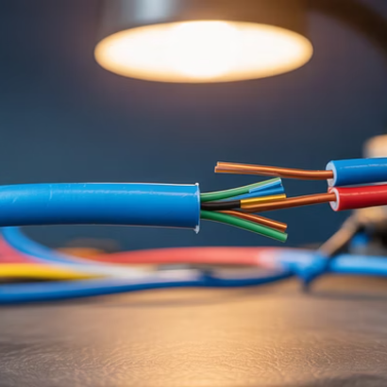
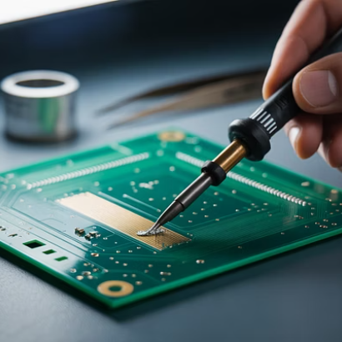
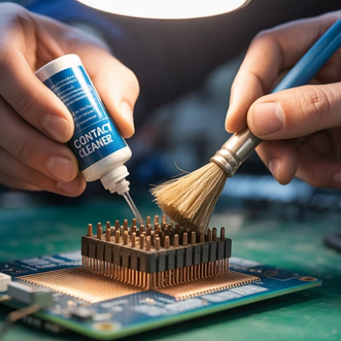
Repair techniques for electrical systems
Repair involves restoring damaged components to functional condition without complete replacement. This approach is often suitable for simple mechanical damage, connection issues, or when replacement parts are unavailable or prohibitively expensive.
Successful repairs require proper techniques and materials rated for the application. Improvised repairs may create safety hazards or reliability issues. Always consider whether a repair will provide the necessary reliability for the system's criticality. Safety-critical systems typically warrant component replacement rather than repair.

Slide 42



Replacement strategies
Component-level replacement
Replacing individual parts like input and output devices
Board-level replacement
Substituting entire circuit boards or modules
Unit replacement
Installing complete new units or subsystems

Slide 43
Verifying successful rectification
1
Functional testing
2
Performance validation
Verify the system operates correctly under normal conditions, performing all expected functions without errors or abnormalities.
Check that the system meets specified performance parameters including speed, accuracy, power consumption, and output quality.
3
Operational monitoring
Observe the system during an extended operational period to catch intermittent issues that might not appear during brief testing.

Slide 44
Verifying successful rectification
Thorough verification is essential to ensure that repairs are effective and haven't introduced new issues.
Documentation of testing procedures and results provides evidence of proper rectification and serves as a baseline for future performance evaluation.
Remember that successful rectification includes not just fixing the immediate fault, but ensuring the system's overall integrity. Secondary inspections of related components often reveal potential issues before they develop into failures.

Slide 45




Root cause analysis
Why did it happen?
Identify the fundamental cause behind the symptom
What connections exist?
2
Discover relationships between system elements
How can we prevent recurrence?
3
Implement preventive measures and
system improvements

Slide 46
Root cause analysis
Root cause analysis (RCA) looks beyond immediate symptoms to identify underlying issues that led to failure.
This process is crucial for preventing repeated failures and improving system reliability.
Common root causes include design flaws, installation errors, maintenance deficiencies, operational misuse, and environmental stresses.
Techniques like the "5 Whys" method involve repeatedly asking why a failure occurred, drilling down through layers of causation to reach fundamental issues.
Other approaches include fault tree analysis, fishbone diagrams, and failure mode and effects analysis (FMEA).

Slide 47
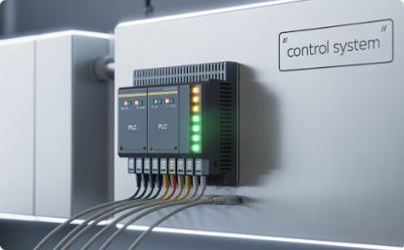
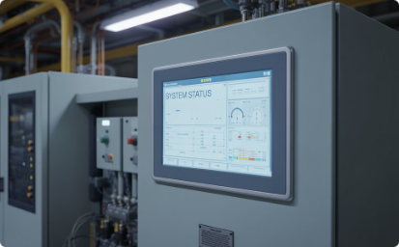
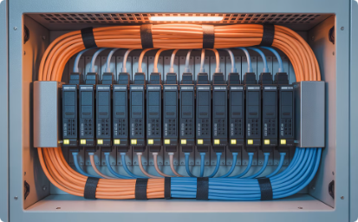
Specialised fault-finding: Control systems
Programmable logic controllers
Check input/output status indicators, program execution status, and communication health. Common issues include sensor failures, incorrect program logic, memory corruption, and power supply problems.
Human-machine interfaces
Verify communication with controllers, screen functionality, and touch calibration. Issues often relate to communication protocols, power supply fluctuations, or physical damage to display components.
Communication networks
Check network connectivity, data transmission quality, and protocol compatibility. Common faults include cable damage, improper termination, addressing conflicts, and electromagnetic interference.

Slide 48
Specialised fault-finding: Control systems
Modern control systems require a methodical approach that considers hardware, software, and communication aspects.
Use built-in diagnostics and monitoring tools to identify issues, paying particular attention to input/output health, program execution, and network communications.

Slide 49
Specialised fault-finding: Electronic circuits
Visual inspection
Power distribution check
Examine for physical damage, bulging capacitors, burnt components, dry solder joints, or signs of overheating. Many electronic faults leave visual evidence that can quickly narrow down the search area.
Verify all supply voltages are present and within specification at key points throughout the circuit. Many electronic failures result from power supply issues rather than component failure.

Slide 50
Specialised fault-finding: Electronic circuits
Electronic troubleshooting requires careful handling to prevent electrostatic damage to sensitive components.
Always use anti-static precautions including wrist straps, mats, and proper grounding when working with modern electronics.

Slide 51




Fault-finding in digital systems and software
Error codes analysis
Log file examination
Interpret system-generated error messages and codes using manufacturer documentation. These often provide specific clues about failure modes and affected subsystems.
Review system logs to identify patterns, sequence of events, and timing relationships. Look for errors, warnings, or unusual events preceding the fault.
State machine verification
Memory integrity check
Confirm proper progression through operational states and correct response to inputs. Identify stuck states or improper transitions that prevent normal operation.
Verify program and data memory for corruption, addressing errors, or capacity issues. Memory problems often cause unpredictable or intermittent behaviour.

Slide 52
Fault-finding in digital systems and software
Software and digital system faults can be particularly challenging due to their complex and sometimes non-deterministic nature.
Version compatibility issues are common when system components are upgraded inconsistently. Always check for recent software updates, configuration changes, or security patches that coincide with the onset of problems.

Slide 53
Intermittent fault diagnosis
Extended monitoring
Use data loggers and recorders to capture system performance over extended periods, triggering on predefined fault conditions. This helps identify patterns related to time, temperature, load, or other variables that may not be apparent during brief testing.
Intermittent faults present a significant diagnostic challenge because they may not be present during testing.
Patient, methodical investigation is essential. Document precisely when and under what conditions the fault occurs, looking for correlations with environmental factors, load conditions, or operational patterns.

Slide 54





Safety considerations during fault-finding
Personal protection
Use appropriate PPE for electrical hazards
Safe isolation
Follow proper lockout/tagout procedures
Proper tools
Use insulated, rated equipment for electrical work
Teamwork
Have assistance for high-risk activities
Permits and procedures
Comply with all safety protocols and regulations

Slide 55
Safety considerations during fault-finding
Electrical fault-finding inherently involves working with potentially hazardous systems.
Never compromise safety for expediency.
Always conduct a thorough risk assessment before beginning work, identifying potential hazards and implementing appropriate control measures.
Be particularly cautious when fault-finding requires measurements on live equipment.
Use properly rated test equipment, maintain safe working distances, and use insulating barriers to prevent accidental contact with live parts.
Where possible, use remote measurement techniques or temporary monitoring equipment to minimise exposure to hazards.

Slide 56








Preventive measures to reduce electrical faults
Condition monitoring
Ongoing analysis of system parameters to detect deterioration
Regular maintenance
Scheduled inspections and service to identify potential issues
Environmental protection
Controlling temperature, humidity, dust, and vibration
3
Operator training
Ensuring proper system operation and early problem recognition
Power quality management
4
Maintaining stable, clean power supply to equipment

Slide 57
Preventive measures to reduce electrical faults
Proactive maintenance strategies dramatically reduce the frequency and severity of electrical faults.
Techniques such as thermographic surveys, ultrasonic inspection, vibration analysis, and insulation resistance trending can identify developing issues before they cause system failure.
Design considerations also play a crucial role in fault prevention.
Proper component selection with adequate ratings, appropriate protection devices, good cable management, and effective cooling all contribute to system reliability.
For critical systems, redundancy and fail-safe designs provide additional protection against unexpected failures.

Slide 58
Professional development for fault-finding skills
Technical knowledge
Practical skills
Personal attributes
Electrical theory and principles
Measurement techniques
Analytical thinking
Component characteristics and failure modes
Systematic troubleshooting approaches
Attention to detail
Patience and persistence
System architecture and interactions
Repair and rectification methods
Problem-solving creativity
Safety procedures and risk assessment
Communication skills
Diagnostic equipment operation
Documentation and reporting
Industry standards and regulations

Slide 59
Professional development for fault-finding skills
Developing expertise in fault-finding requires a combination of theoretical knowledge, practical experience, and personal attributes.
Structured training should include both classroom learning and hands-on practice with realistic fault scenarios.
Mentoring relationships with experienced technicians provide valuable knowledge transfer that goes beyond formal training materials.
Documenting and discussing challenging fault cases helps build organisational knowledge and prepares less experienced staff for complex diagnostic situations.

Slide 60




Diagnostic equipment selection and use
Match equipment to application
Maintain calibration
Select instruments with appropriate measurement ranges, accuracy specifications, and safety ratings for the systems being tested. Using underrated equipment creates safety hazards, while overspecified equipment increases costs unnecessarily.
Ensure all test equipment is regularly calibrated to recognised standards. Calibration certificates should be current and traceable. Inaccurate measurements lead to incorrect diagnoses and wasted effort.
Proper handling and storage
User competence
Protect sensitive instruments from physical damage, environmental extremes, and electromagnetic interference. Many diagnostic errors result from damaged or deteriorated test equipment giving false readings.
Ensure technicians are properly trained in equipment operation, measurement techniques, and result interpretation. Sophisticated instruments require specific knowledge for effective use.

Slide 61
Diagnostic equipment selection and use
Modern diagnostic equipment often features advanced capabilities such as data logging, wireless connectivity, and automated test sequences. These features can enhance diagnostic efficiency but require proper understanding to be used effectively.
Consider total ownership costs when selecting equipment, including calibration requirements, consumables, software updates, and expected service life.
Quality instruments represent a significant investment but deliver reliability and accuracy that ultimately save time and improve diagnostic outcomes.

Slide 62





Continuous improvement in fault-finding
Collect data
Maintain comprehensive fault records and resolution details.
Analyse patterns
Identify recurring issues and common failure modes.
Develop solutions
Create targeted improvements based on analysis.
Implement changes
Apply modifications to systems and procedures.
Evaluate results
Measure effectiveness and refine approach.

Slide 63
Continuous improvement in fault-finding
A structured approach to continuous improvement transforms individual fault events into organisational learning opportunities.
By systematically analysing patterns across multiple incidents, engineers can identify underlying causes that might not be apparent when viewing each fault in isolation.
Regular review meetings help disseminate knowledge throughout the technical team and provide opportunities to discuss challenging cases.
Cross-training in different system types broadens diagnostic capabilities and encourages fresh perspectives on persistent problems. Documentation of successful diagnostic techniques creates valuable reference material for future fault-finding activities.

Slide 64











Summary
Systematic approach
Documentation
Follow structured methodology from symptom identification to solution verification
Maintain thorough records of faults, tests, and rectification actions
3
Collaborative approach
Safety first
Share knowledge and seek input from colleagues on complex issues
Never compromise safety for speed or convenience during fault-finding
Root cause focus
Proper tools
Look beyond symptoms to address underlying issues
Use appropriate, calibrated equipment for accurate diagnosis

Slide 65
Summary
You should now be able to:
Understand how to identify and analyse symptoms or data to recognise faults.
Explain the use of documentation (circuit schedules, specifications, drawings) to support fault-finding.
Complete fault diagnosis by:
determining characteristics through questioning and testing
applying rectification (adjust, repair, replace)
following safe systems of work
diagnosing electrical, electronic, and software-related faults
taking efficient action to resolve issues.

Slide 66
Any questions?
Copyright in this document belongs to and is used under licence from the Department for Education, © 2025.
‘T-LEVELS’ and ‘T Level’ are registered trademarks of the Department for Education.
WJEC is authorised by the Department for Education to develop and deliver this T Level Technical Qualification.
WJEC operates in England under the name Eduqas which is a registered trademark of WJEC.

