Slide 1
Occupational Specialism: Protection Systems Engineering
K1.15 Types of protection system maintenance
PowerPoint 15: Types of protection system maintenance

Slide 2
Introduction
In this session, we will look at:
the different approaches to maintaining protection systems
the legal frameworks that govern these activities, and
the specific tests required during maintenance procedures.
Whether you're responsible for planning maintenance schedules or performing hands-on testing, this will give you the essential knowledge needed to ensure protection systems remain fully operational and compliant with industry standards and regulations.

Slide 3
Objectives
By the end of this session, you should be able to:
Understand the difference between planned (preventive) and reactive (corrective) maintenance.
Understand the legal and regulatory responsibilities for maintaining protection systems.
Understand the types of system tests required and their frequencies (weekly, periodic, annual).
Record maintenance activities accurately, including test results, defects, and updates to documentation.
Carry out basic maintenance tasks in line with standards and manufacturer instructions.

Slide 4





Overview
Types of protection system maintenance
Exploring PPM and reactive maintenance approaches
Legal requirements and responsibilities
Understanding the regulatory framework
Documentation and O&M manuals
Proper record-keeping procedures
Essential maintenance tests
Required testing for various protection systems

Slide 5
Overview
We'll begin by examining the differences between planned preventative maintenance and reactive maintenance before exploring the advantages and limitations of each.

Slide 6
Overview of protection system maintenance types
Planned preventative maintenance (PPM)
Reactive maintenance
A scheduled approach to maintenance that aims to identify and address potential issues before they cause system failure. Maintenance activities are performed at predetermined intervals based on manufacturer recommendations, industry standards, and operational experience.
An approach where maintenance is performed only after equipment failure or malfunction has occurred. This method addresses issues as they arise rather than attempting to prevent them proactively.
Reactive maintenance involves emergency repairs, troubleshooting, component replacement, and system restoration following a failure event, often requiring immediate attention to restore protection functionality.
PPM includes routine inspections, testing, cleaning, calibration, and component replacement to maintain optimal system performance and extend service life.

Slide 7
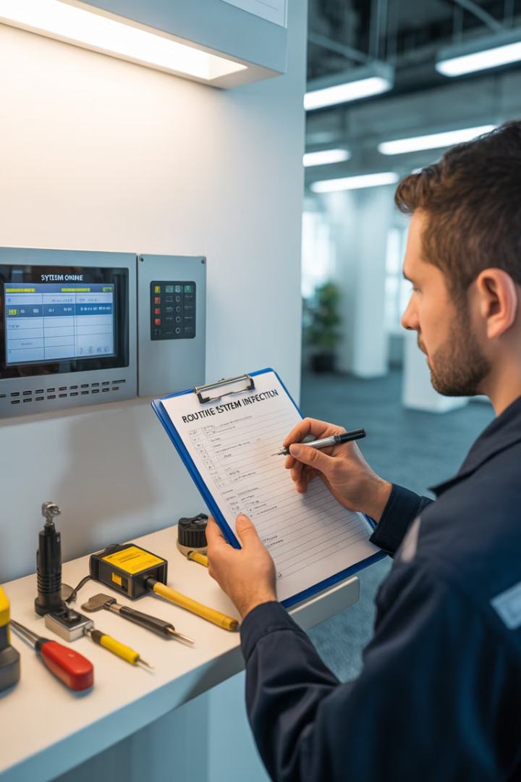




What is planned preventative maintenance?
Scheduled routine activities
Regular inspections and tests conducted according to predetermined intervals established by risk assessment, manufacturer guidelines and regulatory requirements.
Proactive problem identification
Systematic examination of protection systems to detect potential issues before they result in system failure or compromised protection.
Preventative actions
Calibration, cleaning, lubrication, component replacement and system adjustments performed to maintain optimal functionality and prevent degradation.
Performance monitoring
Ongoing assessment of system metrics and response characteristics to identify trends and potential deterioration requiring intervention.

Slide 8

What is reactive maintenance?
Failure detection
System malfunction or failure is identified through alarms, monitoring systems, user reports, or during routine operations. This triggers the reactive maintenance process.
Emergency response
Maintenance personnel are dispatched to assess the situation and implement immediate corrective actions to address the failure. This may involve temporary measures to restore basic functionality.
Repair and restoration
Damaged or malfunctioning components are repaired or replaced to restore the system to full operational status. This includes comprehensive testing to verify system functionality.
Reactive maintenance is a "run to failure" approach where intervention occurs only after a system fault has been detected. While sometimes unavoidable, it represents a higher risk profile than preventative approaches.

Slide 9
Legal requirements for protection system maintenance
Health and Safety at Work Act
Regulatory Reform (Fire Safety) Order
Establishes the general duty of employers to ensure workplace safety, including the proper functioning of protection systems. Requires employers to take reasonable steps to identify hazards and implement appropriate controls.
Mandates regular maintenance of fire protection systems according to manufacturer recommendations and industry standards. Requires the appointment of responsible persons to oversee fire safety measures.
Electricity at Work Regulations
Provision and Use of Work Equipment Regulations (PUWER)
Requires that electrical protection systems be maintained in safe working order and specifies that maintenance activities must be carried out by competent persons with appropriate qualifications.
Specifies that all work equipment, including protection systems, must be maintained in an efficient state, in efficient working order and in good repair.

Slide 10

  Legal responsibilities for maintenance
Protection systems such as:
fire alarms
intruder alarms
access control
CCTV
disabled refuge
nurse call
are critical life safety and security measures.
Once installed, these systems must not only function correctly at the point of commissioning but also continue to perform reliably throughout their life.
Good maintenance ensures compliance, satisfies insurers and regulators.

Slide 11
  Legal responsibilities for maintenance
Maintenance is therefore a legal, contractual, and practical requirement. UK legislation places responsibility on different duty holders depending on the nation (Responsible Person, Dutyholder, or Appropriate Person), but the core principle is the same: systems must be maintained by competent people, kept in efficient working order, and supported by accurate records.
In practice, this involves a balance of planned maintenance (scheduled inspections, tests, and servicing) and reactive maintenance (responding to faults, failures, or false alarms). Engineers and employers must also be aware of sector standards (e.g. BS 5839-1 for fire alarms, BS EN 50131 for intruder alarms) and codes of practice from bodies such as NSI, SSAIB, and FIA.

Slide 12
Legal responsibilities & roles (UK – nation specific)
In the UK, legal responsibility for protection systems is defined differently in each nation:
England & Wales: Responsible Person (Regulatory Reform Order 2005)
Scotland: Dutyholder (Fire (Scotland) Act 2005)
Northern Ireland: Appropriate Person (Fire & Rescue Services (NI) Order 2006)
Although the terms vary, all have the same duty: ensure systems are maintained, in working order, and properly recorded.
What must be done (common across nations):
Ensure systems are maintained by a competent person, kept in efficient working order, and records are retained.
Follow relevant standards/codes: BS 5839-1 (fire), BS EN 50131/50132/50133 (intruder/CCTV/access), BS 7671 (electrical), plus NSI/SSAIB/FIA guidance and manufacturer instructions.

Slide 13
Responsibility for maintenance regimes
Practical role model (nation-neutral wording):
Premises Controller (RP/Dutyholder/Appropriate Person) – appoints competent maintainers, sets testing regime, keeps the logbook, acts on defects
Competent Maintainer/Installer – inspects, tests, rectifies, documents; issues service/commissioning certificates
External Stakeholders – third-party certifiers (NSI/SSAIB), Fire & Rescue Service/Enforcer, Insurer/ARC – may audit or impose additional requirements

Slide 14
Responsibility for maintenance regimes
Premises controller (RP/dutyholder/appropriate person) | Competent maintainer / installer | External stakeholders (NSI/SSAIB, fire & rescue/enforcer, insurer/ARC)
Accountable for compliance and safe operation of protection systems. | Delivers maintenance & testing to standards and manufacturer instructions. | Audits, enforces, or specifies additional requirements.
Sets maintenance regime (planned & reactive); appoints competent provider(s). | Plan and perform inspections, functional tests, battery/PSU checks, comms tests. | Certify (NSI/SSAIB), inspect premises, enforce notices, validate insurance conditions.
Ensures access, permits, and safe systems of work; manages site risks. | Record measured results, identify non-compliances/variations, raise remedials. | Review records, response performance, false alarm rates; require evidence.
Keeps logbook, records, and certificates; acts on defects promptly. | Issue service/commissioning certificates; update O&M/manuals & cause-and-effect. | Receive notifications (ARC, insurer) and escalation reports when required.
Confirms user training and weekly/monthly user tests are carried out. | Advise on upgrades, obsolescence, and improvements to reduce risk/false alarms. | Provide guidance or statutory direction following audits or incidents.

Slide 15



Maintenance approaches in protection systems
Planned preventive maintenance (PPM)
The primary and expected method:
Scheduled inspections, servicing, and tests designed to prevent faults, false alarms, and downtime.
Required by British Standards (e.g. BS 5839-1 for fire, BS EN 50131 for intruder).
Provides compliance evidence for insurers and regulators.
Reactive (corrective) maintenance
Only carried out when a system has already failed or is faulting.
Undesirable in safety-critical systems, as failures can leave buildings and occupants unprotected.
Should be minimised through effective PPM.

Slide 16








Advantages of planned preventative maintenance
Enhanced system
reliability
Extended equipment life
Prevents premature wear and degradation of components
Regular maintenance ensures systems function correctly when needed
Predictable resource
planning
Cost efficiency
Reduces expensive emergency repairs and system downtime
Allows for better budgeting and staff scheduling

Slide 17




Limitations of reactive maintenance
Unpredictable system failures
Increased risk of critical protection systems being unavailable
Higher long-term costs
Emergency repairs and collateral damage typically cost more
Extended downtime
Unplanned failures often lead to longer system outages
Potential safety risks
Protection system failures may compromise personnel
safety

Slide 18





Documentation requirements for maintenance activities
Maintenance
records
Test certificates
Deficiency reports
Official documentation certifying that systems have passed required performance tests. Must be signed by competent persons and kept available for inspection.
Documentation of any identified issues, recommended remedial actions, and timeframes for resolution.
Critical for risk management and compliance.
Detailed logs of all maintenance activities performed, including date, time, personnel involved, and specific tasks completed.
Must be retained for the life of the system.
Performance trending
Analysis of system data over time to identify degradation patterns and predict potential future failures.
Enables proactive intervention.

Slide 19
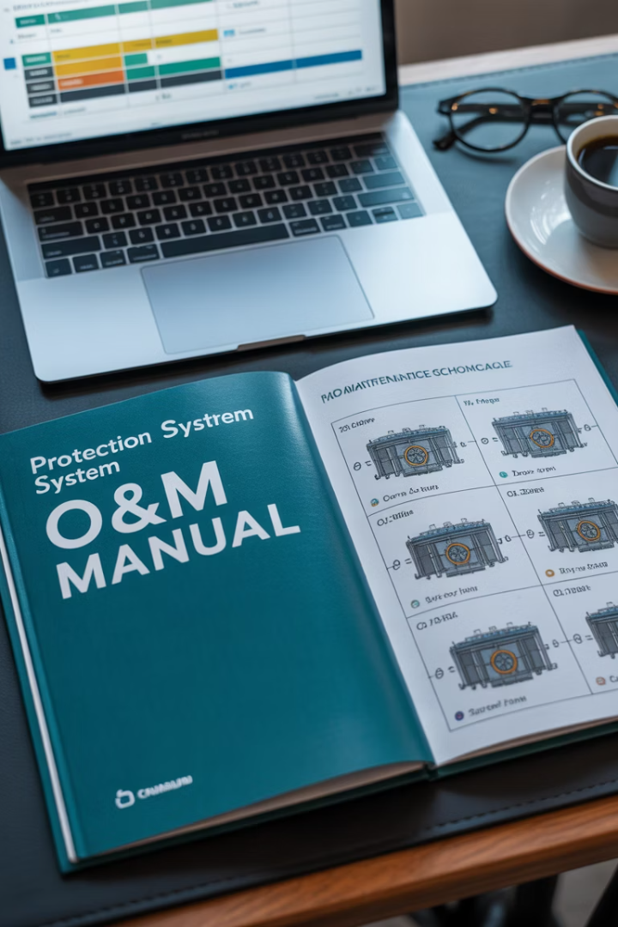




Operation and maintenance (O&M) manuals
Initial documentation
Comprehensive system documentation provided by manufacturers and installers upon commissioning, including technical specifications, operational parameters, and maintenance requirements.
Regular updates
Ongoing documentation amendments reflecting system modifications, component replacements, software updates, and changes to maintenance procedures or schedules.
Historical record maintenance
Creation and preservation of comprehensive maintenance history, including all test results, repairs, and modifications throughout the system lifecycle.
Accessibility requirements
Ensuring documentation is readily available to all authorised personnel who need access, while maintaining appropriate security for sensitive information.

Slide 20
Operation and maintenance (O&M) manuals
O&M manuals serve as the authoritative reference for all aspects of protection system maintenance and must be kept current to retain their value.

Slide 21
Electronic documentation management
Benefits of digital documentation
Implementation requirements
Centralised information repository accessible
to authorised personnel
Secure backup systems to prevent data loss
during system failures
Automated tracking of maintenance schedules
and completion status
Access control mechanisms to ensure
appropriate information security
Instant access to historical data for trend analysis
and auditing
Training for personnel in digital documentation
procedures
Reduced physical storage requirements
and improved document security
Integration with existing asset management
and maintenance systems
Simplified updating and version control
of maintenance procedures
Compliance with electronic record-keeping
regulations and standards
Modern electronic documentation systems offer significant advantages over traditional paper-based methods, particularly for complex protection systems with extensive maintenance requirements.
However, proper implementation requires careful planning and ongoing management.

Slide 22




Essential tests: fire detection and alarm systems
Detector functionality testing
Audible and visual alarm testing
Verification of detector response using appropriate test methods (smoke, heat, CO) according to manufacturer specifications and BS 5839 requirements.
Confirmation that all sounders, bells, and visual alarm devices activate properly and achieve required sound levels and visibility.
Power supply and battery backup testing
Communication and signal transmission testing
Verification of primary power supply integrity and battery condition, including load testing to ensure minimum standby duration compliance.
Confirmation that alarm signals are correctly transmitted to monitoring stations and integrated systems such as door releases and ventilation controls.
Each test must be performed according to the specific requirements of BS 5839 and documented in the system logbook with test results and any remedial actions taken.

Slide 23




Essential tests: fire suppression systems
Sprinkler system testing
Gaseous system testing
Water mist system testing
Foam system testing
Foam concentrate quality testing, proportioning equipment verification, and distribution system inspection.
Testing of detection systems and manual activation mechanisms without foam discharge.
Pressure testing of pipework, flow switch verification, and inspection of sprinkler heads for damage or obstruction. Water supply and pump testing to verify adequate pressure and flow rates.
Cylinder weight and pressure checks, leak testing of pipework, nozzle inspection, and verification of detection and control system integration. Simulation testing of discharge sequences without actual agent release.
Pump functionality verification, pressure testing of distribution lines, nozzle inspection for blockages, and control system integration testing. Water quality testing for systems with stored water supplies.

Slide 24
Essential tests: fire suppression systems
For all:
suppression systems
control panel functionality
power supplies, and
backup batteries
must be tested according to manufacturer specifications and relevant standards.

Slide 25
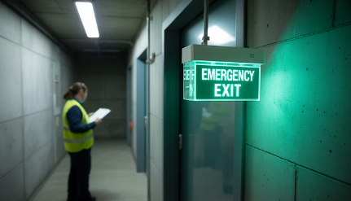
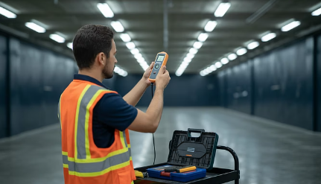
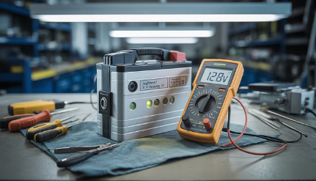

Essential tests: emergency lighting systems
Functional testing
Illumination level testing
Component inspection
Monthly short duration tests
(typically, 30-seconds).
Light level measurements at
key locations.
Battery condition assessment.
Lamp/LED integrity verification.
Annual full duration discharge
test (3-hours for most systems).
Verification against BS 5266
requirements.
Physical damage or
obstruction checks.
Verification of automatic
activation upon power failure.
Identification of areas with
inadequate coverage.

Slide 26




Essential tests: security and access control systems
Access control testing
CCTV system testing
Verification of reader functionality, credential recognition, door release mechanisms, and access rights assignment. Testing of anti-tailgating features and forced entry alarms where applicable.
Image quality assessment, recording functionality verification, motion detection testing, and storage capacity validation. Pan-tilt-zoom functionality testing for applicable cameras.
Intruder detection testing
Control system testing
Sensor coverage and sensitivity verification, alarm transmission testing, and tamper protection validation. Testing of integration with other security systems and monitoring services.
Verification of central management systems, backup and redundancy features, and user interface functionality. Testing of system response during power outages and emergency scenarios.
Security system testing requires careful planning to minimise operational disruption while ensuring thorough verification of all protection features.

Slide 27

Essential tests: gas detection systems
0%
Zero calibration
Testing detector response in clean air environment to
establish baseline reading.
50%
Mid-range test
Verification of detector accuracy at half the alarm threshold level.
100%
Full alarm test
Confirmation of detector response at alarm threshold concentration.
30 sec
Response time
Measurement of time between gas introduction and detector response.

Slide 28
Essential tests: gas detection systems
Gas detection system maintenance requires the use of certified calibration gases specific to each detector type.
Tests must verify not only sensor accuracy but also proper functioning of:
associated alarms
ventilation controls, and
emergency shutdown systems.
Calibration drift must be recorded to identify sensors requiring replacement or more frequent calibration.

Slide 29
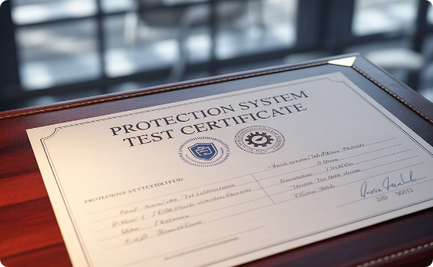
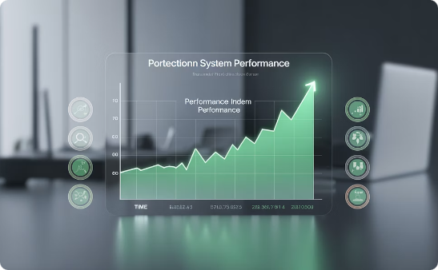

Documentation best practices for test results
Comprehensive
test records
Trend analysis
documentation
Non-compliance
reporting
Each test record should include the date, time, specific tests performed, test equipment used, results obtained, and name of the technician. Any variations from expected values must be clearly documented, along with corrective actions taken.
Sequential test results should be analysed to identify gradual degradation patterns that might indicate potential future failures. This predictive analysis should be formally documented and used to inform maintenance planning.
Any identified deficiencies must be documented in a standardised format that clearly communicates the nature of the issue, potential implications, recommended corrective actions, and required timeframe for resolution.

Slide 30








Integration of maintenance activities across protection systems
Coordinated planning
Interface testing
Synchronising maintenance schedules across interconnected systems
Verifying correct communication between different protection systems
Holistic documentation
Multi-discipline approach
Maintaining integrated records that capture system interdependencies
Combining specialist expertise for a comprehensive system evaluation

Slide 31
Integration of maintenance activities across protection systems
Modern protection systems rarely operate in isolation, with most facilities implementing integrated approaches where multiple systems interact.
Maintenance activities must account for these interdependencies to ensure that testing one system does not compromise the functionality of another.
Effective integration of maintenance activities requires a comprehensive understanding of system interfaces and careful planning to minimise operational disruption while ensuring thorough coverage of all protection components.

Slide 32







Summary
Proactive maintenance culture
Prioritize prevention over reaction
Risk-based approach
Allocate resources according to system criticality
Comprehensive documentation
3
Maintain detailed records of all maintenance activities
Integrated system perspective
Consider interactions between protection systems

Slide 33
Summary
You should now be able to:
Understand the difference between planned (preventive) and reactive (corrective) maintenance.
Understand the legal and regulatory responsibilities for maintaining protection systems.
Understand the types of system tests required and their frequencies (weekly, periodic, annual).
Record maintenance activities accurately, including test results, defects, and updates to documentation.
Carry out basic maintenance tasks in line with standards and manufacturer instructions.

Slide 34
Any questions?
Copyright in this document belongs to and is used under licence from the Department for Education, © 2025.
‘T-LEVELS’ and ‘T Level’ are registered trademarks of the Department for Education.
WJEC is authorised by the Department for Education to develop and deliver this T Level Technical Qualification.
WJEC operates in England under the name Eduqas which is a registered trademark of WJEC.

