Slide 1
Occupational Specialism: Protection Systems Engineering
K1.9 Termination of cables
PowerPoint 1.9: Termination of cables

Slide 2
Introduction
This session covers industry best practices, regulatory requirements and technical specifications for terminating various cable types according to BS 7671 and other relevant UK standards.
We'll explore proper termination methods for thermoplastic, fire-resistant, data, and coaxial cables, with special attention to securing techniques and the appropriate use of cable glands.
Our focus is ensuring all installations meet current British Standards while maintaining system integrity and safety.

Slide 3
Objectives
By the end of this session, you should be able to:
Know the different types of cables used in protection systems engineering.
Understand correct cable termination methods and secure installation techniques.
Understand how to secure terminated cables to meet standards and regulations.

Slide 4








Overview
System integrity
Ensures reliable electrical connections
Electrical safety
Prevents hazards and system failures
Physical protection
Guards against environmental damage
Regulatory compliance
Meets BS 7671 and Building Regulations

Slide 5
Overview
Proper cable termination forms the foundation of reliable electrical and data systems. The process involves more than simply connecting wires - it requires:
attention to detail
understanding of materials
adherence to strict regulatory standards.
Each layer of our approach builds upon the previous, creating a comprehensive system of protection and compliance.
When terminating cables, engineers must consider multiple factors simultaneously:
maintaining electrical continuity
ensuring appropriate mechanical strength
providing environmental protection
complying with all relevant standards and regulations.

Slide 6




Regulatory framework
BS 7671
Requirements for Electrical Installations (IET Wiring Regulations)
Building Regulations
Part P (Electrical Safety) and other relevant sections
Manufacturer instructions
Product-specific installation guidelines
British Standards
BS EN standards for specific cable types

Slide 7
Regulatory framework
Regulations – Fire alarm circuits must use fire-resistant cables (e.g. FP200 Gold) and terminations with heat-resistant glands or crimps to comply with BS 5839-1.
Building – In high-rise blocks, vertical risers may need armoured or steel-trunked cable routes, with glands or couplers suited to the building fabric.
Performance – CCTV over RG59 coax requires solid BNC terminations to maintain signal integrity; alarm loops use screened cable with correctly earthed drain wires to prevent interference.
Safety – LSZH (low smoke zero halogen) cables reduce toxic fumes, and terminations must be enclosed in rated junction boxes to protect users and responders.

Slide 8
Regulatory framework
The regulatory landscape for cable termination in the UK is comprehensive and stringent.
BS 7671, commonly known as the IET Wiring Regulations, provides the primary framework governing cable terminations for electrical installations.
These regulations are complemented by Building Regulations, particularly Part P for domestic installations.
Manufacturer instructions often contain specific requirements that may exceed the minimum standards, while various British Standards documents provide detailed specifications for particular cable types and applications. These regulations ensure all terminations are both safe and compliant.

Slide 9
Thermoplastic cable termination
Cable preparation
Conductor treatment
Termination
Measure and strip outer sheath to appropriate length.
Remove correct amount of insulation from conductors without nicking the copper core.
Apply appropriate ferrules to stranded conductors.
For solid cores, ensure clean cuts with no deformation.
Secure conductors in terminals with appropriate torque.
Verify no exposed conductor is visible outside the terminal.

Slide 10
Thermoplastic cable termination
Single and multi-core thermoplastic cables are among the most common in electrical installations. When terminating these cables, precision in stripping the outer sheath and individual conductors is essential to prevent short circuits and ensure long-term reliability.
For stranded conductors, ferrules should be used to prevent stray strands and ensure proper contact pressure. Terminals must be tightened to the manufacturer's specified torque—too loose creates resistance and heating, while over-tightening can damage conductors.
Always arrange conductors to minimise mechanical stress and ensure adequate space between terminals.

Slide 11




Common mistakes with thermoplastic cables
Excessive stripping
Improper torque
Removing too much insulation exposes conductors beyond the terminal, creating potential contact points for short circuits or electrical shock.
Under-tightened connections cause resistance and heating; over-tightened connections damage conductors and terminals, leading to failure.
Visual inspection failures
Inadequate cable support
Not visually confirming that all strands are properly captured in terminals is a common oversight that leads to system failures.
Failing to provide proper mechanical support causes strain on terminations, particularly under thermal cycling conditions.

Slide 12
Common mistakes with thermoplastic cables
When working with thermoplastic cables, avoiding common mistakes is as important as following proper procedures.
Excessive stripping of insulation creates a shock hazard and potential short circuit points that may not be immediately apparent.
Terminal torque issues are frequently overlooked – use a calibrated torque screwdriver where specified.
Proper cable support is critical; cables should be secured within 150mm of terminations to prevent mechanical strain. Such strain can gradually pull conductors from terminals, especially when thermal expansion and contraction occur during load cycling.

Slide 13








FP200 fire resistant cable termination
Careful stripping
Screen treatment
Use appropriate tools to avoid damaging the special fire-resistant layers.
Properly terminate the metallic screen for electrical continuity earthing where appropriate (not all variants of FP200 have screen).
Mechanical protection
Conductor connection
Apply appropriate glands with fire-resistant properties.
Ensure secure termination with proper torque settings.

Slide 14
FP200 fire resistant cable termination
FP200 fire-resistant cables require specific handling during termination to maintain their critical safety properties. These cables feature a robust construction with special insulating materials designed to function during fire conditions, and incorrect termination can compromise this essential functionality.
When terminating the metallic screen, take care to ensure proper earthing and continuity. Additionally, the cable's unique construction requires specific stripping techniques to avoid damaging the fire-resistant layers; standard cable strippers may need to be adjusted or replaced with tools designed for this purpose.

Slide 15
Gland selection for fire resistant cables
Fire rated glands
IP rating requirements
Material compatibility
Fire rated glands are available but not mandated.
Minimum IP54 for most installations.
Brass for standard installations.
Typically rated to match cable (e.g., 30/60/120 minutes).
Up to IP68 for underground or wet locations.
Stainless steel for corrosive environments.
Nickel-plated for special applications.
Often require special installation methods.

Slide 16
Gland selection for fire resistant cables
Selecting the appropriate gland for fire-resistant cables is critical to maintaining system integrity during emergency conditions.
Glands must be approved for use with the specific cable type and must provide the same fire resistance rating as the cable itself. Failure to match these ratings compromises the entire system's performance in fire conditions.
Environmental conditions must also be considered; in wet areas or outdoor installations, glands must provide adequate ingress protection while maintaining fire-resistant properties.
Always verify that the gland material is compatible with both the cable construction and the environment where it will be installed. Documentation of gland selection should be maintained as part of the system certification.

Slide 17



CAT5e/6e data cable termination
Careful outer sheath removal
Minimise jacket removal to 25mm maximum
Maintain twisted pairs integrity
Untwist pairs less than 13mm for CAT5e and 6mm for CAT6e
Precise conductor placement
Follow T568B wiring schemes consistently

Slide 18
CAT5e/6e data cable termination
Data cable termination requires precision and attention to detail that exceeds most power cable requirements.
CAT5e and CAT6e cables rely on tightly controlled twist ratios to maintain their performance characteristics, and improper termination is the leading cause of network performance issues.
The key performance factor is minimising the untwisted length of each pair - exceeding the standard (13mm for CAT5e, 6mm for CAT6e) degrades performance significantly.
Always use proper termination tools designed for the specific connector type and verify the wiring scheme (T568A or T568B) is consistent throughout the installation.
After termination, testing with a calibrated cable analyser is essential to verify performance meets the required category standards.

Slide 19
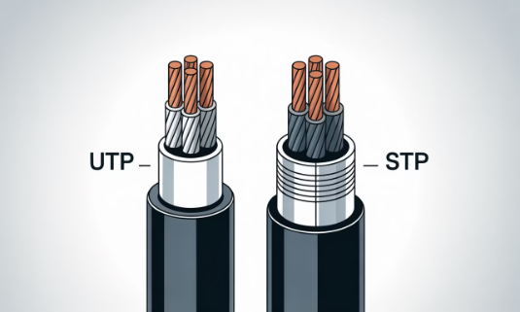
UTP vs STP data cable termination
UTP (unshielded twisted pair)
STP (shielded twisted pair)
Simpler termination process with fewer components. No shield to terminate, reducing installation time and complexity. More susceptible to EMI interference if improperly routed.
More complex termination requiring shield continuity. Provides better noise immunity in high-interference environments. Requires special connectors and termination methods.
Direct conductor termination
Shield drain wire must be terminated
Standard RJ45 connectors
No shield continuity required
Shielded connectors required
Continuity testing needed for shield

Slide 20
UTP vs STP data cable termination
The choice between UTP and STP cables significantly impacts the termination process and overall system performance.
UTP cables offer simpler installation but less protection against electromagnetic interference, while STP cables provide superior noise immunity at the cost of more complex termination procedures.
When terminating STP cables, maintain shield continuity throughout the entire channel is critical - any break in the shield continuity creates an "antenna effect" that can actually increase interference.
Special attention must be paid to the drain wire, which must make solid contact with the shielded connector.
Always use components rated for the same category to maintain system performance.

Slide 21



Coaxial cable termination
Precision cutting
Use specialized tools to ensure perfect dimensions when stripping the outer jacket, shield, and dielectric. Improper dimensions lead to impedance mismatches and signal reflection.
Compression method
Use professional-grade compression tools for F-connectors and BNC terminations. Crimped connections should be made with calibrated crimping tools specific to the connector type.
Testing
Verify terminations with appropriate testing equipment.

Slide 22
Coaxial cable termination
Coaxial cable termination presents unique challenges due to the critical need to maintain characteristic impedance throughout the connection. Each cable type (e.g. RG6, RG11, RG59, etc.) requires specific preparation dimensions that must be followed precisely to avoid signal degradation.
Modern compression connectors have largely replaced older crimp-style connectors due to their superior performance and reliability. These connectors form a moisture-resistant seal when properly installed.
For outdoor or underground installations, additional weatherproofing measures, such as self-amalgamating tape or heat-shrink tubing with an adhesive lining, should be applied. Always verify the connector type is appropriate for the specific application (e.g. digital TV, CCTV, satellite, etc.).

Slide 23



Shielded data cable considerations
Careful preparation
Avoid damaging shield during outer jacket removal. Specialist tools with precise depth settings prevent shield damage
Shield treatment
Fold back foil shield over outer jacket. Ensure drain wire is properly positioned for termination
Connector selection
Use only shielded connectors designed for the specific cable category. Verify shield contact mechanism is appropriate
Earthing considerations
Connect shield to earth at one end only to prevent ground loops. Document earthing scheme for future reference.

Slide 24
Shielded data cable considerations
Shielded data cables offer superior noise immunity but introduce additional complexities during termination.
The integrity of the shield is paramount - even small breaches can significantly reduce effectiveness against electromagnetic interference.
When stripping the outer jacket, specialised tools with precise depth settings should be used to avoid nicking or cutting the delicate foil shield.
The earthing strategy for shielded systems requires careful planning. Earth shields at one end only to prevent current flow through the shield (ground loops). In high-frequency applications or long runs, this approach may require modification to meet specific electromagnetic compatibility requirements.
Always document the earthing scheme implemented to facilitate future troubleshooting and modifications.

Slide 25
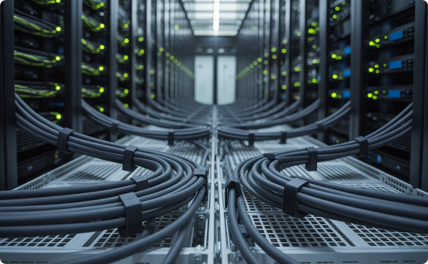
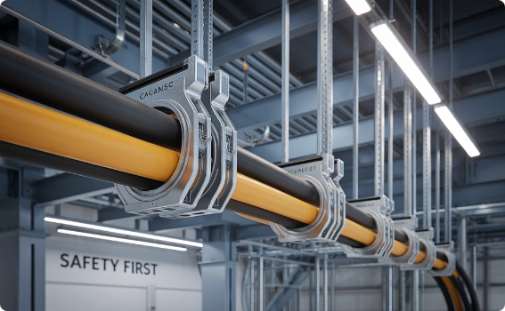
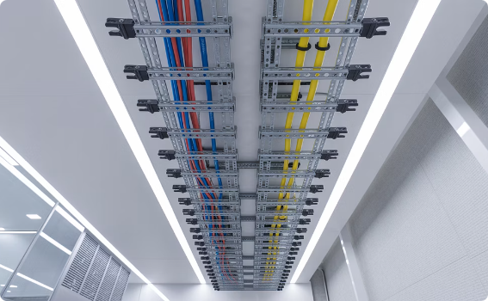
Cable securing methods
Cable ties
Cable cleats
Saddle clips
Provide quick and versatile securing options but must be used correctly. Select UV-resistant ties for outdoor use and low-smoke zero-halogen (LSZH) ties for indoor use. Avoid over-tightening, which damages cable jackets and affects performance.
Provide superior mechanical support and short-circuit protection. Must be installed at manufacturer-specified intervals and correctly torqued. Selection must consider fault current levels and dynamic forces during fault conditions.
Offer a balance between security and installation speed. Suitable for most indoor installations where aesthetic appearance is important. Must use screw size specified by manufacturer and avoid over-compression.

Slide 26
Cable securing methods
Properly securing cables is as important as correct termination. The securing method must provide adequate mechanical support without damaging the cable.
BS 7671 requires cables to be supported at appropriate intervals based on cable type, size, and installation method.
Special consideration must be given to fire-resistant cables. The fixing interval for these cables is typically reduced compared to standard cables to ensure circuit integrity is maintained throughout the fire-rated period.

Slide 27
Termination in control panels
Control panel terminations require particular attention to detail and organisation.
Cables must be routed with proper bending radii to prevent stress on conductors and insulation. This is especially critical for fire-resistant cables, which typically require larger bending radii to maintain their integrity during fire conditions.
Segregation between different circuit types is essential - power, control, and data cables should be physically separated within the panel to prevent interference.
All terminations should be clearly labelled according to the panel schedule, with corresponding documentation maintained for future reference.
For panels in critical applications, use vibration-resistant terminal types, particularly in locations prone to mechanical disturbances.

Slide 28
Testing terminations
Testing terminations is a critical final step that verifies the integrity of the installation.
Visual inspection should check that:
no insulation is trapped in terminals
all strands are captured
terminations are tightened to specification.
For critical systems, thermal imaging during load conditions can identify high-resistance connections before they fail.
Cable resistance testing should be performed for the system.
For shield continuity, a low-resistance ohmmeter should be used to verify end-to-end continuity.
Data cable terminations require specialised testing with cable analysers that can verify performance parameters, including near-end crosstalk (NEXT), return loss, and propagation delay.

Slide 29
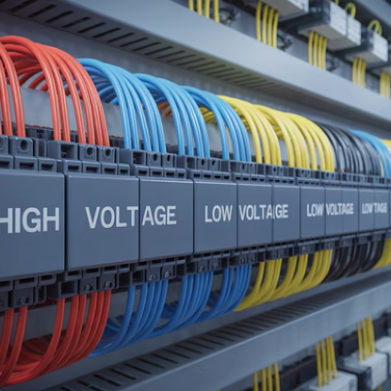
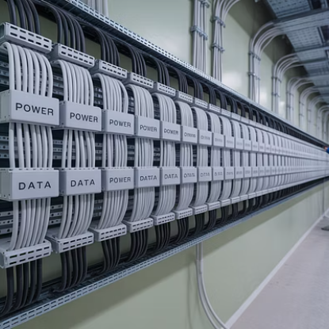
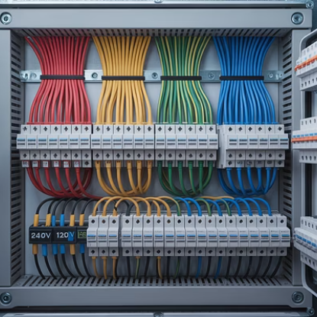
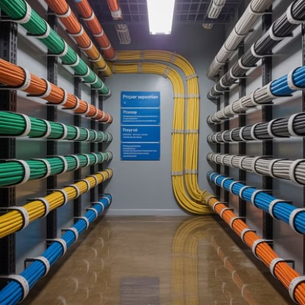
Cable segregation requirements
Cable segregation is crucial for both safety and system performance.
BS 7671 and BS EN 50174 specify the separation distances required between different circuit types.
Power and data cables must be separated to prevent electromagnetic interference, with minimum separation distances varying depending on the cable types and installation methods.

Slide 30
Cable segregation requirements
For fire alarm and emergency lighting systems, cables must be segregated from other services to maintain integrity during emergency conditions. This often requires separate containment systems or fire-rated barriers within shared containment.
When cables of different circuit categories must cross, they should do so at right angles to minimise interference coupling.
Always document the segregation scheme used to facilitate future modifications and maintenance.

Slide 31
Termination in hazardous areas
Terminating cables in hazardous areas introduces additional requirements to prevent the equipment from becoming a source of ignition.
All components must have appropriate certification for the specific zone classification, and installation must strictly follow both manufacturer instructions and relevant standards (BS EN 60079 series).
Special attention must be paid to the temperature rating of the equipment relative to the T-Class of the area.
Cable glands used in hazardous areas often require compound filling or sealing to prevent gas migration through the cable.
For intrinsically safe circuits, terminations must maintain the required separation distances from non-intrinsically safe circuits, typically through the use of separate junction boxes or certified barriers within enclosures.

Slide 32
Specialist tools for cable termination
Cable preparation tools
Termination tools
Testing equipment
Adjustable cable strippers with depth gauges.
Ratcheting crimpers with interchangeable dies.
Cable analysers with permanent link adapters.
Rotary cable strippers for coaxial and data cables.
Compression tools for coaxial connectors.
Insulation resistance testers.
Precision wire strippers with micrometer adjustments.
Impact tools for IDC terminations.
Low-resistance ohmmeters for continuity testing.
Torque screwdrivers with calibration certificates.
Cable shears with clean-cutting action.

Slide 33
Specialist tools for cable termination
Using the correct, professional-grade tools is essential for reliable cable termination.
Each cable type requires specific tools designed for its construction and termination method.
For example, data cable termination requires precise stripping tools that prevent damage to internal conductors, while power cable termination often necessitates hydraulic crimping tools capable of applying the correct pressure.
Tools should be regularly inspected, maintained, and calibrated where appropriate. Torque screwdrivers in particular require annual calibration to ensure they accurately apply the specified torque to terminal connections.
Tools designed for one cable type should never be used for another. For example, using standard wire strippers on FP200 cable can damage the vital fire-resistant layers and compromise system integrity.

Slide 34
Environmental considerations for outdoor terminations
Assess environmental factors
Select appropriate components
Apply supplementary protection
Evaluate exposure to UV radiation, temperature extremes, precipitation, chemical contaminants, and mechanical risks. Each factor influences component selection and additional protection requirements.
Choose UV-resistant, weather-rated components with appropriate IP ratings. Standard indoor-rated materials will degrade rapidly in outdoor conditions, leading to premature failure.
Implement additional weatherproofing using heat-shrink tubing with adhesive lining, self-amalgamating tape, or UV-resistant enclosures. Ensure drainage provisions prevent water accumulation.

Slide 35
Environmental considerations for outdoor terminations
Outdoor terminations face challenges not present in controlled indoor environments.
UV radiation causes degradation of most plastic materials, while temperature cycling can loosen connections and cause condensation. Proper component selection is essential - all materials must be rated for outdoor use with suitable UV and weather resistance.
Water ingress prevention requires particular attention. Cable entries should face downward where possible, with drip loops formed to prevent water tracking along the cable into the enclosure.
In coastal environments, additional protection against salt corrosion may be necessary.
Regular inspection schedules should be established for outdoor terminations, as environmental damage may not be immediately apparent during normal operation.

Slide 36
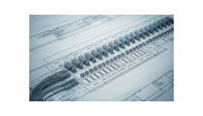
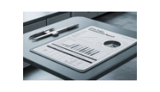
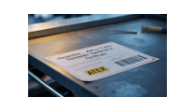
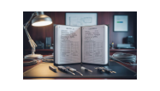
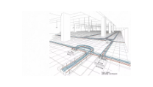
Termination documentation requirements
Comprehensive documentation is a critical aspect of professional cable termination.
BS 7671 requires that appropriate information be provided for inspection and testing, as well as for future maintenance and modifications.

Slide 37
Summary
You should now be able to:
Know the different types of cables used in protection systems engineering.
Understand correct cable termination methods and secure installation techniques.
Understand how to secure terminated cables to meet standards and regulations.

Slide 38
Any questions?
Copyright in this document belongs to and is used under licence from the Department for Education, © 2025.
‘T-LEVELS’ and ‘T Level’ are registered trademarks of the Department for Education.
WJEC is authorised by the Department for Education to develop and deliver this T Level Technical Qualification.
WJEC operates in England under the name Eduqas which is a registered trademark of WJEC.

