Slide 1
Occupational Specialism: Protection Systems Engineering
K1.8 Cable Installation and Containment
PowerPoint 1.8: Cable installation and containment

Slide 2
Introduction
In this session you will learn about various cable types, containment systems, selection criteria, and installation practices that comply with current UK legislation, British Standards, and industry best practices.
This will equip you with the technical knowledge needed to make informed decisions when selecting and installing cable systems in different environments.

Slide 3
Objectives
By the end of this session, you should be able to:
Understand the techniques for installing cables in protection systems.
Prepare and terminate cables to system devices.
Test continuity and insulation of installed cables.

Slide 4

Types of thermoplastic cables
Single-core thermoplastic
Multi-core thermoplastic
Key considerations
Typically utilised for fixed wiring in domestic and commercial installations. Available in various cross-sectional areas from 1.0mm² to 35mm². Commonly used as circuit protective conductors and for final connections to terminals.
Contains two or more insulated conductors within a single outer sheath. Available in twin and earth, three-core and earth, and four-core configurations. Commonly used for lighting, power and control circuits where multiple conductors are required.
Thermoplastic cables require correct selection based on current-carrying capacity, voltage drop calculations, and environmental factors such as temperature and exposure to mechanical damage. Must be installed in compliance with BS 7671 wiring regulations.

Slide 5
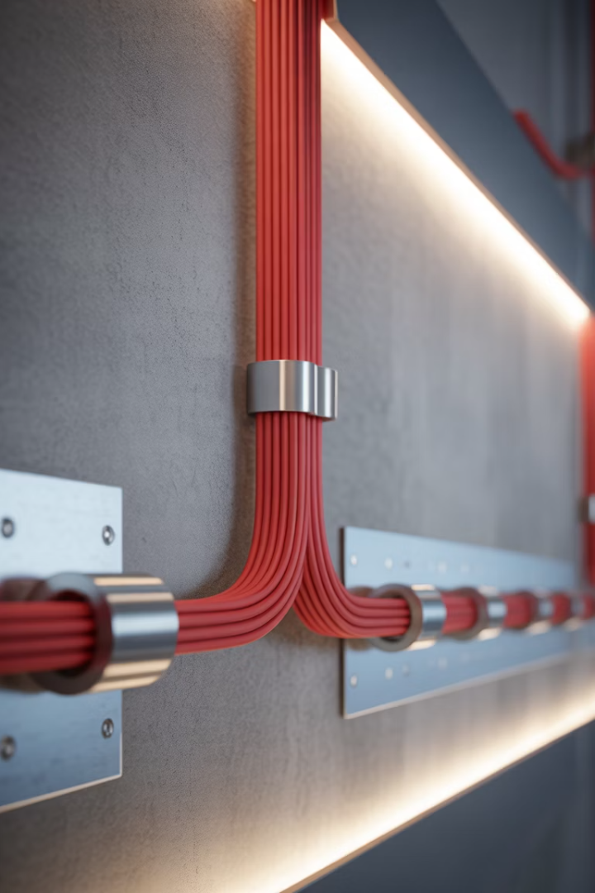



Fire resistant cables - FP200
Construction and properties
Performance standards
FP200 is a fire-resistant cable with a unique construction featuring solid copper conductors, hard grade XLPE insulation, and an aluminium/polymer tape wrapped with an LSF (Low Smoke and Fume) outer sheath.
Maintains circuit integrity for up to 120 minutes in fire conditions as per BS 7629-1. Produces minimal smoke and zero halogen emissions when exposed to fire, crucial for evacuation routes.
Application areas
Essential for fire alarm systems, emergency lighting circuits, voice evacuation systems, and critical safety installations in commercial and public buildings where maintaining circuit integrity during fire is paramount.

Slide 6
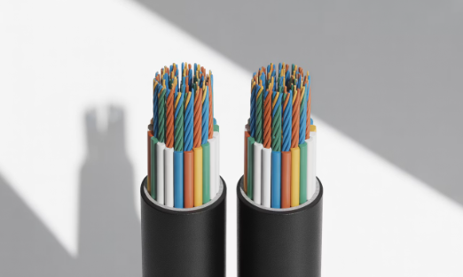
Data cables - CAT5e and CAT6e
CAT5e characteristics
CAT6e advantages
Supports bandwidth up to 100 MHz and data rates of 1 Gbps. Construction includes four twisted pairs with polyethylene insulation. Maximum recommended length of 100 metres between active equipment. Suitable for standard network installations, CCTV systems, and basic access control.
Supports bandwidth up to 250 MHz and data rates of 10 Gbps over shorter distances. Features more stringent specifications for crosstalk and system noise. Includes a physical separator between pairs to further reduce interference. Ideal for high-definition security cameras, advanced access control, and future-proof installations.
Both cable types must be installed with care to maintain performance characteristics. Avoid sharp bends, excessive pulling tension, and proximity to power cables to prevent signal degradation.

Slide 7




Coaxial cable applications
CCTV systems
RG59 and RG6 coaxial cables are commonly used for analogue CCTV installations. Maximum recommended distance of 300 metres for RG59 and 600 metres for RG6 before signal degradation becomes problematic.
Satellite and aerial systems
CT100 and WF100 cables with 75-ohm impedance are standard for satellite and TV distribution systems. Must be installed with minimum bend radius of 10x cable diameter to maintain signal integrity.
Access control
RG58 coaxial often utilised for legacy access control card readers. Maximum distance of 150 metres between reader and controller before signal amplification becomes necessary.
Installation considerations
Proper termination with correct connectors is essential. BNC, F-type, and N-type connectors must be correctly crimped or compression-fitted to maintain screening integrity and prevent signal loss.

Slide 8




Cable tray systems
Load capacity
Select based on combined weight of cables plus 25% for future expansion
Sizing requirements
Minimum 20% spare capacity for future additions
Fixing methods
Maximum support intervals of 1.5m for heavily loaded trays
Earthing considerations
Maintain earth continuity across joints with proper
bonding straps

Slide 9
Cable tray systems
Cable trays provide excellent ventilation for cables and are available in perforated, solid, and heavy-duty varieties.
When installing, ensure proper support spacing according to load calculations and maintain proper bends with appropriate accessories to prevent damage to cable sheaths.

Slide 10








Steel vs PVC conduit
PVC conduit benefits
Steel conduit advantages
Superior mechanical protection and screening against electromagnetic interference. Fire resistant and maintains circuit integrity. Required for hazardous areas and where enhanced mechanical protection is needed.
Corrosion-resistant and suitable for damp environments. Lightweight and easier to cut and install. More economical for non-critical circuits where mechanical damage is less likely.
Installation techniques
Both require appropriate bending tools to prevent deformation. Steel requires reaming of cut ends to prevent cable damage. PVC requires expansion couplings where temperature fluctuations occur.
Earthing requirements
Steel conduit can serve as circuit protective conductor when properly installed with metal-to-metal joints.

Slide 11
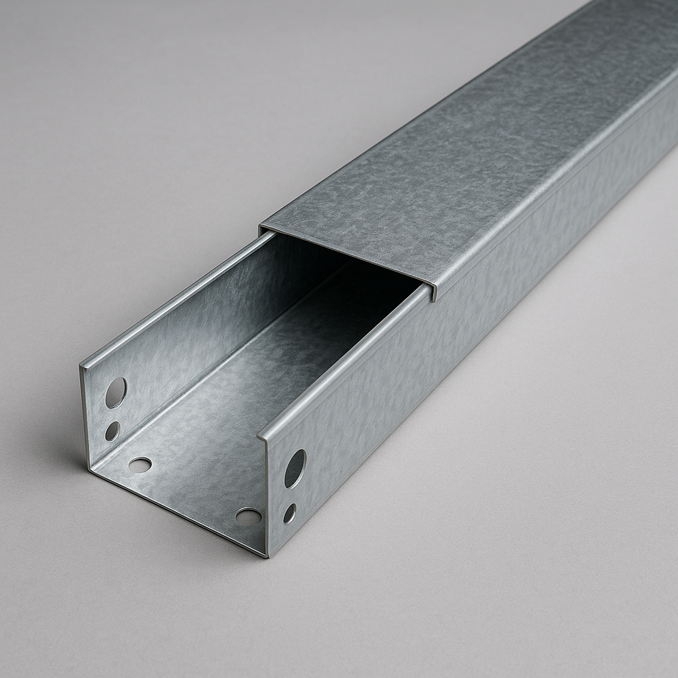
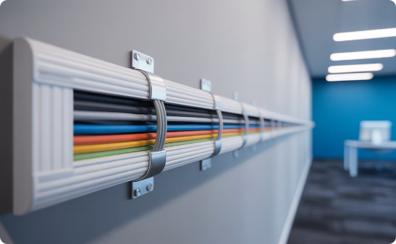
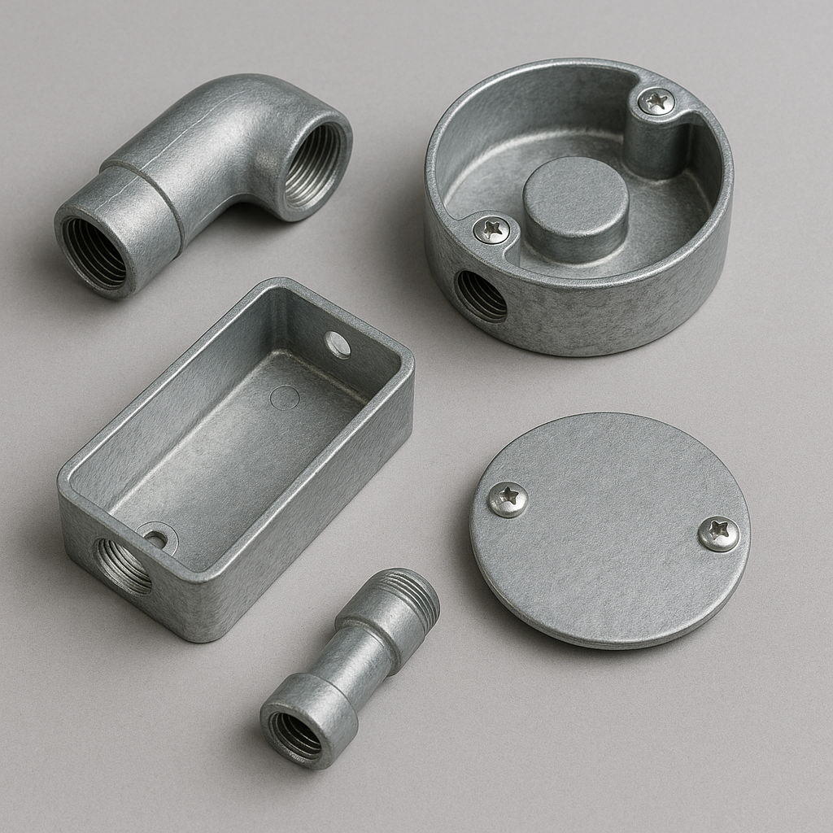
Cable trunking solutions
Steel trunking
PVC trunking
Accessories
Provides excellent mechanical protection and EMI screening. Available in various sizes from 50x50mm to 150x150mm and larger. Required in areas where fire resistance is critical. Must be earthed in accordance with BS 7671 to provide effective screening and safety.
Cost-effective solution for offices and non-hazardous areas. Resistant to corrosion and chemical attack. Available in various colours to match décor. Separate CPC required as PVC does not provide earthing continuity. Less fire resistant than steel alternatives.
Both steel and PVC systems require proper accessories such as internal/external bends, tees, and cross pieces to maintain minimum bending radii for cables. Compartment dividers are essential for maintaining segregation between different circuit types.

Slide 12








Ladder racking systems
Application areas
Data centres, large commercial buildings, industrial sites
Load capacity
Heavy-duty applications, supports larger cable bundles
Ventilation benefits
Open design allows maximum air circulation around cables
Installation flexibility
Modular design adapts to complex routes and
expansions

Slide 13
Ladder racking systems
Ladder racking is the preferred solution for high-density cable installations where heat dissipation is critical. The open design facilitates easy inspection of cables and allows for additions or modifications without dismantling the entire system.
When installing, ensure proper support intervals typically between 1.5-3 metres, depending on load calculations and manufacturer specifications.

Slide 14
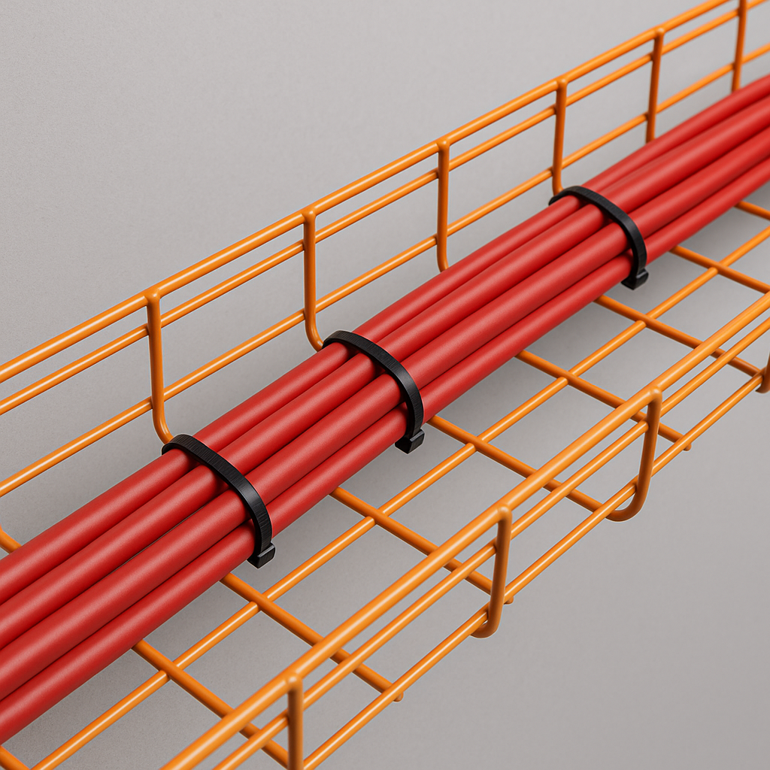
Cable basket solutions
Cable basket systems offer excellent flexibility for dynamic environments where cable routes frequently change. The wire mesh construction allows cables to be easily pushed through sides at any point without special tools or drilling.
When installing, ensure proper support spacing according to load and use appropriate accessories to maintain minimum bending radii at changes of direction.

Slide 15




Legislation and industry standards
BS 7671 (18th Edition Wiring Regulations)
Provides fundamental requirements for electrical installations including cable selection, installation methods, and segregation requirements. Particular attention should be paid to Sections 521 (Selection and Erection of Wiring Systems) and 528 (Proximity to Other Services).
Building Regulations Part P
Covers safety requirements for electrical installations in domestic premises. Requires certain electrical work to be notified to local building control authorities unless completed by a registered competent person.
BS 5839 (Fire Detection Systems)
Specifies requirements for fire-resistant cables and segregation from other services. BS 5839 states the use of enhanced fire-resistant cables for critical circuits in certain categories of systems.
Electricity at Work Regulations 1989
Legal framework requiring electrical systems to be constructed, maintained and operated to prevent danger. Includes requirements for systems to be of appropriate construction for the environmental conditions.

Slide 16
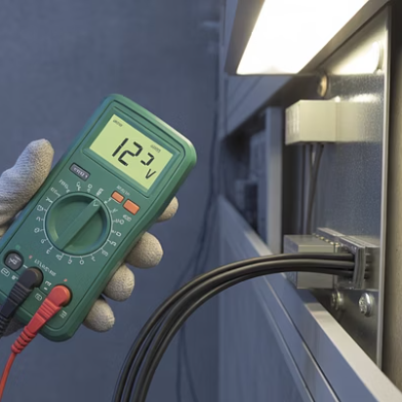
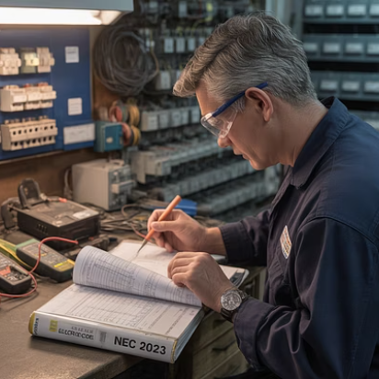
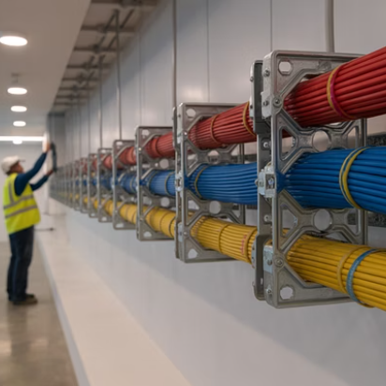
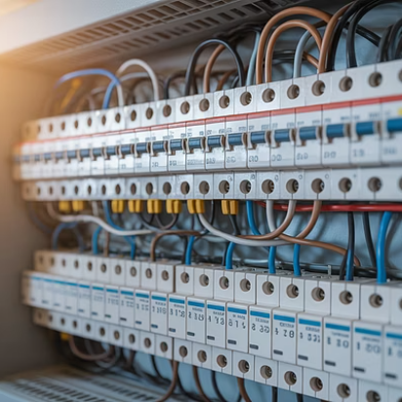
Voltage drop considerations
Voltage drop must not exceed 3% of nominal voltage for lighting circuits or 5% for other circuits as per BS 7671. When selecting cables, particularly for longer runs, voltage drop becomes a limiting factor that may require larger conductor sizes than current-carrying capacity alone would dictate.
For precise calculations, use the formula: Vd = (mV/A/m × I × L) ÷ 1000, where mV/A/m is the voltage drop per ampere per metre (from tables), I is the design current in amperes, and L is the route length in metres. Always verify calculated values against maximum permitted drops.

Slide 17
Signal transmission considerations
Cable Type
Impedance
Max Length
Primary Applications
CAT5e
100 Ω
100m
Standard networking, basic CCTV
CAT6e
100 Ω
100m
High-speed networks, HD CCTV
RG59 Coaxial
75 Ω
300m
Analogue CCTV, standard definition
RG6 Coaxial
75 Ω
600m
Digital video, satellite systems
FP200
N/A
500m
Fire alarm loops, emergency systems
Signal transmission distances can vary greatly, and these are typical in general systems but are not absolute.

Slide 18
Signal transmission considerations
When installing cables for signal transmission, impedance matching is critical to prevent signal reflection and attenuation. Always terminate cables with connectors of matching impedance and avoid exceeding maximum recommended lengths without appropriate signal boosters or repeaters.
For fire and security systems, consider future expansion needs and select cables with appropriate screening to prevent interference. In areas with high electromagnetic interference, enhanced screening such as overall screening plus individual pair screening (S/FTP) may be required.

Slide 19




Environmental factors in cable selection
Temperature
Moisture
Mechanical stress
Chemical exposure
Standard PVC cables are rated for ambient temperatures between -5°C and +70°C. For temperatures outside this range, special cable types such as silicon-insulated or XLPE cables must be selected. Apply appropriate rating factors for high ambient temperatures.
In damp or wet environments, select cables with appropriate IP ratings. Consider LSZH or XLPE insulation for improved moisture resistance. Direct burial cables must have additional mechanical protection, such as armoured construction or installation within conduit.
In areas subject to physical damage, select armoured cables or install standard cables within appropriate mechanical protection such as steel conduit or trunking. Special consideration needed for vibration and movement in flexible installations.
Standard PVC is vulnerable to certain solvents and oils. In environments with chemical exposure, select cables with resistant sheaths such as LSZH, neoprene, or special compounds designed for chemical resistance.

Slide 20
Environmental suitability of containment systems
Indoor dry environments
Damp or wet locations
1
2
Standard galvanised steel or PVC containment systems are generally suitable. In areas where aesthetics are important, PVC mini-trunking or skirting trunking systems provide discrete cable management solutions that can be painted to match décor.
Hot-dip galvanised steel or stainless-steel containment systems provide superior corrosion resistance. PVC systems with minimum IP55 rating can be used where mechanical protection requirements are lower. Ensure proper drainage holes in tray systems.
3
Corrosive atmospheres
4
High fire risk areas
Stainless steel grade 316 offers excellent resistance to chemical attack. Special epoxy-coated steel systems may be appropriate for certain chemical environments. Avoid aluminium in highly alkaline environments due to accelerated corrosion.
Steel containment systems are common in escape routes and areas where maintaining circuit integrity during fire is critical. PVC systems must not be used in temperatures exceeding 70°C or where toxic fume emission during fire could be problematic.

Slide 21
Environmental suitability of containment systems
While steel containment is common in escape routes and critical circuits, it is not mandatory - exact requirements depend on BS 7671, BS 5839, and BS 8519.

Slide 22
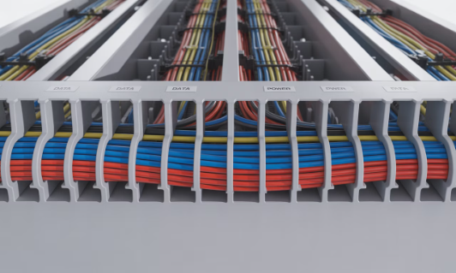
Cable type compatibility with containment
Data cable requirements
Power cable considerations
Minimum bend radius typically 6-8 times the cable diameter for CAT5e/6e. Basket or perforated tray with smooth edges prevents sheath damage. Maximum fill ratio of 40% for optimal performance. Metallic containment provides screening benefits when properly earthed.
Standard thermoplastic cables require minimum bend radius of 3 times cable diameter for single core and 6 times for multicore. Heavy-duty power cables benefit from ladder rack support rather than solid tray to aid heat dissipation.
Fire-resistant cables such as FP200 must be installed with fire-rated clips or within fire-rated containment where circuit integrity maintenance is required. Ensure adequate space around FP cables to prevent heat transfer from standard cables during normal operation.
When calculating tray width for power cables, arrange cables in a single layer where possible to optimise heat dissipation. Rating factors must be applied for grouped cables according to BS 7671 to prevent overheating.
When routing through trunking, maintain segregation from power cables using dividers. Data cables should never be pulled under tension exceeding 110N to prevent damage to internal structure that would degrade performance.

Slide 23
Quantity considerations in containment selection
Calculate total cross-sectional area
Determine appropriate fill ratio
Consider layout and access requirements
Determine the cross-sectional area of each cable by using πr² for circular cables. For non-circular cables, use manufacturers' data. Sum the areas of all cables to be installed, then add at least 25% for future expansion. This gives the minimum internal area required for the containment system.
Different containment types have different recommended maximum fill ratios: 45% for conduit, 40% for trunking with an accessible lid, and 50% for cable tray or basket. Divide the total cable CSA by the appropriate fill ratio percentage to determine the minimum containment size required.
Allow additional space at bends and junctions where cables cross over each other. For containment with multiple compartments, calculate each section separately. Ensure sufficient space for adding and removing cables without disturbing existing installations, particularly important for data and security systems.

Slide 24
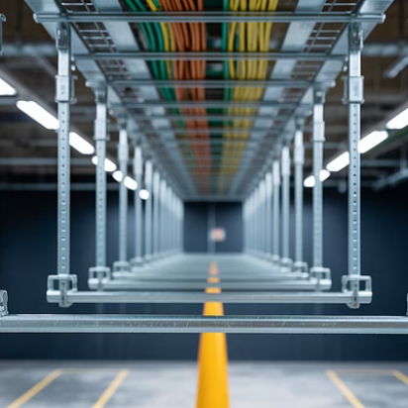
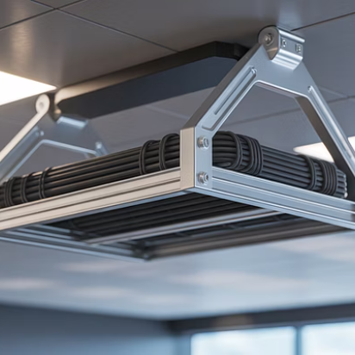
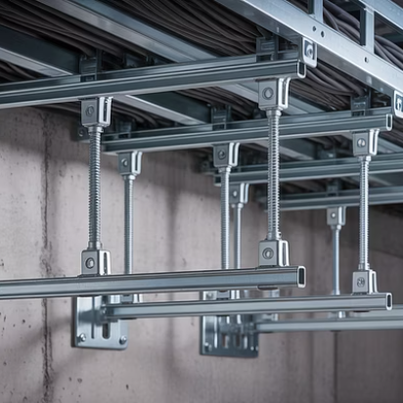
Fixing methods for containment systems
The selection of appropriate fixing methods is critical for the long-term reliability of the installation. Support spacing must be calculated based on the combined weight of the containment system plus the maximum anticipated cable load. Typical support intervals range from 1.2m for heavily loaded systems to 3m for lightly loaded installations.
For ceiling-mounted systems, drop rods or trapeze brackets provide excellent support. Wall-mounted systems typically use cantilever brackets with appropriate load ratings.

Slide 25








Cable segregation requirements
Power circuits
Segregation by voltage bands: LV (230/400V), ELV, and SELV. Maintain minimum 50mm separation between different voltage bands unless physically separated by earthed metal divider
Data circuits (BS 7671) Segregation is required to avoid detrimental influence (interference, overheating, safety risks). The standard doesn’t fix a universal distance — it depends on installation methods, containment, and standards being applied
Security systems Industry practice often recommends 200 mm separation from power cabling to reduce electromagnetic interference. This is good practice but not a strict statutory requirement
Fire alarm systems (BS 5839) Requires separation to avoid EMC issues, typically achieved by separate containment or barriers. Guidance refers to 300 mm, but again this isn’t a fixed figure in law — it depends on the specific installation and environment

Slide 26

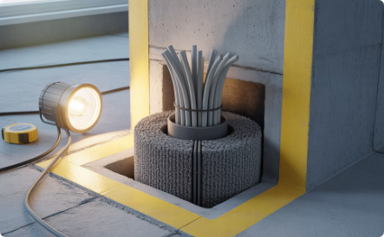
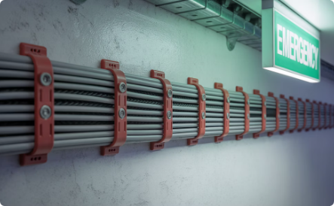
Building regulations compliance
Part P - Electrical Safety
Covers safety requirements for electrical installations in domestic premises. Requires certain electrical work to be notified to local authorities or completed by registered competent persons. Cable installations must protect occupants from fire hazards and electric shock.
Part B - Fire Safety
Mandates fire compartmentation to prevent fire spread. Cable penetrations through fire-rated walls and floors must be properly fire stopped using approved methods and materials. Containment systems in escape routes must be non-combustible.
Part M - Access
Ensures accessibility for all building users. Cable installations must not create trip hazards or impede access. Containment systems in public areas must be installed at appropriate heights and positions to allow safe passage.

Slide 27





Manufacturer's instructions and compliance
Documentation review
Always obtain and thoroughly review manufacturer's installation instructions before commencing work. Pay particular attention to specified fixing methods, support intervals, and maximum loading capacities.
Proper tooling
Use only manufacturer-recommended tools for cutting, bending, and fixing containment systems. Improper tools can damage protective coatings and compromise system integrity.
Connection methods
Follow specified torque settings for bolted connections. Use correct accessories for joins, bends, and tees to maintain system ratings for load capacity and earth continuity.
Warranty compliance
Deviating from manufacturer's instructions may invalidate warranties and potentially compromise safety. Document compliance with installation requirements for client handover.

Slide 28
British standards for cable systems
BS 7671:2018+A2:2022
BS 5839-1:2017
Requirements for Electrical Installations (18th Edition IET Wiring Regulations). Provides fundamental requirements for cable selection and installation. Chapter 52 covers selection and erection of wiring systems, including containment. Appendix 4 provides tables for current-carrying capacity and voltage drop calculations.
Fire detection and fire alarm systems for buildings. Specifies requirements for fire-resistant cables and segregation from other services. Section 26 covers cabling requirements including support systems. Mandates maintaining circuit integrity through appropriate fixing methods for fire alarm cables.
BS EN 61537:2007
BS EN 50085 & BS EN 61386
Cable management - Cable tray systems and cable ladder systems. Defines performance requirements for cable trays including load testing, corrosion resistance, and electrical continuity. Specific requirements for different environments including corrosive, wet, and fire risk areas.
Cover cable trunking systems and conduit systems respectively. Define mechanical properties, electrical characteristics, and environmental ratings. Include classification systems for impact resistance, temperature range, and ingress protection.

Slide 29




Installation best practices
Planning phase
Create detailed cable route plans identifying potential conflicts with other services. Calculate accurate quantities of materials needed including containment, fixings, and accessories. Obtain all relevant drawings and specifications before commencing work.
Installation process
Install containment systems before pulling cables. Ensure all cut edges are deburred to prevent cable damage. Maintain proper bend radii at all direction changes. Use draw wires for complex pulls through conduit systems.
Testing requirement
Verify earthing continuity of metallic containment systems. Test cables in accordance with BS 7671 before energisation. For data cables, perform appropriate certification tests including permanent link or channel tests.
Documentation
Produce as-built drawings showing actual routes and locations. Include test certificates for all circuits. Create maintenance schedules for ongoing inspections, particularly for fire-rated systems.

Slide 30










Installation - summary
Professional excellence
Strive for installations that exceed minimum standards
Documentation discipline
Maintain comprehensive records of all installation details
Technical compliance
Apply BS 7671 and relevant standards to every installation
Thorough assessment
Evaluate all environmental and operational factors
Foundational knowledge
Understand cable characteristics and
containment requirements

Slide 31
Summary
You should now be able to:
Understand the techniques for installing cables in protection systems.
Prepare and terminate cables to system devices.
Test continuity and insulation of installed cables.

Slide 32
Any questions?
Copyright in this document belongs to and is used under licence from the Department for Education, © 2025.
‘T-LEVELS’ and ‘T Level’ are registered trademarks of the Department for Education.
WJEC is authorised by the Department for Education to develop and deliver this T Level Technical Qualification.
WJEC operates in England under the name Eduqas which is a registered trademark of WJEC.

