Slide 1
Occupational Specialism: Protection Systems Engineering
K1.11 Methods of supporting protective system components
PowerPoint 11: Methods of supporting protective system components

Slide 2
Introduction
In this session we will explore how to select appropriate fixing methods that ensure the integrity, longevity and effectiveness of security installations.
The success of any installation depends not only on the quality of the equipment itself but on how securely and appropriately it is mounted. We will examine key factors including:
load-bearing requirements
environmental conditions
building structure compatibility
aesthetic considerations that influence fixing selection.

Slide 3
Objectives
By the end of this session, you should be able to:
Understand the layout and configuration of protection system control panels
Understand addressing and programming of system devices
Understand labelling and documentation of control panel configurations

Slide 4




Overview
Choose load ratings
Match the environment
Choose fixings using the manufacturer’s published load ratings for the substrate (e.g. concrete, brick, plasterboard)
Select fixings suitable for the conditions (e.g. corrosion-resistant for outdoor/wet areas, fire-rated for critical circuits)
Follow compliance rules
Follow manufacturer guidance
Use fire-rated and non-combustible fixings where required by standards (e.g. BS 7671, BS 5839)
Always install according to the fixing manufacturer’s instructions and replace if damaged or unsuitable

Slide 5
Core fixing technologies
Mechanical anchors
Chemical anchors
Self-tapping fixings
Expansion bolts, toggle bolts, and concrete screws. Good for medium to heavy loads in concrete, brick, and blockwork.
Resin-based fixings used with threaded rod. Best for very heavy loads or where there is vibration or wet environments.
Special screws for direct fixing into wood, metal, or light masonry. Quick to install, suited to light to medium loads.

Slide 6
Environmental considerations
Outdoor environments
Corrosive environments
Indoor considerations
When working outdoors, fixings need to withstand exposure to rain, wind, and UV light.
Galvanised, coated, or other weather-resistant fixings should be used to prevent rust and weakening over time.
Always check manufacturer ratings for outdoor use to ensure long-term reliability.
In areas exposed to chemicals, salt air, or high humidity (e.g. coastal sites, industrial plants), standard steel fixings will quickly corrode.
Stainless steel or specially coated fixings are essential to maintain strength and safety. This protects against failure and avoids frequent replacements.
Indoors, standard fixings are generally suitable, provided they are appropriate for the substrate (e.g. brick, block, plasterboard).
Where cabling must meet fire safety standards (such as fire alarm circuits), use metallic or fire-rated fixings in line with BS 7671 and BS 5839 to ensure compliance.

Slide 7


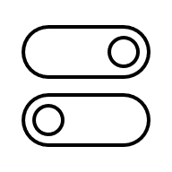

Building structure compatibility
Concrete structures
Ideal for mechanical and chemical anchors. Verify concrete strength class (typically C20-C50) and check for reinforcement before drilling.
Requires hammer drilling with appropriate bit diameter and depth according to fixing specifications.
Masonry and brickwork
Expansion anchors work well but require testing for older or unknown quality materials. Always fix into the brick rather than mortar joints.
Consider frame fixings that distribute load across multiple points for heavier components.
Drywall and partition walls
Requires specialised cavity fixings or direct attachment to structural studs. Toggle bolts, gravity toggles, and spring toggles offer a load capacity of 15-25kg in standard 12.5mm drywall.
Metal stud finding is essential for heavier components.
Metal structures
Self-tapping tek screws or bolts with nuts for through-fixing. Requires verification of metal thickness and type. Consider thermal expansion differential between fixing and structure in outdoor installations.

Slide 8
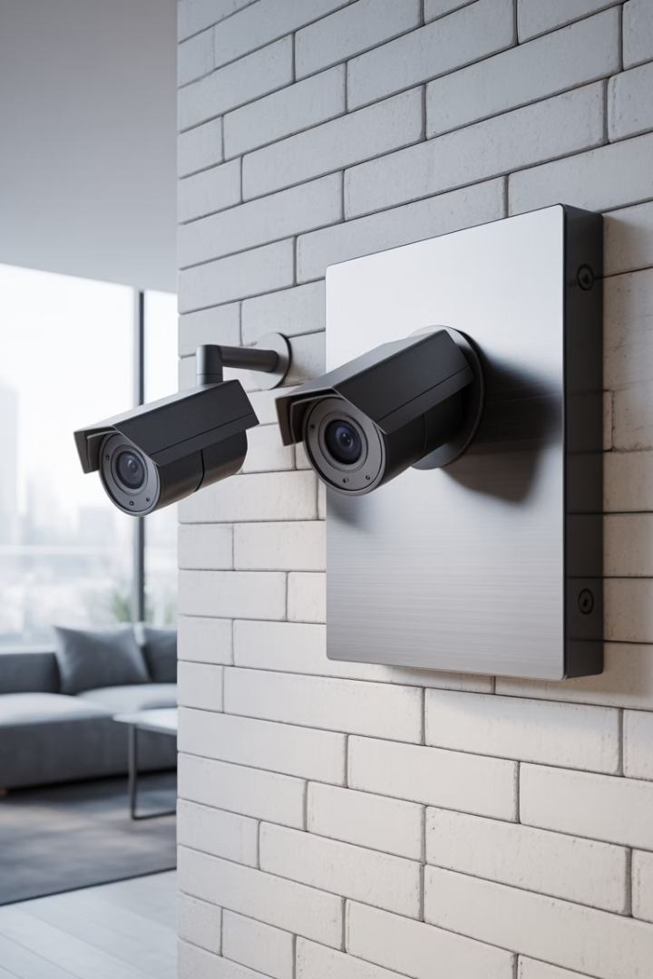



Aesthetic integration considerations
Colour matching
Visibility reduction
Architectural integration
Fixings and mounting hardware should match or complement component housing and surrounding surfaces. Consider powder-coated or anodised finishes for visible fixings, particularly in heritage or high-end commercial environments.
Countersunk fixings with colour-matched caps or plugs minimise visual impact. Rear entry cabling and internal fixing points can eliminate visible hardware entirely in sensitive architectural applications.
Coordinate with architects early in project planning to design integrated mounting solutions that incorporate protective systems within building elements such as soffits, mouldings or purpose-built recesses.

Slide 9
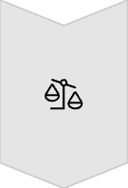



Load calculations: real-world application
Know the weight
Always check the weight of the equipment (e.g. cameras, sounders, panels) so you choose a fixing that can safely support it.
Follow manufacturer guidance
Manufacturers provide load ratings for their fixings and brackets — use these instead of trying to calculate stresses yourself.
Consider the environment
Fixings must be suitable for where they’re installed — outdoors, indoors, corrosive areas, or fire-rated zones.
Comply with standards
British Standards (e.g. BS 7671, BS 5839) set the rules for safe and compliant installation, so always use approved fixings and record your choices.

Slide 10








Specialised mounting solutions
Pole mounting systems
Corner adaptors
Banded or clamped attachments for cylindrical structures, typically using stainless steel straps with tensioning mechanisms rated for specific load and pole diameter combinations.
Specialised brackets that accommodate internal or external building corners, distributing load across multiple fixing points to maintain stability despite asymmetrical positioning.
Parapet/roof mounts
Pendant mounts
Non-penetrative weighted systems that use ballast to secure equipment without compromising roofing membranes, particularly important for maintaining weatherproofing warranties.
Extended drop-down mounting systems for high ceilings or overhead installations, requiring careful load calculation due to leveraged forces and potential oscillation.

Slide 11
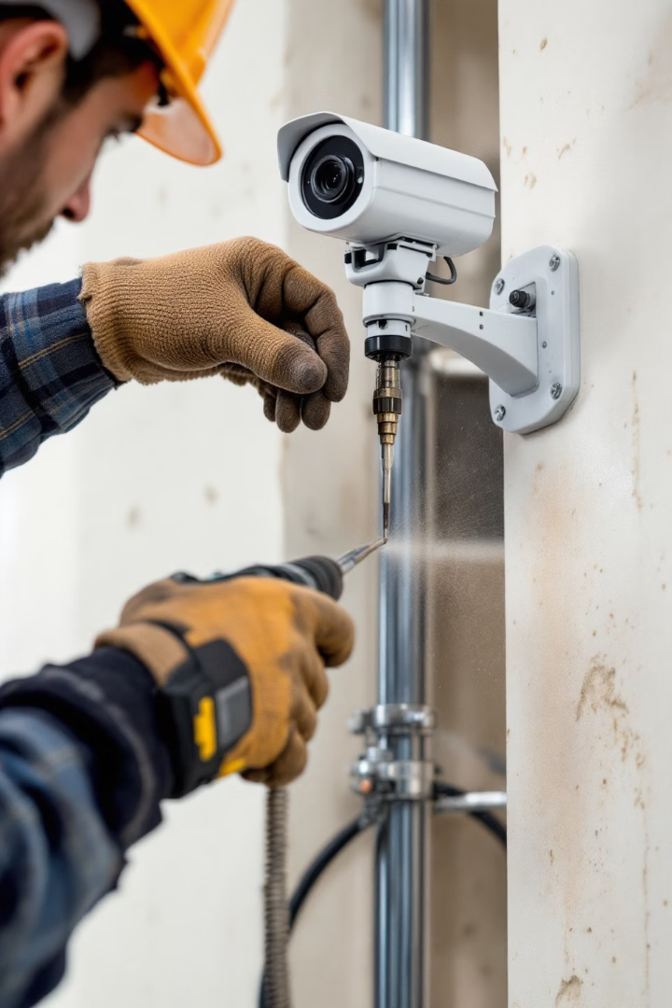
Installation best practices
100%
Compliance rate
Always follow manufacturer specifications for drilling depth,
diameter, and torque settings to achieve full load capacity.
6mm
Minimum edge distance
Keep fixings at least 6× bolt diameter from edges to prevent material
fracture and ensure full expansion capability.
5yr
Documentation retention
Maintain fixing records including type, torque values and
load calculations for all critical security installations.

Slide 12

Preventing common failures
Substrate assessment
Always verify the actual material and condition before selecting fixings. Visual inspection alone is insufficient; test drilling and material hardness checks may be necessary for older buildings. Never assume concrete strength or wall composition.
Proper tool selection
Use calibrated torque drivers for final tightening to prevent over-torquing that can strip threads or crack substrate. Drill bits must match anchor requirements precisely, with hammer function used only in appropriate materials.
Correct installation sequence
Follow the specific sequence prescribed by fixing manufacturers, particularly for chemical anchors where curing time, hole cleaning, and insertion technique directly impact performance. Document installation process for quality assurance.

Slide 13






Material-specific fixing methods
Challenging materials
Hollow clay blocks, aerated concrete, natural stone
Speciality applications
Glass, ceramic tiles, thin sheet materials
Standard building materials
Solid concrete, brick, timber, gypsum board

Slide 14
Material-specific fixing methods
Different building materials require specific fixing approaches.
For standard materials, conventional mechanical fixings are typically sufficient when properly sized.
Speciality applications require purpose-designed fixings such as glass-specific suction mounts, special adhesives, or tension wire systems.
Challenging materials present the greatest difficulty and often require distributed load approaches. For example, hollow clay blocks benefit from chemical injection systems that create a "sock" effect, filling voids and creating a mechanical lock.
Natural stone may need undercut anchors to prevent visible surface damage.

Slide 15



Certification and testing requirements
Product certification
ETA, CE/UKCA marking, DIN/BSI approvals
On-site testing
Pull-out testing, torque verification, inspection
Documentation
Installation records, maintenance schedules

Slide 16
Certification and testing requirements
Follow the manufacturer’s instructions
Always install fixings in line with the manufacturer’s guidance on load ratings, substrates, and environmental conditions.
Check compliance with standards
Use approved fixings that meet the requirements of sector standards such as BS 7671 (electrical wiring), BS 5839 (fire alarms), and BS EN 50132/60839 (CCTV and access control).
Verify installation
Visually inspect and physically check that fixings are secure, suitable for the substrate, and not damaged.
Document your work
Record fixing types and installation methods as part of system commissioning and certification.

Slide 17
Summary
You should now be able to:
Understand the layout and configuration of protection system control panels
Understand addressing and programming of system devices
Understand labelling and documentation of control panel configurations

Slide 18
Any questions?
Copyright in this document belongs to and is used under licence from the Department for Education, © 2025.
‘T-LEVELS’ and ‘T Level’ are registered trademarks of the Department for Education.
WJEC is authorised by the Department for Education to develop and deliver this T Level Technical Qualification.
WJEC operates in England under the name Eduqas which is a registered trademark of WJEC.

