Slide 1
Occupational Specialism: Protection Systems Engineering
K1.10 Methods of terminating and connecting conductors
PowerPoint 10: Methods of terminating and connecting conductors

Slide 2
Introduction
In this session, we will explore the five primary methods used in protective engineering systems:
screwed
crimped
compression
insulation displacement
clamp connections.
Each method offers distinct advantages and limitations.
We'll also examine the consequences of poor connections, material considerations, and regulatory compliance requirements essential for safe, reliable electrical installations.

Slide 3
Objectives
By the end of this session, you should be able to:
Understand the connection methods for protection system components
Correctly connect system components
Verify the operation of connected devices

Slide 4





Overview
Screwed connections
Crimped connections
Compression connections
Terminals with threaded components that secure conductors through applied torque, commonly used in distribution boards and consumer units.
Connections made using hydraulic or mechanical pressure to form permanent bonds, typically used for large-diameter conductors.
Terminals that deform to create permanent connections, ideal for high-current applications and vibration-prone environments.
Insulation displacement
Clamp connections
Connections that pierce insulation without stripping, common in telecommunications and low-voltage systems.
Spring-loaded or mechanical connections that grip conductors, used in terminal blocks and temporary connections.

Slide 5
Screwed connections in detail
Advantages
Limitations
Best practice
Simple to install with basic tools
Potential for loosening under vibration
Always use torque screwdrivers calibrated to the manufacturer’s specifications. For copper conductors, ensure they are properly prepared with the correct stripping length and terminal lugs when required. Regularly inspect for signs of overheating or loosening, especially in environments subject to temperature cycling or vibration.
Easy visual inspection
Requires periodic maintenance and retightening
Can be disconnected and reconnected
Terminal damage from over-torquing
Cost-effective solution
Widely available components
Conductor damage if incorrectly secured
Limited current-carrying capacity compared to some alternatives

Slide 6
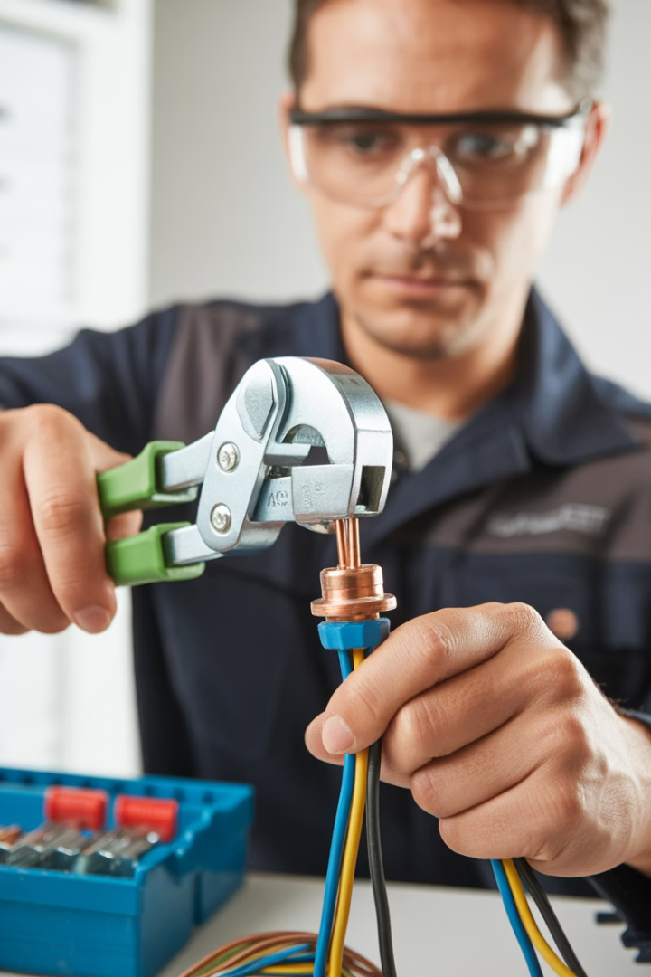
Crimped connections in detail
Advantages
Limitations
Excellent vibration resistance
Requires specialised crimping tools
Low contact resistance
Proper crimping technique is critical
Suitable for high-current applications
Cannot be easily disconnected and reused
Gas-tight connection prevents oxidation
Higher initial cost than screwed connections
No need for periodic retightening
Quality dependent on operator skill
Best practice
Always use manufacturer-approved crimping tools
Select correct terminal size for conductor
Inspect crimp for proper deformation
Consider pull-testing critical connections
Follow British Standard BS 7609 for crimping procedures

Slide 7
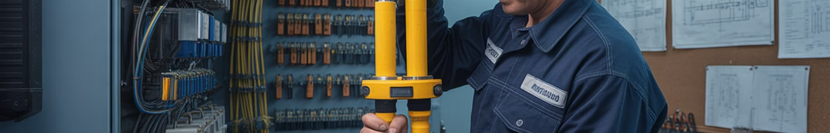




Compression connections in detail
Selection
Preparation
Compression
Inspection
Choose connectors rated for conductor size and material. Verify compatibility with cable type and installation environment
Clean conductor thoroughly. Cut squarely and strip to exact length. Apply inhibitor compound for aluminium conductors
Use calibrated hydraulic tool with correct die set. Apply compression in sequence specified by manufacturer
Verify complete die impressions. Check for cracks or voids. Ensure proper length of compression area

Slide 8








Insulation displacement connections (IDC)
No stripping
Blade contact
IDC technology eliminates the need to strip insulation, saving time and reducing errors
Sharp metal blades slice through insulation to make contact with the conductor
Reliable performance
Gas-tight seal
Consistent connection quality with less dependency on installer skill
Connection is sealed against oxygen, preventing oxidation and corrosion

Slide 9
Insulation displacement connections (IDC)
Insulation displacement connections are predominantly used in telecommunications, data networking, and low-voltage control systems.
They offer exceptional speed of installation and consistency across multiple terminations.
However, they are limited to smaller conductor sizes (typically up to 1.5mm²) and may not be suitable for applications with high mechanical stress.

Slide 10








Clamp connections in detail
Fast installation
Quick termination without special tools
Reusability
Easy disconnection and reconnection without damage
Vibration resistant
Spring pressure maintains contact under movement
Low contact resistance
Consistent pressure ensures good electrical performance

Slide 11
Clamp connections in detail
Clamp connections have become increasingly popular in modern electrical installations, particularly for DIN rail-mounted terminal blocks and wiring accessories.
They provide significant time savings during installation and maintenance compared to traditional screwed connections, while maintaining excellent electrical performance.
Spring-loaded clamp connections are particularly well-suited for installations subject to vibration, such as machinery connections and transportation applications.
However, they typically have more size and current limitations than other connection methods.

Slide 12




Consequences of poor connections
Increased resistance
Poor connections create high-resistance points
Localised heating
Resistance generates heat at connection point
Thermal cycling
Heat/cool cycles further loosen connection
Electrical fire
Extreme heating ignites surrounding materials

Slide 13
Consequences of poor connections
The consequences of poor connections extend beyond immediate electrical failures.
High-resistance connections create significant safety risks by generating heat that can deteriorate insulation and ignite surrounding materials. In protective engineering systems, this can compromise critical safety circuits when they are most needed.
According to the Electrical Safety Council, faulty connections are among the top five causes of electrical fires in UK buildings.
Regular thermal imaging inspections can help identify problematic connections before they reach dangerous temperatures.

Slide 14
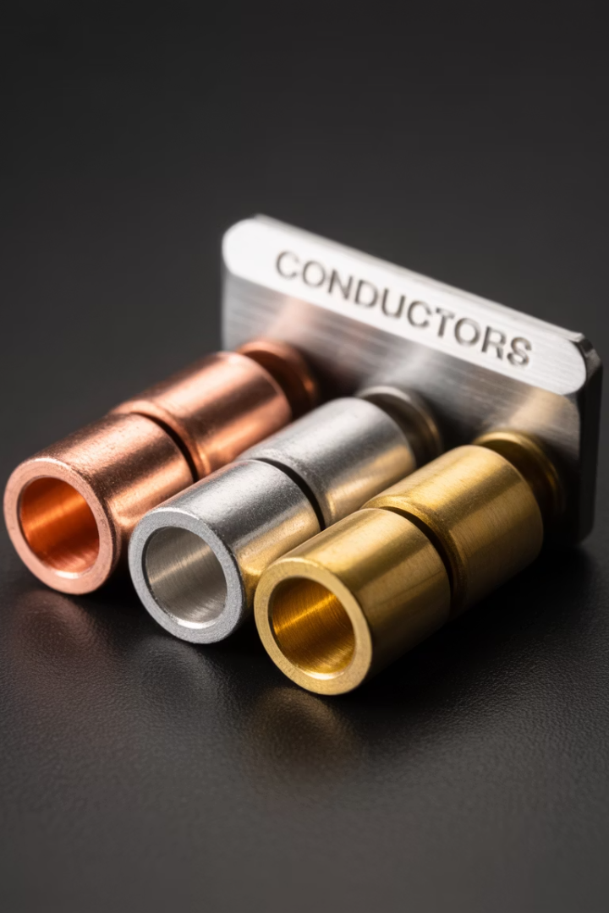
Material considerations in conductor termination
Material
Advantages
Limitations
Special requirements
Copper
Excellent conductivity, ductile, resists corrosion
Higher cost, heavier weight
Standard termination methods suitable
Tinned
Copper
Improved solderability, resists oxidation
Slightly higher resistance than bare copper
Suitable for humid environments
The materials used in both conductors and terminals significantly impact connection quality and longevity. Mismatched materials can lead to galvanic corrosion, particularly in humid or corrosive environments. Always verify compatibility between conductor materials and termination components.

Slide 15



Conductor preparation techniques
Measure twice
Clean cut
Proper stripping
Determine the exact strip length according to manufacturer's specifications for the specific terminal. Different termination types require different strip lengths – too short will cause poor contact, while too long risks exposed conductors.
Use sharp cable cutters to ensure square ends without deformation. Crushed or angled cuts compromise connection quality and increase resistance. Specialised tools should be used for larger conductors.
Use appropriate stripping tools that remove insulation without scoring or damaging the conductor. Even minor nicks can create weak points that lead to conductor failure under load or thermal cycling.

Slide 16




High-volume termination considerations
Heat dissipation
Space constraints
Multiple conductors in close proximity generate more heat. Allow sufficient spacing between high-current terminations.
Plan termination layout to allow proper access for installation and maintenance.
1
Use angled or stepped terminal blocks where appropriate
Consider de-rating factors for grouped cables
Consider future expansion requirements
Maintain minimum bend radii for proper cooling
Identification
Maintenance access
Ensure future maintenance can be performed safely and efficiently.
Clear labelling becomes critical with large numbers of connections.
Group circuits logically
Use standardised numbering systems
Document termination details in wiring schedules
Allow space for test equipment

Slide 17
High-volume termination considerations
Modern electrical installations often require high-density terminations, particularly in control panels and distribution boards.
When dealing with large numbers of conductors, use a systematic approach to organise and document:
installation quality
future maintenance.

Slide 18
Regulatory compliance requirements
UK electrical installations must comply with multiple regulatory frameworks that specifically address connection methods and quality standards. The BS 7671 Wiring Regulations (currently in the 18th Edition) provide detailed requirements in part 6 which covers inspection and testing.
Building Regulations Approved Document Part P applies specifically to domestic installations, requiring notification of certain electrical work and compliance certification. Manufacturers' instructions must be followed precisely, as they form part of the product certification under relevant British or European standards.

Slide 19
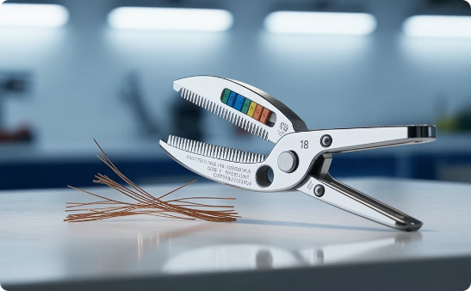
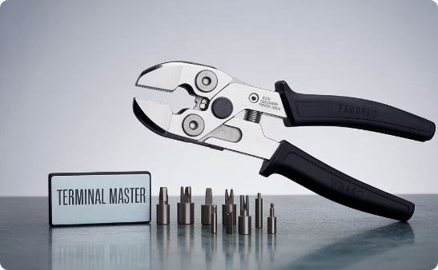
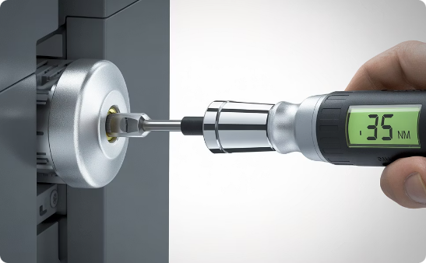
Tools and equipment for quality terminations
Wire preparation tools
Crimping tools
Torque tools
Quality wire strippers with precise gauge settings prevent conductor damage during insulation removal. Self-adjusting strippers are ideal for repetitive work, while specialist tools are required for difficult insulation types like PTFE or high-temperature compounds.
Ratcheting crimpers ensure complete crimping cycle before release, guaranteeing consistent compression. Different terminal types require specific die sets calibrated for the exact terminal design and conductor size, with hydraulic systems needed for larger conductors.
Calibrated torque screwdrivers and wrenches allow precise application of manufacturer-specified tightening forces. Digital models provide additional accuracy and often include data logging capabilities for quality assurance documentation in critical installations.

Slide 20




Termination method selection criteria
Environmental conditions
Consider exposure to vibration, temperature extremes, moisture, and corrosive atmospheres. Crimped connections typically perform better in high-vibration environments, while sealed compression terminations offer superior moisture resistance for outdoor installations.
Electrical requirements
Evaluate current-carrying capacity, voltage level, and resistance requirements. High-current applications generally favour compression or crimped connections due to their lower contact resistance and improved thermal performance.
Maintenance needs
Determine whether future access for testing or replacement will be required. Screwed and clamp connections allow for disconnection and reconnection, while crimped and compression connections are generally permanent once installed.
Economic factors
Consider both material and labour costs. IDC connections may have higher component costs but significantly reduced labour time, while screwed connections typically have the lowest material cost but higher installation time.

Slide 21
Termination method selection criteria
Selecting the optimal termination method requires balancing multiple factors.
For protective engineering systems, reliability should always be the primary consideration, particularly for safety-critical circuits such as:
fire alarm systems
emergency lighting
security installations.

Slide 22
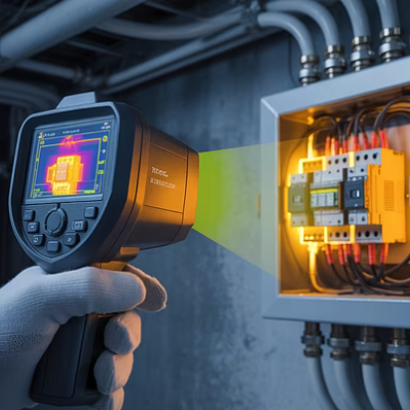

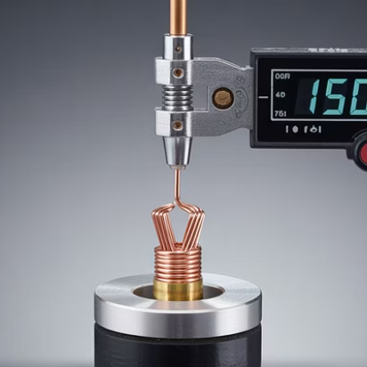
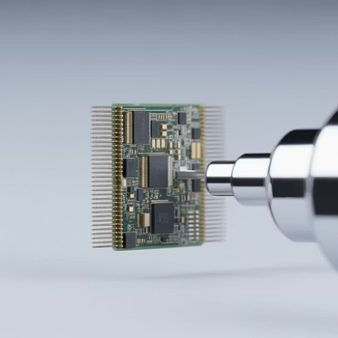
Testing and verification of connections
Proper testing and verification are essential for ensuring connection quality and system reliability.
Visual inspection should be the first step, checking for proper seating, absence of stray strands, and correct conductor insertion depth.
For crimped connections, verify proper die impression and crimp symmetry.
Resistance measurement across connections can identify high-resistance joints before they become problematic.

Slide 23
Comparison of termination methods for specific applications
Application
Preferred method
Alternative method
Rationale
Fire Alarm Systems
Screwed/Clamp
Crimped
Inspectable connections, maintenance access
Power Distribution
Compression
Crimped
High current capacity, low resistance
Machinery/Vibration
Crimped
Spring Clamp
Resistance to loosening, gas-tight connection
Data/Telecom
IDC
Clamp
Speed of installation, consistent quality
Outdoor/Harsh
Compression
Crimped with seal
Weather resistance, long-term stability

Slide 24
Comparison of termination methods for specific applications
Different applications have distinct requirements that make certain termination methods more suitable.
Protective engineering systems often prioritise reliability and resistance to environmental factors, while also considering the need for periodic inspection and testing.
For life safety systems such as fire alarms and emergency lighting, connection methods that allow for visual verification and testing are generally preferred, unless specific environmental challenges (such as extreme vibration) dictate otherwise.

Slide 25
Documentation and record-keeping
3
100%
Critical documents
Inspection coverage
Installation certificates, test records, and as-built diagrams
Required for protective system terminations
For protective engineering systems, thorough record-keeping becomes even more critical, as these systems may be subject to regular inspection and testing regimes under fire safety legislation, workplace regulations, or insurance requirements.
As-built documentation should clearly identify all connection points, including terminal types, conductor sizes, and torque settings where applicable.
All modifications must be promptly updated in system documentation to maintain accuracy throughout the installation's lifetime.

Slide 26





Summary
Proper selection
Choose the right method for the application
Correct tools
Use appropriate quality tools for each method
Follow standards
Adhere to current regulations and manufacturer specifications
Verify quality
Inspect and test all connections thoroughly
Document everything
Maintain comprehensive records of all terminations

Slide 27
Summary
You should now be able to:
Understand the connection methods for protection system components
Correctly connect system components
Verify the operation of connected devices

Slide 28
Any questions?
Copyright in this document belongs to and is used under licence from the Department for Education, © 2025.
‘T-LEVELS’ and ‘T Level’ are registered trademarks of the Department for Education.
WJEC is authorised by the Department for Education to develop and deliver this T Level Technical Qualification.
WJEC operates in England under the name Eduqas which is a registered trademark of WJEC.

