Slide 1
Occupational Specialism: Protection Systems Engineering
K1.14 Verification of protection systems
PowerPoint 14: Verification of protection systems

Slide 2
Introduction
In this session, we will explore the critical processes, requirements, and best practices for ensuring protection systems comply with design specifications, manufacturer guidelines, and relevant industry standards.
Electrical installations must be safe and reliable, so understanding the verification process is crucial for protecting both equipment and personnel.
This session provides a structured approach to verification procedures and documentation requirements that are essential for demonstrating compliance and ensuring effective handover to end users.

Slide 3
Objectives
By the end of this session, you should be able to:
Understand the verification procedure required to ensure installations are safe and reliable
Follow a verification process
Successfully transfer documentation to end users

Slide 4
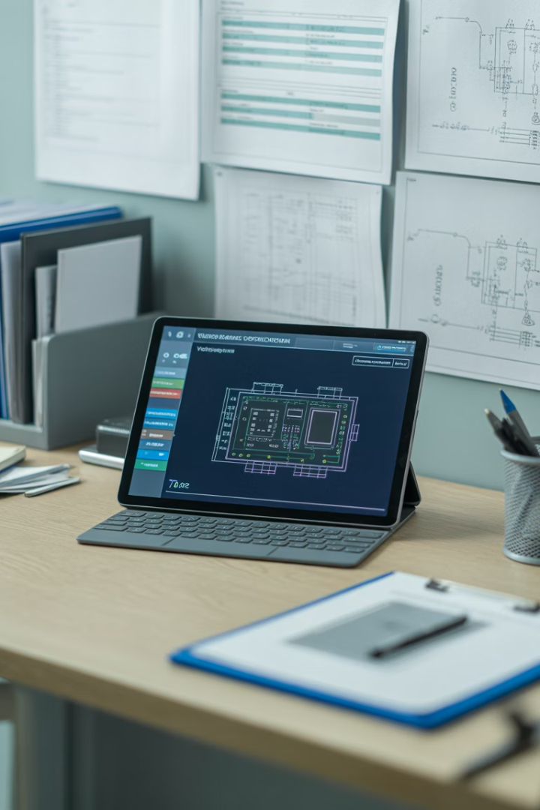




Overview
Legal and regulatory requirements
Overview of UK standards and regulations
Verification procedures
Step-by-step methodology for system testing
Documentation requirements
Essential records and certification processes
Handover procedures
Effective transfer to end users

Slide 5
Overview
Today’s session will guide you through the complete verification journey, from understanding applicable regulations to successfully transferring documentation to end users.
We'll examine practical approaches to ensure the verification processes are thorough, compliant, and effectively documented.

Slide 6



UK regulatory framework
BS 7671 requirements for electrical installations
Electricity at Work Regulations 1989
The fundamental standard for electrical installations in the UK, often referred to as the IET Wiring Regulations, providing the baseline requirements for protection systems.
Legal framework placing duties on employers, the self-employed and employees to ensure electrical systems are constructed and maintained to prevent danger.

Slide 7
UK regulatory framework
Understanding this regulatory landscape is essential before beginning any verification process.
These standards establish the baseline requirements against which protection systems must be verified, forming the legal foundation for compliance assessments.

Slide 8
Industry standards and guidance
Key Standards and Codes of Practice
BS 7671 – Inspection & testing requirements for electrical installations (verification of wiring, insulation, continuity).
BS 5839-1 – Verification, commissioning, and handover of fire detection and fire alarm systems.
BS 6266 – Fire protection of electronic equipment installations (server rooms, comms rooms).
BS EN 50131 / 50132 / 50133 series – System testing and verification for intruder alarms, CCTV, and access control.
Codes of Practice (NSI, SSAIB, FIA) – Sector-specific compliance and best practice guidance for installation, testing, and verification.

Slide 9
Industry standards and guidance
These industry standards and guidance documents provide the detailed technical requirements that supplement the regulatory framework.
When verifying protection systems, you must use both the overarching regulations and these more detailed technical specifications to ensure comprehensive compliance.

Slide 10





Verification planning
Gather documentation
Collect system designs, manufacturer specifications, and relevant standards before beginning verification.
Plan testing equipment
Identify and calibrate all necessary testing instruments per specific system requirements.
Schedule activities
Develop logical sequence of verification steps with
appropriate system access timing.
Assign resources
Designate qualified personnel with appropriate competencies
for each verification task.

Slide 11
Verification planning
Effective verification planning ensures that all necessary resources and preparations are in place before beginning the actual testing process.
This preparation phase is critical for efficient verification, minimising system downtime and ensuring comprehensive assessment without missed elements.

Slide 12










Types of protection systems
Access control systems
BS EN 50133
Intruder alarm systems
CCTV systems
BS EN 50131
BS EN 50132
Fire detection
Other
BS 5839-1
Disabled Refuge, Disabled Persons Alarm, Nurse Call

Slide 13
Types of protection systems
Each protection system type requires specific verification procedures tailored to its function and design.
Understanding the characteristics of these different systems is essential before planning appropriate testing methodologies, as verification requirements vary significantly between different protection technologies.

Slide 14








Visual inspection process
Completeness
Verify all specified components are present and correctly installed
Dimensions and clearances
Check spatial requirements and safety clearances are maintained
Mechanical integrity
Inspect mounting, fixings and physical condition of components
Electrical connections
Examine terminations, cable entries and conductor routing

Slide 15
Visual inspection process
Visual inspection forms the crucial first stage of the verification process, allowing any obvious defects to be spotted before electrical testing begins.
This hierarchical approach ensures that fundamental issues are addressed first, providing a solid foundation for subsequent testing activities.
Make sure you document visual inspection findings, with photographic evidence where appropriate to record the as-built condition of the protection system.

Slide 16
Testing equipment requirements
Multimeter
Battery Load Tester
Decibel Meter
Lux Meter
Insulation/Continuity Tester
Smoke Detector Test Kit
Heat Detector Tester
CO / Multi-sensor Test Equipment
Loop/Addressable Test Tools
CCTV Test Monitor
Network Testers
Lens/FOV Tools
Selecting appropriate testing equipment is essential for accurate verification results.
All equipment must be properly calibrated and suitable for the specific protection systems being verified.
Make sure you understand the limitations of the test equipment and ensure it meets the requirements of relevant standards for the measurements being taken.

Slide 17




Functional testing procedures
Component-level testing
Verify individual device functionality against specifications
Interface testing
Check connections between protection components
System-level testing
Validate complete protection system operation
Coordination testing
Confirm correct sequential operation of devices

Slide 18
Functional testing procedures
Functional testing progresses from simple component verification to complex system coordination checks.
Each stage builds upon the previous, ensuring that individual elements function correctly before testing their interaction with other components.
Testing should replicate real-world operating conditions as closely as possible, including:
normal operation
abnormal conditions
fault scenarios.
Document all test results thoroughly, including actual measured values rather than simple pass/fail notations.

Slide 19

Compliance verification checklist
1
Design compliance
Verify the protection system installation matches the approved design documentation, noting any approved variations and their justification.
2
Manufacturer specifications
Confirm all components are installed according to manufacturer guidelines, including mounting positions, clearances, and environmental conditions.
3
Regulatory standards
Check compliance with all applicable UK standards and regulations, including BS 7671, product-specific standards, and industry guidance.
4
Client requirements
Ensure any additional requirements specified by the end client beyond standard compliance are verified and documented.

Slide 20
Compliance verification checklist
A structured verification checklist ensures a full assessment against all applicable requirements.
Each verification item should be specifically documented with reference to the relevant clause of the standards or specifications, creating a clear audit trail that demonstrates compliance.

Slide 21








Non-compliance management
Identification
Risk assessment
Document specific non-compliances with reference to applicable standards
Evaluate safety, operational and regulatory implications
Re-verification
Remediation
Test corrected systems to
confirm compliance
Implement corrective actions to address non-compliances

Slide 22
Non-compliance management
When non-compliances are identified during verification, a systematic approach to their management is essential.
Each non-compliance should be documented in detail, including its specific nature, the standard or specification clause it violates, and the potential implications for system safety and performance.
For temporary non-compliances where immediate remediation is not possible, formal risk assessment and interim mitigation measures must be implemented and documented.

Slide 23
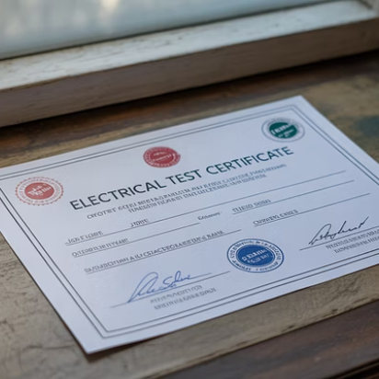
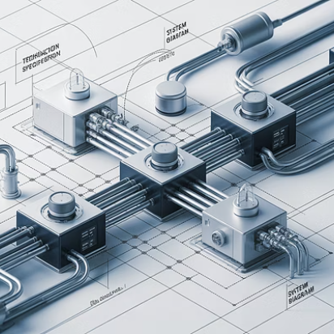
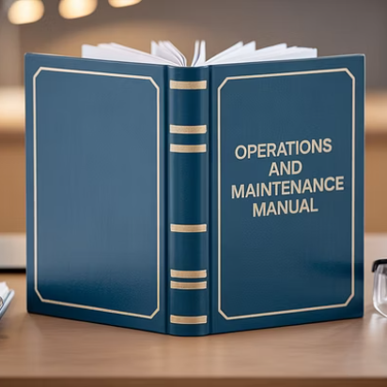
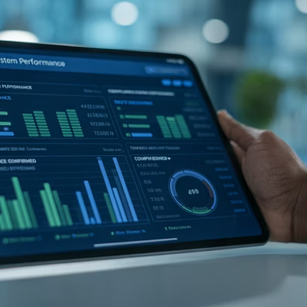
Documentation types and requirements
Comprehensive documentation is a critical deliverable of the verification process. Required documents typically include test certificates confirming compliance with BS 7671 and other applicable standards like BS 5839 for fire, detailed as-built drawings accurately reflecting the installed system, and complete records of all test results with actual measured values.
Documentation must be produced in the format specified by relevant standards and client requirements. Digital documentation is increasingly common, providing improved accessibility and searchability, though formal certificates often still require physical signatures and stamps.

Slide 24
Test records and certification
Test type
Recording requirements
Verification method
Visual Inspection
Checklist with detailed observations
Direct observation against drawings
Continuity Testing
Measured resistance values
Low-resistance ohmmeter
Insulation Resistance
Actual megohm values at specified
voltage
Insulation resistance tester

Slide 25
Test records and certification
Test records must include specific measured values rather than simple pass/fail indications.
This allows future comparison to identify deterioration and provides evidence of the actual margin of compliance.
Records should clearly identify the individual performing each test and verify their competence for the specific test procedures.

Slide 26

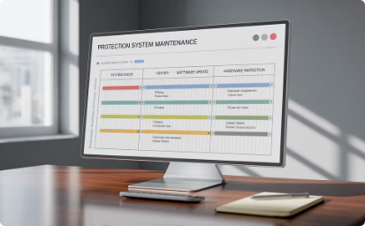
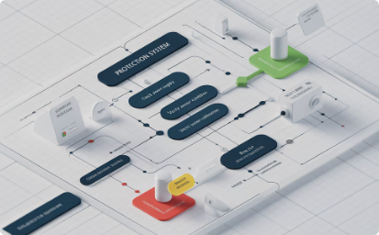
Operation and maintenance documentation
User manuals
Comprehensive documentation explaining system operation, including normal conditions, alarm responses, and emergency procedures.
Should be written in clear language appropriate for the intended users, avoiding unnecessary technical jargon unless essential.
Maintenance schedules
Detailed requirements for routine testing and maintenance activities, including specific procedures, frequencies, and acceptance criteria.
Should be aligned with manufacturer recommendations and industry best practices for the specific protection technologies.
Troubleshooting guides
Systematic approaches to identifying and resolving common protection system issues, including diagnostic procedures and remedial actions.
Should enable first-line maintenance personnel to diagnose basic problems and recognise when specialist assistance is required.

Slide 27
Operation and maintenance documentation
Effective O&M documentation enables safe and efficient long-term operation of protection systems.
Documentation should be tailored to the specific installed system rather than generic templates, with clear cross-referencing to as-built drawings and test certificates.

Slide 28

Digital documentation systems
Modern digital documentation systems offer significant advantages for protection system verification, including:
improved accessibility
automated validation
enhanced searchability.
These systems can integrate with testing equipment to automatically record results, reducing transcription errors and allowing direct comparison with acceptance criteria.
When implementing digital documentation, ensure:
compatibility with client systems
address cybersecurity concerns
maintain appropriate backup procedures to protect critical verification records.

Slide 29
Documentation handover process
Pre-handover review
Formal handover meeting
Post-handover support
Conduct comprehensive internal check of all documentation for completeness, accuracy and compliance before client handover. Address any deficiencies and ensure all required signatures and certifications are in place.
Schedule structured session with client representatives to physically transfer documentation and explain its organization and content. Walk through critical documents and highlight key information requiring particular attention.
Provide technical assistance during initial period after handover to address questions and provide clarification. Establish clear communication channels for documentation-related queries after project completion.

Slide 30
Documentation handover process
A structured documentation handover process ensures that end users fully understand the protection system documentation and can effectively utilise it for operation and maintenance.
The handover should be treated as a formal project milestone rather than a casual transfer of papers, with appropriate preparation and client engagement.
Document the handover process itself, obtaining formal client acknowledgement of receipt and acceptance of the documentation package.

Slide 31








Summary
Comprehensive verification
Verify against design, manufacturer specs, and standards
Detailed documentation
Record specific measurements and compliance evidence
Complete O&M manuals
Provide operational and maintenance information
Structured handover
Ensure effective knowledge transfer to end users

Slide 32
Summary
You should now be able to:
Understand the verification procedure required to ensure installations are safe and reliable
Follow a verification process
Successfully transfer documentation to end users

Slide 33
Any questions?
Copyright in this document belongs to and is used under licence from the Department for Education, © 2025.
‘T-LEVELS’ and ‘T Level’ are registered trademarks of the Department for Education.
WJEC is authorised by the Department for Education to develop and deliver this T Level Technical Qualification.
WJEC operates in England under the name Eduqas which is a registered trademark of WJEC.

