Slide 1
Occupational Specialism: Protection Systems Engineering
K1.13 Testing of Protection Systems
PowerPoint 13: Testing of Protection Systems

Slide 2
Introduction
This session will equip you with the essential knowledge to conduct thorough functional tests and commissioning processes.
We'll explore the identification of expected and incorrect test values, along with potential implications of testing anomalies.

Slide 3
Objectives
By the end of this session, you should be able to:
Understand the purpose of functional testing and commissioning in ELV protection systems
Understand how to identify and record relevant test values (e.g. sound pressure levels, battery standby capacity, loop resistance, detector sensitivity)
Complete functional commissioning tests and interpret the implications of test results for compliance, safety, and system performance

Slide 4
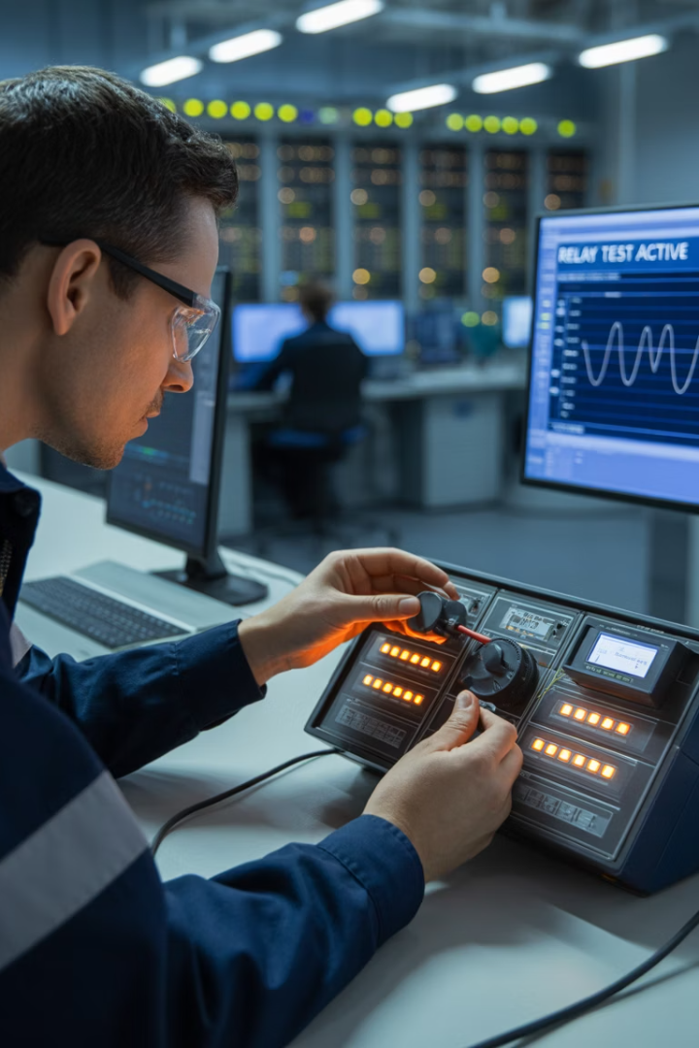



The critical role of protection system testing
Safety assurance
Reliability Confirmation
Comprehensive testing verifies that protection systems will operate correctly when required, preventing potential harm to personnel and equipment during fault conditions.
Regular testing ensures protection systems will respond appropriately to electrical faults, maintaining system integrity and preventing cascading failures.
Compliance verification
Testing validates adherence to BS 5839-1, BS EN 50131 and PD6662, BS EN 62676, BS 7671 and other relevant standards, ensuring legal and regulatory compliance for system operation.

Slide 5

Regulatory framework: standards and codes
BS 5839-1 (Fire detection & alarm — non-domestic) Design, installation, commissioning, and maintenance requirements. Covers cable/fixings, device siting, zoning, interfaces (see BS 7273-4), audibility/VAD checks, battery capacity, cause-and-effect, records and certificates.
BS EN 50131 series + PD 6662 (Intruder & hold-up alarms) System grading, environmental classes, power/tamper requirements, ATS linkage (EN 50136). Install & commissioning tests (zones, EOL/DEOL, setting/unsetting, confirmation per BS 8243), handover documentation for police/insurer acceptance.
BS EN 62676 series (CCTV / Video Surveillance) Application & performance guidance (FoV/identification criteria), installation & commissioning, recording integrity, documentation and user info. (Remember data protection/usage signage externally.)
BS EN 60839-11-1 (Electronic Access Control) System architecture, wiring & power/backup, door hardware interfaces, event logging, commissioning and records. Coordinate with BS 7273-4 / EN 13637 for escape-route door release on fire alarm.

Slide 6








Manufacturer documentation: the foundation of testing
Specific test parameters
Exact values, tolerances and testing sequences
Required testing equipment
Specialised instruments and software
Testing procedures
Step-by-step methodology and safety protocols
Fundamental Documentation
Equipment specifications and reference materials

Slide 7
Manufacturer documentation: the foundation of testing
Manufacturer documentation provides the essential framework for testing electronic protection systems.
It contains specific requirements that must be followed precisely to ensure system functionality and warranty validity.

Slide 8
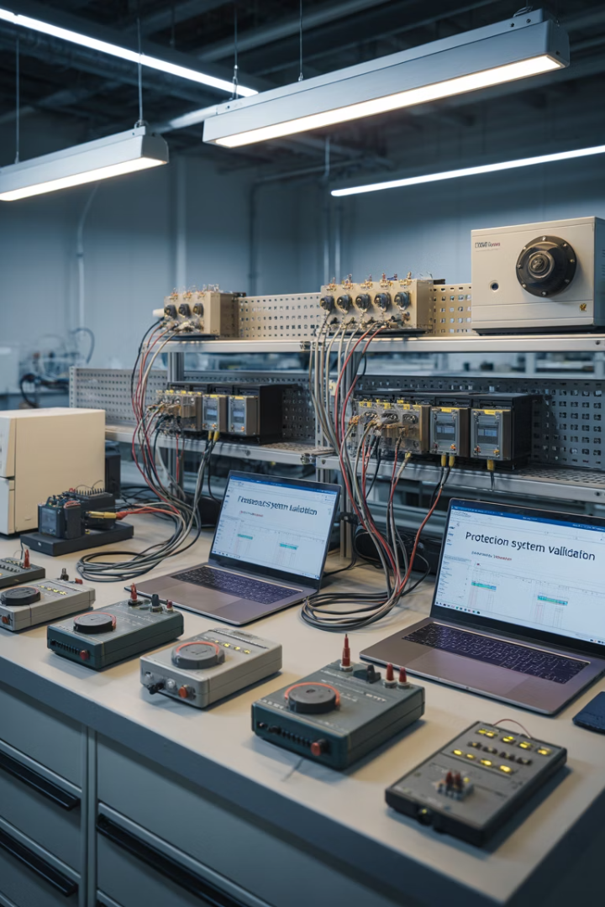



Essential test equipment for protection system verification
Multi-function testers
Test monitors
Smoke and heat testers
Devices for measuring insulation resistance, continuity, loop impedance and other parameters essential for verifying the integrity of protection circuits.
A CCTV test monitor is a portable screen used during installation and maintenance to set up and align cameras. It allows the engineer to check image quality, focus, orientation, and coverage directly at the camera location, ensuring the view is correct and the signal is transmitting properly before final commissioning.
Smoke and heat testers are specialist tools used to functionally test fire detectors. They simulate real fire conditions - smoke aerosols for smoke detectors and heated air for heat detectors - to confirm the devices activate correctly and report to the control panel, as required by BS 5839-1.

Slide 9





Preparation phase: before testing begins
Check drawings and documentation
Review system drawings and zone charts to understand device locations and test points.
Confirm test equipment
Ensure the correct test kits (e.g. smoke/heat testers, CCTV test monitor, multimeter) are available and calibrated.
Carry out a risk assessment
Complete a site-specific risk assessment to identify hazards such as working at height, dust, or live equipment.
Plan functional tests
Agree a testing plan in line with manufacturer requirements and site procedures, ensuring all tests can be carried out safely and effectively.

Slide 10

Initial inspection: visual and mechanical checks
Detectors and devices Functionally test smoke, heat, and CO detectors with approved test equipment. Confirm sounders, strobes, and cameras operate correctly and are unobstructed.
Cabling and connections Check wiring polarity, continuity, and termination quality.
Ensure fire-rated supports are used where required and cabling follows site drawings.
Control panels and ancillaries Verify panels, keypads, and power supplies operate as expected.
Check indicators, displays, and labels match the installed system specification.
Installation vs drawings Confirm devices are installed in the correct locations and heights, aligned with design documents, zone charts, and manufacturer guidance.

Slide 11
Initial inspection: visual and mechanical checks
Before electrical testing begins, a thorough physical inspection is essential to identify any visible issues that could affect performance or safety. This step often reveals problems that might not be detected during electrical tests, such as loose connections or environmental damage.
Make a record of the visual inspection to give a baseline reference for future maintenance and help establish the overall condition of the system before commissioning.

Slide 12
Power supply and hardware testing
PSU output voltage Measure and confirm the output voltage of power supply units (PSUs) matches the manufacturer’s specification for the connected system.
Standby battery capacity Carry out calculations or measured discharge tests to confirm standby duration meets requirements of relevant standards:
BS 5839-1 (fire detection & alarms)
BS EN 50131 / PD 6662 (intruder & hold-up alarms)
BS EN 62676 (CCTV systems).
Fault and alarm simulation Verify that disconnecting the PSU or battery correctly generates fault or alarm signals at the control panel/interface, as per system requirements.
Battery condition Check battery type, age, connections, and physical condition. Replace if swollen, corroded, or unable to hold charge.

Slide 13
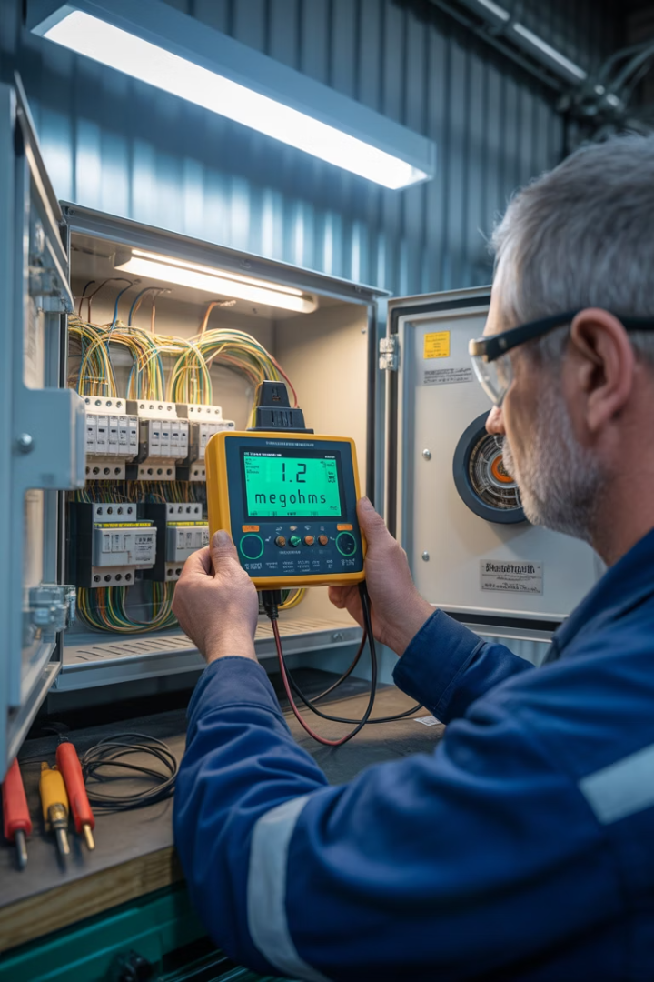
Insulation resistance testing
Test voltage
Minimum acceptable value
Typical expected value
Application
500V DC
1.0 MΩ
>200 MΩ
Fire Alarm Systems

Slide 14
Insulation resistance testing
Insulation resistance testing verifies the integrity of insulation between circuit conductors and earth.
Low values may indicate contamination, moisture ingress or deterioration of insulation materials, which could lead to dangerous leakage currents or system malfunctions.

Slide 15








Protection scheme coordination testing
Fault reporting Check that cable faults, open/short circuits, and PSU failures generate the right panel indications.
Device functionality Confirm that detectors, sounders, cameras, and access devices operate correctly.
Cause-and-effect
Test that triggers (e.g. MCP, detector activation) drive the correct outputs (sounders, relays, door releases, CCTV presets).
Timers and delays Verify programmed entry/exit times, sounder delays, or phased evacuation sequences.
Zoning
Ensure alarm devices/outputs are activated only in their assigned zones.

Slide 16
Failure Mode and Effects Analysis (FMEA)
Fault type | Effect on system | Detection method | Recommended test
Device failure (detector, camera, reader) | No detection, no alarm, or loss of video/entry control | Device test (activation, CCTV feed check, card swipe) | Manual device activation test / visual inspection
Power supply/battery fault | Loss of system during mains failure, no standby | Panel PSU/battery monitoring | Mains drop test / battery capacity test
Communication fault (network or signalling path) | No transmission to ARC or loss of CCTV feeds | Panel/network supervision | Link loss simulation / ARC comms test
Zoning/timer error | Wrong zone activated or incorrect delays | Panel programming check | Functional cause-and-effect test
Wiring fault (open/short/earth fault) | False alarms, devices disabled, incorrect signals | Panel fault monitoring | Continuity/insulation resistance tests

Slide 17



Documentation and test records
Test result records
Record all measured values (voltages, currents, sound levels, resistance, delays). Note: There is no simple pass/fail — measured values must be checked against standards/design criteria.
Non-compliance records
Clear notes of any defects, issues, or variations from the design/standards.
Essential for handover and corrective actions.
Commissioning documentation
Signed evidence that the system has been fully tested.
Confirms readiness for client handover and ongoing maintenance.

Slide 18
Troubleshooting common testing problems
Power issues – blown fuses, PSU/battery faults, no switchover.
Cabling faults – opens, shorts, earth faults, poor terminations, water ingress.
Device faults – detector not activating, sounder/VAD not operating, CCTV camera offline, card reader failing.
Configuration/Programming errors – wrong zones, incorrect timers, misaddressed devices.
Communication faults – loop/network issues, signalling failure, interference.
Environmental causes – dust, condensation, heat, poor installation.
Process (circle flow works well here):
Identify → Isolate → Test → Rectify → Re-test

Slide 19



Final commissioning and handover
Complete certification
Operator training
Documentation transfer
Final commissioning requires formal certification that all tests have been successfully completed according to specifications. This document becomes part of the permanent system record and often has legal significance for warranty and liability purposes.
The commissioning process includes knowledge transfer to operational staff. This ensures they understand normal operation characteristics, alarm interpretation, and basic troubleshooting procedures to maintain system reliability throughout its operational life.
All test records, settings documentation, as-built drawings, and manufacturer documentation must be organized and transferred to the system owner. This information is essential for future maintenance, troubleshooting, and system modifications.

Slide 20
Summary
You should now be able to:
Understand common faults found in protection systems
Use test equipment and fault-finding techniques
Record, report, and resolve system faults

Slide 21
Any questions?
Copyright in this document belongs to and is used under licence from the Department for Education, © 2025.
‘T-LEVELS’ and ‘T Level’ are registered trademarks of the Department for Education.
WJEC is authorised by the Department for Education to develop and deliver this T Level Technical Qualification.
WJEC operates in England under the name Eduqas which is a registered trademark of WJEC.

