Slide 1
Occupational Specialism: Protection Systems Engineering
K1.1 Safe working practices specific to work on protection systems
PowerPoint 1.1: Safe working practices specific to protection systems

Slide 2

Introduction
In this session you will learn about safe working practices for protection systems engineering.
It covers essential procedures for working with fire and security systems to ensure both personal safety and system integrity, proper isolation procedures, appropriate tool selection, and specific precautions to take for various system components.

Slide 3
Objectives
By the end of this session, you should be able to:
Know how to safely isolate electrical systems before working on 230V AC circuits
Understand how to select appropriate tools and PPE for protection system work
Understand how to complete risk assessments and method statements (RAMS) for protection system tasks

Slide 4




Overview of protection systems engineering safety
Comprehensive safety framework
Equipment and tool safety
Understanding and implementing proper safety protocols for all aspects of protection systems
Proper selection and use of tools and equipment for specific tasks
Component-specific procedures
Hazard recognition
Specialised safety procedures for different system components including batteries and fibre-optic cables
Identifying potential hazards and implementing appropriate preventative measures

Slide 5




Electrical isolation fundamentals
Identify circuit
Confirm the circuit to be isolated using diagrams and labels
Isolate power
Switch off and secure the isolation device
Lock and Tag
Apply locks and warning signs to prevent reconnection
Verify isolation
Test with approved voltage indicator to confirm isolation

Slide 6



Importance of proper isolation procedures
Prevent injuries
Protection against electric shock and arc flash incidents
Protect property
Prevent damage to equipment and facilities
Regulatory compliance
Meet legal obligations under safety
regulations

Slide 7
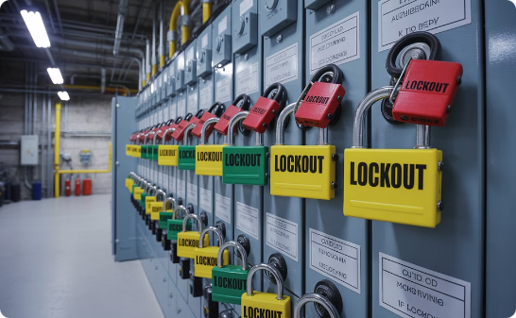
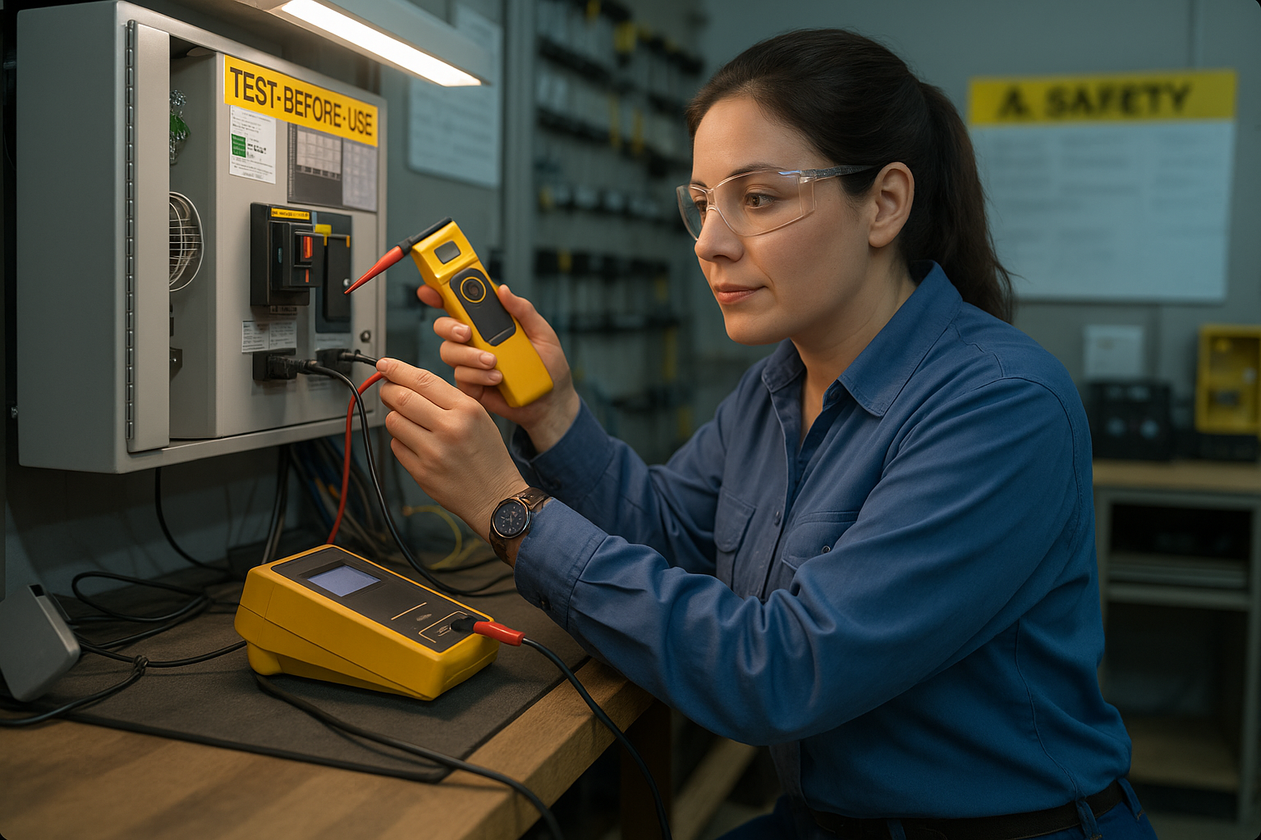

Verification of safe isolation
Securing isolation
Test-before-use
Testing for dead
Applying lockout devices and tags to prevent accidental re-energisation of systems during maintenance
Verifying test equipment functionality on a known live source before and after testing the isolated circuit
Using approved voltage indicators to verify absence of voltage at all conductors after isolation

Slide 8

GS 38 Compliant tools for isolation
GS 38 provides guidelines for electrical test equipment used by electricians. Compliant tools must have:
Insulated handles covering all conductive parts
Finger guards to prevent contact with live parts
Minimum exposed metal at probe tips
Fused leads where appropriate

Slide 9
GS 38 Compliant tools for isolation
Selecting the appropriate tools is essential for ensuring electrical safety. All test equipment must be inspected before use to ensure insulation integrity and proper functionality.
For those that do not include a built-in test function, an appropriate proving unit should be used.
Damaged test equipment should be immediately removed from service and replaced.

Slide 10
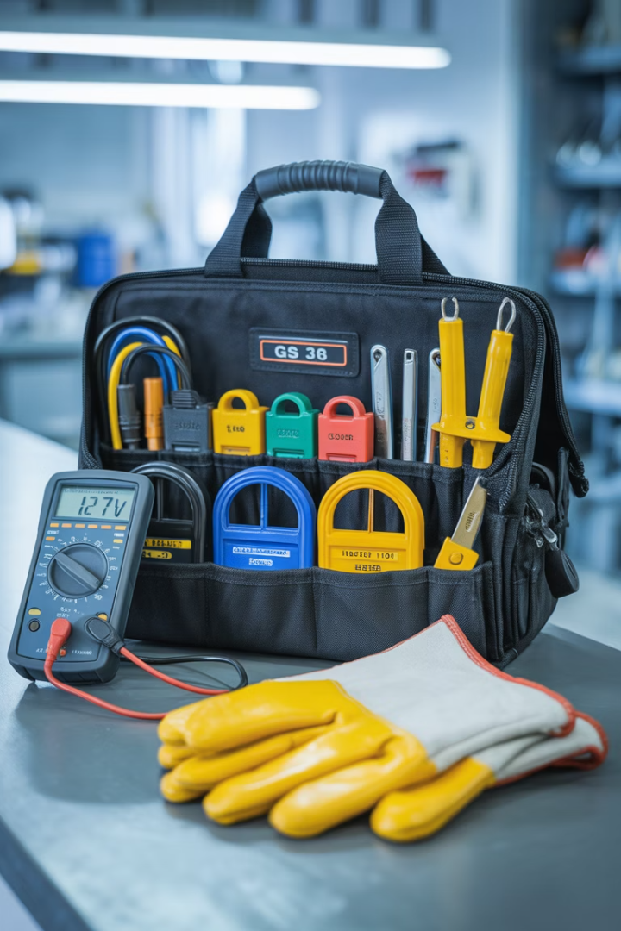
Selecting appropriate tools for isolation
Voltage indicators
Locking off devices
Must comply with HSE GS 38
MCB lockout clips
Suitable for circuit voltage
Fuse carrier locks
Clearly display voltage presence
Padlocks with unique keys
Include built-in test function
Multi-lock hasps for group work
Insulated tools
1000V rated insulation
No exposed metal parts
Regular inspection for damage
Appropriate certification

Slide 11




Tools inspection and maintenance
Pre-use inspection
Visual inspection of tools for damage to insulation, cracks, or exposed metal before each use
Scheduled testing
Regular electrical testing of
equipment as per manufacturer's recommendations and industry standards
Maintenance
Keeping tools clean, properly stored and serviced according to specifications
Disposal/Replacement
Immediate removal and replacement
of damaged or failed equipment

Slide 12








Stand-by power supplies: safety considerations
Identify all sources
Locate all potential energy sources
Battery isolation
Proper disconnection procedures
Capacitor discharge
Safe methods for stored energy release
Verification
Confirm complete power removal

Slide 13

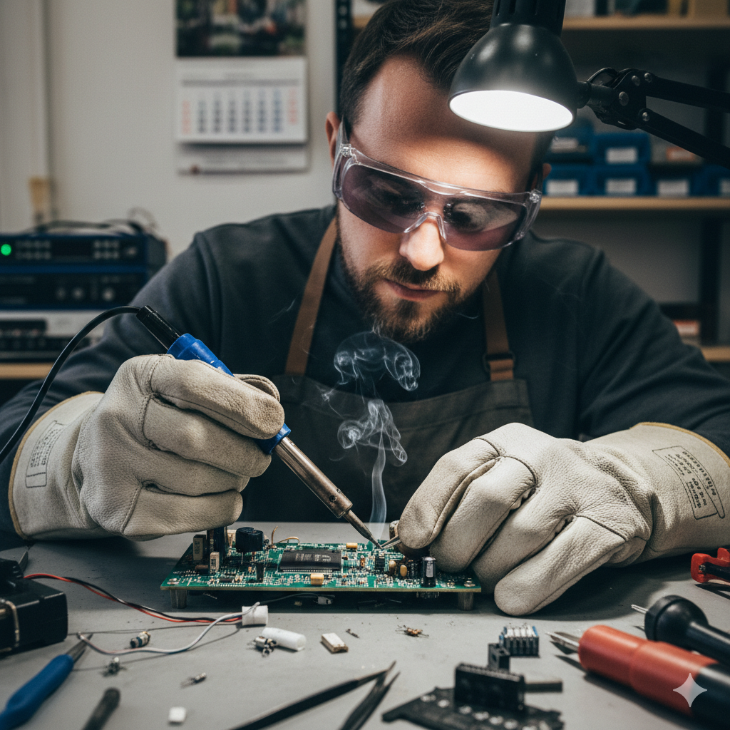


Disconnection of stand-by supplies
When working with standby power supplies, it is essential to follow strict procedures to safely disconnect these energy sources. This includes properly identifying all power sources, following the manufacturer's disconnection procedures, and verifying the complete removal of power before commencing work.

Slide 14
Disconnection of stand-by supplies
Always wear appropriate PPE including insulated gloves when handling batteries or working near capacitors. Document all disconnections and inform relevant personnel about the status of back-up systems.

Slide 15



Chemical battery safety
Chemical hazards
Lead-acid batteries contain sulphuric acid which can cause severe burns. Lithium batteries may present fire risks if damaged. Always refer to the specific SDS (Safety Data Sheet) for handling procedures.
Required PPE
Chemical-resistant gloves, eye protection, and protective clothing must be worn when handling batteries. Face shields may be required when working with larger battery banks.

Slide 16

Chemical battery safety
Ventilation
Work in well-ventilated areas to prevent the accumulation of hydrogen gas released during charging. Never create sparks or flames near batteries.

Slide 17
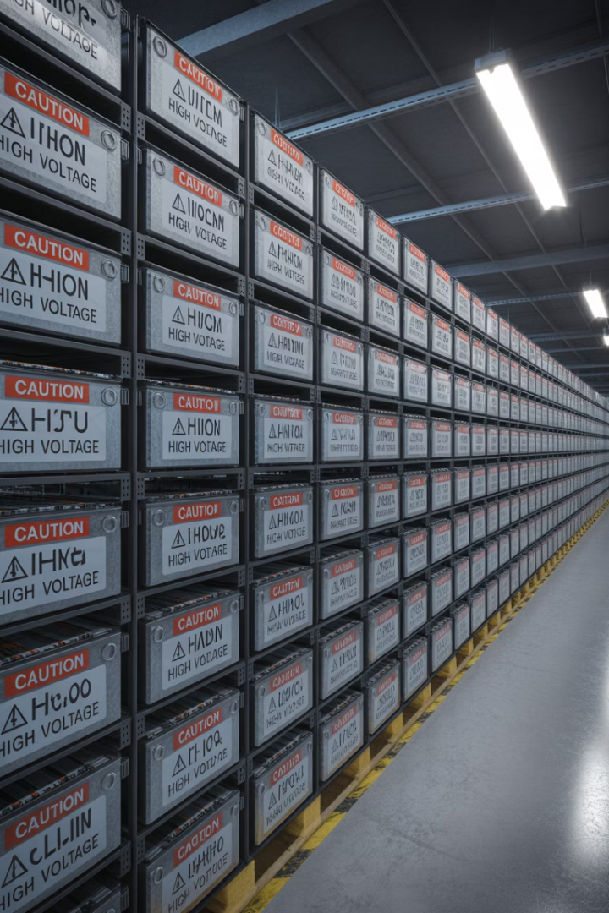
Working with various battery types
Battery type
Primary hazards
Safety requirements
Tool requirements
Lead-Acid
Acid burns, hydrogen gas
Chemical-resistant PPE, ventilation
Insulated tools, acid neutraliser
Lithium-Ion
Fire, thermal runaway
Fire extinguisher (Class D), ventilation
Insulated tools, non-conductive trays
Alkaline
Chemical burns, leakage
Basic PPE, eye protection
Standard insulated tools

Slide 18

Battery handling and transportation
Pre-handling assessment
Before handling any battery, inspect for damage, leakage, or deformation.
Verify the type and chemistry to determine specific handling requirements.
Review applicable SDS and prepare appropriate containment equipment.

Slide 19

Battery handling and transportation
Safe handling procedures
Use proper lifting techniques for heavy batteries.
Never lift batteries by terminals or cables.
When removing, disconnect the negative terminal first and reconnect it last.
Use insulated tools to prevent short circuits and spark risks.

Slide 20
Battery handling and transportation
Transportation requirements
Use approved containers with appropriate labelling.
Secure batteries to prevent movement during transport and keep terminals covered to prevent accidental short circuits.

Slide 21
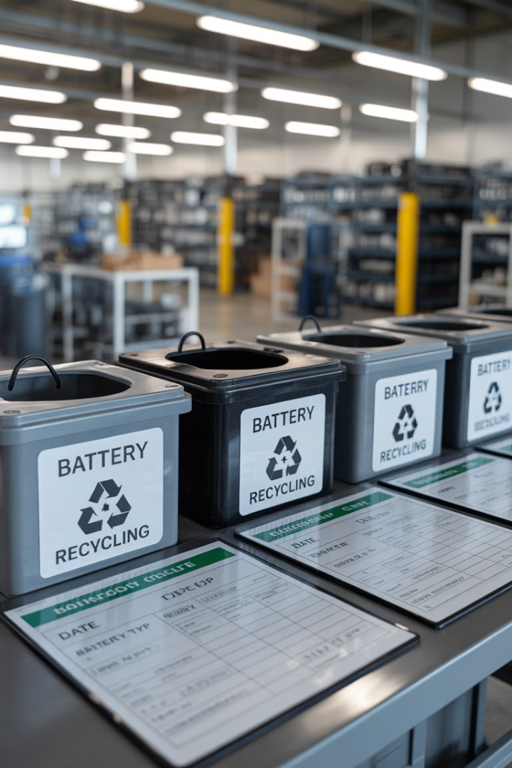
Battery disposal procedures
100%
13kg
Recycling rate
Threshold
UK requirement for lead-acid battery recycling
Maximum classification for hazardous waste transport without a license
3yrs
Records retention
Minimum period to maintain hazardous waste disposal documentation
All batteries must be disposed of in accordance with the Hazardous Waste Regulations and the Waste Batteries and Accumulators Regulations. Companies must use licensed waste carriers and maintain comprehensive records of all battery disposals, including waste transfer notes with appropriate EWC codes.

Slide 22


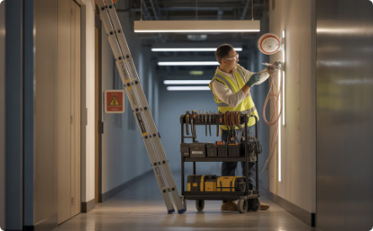
Working with detection devices
Overview
When installing detection devices at height, ensuring proper PPE is critical to minimise risk and maintain operational safety.
Hard hat
Protects against falling objects and accidental head impacts, especially when working near ladders or overhead structures.
Cut-resistant gloves
Necessary when handling wires or sharp components to prevent hand injuries during installation or maintenance.
Safety boots with toe protection
Provides stability on ladders and protects feet from dropped tools or equipment.
Certified ladder or access equipment
Must be stable, inspected, and suitable for the working height. Use fall arrest systems if required.

Slide 23
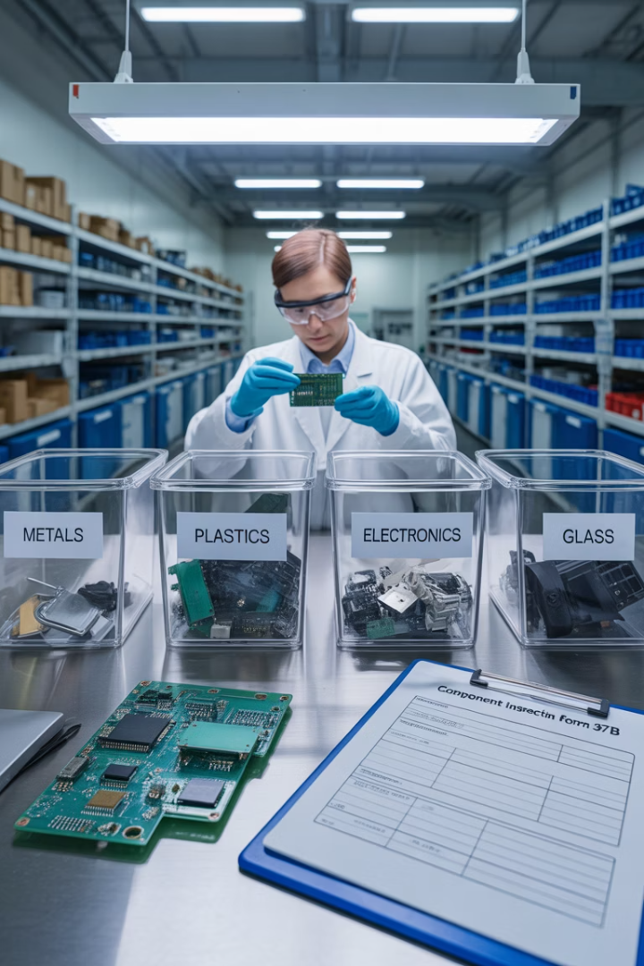




Disposal of detection devices
Identify device type
Determine if device contains radioactive material, hazardous chemicals or electronic components requiring special disposal.
Review disposal requirements
Consult manufacturer guidelines and local regulations for specific disposal procedures – ensuring compliance with WEEE regulations.
Segregate by type
Separate radioactive, hazardous and non-hazardous components according to waste classification.
Arrange proper disposal
Use authorized waste carriers and maintain complete disposal records.

Slide 24

Fibre optic cable hazards
Optical radiation hazards
Physical hazards
Invisible infrared light can damage retina
Glass shards can penetrate
the skin
Direct viewing of active fibres can cause permanent eye injury
Cleaved fibres create nearly invisible sharp ends
Cut fibres can enter
bloodstream
Reflected light from polished fibre ends can be harmful
Risk of embedding in skin causing infection
Higher risk with laser-based systems

Slide 25
Fibre optic cable hazards
Chemical hazards
Cleaning solvents may be flammable
Irritant gel in water-blocked cables
Adhesives or resins used in splicing (may cause skin
or eye irritation)
Solvents used in cleaning fibre ends (vapour or skin
contact risk)

Slide 26


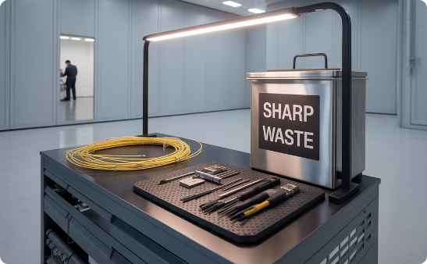
PPE for fibre optic work
Eye protection
Hand protection
Workspace protection
Safety glasses with side shields are essential for protecting against flying glass fragments and to block potentially harmful infrared light from active fibres. Never look directly into fibre ends or use magnification devices to inspect active fibres.
Cut-resistant gloves help prevent glass fibre punctures. However, fingertip sensitivity is needed for some tasks, requiring careful work practices when gloves must be removed for precision tasks.
Containment mats with black surfaces make fibre fragments more visible. Specialised disposal containers for sharp waste prevent injury to cleaning staff. Bright task lighting helps identify nearly invisible glass shards.

Slide 27
Safe handling of fibre optic cables
Before starting work
Before handling fibre optic cables, ensure you have a complete understanding of the system. Identify patch panels, termination points, and active equipment. Whenever possible, shut down optical transmitters or disable the light source before accessing fibres.
Set up a dedicated work area with proper lighting, preferably with a black mat to make glass fragments visible. Gather all necessary tools and PPE before beginning and ensure the work area is clear of unnecessary personnel.

Slide 28
Safe handling of fibre optic cables
During cable work
Never look directly into fibre ends or connectors.
Use indirect methods to check for light transmission.
Keep food and beverages away from the work area.
Place all cut fibres in approved sharps containers.
Use tape to pick up small glass fragments.
Never touch your face or eyes while working with fibres.
Clean tools regularly to prevent fibre contamination.

Slide 29



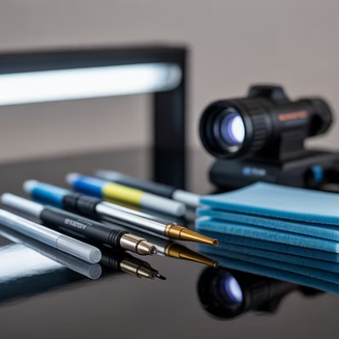
Tools and equipment for fibre optic work
Proper tools are essential for safe and effective fibre optic work. Specialised equipment, such as precision cleavers, ensures clean cuts that minimise dangerous fragments, while visual fault locators help verify connections without directly viewing fibre ends.
Fusion splicers create permanent connections between fibres with minimal loss, and cleaning tools maintain connector performance while reducing contamination risks. All equipment should be maintained according to the manufacturer’s specifications and inspected regularly for damage.

Slide 30
Emergency procedures for fibre optic incidents
Eye exposure
If eyes are exposed to optical radiation, cover both eyes and seek immediate medical attention.
Do not rub your eyes as this may cause corneal abrasion.
Report the wavelength and power level of the source if known.
Even if no immediate symptoms are present, medical evaluation is essential as damage may not be immediately apparent.

Slide 31
Emergency procedures for fibre optic incidents
Skin punctures
For glass fragments embedded in skin, do not attempt to remove deeply embedded fibres.
Clean the area with mild soap and water, apply antiseptic, and cover with a clean bandage.
Seek medical attention as fibres may migrate deeper or cause infection. Use adhesive tape to remove surface fragments by pressing gently and lifting.

Slide 32
Emergency procedures for fibre optic incidents
Chemical exposure
If cleaning solvents or adhesives contact skin, wash thoroughly with soap and water for at least 15 minutes.
For eye contact, flush with water for 15 minutes and seek medical attention. Remove contaminated clothing immediately and refer to specific SDS for additional treatment guidance.

Slide 33








Documenting safe working procedures
Risk assessment
Evaluate specific hazards for each task
Method statement
Detail step-by-step safe working procedure
Competency records
Verify and record worker qualifications
Pre-work checklist
Confirm safety measures before starting

Slide 34

Legal and regulatory framework
HASAWA (Health and Safety at Work etc. Act 1974)
  Scope: Applies to all workplaces in Great Britain
  Key requirements:
    Employers must ensure the health, safety, and welfare of employees and others
    Provide safe systems of work, training, and a safe working environment
    Employees must also take reasonable care for their own and others' safety.

Slide 35
Legal and regulatory framework
2. COSHH (Control of Substances Hazardous to Health)
  Scope: Covers all workplaces using hazardous substances (chemicals, dusts, biological agents).
  Key requirements:
    Assess risks from hazardous substances.
    Implement control measures and provide PPE.
    Provide training and health surveillance where necessary.

Slide 36
Legal and regulatory framework
3. CDM (Construction Design and Management Regulations 2015)
Scope: Applies to all construction projects, regardless of size or duration
Key requirements:
  Assign duty holders (client, designer, principal contractor)
  Prepare a construction phase plan and health & safety file
  Ensure cooperation, coordination, and communication.

Slide 37
Legal and regulatory framework
4. RIDDOR (Reporting of Injuries, Diseases and Dangerous Occurrences Regulations)
Scope: Applies to all workplaces
Key requirements:
  Report work-related deaths, major injuries, and dangerous occurrences
  Report occupational diseases and incidents involving members of the public
  Keep records for at least 3 years.

Slide 38
Legal and regulatory framework
5. LOLER (Lifting Operations and Lifting Equipment Regulations 1998)
Scope: Covers all lifting equipment used at work
Key requirements:
  Ensure lifting equipment is strong, stable, and marked with Safe Working Load (SWL)
  Plan and supervise lifting operations
  Carry out regular inspections and thorough examinations.

Slide 39
Legal and regulatory framework
6. PUWER (Provision and Use of Work Equipment Regulations 1998)
Scope: Applies to all equipment used by employees at work
Key requirements:
  Equipment must be suitable, maintained, and inspected
  Provide training and information to users
  Ensure equipment is used safely and risks are controlled.

Slide 40
Legal and regulatory framework
7. PPE Regulations (Personal Protective Equipment at Work Regulations 1992 & 2022)
Scope: Applies to all workers, including casual and agency workers
Key requirements:
  Provide suitable PPE free of charge
  Ensure PPE is compatible, maintained, and replaced when necessary
  Train workers on correct use and storage

Slide 41
Legal and regulatory framework
8. WEEE (Waste Electrical and Electronic Equipment Regulations 2013 & 2025)
Scope: Applies to producers, importers, and distributors of electrical/electronic equipment
Key requirements:
  Register as a producer and finance the collection and recycling of WEEE
  Mark products with the crossed-out wheelie bin symbol
  Provide information on safe disposal and treatment.

Slide 42


Training and competency requirements
Training and Certification
Engineers on some construction sites must hold industry-recognised qualifications (e.g. ECS, BAFE) covering technical skills and safety.
They may be employer or sector-driven rather than legally required, but companies must keep certifications current for specialised work such as electrical, fibre optics, or hazardous waste.

Slide 43

Training and competency requirements
Ongoing development
Regular refresher training is essential to stay up-to-date with changing safety standards and procedures.
This should include practical assessments of key skills such as safe isolation and emergency response procedures.

Slide 44




Auditing and compliance verification
Regular safety audits
Field
Observations
Compliance reporting
Continuous improvement
Scheduled evaluations of safety procedures and compliance with regulations
On-site monitoring of actual work practices to verify adherence to safe working procedures
Documentation of findings, identification of non-conformities, and implementation of corrective actions
Regular review and enhancement of safety systems based on audit findings and industry developments

Slide 45
Summary
You should now be able to:
Know how to safely isolate electrical systems before working on 230V ac circuits
Understand how to select appropriate tools and PPE for protection system work
Understand how to complete risk assessments and method statements (RAMS) for protection system tasks

Slide 46
Any questions?
Copyright in this document belongs to and is used under licence from the Department for Education, © 2025.
‘T-LEVELS’ and ‘T Level’ are registered trademarks of the Department for Education.
WJEC is authorised by the Department for Education to develop and deliver this T Level Technical Qualification.
WJEC operates in England under the name Eduqas which is a registered trademark of WJEC.

