Slide 1
Occupational Specialism: Protection Systems Engineering
K1.20 Methods of identifying potential issues before decommissioning systems
PowerPoint 20: Methods of identifying potential issues before decommissioning

Slide 2
Introduction
In this session we will explore the critical approaches, techniques, and factors necessary for effective system decommissioning.
Proper identification of potential issues before decommissioning is crucial for maintaining safety, ensuring compliance with regulations, and achieving operational efficiency.
This session will provide you with practical guidance based on industry best practices and technical expertise.

Slide 3
Objectives
By the end of this session, you should be able to:
Understand the common risks that may arise before decommissioning, such as shared circuits, dependencies with other systems, and loss of fire compartmentation.
Understand the importance of reviewing drawings, records, and client requirements to identify hidden or undocumented modifications.
Complete pre-decommissioning checks to highlight potential issues (e.g. false alarm risks, disabled security coverage, exposed penetrations) and report them for resolution before work begins.

Slide 4

Overview
1
Review decommissioning fundamentals
Establish baseline understanding of system decommissioning principles and requirements.
2
Explore documentation methods
Detail the systematic approach to reviewing O&M manuals, component data sheets and technical drawings.
3
Identify advanced assessment techniques
Examine modern tools and methodologies for system evaluation.
4
Develop timely planning strategies
Understand the benefits and implementation of effective
decommissioning timelines.

Slide 5
Understanding decommissioning fundamentals
Definition and scope
Regulatory framework
Risk factors
Decommissioning encompasses the systematic shutdown, dismantling, and removal of protective engineering systems that have reached the end of their operational lifecycle or require replacement.
Compliance with UK regulatory standards including Health and Safety at Work Act, Control of Substances Hazardous to Health (COSHH), and specific industry regulations is mandatory for all decommissioning activities.
Primary concerns include hazardous materials exposure, system interdependencies, structural integrity issues, and environmental impact considerations that must be identified before commencing work.
These fundamental aspects provide the essential foundation for developing effective strategies to identify potential issues before initiating the decommissioning process.

Slide 6








The importance of preliminary assessment
Personnel safety
Protecting team members from hazards
Regulatory compliance
Meeting legal and industry standards
Cost efficiency
Reducing unexpected expenses
Time management
Preventing project delays

Slide 7
The importance of preliminary assessment
A thorough preliminary assessment serves as the foundation for successful decommissioning operations.
Invest time in this crucial first step to significantly reduce risks, avoid costly surprises, and ensure adherence to both regulatory requirements and project timelines.
The hierarchy diagram on the previous slide shows the order of priorities in your assessment process – with safety always remaining the most important concern throughout all decommissioning activities.

Slide 8
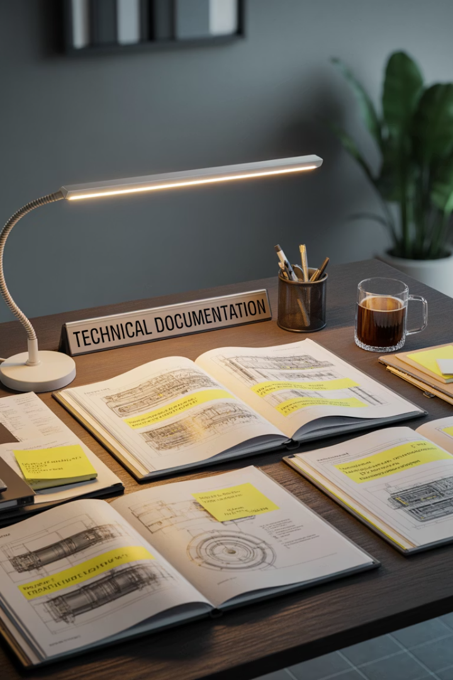




Review of operation and maintenance manuals
System architecture review
Identify all system components, their interconnections, and critical dependencies as documented in original O&M materials.
Maintenance history analysis
Examine documented maintenance records to identify recurring issues, repairs, and modifications that could impact decommissioning.
Safety procedure verification
Review manufacturer's specified shutdown procedures, safety protocols, and hazard warnings related to system deactivation.
Component-specific requirements
Document special handling instructions, disposal considerations, and decommissioning sequences for individual components.

Slide 9
Review of operation and maintenance manuals
O&M manuals contain invaluable information regarding the system's original specifications, operational parameters, and manufacturer's recommendations for proper system shutdown.
These documents often reveal critical details that might otherwise be overlooked during the planning phase.

Slide 10




Extracting value from component data sheets
Compile all data sheets
Identify critical components
Document specifications
Analyse compatibility
Gather comprehensive documentation for each component within the system, ensuring no parts are overlooked.
Prioritise components that pose higher risk during decommissioning based on material composition, pressure ratings, or electrical characteristics.
Create a consolidated database of key technical specifications relevant to the decommissioning process.
Evaluate component interactions and dependencies that could impact the sequence of disassembly.

Slide 11
Extracting value from component data sheets
Component data sheets provide essential technical specifications that directly impact decommissioning procedures. These documents reveal critical information about materials, operating parameters, and safety considerations that must be factored into your planning process.
Careful analysis of these specifications helps identify:
components containing hazardous materials
parts under pressure or tension
elements requiring specialised handling or disposal protocols.

Slide 12
Utilising technical drawings and schematics
System layout analysis
Connection identification
Structural considerations
Zone charts and as-fitted drawings to locate detectors, call points, sounders, cameras, and access devices.
Identify containment routes (trunking, tray, conduit).
Spot ceiling and riser access points.
Use wiring schematics to trace loops, zones, and device addressing.
Confirm PSU, battery, and comms connections.
Check for dependencies between fire, intruder, access, and CCTV systems.
Identify wall, floor, and ceiling penetrations.
Note fire compartment lines and required fire-stopping.
Check for clashes with other services (HVAC, lighting, electrical).

Slide 13
Utilising technical drawings and schematics
Technical drawings provide the spatial context essential for planning physical decommissioning activities.
These documents reveal the practical challenges teams will face during the actual dismantling process.

Slide 14








Physical system inspection techniques
Cabling and containment
Inspect for damaged cables, poor terminations, or inadequate support
Ensure fire-resistant fixings are in place where required
Check segregation from mains and other services
Component condition
Verify PSU and battery health (visual + capacity/voltage checks)
Check lenses, housings, and seals on cameras and detectors
Confirm that covers, brackets, and enclosures are secure
Visual assessment
Check condition of detectors, call points, sounders, cameras, and access devices
Look for signs of damage, dirt, obstruction, or tampering
Confirm correct labelling and accessibility of devices

Slide 15
Physical system inspection techniques
Physical inspection serves as a crucial verification step that complements documentation review.
Even the most comprehensive documentation may not reflect the current state of systems that have been in operation for extended periods of time.

Slide 16




Hazardous materials assessment
Batteries
Lead-acid, lithium, or NiMH cells in panels and PSUs.
Must be removed and disposed of via approved recycling.
Older components
PCB-containing capacitors in very old kit (rare, legacy systems).
Check manufacturer’s data if unsure.
Building materials
Asbestos risk in older buildings.
Always follow site asbestos register before drilling
Safety Data Sheets (SDS)
Review product information for sealants and adhesives.
Store and handle in line with manufacturer guidance.

Slide 17
Hazardous materials assessment
This is crucial for identifying substances that require special handling, containment, or disposal procedures.
Common concerns include:
asbestos insulation
PCBs in electrical components
mercury in switches
lead in paints and solders
various industrial chemicals trapped within systems.
Proper identification of these materials allows for the development of appropriate handling protocols, personal protective equipment requirements, and disposal pathways in compliance with environmental regulations. This assessment is often a legal requirement under UK Control of Substances Hazardous to Health (COSHH) Regulations.

Slide 18
Assessment area | Key considerations | Testing methods
Circuit Isolation | Identify isolation points, confirm safe disconnection before removal or maintenance. | Visual checks, proving dead, safe isolation procedure.
Detector & Device Circuits | Ensure correct wiring, termination quality, and that no devices are bypassed or disabled. | Loop continuity testing, polarity check, resistance measurement.
Standby Power (Batteries/PSUs) | Confirm capacity and switchover capability of standby supplies. | Battery load test, voltage measurement, PSU output check.
Loop Integrity & Continuity | Ensure loops are complete, labelled, and compliant with BS requirements. | Continuity and insulation resistance testing, earth fault checks.
Safety-Critical Wiring | Confirm fire-resistant cables and fixings remain undisturbed; no compromise to fire barriers. | Visual inspection, confirm fire-stopping reinstated after works.

Slide 19
Electrical system assessment protocols
Electrical systems present unique challenges during decommissioning due to their interconnected nature and potential for hazardous energy. A practical assessment may identify dependencies that are not obvious from just a technical review.
Pay attention to identifying systems where deactivation might impact other operational equipment through shared power supplies, control interfaces, or safety circuits.
Complete circuit mapping prevents unintended consequences during sequential shutdown procedures.

Slide 20








Structural and load-bearing analysis
Cable containment
Check trunking, tray, and conduit loadings before adding or removing cables
Ensure fire-resistant fixings are intact where required.
Mounting structures
Inspect ladders, brackets, poles, and fixings for stability before dismantling.
Remove heavy or elevated equipment safely (e.g. CCTV columns, external sounders).
Safe removal order
Plan removal so that live/retained circuits are not disturbed
Disconnect and remove redundant cables systematically to avoid snags or damage.

Slide 21
Safety system interconnection mapping
Fire alarms
Map how zones interconnect with detectors, MCPs, sounders, and VADs.
Note links to building services (e.g. lifts, HVAC, door release).
Access control
Check for doors tied into the fire alarm for release.
Map interconnections with intruder or CCTV for event logging.
CCTV systems
Note integrations with access or intruder (e.g. camera presets on alarm).
Confirm recording continuity if devices are disconnected.
Intruder alarms
Identify circuits that loop through multiple devices.
Removing or bypassing one device may disable the rest.

Slide 22
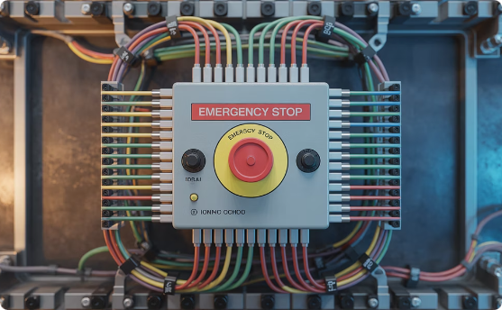
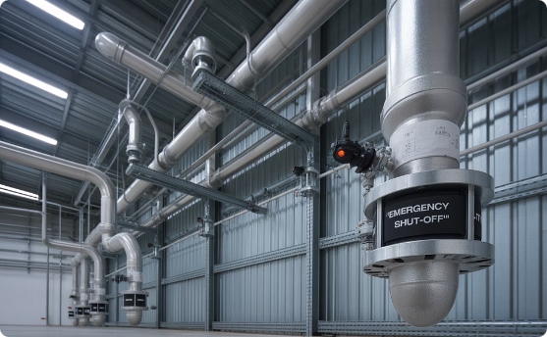
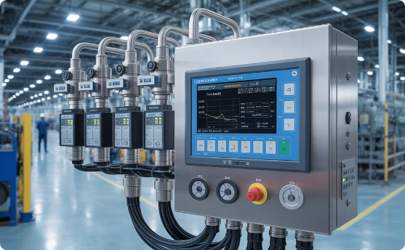
Safety system interconnection mapping
Fire alarm systems
Map how detectors, call points, sounders, and VADs link together.
Note connections to building systems (e.g. lifts, HVAC shutdown, access control release).
Intruder alarm systems
Identify loops and circuits with multiple devices.
Recognise that removing one device may disable others.
Access control systems
Check for fire alarm integration (automatic door release).
Map links to intruder/CCTV for event logging.
CCTV systems
Note interconnections with access or intruder (camera presets on alarm).
Confirm recording continuity when devices are disconnected.

Slide 23
Consultation with operations personnel
Capture undocumented changes
Speak with maintainers/engineers who know where additional devices, rerouted cables, or non-standard fixes have been added.
Identify system quirks
Note panels that behave unpredictably, detectors that falsely alarm or access doors that regularly fail.
On-site considerations
Understand access restrictions (e.g. secure areas, 24/7 operations).
Clarify which systems can be taken offline and what temporary measures are required.
Client/user input
Confirm critical dependencies (e.g. fire alarm releasing doors, CCTV linked to intruder alarms).
Agree on timings and disruption windows.

Slide 24

Benefits of timely decommissioning planning
Safety - Avoids creating faults, false alarms, or compromised fire/intruder protection during works.
Continuity - Ensures retained systems remain fully operational with no downtime or coverage gaps.
Compliance - Helps maintain alignment with British Standards (e.g. BS 5839, BS EN 50131) and insurance requirements.
Efficiency - Clear sequencing reduces unnecessary site visits, duplication of effort, and disruption to building users.
Clarity - Ensures that all stakeholders understand what will be removed, retained, and how risks will be managed.

Slide 25
Digital documentation and management systems
Accurate records
Keep up-to-date as-fitted drawings showing device and cable routes.
Maintain zone charts, schematics, and circuit details.
Digital field tools
Use mobile apps or tablets to record inspection/test results on-site.
Capture photos of cabling, containment, and device positions for reference.
Compliance and safety
Store commissioning certificates, maintenance logs, and variation records digitally.
Ensure documentation is accessible for audits and aligns with BS 5839, BS EN 50131, and other standards.

Slide 26
Digital documentation and management systems
Modern digital tools have transformed the documentation and management of system information, enabling more comprehensive and accessible records for decommissioning planning.
These technologies make collaboration between teams easy and provide powerful visualisation aids that give a good understanding of complex systems.

Slide 27


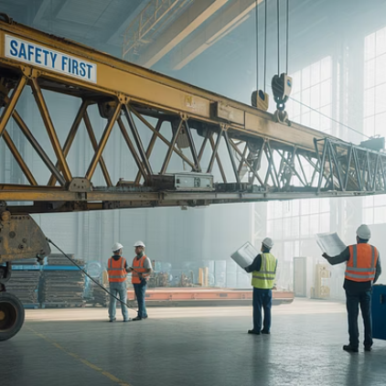

Case study: Successful decommissioning by issue identification
This case study examines the decommissioning of a complex industrial protection system at a UK chemical processing facility.
Using a methodical process of issue identification, the project team successfully identified several critical concerns not documented in the original system records.

Slide 28
Case study: Successful decommissioning by issue identification
Key findings included:
undocumented asbestos insulation
cross-connected control systems affecting adjacent operational areas
structural modifications that required specialised dismantling sequences.
By identifying these issues during the planning phase, the team developed appropriate mitigation strategies, resulting in zero safety incidents, no environmental releases. completion three weeks ahead of schedule and 12% under budget.

Slide 29
Summary
You should now be able to:
Understand the common risks that may arise before decommissioning, such as shared circuits, dependencies with other systems, and loss of fire compartmentation.
Understand the importance of reviewing drawings, records, and client requirements to identify hidden or undocumented modifications.
Complete pre-decommissioning checks to highlight potential issues (e.g. false alarm risks, disabled security coverage, exposed penetrations) and report them for resolution before work begins.

Slide 30
Any questions?
Copyright in this document belongs to and is used under licence from the Department for Education, © 2025.
‘T-LEVELS’ and ‘T Level’ are registered trademarks of the Department for Education.
WJEC is authorised by the Department for Education to develop and deliver this T Level Technical Qualification.
WJEC operates in England under the name Eduqas which is a registered trademark of WJEC.

