Slide 1
Occupational Specialism: Plumbing & Heating Engineering
K1.24 Ventilation in relation to gas and the combustion process
Gas combustion and ventilation requirements

Slide 2
Starter
Warm-up:
What happens when there isn’t enough oxygen supplied to a gas appliance?

Slide 3
Objectives
You should be able to:
Understand the need for ventilation in gas appliances.
Describe types of ventilation used with gas appliances.
You might also be able to:
Identify correct installation methods.
Apply safe ventilation practices during installation and servicing.

Slide 4
The role of ventilation in combustion
Gas combustion requires a steady supply of oxygen to burn efficiently. If ventilation is restricted or absent, incomplete combustion can occur.
This may produce carbon monoxide, a dangerous and potentially lethal gas. Proper ventilation helps remove combustion products and supply fresh air.
It also improves appliance efficiency and prevents overheating.

Slide 5
Complete vs incomplete combustion
Complete combustion: sufficient oxygen, producing CO₂ and water.
Incomplete combustion: insufficient oxygen, producing CO and soot.
Carbon monoxide is odourless and deadly.
A clear flame = complete combustion.
Yellow/orange flame = warning sign of incomplete combustion.

Slide 6
Why combustion air is vital
Combustion air enables gas appliances to operate safely and efficiently. Without it, combustion becomes unstable.
For open-flued appliances, this air often comes from the room. Modern appliances may use external air. In all cases, unrestricted airflow is necessary.
Question: What visible signs might indicate poor combustion?

Slide 7
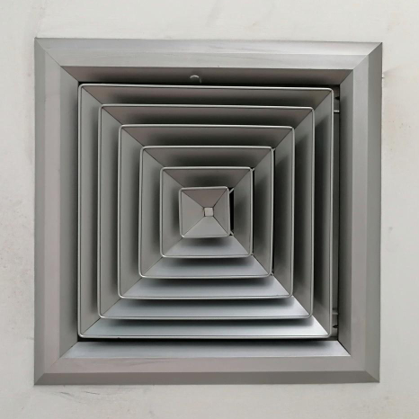
Ventilation openings
Openings provide permanent air supply. They must be unobstructed, correctly sized, and correctly located.
Common locations: walls, floors, and doors. Metal grilles or plastic panels are used.
Openings should comply with manufacturer guidelines and Building Regulations.

Slide 8
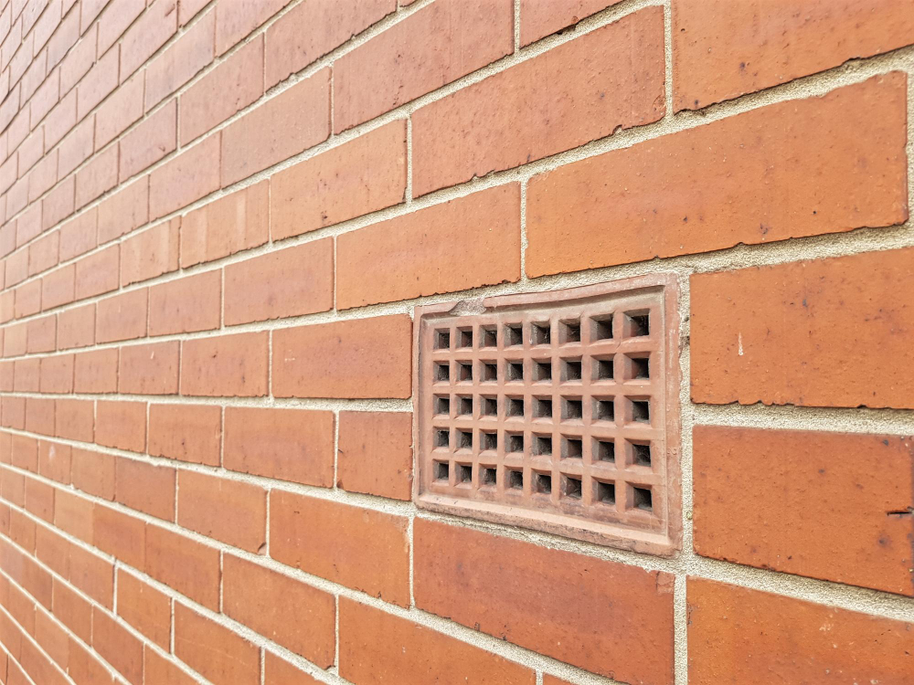
Natural ventilation
Natural ventilation occurs through openings that allow air movement without mechanical assistance.
This may include air bricks, vents, or purpose-made apertures. Relying on natural forces like wind and pressure differences requires careful design.
Suitable for open-flue appliances. Simpler, but affected by room layout and external conditions.

Slide 9
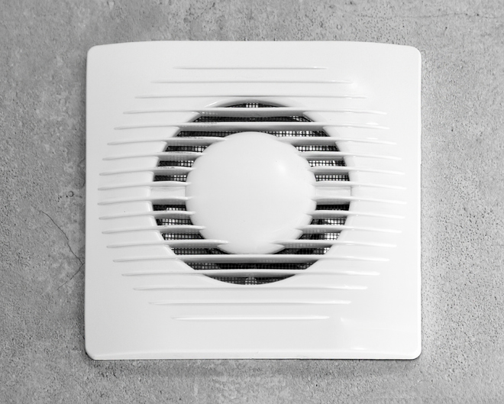
Mechanical ventilation
Uses powered fans to deliver or extract air. Common in commercial environments or sealed systems. More reliable than natural methods, especially in larger or airtight buildings.
Mechanical systems can be supply-only, extract-only, or balanced. Must fail-safe to avoid unsafe appliance operation.

Slide 10
Comparison table: natural vs mechanical
Feature | Natural | Mechanical
Power required | No | Yes
Reliability | Weather dependent | Consistent
Complexity | Simple | Higher
Maintenance | Low | Higher
Use case | Small dwellings | Commercial buildings
Question: Which method would be more reliable in a sealed, airtight building?

Slide 11
Legal and safety requirements
Building Regulations Part J (England/Wales)
Gas Safety (Installation and Use) Regulations
Manufacturer’s instructions must always be followed
Air supply must not be from a contaminated area
Inspectors will check during commissioning

Slide 12

Sizing ventilation openings
Correct sizing depends on appliance type and rating. Guidance is given in IGEM standards and British Standards.
Undersized openings can cause poor performance or pose a danger. Oversized may waste energy.
Always calculate size based on the heat input and the appliance’s location.

Slide 13
Formula for ventilation sizing
To determine the correct ventilation size in the UK, you need to calculate the required airflow based on the building's size and occupancy, and then select a ventilation system that can deliver that airflow.
A key factor is the minimum ventilation rate of 0.3 litres per second per square metre of floor area, as stipulated by UK Building Regulations Part F.

Slide 14
Formula for ventilation sizing
For open-flued appliances:
For open-flued gas appliances in the UK, the general ventilation sizing formula is 5 cm² of free area per kW of net heat input above 7 kW
5cm² per kW of appliance rated input (natural gas)
Multiply the kW rating by 5 to get the minimum free area in cm². Adjust for high/low level, external walls, and location.

Slide 15
Practical example – sizing vent
Calculate the vent size required for an appliance rated at 10kW.
Research and select a suitable vent or grille to match or exceed this figure. Check that flyscreens do not reduce the free area.
Question: How much ventilation area is required for an 8.5kW appliance?

Slide 16
Continuous size and free area
Vents must provide a continuous air path.
Free area = actual open space, not just grille size.
Louvred or mesh grilles reduce free area.
Manufacturer charts show effective sizes.
Check if vents are labelled with effective area.

Slide 17
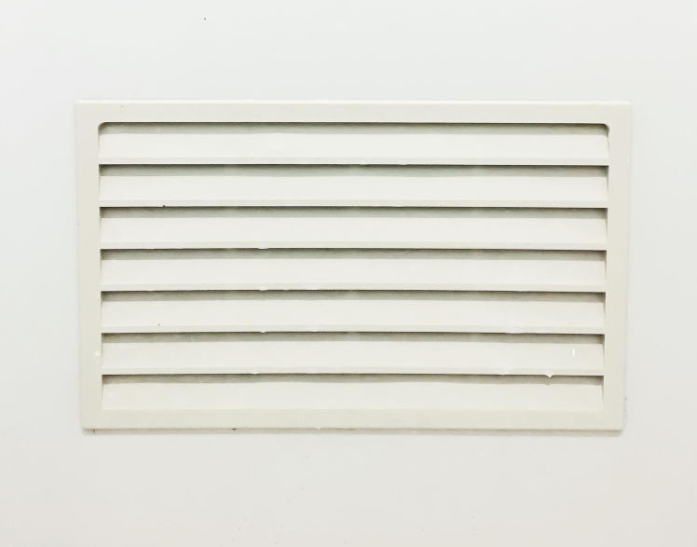
Permanently open vents
Permanently open vents must not be blocked or closed. These are required for many older and open-flued appliances.
Signs reading “Do not block this vent” should be present. Any closure device makes it non-compliant.
Periodic checks ensure vents remain open.

Slide 18
Sleeved ventilation
When ducts pass through walls, they must be sleeved.
Sleeve protects the wall and ensures a continuous path.
Helps prevent vermin and moisture ingress.
Typically plastic or metal.
Proper sealing prevents air leakage.

Slide 19

Flyscreens and obstructions
Flyscreens can reduce effective air flow and must be removed from combustion vents. They may clog over time, restricting airflow. Regulations do not permit them in ventilation openings for gas appliances.
Visual inspections should confirm they are absent.

Slide 20
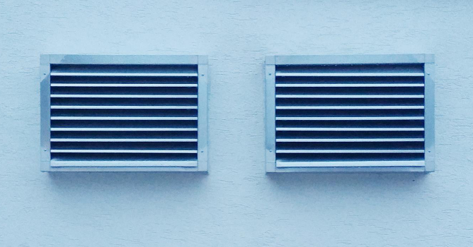
Positioning of vents
Correct placement ensures even air distribution and avoids dead zones. High-level vents may supply or extract air depending on use. Avoid placing vents behind furniture or curtains.
Room layout and appliance location influence positioning. Symmetry between supply and extract points improves airflow.

Slide 21
Midpoint knowledge check
Name two types of ventilation.
What’s the formula to calculate vent size?
What does “free area” mean?
Why should flyscreens be removed?
What regulation relates to ventilation?

Slide 22
Midpoint knowledge check – answers
Natural, mechanical
5cm² per kW (natural gas)
The actual open space through which air passes
They reduce airflow and may clog
Building Regulations Part J / GSIUR

Slide 23
Types of mechanical systems
Supply-only: brings in fresh air, typically to sealed rooms.
Extract-only: removes stale/combustion air.
Balanced: both supply and extract, maintaining pressure.
May include filters, heat recovery, and alarms.
Used in plant rooms or non-domestic environments.

Slide 24
Fan-assisted combustion
Some appliances include fans to aid combustion air intake or flue gas removal. This improves combustion reliability and appliance siting flexibility.
Fan failure should trigger safety lockout. Installer must confirm airflow is correct during commissioning.

Slide 25
Commissioning ventilation
During commissioning:
Check vent presence, size, and condition.
Confirm no blockages or obstructions.
Verify permanent openings where required.
Record measurements and compliance checks.
Include in installation certificate.
Question: Why is it essential to check for obstructions during commissioning?

Slide 26
Maintaining ventilation systems
Regular inspections during servicing.
Clean dust or insect build-up from grilles.
Replace filters in mechanical systems.
Check for damage, corrosion, or tampering.
Report any deficiencies and remediate promptly.

Slide 27
Recognising ventilation faults
Staining around appliance or vent.
Yellow appliance flame.
Excessive condensation or musty smell.
Frequent CO alarm activations.
Poor appliance performance.
Always investigate and report immediately.

Slide 28
Visual check walkthrough
Is the vent installed?
Is it permanently open?
Is it correctly positioned?
Is there a flyscreen?
Is the size appropriate for appliance rating?

Slide 29
Servicing – what to record
Vent size and condition.
Any restrictions or blockages.
Airflow if measured.
Fan operation (mechanical systems).
Include photos or sketches for record.
Question: What might happen if you skip checking vents during an annual service?

Slide 30
Flueless appliance considerations
Flueless gas appliances rely entirely on room air. Strict air volume and ventilation requirements apply. They must not be used in small or poorly ventilated spaces.
Permanent ventilation is always required.
Additional safety controls may be included.

Slide 31
Modern building challenges
New builds are more airtight. This makes natural ventilation less reliable. Requires mechanical solutions or pre-designed venting paths. Designers must account for this in building plans. Older properties may still rely on air bricks or trickle vents. In modern, well-sealed homes, the reduced infiltration of outside air can lead to poor indoor air quality if not properly managed.
Proper planning during the design stage is essential to balance airtightness with healthy indoor air exchange.

Slide 32
Cross ventilation in larger rooms
Cross ventilation ensures airflow across the space and requires inlets and outlets on opposite sides. This is essential for large boiler rooms, commercial kitchens, or appliance clusters as it balances pressure and disperses heat and combustion gases effectively.
Without cross ventilation, hot air and fumes can build up, creating unsafe and inefficient working conditions.
Strategically placed openings allow cooler air to enter while pushing warm, stale air out. This helps maintain a safe environment and supports the efficient operation of appliances.

Slide 33
Outdoor air supply guidelines
Ventilation air must come from a clean, uncontaminated source. Not from garages, toilets, or waste areas. Vent placement should consider prevailing winds and external obstructions. Intake grilles should be 300mm or more from soil or water.
Drawing air from polluted or unhygienic areas can compromise indoor air quality and pose health risks. Vents should also be positioned away from flue terminals or exhaust outlets to prevent the recirculation of harmful gases.
Careful site assessment is essential to ensure safe, effective, and compliant ventilation design.

Slide 34
Building regulations summary
Part J: Combustion appliances and fuel storage
Applies to dwellings and commercial premises
Requires appropriate permanent ventilation
Covers appliance types, locations, and vent sizing
Must be followed in all new or replacement installations

Slide 35
Role of manufacturers & customer education
Manufacturers provide specific guidance on ventilation. This includes required free area, vent type, and location. Installers must not assume or guess. Non-compliance voids warranty and may breach legislation.
Customers must be advised not to block vents. Leave written instructions where needed. Explain risks of tampering or sealing vents. Label important vents clearly. Include details on commissioning sheets.

Slide 36
Final knowledge check
List two reasons ventilation is essential for gas appliances
What is a permanently open vent?
Give one example of a mechanical system.
What’s wrong with using a flyscreen?
Why must vent size be calculated based on appliance rating?

Slide 37
Final knowledge check
Supplies combustion air, prevents CO build-up
A vent that cannot be closed/blocked
Extract fan, HRV system, fan-assisted flue
It clogs and restricts airflow
Ensures safe, efficient combustion and regulatory compliance

Slide 38
Summary
You should now be able to:
Identify different types of ventilation.
Explain why ventilation is needed for combustion.
Apply correct sizing and installation methods.
You might also be able to:
Perform fault finding on vent systems.
Recommend safe modifications for poor ventilation.

Slide 39
Exit quiz – recap
Name one regulation that covers ventilation.
What unit is used to calculate free area?
List one difference between natural and mechanical ventilation.
Where should vent air not come from?
What must be done during commissioning?

Slide 40
Exit quiz – recap
Building Regulations Part J (or Gas Safety (Installation and Use) Regulations)
cm² or mm²
Natural uses passive airflow; mechanical uses powered fans
Garages, toilets, waste areas, or other contaminated sources
Check vent size, ensure it’s unobstructed, confirm it's permanently open, and record all compliance checks

Slide 41
Any questions?
Copyright in this document belongs to and is used under licence from the Department for Education, © 2025.
‘T-LEVELS’ and ‘T Level’ are registered trademarks of the Department for Education.
WJEC is authorised by the Department for Education to develop and deliver this T Level Technical Qualification.
WJEC operates in England under the name Eduqas which is a registered trademark of WJEC.

