Slide 1
Occupational Specialism: Plumbing & Heating Engineering
K1.21 Scientific principles and concepts of heating engineering
Force, pressure, and flow characteristics

Slide 2
Starter
Warm-up:
Why does water flow faster out of a narrow pipe than a wide one?
Think about pressure and flow.

Slide 3
Objectives
You should be able to:
Perform basic force and pressure calculations.
Explain the concepts of static and dynamic pressure.
You might also be able to:
Understand the role of draught in fluid movement.
Explore how pressure, velocity, and flow interact.
Assess system restrictions and their impact on performance.

Slide 4
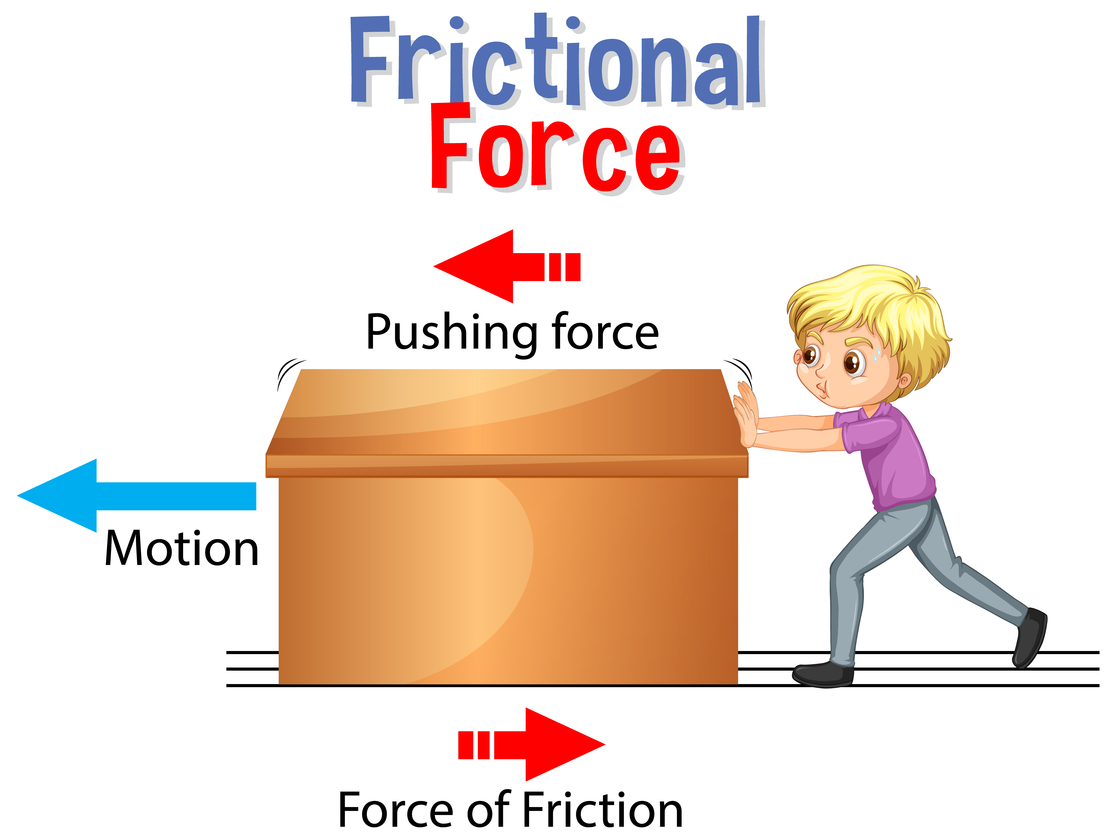
What is Force?
Force is a push or pull acting upon an object as a result of its interaction with another object.
In plumbing, force is often related to fluid movement and pressure exerted within a system. It is measured in newtons (N).

Slide 5
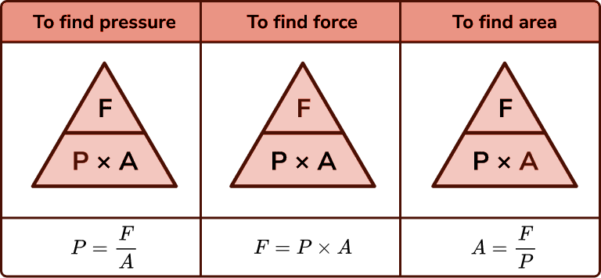
Force formula
The basic formula for force: F = P × A
Where:
F = Force (N)
P = Pressure (Pa)
A = Area (m²)
This helps calculate the force exerted by a fluid on a surface.

Slide 6
Pressure units
The units of force are Newtons (N) and the derived SI units of area are square metres (m2). So the units of pressure are Newtons per square metre (N/m2).
However, the standard unit of pressure is Pascals (Pa). 1 Pascal is equal to 1 N/m2 and 100,000 Pa=1 Bar (another unit of pressure).
Air pressure (or atmospheric pressure) can change depending on where we are in the world. If we are on a mountain the air pressure is less than when we are at sea level.
The air pressure at sea level is approximately 14.7 pounds per square inch or 1.01325Bar

Slide 7
Pressure head
CWSC
Pressure head is the height of a fluid column that produces pressure.
The higher the column, the greater the pressure at the base.
This principle is critical in gravity-fed plumbing systems.
Question: What would happen to pressure in a system if the water tank is raised higher?

Slide 8
Pressure calculations
Pressure can be calculated using: P = ρ × g × h
Where:
ρ = density (kg/m³)
g = gravity (9.81 m/s²)
h = height (m)
This is key to understanding gravity-fed systems and hydrostatic pressure.

Slide 9
Pressure calculations
CWSC
Using P = ρ × g × h, calculate the pressure at the kitchen tap
Where:
ρ = 1000
g = 9.81
h = 6
So 1000 x 9.81 x 6 =
6m
58,860Pa or 58.86 kPa
Kitchen tap

Slide 10
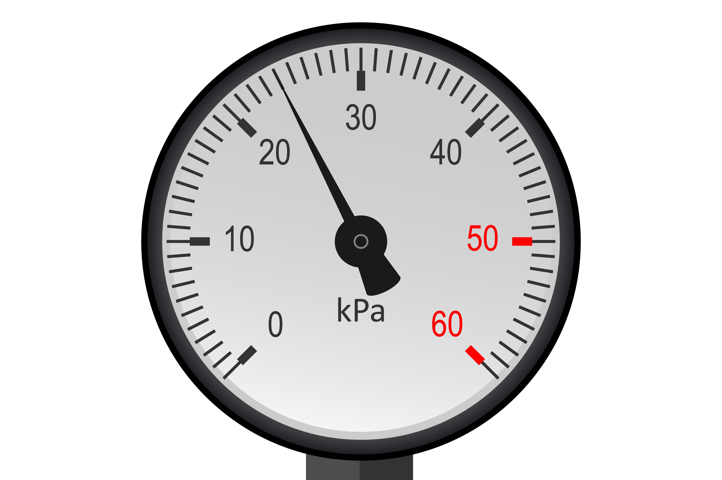
Static pressure
Static pressure is the pressure exerted by a fluid at rest. It’s what you measure when no water is flowing.
Static pressure is important for checking the capability of appliances and ensuring systems maintain integrity.

Slide 11
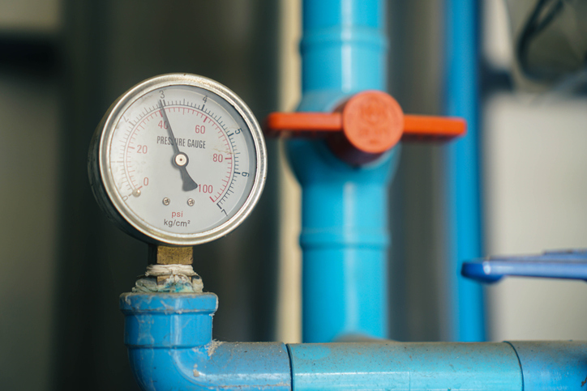
Dynamic pressure
Dynamic pressure is the pressure of moving fluid. It depends on velocity and density. It’s typically lower than static pressure because some energy is used to move the fluid. Both static and dynamic pressures affect system design.
Question: Why might dynamic pressure be lower than static pressure in a running tap?

Slide 12
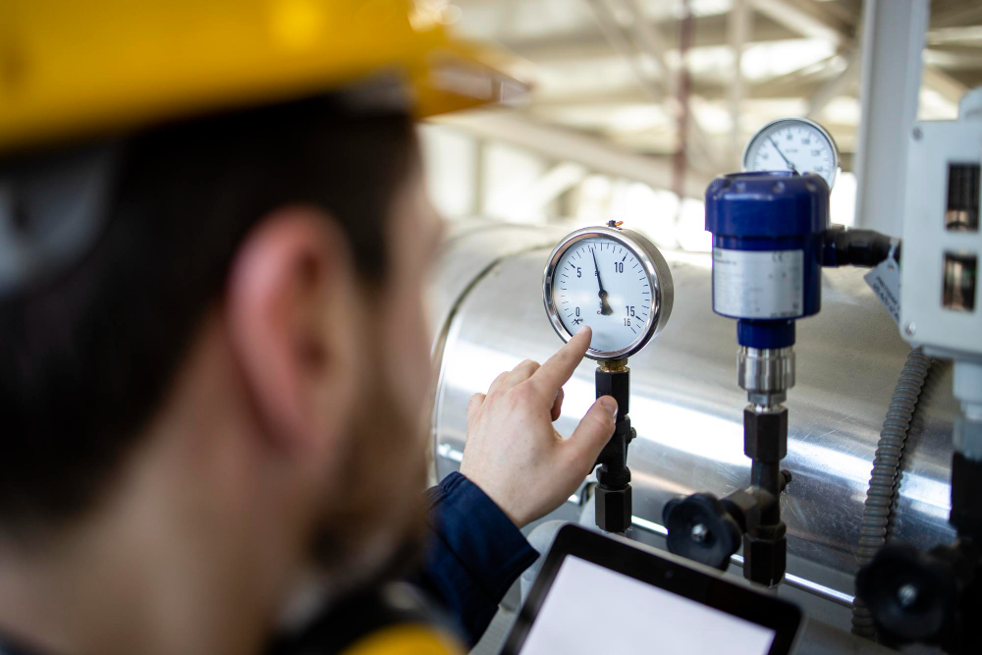
Total pressure
Total pressure =
Static Pressure + Dynamic Pressure
Engineers must consider both when sizing systems.
Measuring only one gives an incomplete picture of performance.

Slide 13
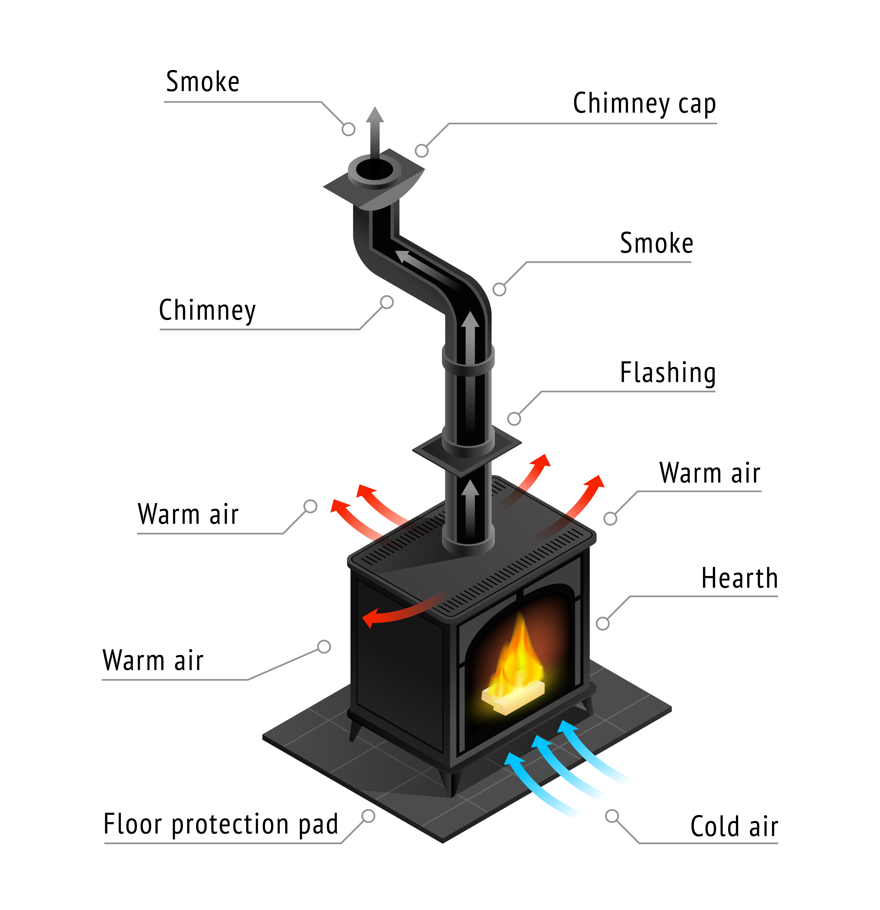
Introduction to draught
Draught refers to the movement of air or flue gases due to pressure differences.
Natural draught occurs from thermal gradients.
Forced draught uses mechanical fans.
Effective draught ensures safe and efficient flue operation.

Slide 14
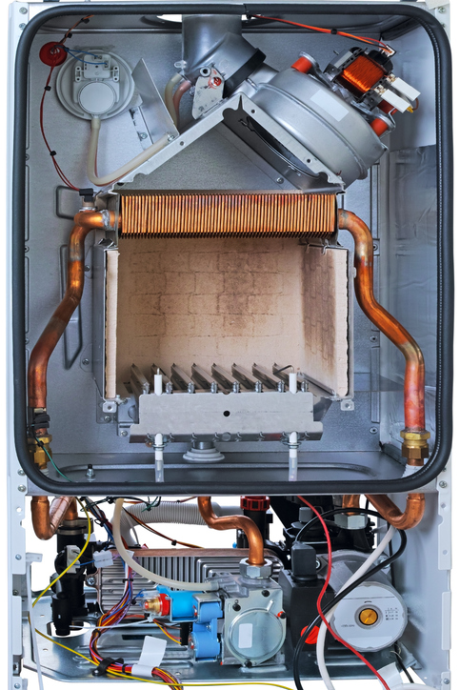
Forced draught
Forced draught systems use fans to push or pull gases through flues. Common in boilers and combustion systems.
Helps regulate combustion and reduce backflow of gases. Important in sealed systems or where natural draught is insufficient.
Question: What advantages might forced draught systems have over natural draught?
Fan

Slide 15
Midpoint knowledge check
Define pressure head.
What is the formula for force?
What is static pressure?
Name one benefit of forced draught systems.

Slide 16
Midpoint knowledge check - answers
The height of a fluid column generating pressure.
F = P × A.
Pressure when fluid is at rest.
Controls airflow in sealed systems.

Slide 17
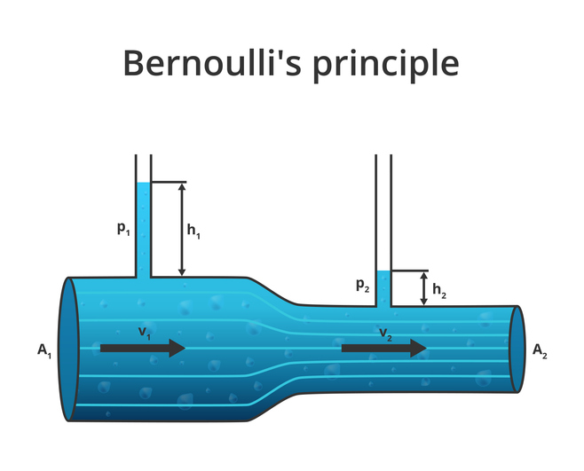
Velocity and pressure
As pressure increases in a fluid system, the velocity of the fluid may also increase—this is particularly the case where the fluid is allowed to flow through a reduced cross-sectional area, such as a nozzle or narrowed section of pipe.
This relationship is influenced by the principles of Bernoulli’s theorem, which states that an increase in the speed of a fluid occurs simultaneously with a decrease in pressure or potential energy of the fluid.

Slide 18
Velocity and pressure 2
In open-ended or unrestricted systems, a high-pressure source can lead to the formation of fast-moving fluid jets. These jets are often seen in water mains or booster pump outlets, where pressure is intentionally increased to achieve higher flow rates.
Excessive system pressure can overstress pipework and components such as joints, valves, and fittings, potentially leading to bursts, leaks, or premature failure.

Slide 19
Velocity and pressure 3
Insufficient pressure can result in poor system performance, including inadequate water delivery to appliances, airlocks in pipework, and an inability to activate flow-dependent valves or controls.
Maintaining optimal pressure is therefore crucial to ensuring both the efficiency and safety of plumbing and heating systems.

Slide 20
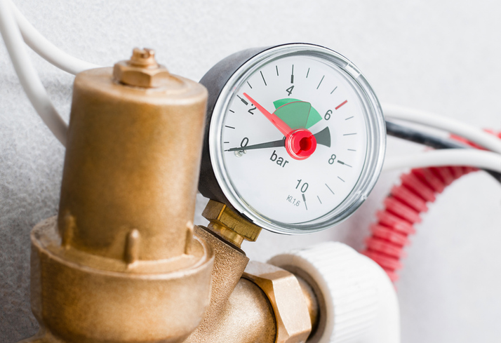
Velocity and pressure 4
To control this, systems often incorporate pressure-reducing valves (PRVs), expansion vessels, and other safety mechanisms.
Installers must understand the rated pressures of materials and appliances in a system and ensure compliance with the Water Supply (Water Fittings) Regulations 1999 and appropriate British Standards.

Slide 21
Flow rate definition
Flow rate is the volume of fluid that moves through a pipe per unit time. It is affected by pipe size, pressure, and restrictions. Usually measured in litres per second (L/s) or litres per minute (L/min).
Question: What might happen to flow rate if pressure drops suddenly?

Slide 22
Flow rate definition
Q = A × v is used to calculate flow rate in fluid systems, where:
Q is the flow rate in cubic metres per second (m³/s)
A is the cross-sectional area of the pipe in square metres (m²)
v is the velocity of the fluid in metres per second (m/s)
This equation shows the direct relationship between the area of the pipe and the speed at which the fluid moves through it.
If you increase the diameter of a pipe, the velocity will generally decrease for the same flow rate.

Slide 23
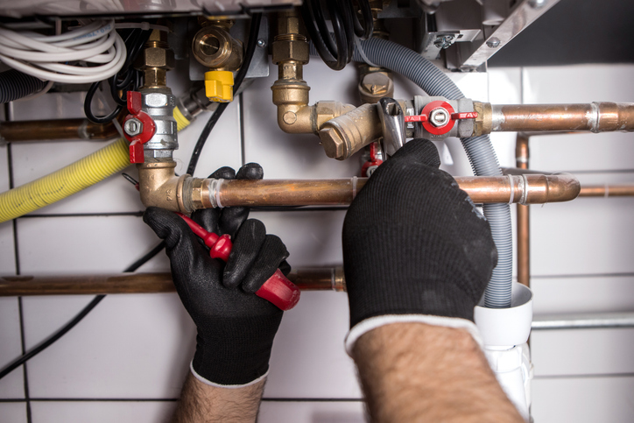
Restrictions in pipe systems
Common restrictions include:
Fittings
Valves
Restrictions or reducers
Rough surfaces inside pipe
Blockages or debris
All reduce flow and increase energy use.

Slide 24
Restrictions in pipe systems
Bends and tees
Each bend or tee introduces turbulence. This slows flow and increases friction. Use swept bends where possible. Straight runs minimise loss.
Pipe reductions and expansions
Reducing pipe diameter increases velocity and pressure loss. Expanding diameter too quickly can cause cavitation or noise.
Material surface roughness
Smooth pipe interiors reduce friction. Rougher materials (e.g., old steel or limescale) slow flow. Plastic pipes can offer better internal smoothness than metal.

Slide 25
Restrictions in pipe systems
Valve constrictions
Partially open valves reduce area and flow. Full bore spherical plug valves are less restrictive than standard spherical plug valves and stop valves. Gate valves offer less resistance to water flow, but are only designed for use on low pressure systems.
Designers must allow for valve loss in flow calculations.

Slide 26
Restrictions in pipe systems
Expansion issues
Rapid expansion can cause pressure drops. Air gaps and turbulence occur. Control fittings must manage flow transitions gradually. Expansion vessels and buffers can help.
The control of pressure in a sealed heating system is essential to maintain performance and to avoid failure of vulnerable components within the system.
Without the pressure vessel, the expansion of water when the system heats up may activate the pressure relief valve.

Slide 27
Practical impacts in plumbing systems
Poor shower flow due to undersized pipe.
Noisy pipes from pressure surges.
Valve selection influencing flow rates.
Excess bends reducing heating efficiency.

Slide 28
Measuring pressure and flow
Tools:
Manometer (pressure)
Flow meter
Pitot tube (velocity)
Temperature probes
Proper measurement is critical during commissioning.

Slide 29
Building regulations and flow
Part G outlines maximum water flow rates for appliances (see Table 2.1, page 16).
Manufacturers will provide information on minimum flow rates for specific appliances such as showers, boilers and pumps.
Non-compliance leads to poor user experience. Design must ensure compliance under worst-case conditions.

Slide 30
Summary – force and pressure
Force = pressure × area.
Static = pressure at rest.
Dynamic = pressure in motion.
Head height affects gravity-fed pressure.
Forced draught aids system control.

Slide 31
Summary – flow and velocity
Flow = velocity × area.
Pipe size affects pressure and flow.
Bends, tees, valves reduce flow.
Smooth pipes improve flow.
Good design balances all factors.

Slide 32
Final knowledge check
What is pressure head?
What causes static pressure to change?
How does reducing pipe size affect velocity?
Name two causes of flow restriction.
Why is surface roughness important?

Slide 33
Final knowledge check - answers
Height-based pressure from fluid column.
Changes in elevation or pump pressure.
Velocity increases, pressure may drop.
Bends, valves, debris.
Roughness increases resistance.

Slide 34
Reflection task
Where have you seen issues with pressure or flow in real systems?
What could have been done differently in terms of pipe sizing or system design?

Slide 35

Resources and references
BS EN 806: Water supply
CIBSE Guide G: Public Health
Building Regulations: Approved Document G
WRAS Guidance on pipe sizing
Manufacturer data for valves and fittings

Slide 36
Summary
You should now be able to:
Define and calculate force, pressure, and flow rate.
Identify effects of pipe size and pressure on system performance.
You might also be able to:
Evaluate a system layout for restrictions and losses.
Optimise pipe and valve selections to enhance flow.

Slide 37
Extended learning and review
Worked example calculations
Visual diagrams of pipe systems with pressure drop points
Animated explanation of draught and flow
Learner activity: system redesign for improved flow
Practical recap: measure and record system pressure across different points in a system

Slide 38
Any questions?
Copyright in this document belongs to and is used under licence from the Department for Education, © 2025.
‘T-LEVELS’ and ‘T Level’ are registered trademarks of the Department for Education.
WJEC is authorised by the Department for Education to develop and deliver this T Level Technical Qualification.
WJEC operates in England under the name Eduqas which is a registered trademark of WJEC.

