Slide 1
Occupational Specialism: Plumbing & Heating Engineering
K1.20 Electrolyte qualities of materials and the periodic table
Electrolytic corrosion and the electromotive series

Slide 2
Starter
Warm-up:
Why do some metal joints or fittings corrode faster than others, even when in the same system?
What might explain this?

Slide 3
Objectives
You should be able to:
Explain the principles of electrolytic corrosion.
Understand how the electromotive series influences corrosion risk.
Identify common signs and causes in plumbing systems.
You might also be able to:
Apply preventative measures using correct material choices.
Evaluate water quality and system design for corrosion potential.

Slide 4
Introduction to electrolytic corrosion
Electrolytic corrosion is a type of galvanic corrosion that happens when electric currents pass through water containing dissolved ions. This can cause metal atoms to lose electrons and form ions, effectively eating away at pipework and components.
It’s common in heating systems, especially where electrical grounding or stray currents are involved. Understanding this process is vital in selecting materials and maintaining electrical continuity.

Slide 5
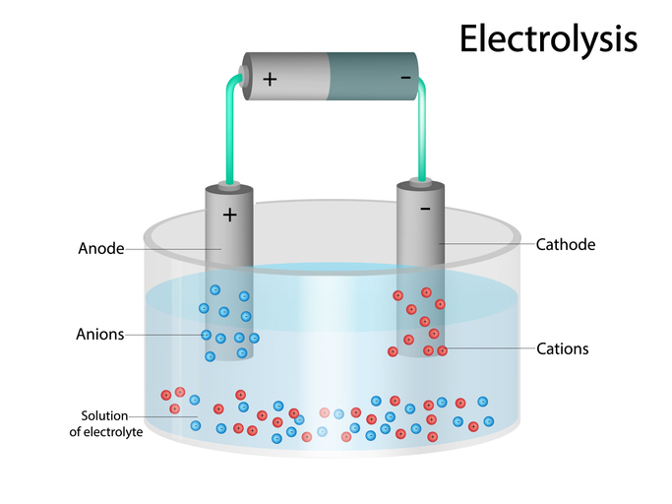
Conditions required for electrolytic corrosion
Presence of an electrolyte (conductive fluid like water with dissolved salts).
Two different metals with electrical contact.
A closed electrical circuit or stray electrical current.
A difference in electrode potential (voltage).
Environmental triggers (humidity, poor bonding, voltage leaks).

Slide 6
Role of the electromotive series (EMF series)
The EMF series ranks metals based on their electrode potentials. Metals higher up (more reactive) corrode more readily than those lower down (less reactive). When two metals from different points on the series are connected in an electrolyte, the higher metal (most reactive) becomes the anode and corrodes.
Examples include zinc corroding when paired with copper. Knowing this helps prevent poor metal pairings.
Question: Where would you find zinc and copper in close proximity? Why might this be a problem? How do we overcome this issue? (Think DZR* fittings)

Slide 7
Example of the EMF series (simplified)
Magnesium (most reactive – anodic)
Zinc
Iron/Steel
Lead
Copper
Silver (least reactive – cathodic).
Using metals with large potential differences in a wet system invites electrolytic corrosion unless precautions are taken.

Slide 8
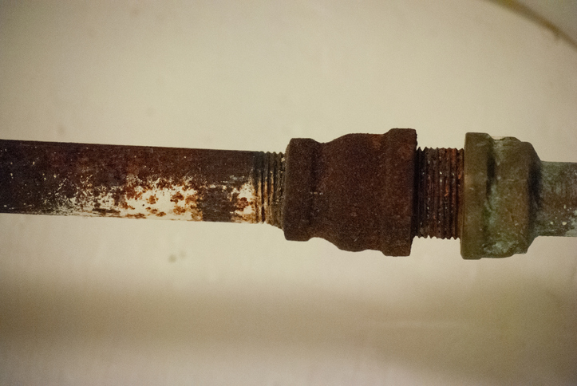
Real-life example of failure
In a commercial heating system, steel pipe was connected directly to a copper component without a dielectric (poor conducting material - plastic) barrier. The system water was untreated and contained dissolved salts and was slightly acidic.
Within two years, the steel had corroded severely, leading to pinhole leaks. The EMF series helps explain why the steel, being higher up, became the sacrificial anode in the system.

Slide 9
Stray current corrosion
Occurs when unintended electrical currents flow through pipework.
May come from nearby electrical systems or poor bonding.
Copper pipes are particularly vulnerable if used as grounding paths.
Damage often appears near electrical appliances.
Prevented by correct bonding and electrical separation.
Question: How might electrical grounding contribute to electrolytic corrosion?

Slide 10
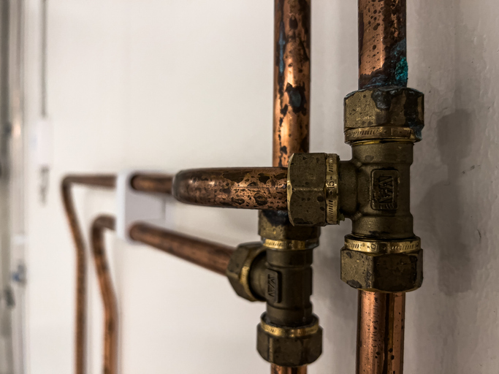
Recognising electrolytic corrosion
Electrolytic corrosion may appear as pitting, pinhole leaks, or rapid thinning of metal. It often starts near joints or grounding points.
Discolouration or a green/blue deposit may be visible, especially with copper. Unexplained rapid failure, especially on new systems, may indicate electrical involvement.
Always inspect bonded points and check continuity.

Slide 11
Water quality impact
Low pH (acidic water) increases corrosion rate.
High conductivity speeds up electrolytic processes.
Chlorides and dissolved salts increase reactivity.
Oxygenated water promotes oxidisation.
Water softeners can sometimes unbalance natural protections.

Slide 12
Electromotive series in system design
The EMF series should be considered when designing multi-metal systems. Avoid placing reactive metals (like aluminium or zinc) in contact with noble metals (like copper).
Use of intermediary fittings such as plastic or brass breaks the galvanic path. Proper design ensures longer service life and reduced maintenance.

Slide 13
Midpoint knowledge check
What three conditions are necessary for electrolytic corrosion?
Why does the more reactive metal corrode first?
What visual clues suggest electrolytic corrosion?
Name two high-risk areas for stray current damage.

Slide 14
Midpoint knowledge check - answers
Electrolyte, two dissimilar metals, electrical current.
It acts as the anode and loses electrons first.
Pitting, pinholes, or green deposits near joints.
Bonded copper pipes near appliances or boilers.

Slide 15
Mitigating risk through material choice
Avoid extreme pairings from the EMF series.
Use brass (DZR) or plastic fittings as isolators.
Consult manufacturer compatibility charts.
Use stainless steel or plastic where possible in reactive conditions.
Avoid connecting copper directly to galvanised steel.

Slide 16
Design and installation best practices
Good design avoids galvanic couples and stray currents. Components should be isolated where needed, and system flow direction should avoid dragging dissolved ions across mixed metal junctions.
Ensure the use of dielectric unions e.g. a fitting constructed of a material with poor or no electrical conduction - such as a plastic fitting where mixed metals are unavoidable.
Position inspection points at likely failure areas for maintenance ease.

Slide 17
Role of dielectric unions
The term dielectric refers to a material that can store electrical energy by becoming polarized in an electric field, but does not conduct electricity.
Essentially, it's an insulator with the added property of being able to be polarized by an electric field. This polarization involves the slight shifting of charges within the material, creating an internal electric field that opposes the applied field.
Dielectric unions act as non-conductive barriers between different metals. They stop the transfer of electrical current between materials, breaking the galvanic circuit. These are vital in systems where copper connects to steel or iron. Always check for proper installation and regular maintenance.

Slide 18
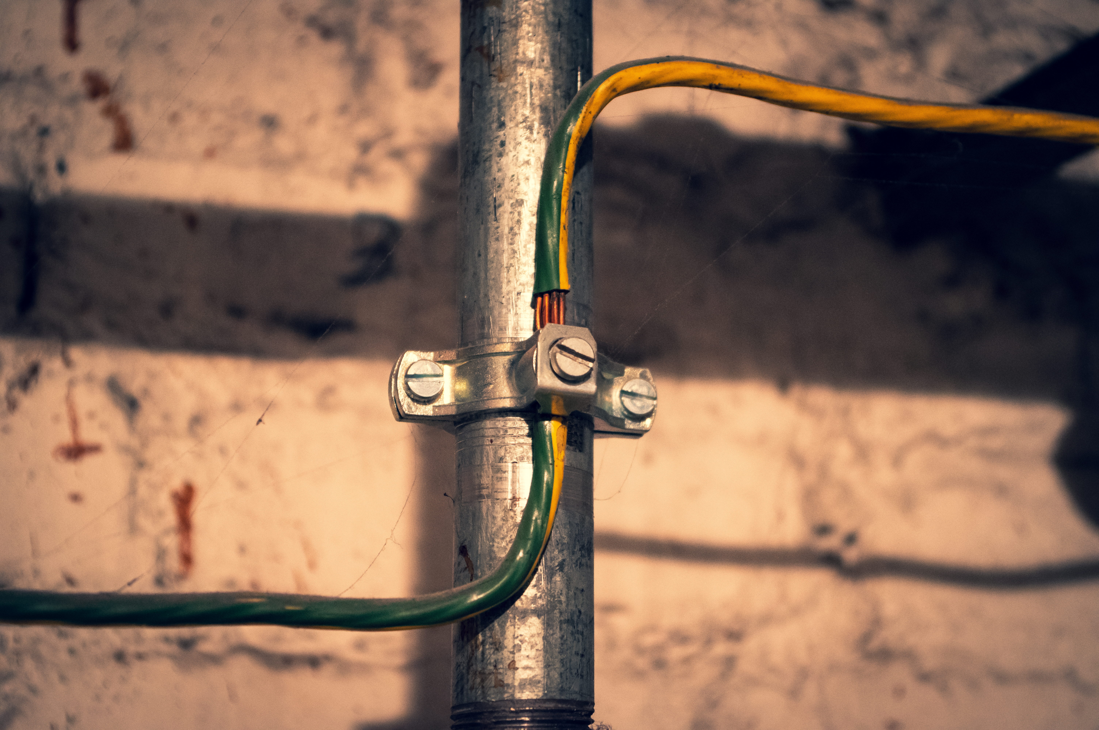
Electrical bonding and earthing
All plumbing systems must be properly bonded and earthed to comply with regulations. However, they should not be used as electrical paths unless specifically designed.
Incorrect use of plumbing as earth return can create corrosion hotspots. Coordination with electricians is essential in building design.

Slide 19
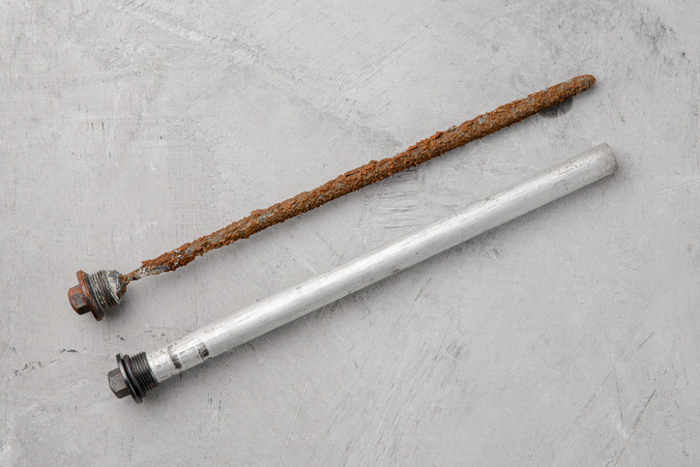
Sacrificial anodes and cathodic protection
Sacrificial anodes made from reactive metals can be used to protect key components. They corrode preferentially, preserving the integrity of more valuable parts.
This method is commonly seen in hot water cylinders.
Routine inspection and timely replacement are critical.

Slide 20
Maintenance responsibilities
Inspect fittings for early corrosion.
Monitor water quality regularly.
Test bonding and continuity.
Replace anodes on schedule.
Record faults and follow up with corrective action.
Question: What are sacrificial anodes in hot water cylinders commonly made from?

Slide 21
Case study – stray current in a domestic system
A new combi boiler installation showed signs of copper pipe corrosion within 18 months. Investigation revealed the system had been used as an earthing path for other domestic circuits.
What has happened? What corrective action can you take?
The stray current accelerated corrosion, especially near joints. A bonding fault was corrected and pipes replaced with dielectric breaks.

Slide 22
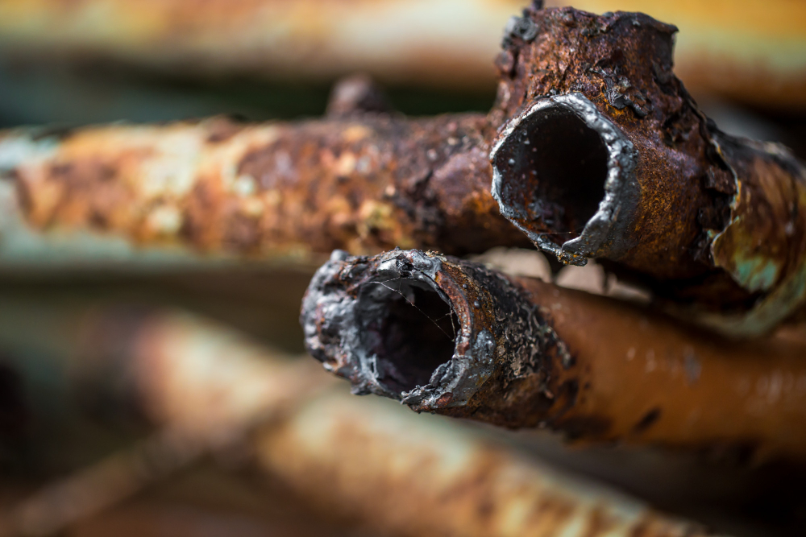
Environmental influence on EMF activity
Wet and humid environments enhance electrolytic corrosion risk. Water containing salts, as found in coastal or polluted areas, increases conductivity.
Even underground systems are at risk if the surrounding soil is acidic or wet. Always factor the local environment into your material selection and system layout.

Slide 23
Final knowledge check
What is the EMF series used for?
What are dielectric unions designed to prevent?
Give two signs of stray current corrosion.
What makes soft water more corrosive?
Where should sacrificial anodes be installed?

Slide 24
Final knowledge check - answers
To rank metals by reactivity and predict corrosion risk.
Preventing galvanic or electrolytic corrosion.
Pinholes, green deposits near bonding points.
Low pH and increased ionic activity.
In hot water cylinders.

Slide 25
Reflection task
Think of a system you've worked on where metal corrosion was a problem.
Would knowledge of the EMF series or electrolytic processes have helped you prevent the issue?
How? What would have done differently?

Slide 26
Good practice summary
Avoid reactive metal pairings.
Use dielectric breaks and isolators.
Maintain correct bonding and earthing.
Regularly test water quality and check fittings.
Apply EMF knowledge in all system designs.

Slide 27
Useful resources
BS EN 60426:2007 Electrical insulating materials. Determination of electrolytic corrosion caused by insulating materials.
WRAS - approved components for multi-metal systems
Manufacturer EMF series charts
IET wiring regulations (bonding)
CIBSE Guide G: Public Health and Plumbing

Slide 28
Summary
You should now be able to:
Explain electrolytic corrosion mechanisms.
Apply the EMF series in material selection.
You might also be able to:
Detect symptoms of electrolytic corrosion.
Implement protective installation practices.
Understand environmental and design considerations.

Slide 29
Any questions?
Copyright in this document belongs to and is used under licence from the Department for Education, © 2025.
‘T-LEVELS’ and ‘T Level’ are registered trademarks of the Department for Education.
WJEC is authorised by the Department for Education to develop and deliver this T Level Technical Qualification.
WJEC operates in England under the name Eduqas which is a registered trademark of WJEC.

