Slide 1
Occupational Specialism: Plumbing & Heating Engineering
K1.18 Relationship between mass/volume and specific heat capacity
How to calculate density

Slide 2
Starter
Warm-up:
If you have 2kg of copper and it takes up 0.00025m³ of space, what is its density?

Slide 3
Objectives
You should be able to:
Define the concept of density.
Use the mass/volume formula to calculate density.
You might also be able to:
Understand the difference in density across solids, liquids, and gases.
Apply density knowledge to real-world plumbing applications.

Slide 4
What is density?
Density is the measure of how much mass is packed into a given volume. It explains how heavy a material is for its size. The formula is:
Density = Mass / Volume
The unit of density is typically kg/m³. High-density materials are heavier for the same size compared to low-density ones. This principle is vital when choosing materials for heating systems and pipework.

Slide 5
Mass and volume explained
Mass: the amount of matter in an object, measured in kilograms (kg).
Volume: the amount of space an object takes up, measured in cubic metres (m³).
Together they determine how compact a material is.
Example: 1m³ of water has a mass of 1000kg → density = 1000kg/m³.

Slide 6
Volume in different units
Volume is often measured in litres in plumbing. 1 litre = 0.001m³. Converting between litres and cubic metres is essential in calculating density in the correct unit.
For example, 3L = 0.003m³.
Using incorrect volume units leads to incorrect density results. Always check your units before performing calculations.

Slide 7
Why density matters in plumbing
Water and oil flow differently due to density differences and pipe support and material choice depend on how heavy liquids or solids are per unit volume.
Copper's high density, results in strong and durable pipes capable of withstanding high water pressure and resisting corrosion. This structure also facilitates rapid and efficient heat transfer through the free movement of electrons, ensuring fast and consistent hot water delivery.
Understanding gas densities also helps when working with ventilation and combustion systems.

Slide 8
Calculating density – solids
To find the density of a solid:
Measure the mass using a scale
Measure the volume (length × width × height)
Use the formula: Density = Mass / Volume
Example: A copper block weighing 2kg and measuring 0.00025m³ has a density of 8000kg/m³
This is how dense and heavy copper is compared to other materials.

Slide 9
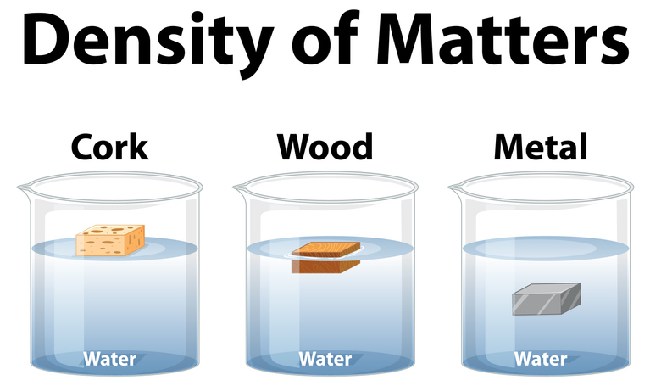

Slide 10
Common mistakes when measuring solids
Forgetting to convert mm³ or cm³ to m³.
Using mass in grams instead of kg.
Assuming irregular shapes can be measured like cubes.
Not using calibrated measuring tools.
Always double-check units and measurements for accuracy.

Slide 11
Calculating density – liquids
Measure volume with a measuring cylinder.
Weigh the container with liquid and subtract the container's mass.
Example: 1L (0.001m³) of water weighs 1kg → density = 1000kg/m³.
Liquids typically have consistent densities unless temperature changes.
Note – Water achieves a maximum density at 4°C.

Slide 12
Practical check – liquid density
You pour 2L of antifreeze into a cylinder. It weighs 2.12kg.
Convert volume to m³: 0.002m³
Density = 2.12 / 0.002 = 1060kg/m³
This antifreeze is slightly denser than water, which may affect how it behaves in sealed systems.
Question: Would antifreeze rise or sink in a water-based system?

Slide 13
Calculating density – gases
Gases are more complex due to compressibility.
Standard temperature and pressure (STP) are used for comparisons.
Air at STP has a density of about 1.225kg/m³.
Use gas charts or equations for accuracy in calculations.
Important in combustion, flue, and ventilation system design.

Slide 14
Practical example
You have 5kg of oil and it occupies 0.0058m³.
Density = 5 / 0.0058 = 862kg/m³
This shows that oil is less dense than water. It will float on water in systems.
Plumbers use this knowledge when separating substances or setting up tanks.

Slide 15
Midpoint knowledge check
What is the formula for density?
What unit is used to measure density?
How would you find the volume of a rectangular block?
Why is gas density more complex to calculate?
What is the typical density of water?

Slide 16
Midpoint knowledge check - answers
Density = Mass / Volume
kg/m³
Length × Width × Height
Gases are compressible and affected by temperature/pressure
1000kg/m³

Slide 17
Understanding relative density
Relative density (or specific gravity) compares the density of a material to water. A relative density >1 means it’s denser than water. This is a useful comparison method in fluid selection.
Oil's relative density is less than 1, so it floats. This principle applies when choosing fluids for separation systems.

Slide 18
Effects of temperature on density
As temperature increases, most substances expand, reducing density. Water is unique – its maximum density is at 4°C.
Gases show the greatest density change with temperature.
This is important when dealing with hot water and gas systems. Always consider temperature when applying density values practically.

Slide 19
Plumbing scenarios using density
Choosing between copper and plastic pipe.
Installing tanks for different fluids.
Working with antifreeze mixes.
Managing condensate in gas boilers.
Understanding density helps determine volume, material suitability, and load support in these systems.

Slide 20
Density and flow rate
Heavier fluids (higher density) may flow slower in pipes due to resistance. Pump selection and pipe sizing depend on fluid density. In hydronic systems, knowing density helps balance flow rates.
Misjudging density can lead to inefficient system operation. This is why it matters even after installation.
Question: How could using a fluid with higher density than expected affect your pipework design?

Slide 21
Recap formula practice
A gas weighs 0.98kg and fills 0.85m³.
Density = 0.98 / 0.85 = 1.15kg/m³
This is slightly less dense than air, which can impact ventilation needs.
Calculations like this guide safe flue sizing and appliance compatibility.

Slide 22
Exit quiz – quick recap
What is the formula for density?
Why do plumbers need to know the density of fluids?
What unit is density measured in?
Which expands more with heat: liquids or gases?
Why must you convert litres to m³ in density calculations?

Slide 23
Exit quiz – quick recap - answers
Density = Mass / Volume
To ensure correct material selection, system efficiency, and structural safety
kg/m³
Gases
To ensure consistency in units when calculating density (standard formula uses m³)

Slide 24
Summary
You should now be able to:
Define and calculate density.
Understand how mass and volume affect density.
Compare density values across materials.
You might also be able to:
Apply density knowledge to plumbing system designs.
Explain density variations due to temperature.
Solve practical problems using the density formula.

Slide 25
Any questions?
Copyright in this document belongs to and is used under licence from the Department for Education, © 2025.
‘T-LEVELS’ and ‘T Level’ are registered trademarks of the Department for Education.
WJEC is authorised by the Department for Education to develop and deliver this T Level Technical Qualification.
WJEC operates in England under the name Eduqas which is a registered trademark of WJEC.

