Slide 1
Occupational Specialism: Plumbing & Heating Engineering
K1.16 Scientific principles and concepts to plumbing engineering
Gases and their properties

Slide 2
Starter
Warm-up:
What gases do you commonly hear about in plumbing or HVAC systems?

Slide 3
Objectives
You should be able to:
Identify key gases used in the industry.
Understand their physical properties.
You might also be able to:
Explain how temperature, pressure, and volume relate.
Apply knowledge of gases to real-world installations.

Slide 4
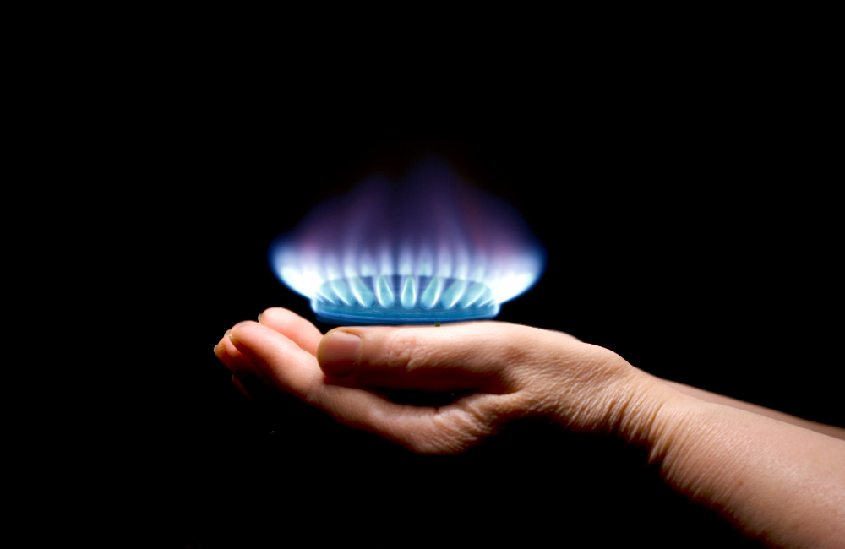
Natural gas
Natural gas is a hydrocarbon-based fuel.
Mainly composed of methane (CH4).
Colourless, odourless (smell added for detection).
Highly flammable and used in heating appliances.
Supplied via mains network.
Must be handled with care to prevent leaks.

Slide 5
Natural gas
Natural gas is one of the most commonly used fuels in domestic heating. It is valued for its efficiency and widespread availability through the mains supply. However, due to its flammability and tendency to rise in air, leaks pose a serious risk if not detected early.
Installations must comply with gas safety regulations, and operatives must be trained to handle it correctly. Regular inspections and carbon monoxide alarms are recommended in systems using natural gas.
Question: What makes natural gas especially hazardous in enclosed environments?

Slide 6
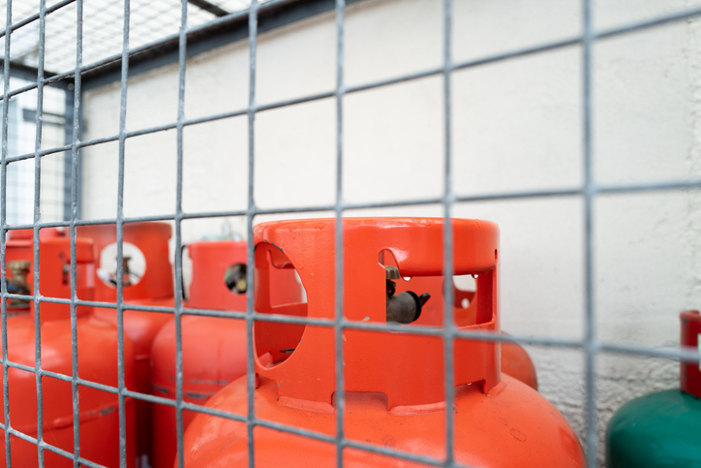
Liquefied Petroleum Gas (LPG)
LPG is a mixture of propane and butane.
Stored in pressurised cylinders.
Used where natural gas is unavailable.
Heavier than air, sinks in enclosed spaces.
Highly flammable.
Requires proper ventilation during use.

Slide 7
Liquefied Petroleum Gas (LPG)
LPG is an essential alternative fuel in rural areas and temporary installations. Due to its heavier-than-air properties, it tends to pool in low-lying areas if leaked, increasing explosion risks.
Appropriate ventilation and gas leak detection systems are crucial when working with or around LPG.
Appliances using LPG must be properly adjusted to the gas type. Fittings must be tight and regularly checked to avoid dangerous leaks.
Question: Why is LPG storage always done in upright cylinders?

Slide 8
Air
Air is a mixture of gases including:
Nitrogen (~78%).
Oxygen (~21%).
Others like CO2, argon, water vapour.
Used for combustion and pressurisation.
Acts as a medium for heat transfer in systems.

Slide 9
Steam
Steam is water in a gaseous state.
Produced by boiling water.
Used in sterilisation.
Must be controlled due to high pressure/temperature.
Can cause burns or equipment damage.
Not to be confused with water vapour.

Slide 10
Steam
Steam carries more energy than hot water due to its latent heat content. This makes it ideal for high-intensity heating applications like sterilisation and industrial boilers. However, this energy can also cause significant harm if not controlled.
Systems using steam must have robust pressure relief valves and temperature control devices. Pipework should be insulated and clearly labelled.
Question: What risk does sudden condensation of steam present to pipework integrity?

Slide 11
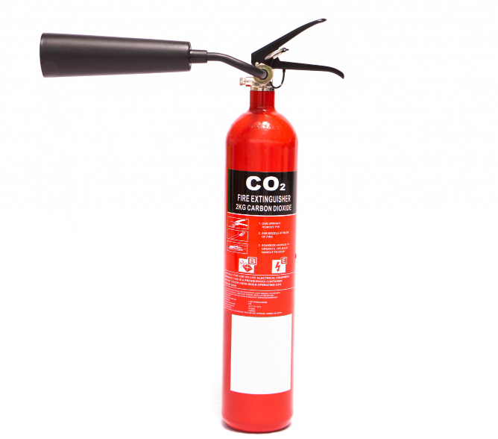
Carbon dioxide (CO2)
Used in fire suppression and refrigeration.
Colourless, odourless gas.
Heavier than air.
Non-flammable.
Can displace oxygen – hazard in confined spaces.

Slide 12
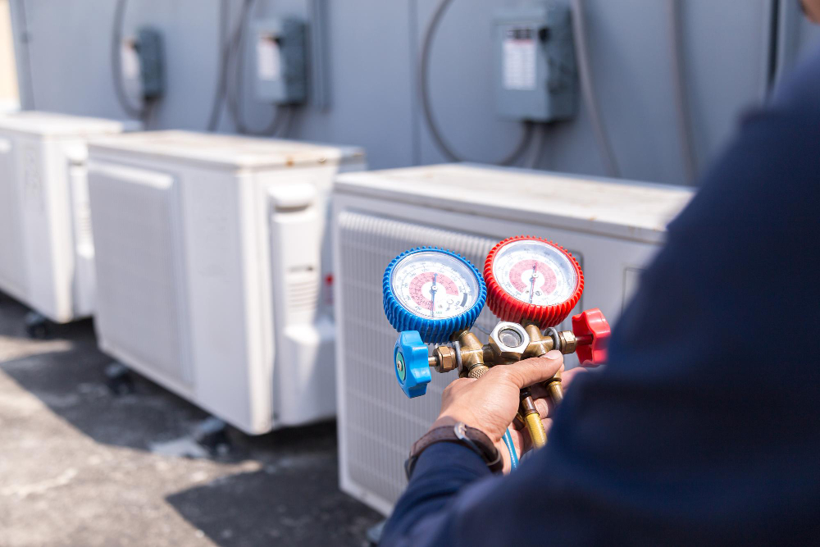
Refrigerant gases
Examples: R134a, R410a, R32
Used in cooling systems.
Designed for specific pressure/temp ranges.
Can be harmful to the environment and health.
Requires F-Gas qualification for handling.

Slide 13
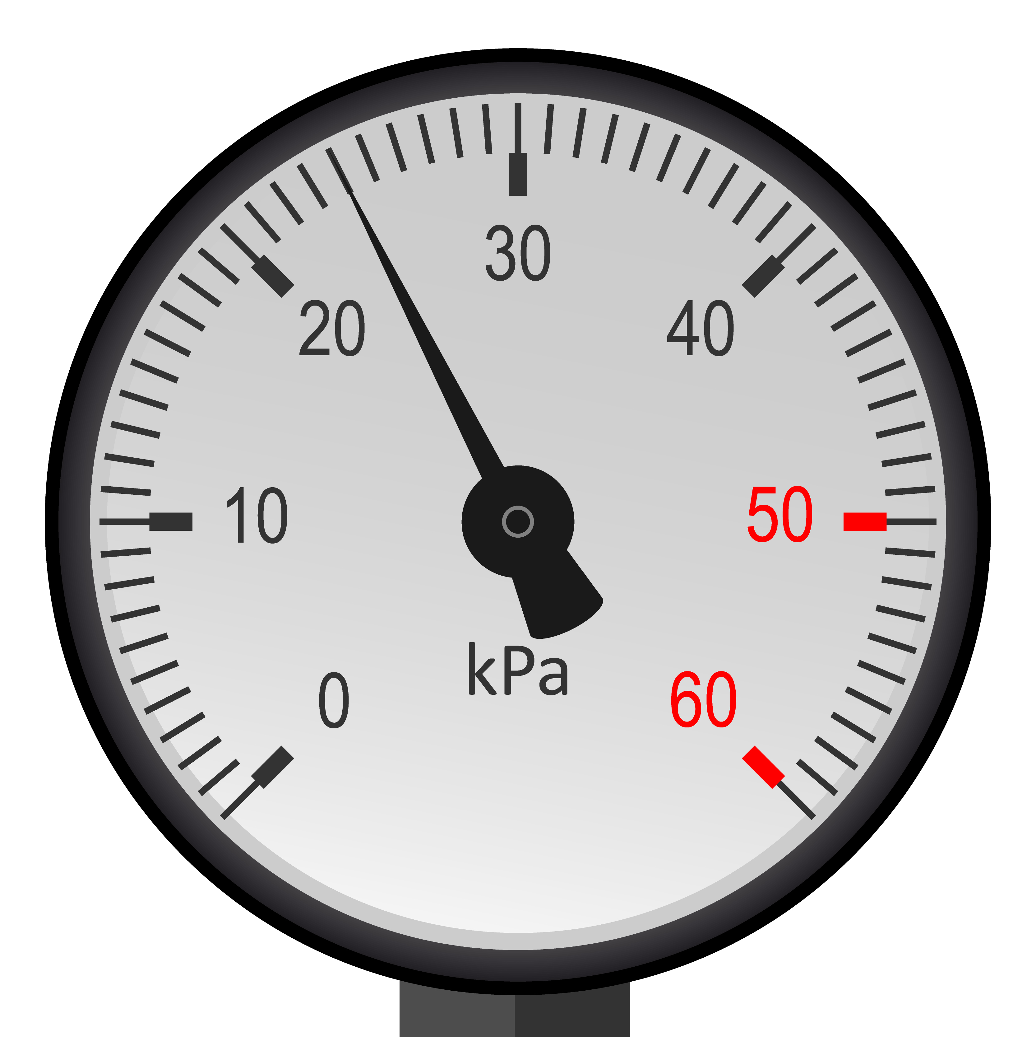
Pressure
Gas pressure = force exerted on container walls.
Measured in Pascals (Pa) or bar.
Affects appliance performance and safety.
High pressure gases require proper regulation.

Slide 14
Pressure
The pressure of gases directly affects how they behave in systems. When pressurised, gases become denser and more reactive. Plumbing systems often use pressurised gases in heating or control applications.
Sudden drops or rises in pressure can cause malfunctions or damage components. Monitoring pressure using reliable instruments is critical for operational safety and efficiency.
Question: What happens to gas pressure in a sealed container if the temperature rises?

Slide 15
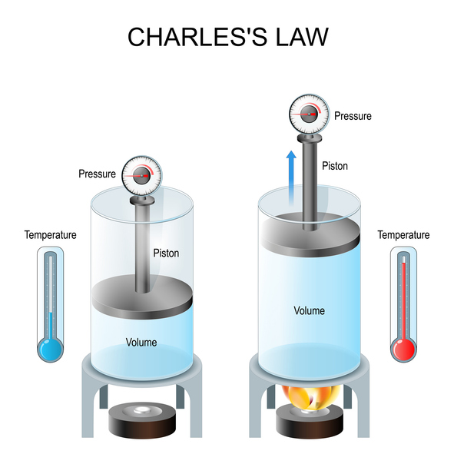
Volume + temperature
Gas volume changes with temperature
Measured in litres or cubic metres (m3).
Expands with heat, contracts when cooled.
Important for storage and system design.
Charles’s Law V₁/T₁ = V₂/T₂
The volume of a gas is directly proportional to its absolute temperature when pressure is held constant.

Slide 16
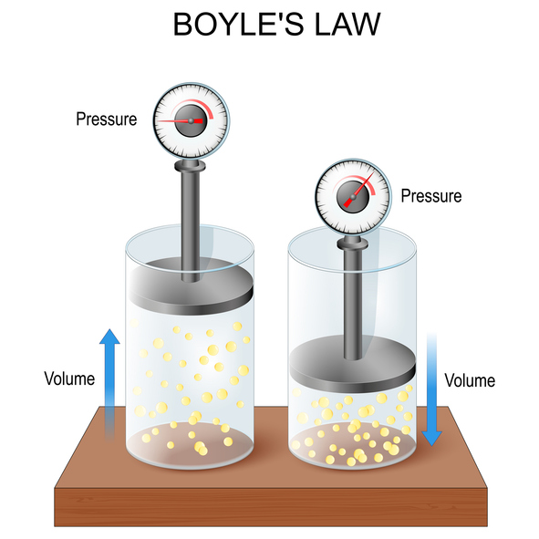
Volume + pressure
Boyle’s Law P₁V₁ = P₂V₂
Pressure and volume are inversely proportional, meaning that if you increase the pressure on a gas, its volume will decrease, and vice versa, as long as the temperature remains the same.

Slide 17
Combined gas law
(P1 x V1)/T1 = (P2 x V2)/T2
Explains how pressure, volume, and temperature are interrelated.
Useful for calculating changes in gas conditions.
Vital for safe system design.
P1 Initial pressure
V1 Initial volume
T1 Initial temperature in Kelvin
P2 Final pressure
V2 Final volume
T2 Final temperature in Kelvin

Slide 18
Gas safety considerations
Always use proper regulators and detection
Ensure adequate ventilation
Handle and store cylinders upright
Regularly check for leaks
Question: If a sealed container of gas is heated, what happens?
Volume stays same / Temperature increases / Pressure increases
Potential risk if pressure isn’t regulated

Slide 19
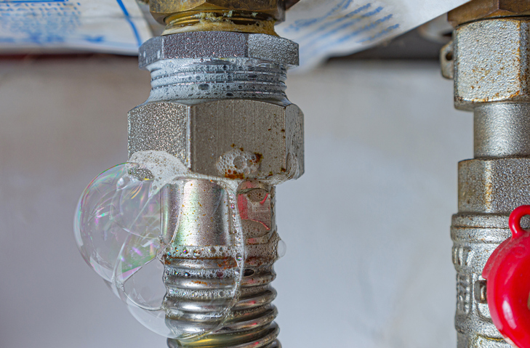
Gas safety considerations
Always use proper regulators and detection.
Ensure adequate ventilation.
Handle and store cylinders upright.
Regularly check for leaks.

Slide 20
Legislation and regulations
Gas Safety (Installation and Use) Regulations 1998.
F-Gas Regulations for refrigerants.
COSHH for hazardous substances.
PPE requirements for gas handling.

Slide 21
Legislation and regulations
All work involving gases must adhere to UK regulations. These rules exist to minimise risks to health, safety and the environment. Gas appliances, particularly those using natural gas and LPG, must be installed and serviced by Gas Safe registered engineers.
Refrigerant gases fall under F-Gas regulations, and only certified personnel may handle them. The Control of Substances Hazardous to Health (COSHH) framework also applies when working with or near refrigerants and combustion byproducts.
Question: What PPE would be most appropriate for working with refrigerants in a confined plant room?

Slide 22
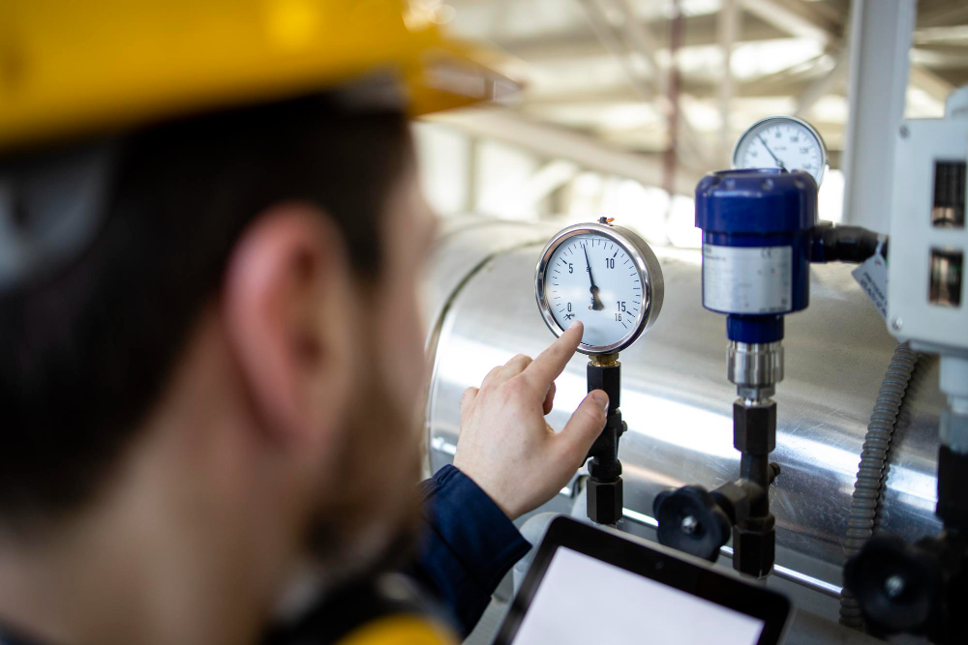
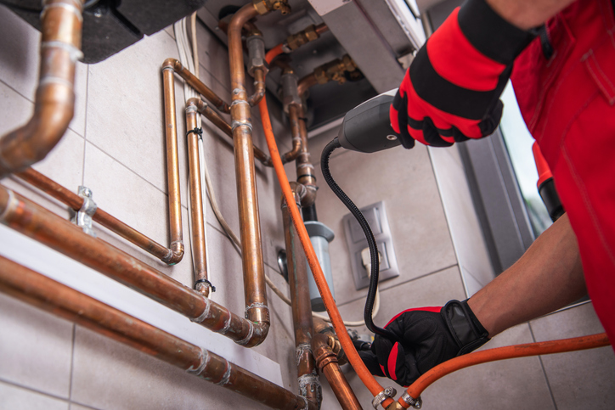
Industry tools for testing gases
Manometers
Gas leak detectors
Pressure gauges
Temperature probes
Flow meters.

Slide 23
Summary quiz
1. What is the primary component of natural gas?
A) Propane
B) Methane
C) Carbon dioxide
D) Butane

Slide 24
Summary quiz
2. Why is an odourant added to natural gas?
A) To improve combustion efficiency
B) To prevent corrosion of pipes
C) To make gas leaks detectable by smell
D) To enhance energy output

Slide 25
Summary quiz
3. What makes LPG particularly dangerous in enclosed spaces?
A) It evaporates quickly
B) It is lighter than air
C) It is highly corrosive
D) It sinks and can pool

Slide 26
Summary quiz
4. Which of the following gases is non-flammable?
A) LPG
B) Natural gas
C) Carbon dioxide
D) Hydrogen

Slide 27
Summary quiz
5. What physical law relates pressure, volume, and temperature of gases?
A) Boyle’s Law
B) Newton’s Law
C) Combined Gas Law
D) Bernoulli’s Principle

Slide 28
Summary quiz
6. How is steam different from air in heating systems?
A) It has lower energy density
B) It is not used in plumbing
C) It carries more heat due to latent heat
D) It requires no insulation

Slide 29
Summary quiz
7. What does a manometer measure?
A) Gas flow rate
B) Gas pressure
C) Gas temperature
D) Gas purity

Slide 30
Summary quiz
8. What qualification is required to handle refrigerant gases legally in the UK?
A) Water Regs Certificate
B) Gas Safe Registration
C) F-Gas Certification
D) COSHH Permit

Slide 31
Summary quiz
9. What happens to the pressure of a gas in a sealed container when the temperature increases?
A) Pressure decreases
B) Pressure remains unchanged
C) Pressure increases
D) Volume increases

Slide 32
Summary quiz
10. Which two gases mentioned are heavier than air and can settle in low areas?
A) Steam and air
B) CO₂ and LPG
C) Natural gas and air
D) R134a and nitrogen

Slide 33
Summary quiz - answers
B) Methane
C) To make gas leaks detectable by smell
D) It sinks and can pool
C) Carbon dioxide
C) Combined Gas Law
C) It carries more heat due to latent heat
B) Gas pressure
C) F-Gas Certification
C) Pressure increases
B) CO₂ and LPG

Slide 34
Summary
You should now be able to:
Recall the different types of gases used in the industry.
Explain how pressure, volume and temperature affect gas behaviour.
You might also be able to:
Examine risks associated with handling specific gases in confined or pressurised systems.
Select and justify appropriate safety measures for different gas applications.

Slide 35
Any questions?
Copyright in this document belongs to and is used under licence from the Department for Education, © 2025.
‘T-LEVELS’ and ‘T Level’ are registered trademarks of the Department for Education.
WJEC is authorised by the Department for Education to develop and deliver this T Level Technical Qualification.
WJEC operates in England under the name Eduqas which is a registered trademark of WJEC.

