Slide 1
Occupational Specialism: Plumbing & Heating Engineering
K1.16 Scientific principles and concepts to plumbing engineering
Corrosion and reasons for breakdown

Slide 2
Starter
Warm-up:
What materials have you seen in plumbing systems that look worn, damaged or rusted?
What might have caused it?

Slide 3
Objectives
You should be able to:
Identify types and causes of corrosion and material breakdown.
Explain how environmental factors affect material longevity.
You might also be able to:
Understand how to recognise damage due to heat and UV.
Discuss erosion corrosion and its effects on plumbing systems.
Suggest prevention and maintenance strategies.

Slide 4
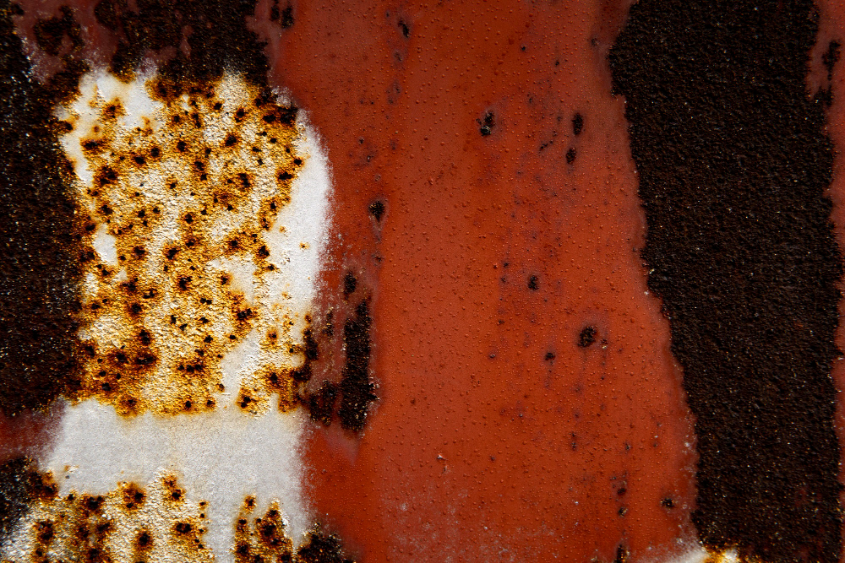
Introduction to material degradation
Material degradation in plumbing systems refers to the physical or chemical breakdown of materials over time. This process can result in a loss of functionality, failure of components, and potential safety hazards.
Corrosion and environmental wear are particularly concerning as they often go unnoticed until a failure occurs.
Understanding the different forms of degradation is essential to ensure systems remain safe, effective, and long-lasting.

Slide 5
What is corrosion?
Corrosion is the gradual degradation of materials, especially metals.
It is often caused by chemical reactions with environmental elements.
Can lead to reduced functionality and structural integrity.
Often affects plumbing components like pipes, radiators, boiler heat exchangers, valves.
Common in areas with high humidity or chemical exposure.

Slide 6
Types of corrosion in plumbing
Corrosion in plumbing systems can take several forms, each with distinct causes and effects. Atmospheric corrosion occurs when metal is exposed to air and moisture, while oxidisation results from chemical reactions between metals and oxygen.
Erosion corrosion is caused by the physical action of fluid movement wearing down materials. Galvanic and microbiologically induced corrosion are also concerns, though more complex in nature. Awareness of these types is key to identifying and preventing failures.
Question: What are two typical signs of atmospheric corrosion on metal surfaces?

Slide 7
Atmospheric corrosion
Occurs when metal surfaces are exposed to air and moisture.
Accelerated in polluted or coastal areas.
May cause pitting, flaking or rust.
Affects external pipework and exposed components.
Requires protective coatings or design modifications.

Slide 8
Oxidisation of metals
Oxidisation occurs when oxygen reacts with the surface of a metal, leading to the formation of oxides. This process weakens the metal's structural properties and can change its appearance significantly.
For example, iron forms reddish-brown rust, while copper may develop a green patina. In plumbing systems, oxidisation can occur inside radiators or pipes, especially when oxygen-rich water is present.
This damage can eventually cause leaks, blockages, or complete system failure.

Slide 9
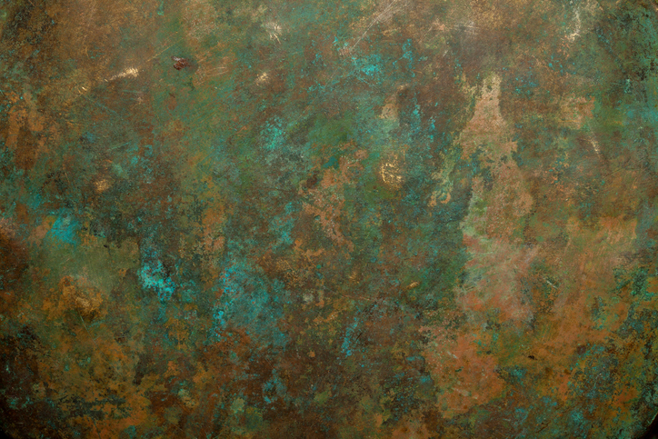
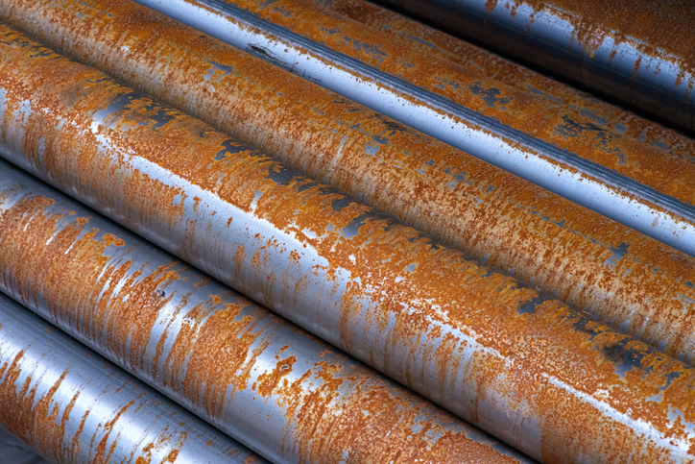
Oxidisation of metals
Oxidisation of copper
Oxidisation of steel

Slide 10
UV damage to plastics
Ultraviolet light breaks down plastic molecules.
Causes brittleness, discolouration, and cracking.
Common on exposed pipework or fittings outdoors.
uPVC and other plastics often degrade under prolonged sun.
Mitigated with UV-resistant materials or shielding.
Question: Where might UV damage most likely occur in a plumbing installation?

Slide 11
Heat damage to plastics
Heat damage in plastics is typically caused by excessive exposure to high temperatures. Plastic pipes and fittings can deform, warp or even melt when subjected to heat beyond their designed tolerance.
This can result from proximity to heat-producing equipment such as boilers or insufficient insulation.
When this happens, joints can loosen, creating leaks or complete system breaches. Selecting the correct grade of plastic and implementing proper shielding is critical in these environments.

Slide 12
Erosion corrosion
Occurs when fluid movement wears away protective layers.
Common in high-velocity or turbulent flow systems.
Affects bends, valves and narrow fittings.
Leads to pitting, thinning, or leaks.
Prevented by controlling flow rates and smooth pipe routing.
Question: What part of a system is most vulnerable to erosion corrosion and why?

Slide 13
Factors accelerating corrosion
Many environmental and operational factors accelerate corrosion. Moisture, pollutants, and salts in the air can increase surface reactions. High temperatures and acidic or alkaline water can also contribute to chemical attacks on materials.
Poor system design, such as sharp bends or joints that create turbulence, may further promote erosion.
Inadequate maintenance or incorrect material selection often leads to early failures due to corrosion.

Slide 14
Summary of causes of breakdown
Chemical: oxygen, chlorides, acids.
Physical: heat, UV, abrasion.
Mechanical: flow-induced wear.
Environmental: moisture, pollution, temperature changes.
Design/material choice: wrong materials for the environment.

Slide 15
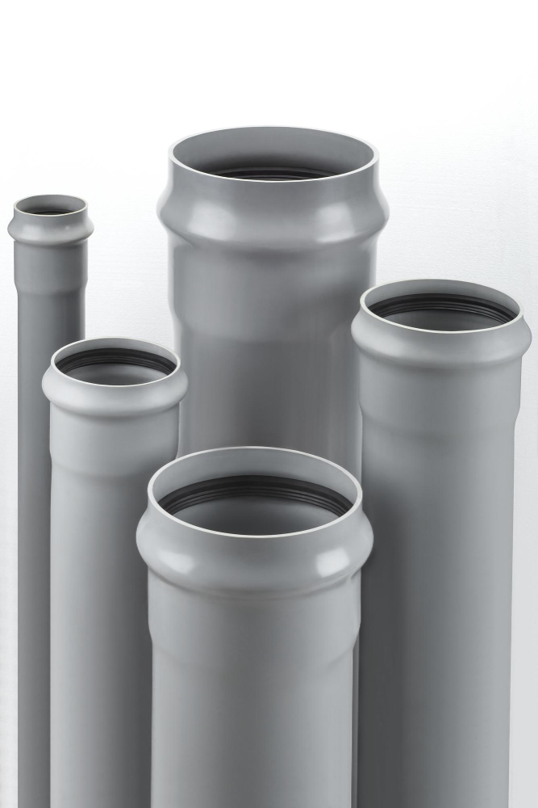
Case study: UV and heat damage
Consider an installation where uPVC waste pipes were installed on the exterior of a building. These pipes were exposed to direct sunlight without any shielding.
What is likely to happen over time?
What can be done to prolong the life of the materials?

Slide 16
Midpoint knowledge check
What causes oxidisation in metals?
Name one visual sign of UV damage to plastics.
Which form of corrosion is associated with high flow velocity?
How can atmospheric corrosion be prevented?

Slide 17
Midpoint knowledge check - answers
Oxygen reacting with the metal surface.
Discolouration or cracking.
Erosion corrosion.
Use of protective coatings and careful material selection.

Slide 18
Real-world examples
Radiators rusting due to poor maintenance.
Plastic solvent weld and push-fit joints cracking under sunlight.
Elbows in high-pressure systems thinning out.
Soil stack / waste fittings and clips failing due to lack of UV protection.
Corroded pipework in chlorinated environments.

Slide 19
Consequences of ignoring corrosion
If corrosion or other types of degradation are ignored, the consequences can be severe. Small leaks can become floods, and minor cracks can lead to major component failures.
In commercial or domestic settings, this can cause water damage, health risks and system downtime. Ignoring early signs increases maintenance costs over time.
Proactive identification and mitigation strategies are essential to prolonging system life.

Slide 20
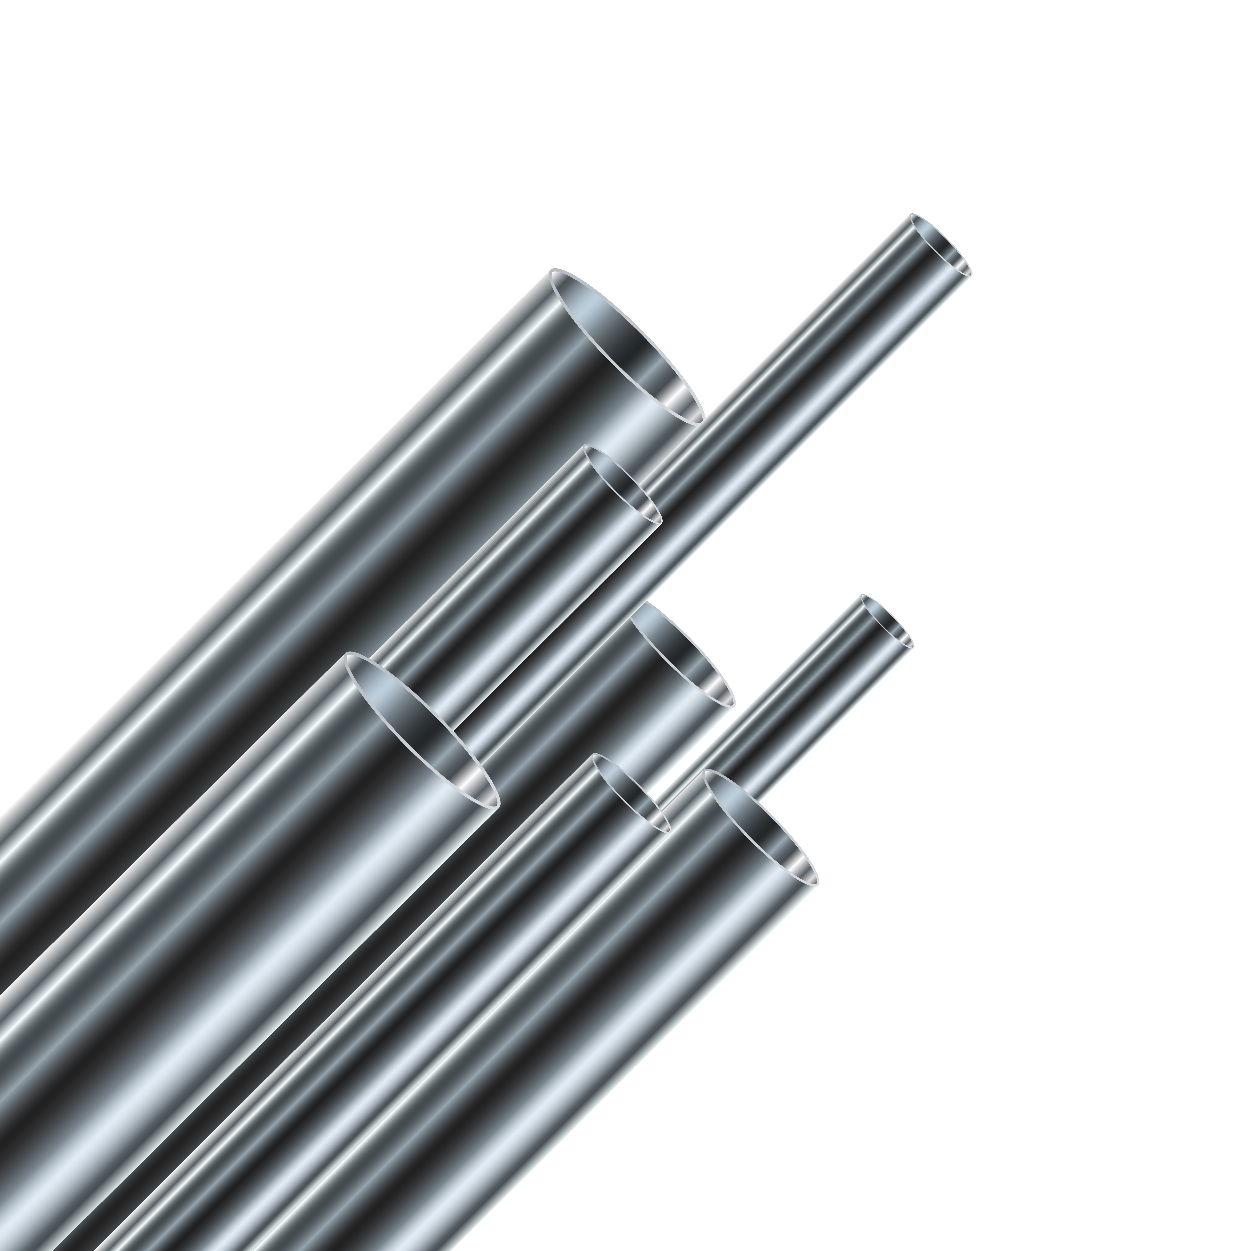
Prevention techniques
Use of corrosion-resistant materials (e.g., stainless steel).
Application of protective coatings or galvanising.
Installation of sacrificial anodes.
Regular inspections and maintenance.
System design considering flow rate and exposure.

Slide 21
Role of design in prevention
Good system design plays a crucial role in preventing corrosion and damage. Designers must consider environmental conditions, expected temperatures, water quality and pressure.
Avoiding sharp bends and ensuring consistent pipe diameters helps reduce turbulent flow. Choosing the right materials based on exposure risk can significantly reduce long-term damage.
Incorporating inspection points and drainage also aids future maintenance.
Question: Why might a plastic fitting crack even if it hasn’t been physically struck or heated?

Slide 22
Maintenance strategies
Scheduled visual inspections.
Water quality testing (pH, oxygen content).
Replacing worn components.
Applying insulation and shielding.
Adjusting flow rate and temperature settings.

Slide 23
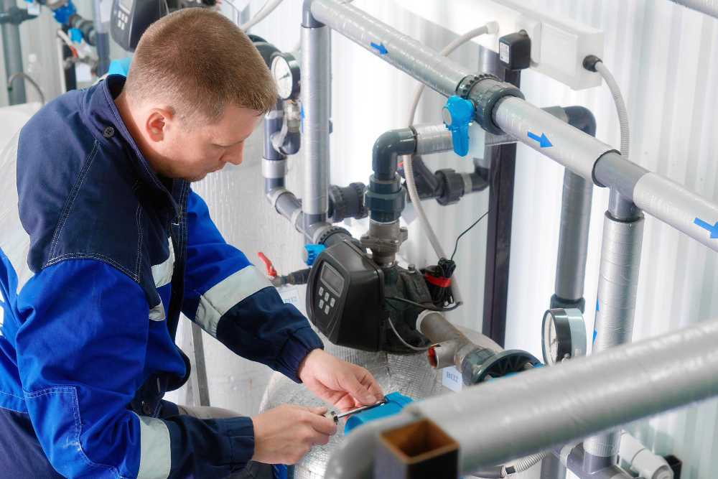
Water quality impact
Water quality directly affects corrosion rates. Hard water can cause scale, which leads to under-deposit corrosion, while soft water may be aggressive to metal surfaces.
Chlorides in water are especially damaging to stainless steel. Maintaining appropriate pH levels and using inhibitors can greatly reduce the risk.
Regular monitoring helps identify imbalances early.

Slide 24
Role of water treatment
pH balancing prevents aggressive acidic or basic environments.
Oxygen scavengers reduce oxidisation.
Inhibitors coat metal surfaces.
Softening prevents scaling which can lead to under-deposit corrosion.
Continuous dosing systems are used in commercial settings.
Question: What is one chemical treatment used to prevent metal corrosion?

Slide 25

External influences – case example
In one coastal installation, mild steel pipework degraded rapidly within two years. Investigation revealed airborne salt and high humidity as contributing factors.
These accelerated atmospheric corrosion beyond design expectations.
What solutions could you offer to resolve the issue and prevent further problems?

Slide 26
Summary of key learning points
Corrosion comes in various forms: atmospheric, oxidisation, erosion, and more.
Plastics are vulnerable to both UV and heat damage.
Environmental and operational conditions must guide design and material choice.
Water treatment and flow control can significantly extend component life.
Regular maintenance and inspection are essential for prevention.

Slide 27
Final knowledge check – answers
What conditions encourage atmospheric corrosion?
What is the main cause of heat damage to plastics?
Name a solution for preventing erosion corrosion.
What visual cue might indicate oxidation on copper?
List one maintenance action to prevent breakdown.

Slide 28
Midpoint knowledge check - answers
Moisture, pollution, exposure to open air.
Proximity to heat sources exceeding material tolerance.
Control of flow rate and use of appropriate fittings.
Green discolouration (patina).
Regular inspection, recoating and replacement of worn parts.

Slide 29
Discussion – industry standards
Plumbing systems must comply with standards such as BS EN 12502 for corrosion and WRAS guidance for material compatibility. Following regulations not only ensures safety but also prevents liability issues. Installers and designers should stay informed on updates to legislation.
Training and CPD help ensure best practice is followed on all projects.
Think about a time you observed pipe or system failure. Was the cause linked to one of the issues discussed today? How would you approach it differently now?

Slide 30
Summary
You should now be able to:
Identify corrosion and breakdown types.
Explain their causes and effects.
Recognise signs of material degradation.
You might also be able to:
Apply prevention and treatment techniques.
Understand the importance of system design in preventing failure.

Slide 31
Any questions?
Copyright in this document belongs to and is used under licence from the Department for Education, © 2025.
‘T-LEVELS’ and ‘T Level’ are registered trademarks of the Department for Education.
WJEC is authorised by the Department for Education to develop and deliver this T Level Technical Qualification.
WJEC operates in England under the name Eduqas which is a registered trademark of WJEC.

