Slide 1
Occupational Specialism: Plumbing & Heating Engineering
K1.7 Plumbing and heating systems
K1.8 Components used in plumbing and heating systems
K1.11 Appliances supported by plumbing and heating systems
Boilers

Slide 2
Starter
Warm-up:
What type of boiler do you think is most common in UK homes today, and why?

Slide 3
Objectives
You should be able to:
Describe principles of heat only, system, and combi boilers
Identify installation methods and system suitability
Explain advantages and disadvantages of each type
You might also be able to:
Recognise layouts and components in working systems
Discuss boiler choice with reference to different scenarios

Slide 4
Introduction to boilers
Boilers are the central heating appliance for most UK homes. They burn gas, oil, or other fuels to heat water for radiators and domestic hot water. The three main types are heat only, system, and combination boilers. Each follows the same basic principle of transferring heat into water but differs in layout, storage, and pressure management.
Choosing the correct boiler is critical for meeting the needs of the household, ensuring efficiency, and complying with building regulations.
Understanding the features of each boiler type enables engineers to recommend the right solution for different property sizes and usage patterns.

Slide 5
Heat only boiler – overview
Traditional boiler type.
Requires separate cylinder for hot water.
Needs pump and mechanism for expansion (F&E or vessel).
Historically installed with open vented systems but now fitted as sealed system.
Suitable for larger properties with high demand.
Question: Why does a heat only boiler require a pump compared to other types?

Slide 6
Heat only boiler – principles
A heat only boiler supplies hot water to both a central heating circuit and a separate hot water cylinder. The cylinder stores heated water until it is needed, while the feed and expansion tank keep the system topped up and accommodate thermal expansion (a pressure vessel and filling loop can replace the F&E to pressurise the system).
This type of boiler is well suited to homes with more than one bathroom, where several taps may be in use at once. Although reliable, they require space for cisterns and a cylinder, often located in a loft and airing cupboard.
They are most effective when combined with gravity-fed systems and good water storage capacity.

Slide 7
Heat only boiler – installation methods
Requires hot water cylinder in airing cupboard.
Cold water storage cistern in loft.
Feed and expansion cistern in loft.
Pipework connections are more complex.
Installation needs space for multiple components.
Question: What building features make heat only boilers unsuitable for some modern homes?

Slide 8
System boiler – overview
System boilers were designed to simplify installations compared to heat only systems. They integrate key components such as the pump and expansion vessel inside the boiler casing. This removes the need for a separate feed and expansion cistern in the loft.
Although they still require a hot water cylinder, the overall installation is more compact and reliable.
System boilers are particularly suitable for medium to large homes with good mains water pressure.

Slide 9
System boiler – principles
Contains pump and expansion vessel inside casing.
Requires a hot water cylinder but no F&E.
Works on sealed system principle.
Reduces installation time and components.
Efficient for homes with regular hot water demand.
Question: Why is a system boiler generally easier to install than a heat only boiler?

Slide 10
System boiler – installation
System boilers connect directly to the mains supply and use their internal expansion vessel to deal with pressure changes. They are normally paired with an unvented hot water cylinder, giving good flow rates at mains pressure.
This makes them more versatile in modern housing, where loft space may be limited.
Although simpler than heat only systems, installation still requires space for the cylinder and careful pipework planning. They offer a balance between capacity and compact design.

Slide 11
Combination boiler – overview
Most common domestic boiler in the UK.
Provides hot water on demand, no storage.
No hot water cylinder or loft tanks needed.
Compact, wall mounted.
Best for small to medium homes.
Question: Why do combi boilers remove the need for hot water storage cylinders?

Slide 12
Combination boiler – principles
Combination boilers heat water directly from the mains whenever a tap is opened. They have two separate circuits: one for central heating and one for domestic hot water.
Because water is heated instantly, there is no need for a cylinder or storage tank. This design saves space and eliminates standing heat losses, making them very energy-efficient.
However, the hot water output depends on mains flow rate, which can be a limitation in areas with poor supply or in homes with high simultaneous demand.

Slide 13
Combination boiler – installation
Connects directly to mains supply.
No storage tanks or cylinder required.
Usually wall-mounted in kitchens, bathrooms, or cupboards.
Requires reliable mains water pressure.
Quick, straightforward installation compared to other types.
Question: What issue may occur in a combi boiler system if mains pressure is low?

Slide 14
Tutor demonstration
The tutor shows students working examples of each boiler type, either live systems or training rigs.
Students observe pipework arrangements, components, and space requirements.
Students are encouraged to ask questions and identify features that distinguish heat only, system, and combi boilers.

Slide 15
Student task – identify components
Students provided with schematic diagrams of three boiler systems.
Label components: cylinder, expansion vessel, pump, tanks.
Compare layouts between boiler types.
Discuss differences in groups.

Slide 16
Suitability of heat only boilers
Heat only boilers are most suitable for larger properties where there is high hot water demand across multiple bathrooms. They can deliver consistent supply to several outlets at once.
They are also compatible with older gravity-fed heating systems, making them useful in retrofits.
However, they require loft space for cisterns and airing cupboard space for the cylinder, which modern homes often lack. For new builds, heat only systems are less common due to their space demands.

Slide 17
Suitability of system boilers
Good for medium to large homes.
Reliable hot water for multiple outlets.
No loft cisterns needed – suitable for properties without attic space.
Requires good mains water pressure.
Not ideal for very small homes.
Question: Why are system boilers often chosen for properties without loft space?

Slide 18
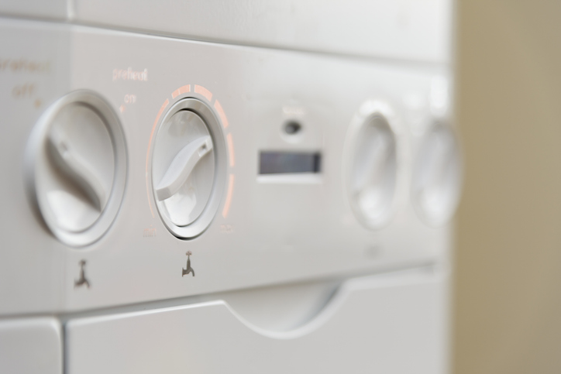
Suitability of combi boilers
Combination boilers suit small to medium homes where space is limited and demand is moderate. They are the most popular choice for flats and two-bedroom houses.
As there is no need for a cylinder or cistern, valuable storage space is saved.
However, combis struggle to supply multiple bathrooms at the same time. They are best suited for single bathroom properties or households with predictable demand patterns.

Slide 19
Advantages of heat only boilers
Can handle high simultaneous demand.
Suitable for multiple bathrooms.
Proven, reliable technology.
Easier to repair and maintain.
Works with traditional open-vented systems.
Question: Why might heat only boilers remain common in large traditional homes?

Slide 20
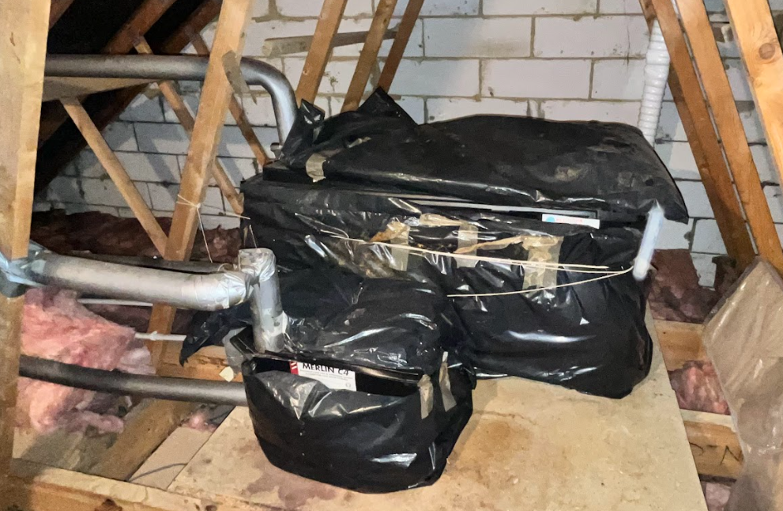
Disadvantages of heat only boilers
Heat only boilers historically required extensive space for tanks and a cylinder. They involve complex pipework and longer installation times.
Cisterns in lofts can freeze in winter if not properly insulated. Hot water is stored and can run out, requiring reheating.
These limitations make open vented heat only systems less attractive in modern compact housing.

Slide 21
Advantages of system boilers
Built-in pump and expansion vessel.
No loft cisterns required.
More compact than heat only systems.
Can supply more than one outlet at once.
Quicker to install and maintain.
Question: What built-in feature of system boilers removes the need for loft cisterns?

Slide 22
Disadvantages of system boilers
System boilers still need a hot water cylinder, which takes space and adds cost. Hot water can run out if the cylinder is emptied.
Their complex and compact internal components can make repairs more expensive than heat only systems.

Slide 23
Advantages of combi boilers
Compact, ideal for smaller homes.
Instant hot water on demand.
Easy and fast to install.
No standing heat losses from storage.
Highly energy-efficient.
Question: Why are combi boilers considered more energy efficient than stored hot water systems?

Slide 24
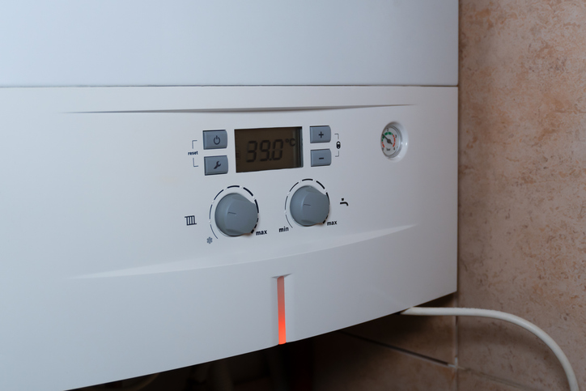
Disadvantages of combi boilers
Combis struggle with multiple bathrooms and high demand at the same time. They rely fully on mains pressure and flow, making them unsuitable in areas with weak supply.
If the unit fails, there is no backup hot water from storage.
They also do not integrate easily with some renewable systems such as solar thermal.

Slide 25
Midpoint knowledge check
Name the three main boiler types.
Which type requires feed and expansion tanks?
What feature makes system boilers easier to install than heat only?
Why are combi boilers popular in flats?
What issue affects combi boilers with poor mains pressure?

Slide 26
Midpoint knowledge check – answers
Heat only, system, combination.
Heat only boiler.
Pump and expansion vessel built in.
Compact size and instant hot water, no cisterns needed.
Low flow rate and poor performance.

Slide 27
Tutor discussion – system layouts
Tutor presents diagrams of boiler layouts, showing how water storage and distribution differ.
Students discuss the role of cisterns, cylinders, and mains supply.
The discussion highlights space, efficiency, and installation complexity. Comparing diagrams reinforces understanding of principles and suitability.

Slide 28
Student task – boiler suitability
Groups assigned different property types: flat, 3-bed house, large family home.
Students choose most suitable boiler type.
Justify decision with reference to demand and space.
Share answers with class.

Slide 29
Group activity – advantages & disadvantages
Students work in groups to list pros and cons of each boiler type on posters.
Groups then rotate and add comments to others’ work.

Slide 30
Heat only boiler recap
Typically requires cistern and cylinder.
Reliable and traditional.
Suited to high demand.
Complex installation.
Unsuitable for modern compact homes.
Question: What is the biggest space requirement difference between heat only and combi boilers?

Slide 31
System boiler recap
System boilers eliminate the need for loft tanks but still use a cylinder.
They are simpler to install than heat only systems and suitable for medium homes.
They balance compactness and supply but depend on mains pressure and cylinder storage.

Slide 32
Combi boiler recap
No cylinder or cisterns required.
Instant hot water.
Compact design.
Relies on mains pressure.
Best for small to medium homes.
Question: Why is a combi boiler often chosen for smaller modern properties?

Slide 33
Tutor demonstration – identifying boilers
Tutor shows examples of real boilers or images.
Students identify boiler type and key components.
Hands-on recognition improves ability to diagnose systems in the field.

Slide 34
Student task – sketch & label
Students sketch layouts for heat only, system, and combi boilers.
Label key parts such as tanks, cylinders, pumps, and expansion vessels.
Compare to tutor’s diagrams.

Slide 35
Energy efficiency
Boiler type affects energy efficiency. Combi boilers reduce standing losses by eliminating cylinders, but may be less efficient under high demand.
Heat only and system boilers paired with modern unvented cylinders can achieve good efficiency. Installers must consider ErP ratings and compliance with Part L of Building Regulations when recommending systems.

Slide 36
Sustainability and regulations
Building Regulations Part L requires minimum efficiency.
Modern boilers must meet NOx emission standards.
Hydrogen-ready boilers are emerging.
Installers must be Gas Safe registered.
Renewable integration may influence choice.
Question: Why is it important to consider Building Regulations when recommending a boiler system?

Slide 37
Tutor case study
Case study: A 4-bed detached home with two bathrooms including;
2 x showers
1 bath
2 x basins
2 x sinks
Students decide between system and combi boilers.
Discussion covers demand, efficiency, and space availability.

Slide 38
Student role-play – client discussion
In pairs, one acts as client, one as installer.
Installer explains boiler options, pros and cons
Client asks questions
This exercise builds communication and advisory skills.

Slide 39
Faults and maintenance
Each boiler type has common faults.
Heat only systems are often reliable but are at the mercy of other system components.
System boilers can develop pump or expansion vessel failures.
Combi boilers are prone to limescale build-up in hard water areas.
Engineers must understand layouts to diagnose quickly and maintain safety.

Slide 40
Final knowledge check 1
Which boiler type is most compact?
What is the main disadvantage of heat only boilers?
What built-in parts make system boilers simpler?
Why might combis struggle with multiple bathrooms?
Which regulation covers boiler efficiency?

Slide 41
Final knowledge check 1 – answers
Combination boiler.
Often requires multiple cisterns and more space for components & pipework.
Pump and expansion vessel.
Flow rate cannot supply multiple outlets simultaneously.
Part L of the Building Regulations.

Slide 42
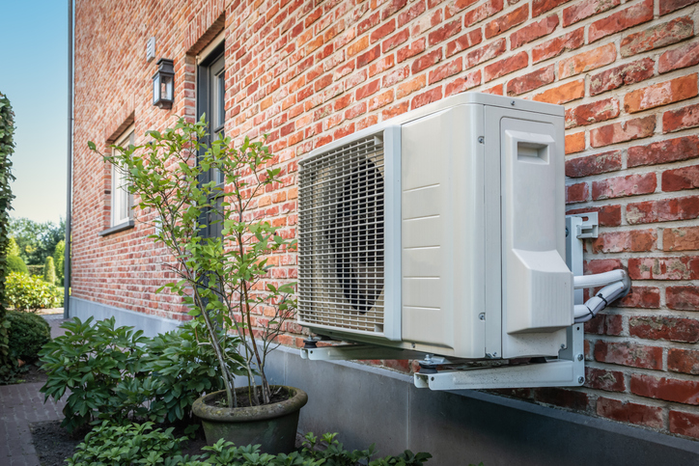
Energy future of boilers
The heating industry is moving toward sustainable solutions.
Hydrogen-ready boilers, hybrid heat pumps, and renewable technologies may replace traditional gas systems in coming decades.
Engineers must understand today’s boilers as a foundation for adapting to future systems.

Slide 43
Industry standards
Gas Safe registration required.
Compliance with Building Regulations.
Benchmark certification for installations.
Consumer protection via warranties and service records.
Question: Why is Gas Safe registration essential for gas boiler installers?

Slide 44
Final knowledge check 2
What is a disadvantage of a combi?
Which type suits large homes with high demand?
Can combi boilers run DHW and Heating at the same time?
What space requirements do system boilers reduce compared to heat only?
Which boiler type is most common in UK homes today?

Slide 45
Final knowledge check 2 – answers
Struggles with high demand, not suitable for renewable integration.
Heat only boiler.
No, combi boilers include a diverter valve and prioritise hot water.
No feed and expansion cisterns in loft.
Combination boiler.

Slide 46
Summary
You should be able to:
Describe principles of heat only, system, and combi boilers
Identify installation methods and system suitability
Explain advantages and disadvantages of each type
You might also be able to:
Recognise layouts and components in working systems
Discuss boiler choice with reference to different scenarios

Slide 47
Any questions?
Copyright in this document belongs to and is used under licence from the Department for Education, © 2025.
‘T-LEVELS’ and ‘T Level’ are registered trademarks of the Department for Education.
WJEC is authorised by the Department for Education to develop and deliver this T Level Technical Qualification.
WJEC operates in England under the name Eduqas which is a registered trademark of WJEC.

