Slide 1
Occupational Specialism: Plumbing & Heating Engineering
K1.7 Plumbing and heating systems
K1.8 Components used in plumbing and heating systems
K1.11 Appliances supported by plumbing and heating systems
Air source heat pumps & electric boilers

Slide 2
Starter
Mind Map:
How can heat be generated without gas?
Students work in small groups to brainstorm ideas.
Feed back into class discussion led by tutor.

Slide 3
Objectives
You should be able to:
Describe principles of air source heat pumps and electric boilers
Discuss advantages and disadvantages
Identify layouts for alternative heating systems
You might also be able to:
Understand basic refrigerant cycle operation
Evaluate suitability for domestic use

Slide 4
Introduction to alternative heating
Heating does not always rely on natural gas. Growing sustainability targets and changes in building regulations encourage the use of renewable and electric alternatives.
Air source heat pumps and electric boilers are the two most common substitutes for gas boilers. Both provide heat for wet central heating systems, but they work in very different ways.
Engineers must understand their principles, installation, and limitations to recommend suitable systems for modern homes.

Slide 5
Air source heat pumps – overview
Extract heat from outside air.
Use refrigerant cycle to upgrade heat.
Supply low-temperature water to heating system.
Work even in cold conditions.
Increasingly popular under government incentives.
Question: Why can an air source heat pump still work in cold winter weather?

Slide 6
Air source heat pumps – principles
Air source heat pumps use a refrigeration cycle to absorb heat from the outside air. A fan draws air over an evaporator coil, where refrigerant absorbs heat and evaporates.
The refrigerant is compressed, increasing its temperature, then transfers heat into the central heating water.
Finally, it expands back to repeat the cycle. Although efficiency drops in low temperatures, the system can still provide usable heat for domestic properties.

Slide 7
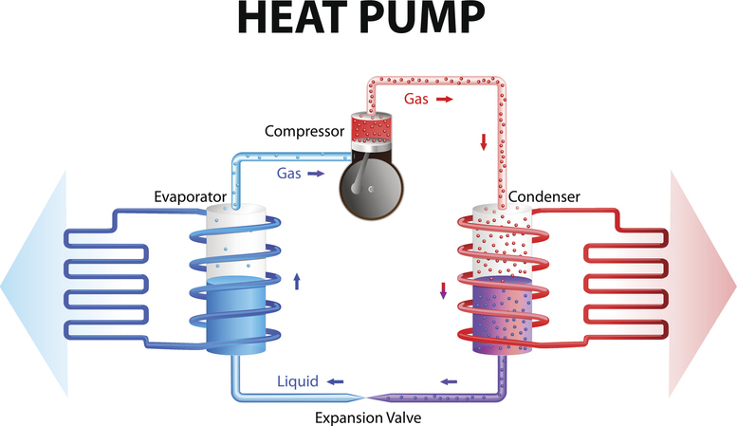
Air source heat pumps – principles

Slide 8
Basic refrigerant cycle – step by step
Evaporation: refrigerant absorbs heat from outside air.
Compression: compressor raises refrigerant temperature.
Condensation: refrigerant transfers heat into heating water.
Expansion: refrigerant pressure drops ready to absorb heat again.
Continuous closed cycle.
Question: Where could you find this process at home?

Slide 9
System layout – air source heat pump
Outdoor unit with fan and evaporator coil.
Indoor cylinder with heat exchanger.
Pump to circulate heating water.
Flow and return pipes into radiator/underfloor heating.
Controls integrated for efficiency.
Question: Why are underfloor heating systems often paired with heat pumps?

Slide 10
Advantages of air source heat pumps
Renewable, low-carbon energy.
Can reduce heating bills.
Provides heating and hot water.
Works year-round.
Eligible for government support schemes.

Slide 11
Disadvantages of air source heat pumps
Higher upfront cost than boilers.
Lower flow temperatures – may require larger radiators.
Efficiency reduced in very cold weather.
Requires outdoor space for unit.
May need backup heating in some properties.
May require planning permission due to noise.
Question: Why do heat pumps often require larger radiators than boilers?

Slide 12
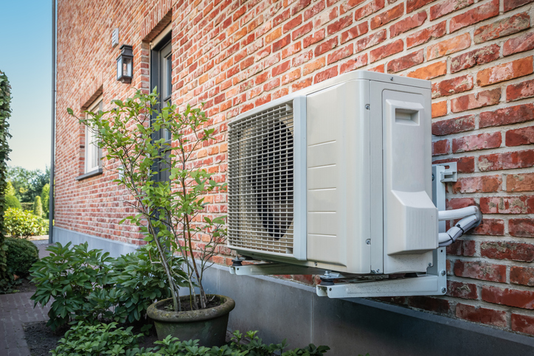
Tutor video resource
Tutor plays suitable video. Pause to highlight:
Heat exchange process
Components
Efficiency figures
Real installations
Example video
Notes:
https://www.youtube.com/watch?v=6WFEzZOZ7vA&t=12s&ab_channel=SkillBuilder

Slide 13
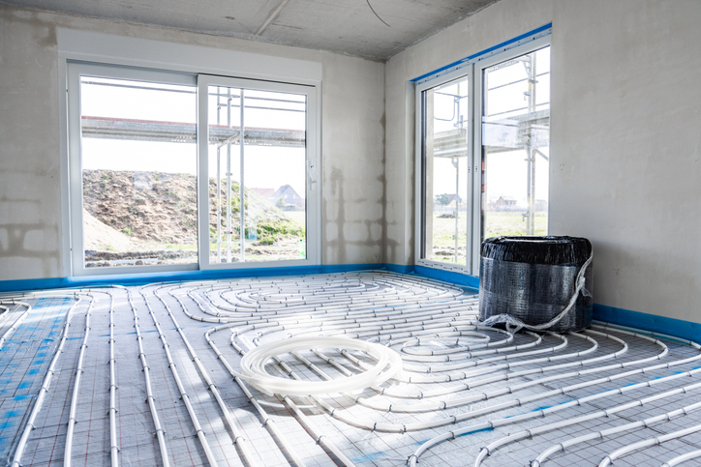
Temperatures and coupling with systems
Heat pumps typically deliver water at 35–55°C, compared to 65–75°C for gas boilers. To compensate, they are often coupled with underfloor heating or oversized radiators (radiators are often 2.2x larger).
Cylinders designed for lower temperatures are used to store hot water. Correct coupling ensures comfort and efficiency in domestic installations.

Slide 14
Student task – identify components
Students to examine a diagram of an air source heat pump.
Label evaporator, compressor, condenser, expansion valve.
Identify flow of refrigerant and heating water.

Slide 15
Case study – domestic heat pump
A 3-bed home installs an air source heat pump. Students discuss:
Why oversized radiators were fitted
How insulation helps improve efficiency
What backup heating could be provided.

Slide 16
Knowledge check 1
What cycle do air source heat pumps use to generate heat?
Name two advantages of heat pumps.
What is the role of the compressor in the refrigerant cycle?
Why are underfloor systems well-suited to heat pumps?
What is one limitation of heat pumps in cold weather?

Slide 17
Knowledge check 1 – answers
Refrigeration cycle.
Low-carbon, lower bills, renewable, year-round (any 2).
Increases refrigerant temperature and pressure.
They operate effectively at low water temperatures.
Reduced efficiency and lower output.

Slide 18
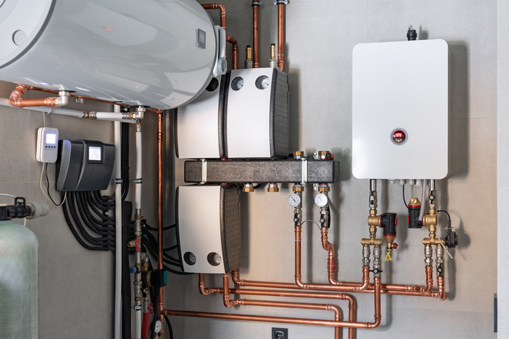
Transition to electric boilers
Electric boilers are another alternative to gas systems. They use electrical resistance elements to heat water directly.
Although simpler in design than heat pumps, they can be installed easily and are compact.
Their main drawback is the cost of electricity compared to gas, but they have no on-site emissions.

Slide 19
Electric boilers – overview
Compact wall-mounted units.
Use electric elements to heat water.
Work with standard wet heating systems.
No flue, no combustion.
Simple to install.
Question: Why do electric boilers not require a flue?

Slide 20
Electric boiler – principles
An electric boiler operates much like a large kettle. Electrical resistance elements heat water inside the unit. The heated water is then pumped into the heating system.
Because there is no combustion, there are no emissions at the property.
However, the electricity must be supplied reliably, and running costs can be high compared to gas.

Slide 21
Electric boiler – layout
Heating elements.
Circulating pump.
Expansion vessel and safety valve.
Controls for temperature and flow.
Connection to radiators or underfloor heating.

Slide 22
Tutor demonstration – electric boiler
Tutor shows an example electric boiler unit (live or images). Discuss:
Location of heating elements.
Control panel.
Safety devices.
Connections to heating system.

Slide 23
Advantages of electric boilers
No combustion gases or flue needed.
Very compact, simple installation.
Quiet in operation.
Compatible with existing radiators.
Good option where gas is not available.

Slide 24
Disadvantages of electric boilers
Higher running costs due to electricity prices.
Limited capacity.
Requires high electrical supply load.
Not renewable unless paired with green electricity.
May need upgrades to wiring.
Question: Why are electric boilers often unsuitable for large properties?

Slide 25
Comparing heat pumps and electric boilers
Heat pumps use refrigerant cycle, electric boilers use elements.
Heat pumps lower running costs, electric boilers simpler to fit.
Heat pumps need outdoor space, electric boilers do not.
Heat pumps require system design changes, electric boilers don’t.
Both provide wet heating system compatibility.

Slide 26
Sustainability considerations
Heat pumps are classed as renewable.
Electric boilers only sustainable with green electricity.
Both reduce reliance on gas.
Government incentives may apply for heat pumps.
Important for future energy policy.

Slide 27
Knowledge check 2
How do electric boilers heat water?
What is the biggest drawback of electric boilers?
Which system is quieter in operation?
Which system requires outdoor installation?
Which system is classed as renewable?

Slide 28
Knowledge check 2 – answers
Electrical resistance elements.
High running costs due to electricity prices.
Electric boilers.
Air source heat pumps.
Air source heat pumps.

Slide 29


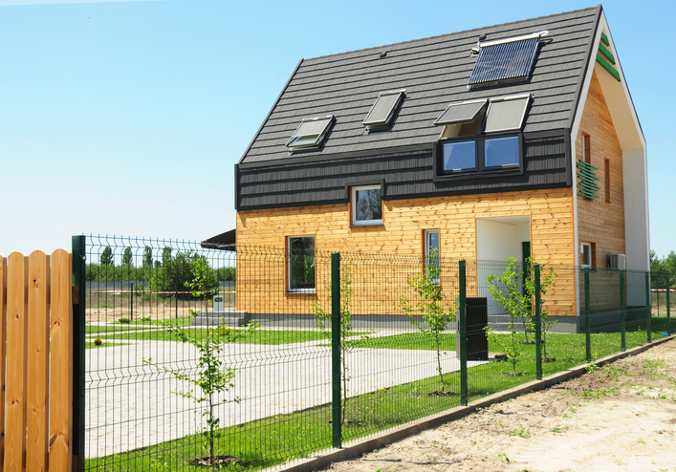
Tutor discussion – suitability
Tutor presents scenarios: rural cottage, urban flat, modern eco-home.
Students choose which system is most suitable and explain why.

Slide 30

Energy efficiency and running costs
Heat pumps typically achieve efficiencies of 250–400% (COP of 2.5–4).
Electric boilers are close to 100% efficient, but electricity costs make them more expensive to run. The coefficient of performance (COP) for a heat pump drops when the outside temperature gets colder.
This happens because the system must work harder to extract heat as the temperature difference between the indoors and outdoors increases.

Slide 31
Industry standards and regulations
MCS certification for heat pumps.
Building Regulations Part L apply.
Electrical safety standards for electric boilers.
Installers must be qualified and competent.
Compliance ensures safety and efficiency.

Slide 32
Recap and reflection
Tutor revisits both systems.
Students identify components, operation principles, and system layouts.
Students consider: “If you were advising a homeowner, which system would you recommend and why?”
They take into account property type, energy costs, space, and sustainability.

Slide 33
Knowledge check 3
Describe how air source heat pumps generate heat.
List two disadvantages of heat pumps.
How does an electric boiler heat water?
Why are electric boilers compact and easy to install?
Which system is more suitable for a small flat with no outdoor space?

Slide 34
Knowledge check 3 – answers
Use refrigeration cycle to absorb heat from air and transfer to heating water.
High upfront cost, low temperature output, efficiency drops in cold weather.
Using electric resistance heating elements.
No flue or combustion, few components.
Electric boiler.

Slide 35
Summary
You should be able to:
Describe principles of air source heat pumps and electric boilers
Discuss advantages and disadvantages
Identify layouts for alternative heating systems
You might also be able to:
Understand basic refrigerant cycle operation
Evaluate suitability for domestic use

Slide 36
Exit quiz
What outdoor component draws air into a heat pump?
What temperature do heat pumps typically supply water at?
Why do electric boilers not need a flue?
Which system has higher running costs?
Which system is supported by government incentives?

Slide 37
Exit quiz – answers
Fan and evaporator coil.
Around 35–55°C.
No combustion takes place.
Electric boilers.
Heat pumps.

Slide 38
Further learning
Class discussion: each student shares one advantage and one disadvantage of either system.
Tutor summarises and links back to session objectives.
Students sketch layout of a heat pump and an electric boiler, labelling main components.
Tutor collects feedback on student tasks. Clarifies misconceptions, reinforces main learning points.

Slide 39
Any questions?
Copyright in this document belongs to and is used under licence from the Department for Education, © 2025.
‘T-LEVELS’ and ‘T Level’ are registered trademarks of the Department for Education.
WJEC is authorised by the Department for Education to develop and deliver this T Level Technical Qualification.
WJEC operates in England under the name Eduqas which is a registered trademark of WJEC.

