Slide 1
Occupational Specialism: Plumbing & Heating Engineering
K1.7 Plumbing and heating systems
K1.8 Components used in plumbing and heating systems
K1.10 Types of control systems required for plumbing systems
K1.14 Safety devices applicable to heating systems
Control components (Part 1)

Slide 2
Starter
Warm-up:
Why do we need controls in heating systems rather than simply switching the boiler on and off?

Slide 3
Objectives
You should be able to:
Explain the purpose of control components in heating systems
Identify radiator valves, thermostats, and programmers
Describe how cylinder control valves and timers work
You might also be able to:
Discuss advantages of thermostatic vs manual control
Recognise principles of open and closed loop control

Slide 4
Introduction to heating controls
Controls regulate when and how heating systems operate. They ensure comfort, efficiency, and safety. Without controls, heating would waste energy, overheat rooms, or fail to protect against freezing.
Building Regulations require systems to be fitted with a minimum set of controls.
Understanding these components is critical for correct design, installation, and maintenance.

Slide 5
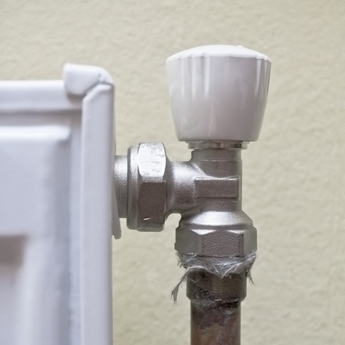
Radiator valves – manual
Simple on/off or flow control.
No automatic regulation.
Inexpensive and reliable.
Require user input.
Less efficient than thermostatic options.

Slide 6
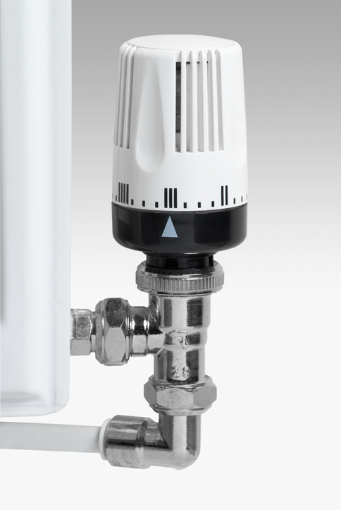
Radiator valves – thermostatic
Thermostatic radiator valves (TRVs) automatically regulate room temperature by adjusting flow through radiators.
They use a sensor head that expands or contracts with room temperature, throttling the water flow. TRVs prevent overheating and improve comfort.
They cannot control the boiler directly but reduce waste in individual rooms. Do not install in the same room as a room thermostat.

Slide 7
Thermo-mechanical cylinder control valves
Located on hot water cylinder.
Thermostat linked to valve.
Regulates hot water flow from boiler to cylinder.
Prevents overheating of stored water.
Ensures efficient water heating cycle.

Slide 8
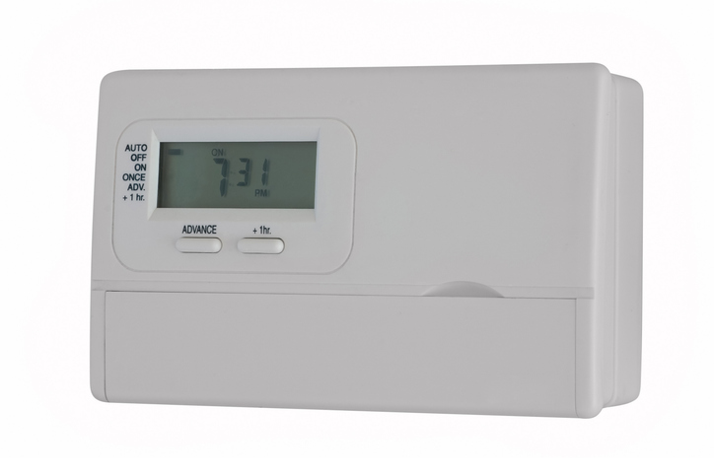
Programmer and timer
Programmers allow separate heating and hot water scheduling.
Timers set fixed on/off times for the boiler. These ensure heating runs only when required.
Modern programmers allow daily or weekly scheduling with different zones.
Question: Why does zoning improve heating system efficiency?

Slide 9
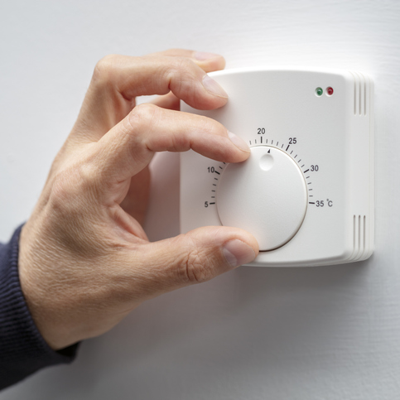
Room thermostats
Sense air temperature in room.
Switch heating system on/off to maintain set level.
Prevents waste energy by limiting overheating.
Best sited away from draughts and heat sources.
Key part of open-loop control.

Slide 10
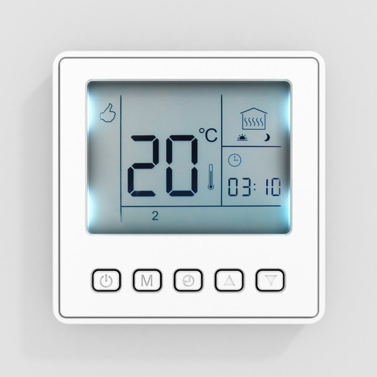
Programmable room stat
Programmable stats combine thermostat and timer. They allow temperature settings to change at different times of day.
This avoids wasting energy heating empty rooms.
Many are now digital or smart-enabled, improving accuracy.

Slide 11
Optimizers
An optimizer adapts boiler start and stop times automatically.
It learns how long the system takes to heat up and switches on earlier in cold weather.
This avoids overheating and keeps the home comfortable at scheduled times.

Slide 12
Weather compensation
Control adjusts boiler flow temperature to outdoor conditions.
Uses external temperature sensor.
Reduces boiler output in mild weather.
Increases efficiency, especially in condensing boilers.
Often built into smart controls.
Question: Why does weather compensation improve condensing boiler efficiency?

Slide 13
Optimum start
Optimum start calculates when heating must begin so the building reaches the desired temperature by the required time.
It prevents unnecessary early starts. It ensures comfort with minimal energy use.

Slide 14
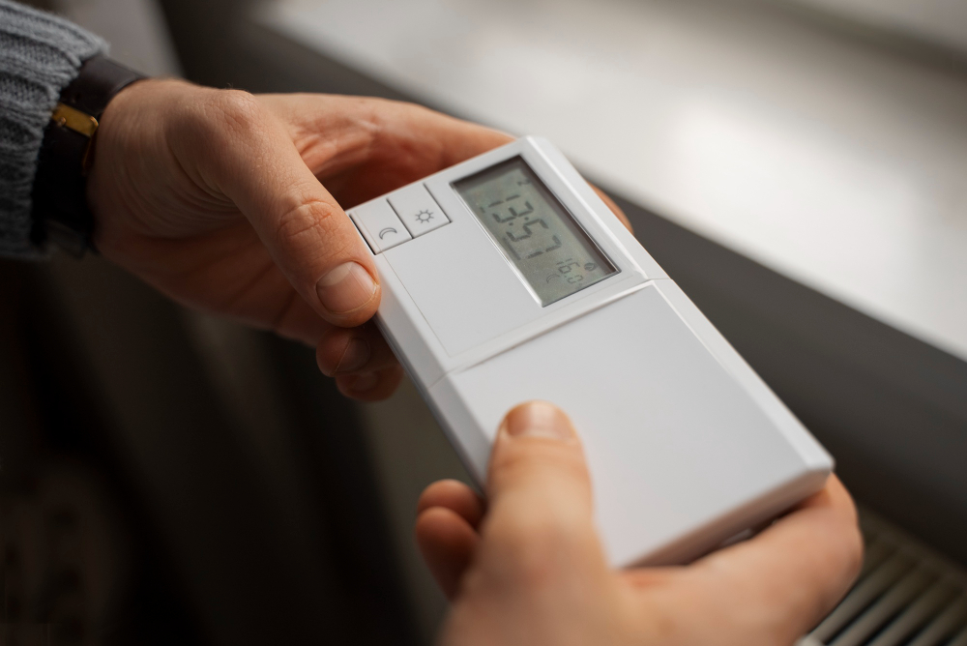
Night setback
Reduces heating set point overnight.
Prevents freezing but saves energy.
Useful in commercial systems.
Keeps system running at lower level.
Can be linked with frost protection.

Slide 15
Frost stat
A frost stat activates heating if system or building temperature drops too low.
Protects pipework and boiler from freezing.
Usually set between 3–5°C. Often installed in unheated areas such as garages or lofts.

Slide 16
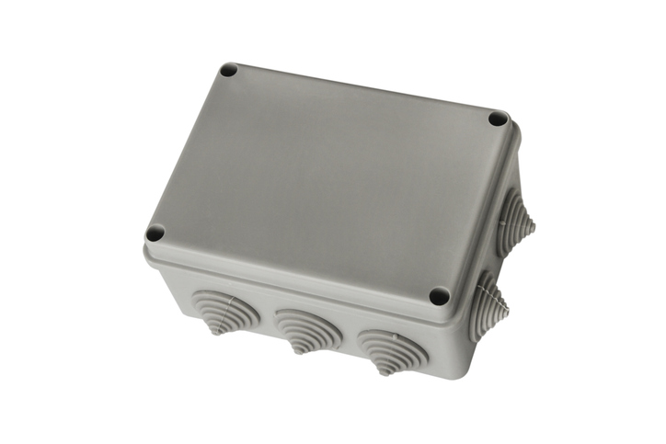
Wiring centre
Junction box for control wiring.
Connects programmer, thermostat, cylinder stat, valves, pump.
Ensures system components communicate correctly.
Central part of S and Y plan systems.

Slide 17
Cylinder stat
Cylinder thermostats sense hot water cylinder temperature. They control motorised valves to stop heating once water reaches set temperature.
Prevents scalding and saves energy.
Usually set to 60°C for legionella protection.

Slide 18
Tutor demonstration – control components
Tutor shows examples of valves, stats, and timers.
Students identify each component and discuss its purpose.

Slide 19
Knowledge check
What does a TRV do?
Why are manual radiator valves less efficient?
Where should a room thermostat NOT be placed?
What is the set temperature of most cylinder thermostats?
What is the function of a wiring centre?

Slide 20
Knowledge check – answers
Regulates radiator flow based on room temperature.
They do not regulate temperature automatically.
Near draughts, direct sunlight, or heat sources.
~60°C.
To connect and coordinate system controls.

Slide 21
Tutor demo – manufacturer instructions
Tutor shares examples of instructions from Honeywell, Drayton, or ESi.
Students review diagrams to see wiring and siting guidance.

Slide 22
Open and closed loop control
Open-loop: heating on/off without feedback (e.g. timer).
Closed-loop: system adjusts automatically based on feedback (e.g. thermostat).
Closed-loop controls improve efficiency and comfort.

Slide 23
Tutor discussion – efficiency
Tutor explains how controls reduce running costs and emissions.
Students calculate potential savings from using TRVs and programmers compared to uncontrolled heating.
Case Study: House with only manual valves and boiler switch. Students identify issues: overheating, wasted energy, poor comfort. Discussion on how controls improve performance.

Slide 24
Knowledge check 2
Define open-loop control.
Give two examples of closed-loop control.
What does a programmer allow you to do?
Why must cylinder stats be set at ~60°C?
What is the purpose of a frost stat?

Slide 25
Knowledge check 2 – answers
Control without feedback.
Thermostat, TRV, weather compensation.
Schedule heating and hot water separately.
To prevent legionella and save energy.
Protects system from freezing.

Slide 26
Regulations – zoning requirements
Building Regulations Part L require zoned heating controls.
Separate controls for hot water and heating.
Large properties must be split into zones. For new domestic dwellings and when replacing a boiler in existing homes, Part L of the Building Regulations requires a minimum of two independent heating zones for properties over 150m².
BS 7593 covers system water quality and commissioning.

Slide 27
Knowledge check 3
Name two types of radiator valves.
What is the difference between programmer and timer?
Why is weather compensation effective?
Give one safety reason for cylinder stats.
What is zoning and why is it required?

Slide 28
Knowledge check 3 answers
Manual and thermostatic (TRVs).
Programmer offers separate heating/hot water scheduling; timer is simple on/off.
Matches boiler flow temperature to outside weather, improving efficiency.
Prevents overheating and protects against legionella.
Divides system into separately controlled areas to save energy.

Slide 29
Summary
You should be able to:
Explain the purpose of control components in heating systems
Identify radiator valves, thermostats, and programmers
Describe how cylinder control valves and timers work
You might also be able to:
Discuss advantages of thermostatic vs manual control
Recognise principles of open and closed loop control

Slide 30
Any questions?
Copyright in this document belongs to and is used under licence from the Department for Education, © 2025.
‘T-LEVELS’ and ‘T Level’ are registered trademarks of the Department for Education.
WJEC is authorised by the Department for Education to develop and deliver this T Level Technical Qualification.
WJEC operates in England under the name Eduqas which is a registered trademark of WJEC.

